Slide 1
Georgios Iakovidis, 1853-1932
Paintings of Children

Slide 2
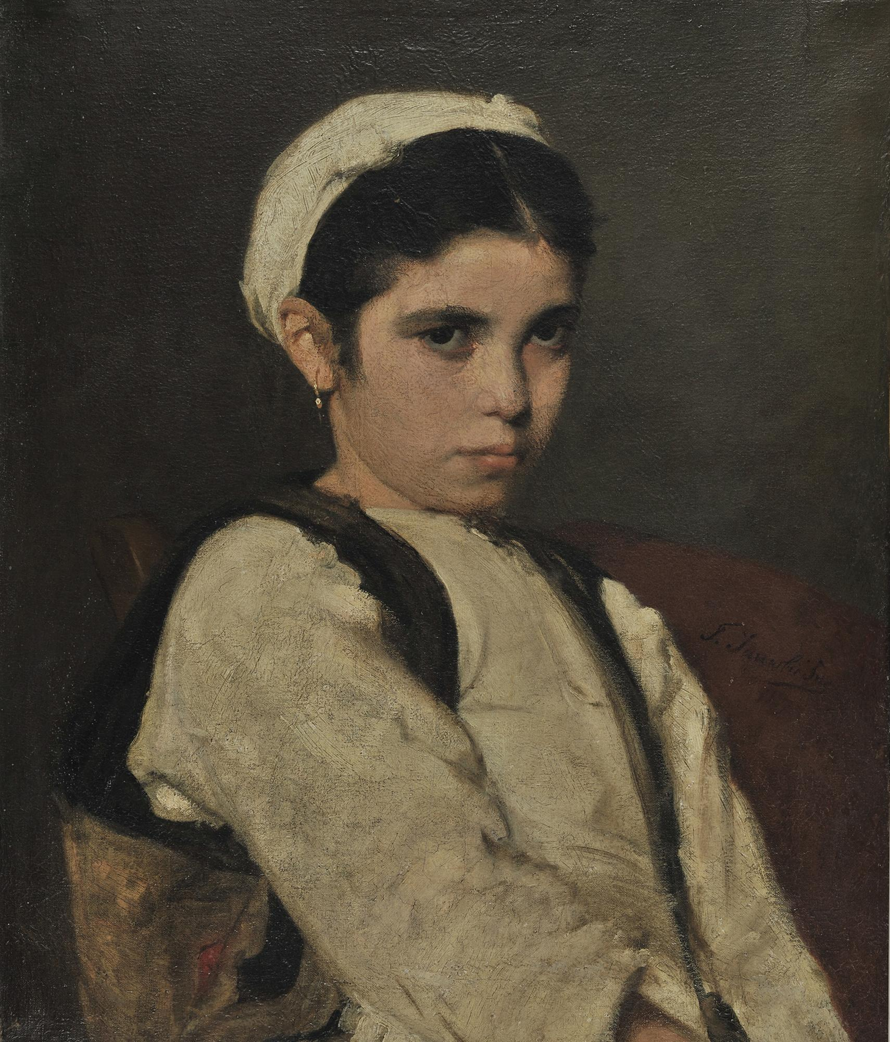
The Girl from Megara, 1870-77, Oil on Canvas, 60x50 cm, National Gallery, E. Koutlidis Foundation Collection, Athens, Greece https://www.nationalgallery.gr/en/all-collections/collection/collections/the-girl-from-megara.html

Slide 3
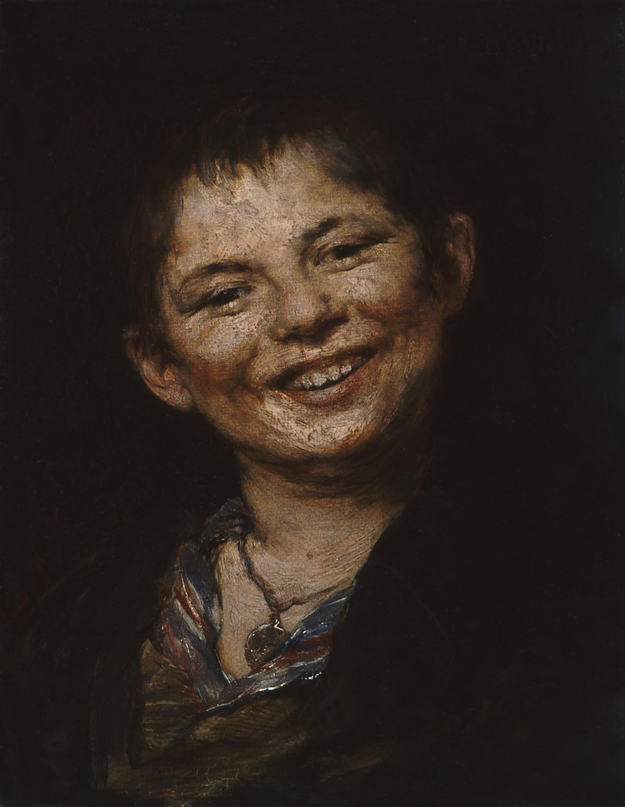
Italian Boy Laughing, 1882, Oil on Canvas, 18x14 cm, National Gallery, E. Koutlidis Foundation Collection, Athens, Greece https://www.nationalgallery.gr/en/all-collections/collection/collections/italian-boy-laughing-or-the-little-chestnut-seller.html

Slide 4
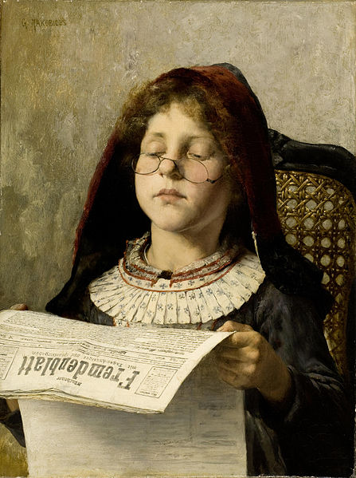
Girl Reading, circa 1882, Oil on Canvas, 53x40 cm, Private Collection, Athens, Greece https://commons.wikimedia.org/wiki/File:Georgios_Jakobides_Girl_reading_c1882.jpg

Slide 5
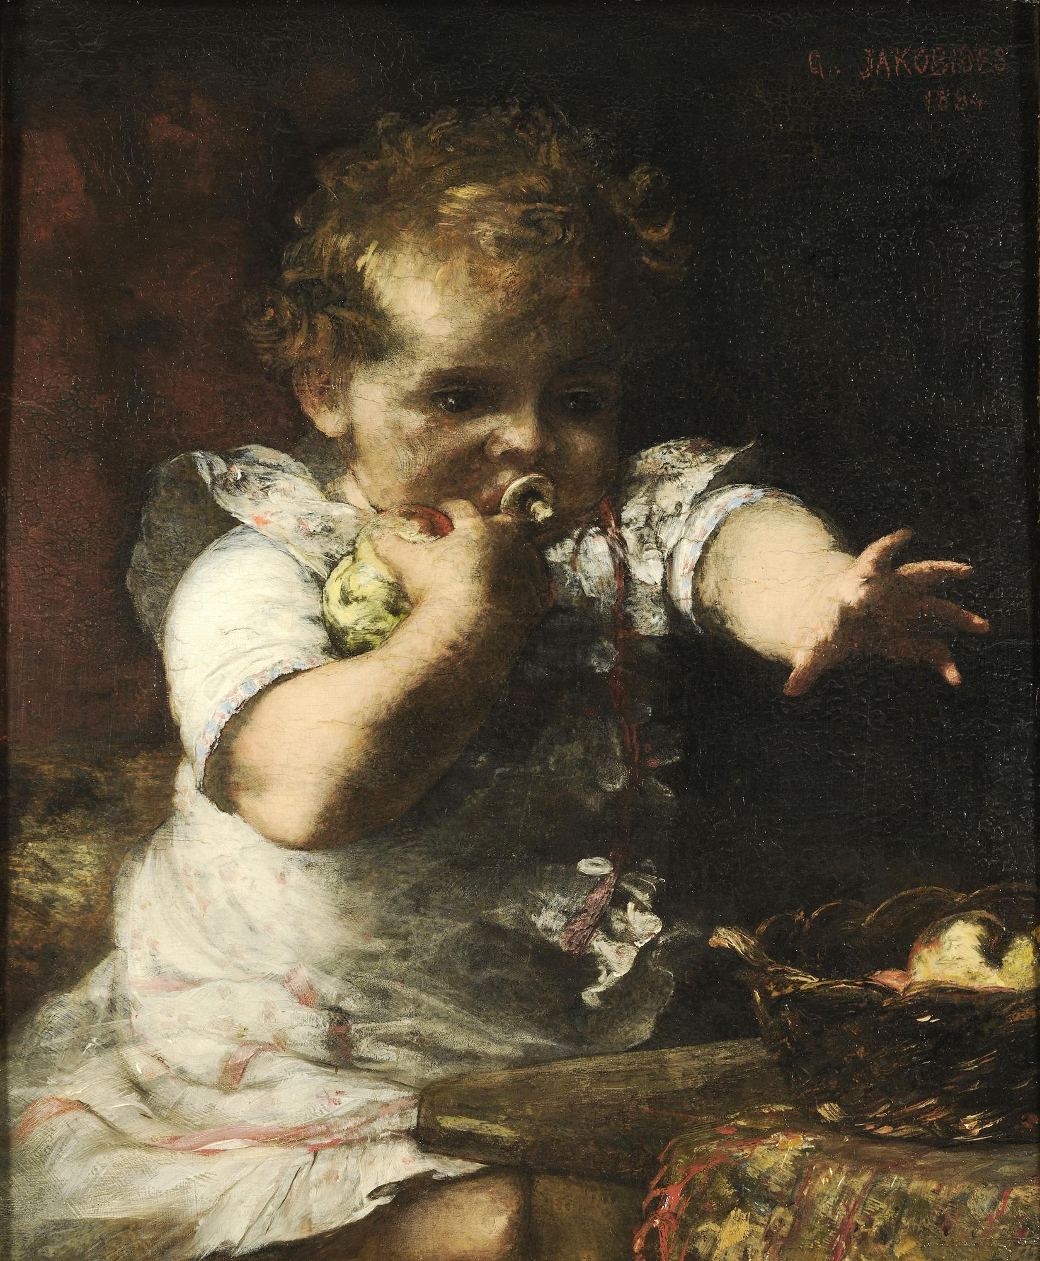
Greedy, 1884, Oil on Panel, 29,6x24 cm, National Gallery, Athens, Greece https://www.nationalgallery.gr/en/all-collections/collection/collections/greedy.html

Slide 6
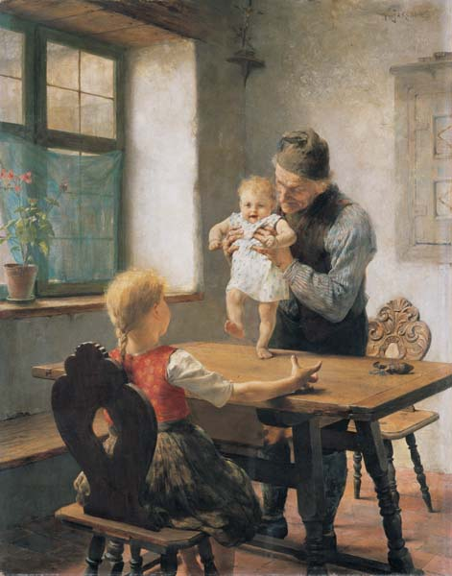
First Steps, 1883, Oil on Canvas, 64x50 cm, Averoff Museum of Neo-Hellenic Art, Metsovo, Greece https://www.averoffmuseum.gr/%cf%84%ce%b1-%cf%80%cf%81%cf%8e%cf%84%ce%b1-%ce%b2%ce%ae%ce%bc%ce%b1%cf%84%ce%b1/

Slide 7
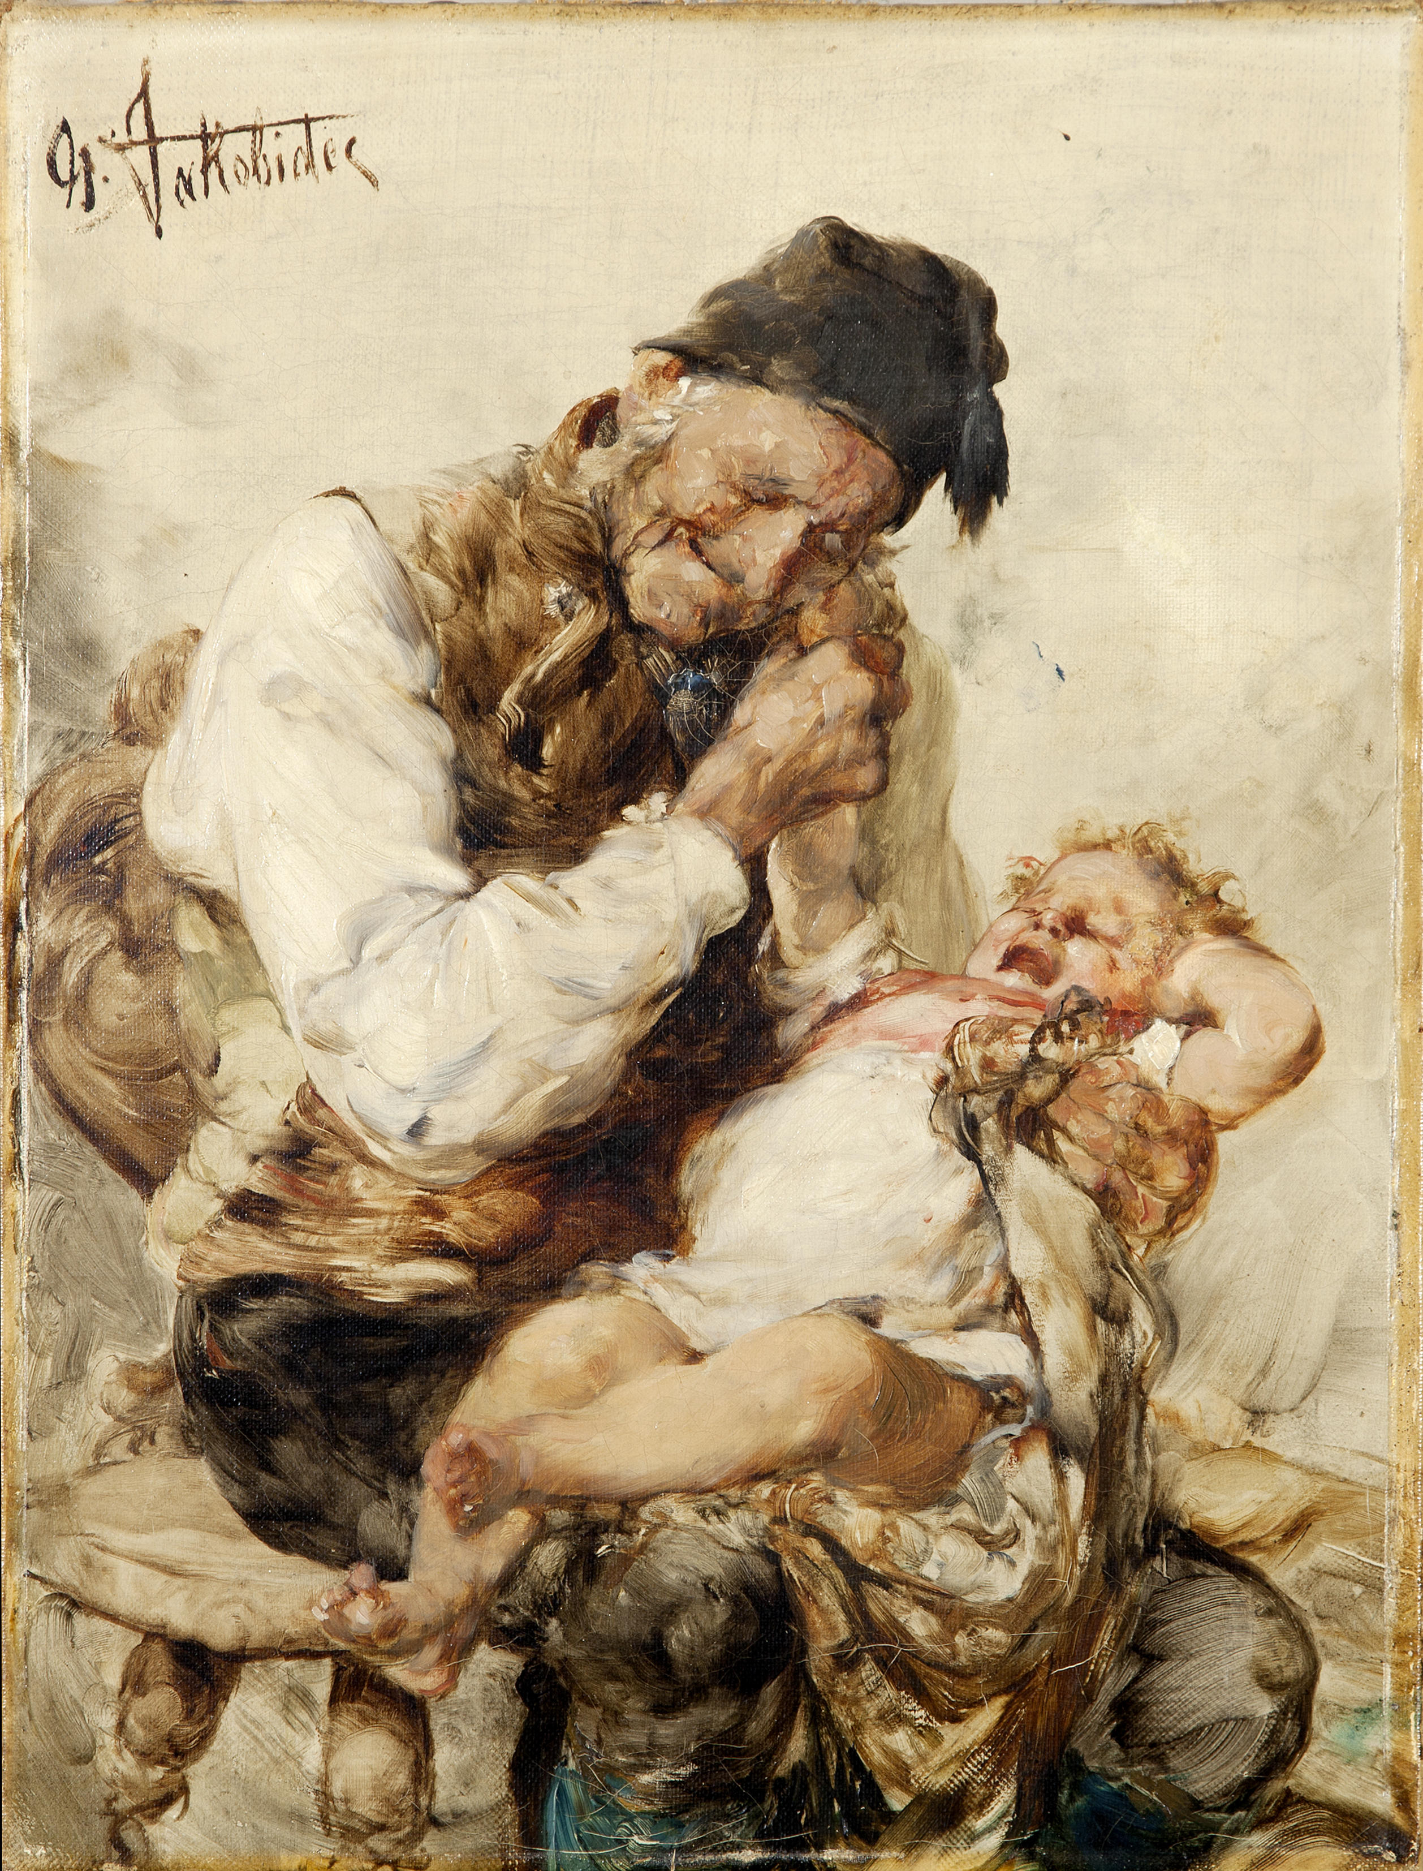
Naughty grandson, 1884, Oil on Canvas, 38.5x30 cm, Private Collection, Athens, Greece https://commons.wikimedia.org/wiki/File:%CE%93%CE%B5%CF%8E%CF%81%CE%B3%CE%B9%CE%BF%CF%82_%CE%99%CE%B1%CE%BA%CF%89%CE%B2%CE%AF%CE%B4%CE%B7%CF%82_-_%CE%9F_%CE%9A%CE%B1%CE%BA%CF%8C%CF%82_%CE%95%CE%B3%CE%B3%CE%BF%CE%BD%CF%8C%CF%82_(%CE%BC%CE%B5%CF%84%CE%AC_%CF%84%CE%BF_1884).jpg

Slide 8
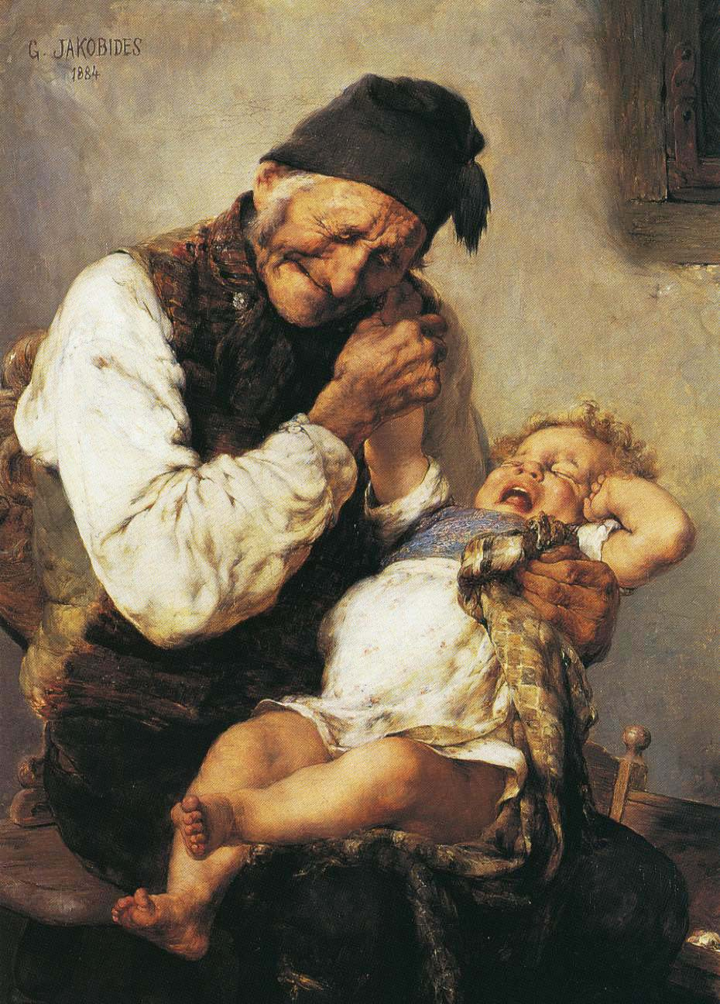
Naughty grandson, 1884, Oil on Canvas, 38.5x30 cm, Museum Wiesbaden, Germany https://upload.wikimedia.org/wikipedia/commons/9/99/The_Naughty_Grandson.jpg

Slide 9
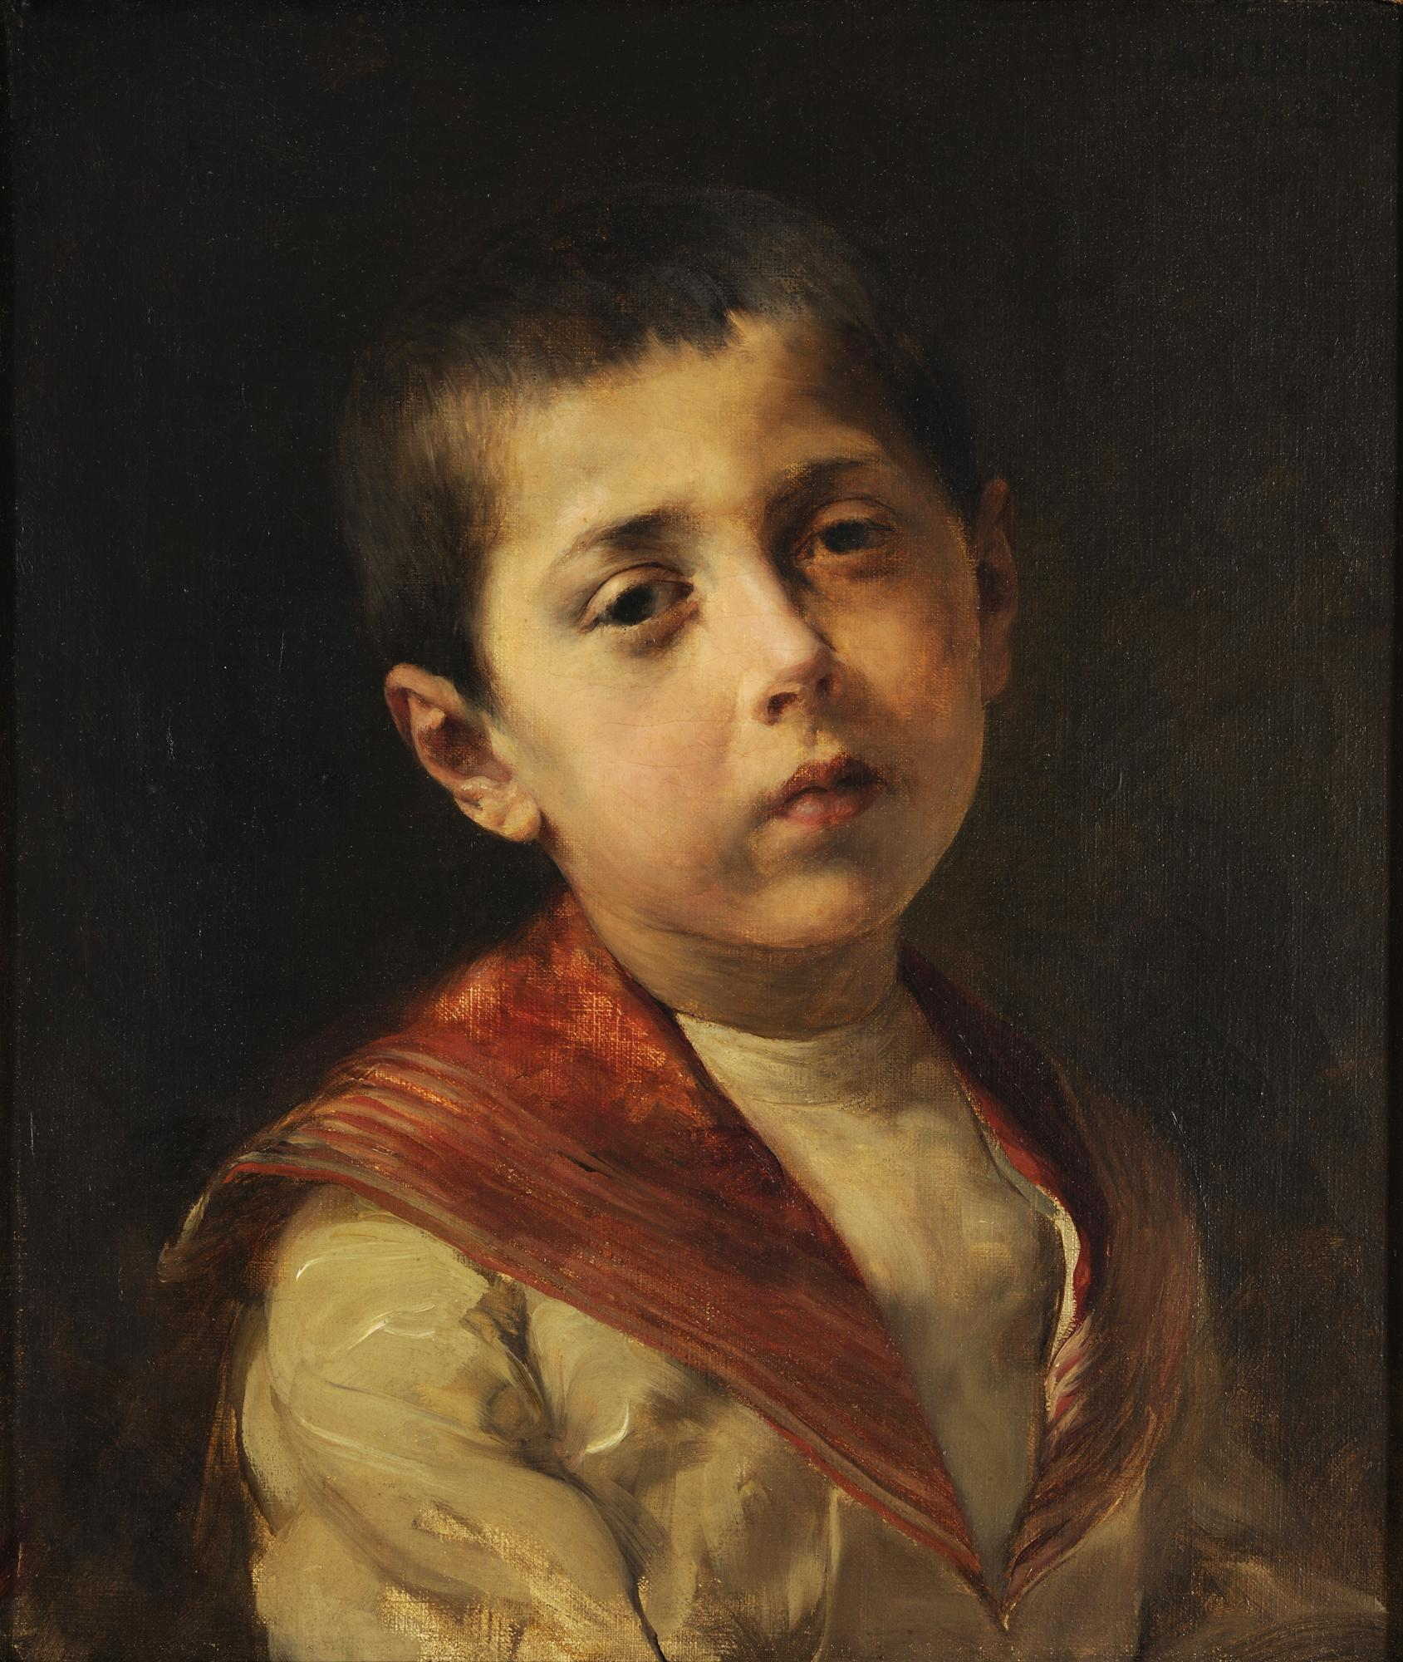
Portrait of Vasilakis Melas, 1885, Oil on Canvas, 41x34 cm, National Gallery, E. Koutlidis Foundation Collection, Athens, Greece https://www.nationalgallery.gr/en/all-collections/collection/collections/portrait-of-vasilakis-melas.html

Slide 10
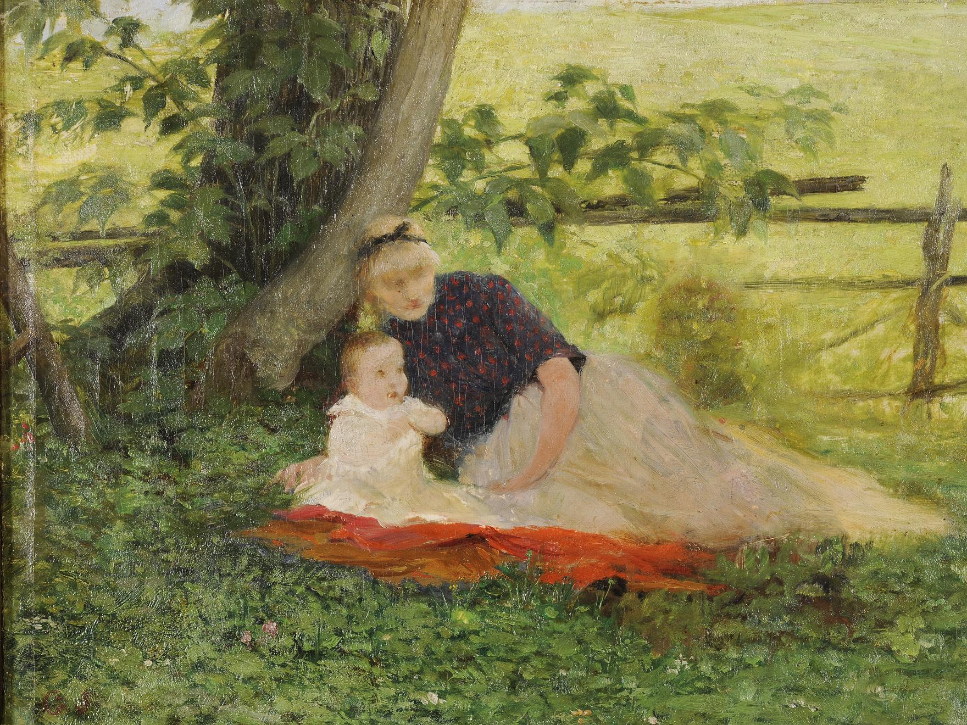
The Artist’s Son in the Carden, 1890, Oil on Canvas, 25x35 cm, National Gallery, E. Koutlidis Foundation Collection, Athens, Greece https://www.nationalgallery.gr/en/all-collections/collection/collections/the-artist-s-son-in-the-garden.html

Slide 11
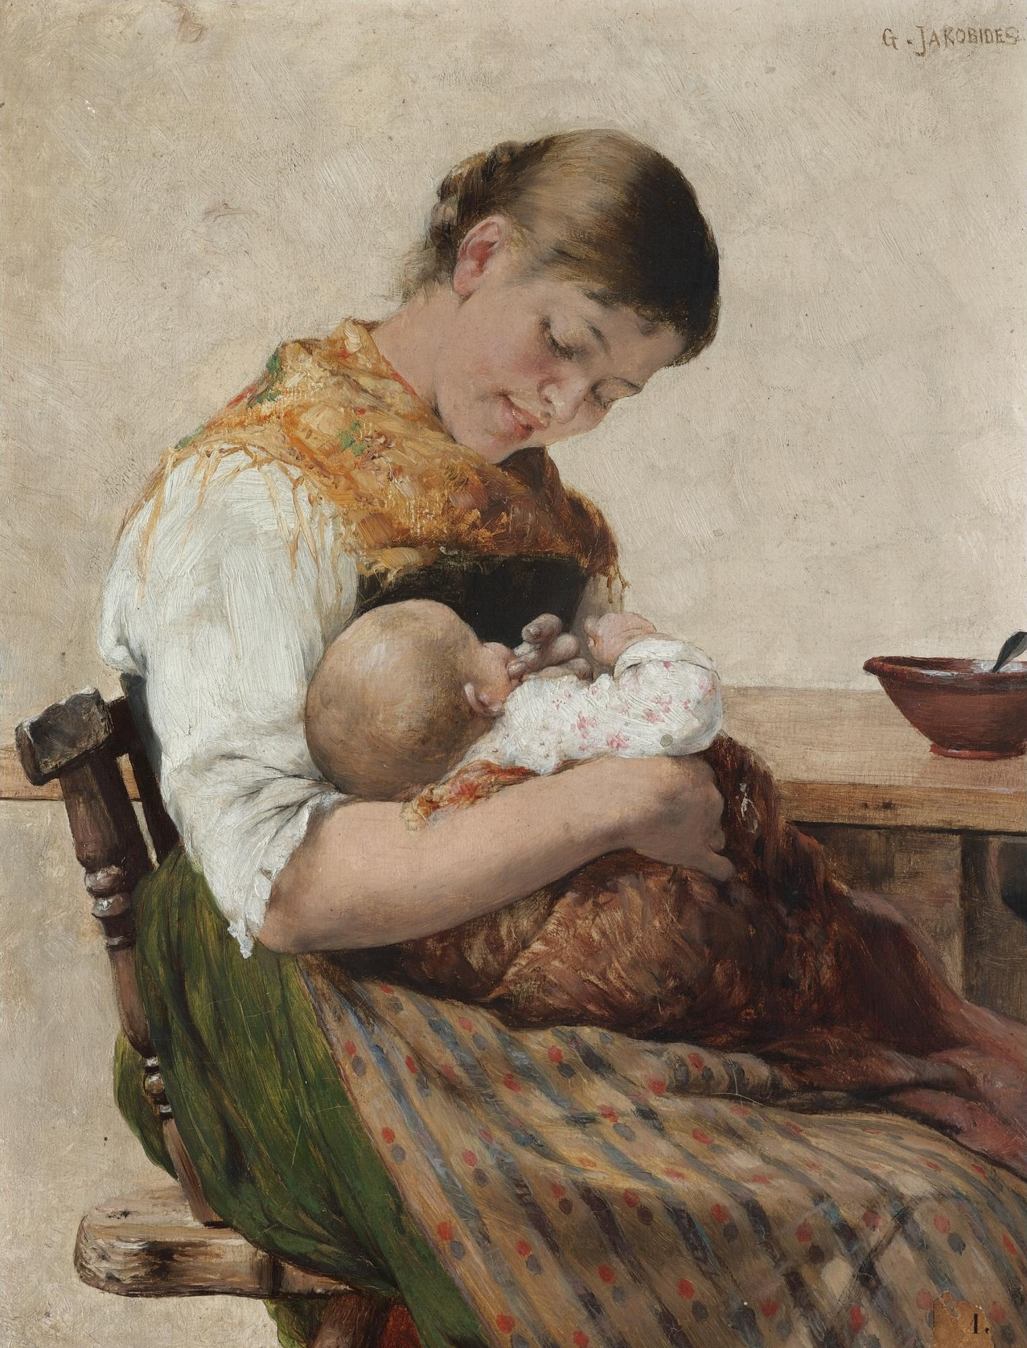
Maternal affection, 1890s, Oil on Canvas, 28x22 cm, Private Collection, Athens, Greece https://upload.wikimedia.org/wikipedia/commons/c/c9/%CE%93%CE%B5%CF%8E%CF%81%CE%B3%CE%B9%CE%BF%CF%82_%CE%99%CE%B1%CE%BA%CF%89%CE%B2%CE%AF%CE%B4%CE%B7%CF%82_-_%CE%9C%CE%B7%CF%84%CF%81%CE%B9%CE%BA%CE%AE_%CF%83%CF%84%CE%BF%CF%81%CE%B3%CE%AE.jpg

Slide 12
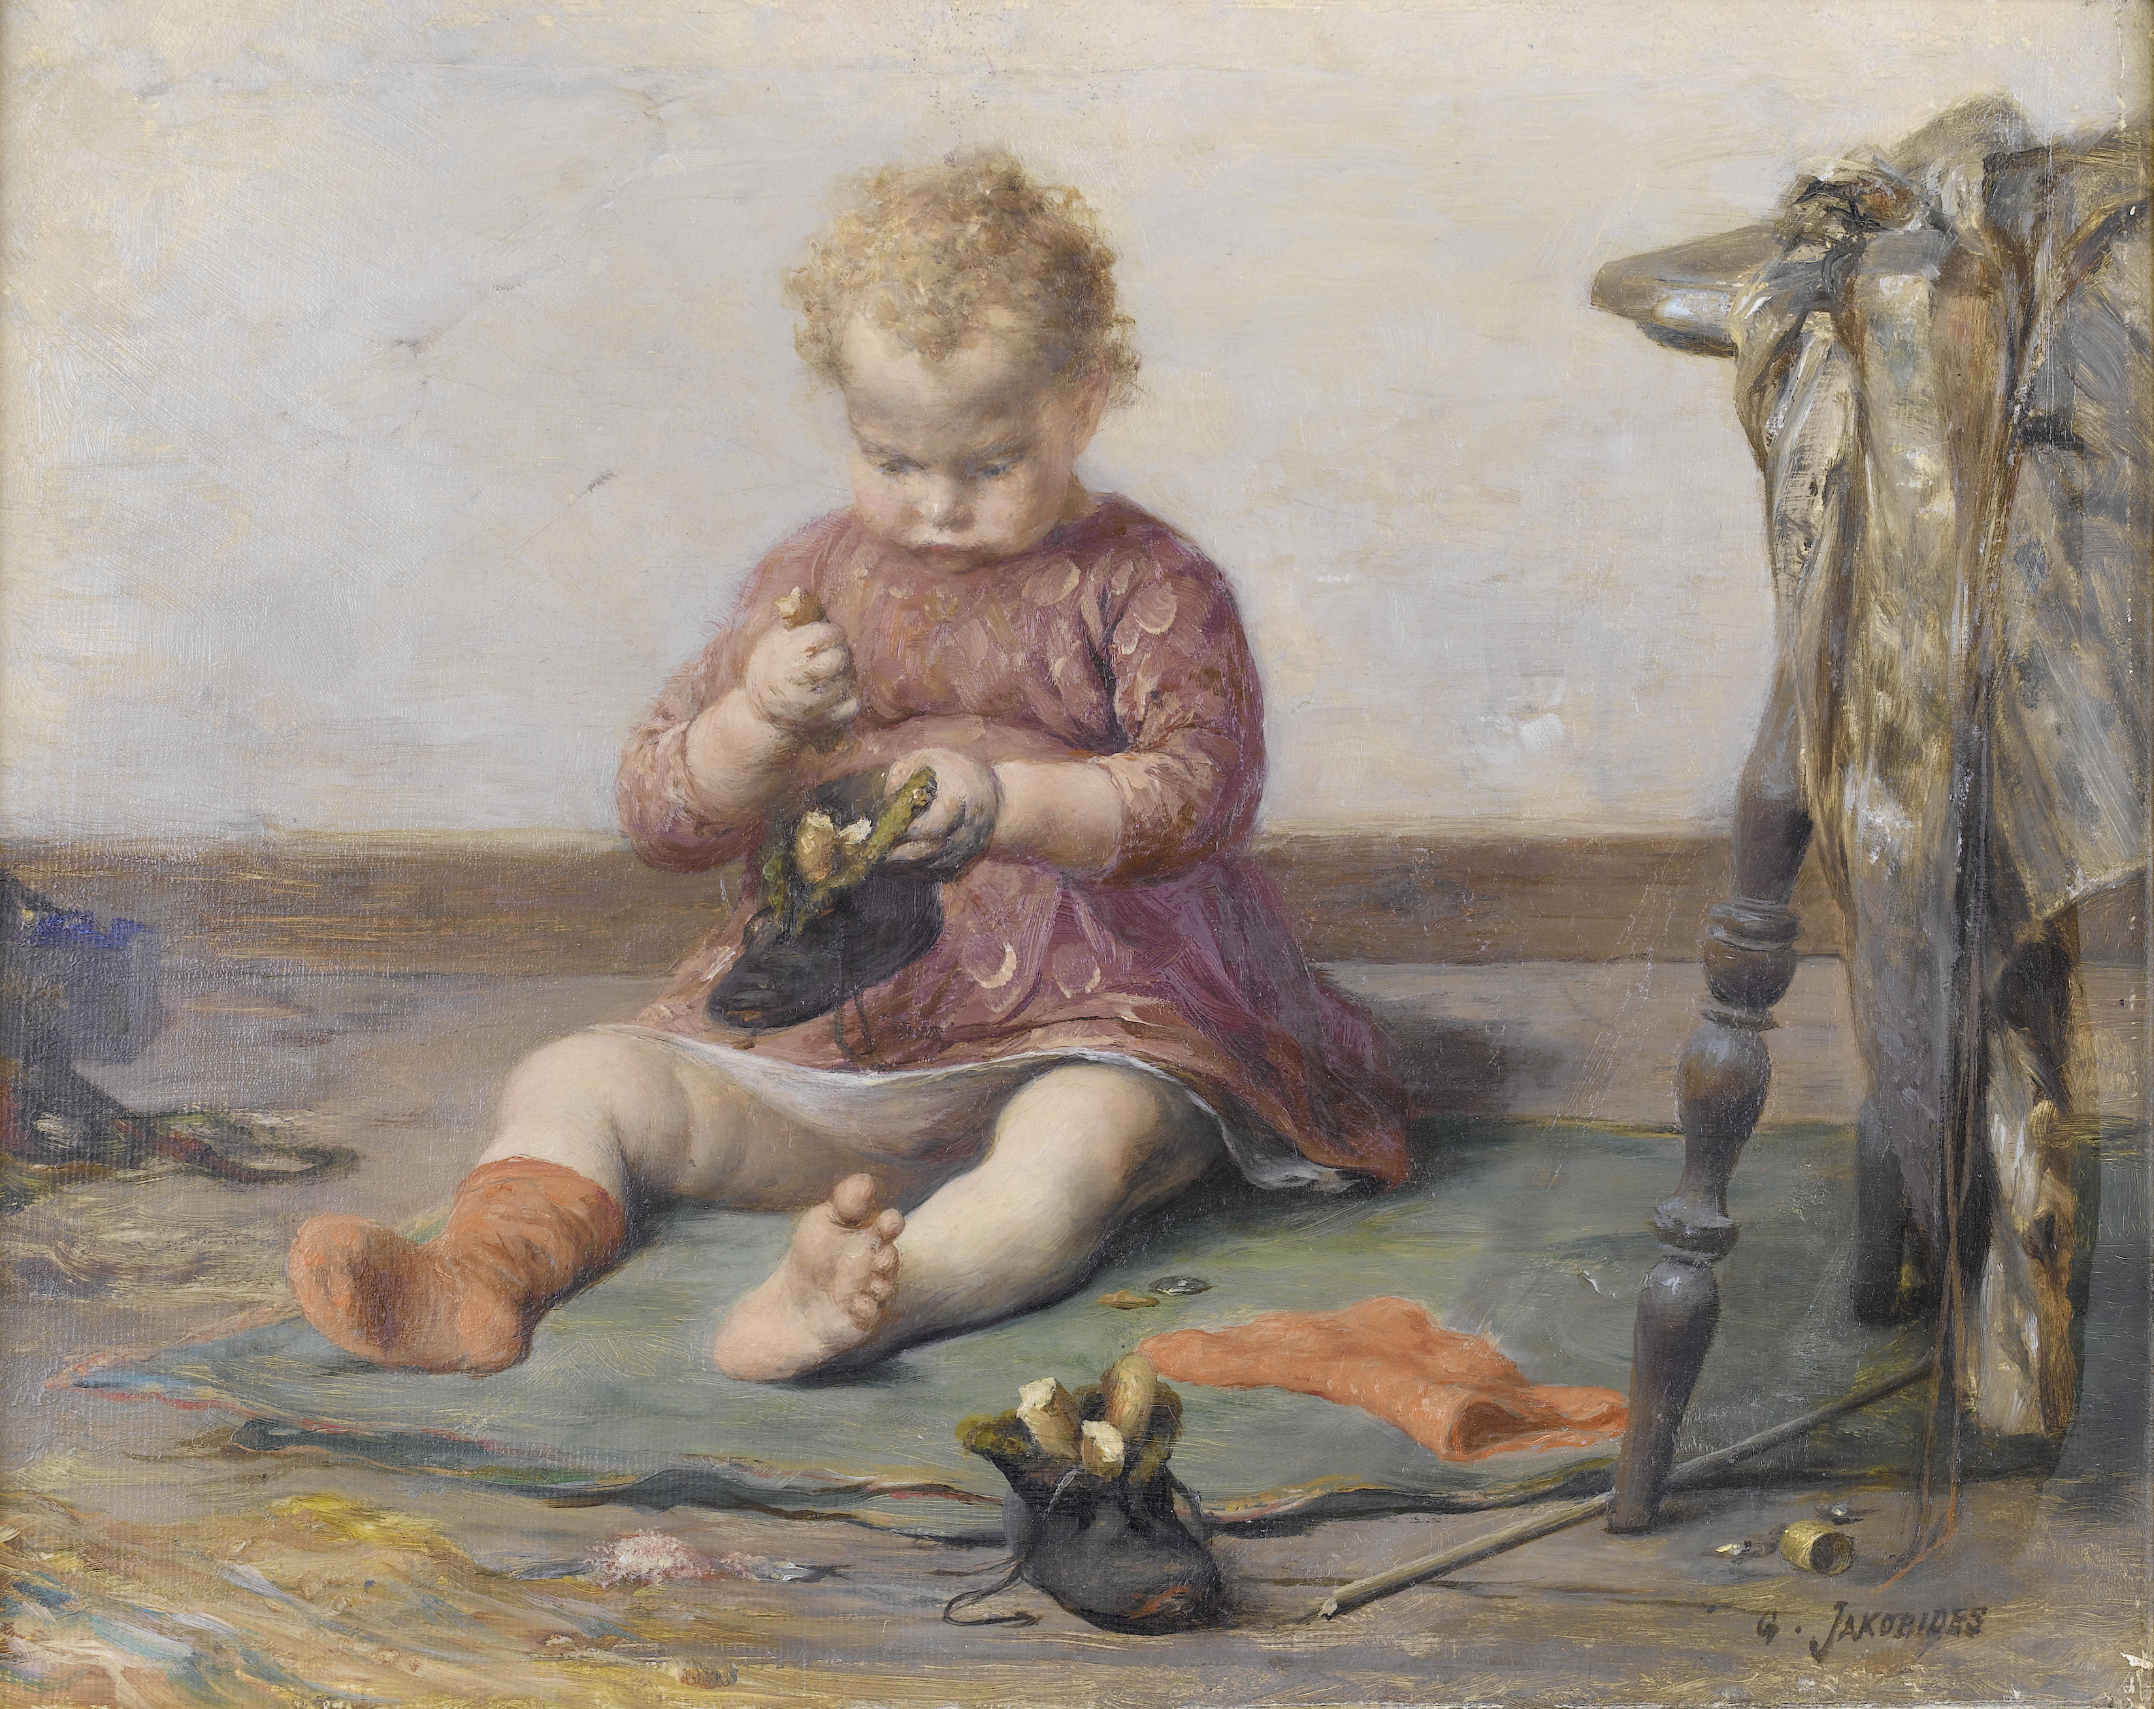
Play Time, 1890s, Oil on Canvas, 22x28 cm, Private Collection, Unknown Location https://commons.wikimedia.org/wiki/Category:Georgios_Jakobides#/media/File:Georgios_Jakobides-Playtime.jpg

Slide 13
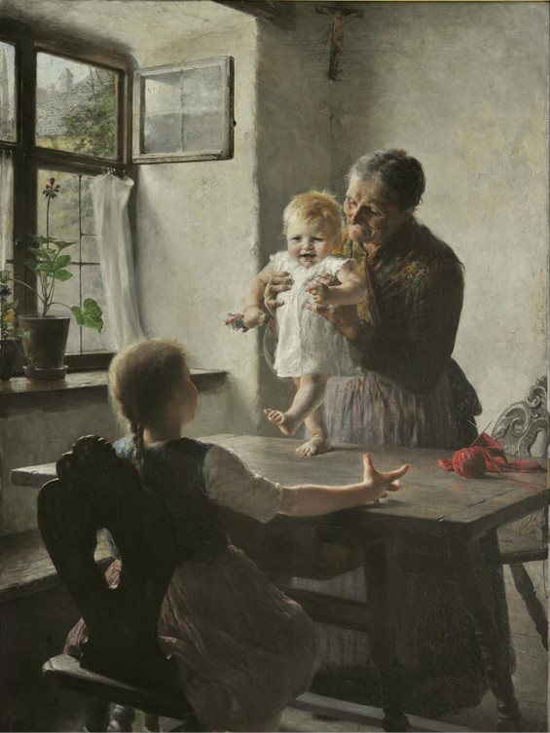
Georgios Iakovidis, 1853-1932
First Steps, 1892, Oil on canvas, 140x110 cm, National Gallery, E. Koutlidis Foundation Collection, Athens, Greece https://www.nationalgallery.gr/en/painting-permanent-exhibition/painting/the-bourgeois-class-and-its-painters/genre-painting/first-steps.html

Slide 14
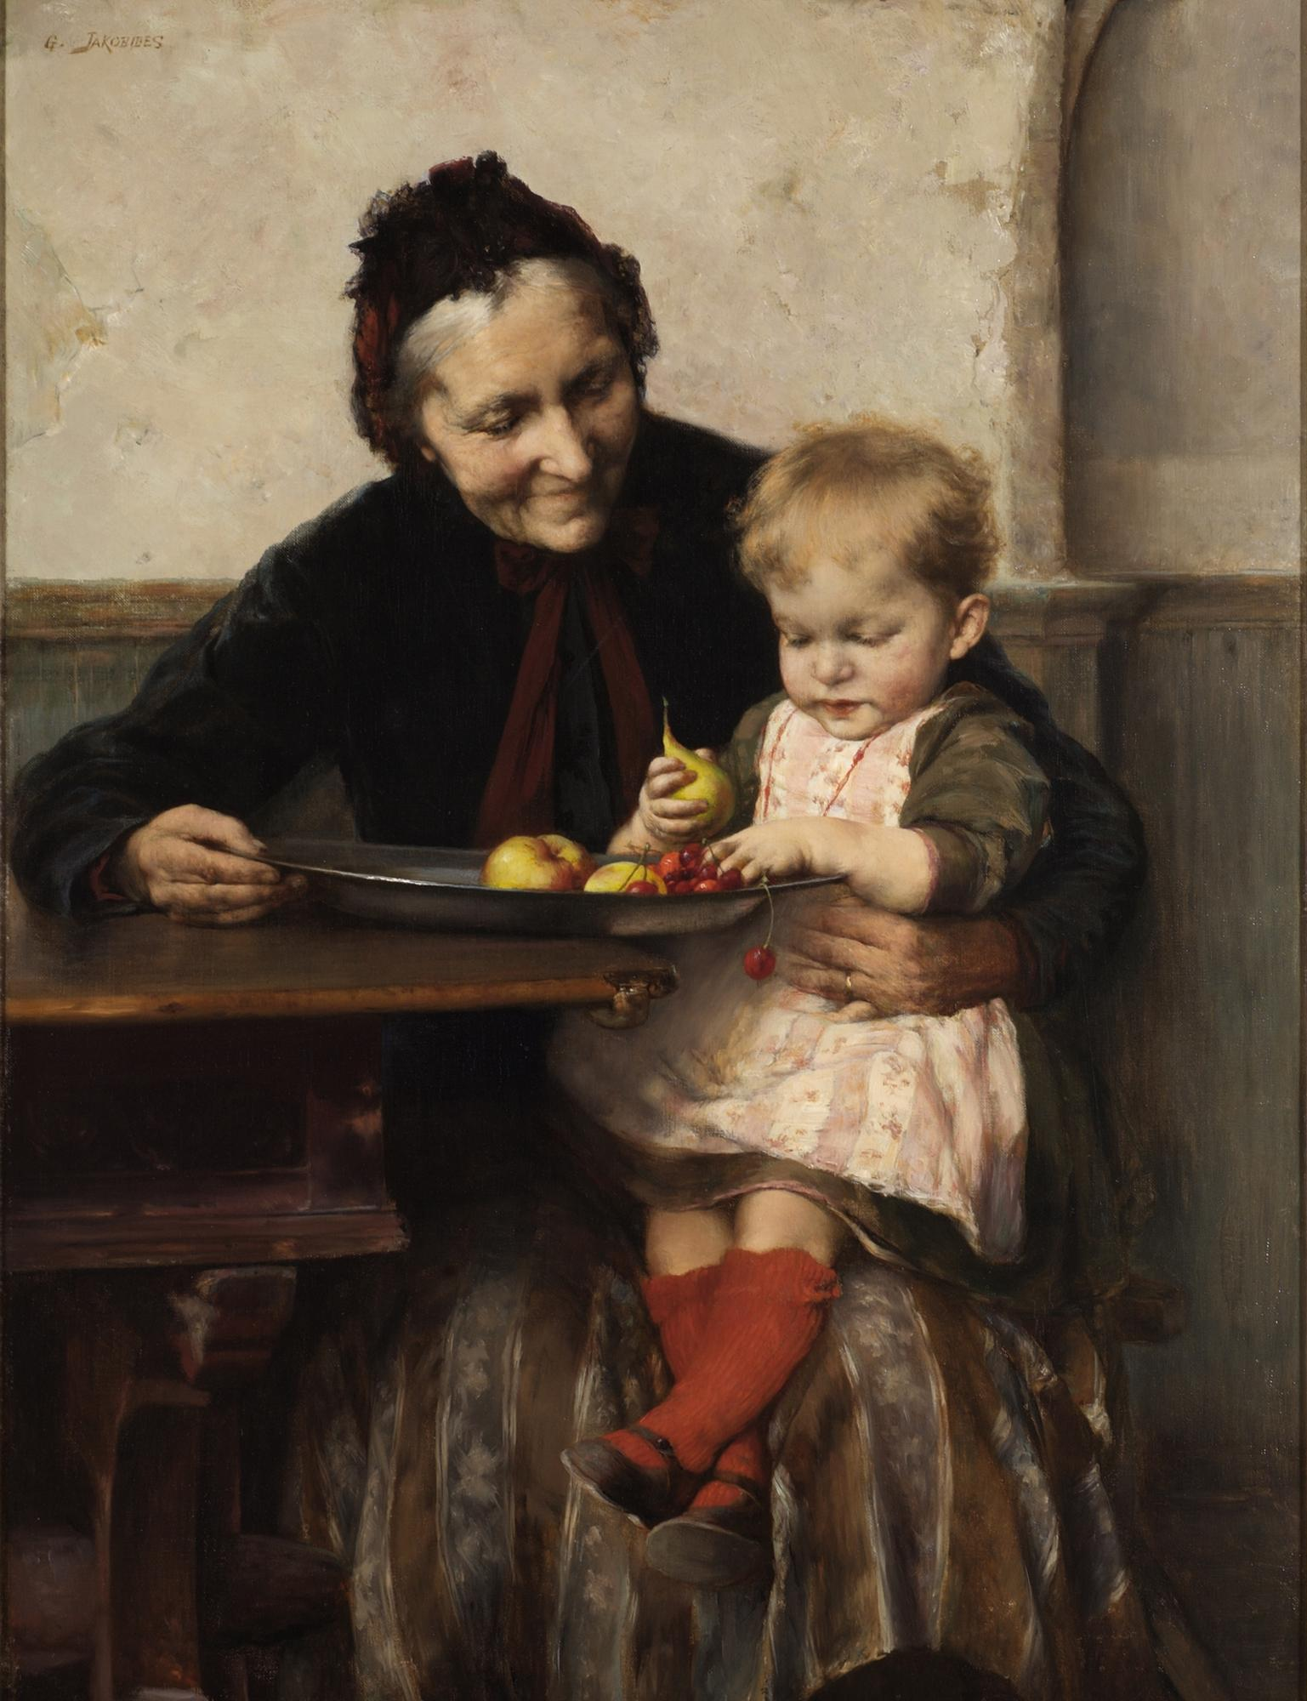
Grandma’s Favourite, 1893, Oil on Canvas, 78,5x60,3 cm, National Gallery, Athens, Greece https://www.nationalgallery.gr/en/painting-permanent-exhibition/painting/the-bourgeois-class-and-its-painters/genre-painting/grandma-s-favourite.html

Slide 15
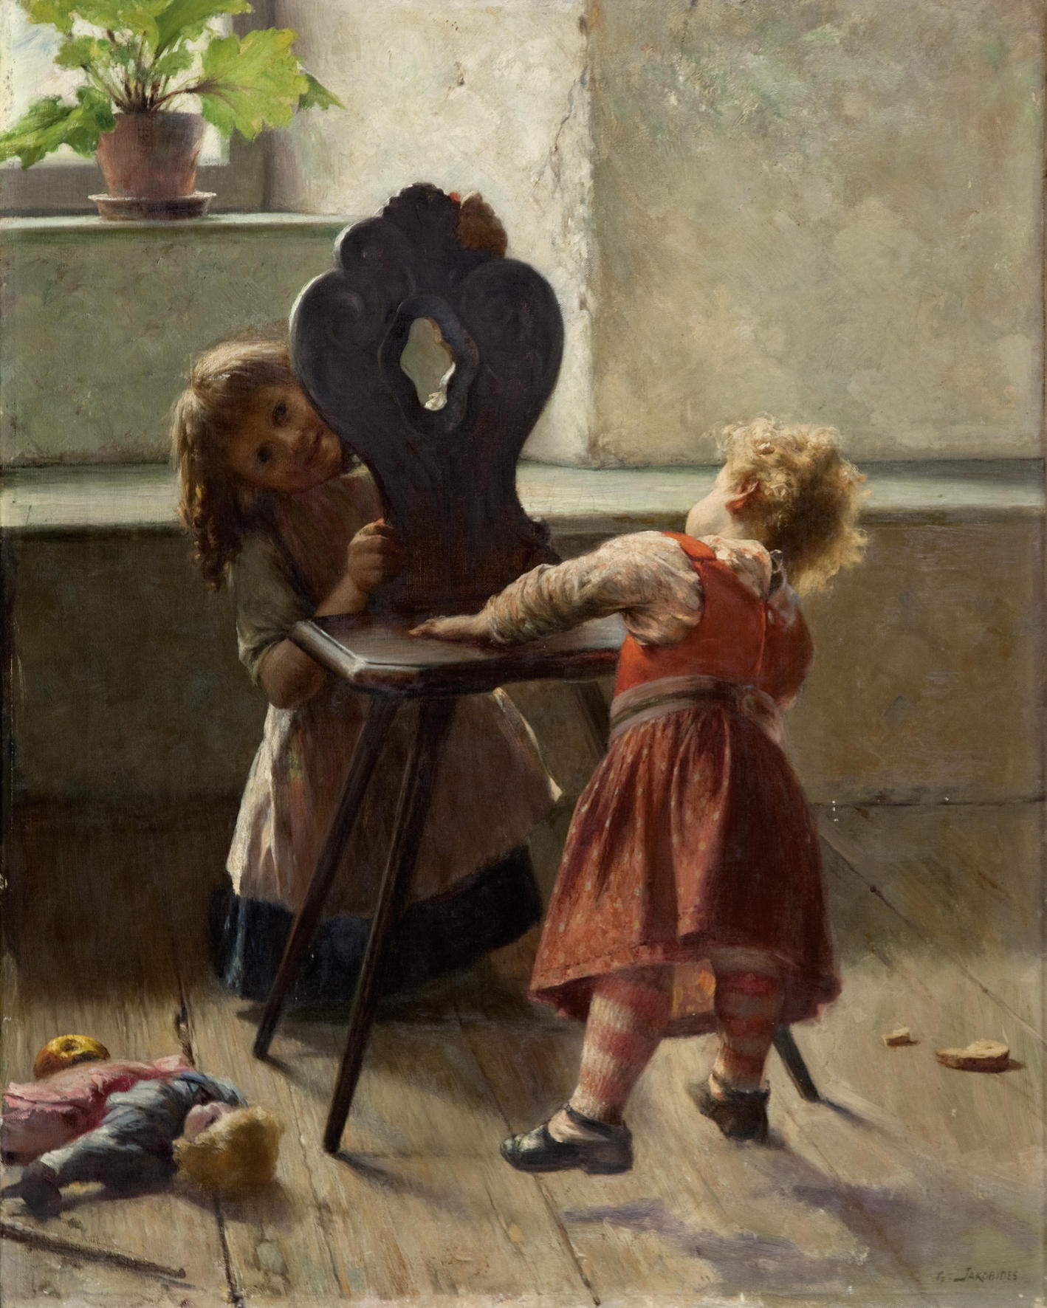
Kou-Kou, 1895, Oil on Canvas, 115x90 cm, Private Collection, Unknown Location https://upload.wikimedia.org/wikipedia/commons/7/74/Georgios_Jakobides_-_Peek_a_boo_%28ca.1896%29.jpg

Slide 16
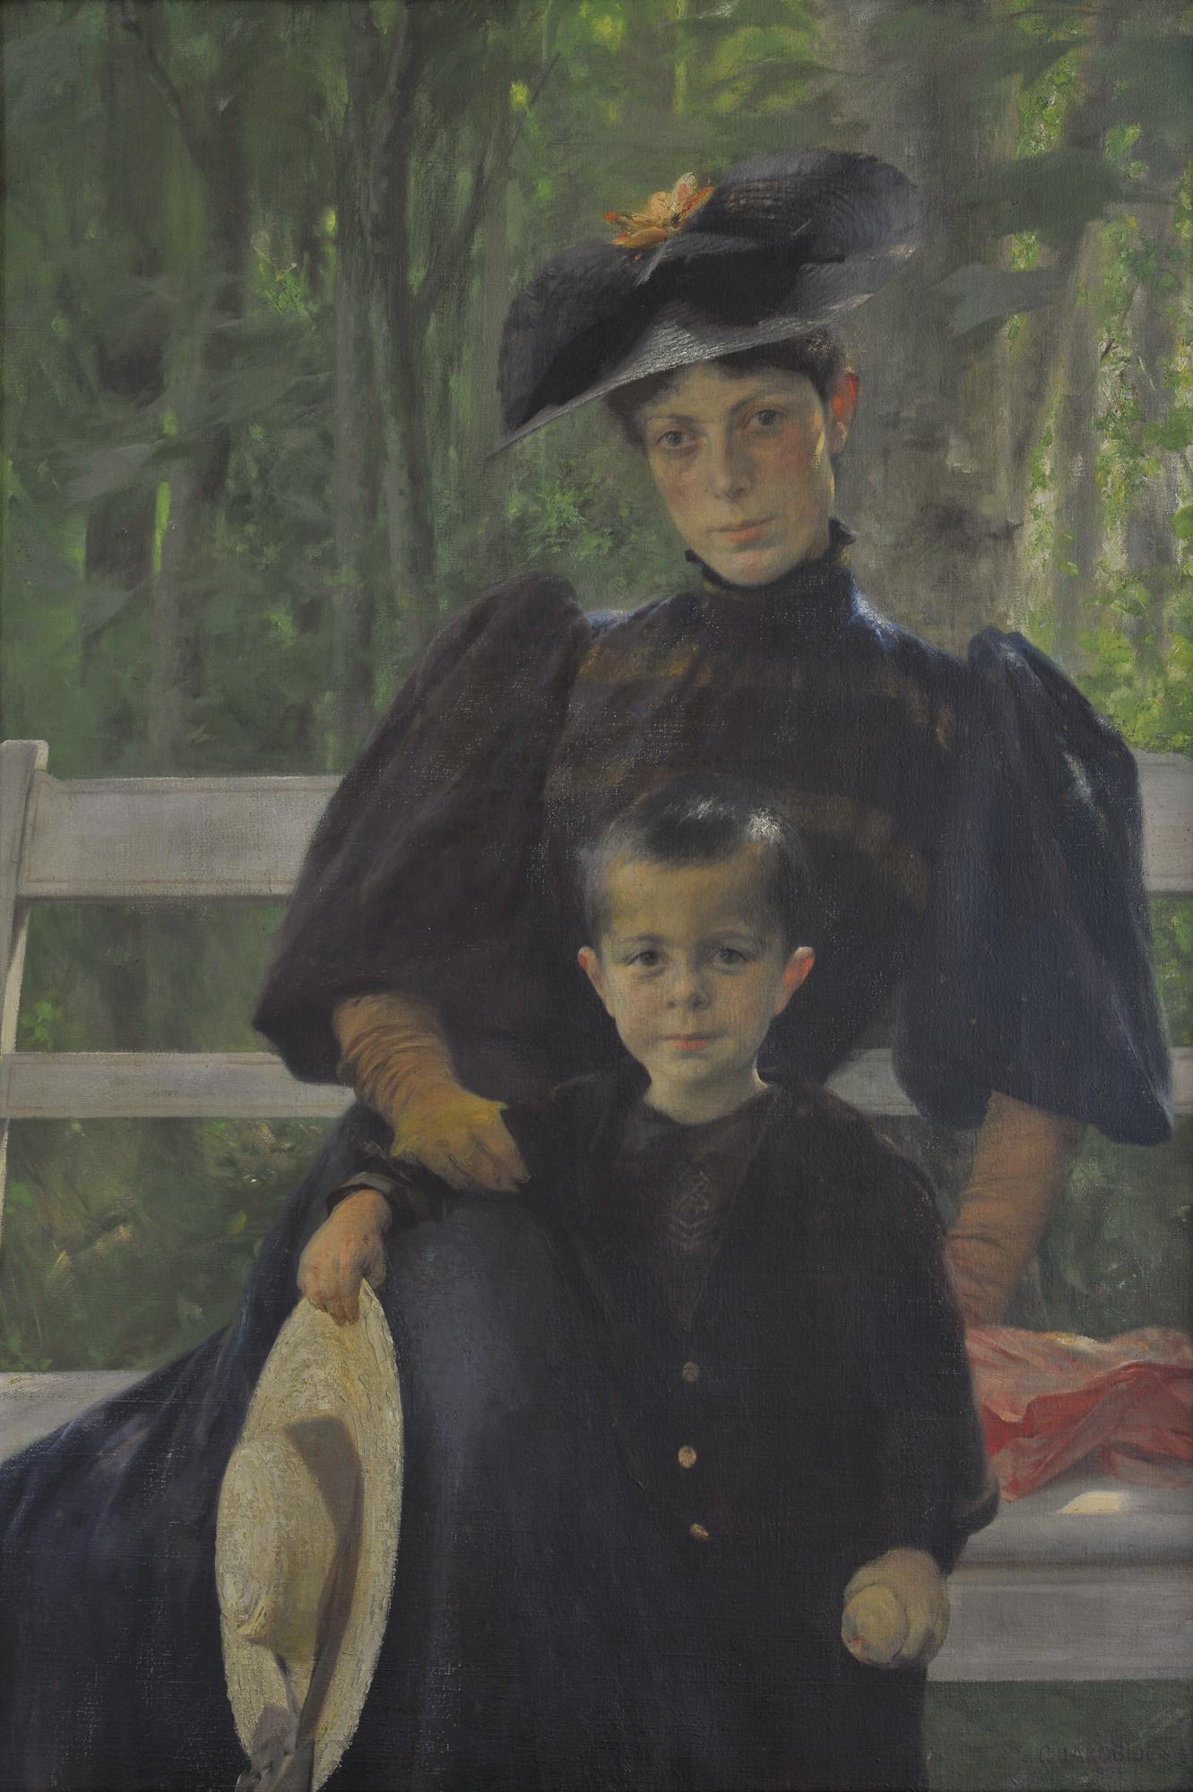
The Artist’s Wife with their Son, 1895, Oil on Canvas, 109x75 cm, National Gallery, E. Koutlidis Foundation Collection, Athens, Greece https://www.nationalgallery.gr/en/painting-permanent-exhibition/painting/around-1900/impressionistic-remnants/the-artist-s-wife-with-their-son.html

Slide 17
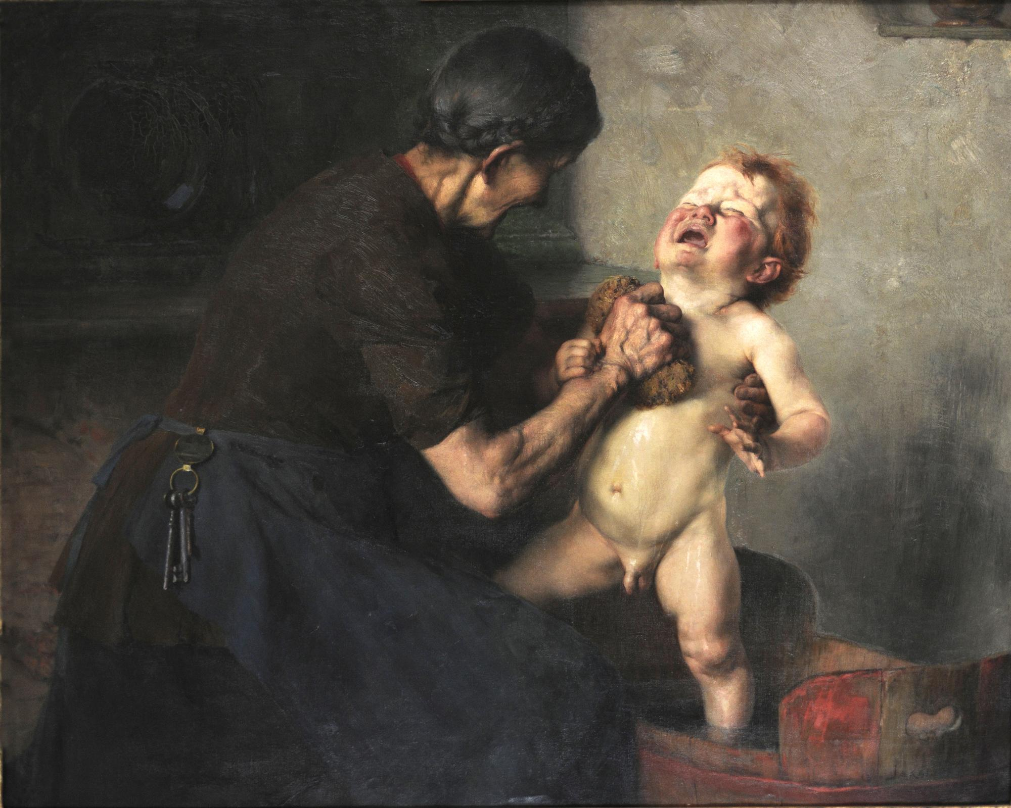
Cold Shower, 1898, Oil on Canvas, 89x100 cm, National Gallery, E. Koutlidis Foundation Collection, Athens, Greece https://www.nationalgallery.gr/en/painting-permanent-exhibition/painting/the-bourgeois-class-and-its-painters/genre-painting/cold-shower.html

Slide 18
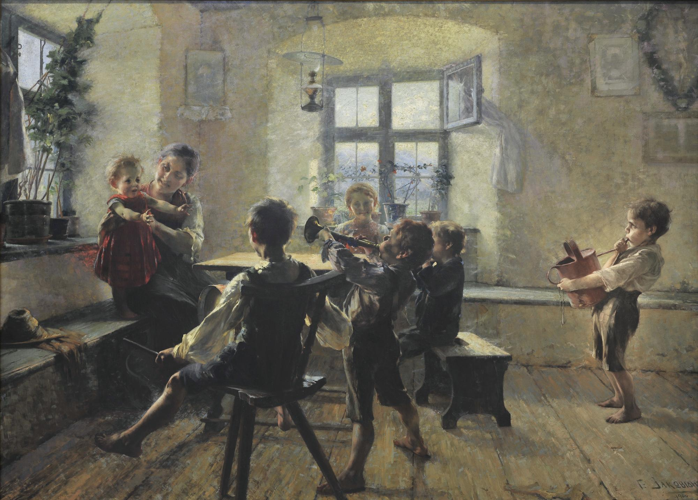
Children’s Concert, 1900, Oil on Canvas, 176x250 cm, National Gallery, Athens, Greece https://www.nationalgallery.gr/en/painting-permanent-exhibition/painting/around-1900/impressionistic-remnants/children-s-concert.html

Slide 19
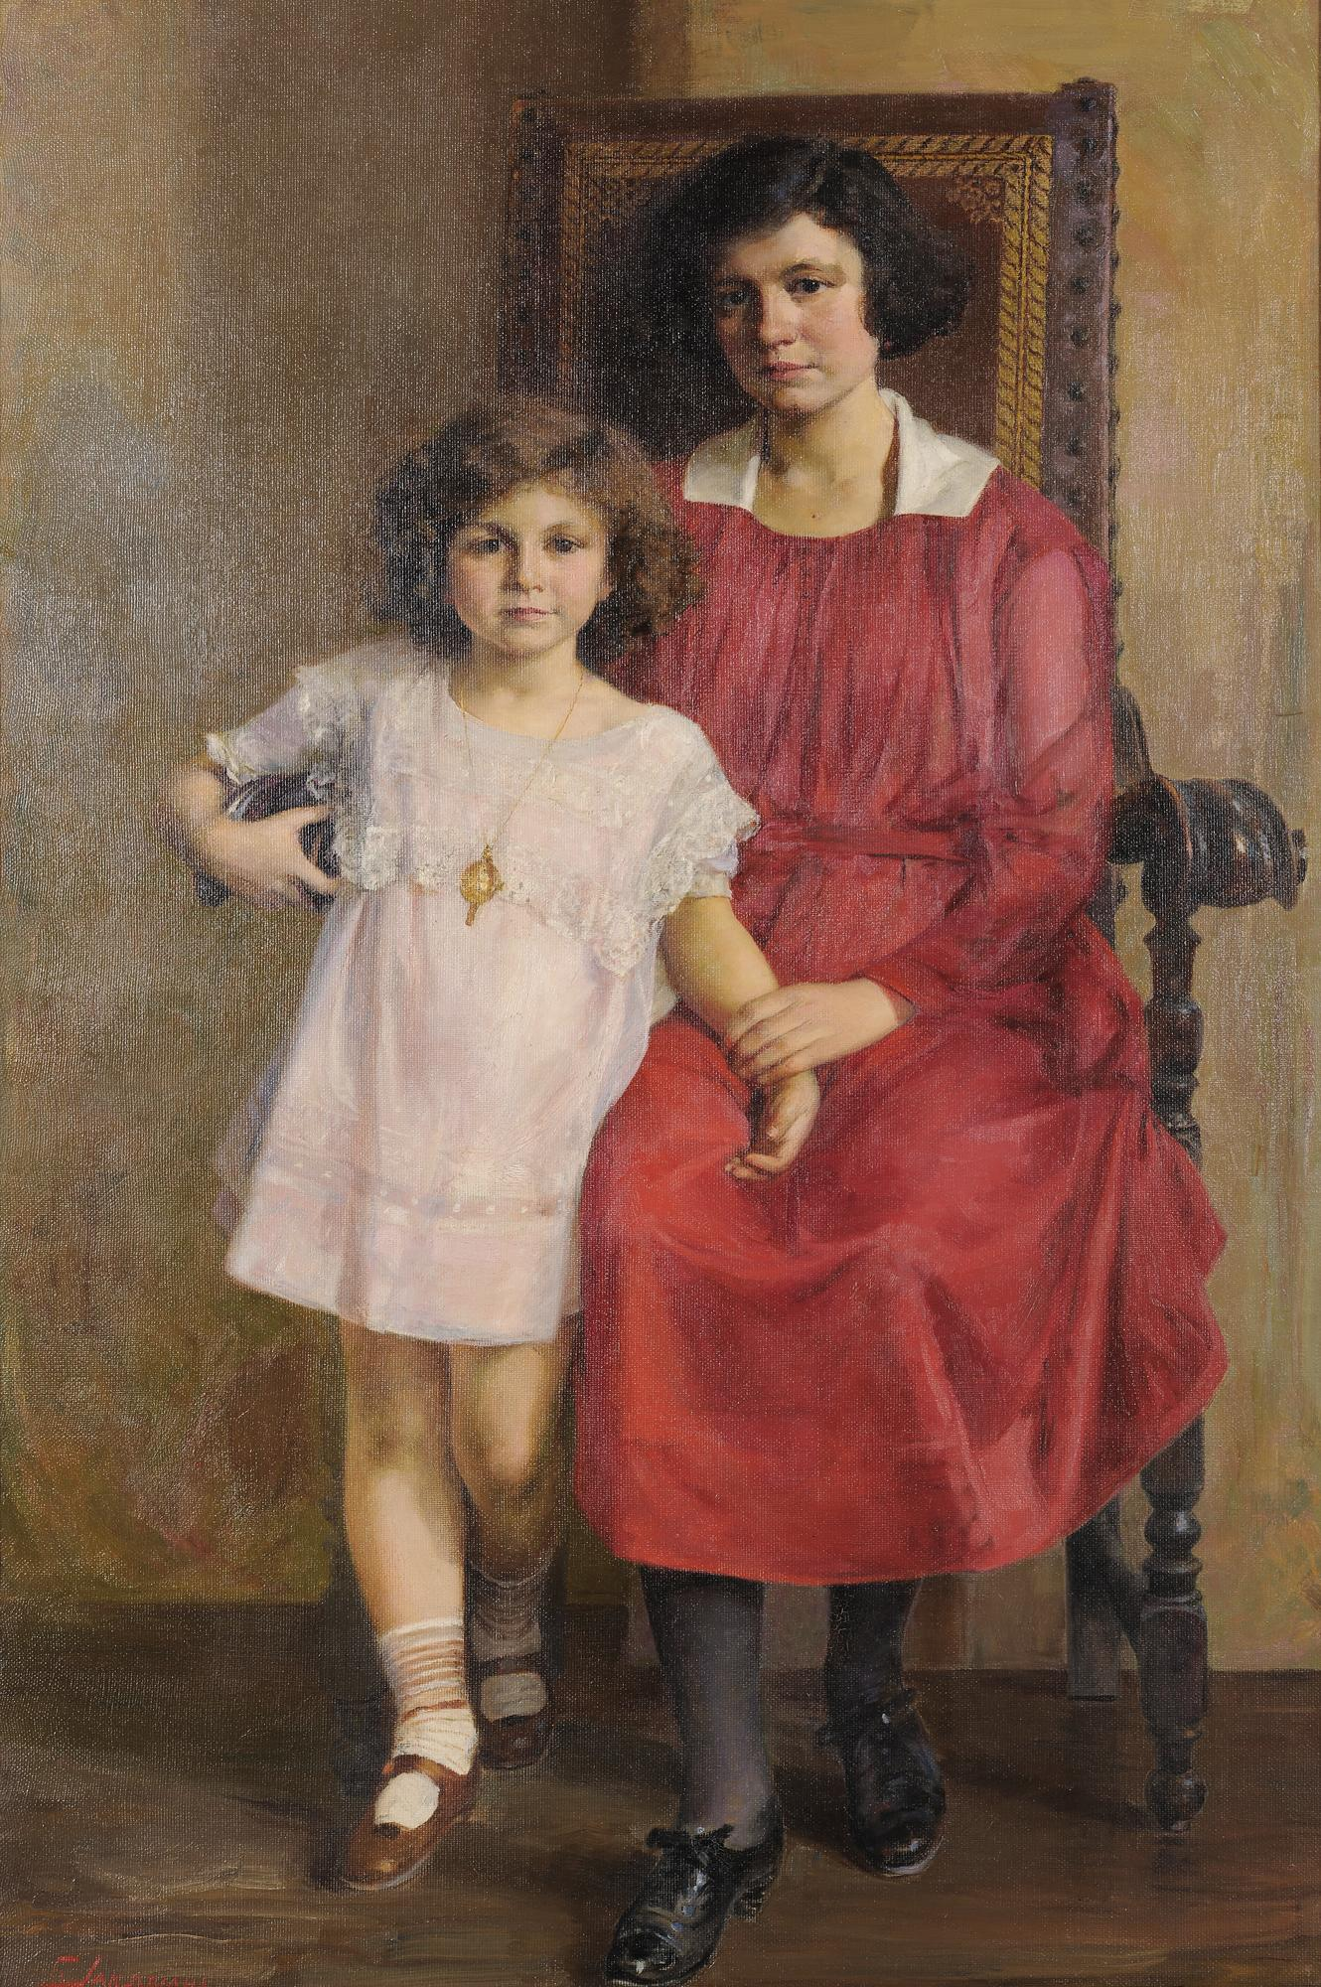
Mother and Little Girl, 1919, Oil on Canvas, 91x45 cm, National Gallery, Apostolos Chatziargyris Bequest, Athens, Greece https://www.nationalgallery.gr/en/all-collections/collection/collections/mother-and-little-girl.html

Slide 20
The End

