Slide 1
Titian
Women, Myth & Power

Slide 2
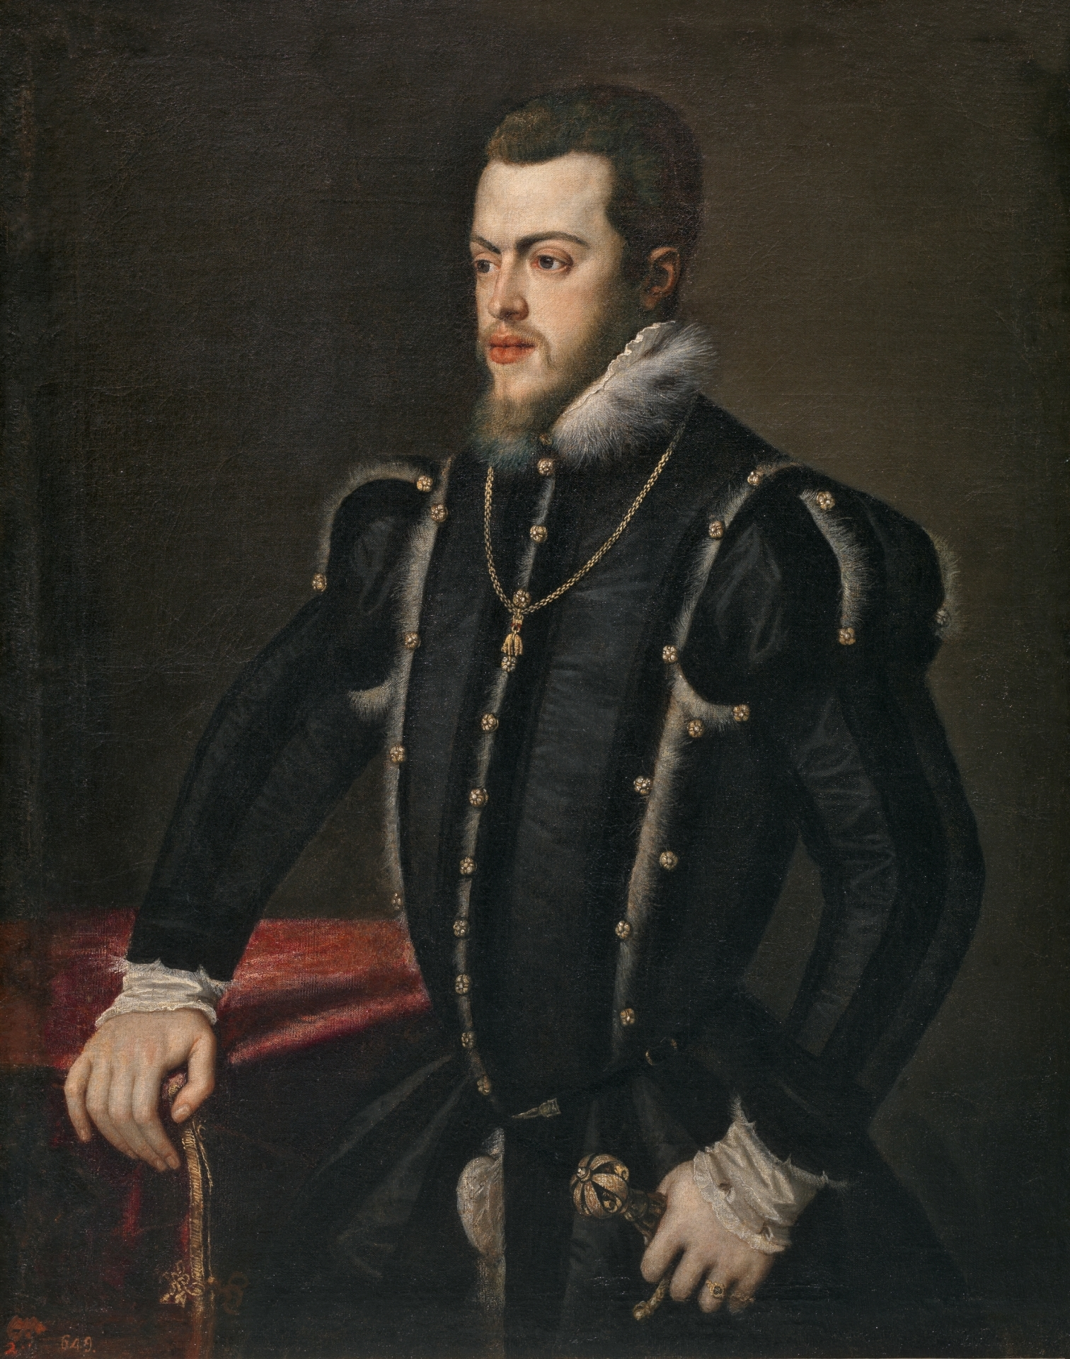
Tiziano Vecelli (Titian in English), c. 1488/90-1576
Philip II of Spain, between 1549 and 1550, Oil on Canvas, 103x82 cm, Museo del Prado, Madrid, Spain
Photo Credit: https://upload.wikimedia.org/wikipedia/commons/e/ec/Philip_II_portrait_by_Titian.jpg

Slide 3
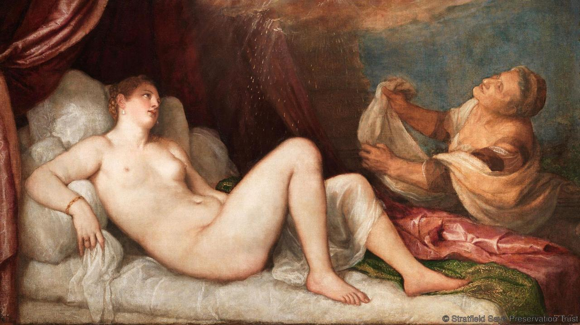
Tiziano Vecelli (Titian in English), c. 1488/90-1576
Danaë, probably 1554–6, Oil on Canvas, 114.6 × 192.5 cm, Wellington Collection, Apsley House © Stratfield Saye Preservation Trust
Photo Credit: https://upload.wikimedia.org/wikipedia/commons/7/77/Wellington_Danae.jpg

Slide 4
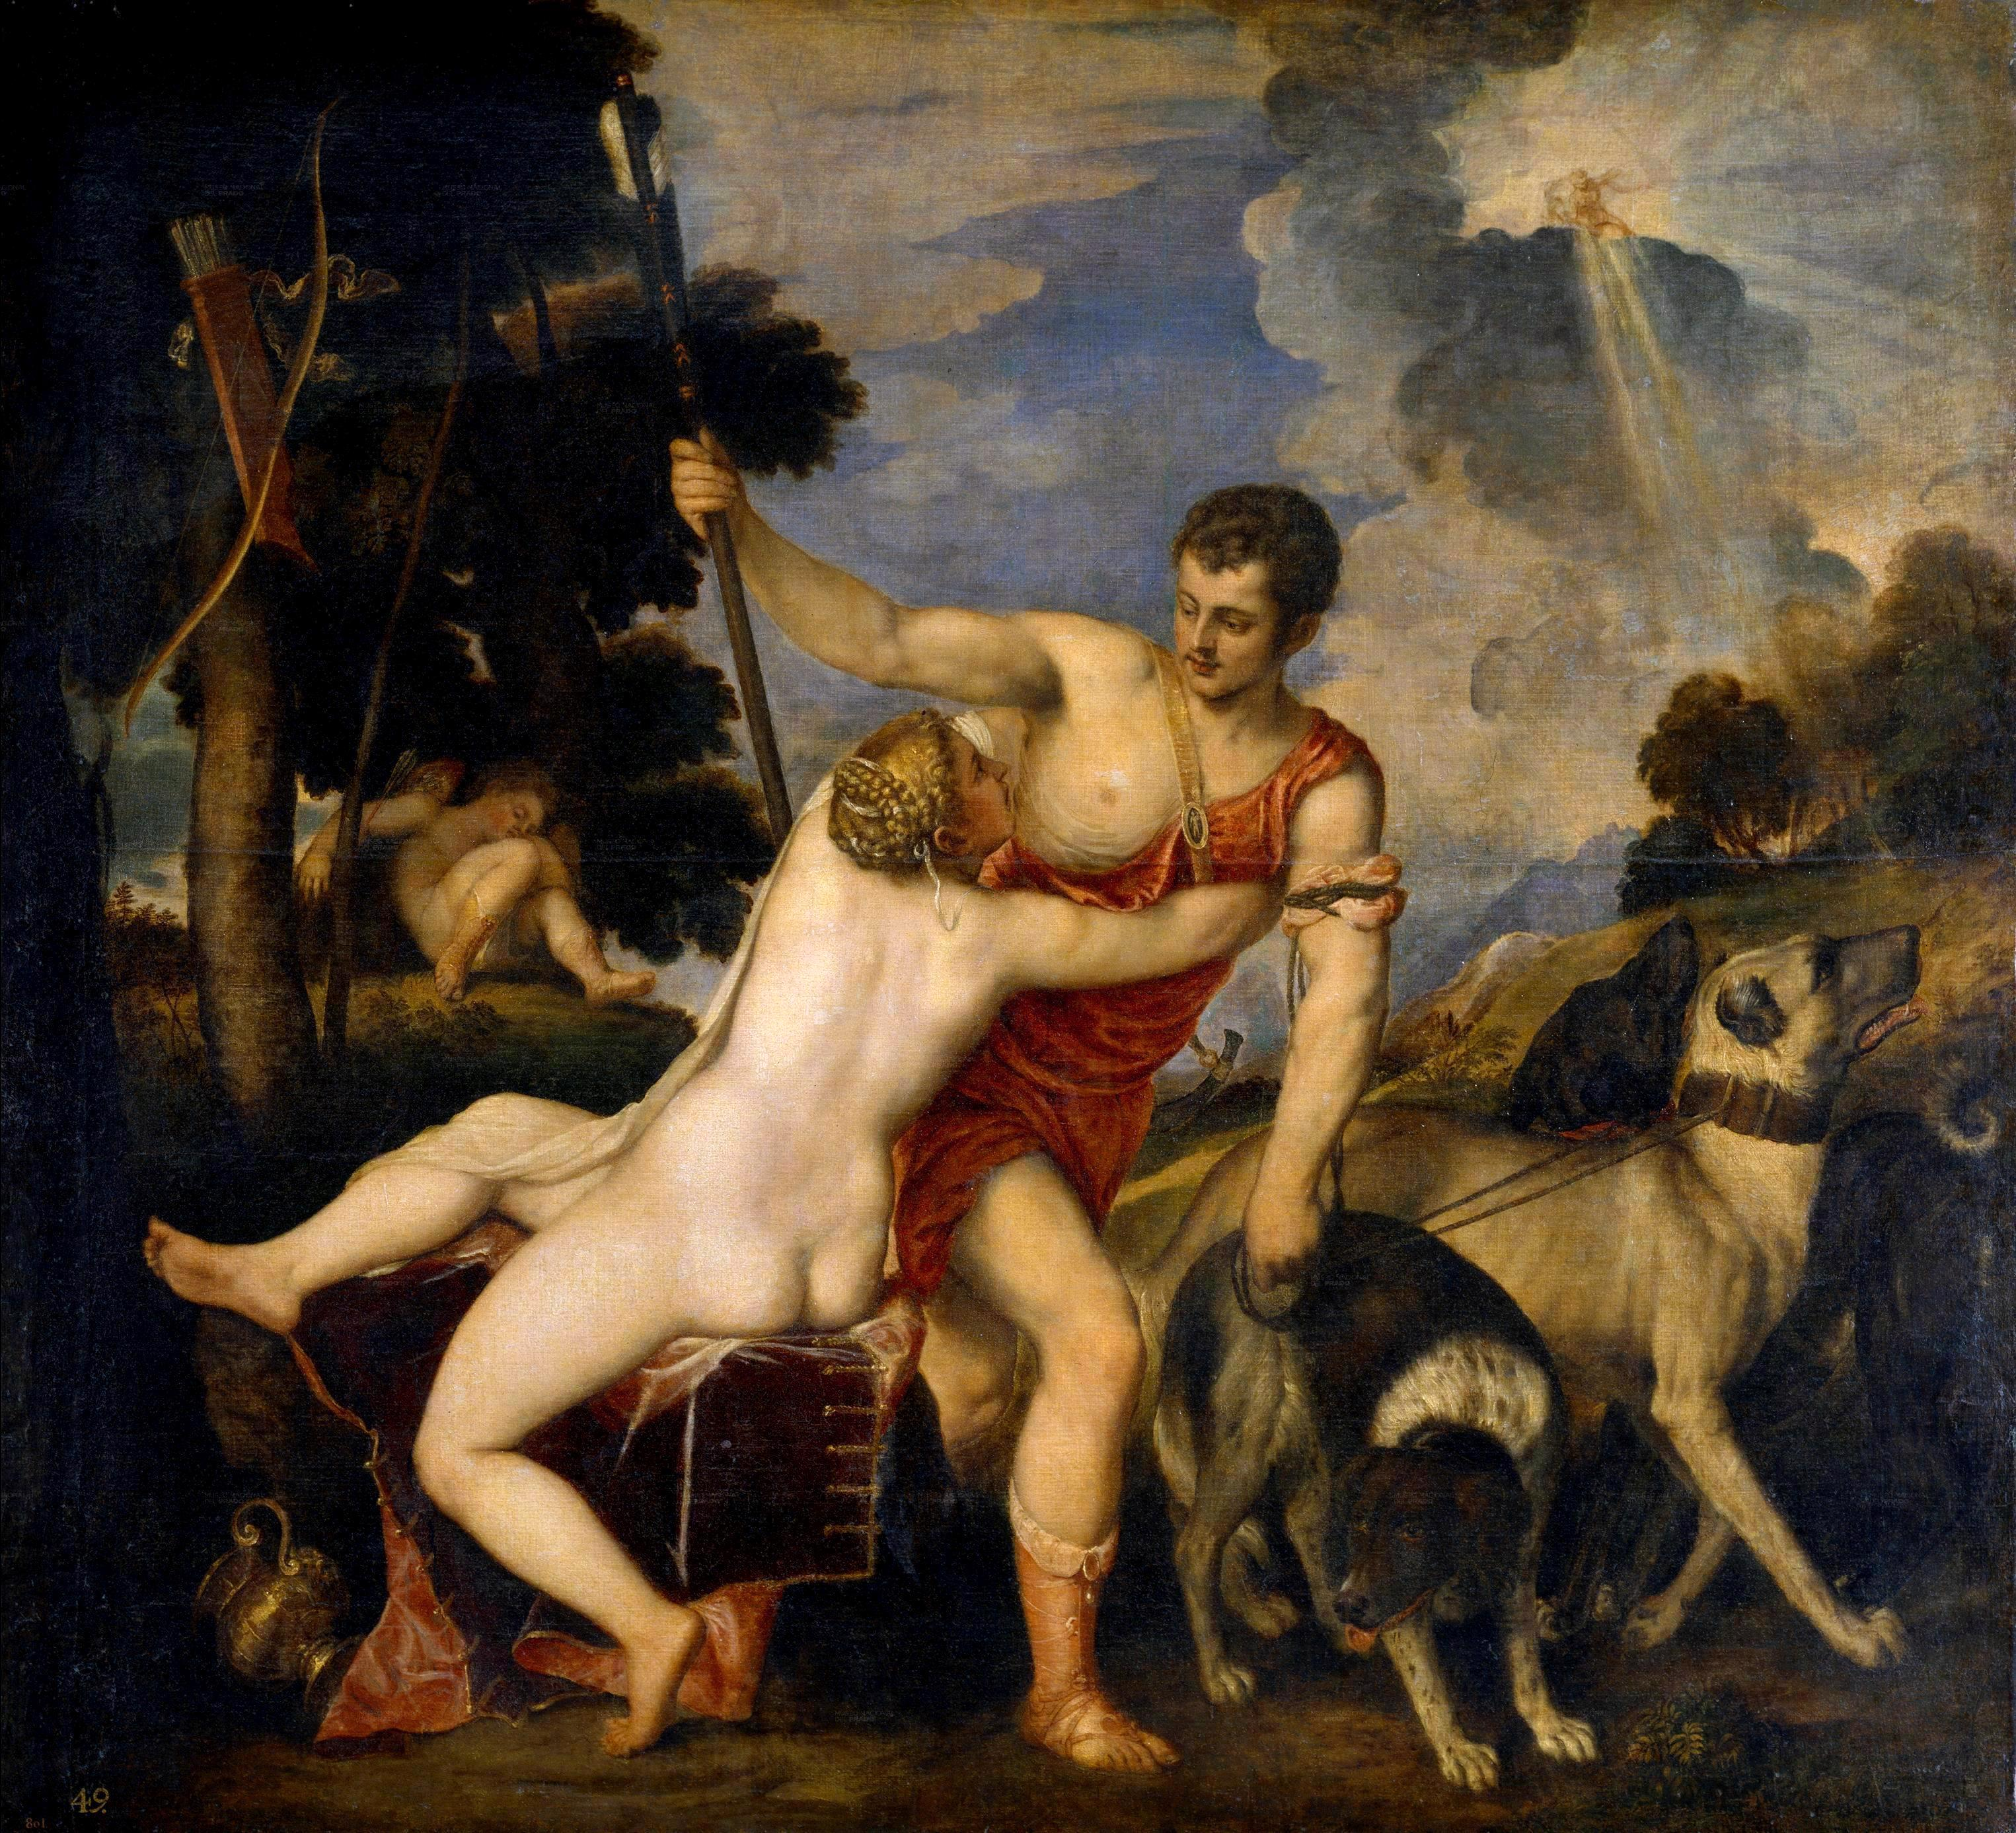
Tiziano Vecelli (Titian in English), c. 1488/90-1576
Aphrodite and Adonis, 1554, Oil on Canvas, 186x207 cm, Museo del Prado, Madrid, Spain
Photo Credit: https://upload.wikimedia.org/wikipedia/commons/d/d9/Venus_prado.jpg

Slide 5
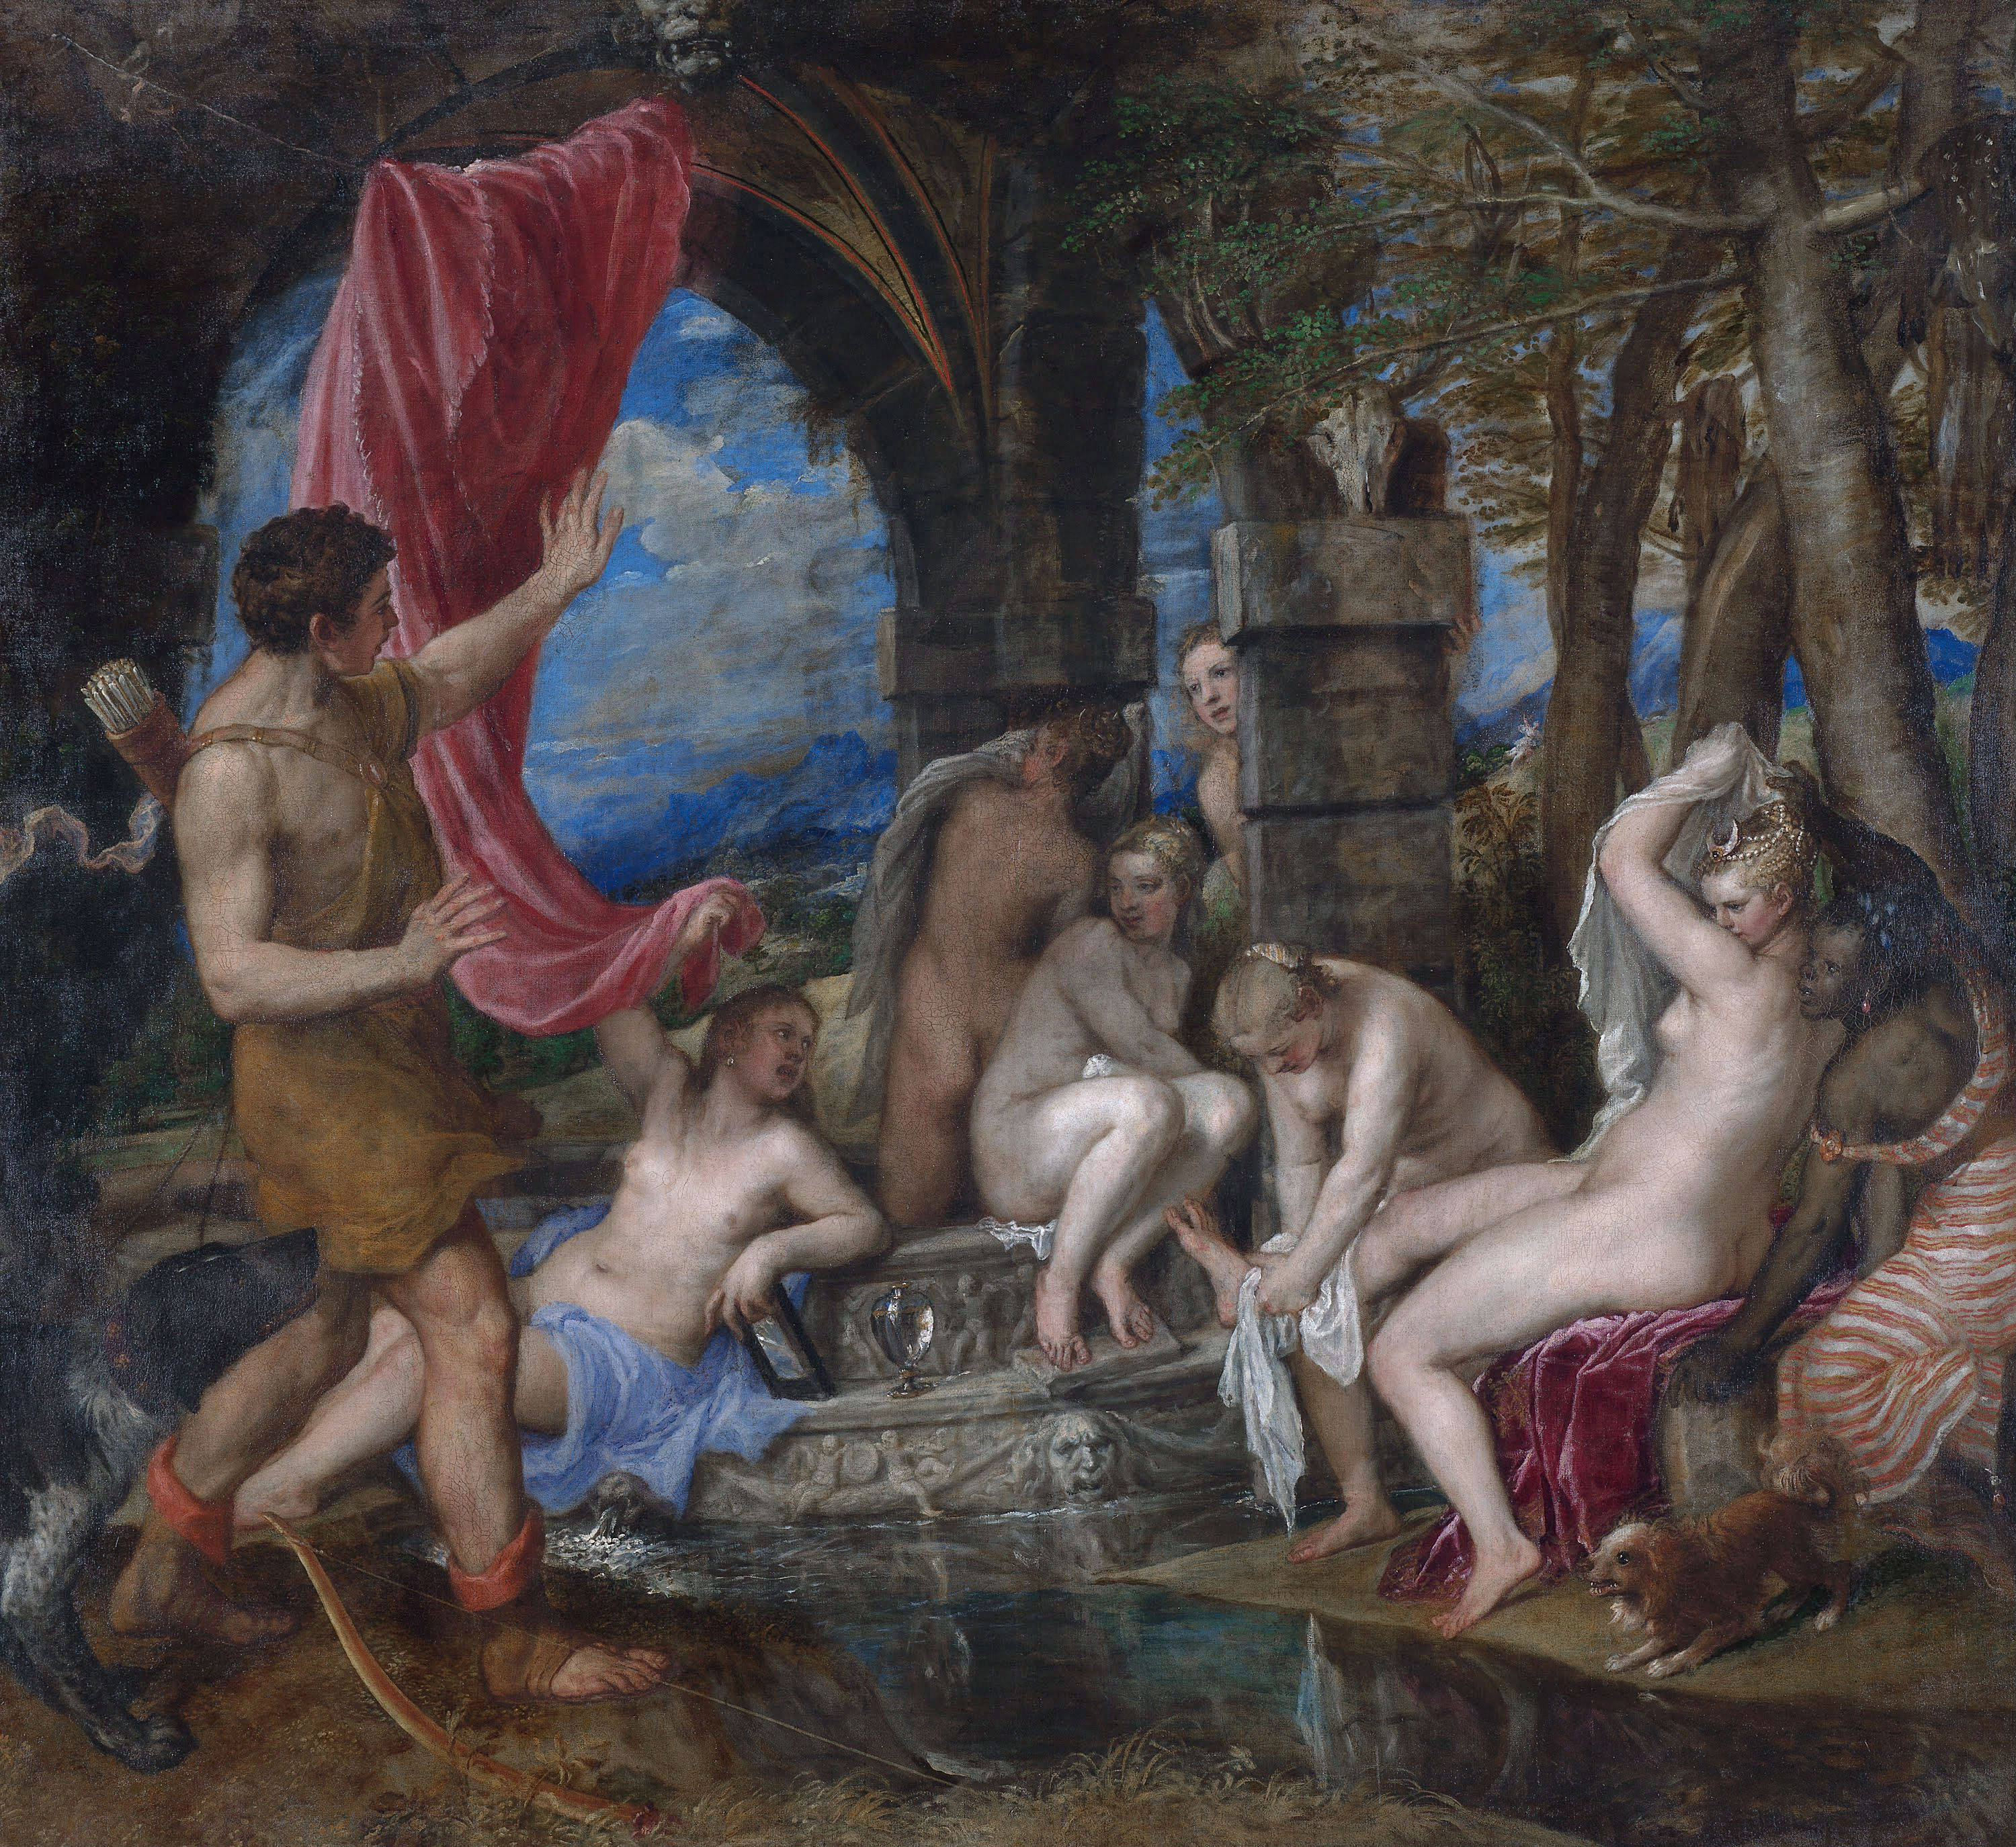
Tiziano Vecelli (Titian in English), c. 1488/90-1576
Artemis and Actaeon, circa 1556-1559, Oil on Canvas, 184.5 × 202.2 cm, Scottish National Gallery, Edinburgh, UK
Photo Credit: https://upload.wikimedia.org/wikipedia/commons/a/a9/Titian_-_Diana_and_Actaeon_-_Google_Art_ProjectFXD.jpg

Slide 6
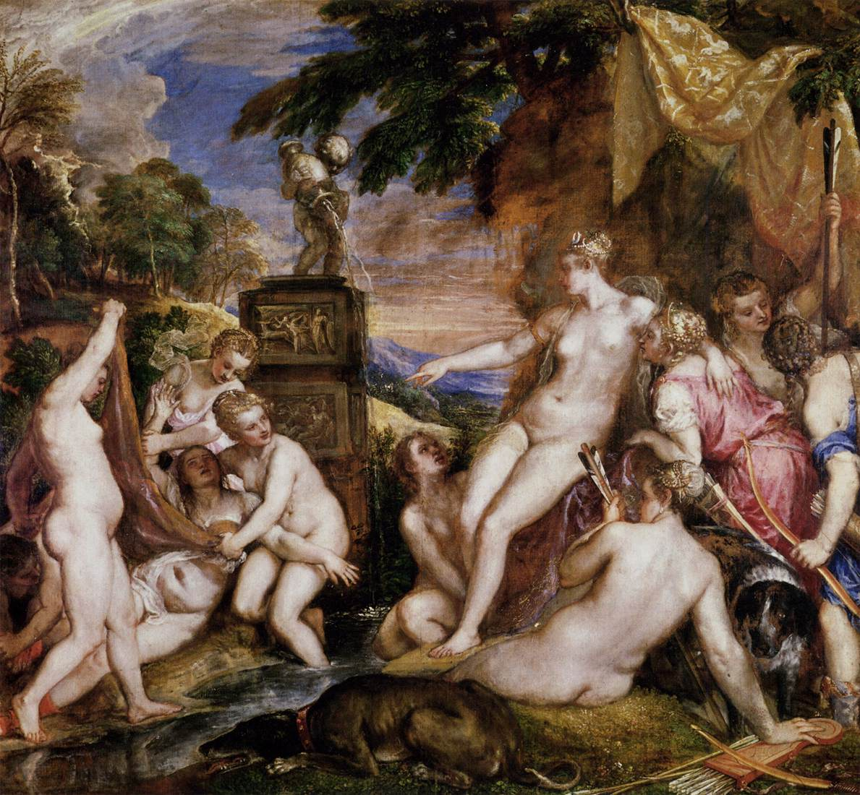
Tiziano Vecelli (Titian in English), c. 1488/90-1576
Artemis and Callisto, circa 1556-1559, Oil on Canvas, 187 × 205 cm, Scottish National Gallery, Edinburgh, UK
Photo Credit: https://upload.wikimedia.org/wikipedia/commons/7/72/Titian_-_Diana_and_Callisto_-_WGA22885.jpg

Slide 7
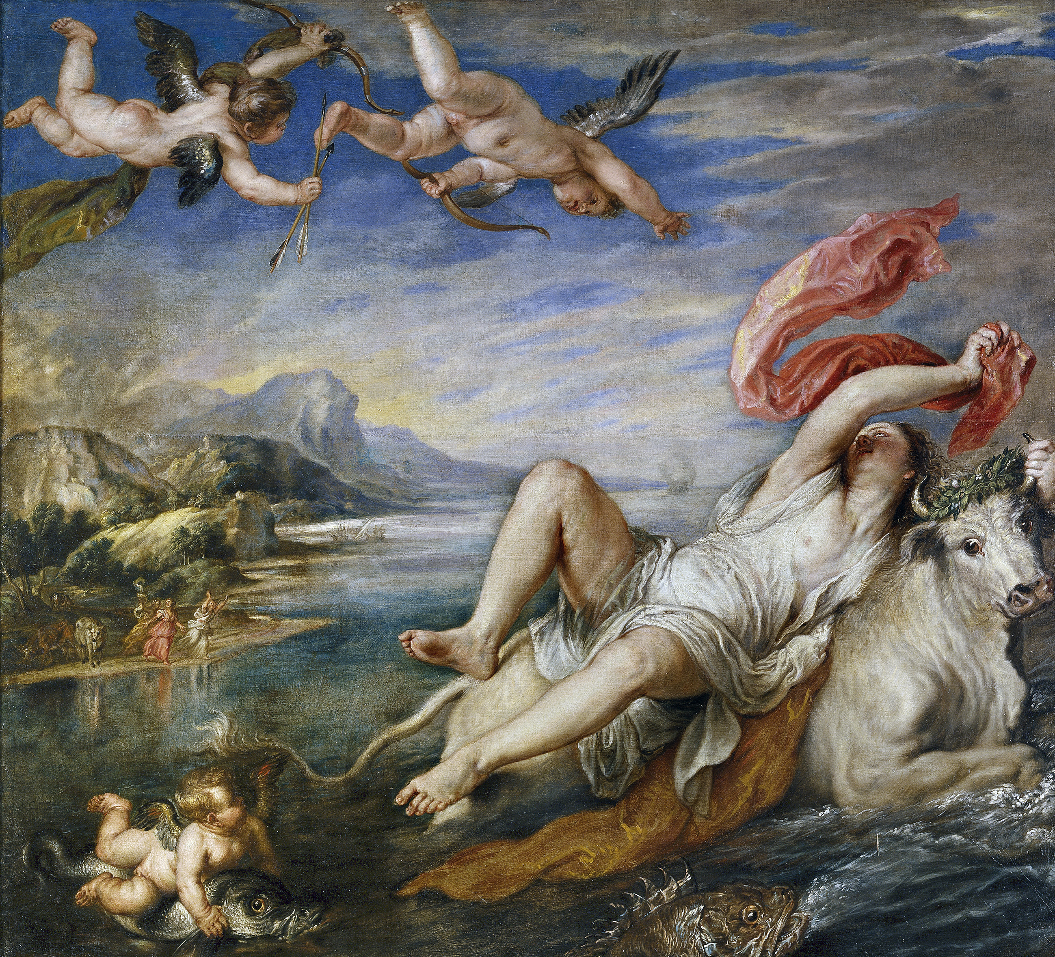
Tiziano Vecelli (Titian in English), c. 1488/90-1576
The Rape of Europa, between 1560 and 1562, Oil on Canvas,
178 ×205 cm, Isabella Stewart Gardner Museum, Boston, USA
Photo Credit: https://upload.wikimedia.org/wikipedia/commons/a/a3/L%27Enl%C3%A8vement_d%27Europe_Rubens.jpeg

Slide 8
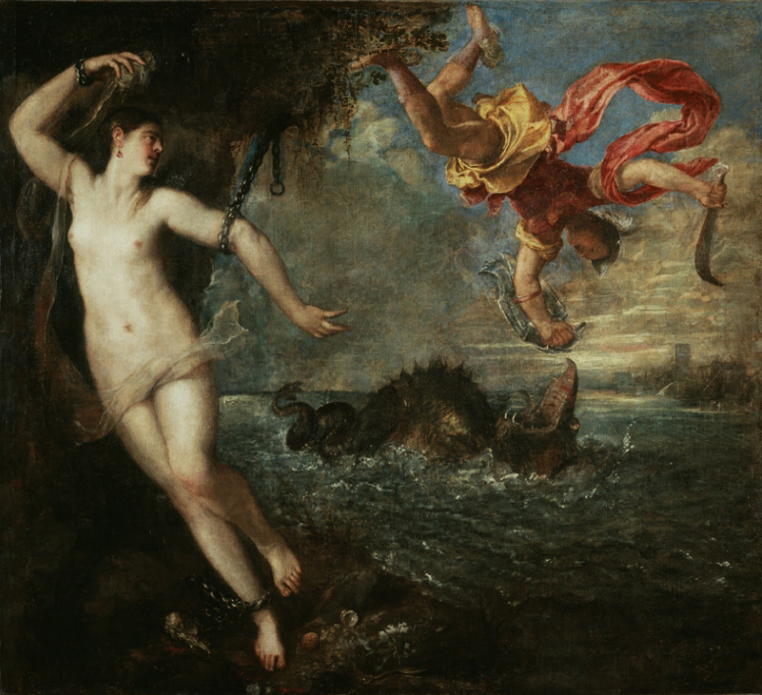
Tiziano Vecelli (Titian in English), c. 1488/90-1576
Perseus and Andromeda, between 1554 and 1556, Oil on Canvas, 185x199 cm, Wallace Collection, London, UK
Photo Credit: https://upload.wikimedia.org/wikipedia/commons/archive/7/75/20180802141150%21Perseo_y_Andr%C3%B3meda%2C_por_Tiziano.jpg

Slide 9
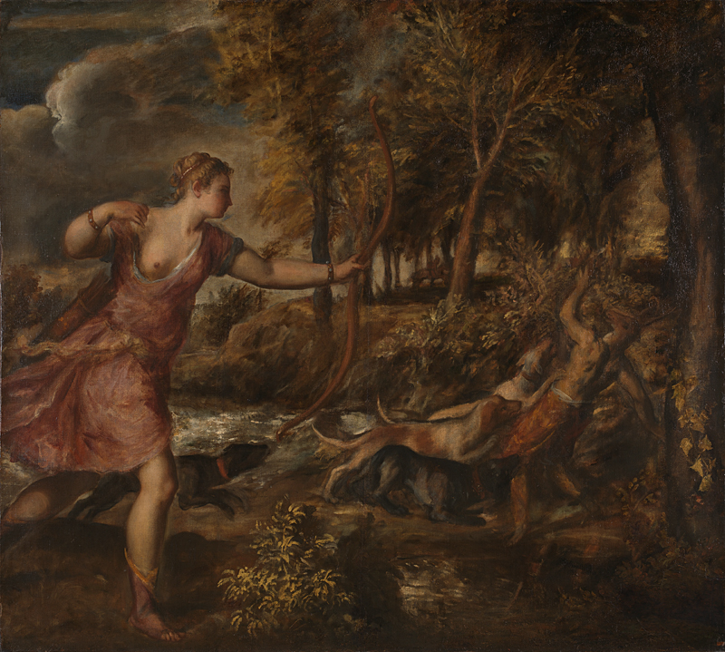
Tiziano Vecelli (Titian in English), c. 1488/90-1576
Death of Actaeon, between 1559 and 1575, Oil on Canvas, 178.8 x 197.8 cm, National Gallery, London, UK
Photo Credit: https://www.nationalgallery.org.uk/paintings/titian-the-death-of-actaeon

Slide 10
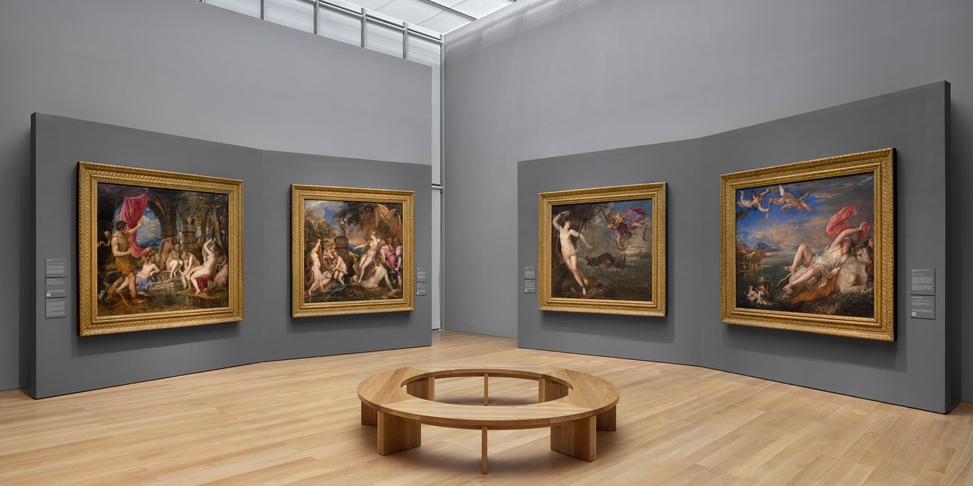
Titian - Women, Myth & Power Exhibition (Installation View)
Isabella Stewart Gardner Museum - August 12 to January 2, 2022
Photo Credit: https://twitter.com/gardnermuseum/status/1434509876898717699/photo/1

Slide 11
The End

