Slide 1
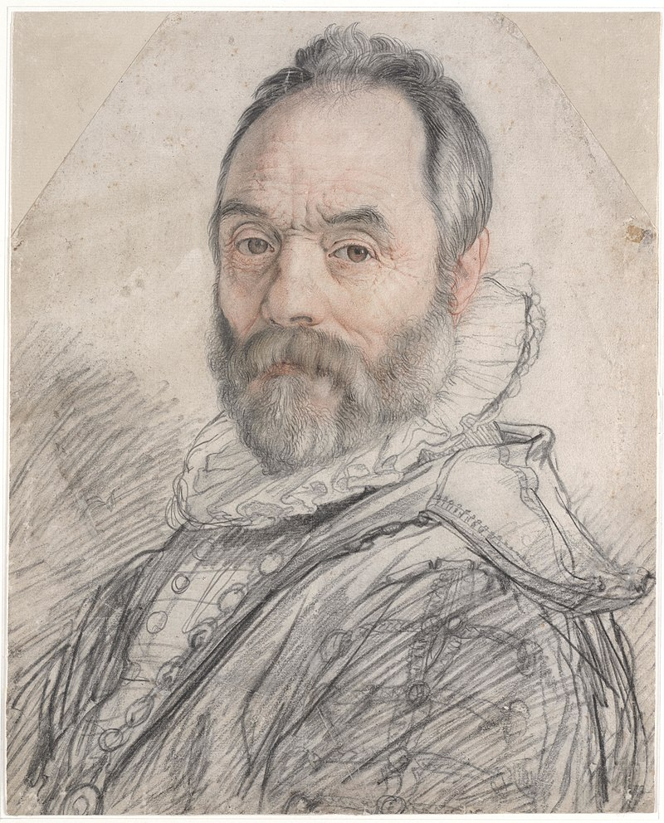
Giambologna,
1529-1608
Hendrick Goltzius, or Hendrik, 1558-1617
Portrait of Giambologna, 1591, chalk, 37x30 cm, Teylers Museum, Netherlands
Photo Credit: https://commons.wikimedia.org/wiki/File:Portrait_of_Giambologna.jpg

Slide 2
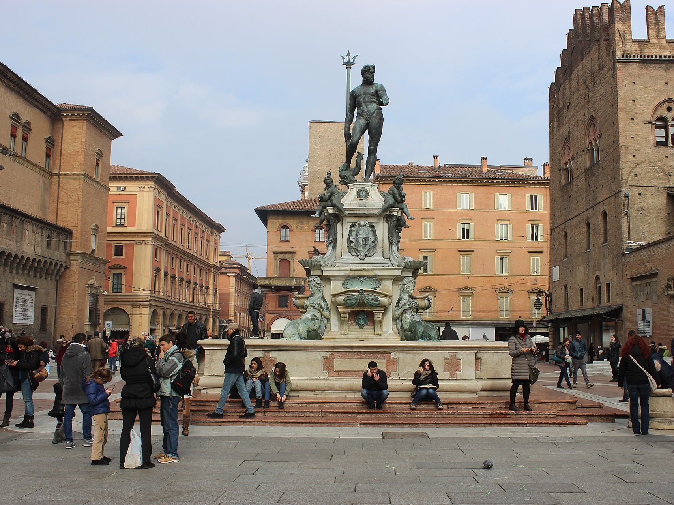
Fountain of Neptune, 1563-66, Bronze and marble, 335 cm (central figure)
Piazza Maggiore, Bologna, Italy
Photo Credit: https://commons.wikimedia.org/wiki/Category:Fontana_del_Nettuno_(Bologna)#/media/File:Piazza_di_Nettuno_a_Bologna.JPG

Slide 3
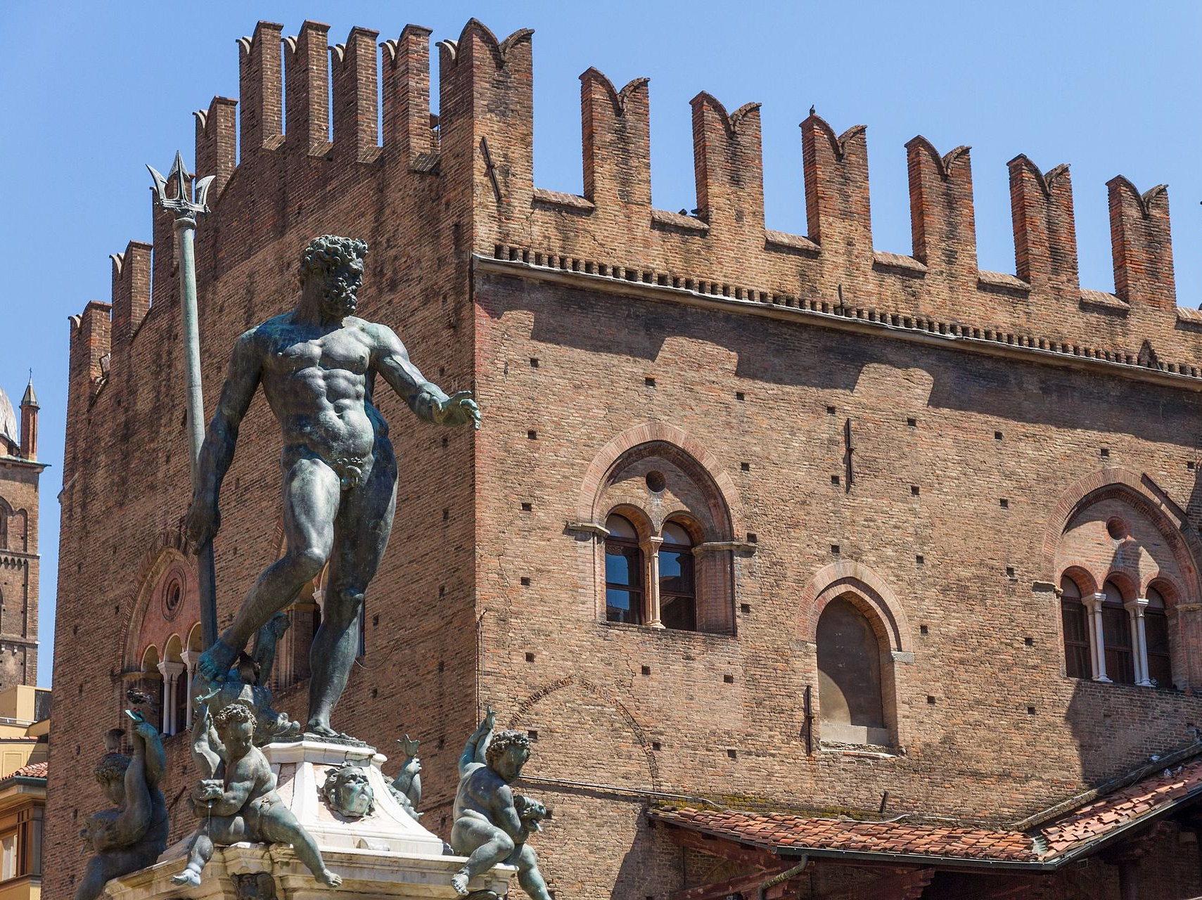
Poto Credit: https://commons.wikimedia.org/wiki/Category:Fontana_del_Nettuno_(Bologna)#/media/File:Nettuno_with_Palazzo_Re_Enzo_in_the_background.jpg

Slide 4
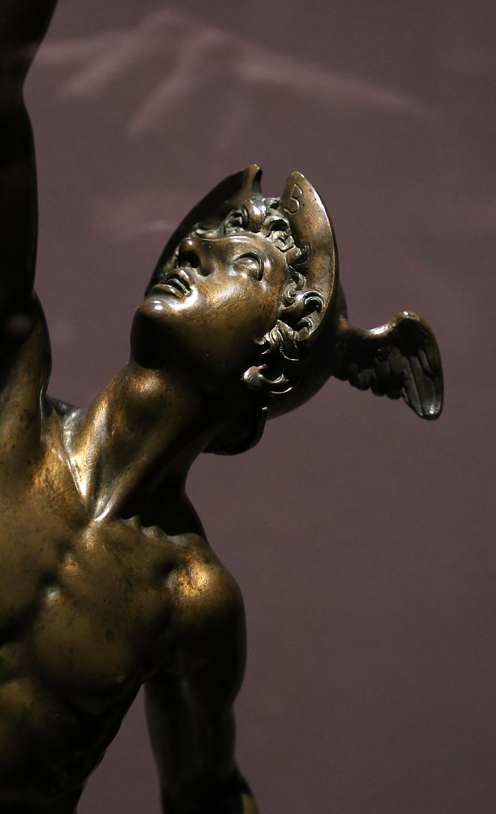
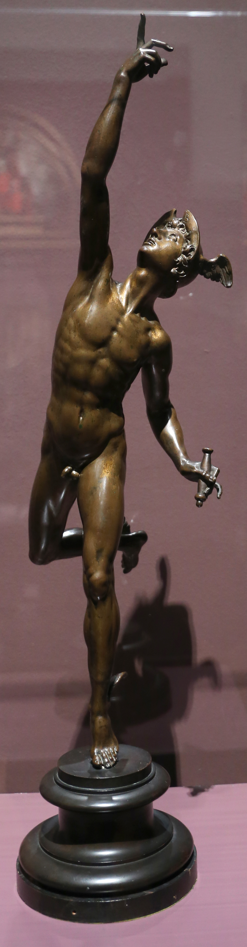
Mercury, 1585, Bronze, 73,5×21×26,5 cm, Kunsthistorisches Museum, Vienna, Austria
Photo Credits: https://commons.wikimedia.org/wiki/Category:Mercurius_by_Giambologna#/media/File:Giambologna,_mercurio,_1585_ca._(vienna,_khm)_02.jpg https://upload.wikimedia.org/wikipedia/commons/6/65/Giambologna%2C_mercurio%2C_1585_ca._%28vienna%2C_khm%29_01.jpg

Slide 5
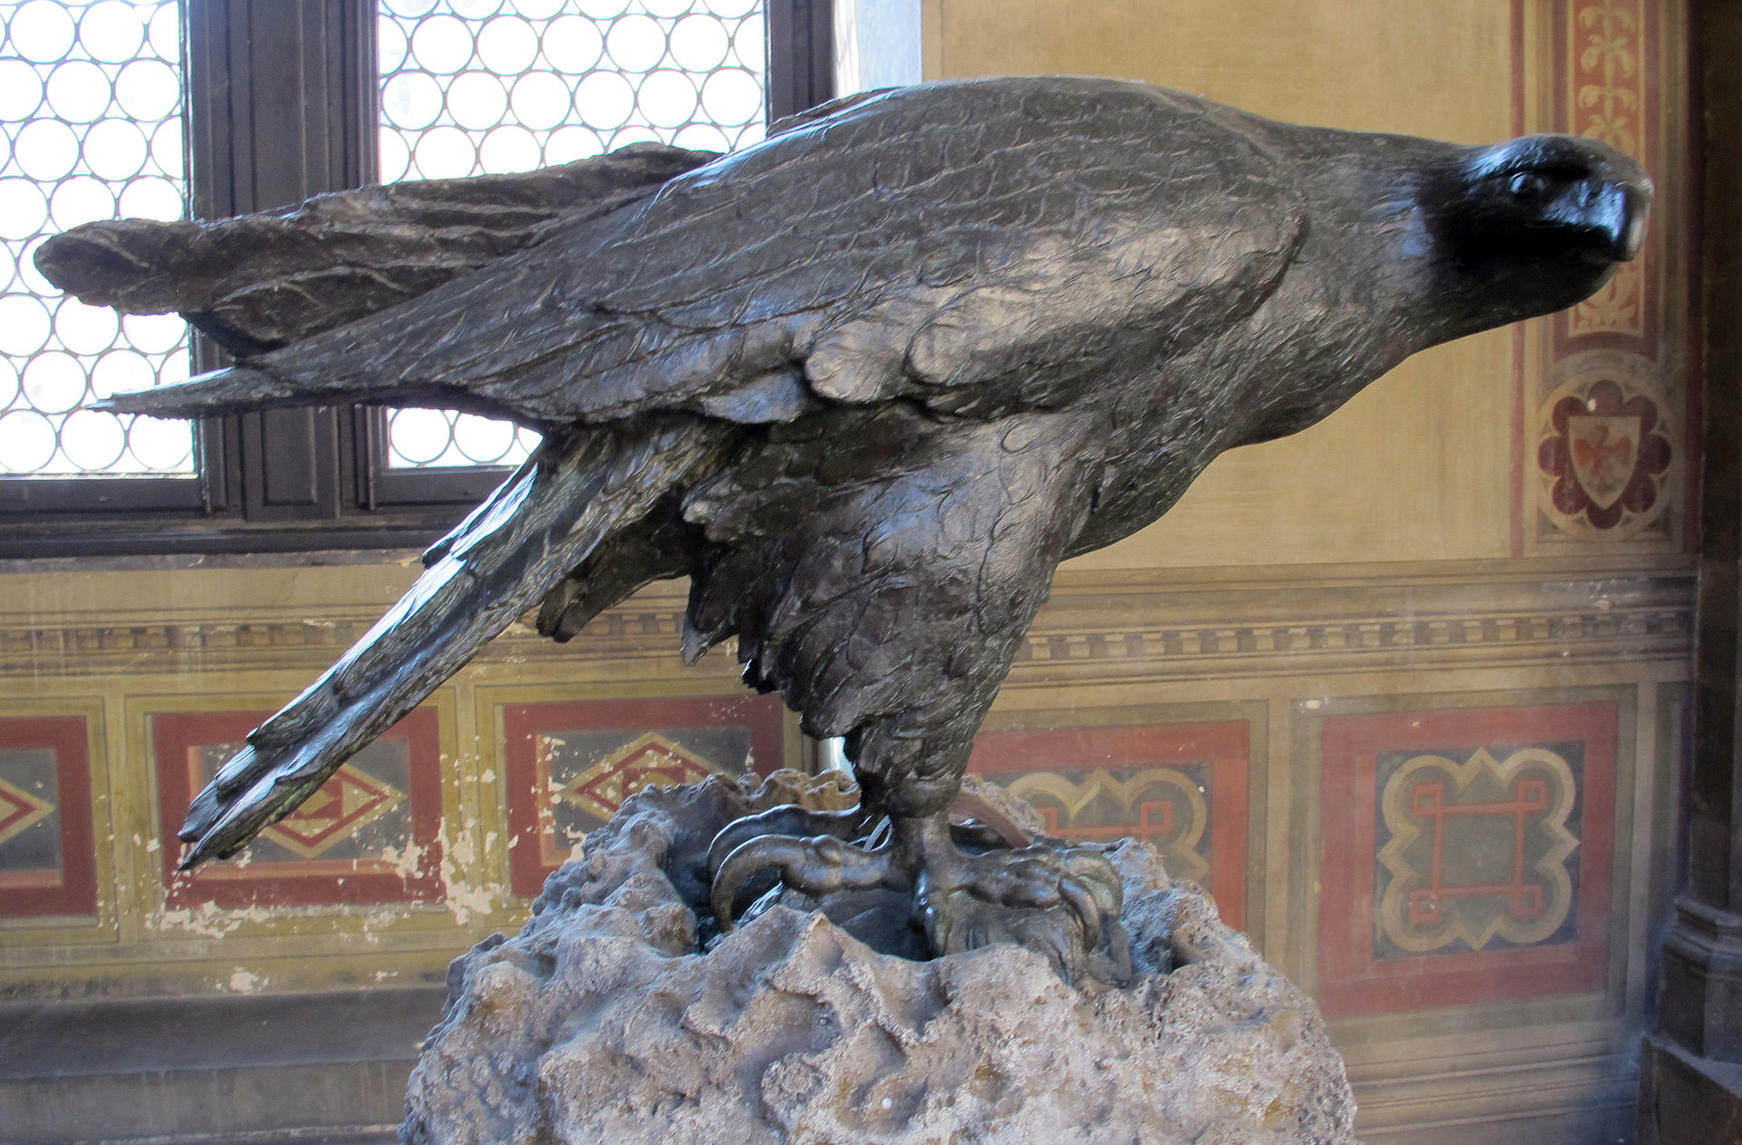
Eagle, 1567, Bronze, Museo Nazionale del Bargello, Florence, Italy
Photo Credit: ttps://commons.wikimedia.org/wiki/Category:Birds_sculptures_by_Giambologna_(Museo_del_Bargello)#/media/File:Giambologna,_aquila_reale,_1567.JPG

Slide 6
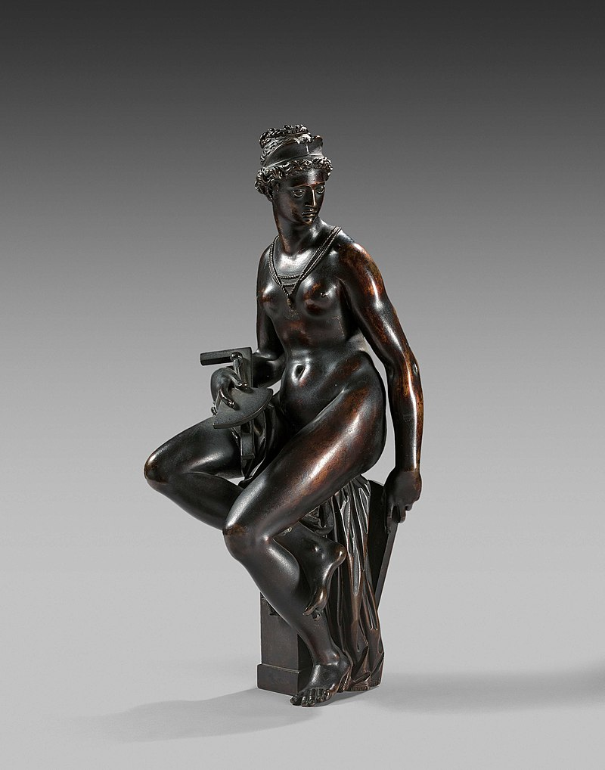
Architecture, 1560s, Bronze, H. 45 cm, Museum of Fine Arts, Boston, USA
Photo Credit: https://commons.wikimedia.org/wiki/Category:Allegory_of_Architecture_by_Giambologna#/media/File:Allegorie_de_l'architecture.jpg

Slide 7
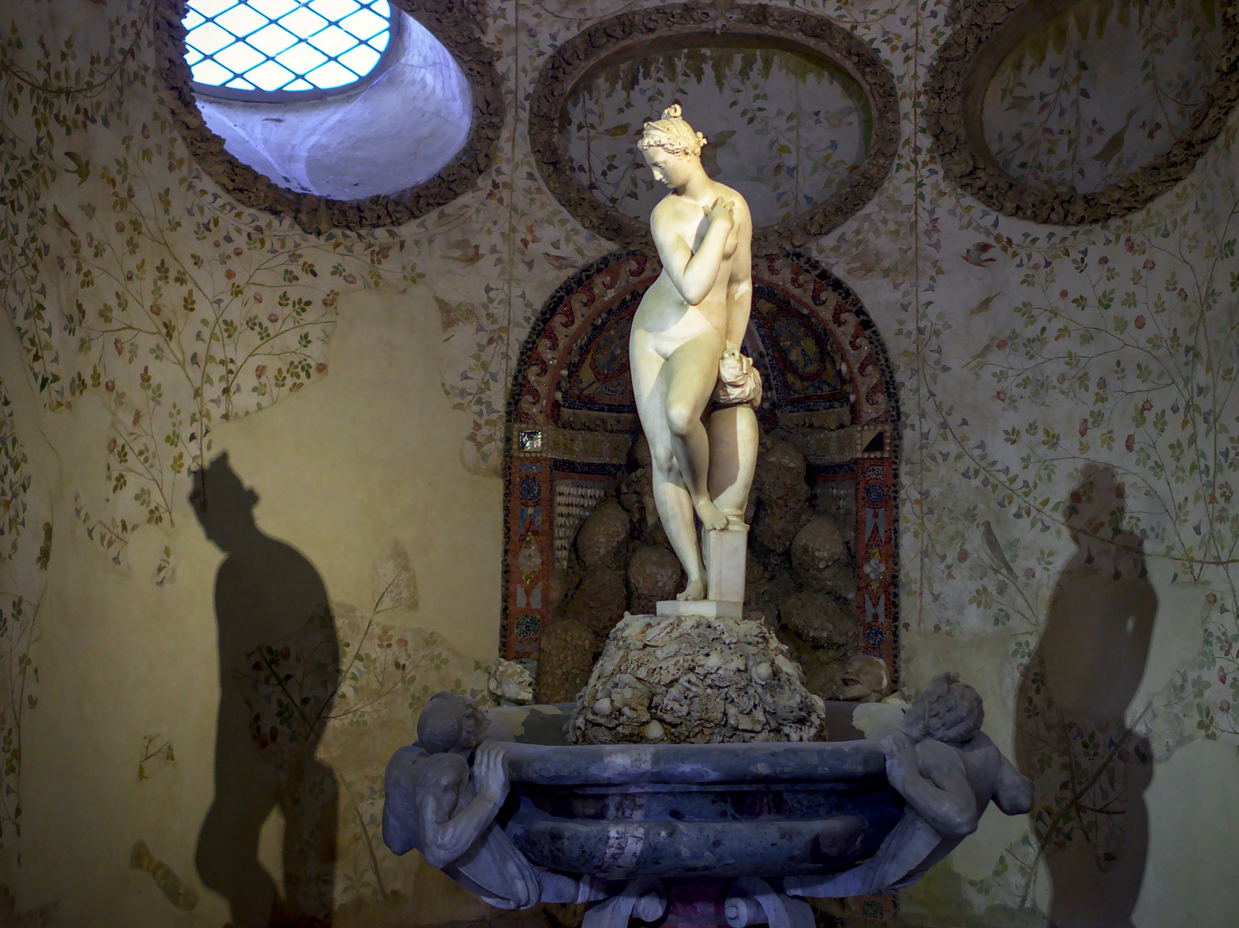
Venus, 1573, Marble, Grotto Buontalenti, Boboli Gardens, Florence, Italy
Photo Credit: https://commons.wikimedia.org/wiki/Category:Bathing_Venus_by_Giambologna#/media/File:Bathing_Venus_statue_in_Buontalenti_Grotto,_Boboli_Gardens,_Florence.jpg

Slide 8
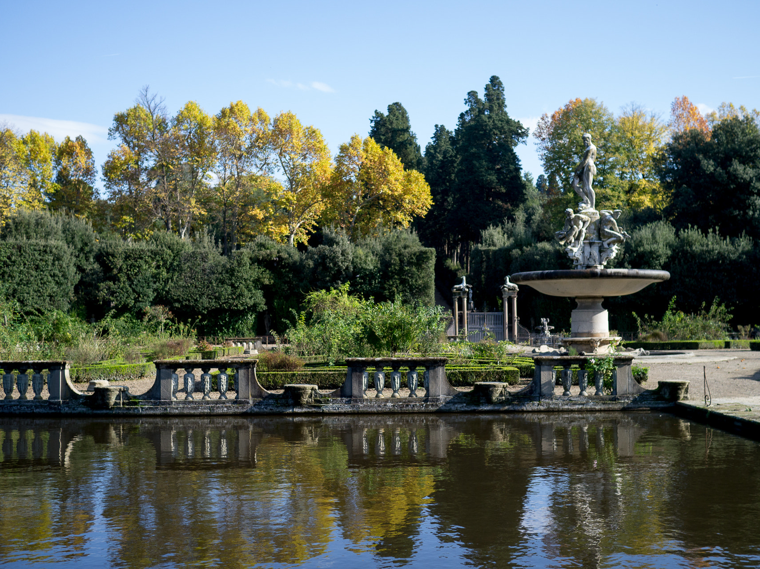
The Fountain of Oceanus, 1576, Marble, Boboli Gardens, Florence, Italy
Photo Credit: https://commons.wikimedia.org/wiki/Category:Fountain_of_Oceanus_by_Giambologna#/media/File:Boboli_isolotto_(165453369).jpg

Slide 9
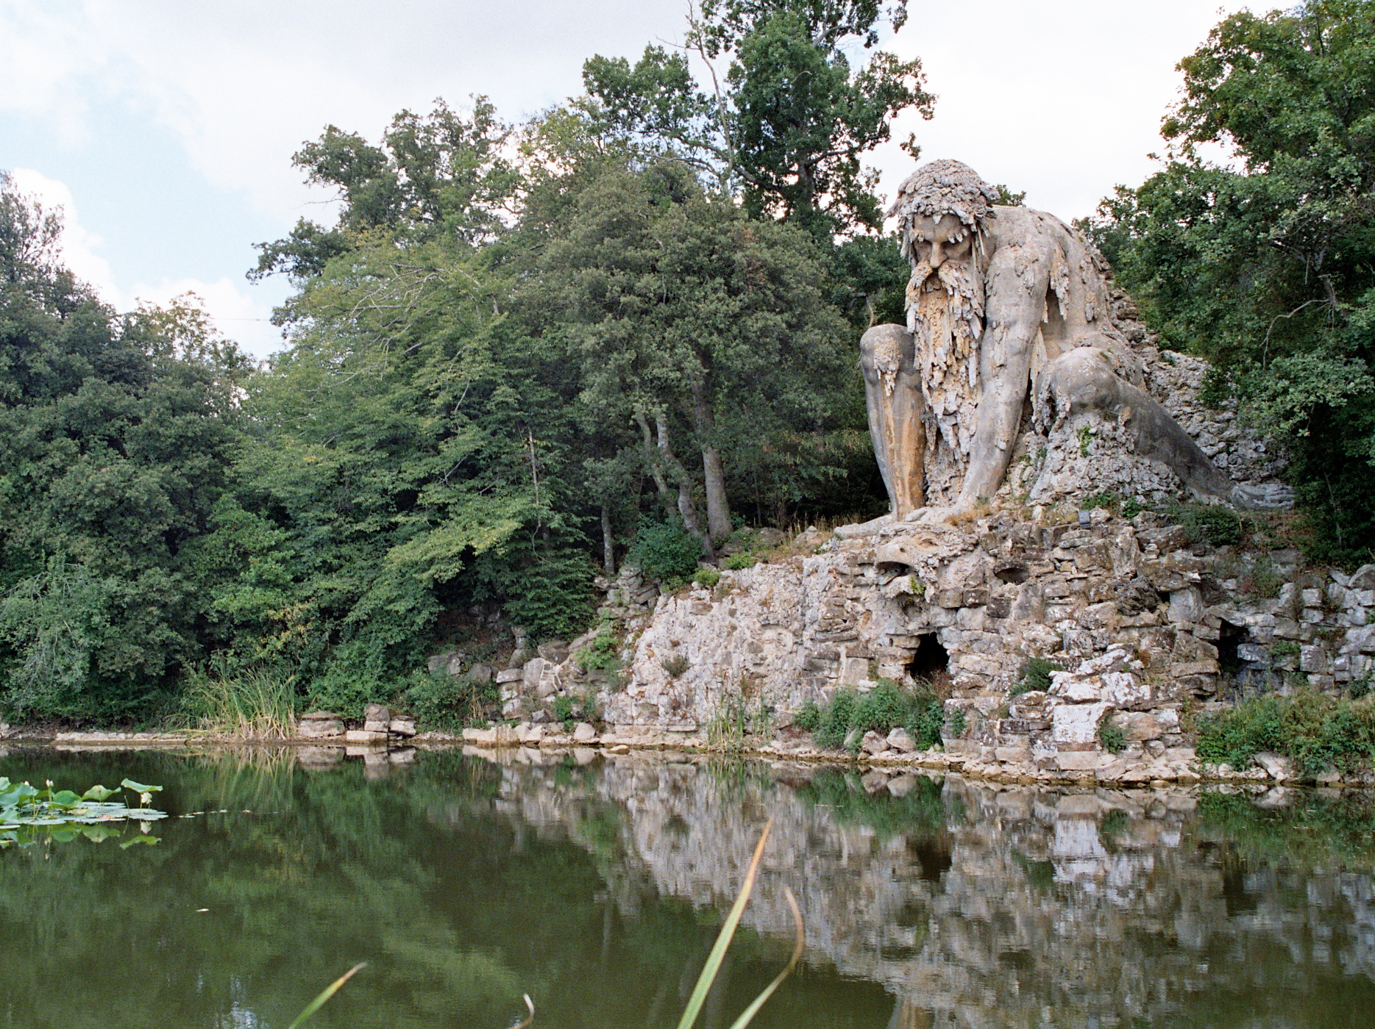
Colosso del’Appenino, 1570s, Rock, lava, brick, etc., H. 10 m, Garden of the Villa Medici, Pratolino, Italy
Photo Credit: https://commons.wikimedia.org/wiki/File:Demidoff_01.jpg

Slide 10
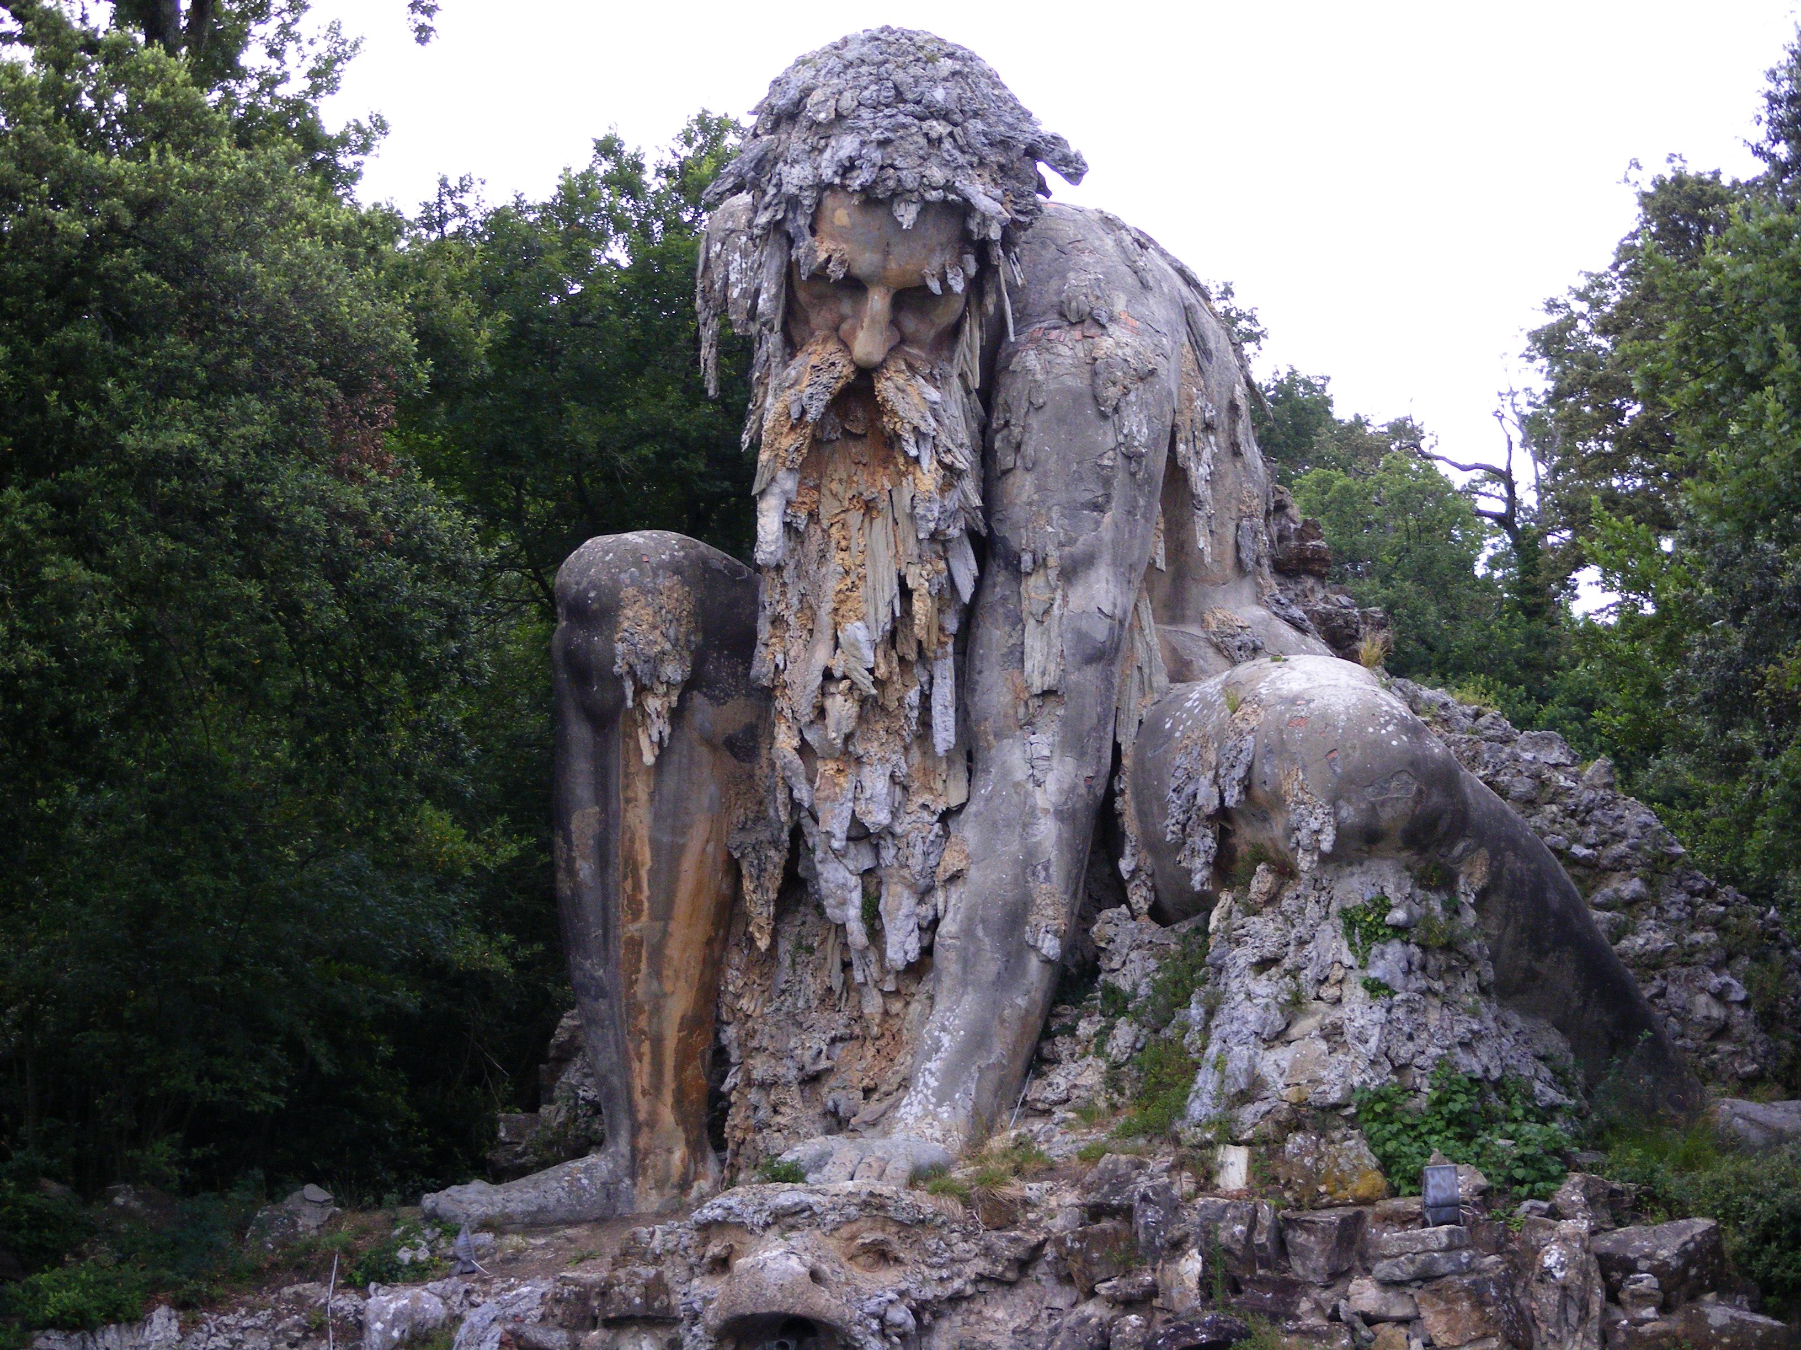
https://upload.wikimedia.org/wikipedia/commons/b/b0/Gigante_dell%27Appennino_del_Giambologna.jpg

Slide 11
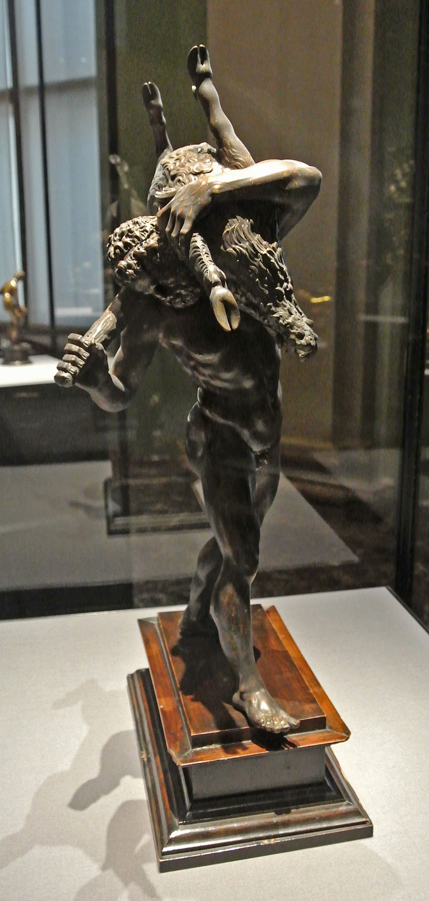
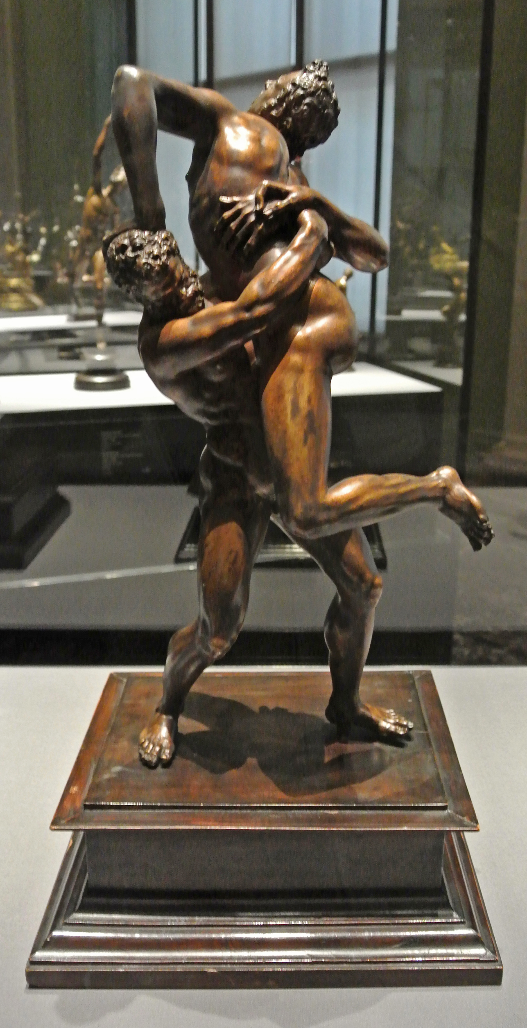
Hercules with the Erymanthian Boar, 1575-80, Bronze, H. 47 cm, Kunsthistorisches Museum, Vienna, Austria
Photo Credit: https://commons.wikimedia.org/wiki/File:Herkules_(Giambologna_1575).jpg
Hercules and Antaeus,
1578-80, Bronze, H. 51 cm,
Kunsthistorisches Museum, Vienna, Austria
Photo Credit: https://upload.wikimedia.org/wikipedia/commons/b/ba/Herkules_%28Giambologna_1578%29.jpg

Slide 12
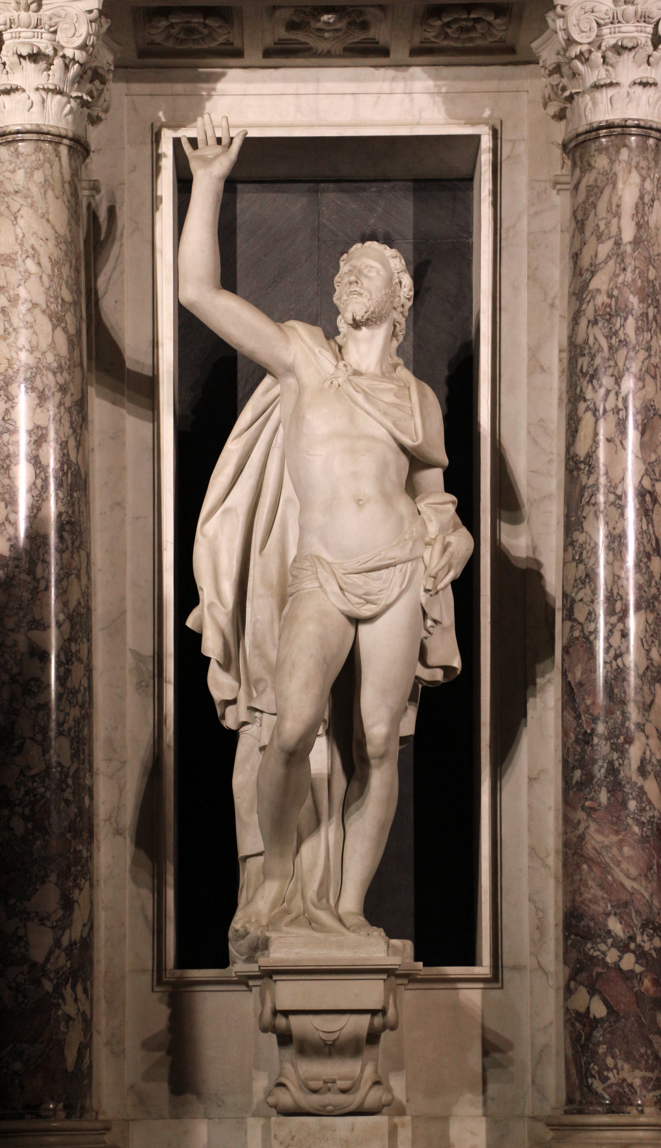
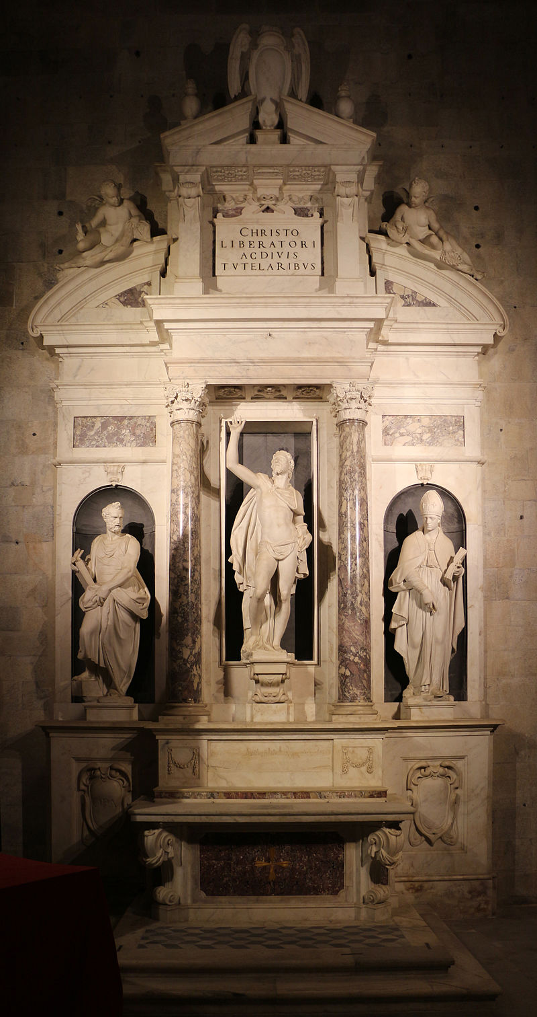
Altar of Liberty, 1579, Marble, Cathedral of San Martino, Lucca, Italy
Photo Credits: https://upload.wikimedia.org/wikipedia/commons/6/62/Giambologna%2C_altare_della_libert%C3%A0%2C_1579%2C_05_cristo_salvatore.JPG https://commons.wikimedia.org/wiki/Category:Altar_of_Freedom#/media/File:Giambologna,_altare_della_libert%C3%A0,_1579,_01.JPG

Slide 13
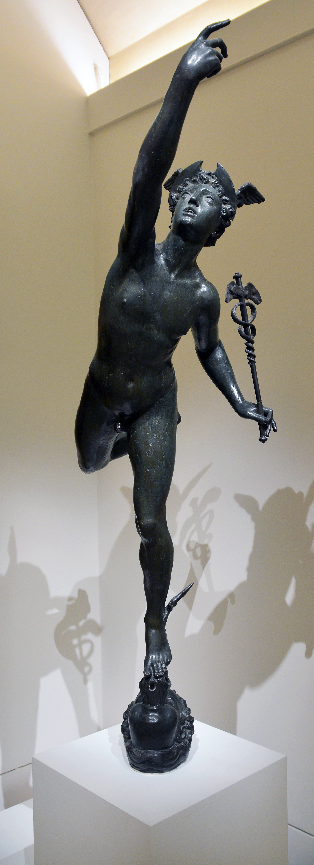
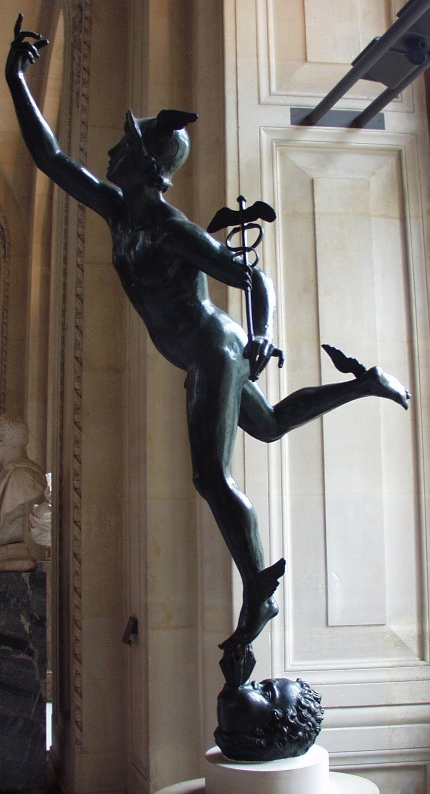
Mercury, 1580, Bronze, H. 180 cm, the Louvre, Paris, France
Photo Credits: https://commons.wikimedia.org/wiki/Category:Mercurius_by_Giambologna_(Louvre)#/media/File:Mercurius_by_Giambologna_(Louvre).jpg https://commons.wikimedia.org/wiki/File:Giambologna,_mercurio_volante,_01.JPG

Slide 14
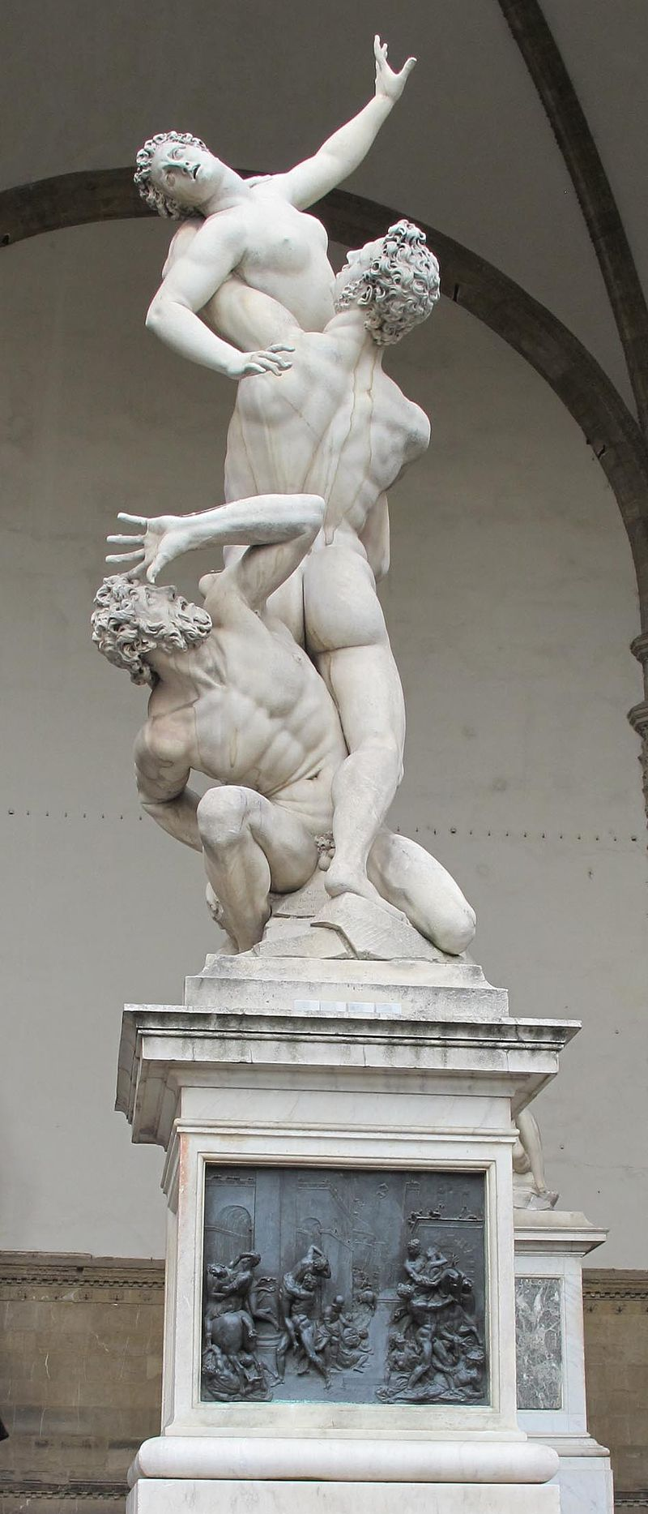
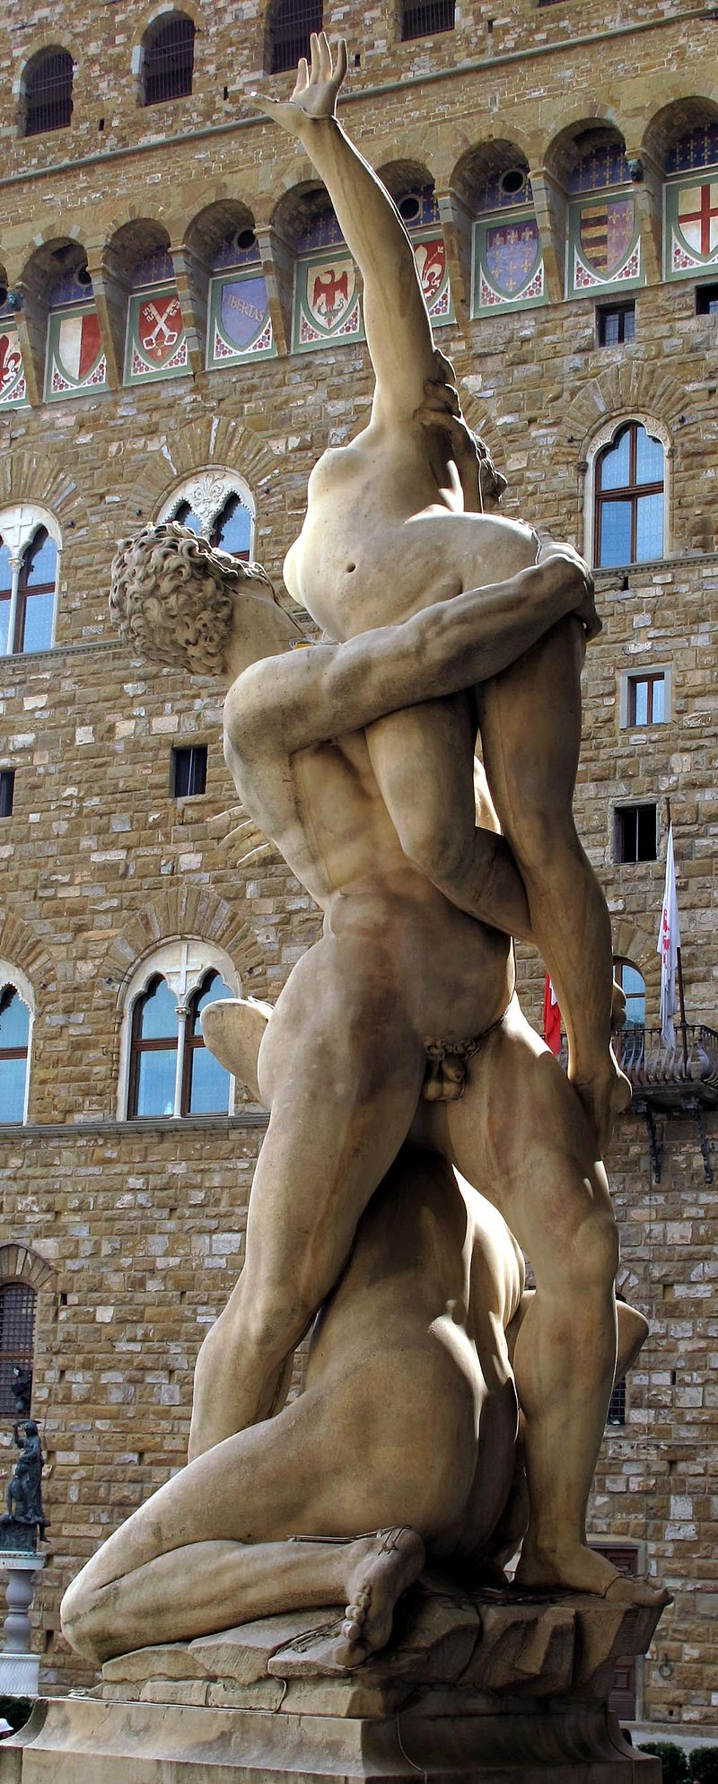
Rape of a Sabine, 1581-83, Marble, H. 410 cm, Loggia dei Lanzi, Florence
Photo Credit: https://commons.wikimedia.org/wiki/Category:Rape_of_the_Sabine_Women_at_Loggia_dei_Lanzi#/media/File:Giambologna,_ratto_delle_sabine_01.JPG https://commons.wikimedia.org/wiki/Category:Rape_of_the_Sabine_Women_at_Loggia_dei_Lanzi#/media/File:Giambologna,_ratto_delle_sabine_05.JPG

Slide 15
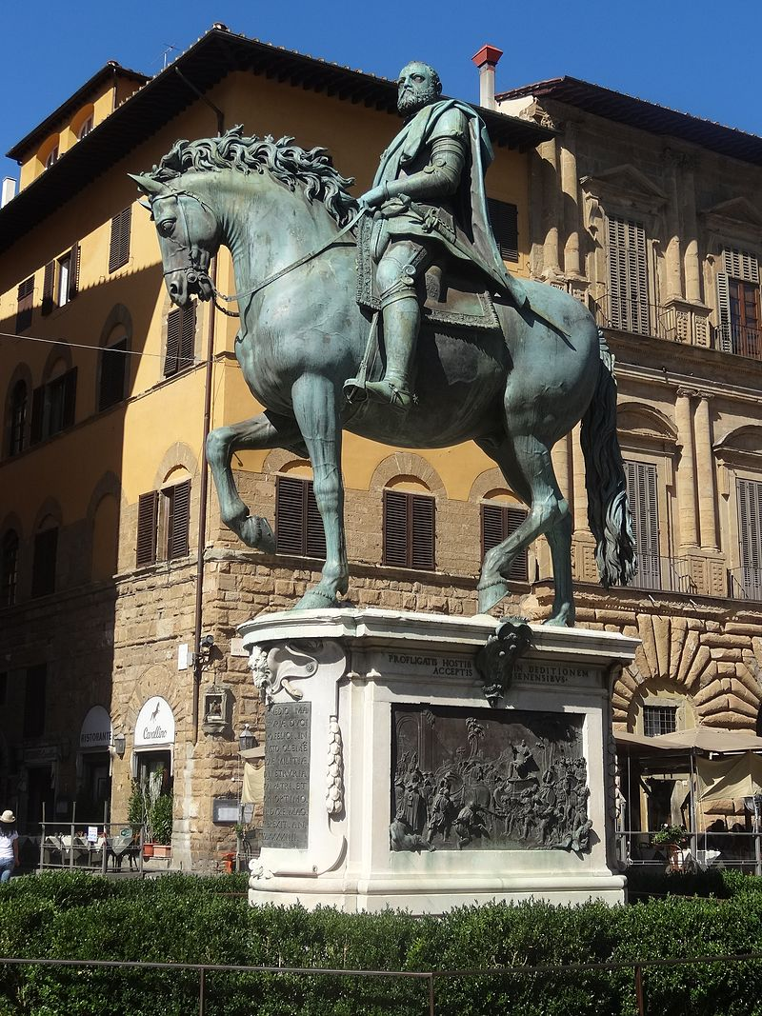
Equestrian Portrait of Cosimo I, 1587-94, Bronze, H. 450 cm, Piazza della Signoria, Florence, Italy
Phoyo Credit: https://commons.wikimedia.org/wiki/Category:Statue_to_Cosimo_I_by_Giambologna#/media/File:2016_Statue_to_Cosimo_I_by_Giambologna.jpg

Slide 16
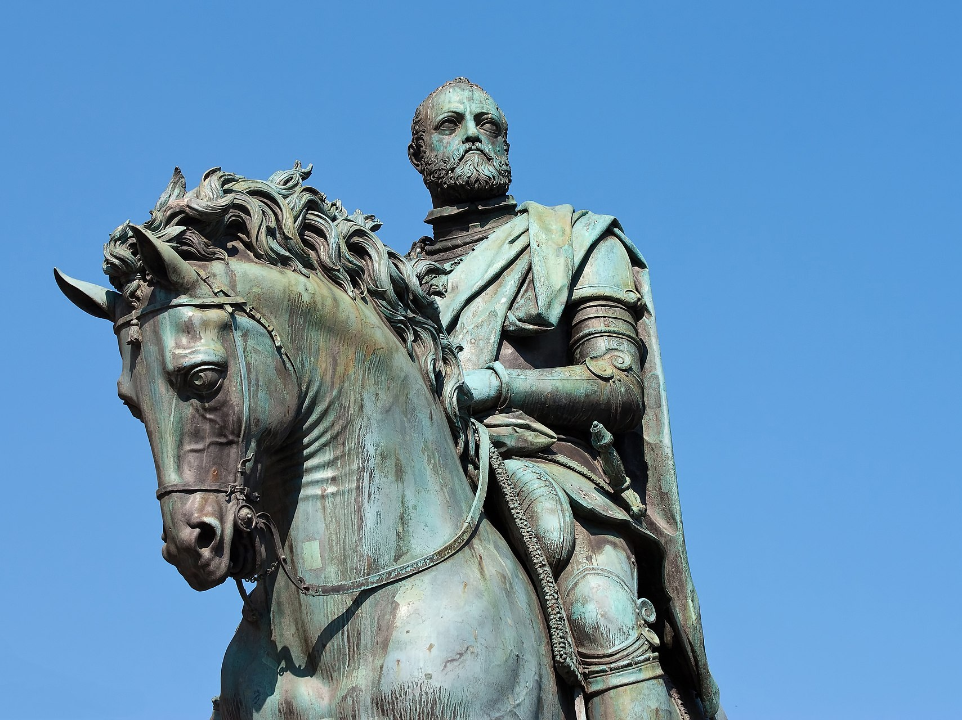
Photo Credit: https://commons.wikimedia.org/wiki/Category:Statue_to_Cosimo_I_by_Giambologna#/media/File:Florence_-_Cosme_de_M%C3%A9dicis.JPG

Slide 17
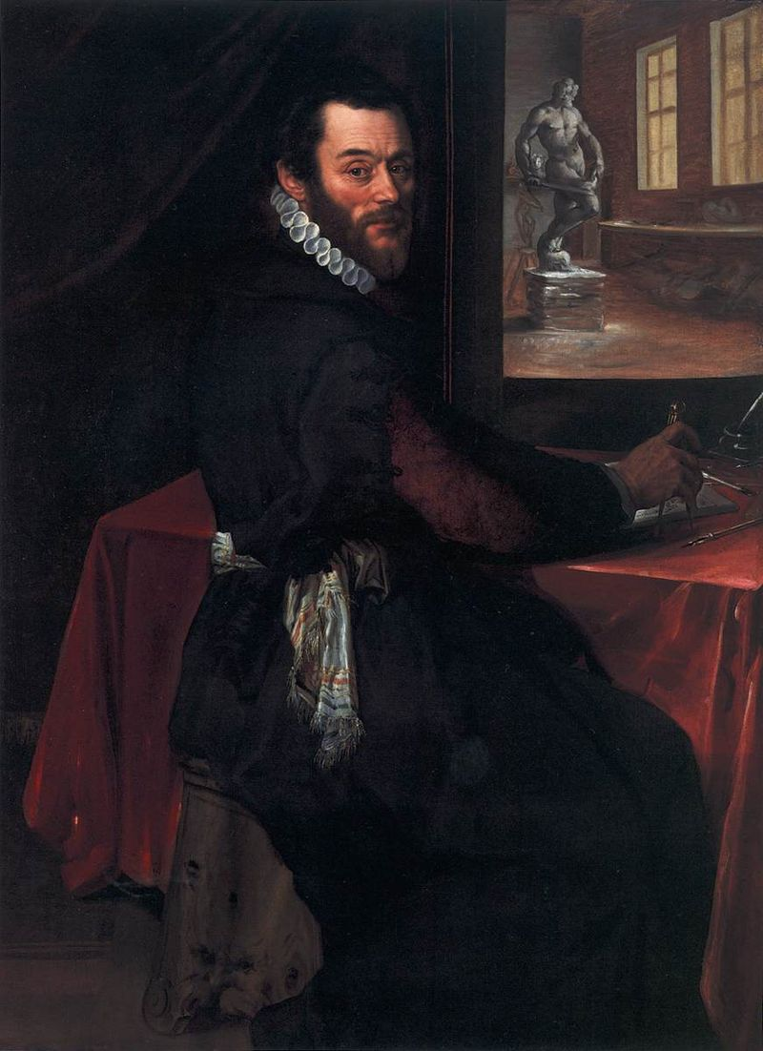
The End
Unknown Flemish Master, late 16th century
Portrait of Giambologna in his Studio, 1570s, oil on panel, 89x66 cm, Scottish National Gallery, UK
Photo Credit: https://commons.wikimedia.org/wiki/File:16th-century_unknown_painters_-_Portrait_of_Giambologna_in_his_Studio_-_WGA23628.jpg

