Slide 1
Jacopo Carucci
called Pontormo
1494 – 1557
Portraits

Slide 2
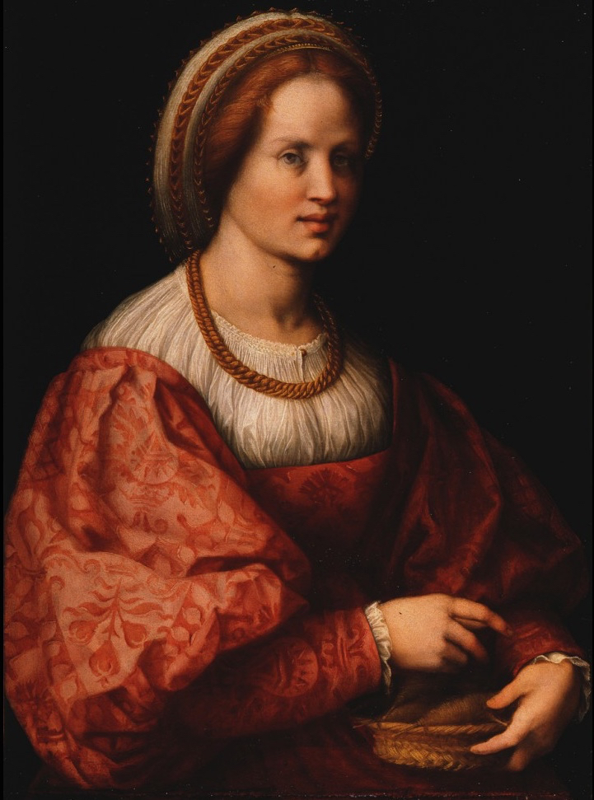

Slide 3
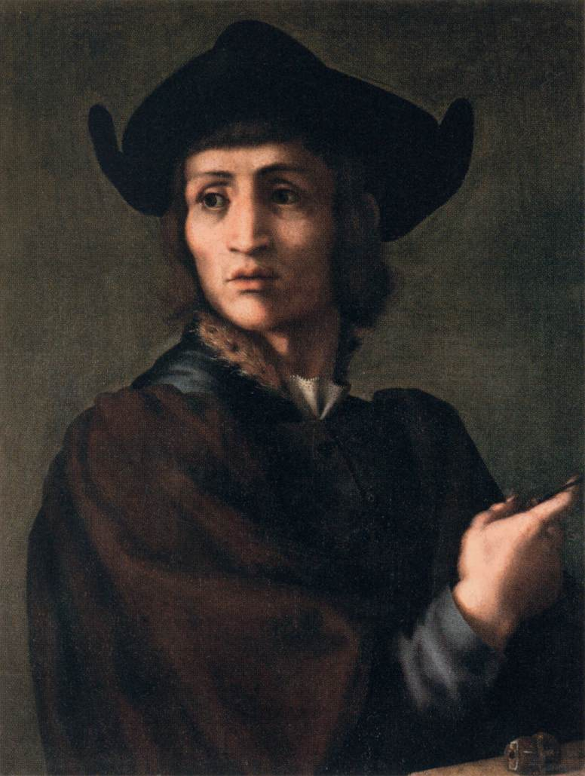

Slide 4
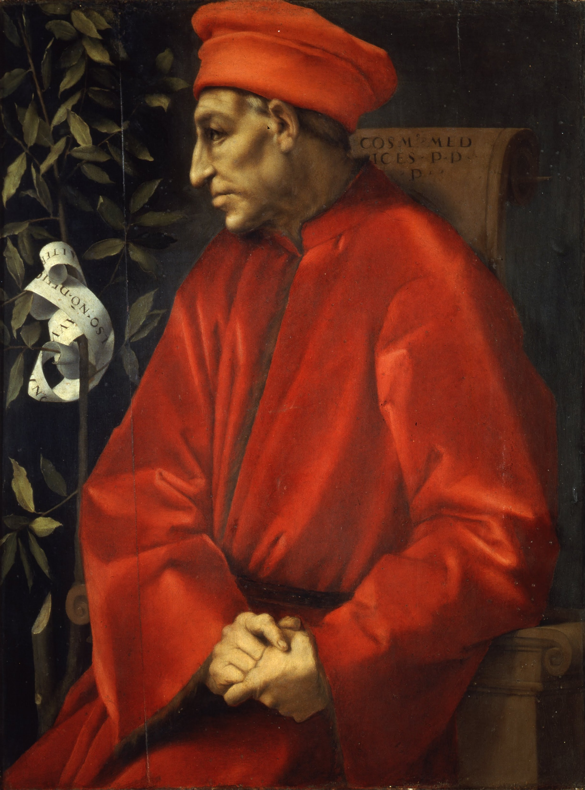

Slide 5
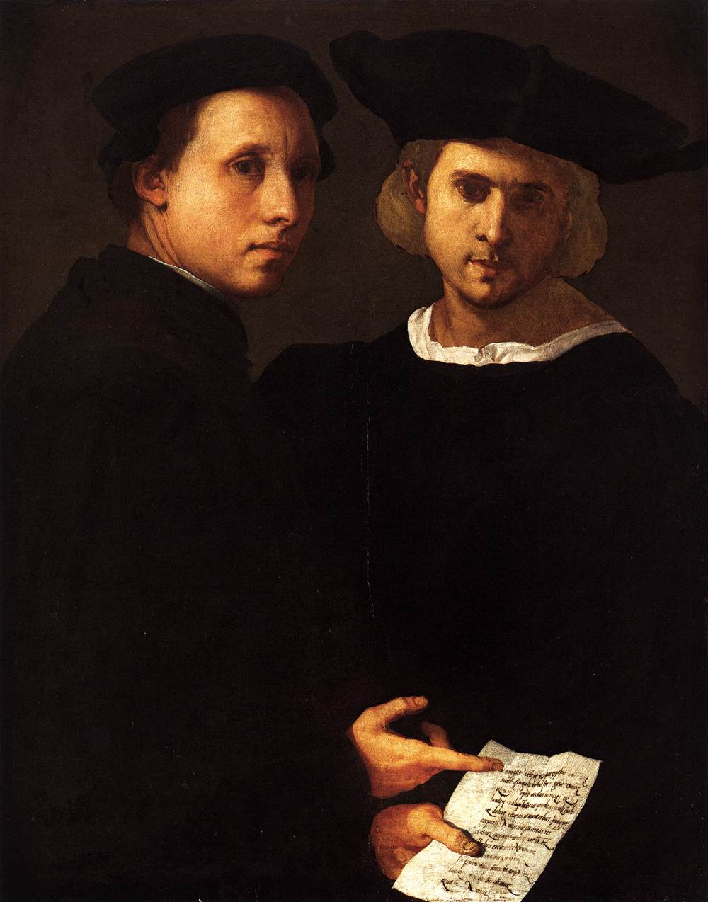

Slide 6
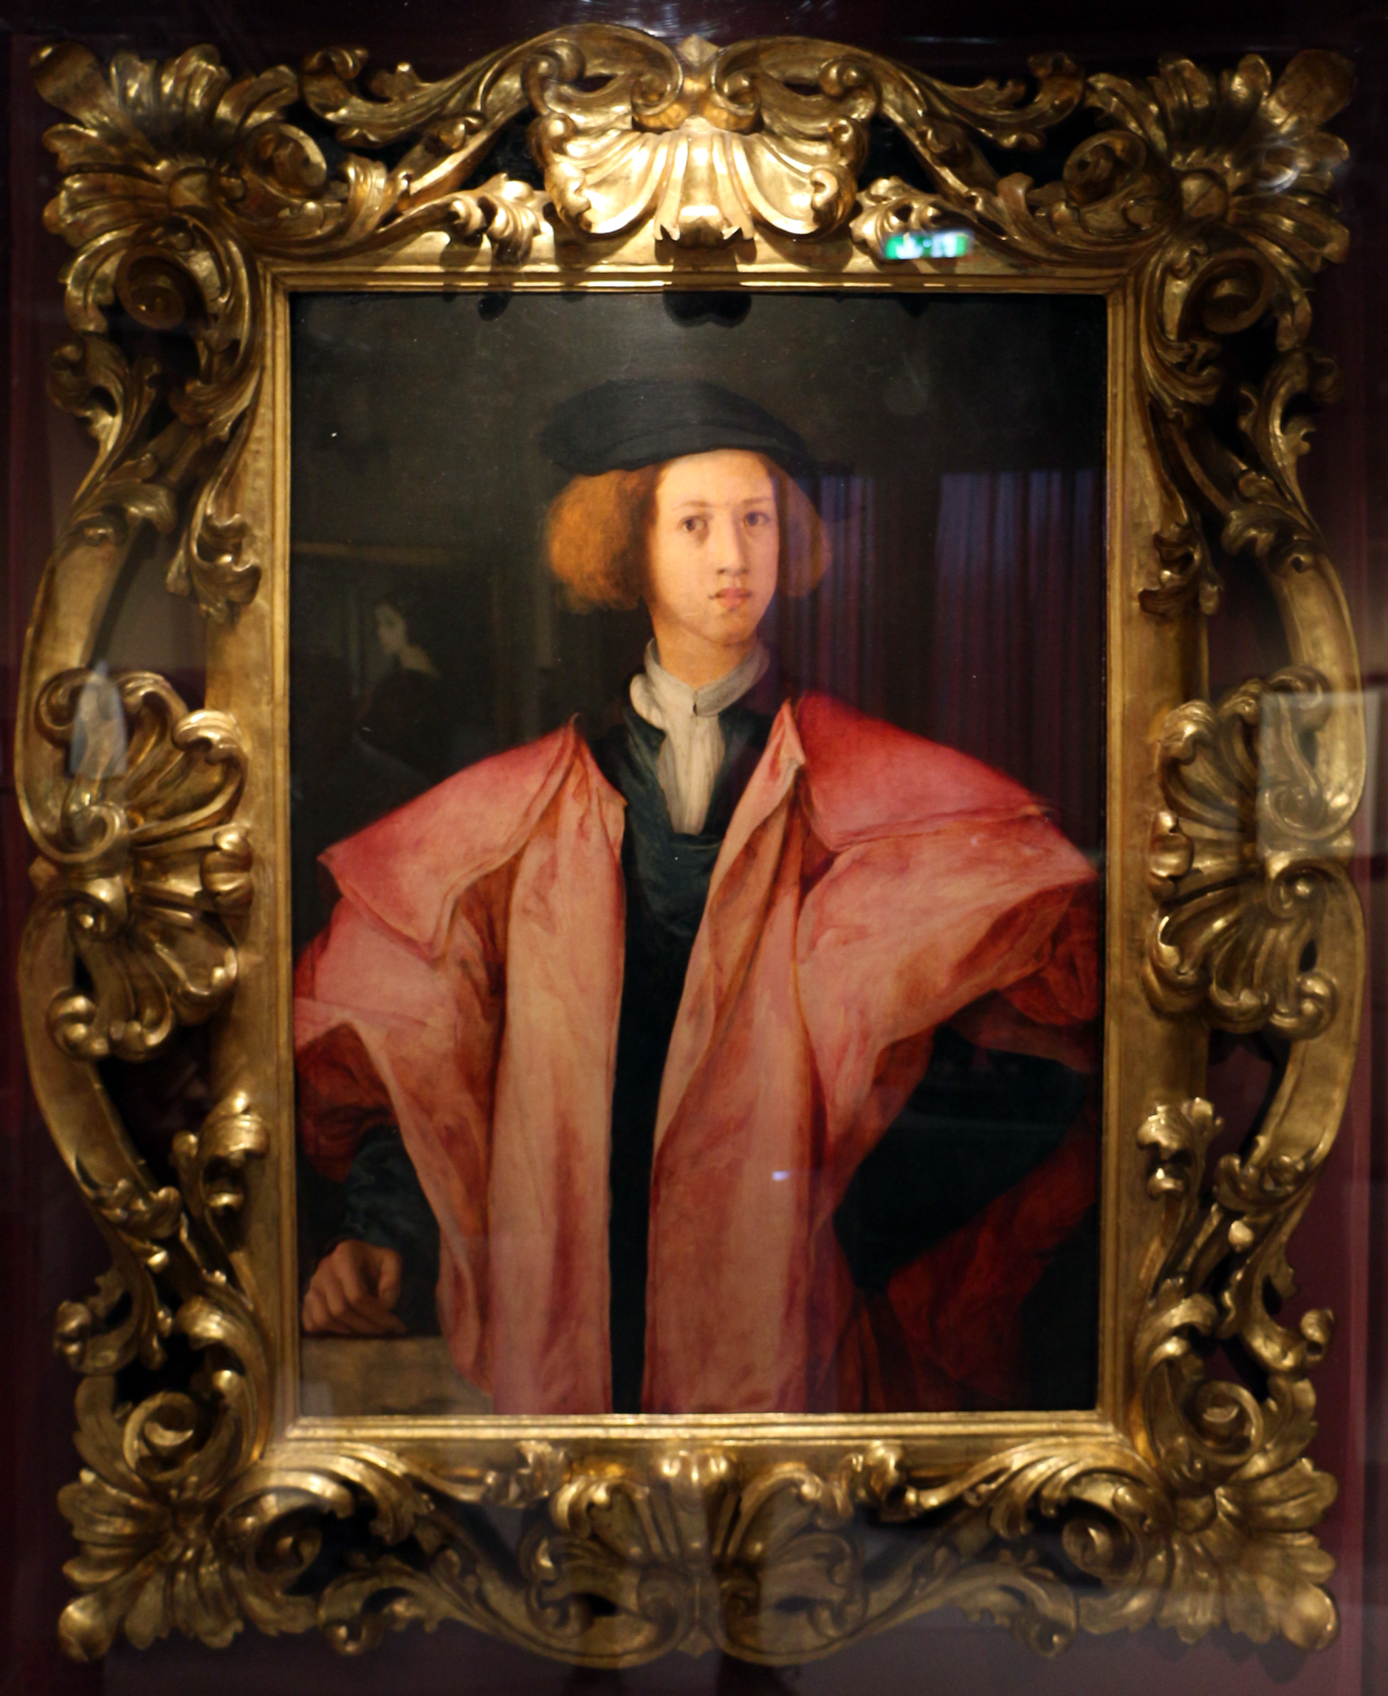

Slide 7
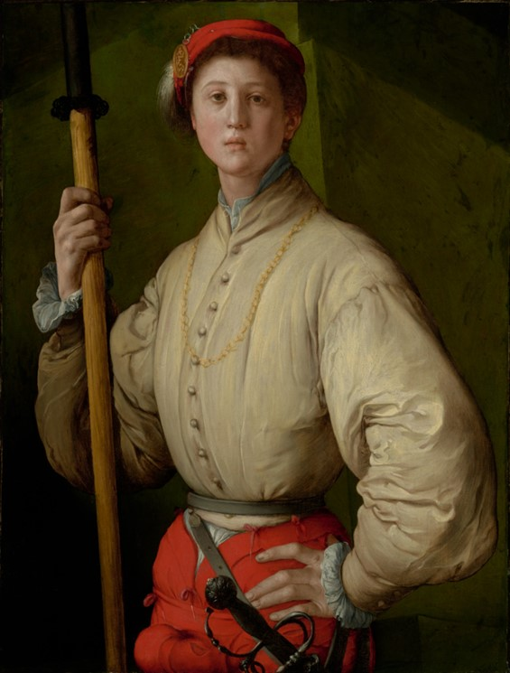

Slide 8
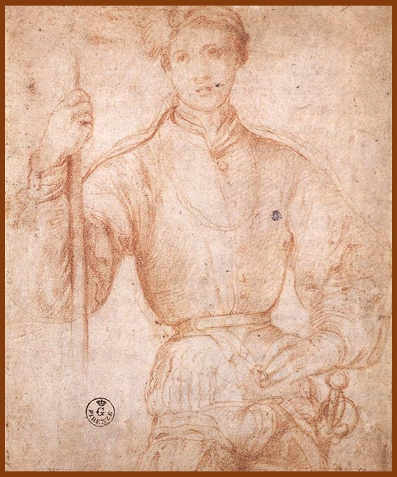

Slide 9
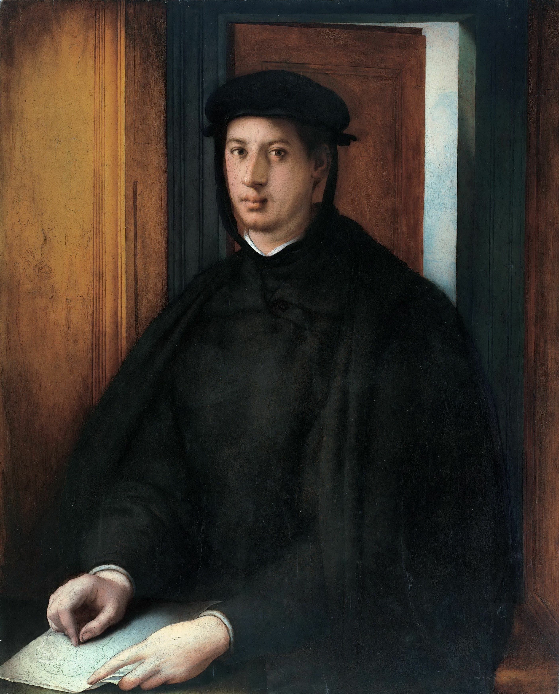

Slide 10
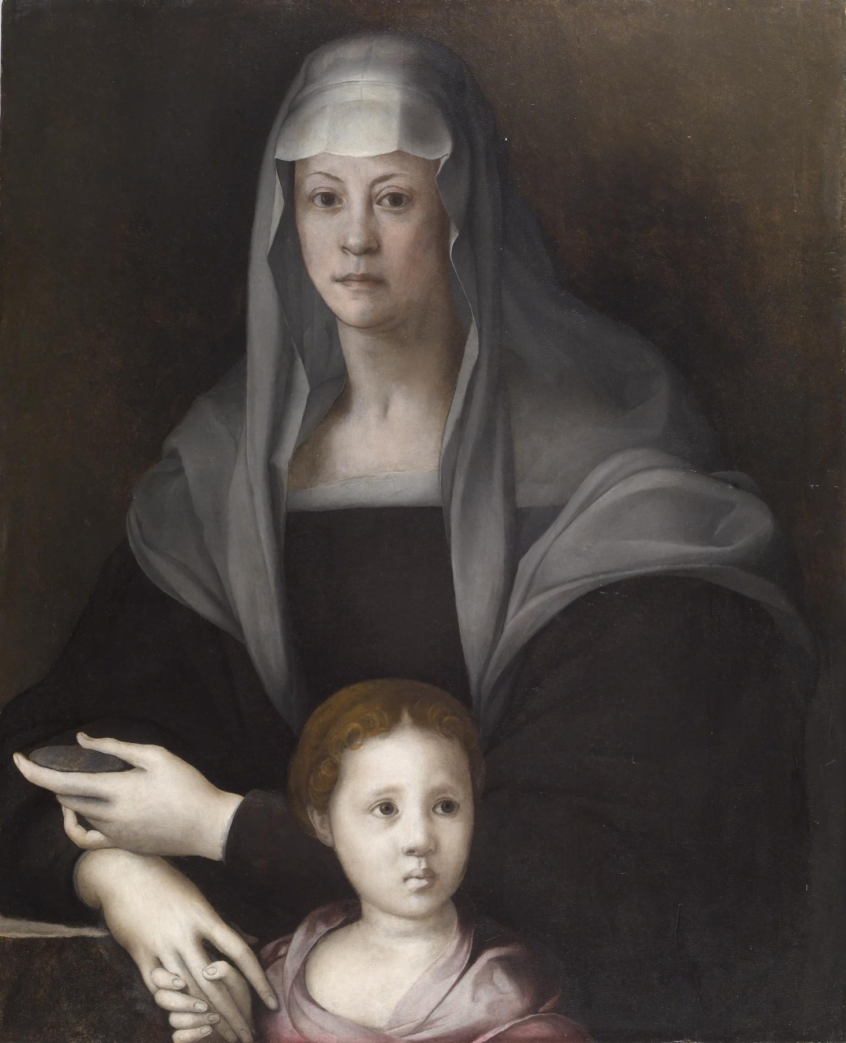

Slide 11
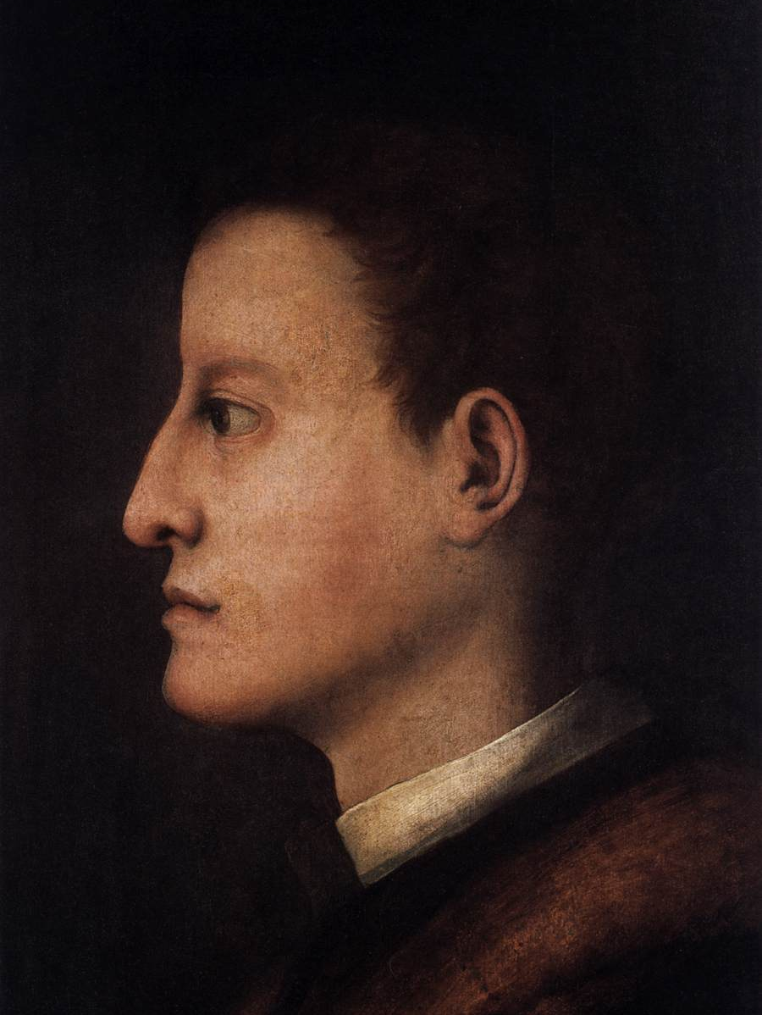

Slide 12
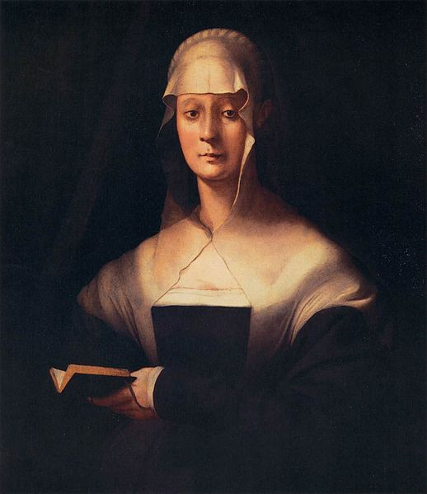

Slide 13
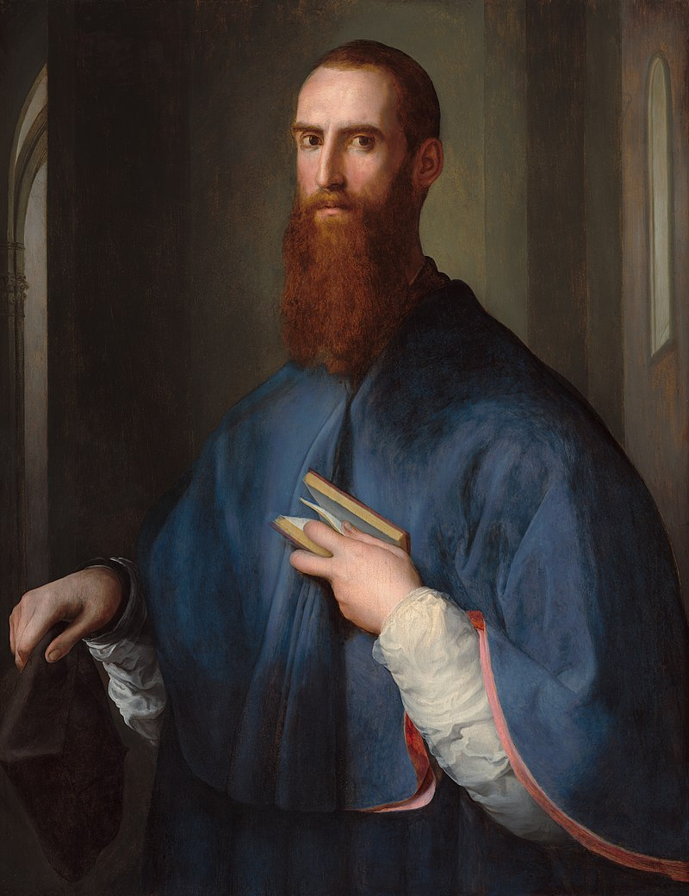

Slide 14
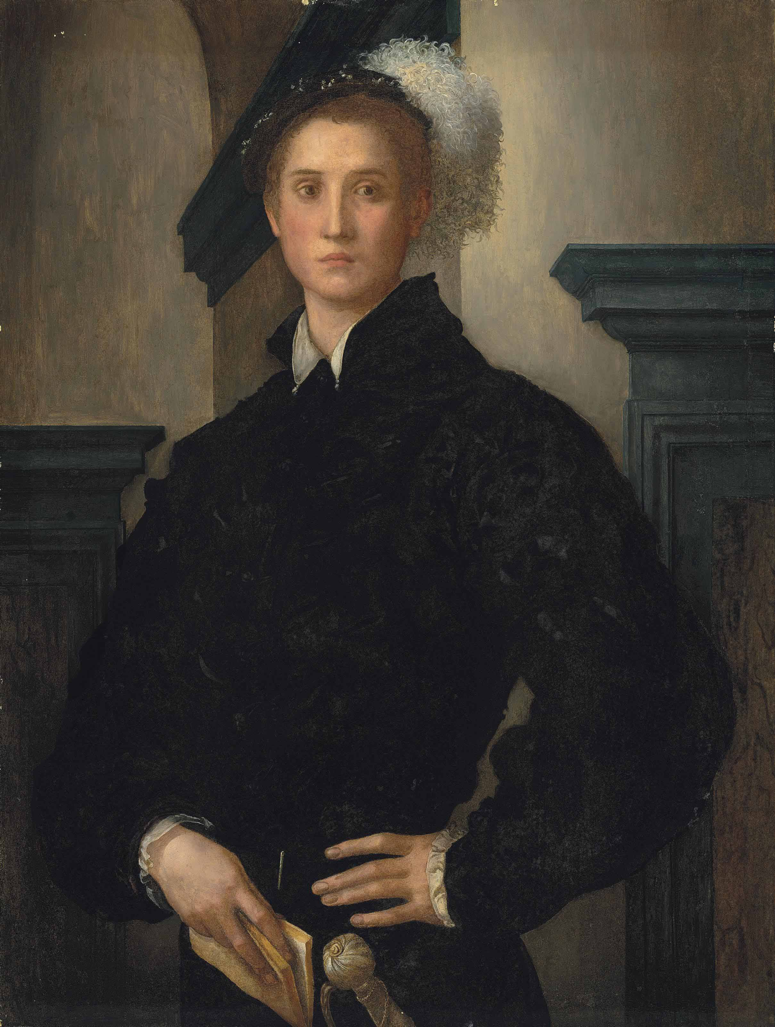

Slide 15
Photo Credits
Slide 1: Introduction
Slide 2: Lady with a Basket of Spindles, c. 1516, Oil on wood, 76 x 54 cm, Galleria degli Uffizi, Florence, Italy
Photo Credit: https://upload.wikimedia.org/wikipedia/commons/f/ff/Andrea_del_Sarto_-_Portrait_of_a_Woman_with_a_Basket_of_Spindles_-_WGA0377.jpg
Slide 3: Portrait of an Engraver of Semi-Precious Stones, 1517-18, oil on wood, 70 x 53 cm, Musée du Louvre, Paris, France
Photo Credit: https://upload.wikimedia.org/wikipedia/commons/e/ef/Jacopo_Pontormo_-_Portrait_of_an_Engraver_of_Semi-Precious_Stones_-_WGA18083.jpg
Slide 4: Cosimo il Vecchio, c. 1520, oil on panel, 86 x 65 cm, Galleria degli Uffizi, Florence, Italy
Photo Credit: https://upload.wikimedia.org/wikipedia/commons/6/6b/Pontormo_-_Ritratto_di_Cosimo_il_Vecchio_-_Google_Art_Project.jpg
Slide 5: Portrait of Two Friends, c. 1522, Panel, 88 x 68 cm, Collezione Vittorio Cini, Venice, Italy
Photo Credit: https://upload.wikimedia.org/wikipedia/commons/c/cb/Jacopo_Pontormo_-_Portrait_of_Two_Friends_-_WGA18109.jpg
Slide 6: Youth in a Pink Coat, c. 1525, oil on panel, 85 x 61 cm, Museo Nazionale di Palazzo Mansi, Lucca, Italy
Photo Credit: https://upload.wikimedia.org/wikipedia/commons/6/68/Pontormo%2C_ritratto_di_giovinetto_%28lucca%2C_pal._mansi%29_01.JPG
Slide 7: Portrait of a Halberdier (Francesco Guardi?), 1529–1530, Oil (or oil and tempera) on panel transferred to canvas, 95.3 × 73 cm, The J. Paul Getty Museum, CA, USA
Photo Credit: http://www.getty.edu/art/collection/objects/824/pontormo-jacopo-carucci-portrait-of-a-halberdier-francesco-guardi-italian-florentine-1529-1530/?dz=0.5000,0.5000,0.62

Slide 16
Slide 8: Study of Francesco Guardi as a Halberdier, 1529-30, Red Chalk, 209 x 169 mm, Galleria degli Uffizi, Florence, Italy
Photo Credit: https://upload.wikimedia.org/wikipedia/commons/9/98/Jacopo_Pontormo_-_Halberdier_-_WGA18130.jpg
Slide 9: Alessandro de' Medici, 1534-35, oil on panel, 101 x 82 cm, Philadelphia Museum of Art, Philadelphia, USA
Photo Credit: https://commons.wikimedia.org/wiki/File:Jacopo_Pontormo_056.jpg
Slide 10: Maria Salviati with Giulia de' Medici, c. 1537, oil on panel, 88 x 71 cm, Walters Art Museum, Baltimore, USA
Photo Credit: https://upload.wikimedia.org/wikipedia/commons/1/13/Pontormo_-_Portrait_of_Maria_Salviati_de%27_Medici_with_Giulia_de%27_Medici_-_Walters_37596.jpg
Slide 11: Cosimo I de' Medici, 1537, oil on panel, 48 x 31 cm, Galleria Palatina (Palazzo Pitti), Florence, Italy
Photo Credit: https://commons.wikimedia.org/wiki/File:Pontormo_-_Cosimo_I_de%27_Medici,_1537.jpg
Slide 12: Portrait of Maria Salviati, between 1537 and 1543, oil on panel, 87x71 cm, Galleria degli Uffizi, Florence, Italy
Photo Credit: https://commons.wikimedia.org/wiki/File:Jacopo_Pontormo_-_Portrait_of_Maria_Salviati_-_WGA18110.jpg
Slide 13: Giovanni della Casa, 1542-46, oil on panel, 102 x 79 cm, National Gallery of Art, Washington
Photo Credit: https://upload.wikimedia.org/wikipedia/commons/0/02/Jacopo_Pontormo_057.jpg
Slide 14: Portrait of Cosimo I de' Medici, 1545, oil on panel, 100.6 x 77 cm, Private Collection
Photo Credit: https://commons.wikimedia.org/wiki/File:Jacopo_Pontormo_-_Portrait_of_Cosimo_I_de%27_Medici_2014_NYR_02819_0166.jpg
Slides 15 and 16: Photo credits

