Slide 1

Amasis Painter…
active around 550–510 BC
Black-Figure…

Slide 2
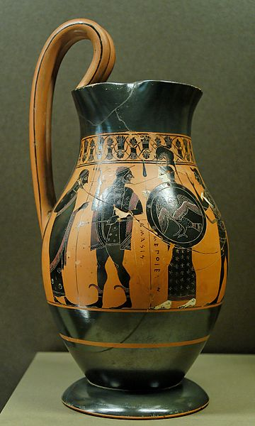

Slide 3
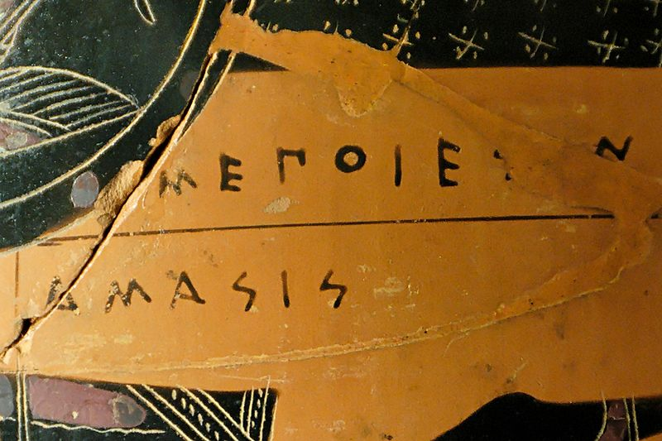

Slide 4
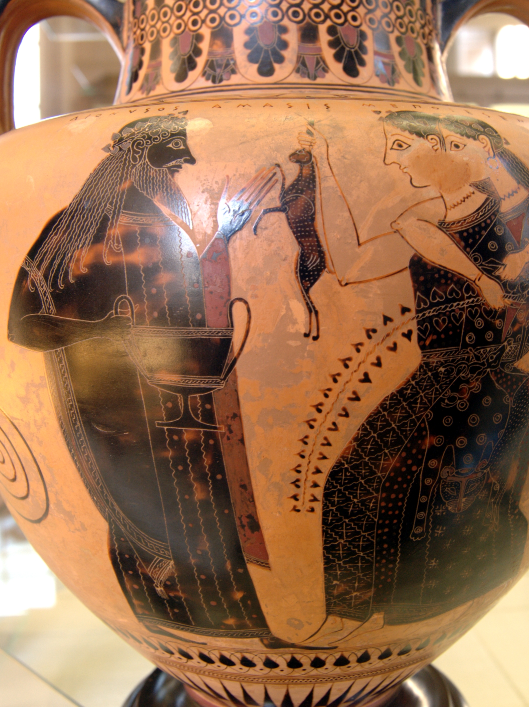

Slide 5
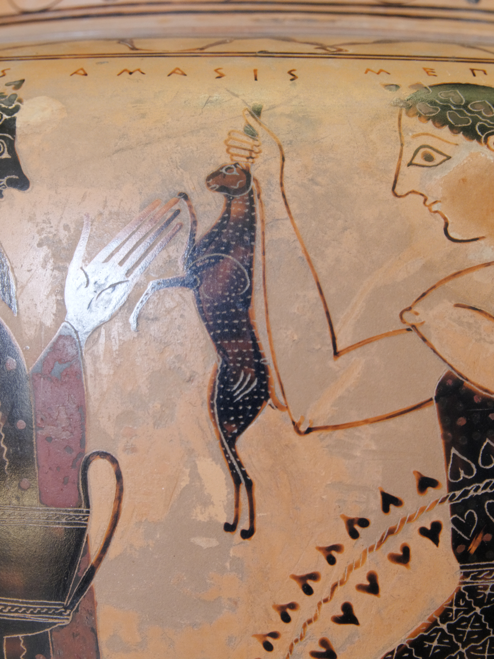

Slide 6
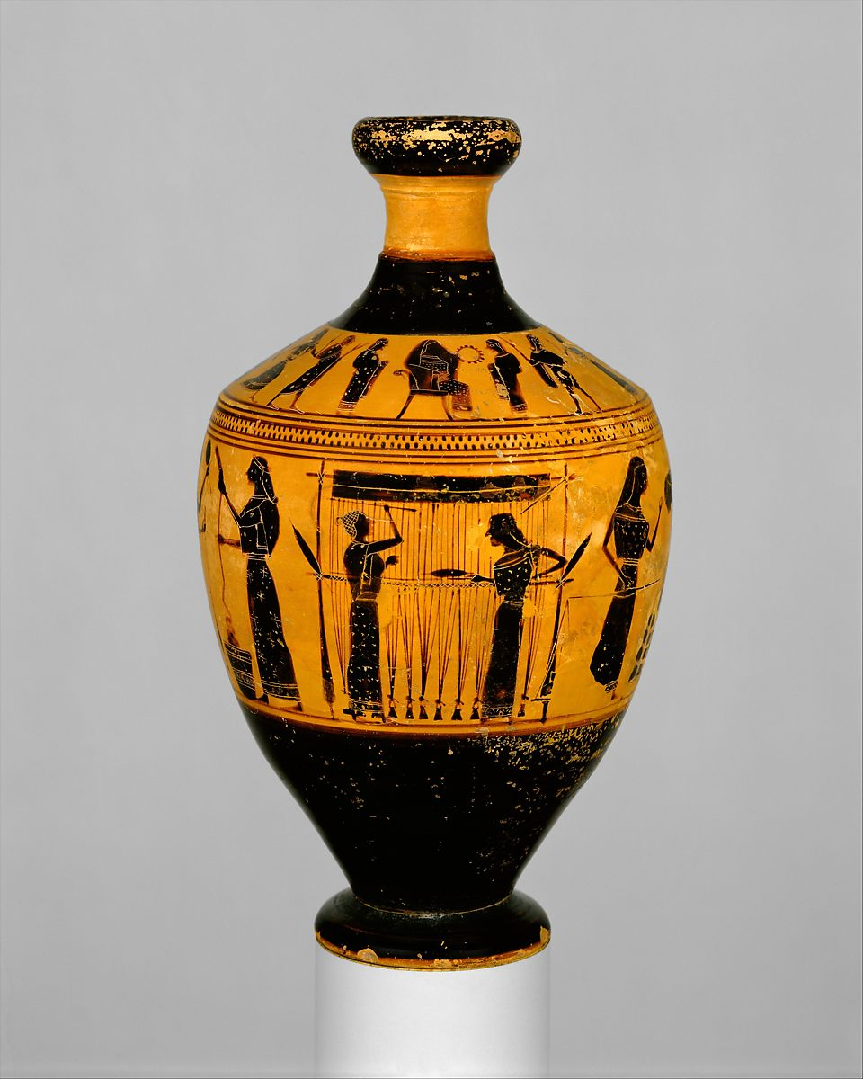

Slide 7
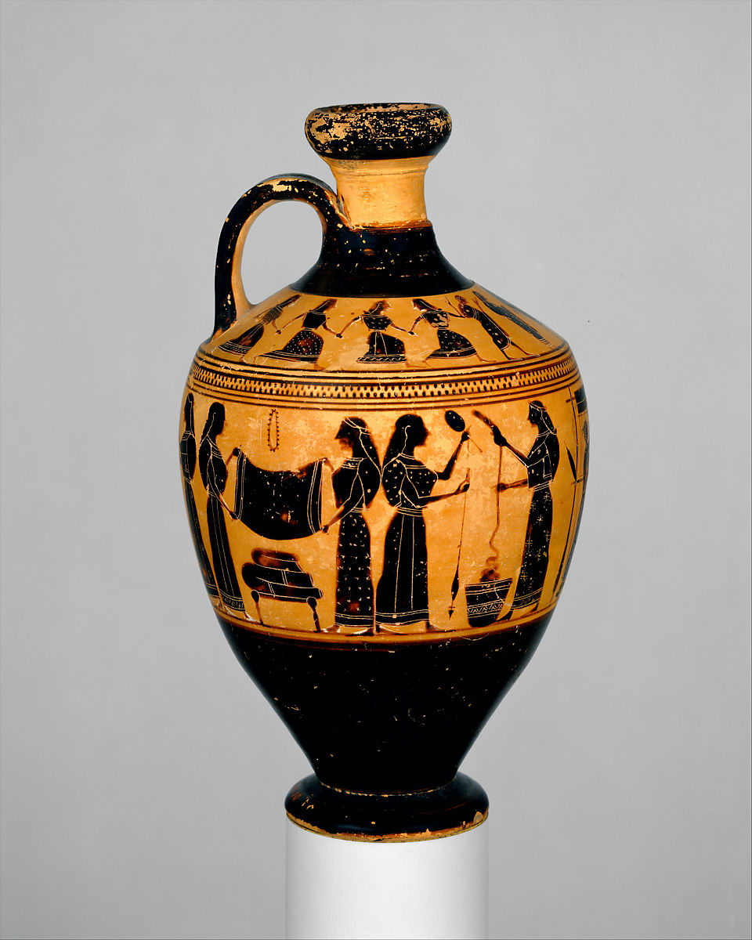

Slide 8
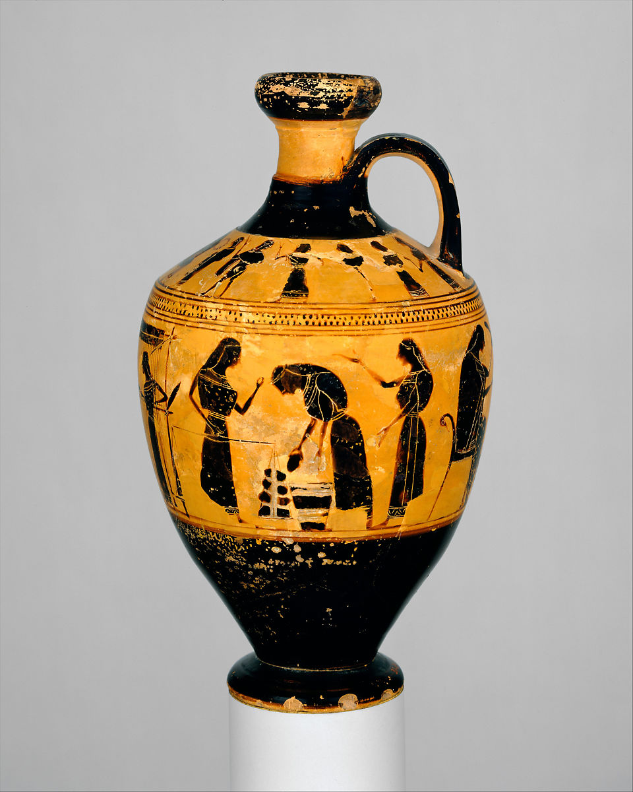

Slide 9
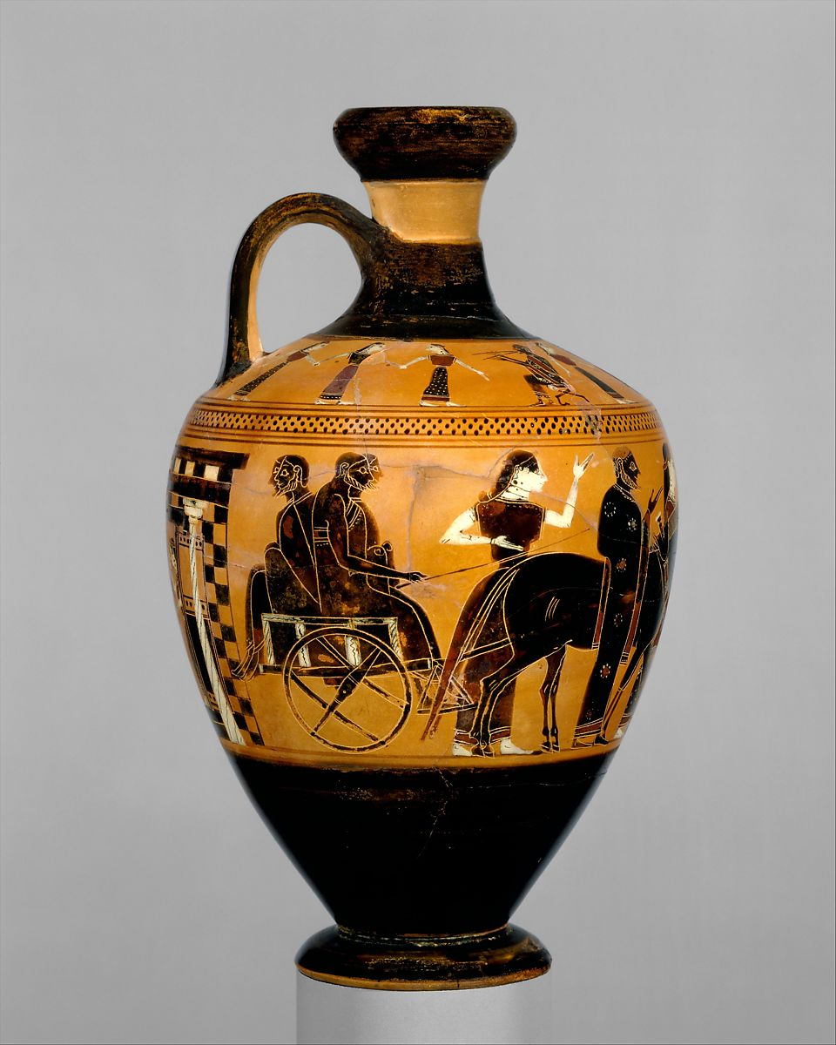

Slide 10
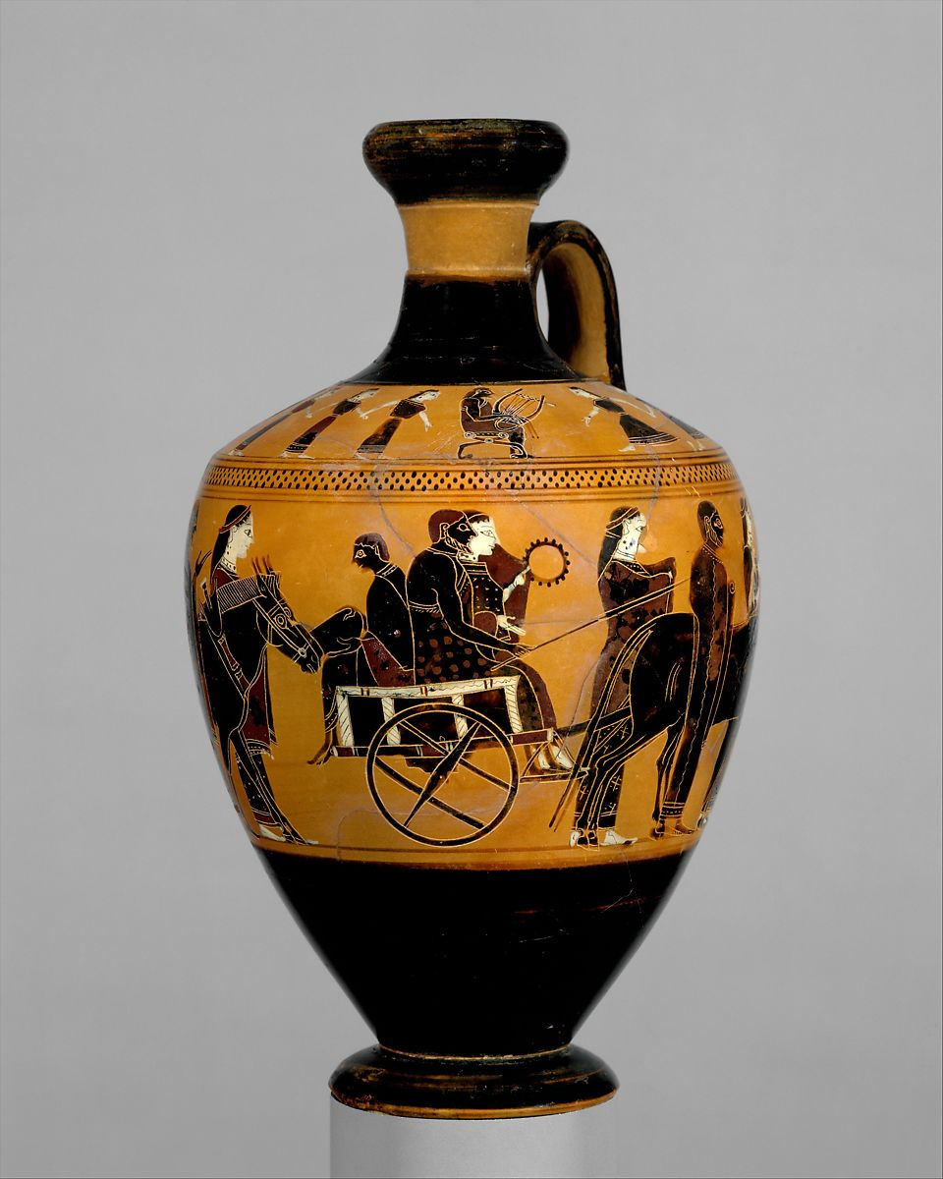

Slide 11
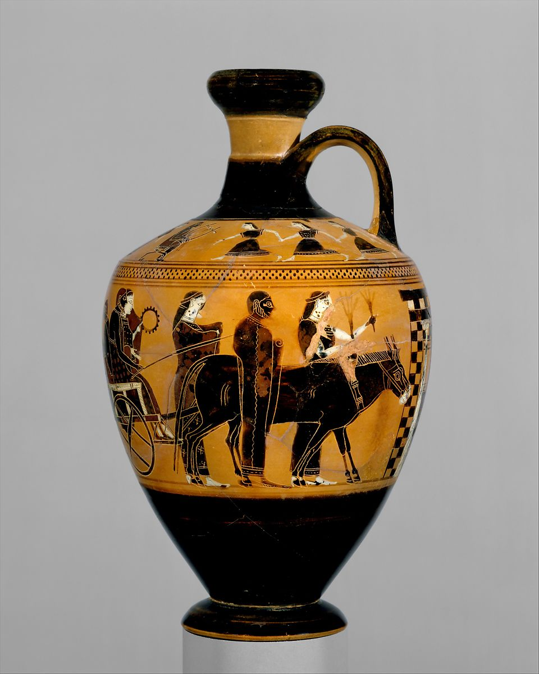

Slide 12
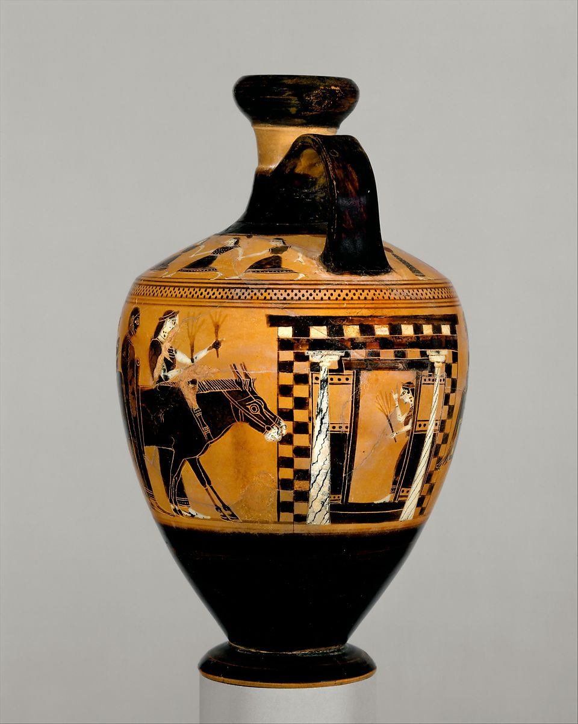

Slide 13
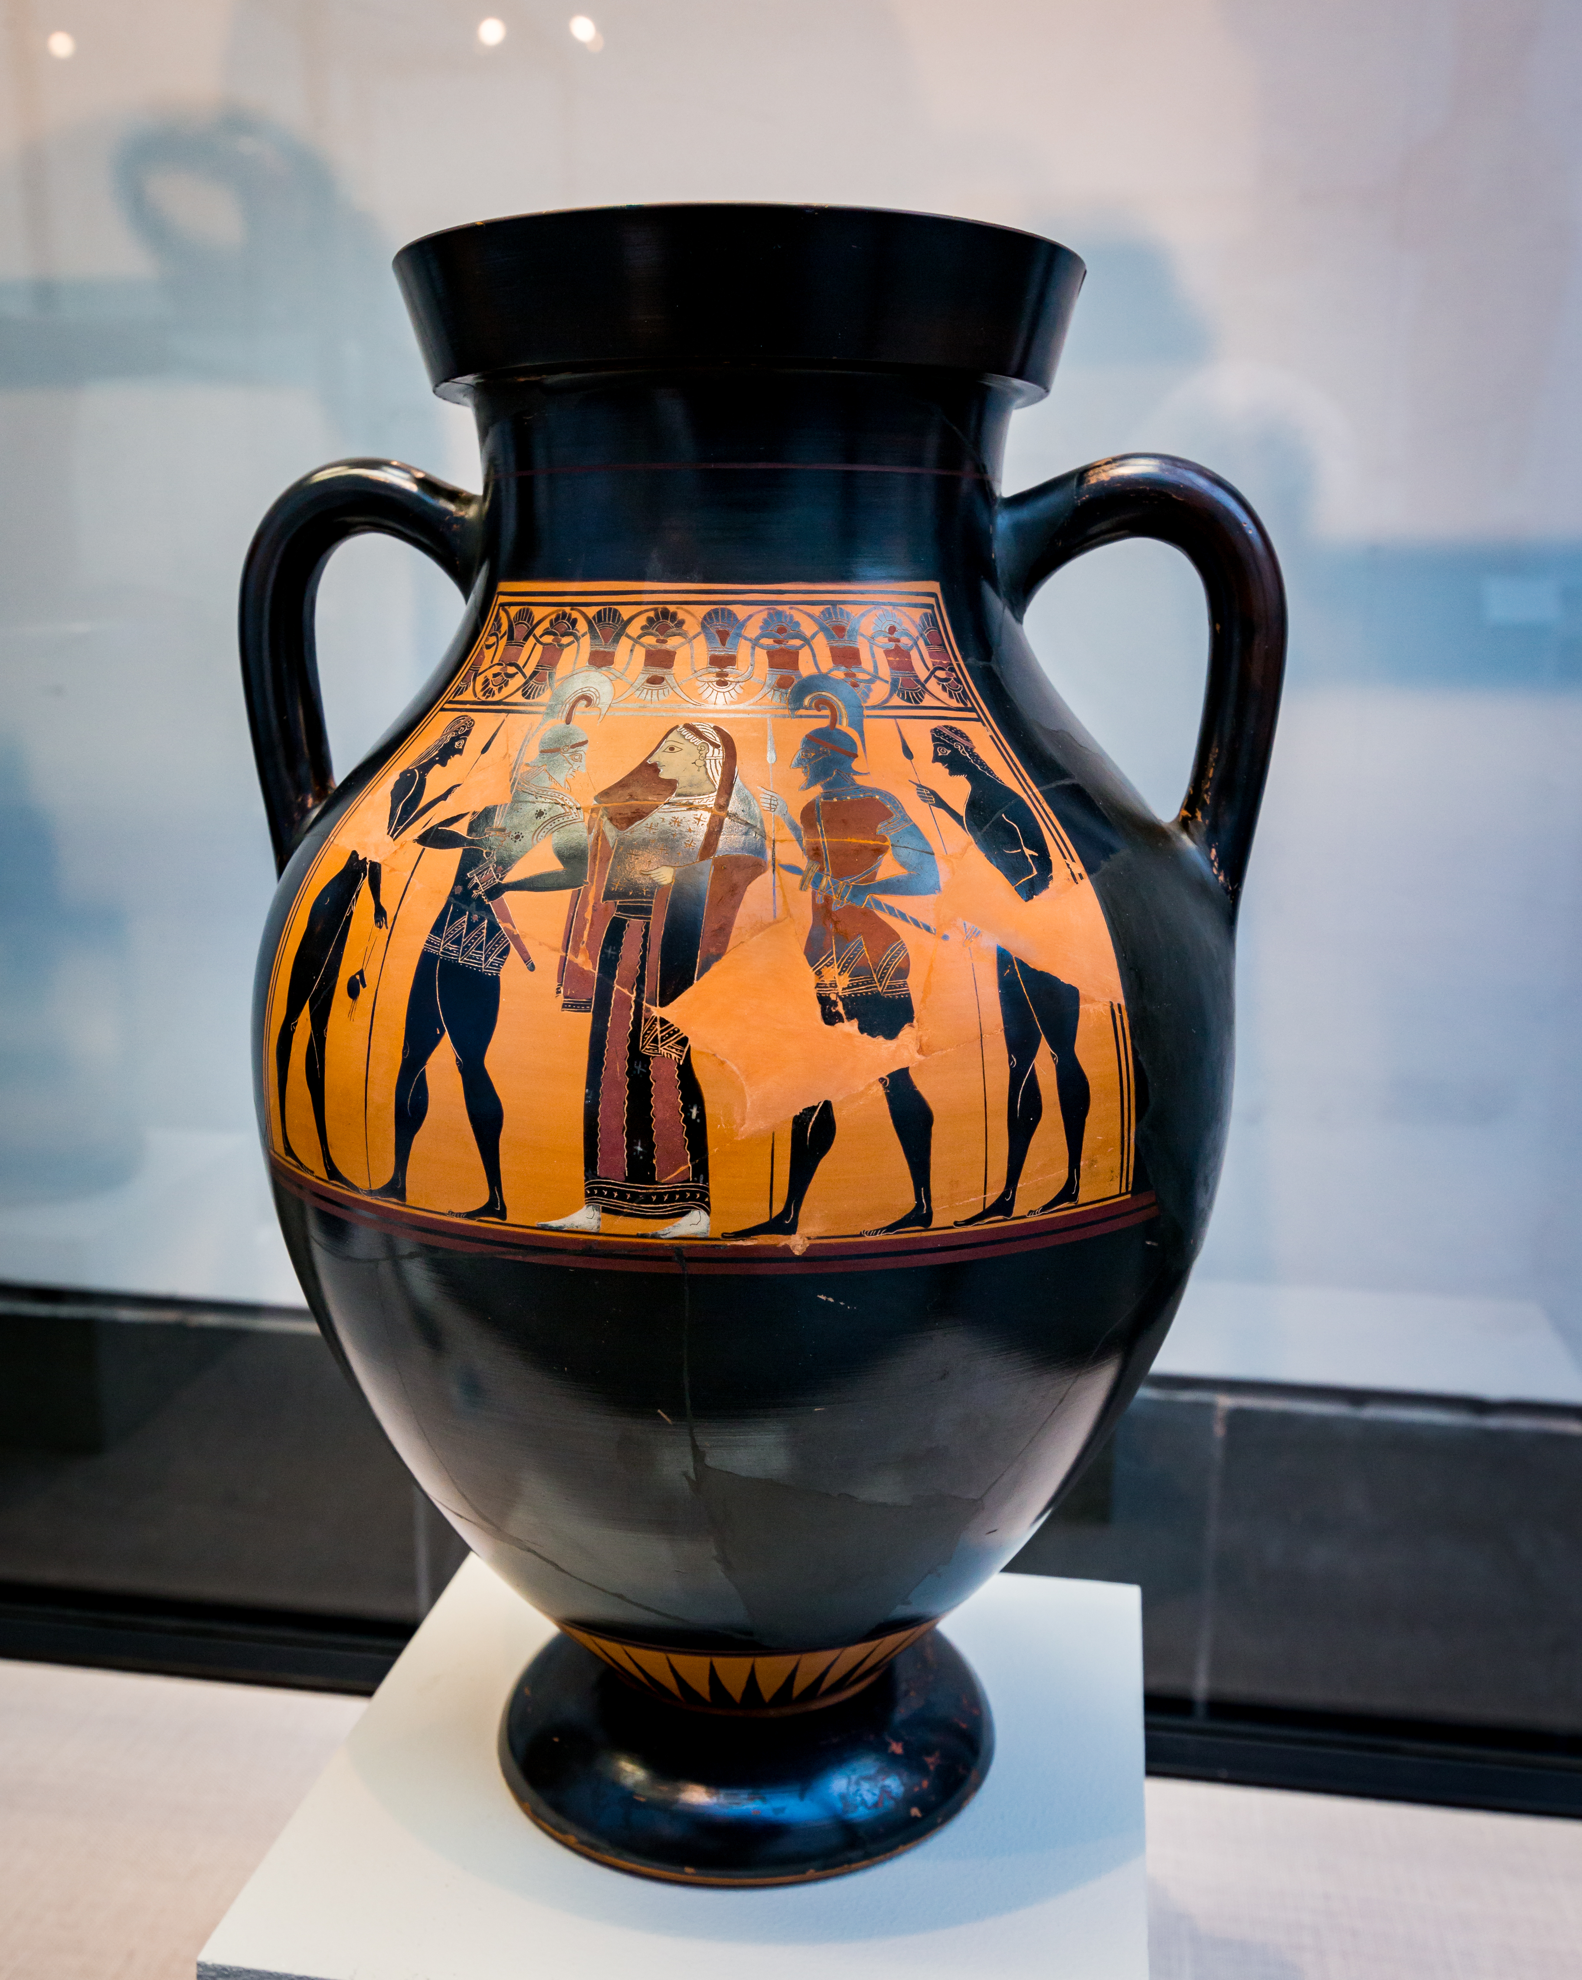

Slide 14
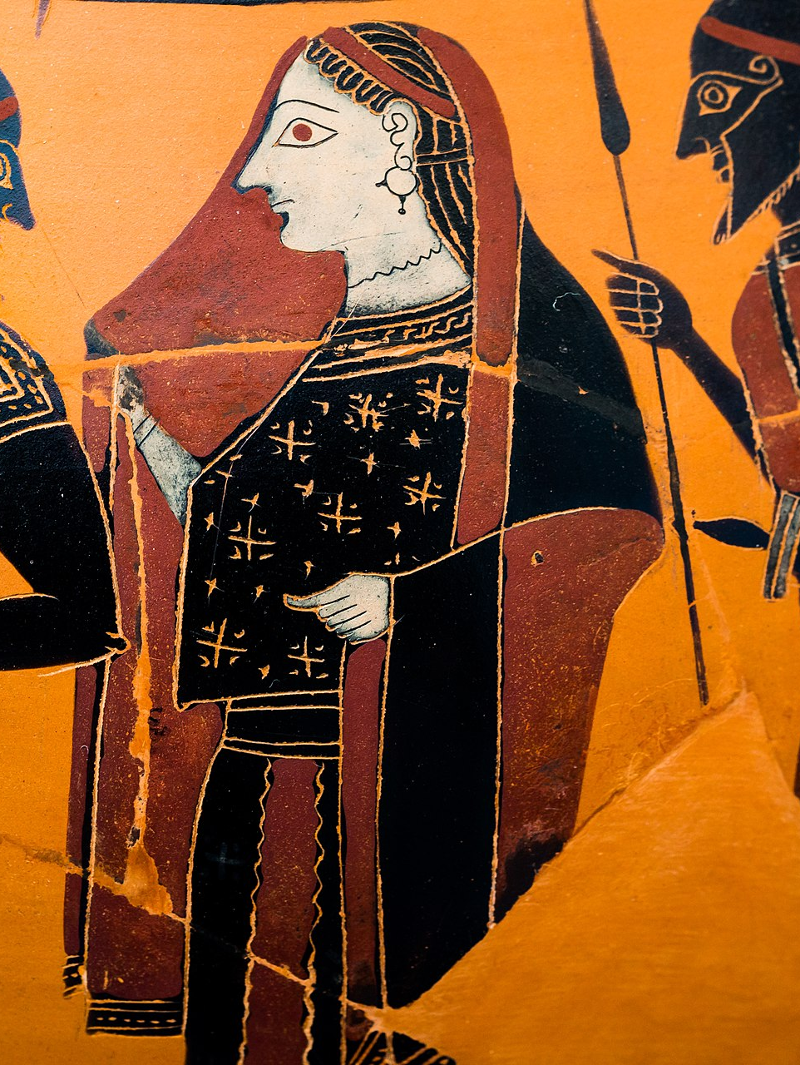

Slide 15
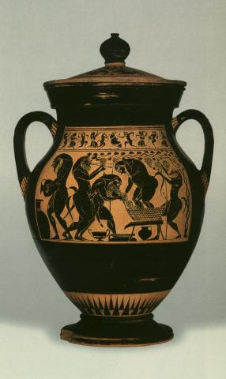

Slide 16
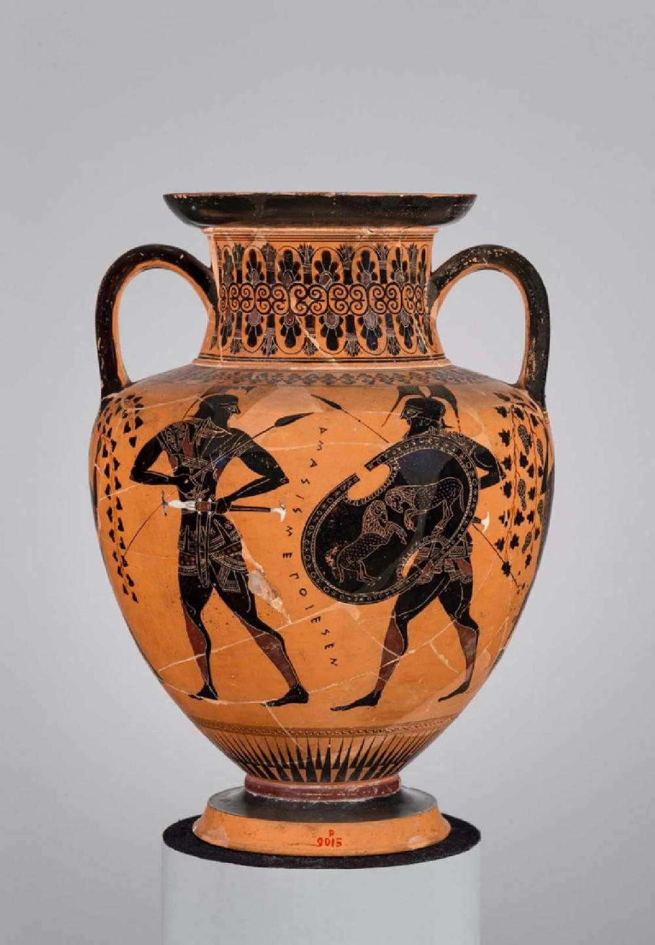

Slide 17
Slide 1
Introduction Page
Slides 2 and 3
Terracotta Black-Figure Attic Olpe depicting Herakles entering Olympus with Poseidon, Hermes, and Athena (Details with the artist’s signature), 540 BC, H.26.4 cm, Louvre Museum, Paris France https://commons.wikimedia.org/wiki/File:Herakles_Olympos_Louvre_F30_full.jpg https://commons.wikimedia.org/wiki/File:Herakles_Olympos_Louvre_F30_full.jpg#/media/File:Signature_Amasis_Louvre_F30.jpg
Slides 4 and 5
Terracotta Black-Figure Attic Amphora depicting Dionysos and two maenads, one holding a hare (Detail with the artist’s signature), 540 BC, H. 33 cm, Cabinet des Médailles, Paris, Frnce https://commons.wikimedia.org/wiki/File:Dionysos_Mainades_Cdm_Paris_222.jpg
Slides 6, 7 and 8
Terracotta Black-Figure Lekythos depicting the preparation of wool and the weaving of cloth (three sides), ca. 550–530 BC, H. 17.15 cm, the MET, NY, USA https://www.metmuseum.org/art/collection/search/253348?searchField=All&amp;sortBy=Relevance&amp;high=on&amp;ao=on&amp;showOnly=openAccess&amp;ft=*&amp;offset=560&amp;rpp=80&amp;pos=573
Slides 9, 10, 11 and 12
Terracotta Black-Figure Amphor depicting an Attic wedding (four sides), ca. 550–530 BC, H. 175 cm, the MET, NY, USA https://www.metmuseum.org/art/collection/search/254843
Slides 13 and 14
Terracotta Black-Figure Attic Amphora depicting the Recovery of Helen by Menelaus (and detail of Helen), 550 BC, H. 34 cm, Staatliche Antikensammlungen, Munich, Germany https://upload.wikimedia.org/wikipedia/commons/5/53/Amasis_Painter_-_ABV_151_extra_-_Menelaos_recovering_Helena_-_Dionysos_with_youths_-_M%C3%BCnchen_AS_1383_-_02.jpg https://commons.wikimedia.org/wiki/Category:Amasis_Painter#/media/File:Amasis_Painter_-_ABV_151_extra_-_Menelaos_recovering_Helena_-_Dionysos_with_youths_-_M%C3%BCnchen_AS_1383_-_05.jpg

Slide 18
Slide 15
Terracotta Black-Figure Attic Amphora with a lid depicting satyrs producing wine. 540–530 BC, H. 34.8 cm, Martin-von-Wagner-Museum, University of Würzburg Germany http://icon.dickinson.edu/artifacts/amphora-amasis-painter
Slide 16
Terracotta Black-Figure Attic Amphora depicting two warriors, 520–515 BC, H. 25.8 cm, MFA, Boston, MA, USA https://collections.mfa.org/objects/153405/twohandled-jar-amphora;jsessionid=82D87970DAAAD22879498D54D73F0211?ctx=a83956c7-ad66-46c3-8cd1-9aee2f57dde0&idx=0
Slides 17 and 18
Identifications and Photo Credits
Slide 19
The End

Slide 19
The End

