Slide 1
Nicola da Urbino
active by 1520–died ?1537/38
The Isabella D’Este Credenza

Slide 2
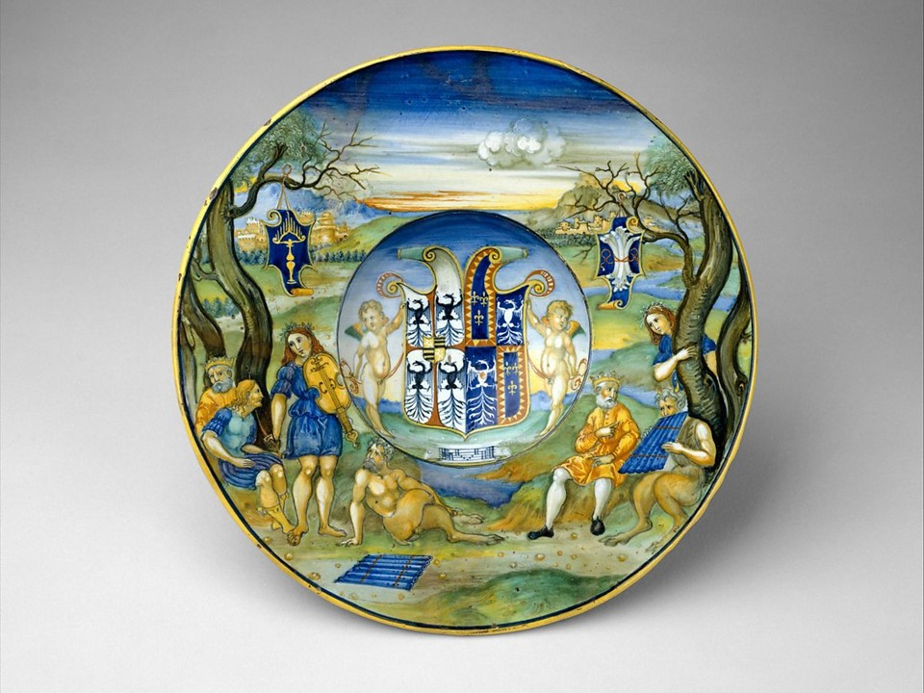
Pan, Apollo, and King
Midas, c. 1524,
Tin-glazed earthenware,
D. 27.5 cm, the MET,
NY, USA https://ideaceramics.web.unc.edu/prsp-record/pan-apollo-and-king-midas/

Slide 3
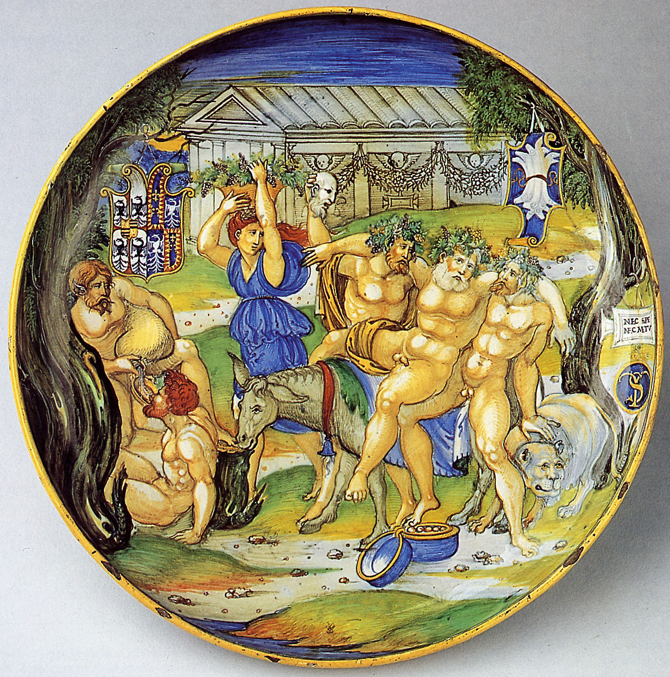
Triumph of Silenus, c. 1524, Tin-glazed earthenware, D. 27.5 cm, the MET, NY, USA https://www.metmuseum.org/art/collection/search/460191

Slide 4
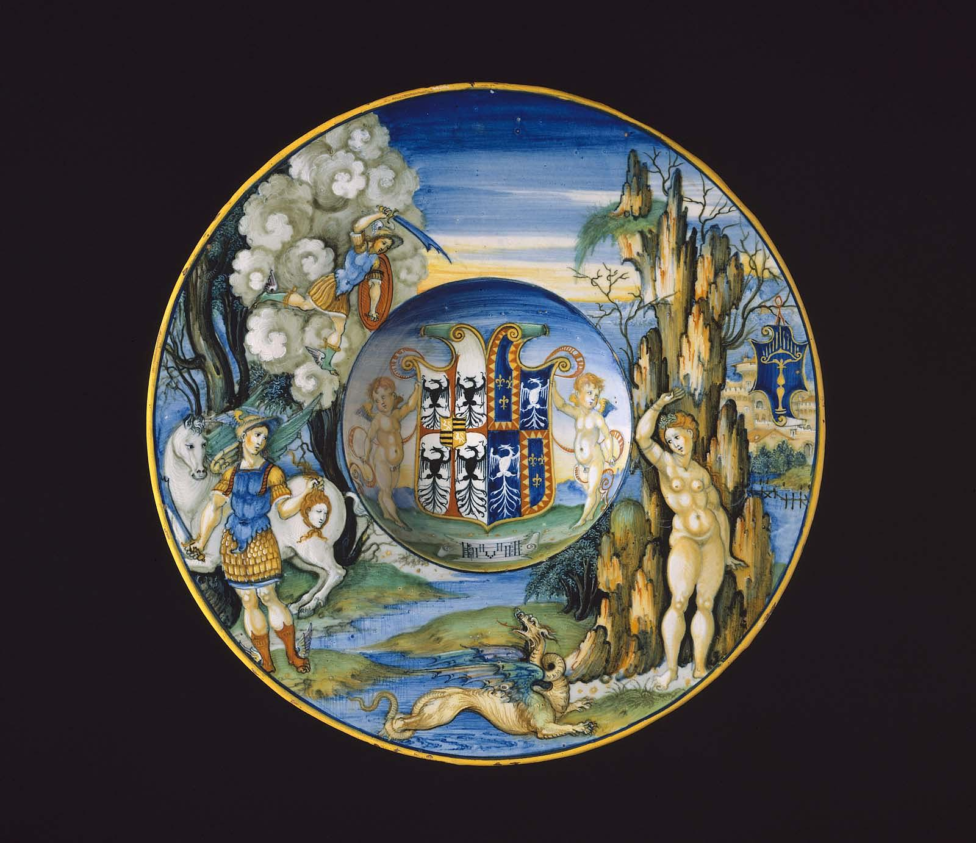
Perseus and Andromeda, c. 1524, Tin-glazed earthenware, D. 26.8 cm, Museum of Fine Arts, Boston, MA, USA https://collections.mfa.org/objects/58792/plate-depicting-the-story-of-perseus-and-andromeda-from-the;jsessionid=0FA487A0AB4FD1C31CBFDFBE43737998

Slide 5
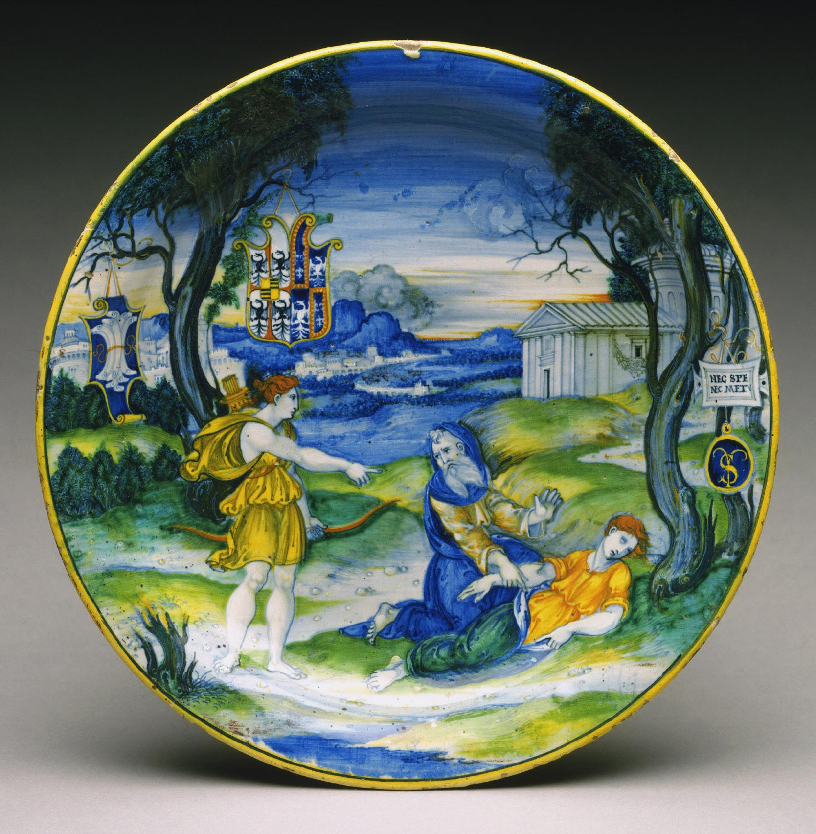
Revival of Hippolytus, c. 1524, Tin-glazed earthenware,
D. 27.3 cm, Philadelphia Museum of Art, PA, USA https://ideaceramics.web.unc.edu/wp-content/uploads/sites/10461/2016/02/DianaHippolytus.jpg

Slide 6
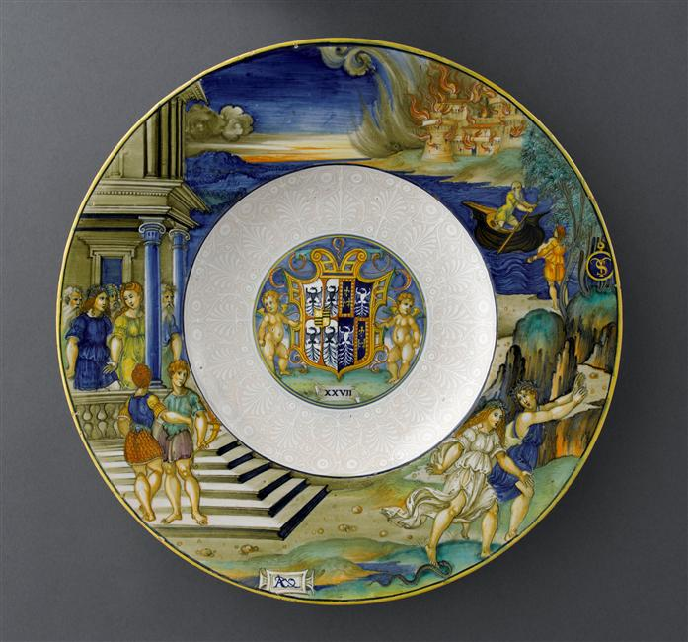
Orpheus and Eurydice, c. 1524, Tin-glazed earthenware, D. 39 cm, Musée du Louvre, Paris, France https://ideaceramics.web.unc.edu/wp-content/uploads/sites/10461/2016/02/OrpheusEurydice.jpg

Slide 7
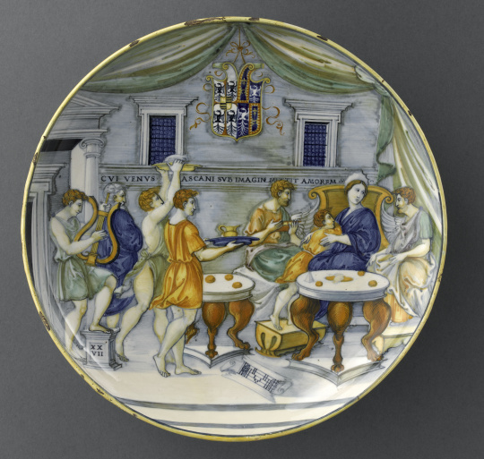
Banquet of Dido and Aeneas, c. 1524, Tin-glazed earthenware, D. 27 cm, Musée du Louvre, Paris, France https://art.rmngp.fr/fr/library/artworks/da-urbino-nicola_coupe-a-pied-festin-de-didon-et-enee_faience

Slide 8
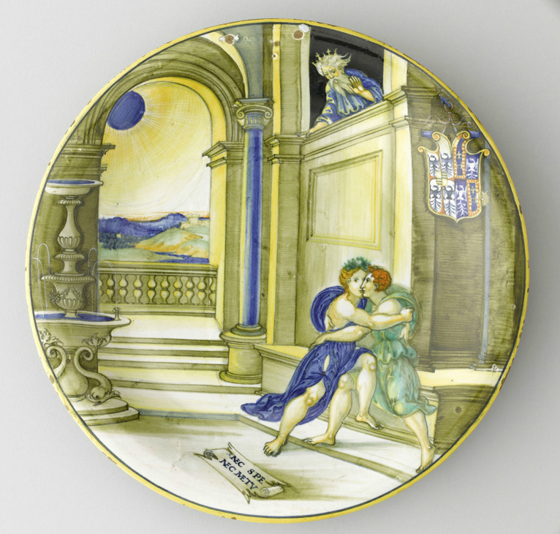
Abimelech spies Isaac and Rebecca, c. 1524
Tin-glazed earthenware (maiolica), D. 27 cm, Musée du Louvre, Paris, France https://ideaceramics.web.unc.edu/wp-content/uploads/sites/10461/2016/02/RebeccaIsaac.jpg

Slide 9
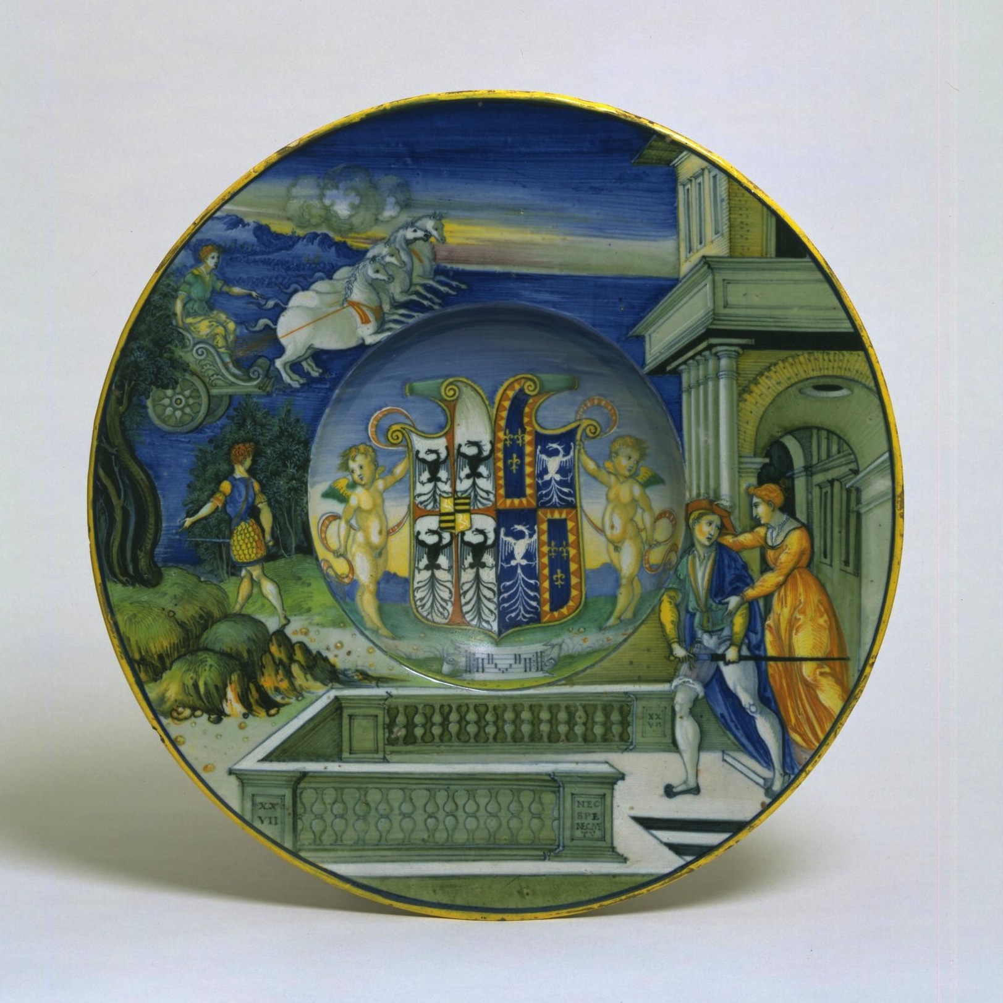
Hippolytus and Phaedra, c. 1524, Tin-glazed earthenware, D. 27.2 cm, Victoria and Albert Museum, London, UK https://ideaceramics.web.unc.edu/wp-content/uploads/sites/10461/2016/02/HippoPhaedra.jpg

Slide 10
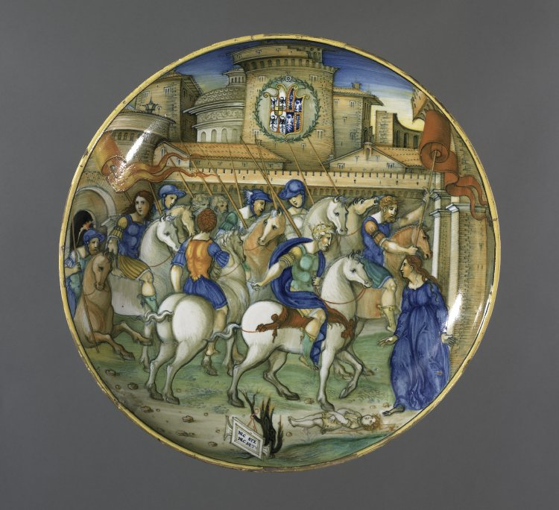
Justice of
Trajan, c. 1524,
Tin-glazed earthenware, D. 26.9 cm,
British Museum, London, UK https://www.britishmuseum.org/collection/object/H_1855-1201-96

Slide 11
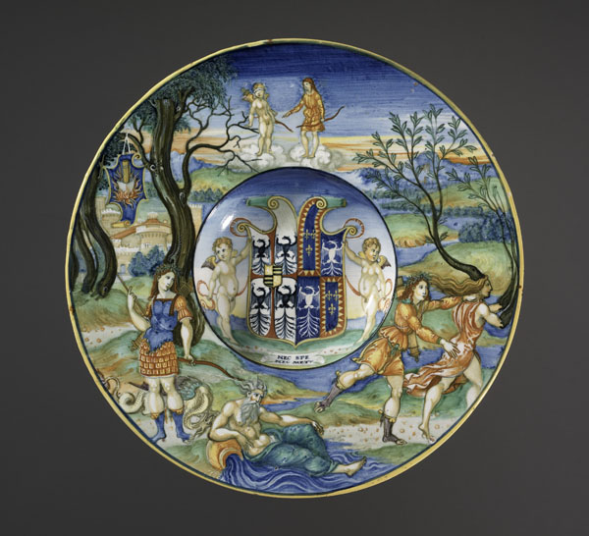
Apollo, Python, and Daphne, c. 1524,
Tin-glazed earthenware,
D. 27.1 cm,
British Museum, London, UK https://ideaceramics.web.unc.edu/prsp-record/apollo-python-and-daphne/

Slide 12
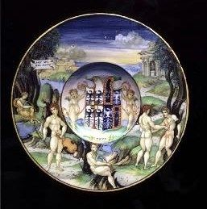
Apollo and Marsyas, c. 1524, Tin-glazed earthenware,
D. 23 cm, Wernher collection, Ranger’s House, London, UK https://ideaceramics.web.unc.edu/prsp-record/apollo-and-marsyas/

Slide 13
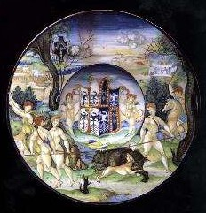
Meleager and Atalanta, c. 1524, Tin-glazed earthenware, D. 23 cm, Wernher collection, Ranger’s House, London, UK https://ideaceramics.web.unc.edu/prsp-record/meleager-and-atalanta/

Slide 14
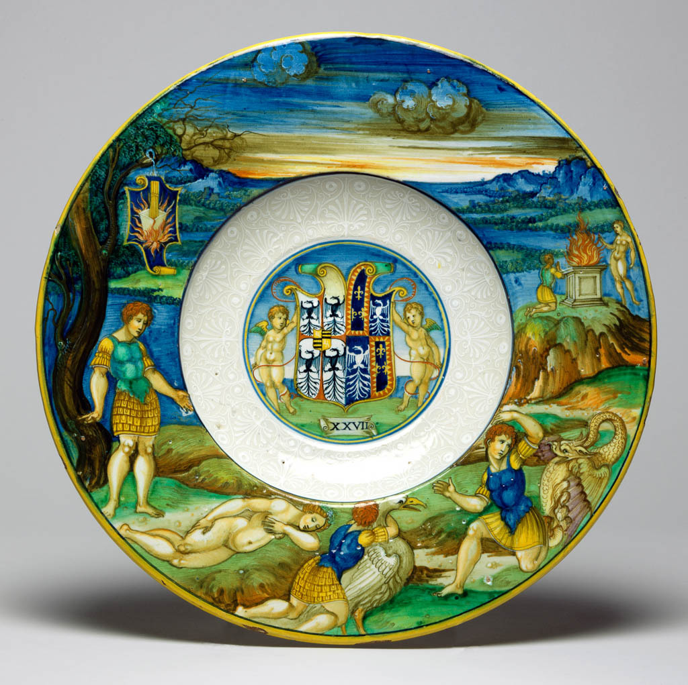
Peleus and Thetis, c. 1524, Tin-glazed earthenware, D. 30.2 cm, The Fitzwilliam Museum, University of Cambridge, UK https://ideaceramics.web.unc.edu/wp-content/uploads/sites/10461/2016/02/PeleusThetis.jpg

Slide 15
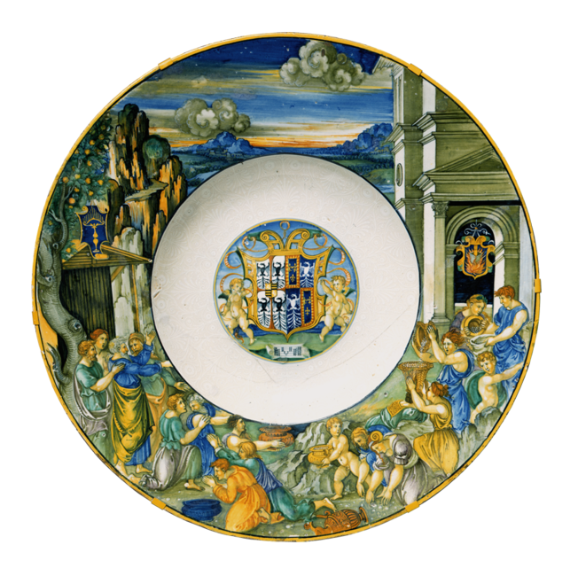
Gathering of Manna, c. 1524, Tin-glazed earthenware (maiolica),
D. 52.3 cm,
Museum für Kunst and Gewerbe, Hamburg, Germany https://www.mkg-hamburg.de/en/collection/permanent-collection/ceramics/decorative-serving-bowl-from-the-royal-banquet-service-of-isabella-d-este-of-mantua.html

Slide 16
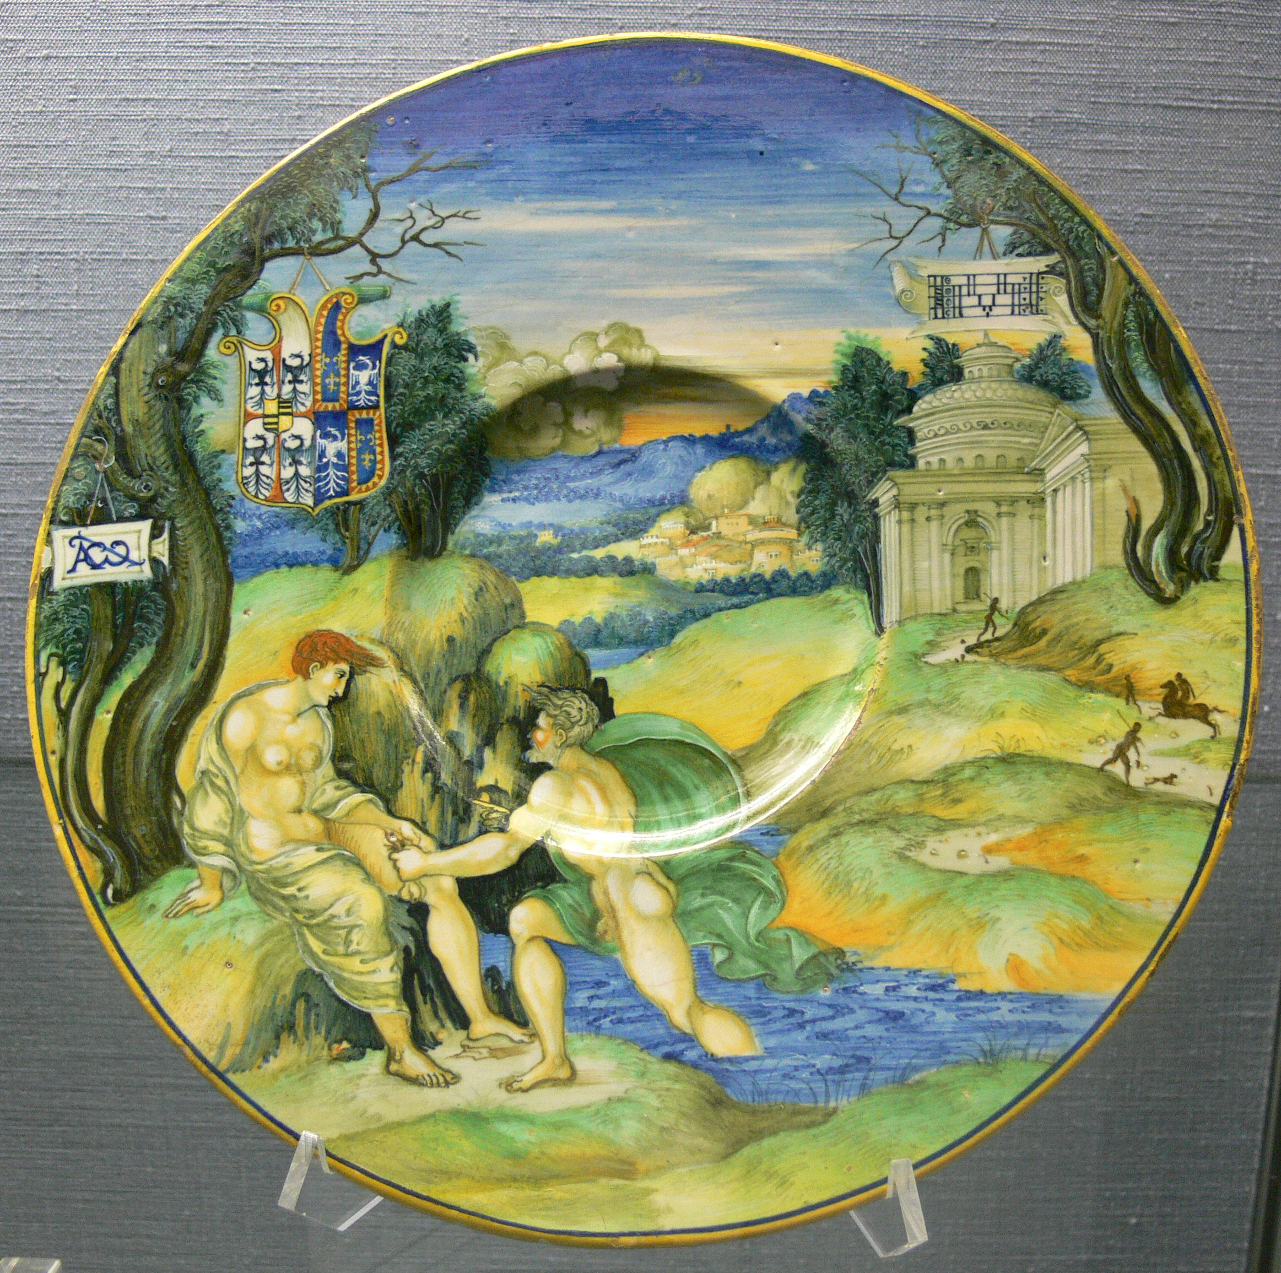
Tiber and Manto, c. 1524, Tin-glazed earthenware, D. 26.9 cm, Kunstgewerbemuseum, Berlin, Germany https://ideaceramics.web.unc.edu/prsp-record/tiber-and-manto/

Slide 17
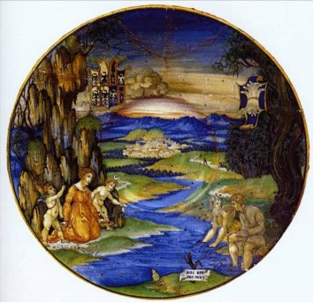
Latona and the Lycian Peasants, c. 1524, Tin-glazed earthenware, D. 27 cm, Museo Miniscalchi-Erizzo, Verona, Italy https://ideaceramics.web.unc.edu/wp-content/uploads/sites/10461/2016/02/LatonaTwins.jpg

Slide 18
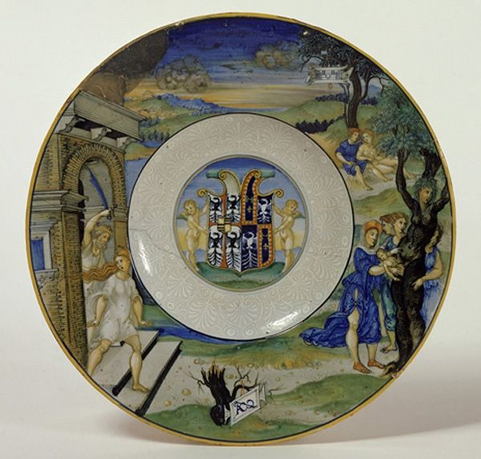
Expulsion of Myrrha and Birth of Adonis, c. 1524,
Tin-glazed earthenware, D. 32 cm, Museo Civico Medievale, Bologna, Italy https://www.pinterest.it/pin/456904324678529713/

Slide 19
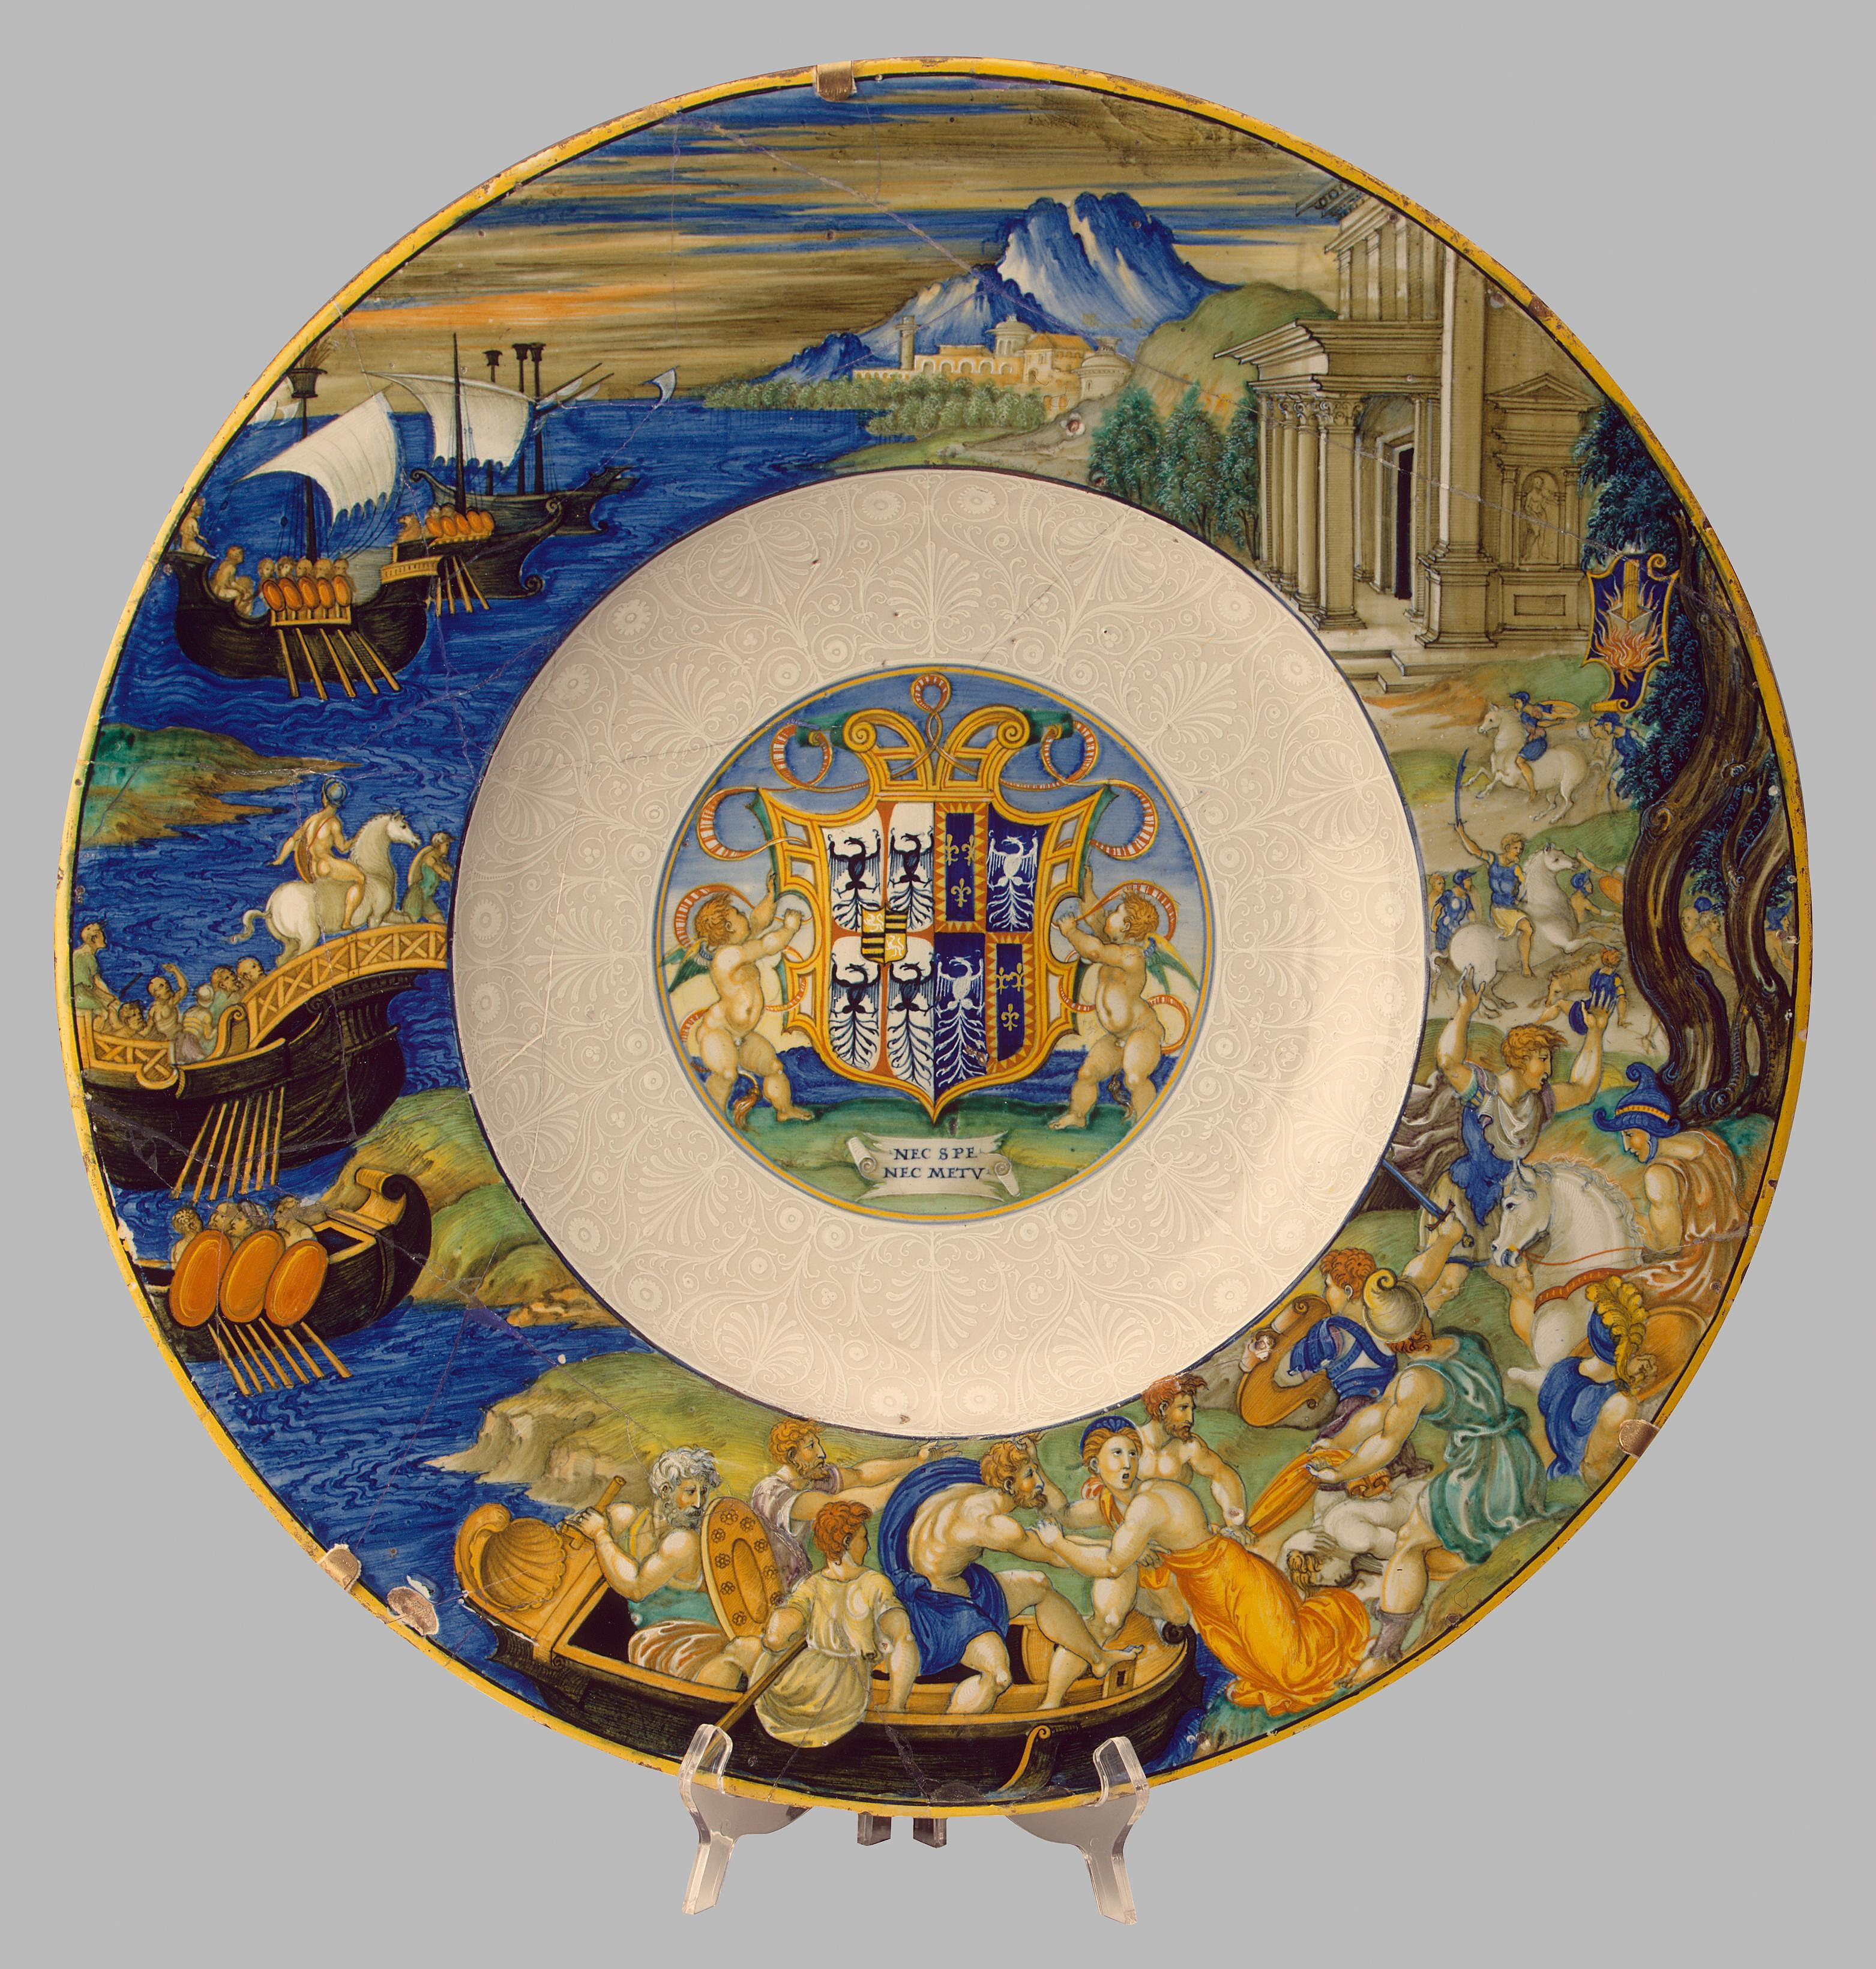
Abduction of Helen, c. 1524, Tin-glazed earthenware,
D. 52 cm,
The State Hermitage Museum, Russia https://ideaceramics.web.unc.edu/prsp-record/abduction-of-helen/

Slide 20
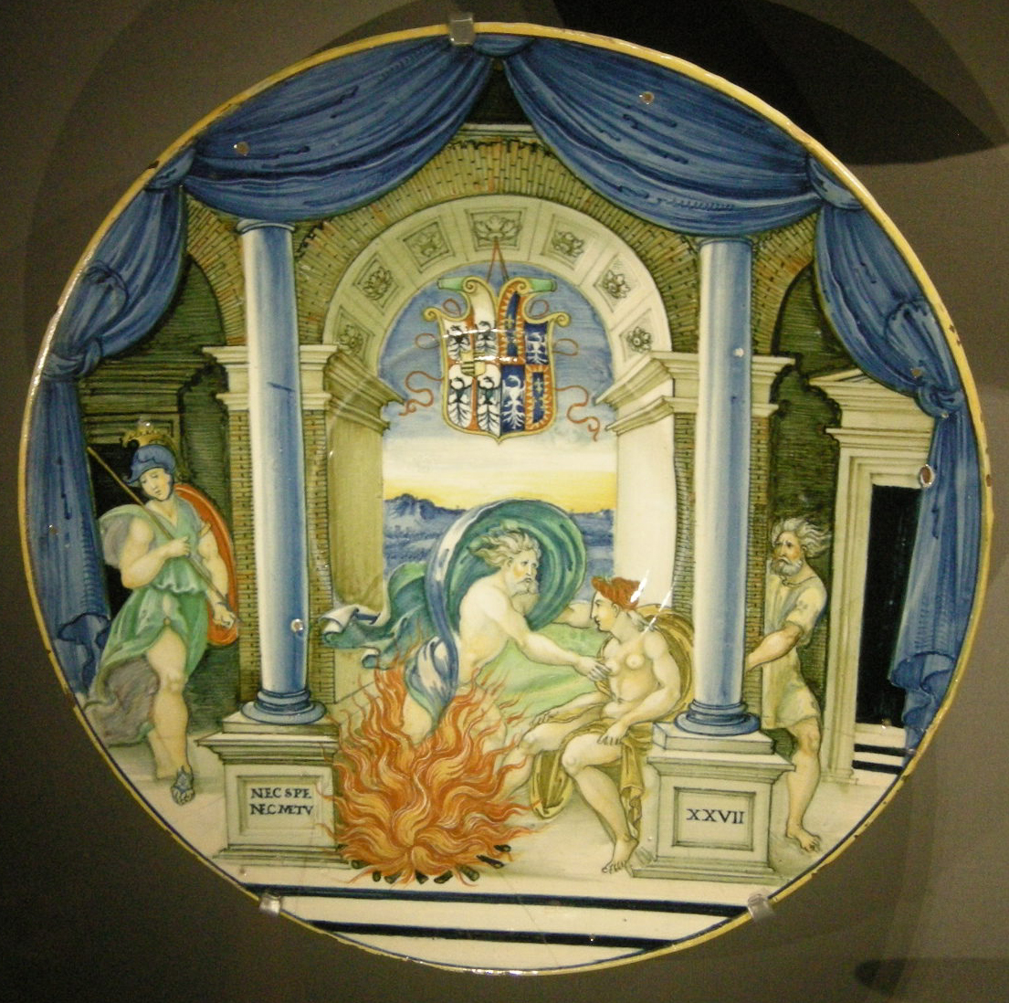
Jupiter and Semele, c. 1524,
Tin-glazed earthenware, D. 27.1 cm,
National Gallery of Victoria, Melbourne, Australia https://upload.wikimedia.org/wikipedia/commons/e/e8/Ngv%2C_nicola_da_urbino%2C_piatto_con_giove_e_semele%2C_1524_circa.JPG

Slide 21
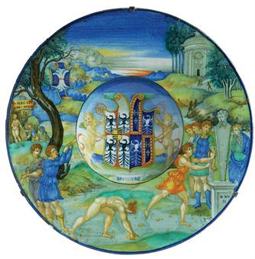
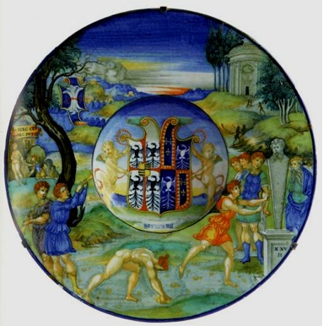
Hippomenes and Atalanta, c. 1524, Tin-glazed earthenware, D. 27.5 cm, Private Collection http://www.authenticite.fr/authenticite_fr_actu_view-faiences_d_urbino__les_prix_font_le_grand_ecart_-303-2.html

Slide 22
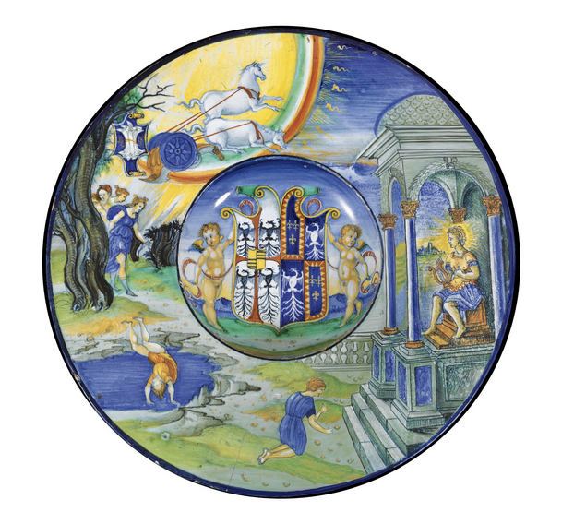
Fall of Phaeton, c. 1524, Tin-glazed earthenware,
D. 25 cm, Private Collection https://ideaceramics.web.unc.edu/wp-content/uploads/sites/10461/2016/02/Screen-Shot-2016-02-23-at-5.01.42-PM.png

Slide 23
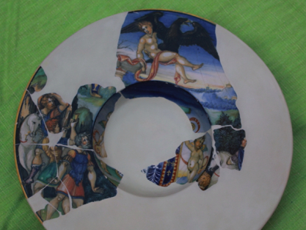
Abduction of Ganymede, c. 1524, Tin-glazed earthenware (maiolica),
D. 27.5 cm, Private Collection https://ideaceramics.web.unc.edu/prsp-record/abduction-of-ganymede/

Slide 24
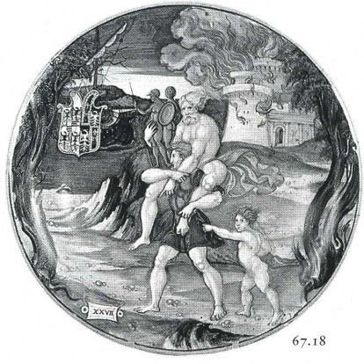
Flight of Aeneas, Anchises, and Ascanius, c. 1524
Tin-glazed earthenware,
D. 24.2 cm,
Private Collection
Image via
Italian Majolica in the Robert Lehman Collection by Jörg Rasmussen

Slide 25
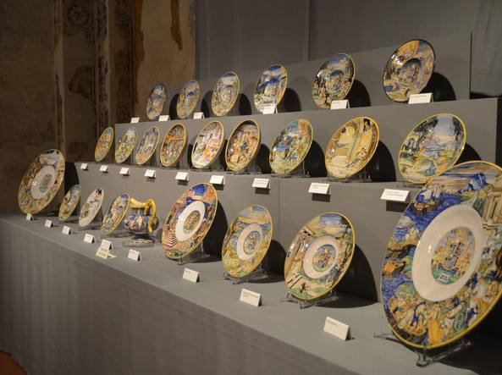
Replicas of the twenty-three surviving dishes that make up Isabella d’Este’s maiolica credenza by Mantuan artist Ester Mantovani https://milano.corriere.it/notizie/cronaca/15_novembre_01/i-piatti-raccontano-rinascimento-mostra-gioielli-isabella-d-este-71ab65c2-80b2-11e5-aac9-59b4cd97071f.shtml

Slide 26
Inspiration for this PowerPoint is credited to IDEA
and https://ideaceramics.web.unc.edu/prsp-exhibit/ceramics-exhibit/

