Slide 1
NEOCLAssIcIsM
Jacques-Louis David,
1748-1825

Slide 2
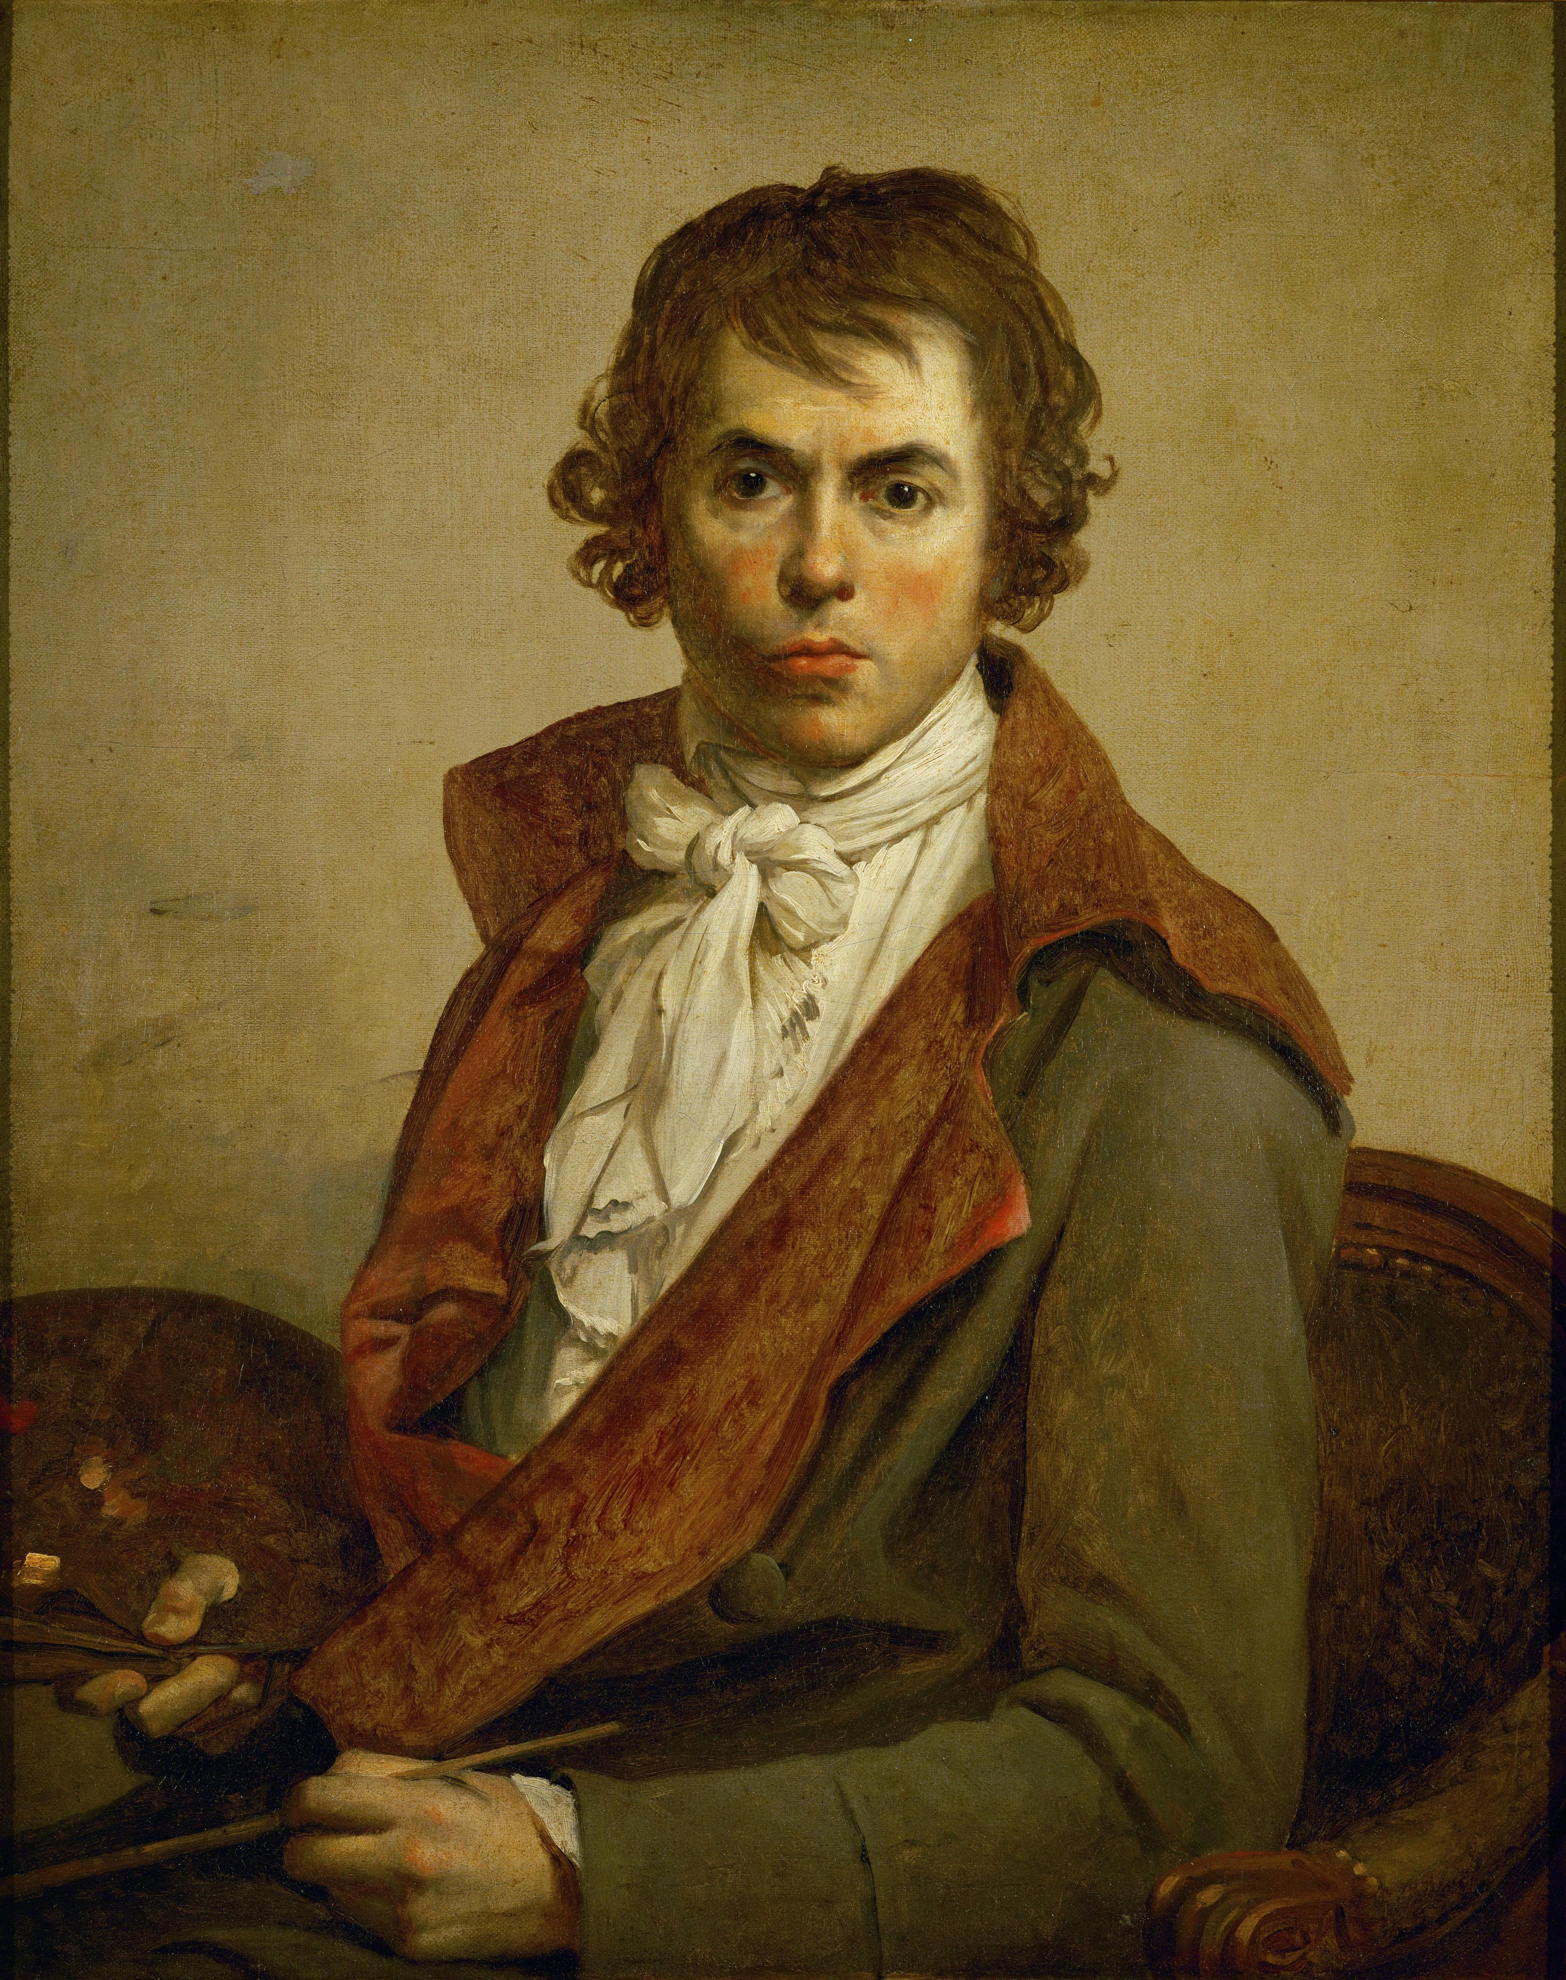
Self Portrait 1794, oil on canvas,
81 x 64 cm, the Louvre, Paris, France

Slide 3
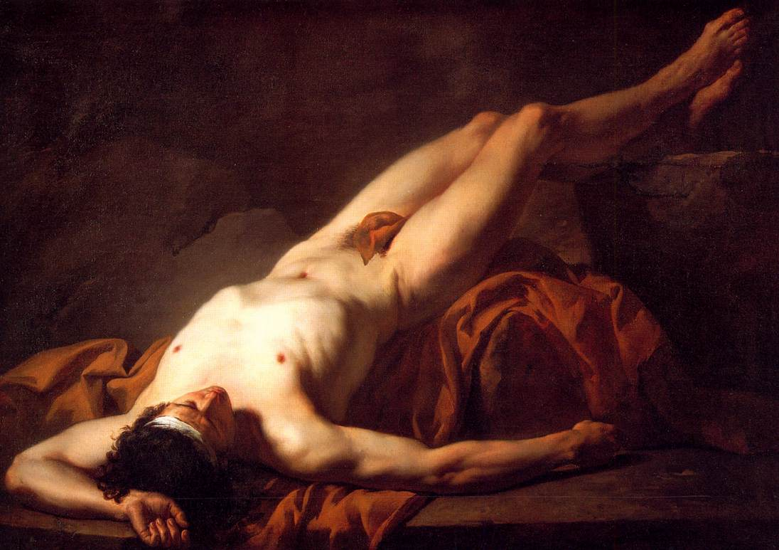
Hector, 1778, oil on canvas, 123 x 172 cm, Musée Fabre, Montpellier, France

Slide 4
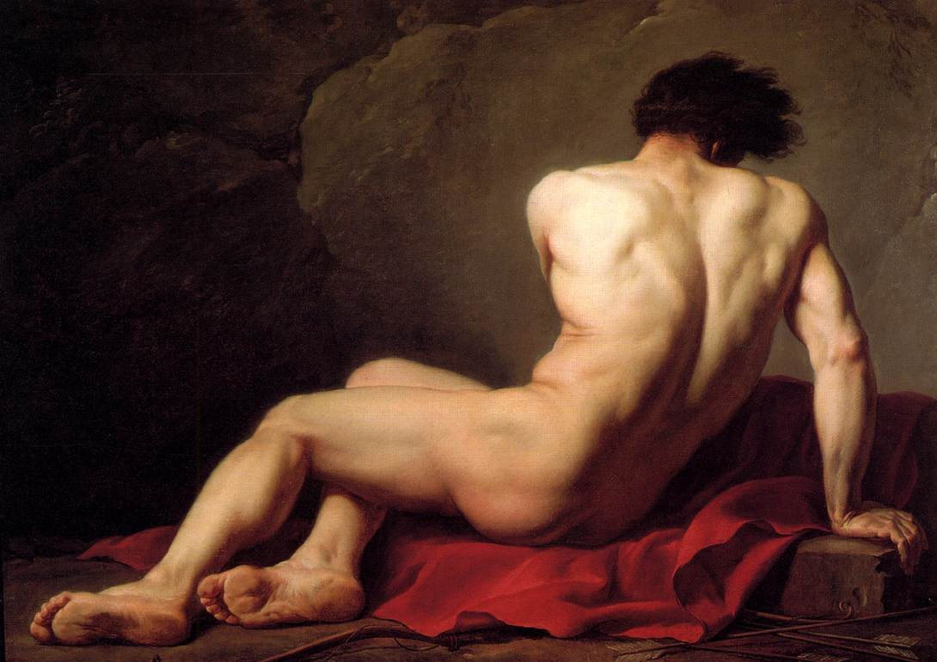
Patroclus, 1780, oil on canvas, 122 x 170 cm, Musée Thomas Henry, Cherbourg, France

Slide 5
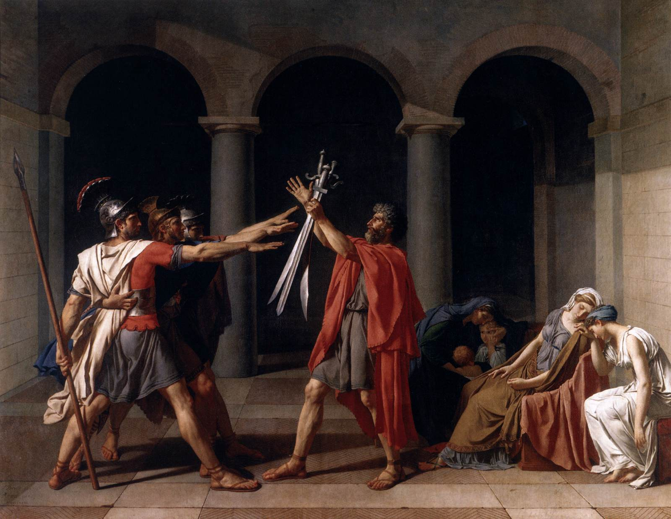
The Oath of the Horatii, 1784, oil on canvas, 330 x 425 cm, the Louvre, Paris, France

Slide 6
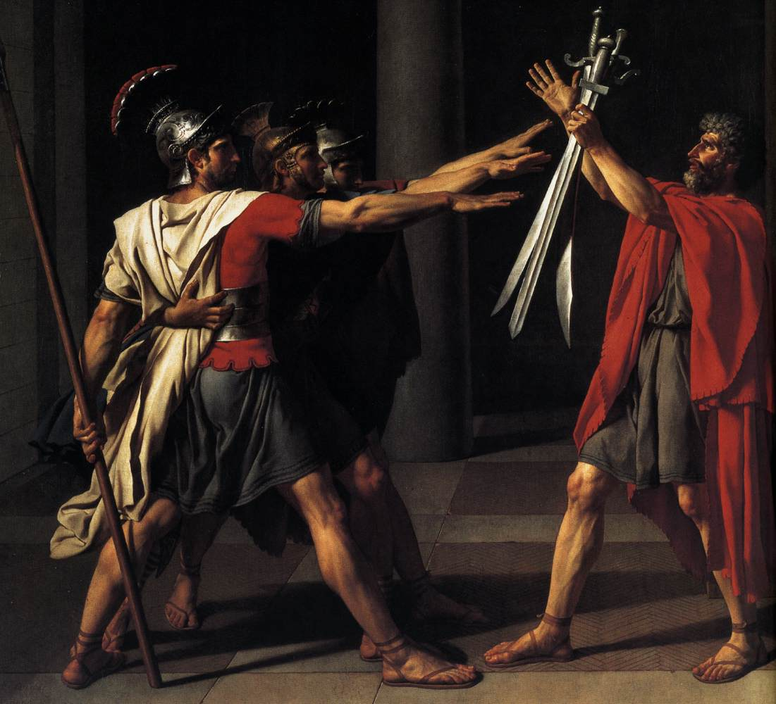
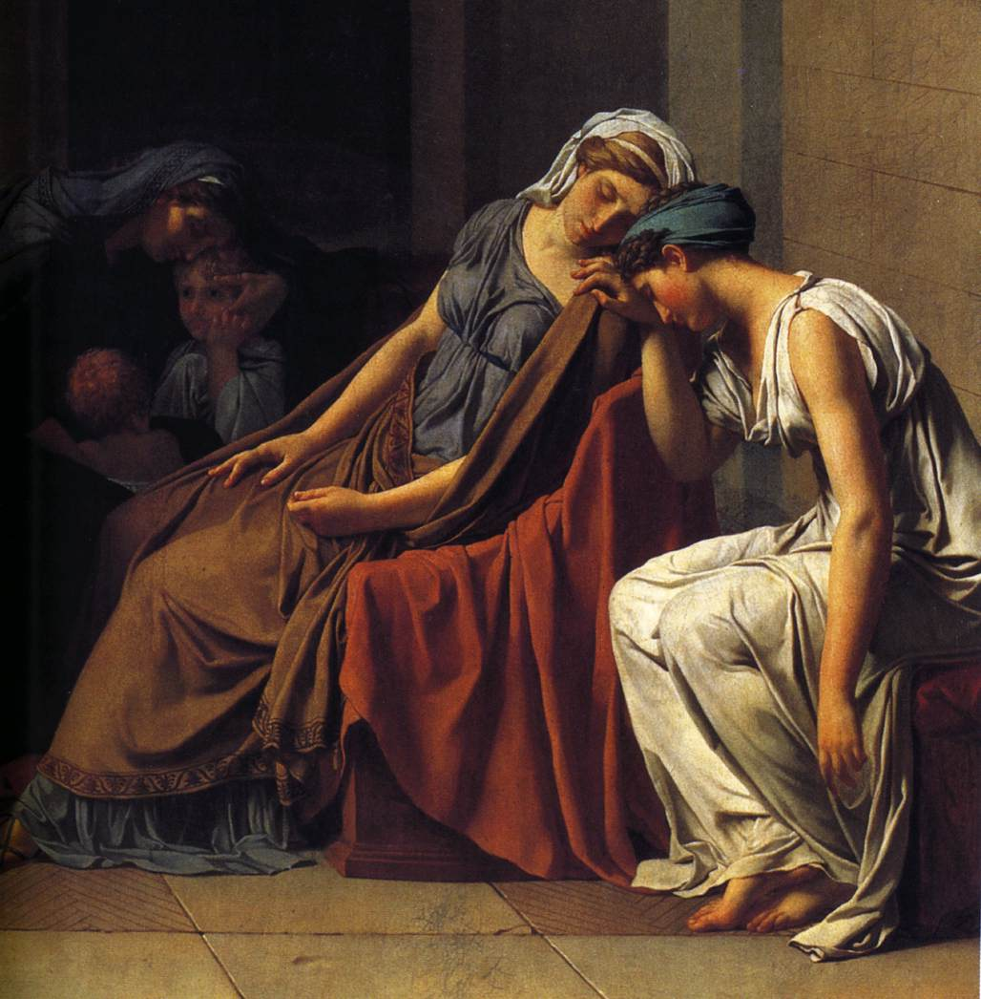

Slide 7
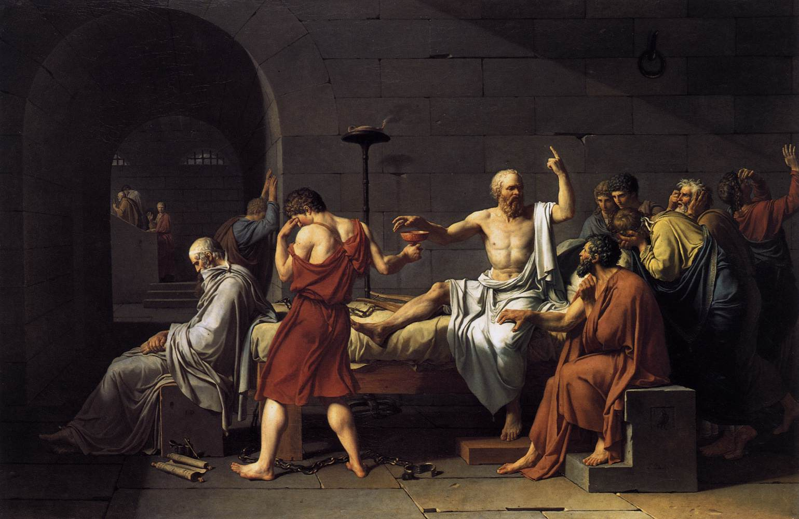
The Death of Socrates, 1787, oil on canvas, 130 x 196 cm, the MET, NY, USA

Slide 8
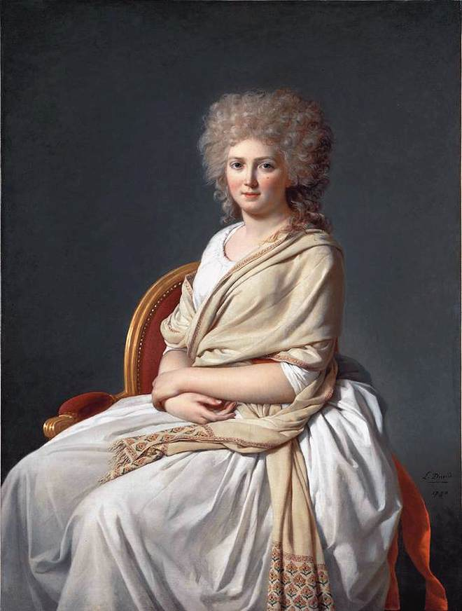
Anne-Marie-Louise Thélusson, Comtesse de Sorcy, 1790, oil on canvas, 129 x 97 cm, Neue Pinakothek, Munich, Germny

Slide 9
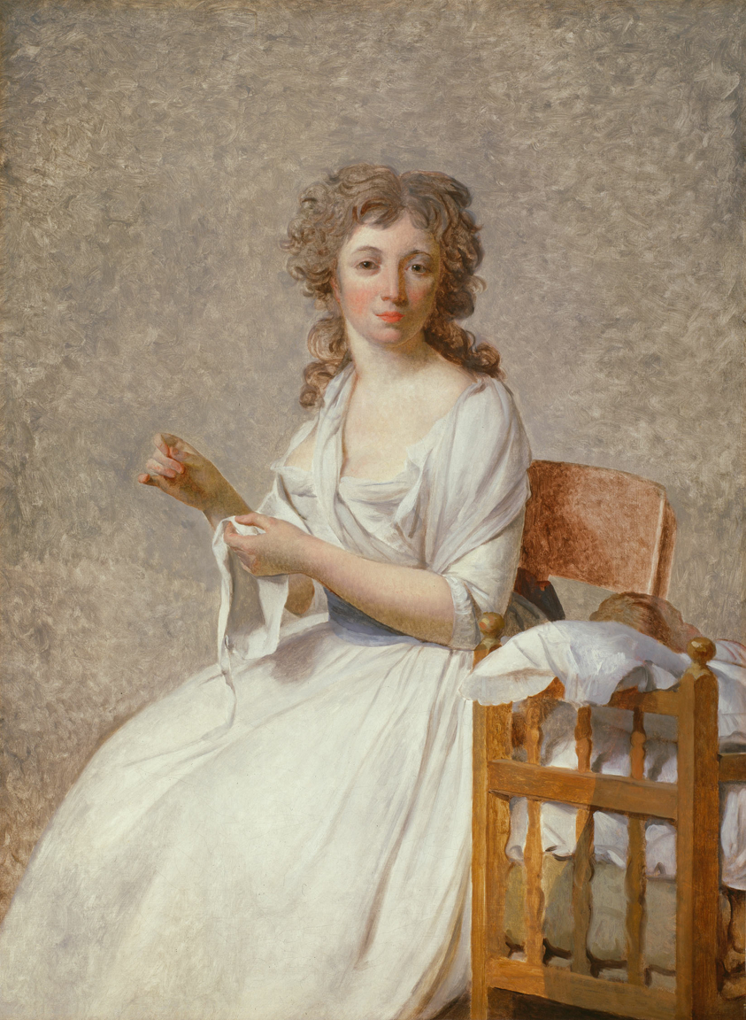
Portrait of Madame Adélaide Pastoret, 1791-92, oil on canvas, 130 x 97 cm, Art Institute, Chicago, USA

Slide 10
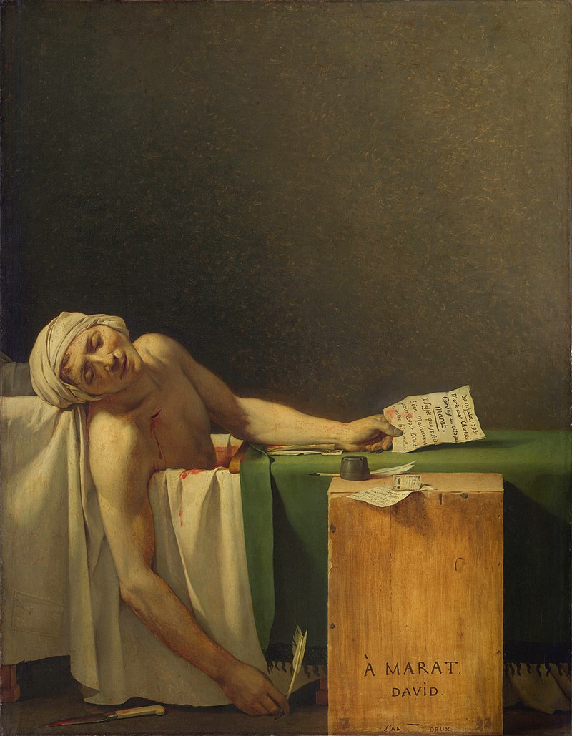
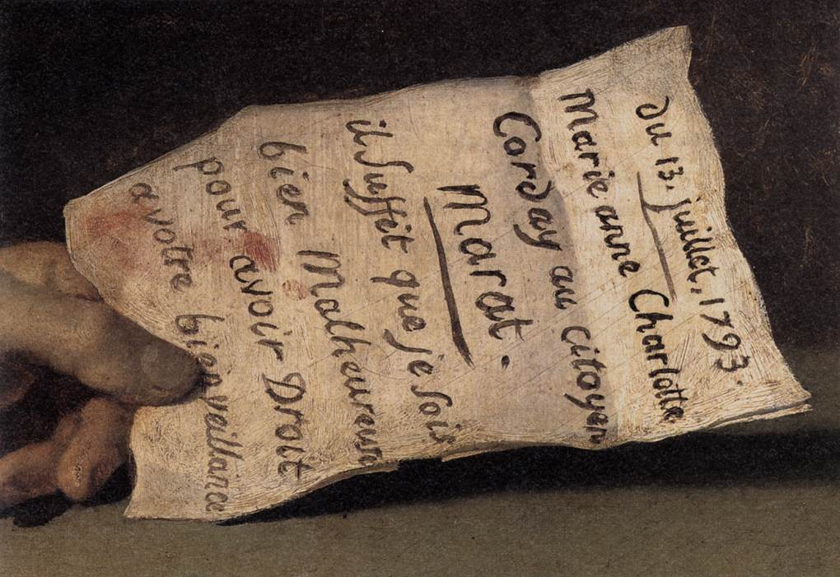
The Death of Marat, 1793, oil on canvas, 162 x 128 cm, Musées Royaux des Beaux-Arts, Brussels, Belgium

Slide 11
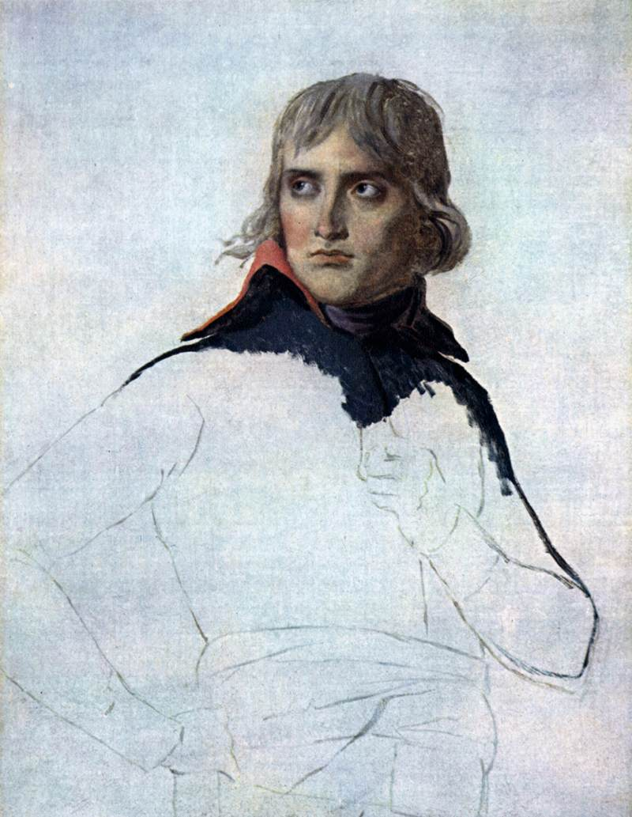
Portrait of General Bonaparte, 1797, oil on canvas, 81 x 65 cm the Louvre, Paris, France

Slide 12
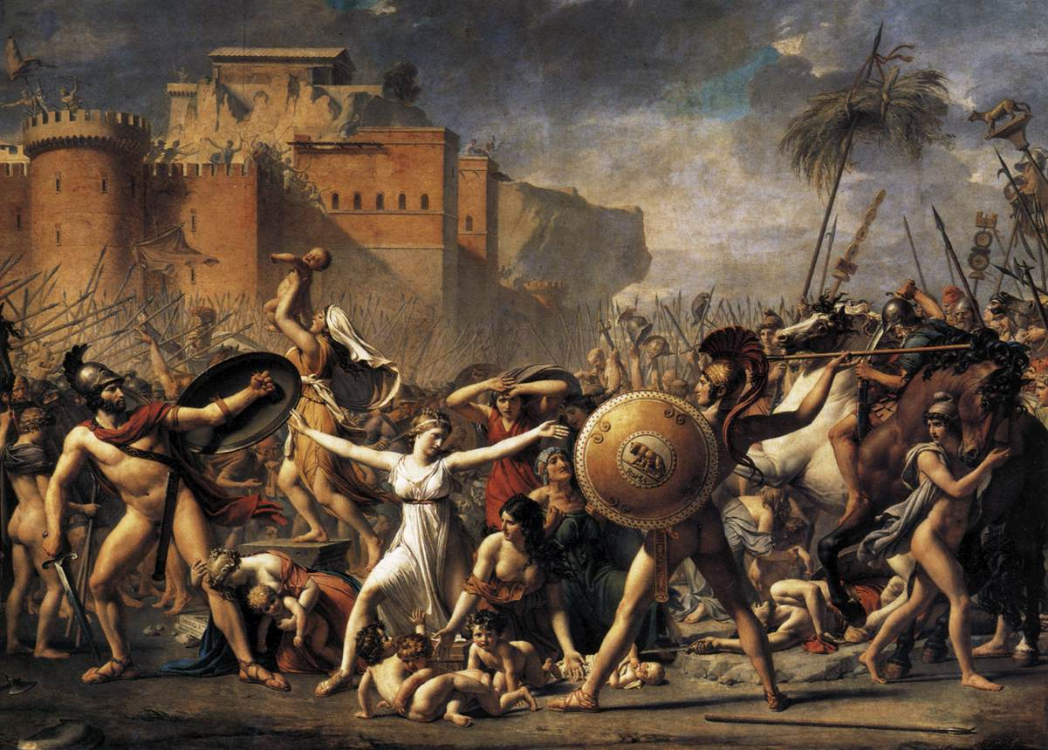
The Intervention of the Sabine Women, 1799, oil on canvas, 385 x 522 cm, Musée du Louvre, Paris, France

Slide 13
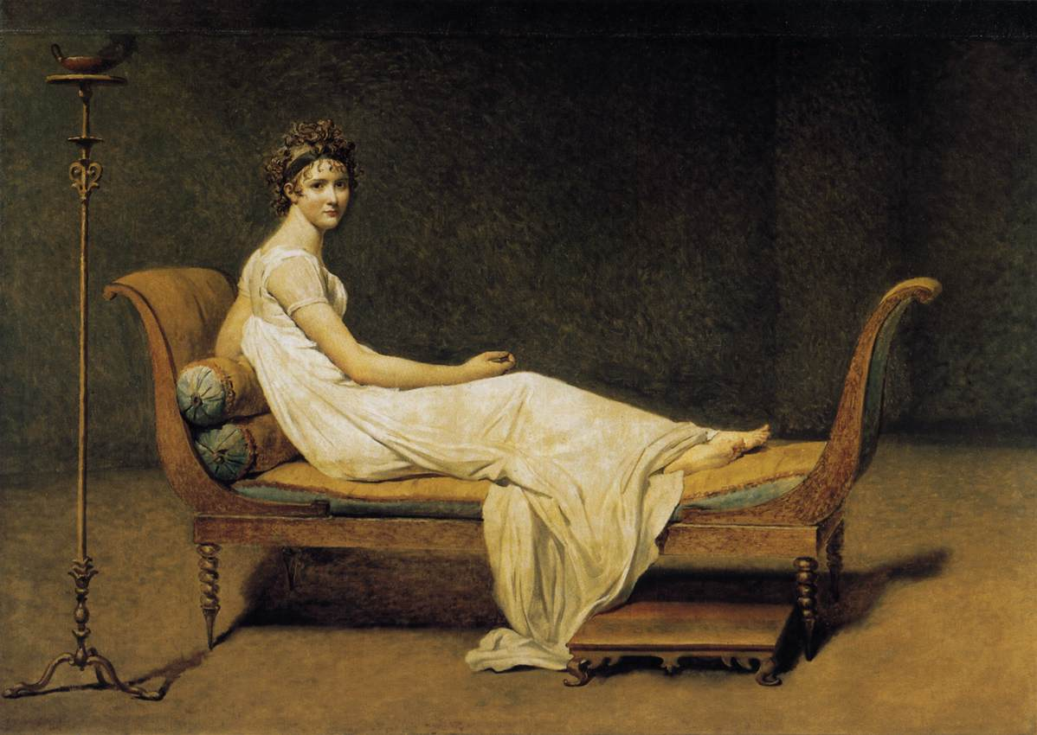
Madame Récamier, 1800, oil on canvas, 173 x 244 cm, the Louvre, Paris, France

Slide 14
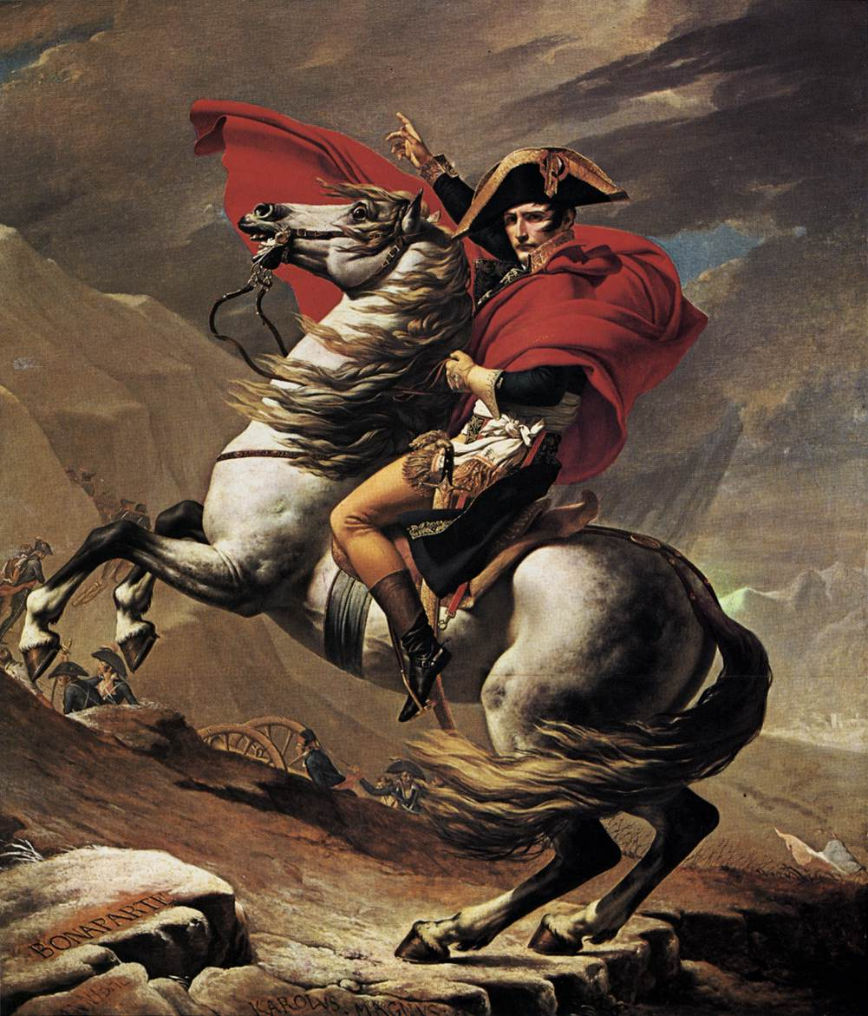
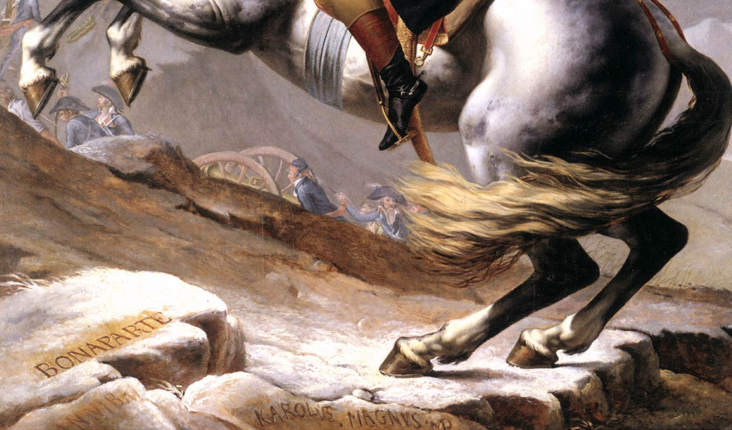
Napoleon at the St. Bernard Pass, 1801, oil on canvas, 246 x 231 cm, Österreichische Galerie Belvedere, Vienna

Slide 15
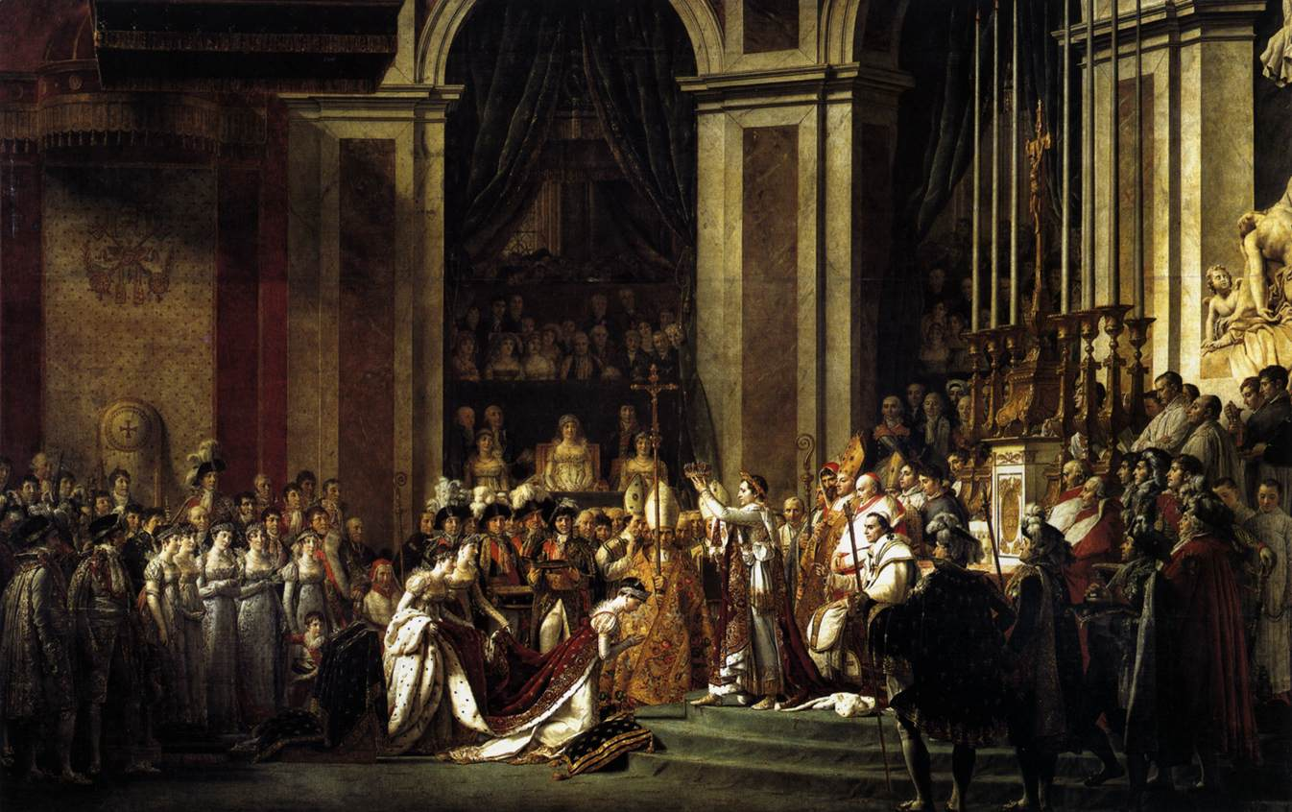
Consecration of the Emperor Napoleon I and Coronation of the Empress Josephine, 1805-07, oil on canvas, 629 x 979 cm, the Louvre, Paris, France

Slide 16
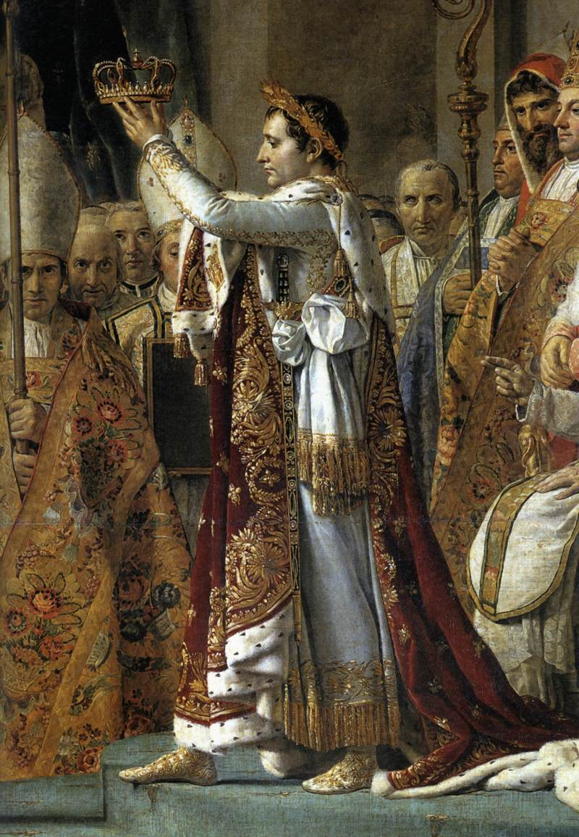
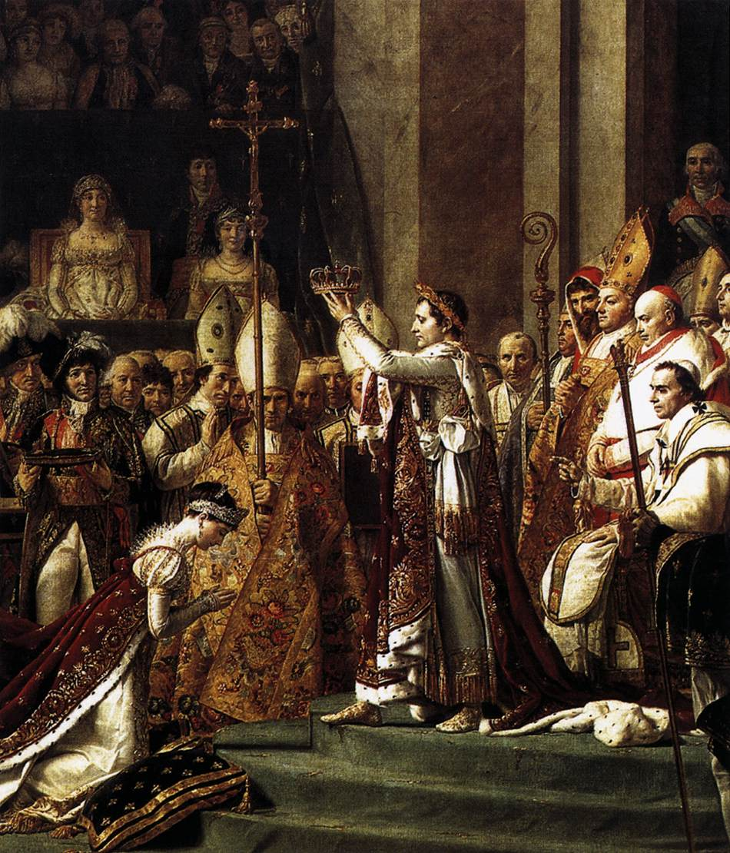

Slide 17
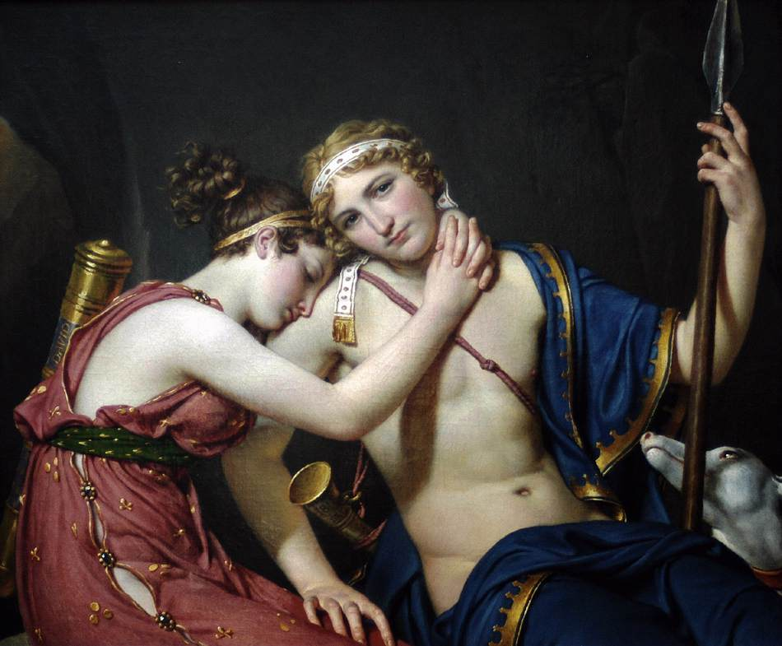
The Farewell of Telemachus and Eucharis, 1818, oil on canvas, 87 x 103 cm, Private Collection

Slide 18
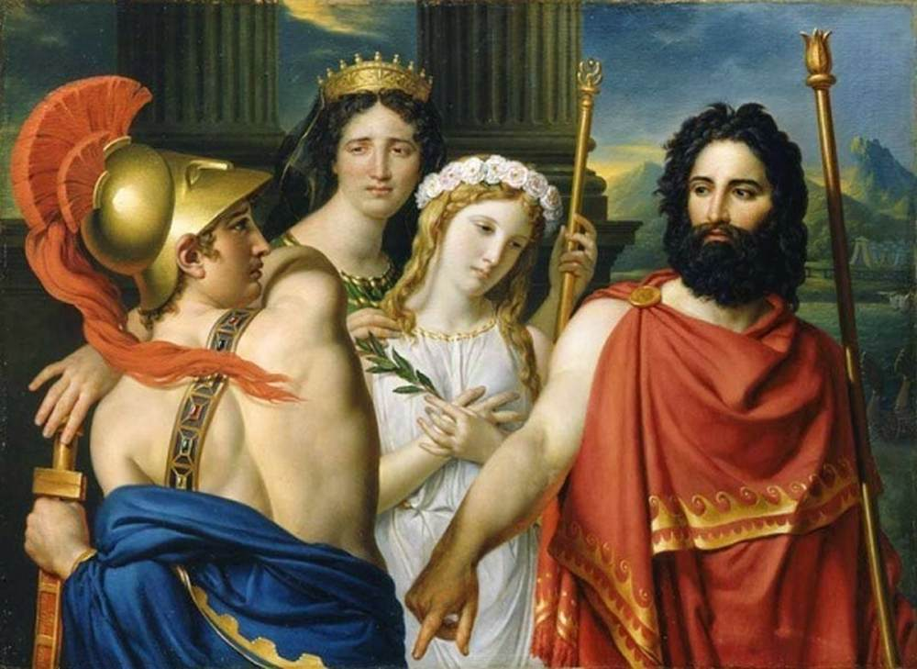
The Anger of Achilles, or Sacrifice of Iphigénie, 1825, oil on canvas, 110 x 151 cm, Private Collection

Slide 19
Photo Credits for the PowerPoint
Slide 1
Introduction – Neoclassicism, Jacques-Louis David, 1748-1825
Slide 2
Self Portrait, 1794, oil on canvas, 81 x 64 cm, the Louvre, Paris, France https://upload.wikimedia.org/wikipedia/commons/3/3c/Jacques-Louis_David_-_Self-portrait%2C_1794.jpg
Slide 3
Hector, 1778, oil on canvas, 123 x 172 cm, Musée Fabre, Montpellier, France https://www.wga.hu/html_m/d/david_j/1/106david.html
Slide 4
Patroclus, 1780, oil on canvas, 122 x 170 cm, Musée Thomas Henry, Cherbourg, France https://www.wga.hu/html_m/d/david_j/1/index.html
Slide 5
The Oath of the Horatii, 1784, oil on canvas, 330 x 425 cm, the Louvre, Paris, France https://www.wga.hu/html_m/d/david_j/2/index.html
Slide 6
The Oath of the Horatii (details), 1784, oil on canvas, 330 x 425 cm, the Louvre, Paris, France https://www.wga.hu/html_m/d/david_j/2/index.html
Slide 7
The Death of Socrates, 1787, oil on canvas, 130 x 196 cm, the MET, NY, USA https://www.wga.hu/html_m/d/david_j/2/index.html

Slide 20
Slide 8
Anne-Marie-Louise Thélusson, Comtesse de Sorcy, 1790, oil on canvas, 129 x 97 cm, Neue Pinakothek, Munich, Germany https://www.wga.hu/html_m/d/david_j/2/index.html
Slide 9
Portrait of Madame Adélaide Pastoret, 1791-92, oil on canvas, 130 x 97 cm, Art Institute, Chicago, USA https://www.artic.edu/artworks/27307/madame-de-pastoret-and-her-son
Slide 10
The Death of Marat (and detail), 1793, oil on canvas, 162 x 128 cm, Musées Royaux des Beaux-Arts, Brussels, Belgium https://en.wikipedia.org/wiki/The_Death_of_Marat#/media/File:Death_of_Marat_by_David.jpg https://www.wga.hu/html_m/d/david_j/3/index.html
Slide 11
Portrait of General Bonaparte, 1797, oil on canvas, 81 x 65 cm, the Louvre, Paris, France https://www.wga.hu/html_m/d/david_j/3/index.html
Slide 12
The Intervention of the Sabine Women, 1799, oil on canvas, 385 x 522 cm, Musée du Louvre, Paris, France https://www.wga.hu/html_m/d/david_j/3/index.html
Slide 13
Madame Récamier, 1800, oil on canvas, 173 x 244 cm, the Louvre, Paris, France https://www.wga.hu/html_m/d/david_j/4/index.html

Slide 21
Slide 14
Napoleon at the St. Bernard Pass (and detail), 1801, oil on canvas, 246 x 231 cm, Österreichische Galerie Belvedere, Vienna https://www.wga.hu/html_m/d/david_j/4/index.html
Slide 15
Consecration of the Emperor Napoleon I and Coronation of the Empress Josephine, 1805-07, oil on canvas, 629 x 979 cm, the Louvre, Paris, France https://www.wga.hu/html_m/d/david_j/4/index.html
Slide 16
Consecration of the Emperor Napoleon I and Coronation of the Empress Josephine (details), 1805-07, oil on canvas, 629 x 979 cm, the Louvre, Paris, France https://www.wga.hu/html_m/d/david_j/4/index.html
Slide 17
The Farewell of Telemachus and Eucharis, 1818, oil on canvas, 87 x 103 cm, Private Collection https://www.wga.hu/html_m/d/david_j/4/index.html
Slide 18
The Anger of Achilles, or Sacrifice of Iphigénie, 1825, oil on canvas, 110 x 151 cm, Private Collection https://www.wga.hu/html_m/d/david_j/4/index.html
Slides 19, 20, 21
Identifications and Photo Credits
Slide 22
The End

Slide 22
end

