Slide 1
Kenneth Clark called it "the first beautiful nude in art.” It is attributed, on slender evidence, to Kritios who worked together with Nesiotes.
This is the amazing 480 BC marble statue, 116.7 cm in height, of the
Kritios Boy
in the Acropolis Museum, in Athens

Slide 2
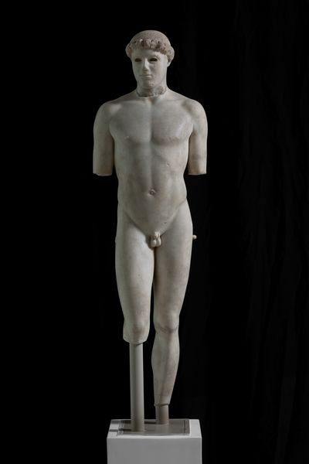
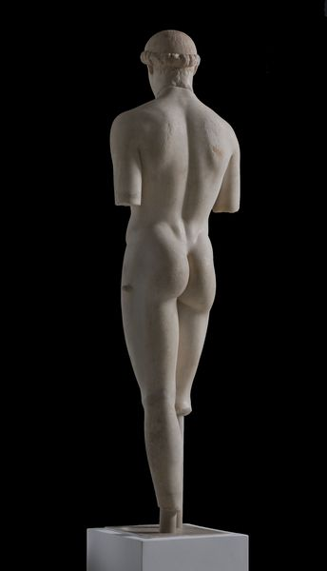
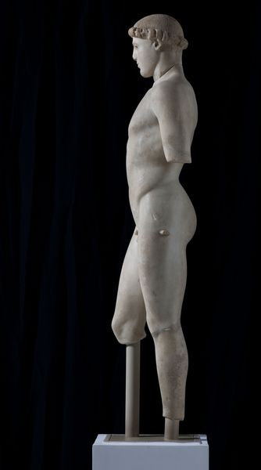

Slide 3
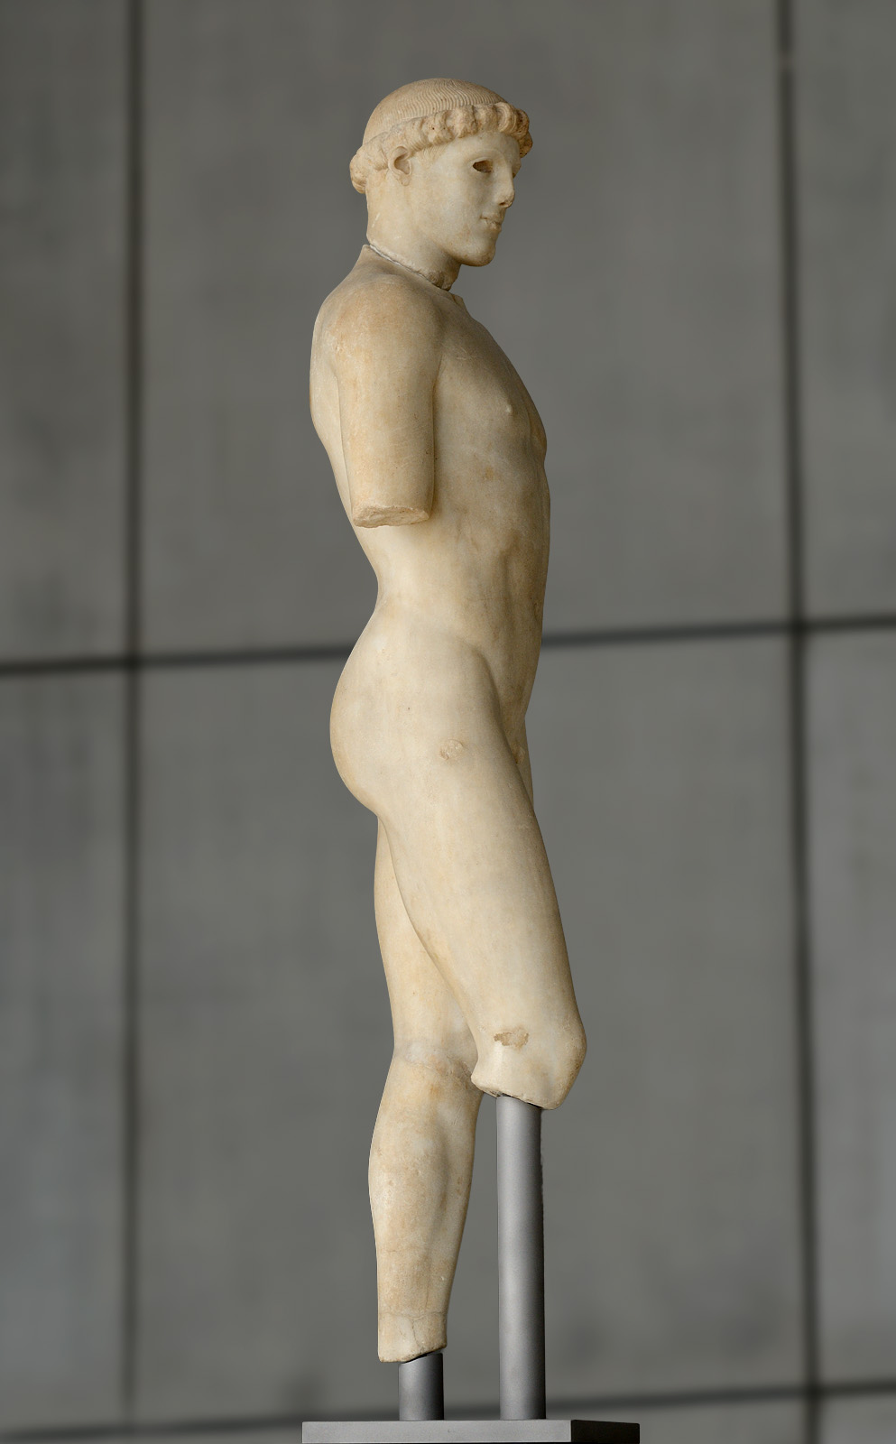
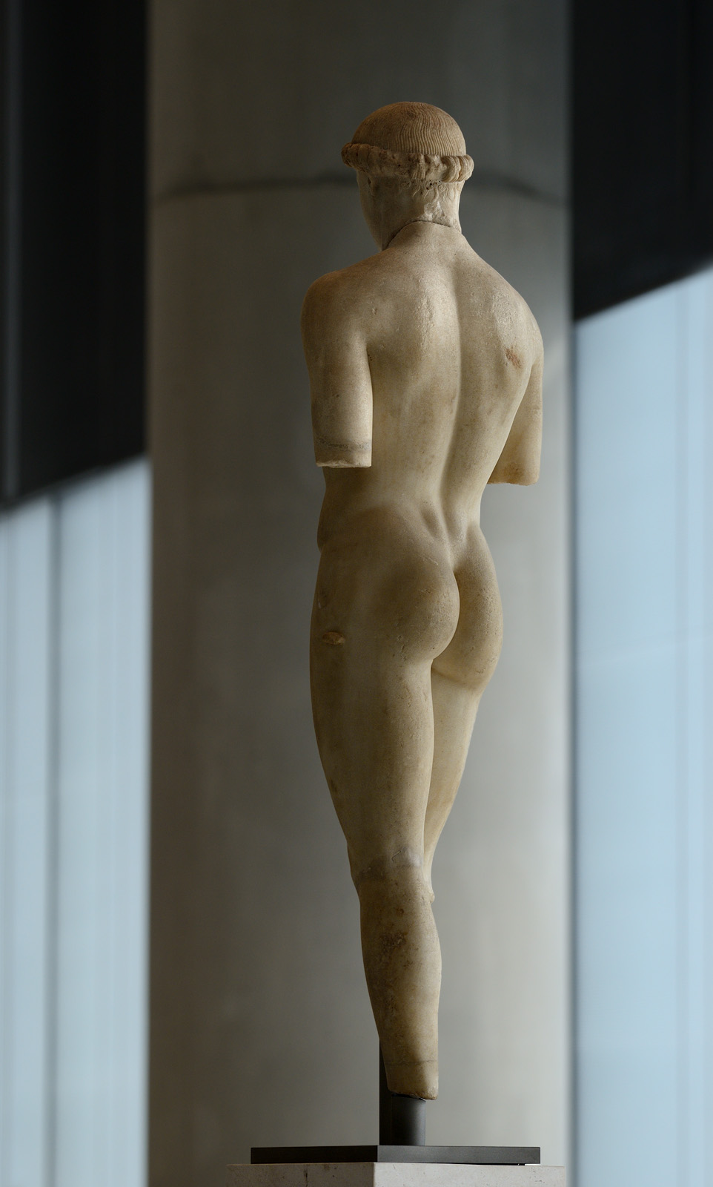

Slide 4
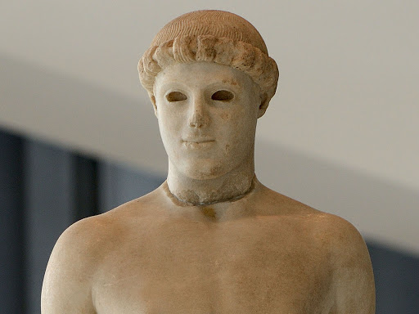

Slide 5
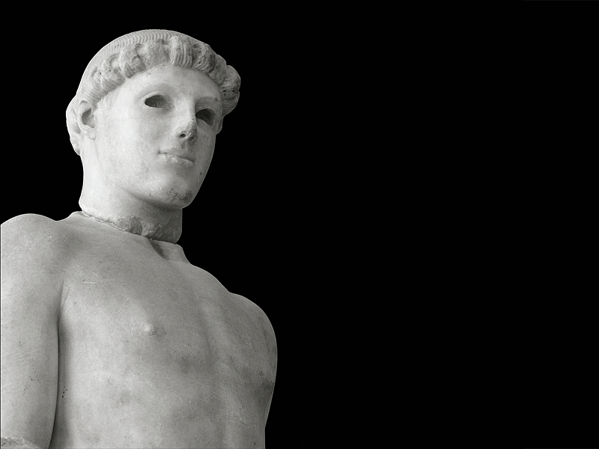

Slide 6
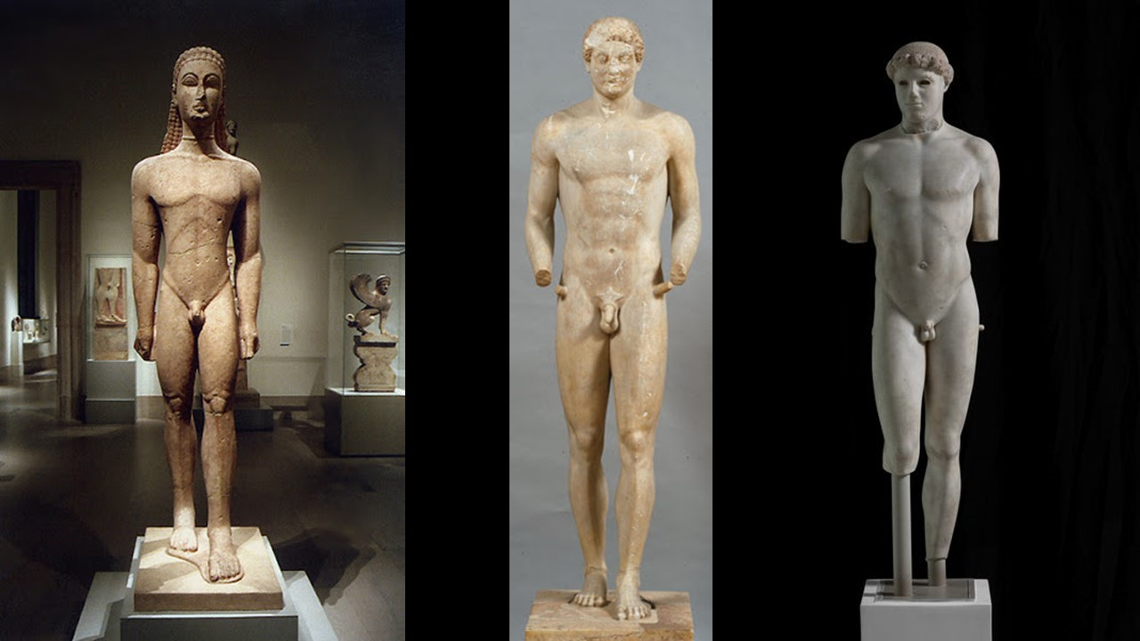

Slide 7
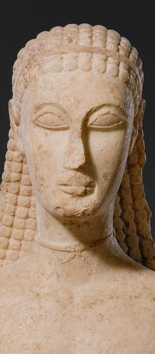
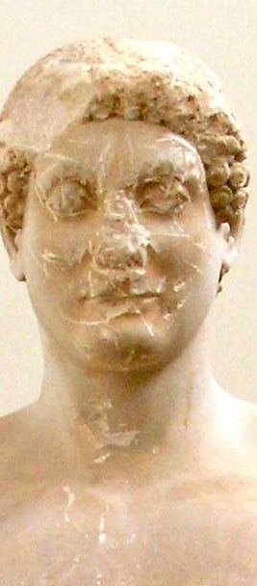


Slide 8
Photo Credits
Slide 1
Introduction - Kenneth Clark called it "the first beautiful nude in art.” It is attributed, on slender evidence, to Kritios who worked together with Nesiotes or their school… This is the amazing 480 BC Kritios Boy in the Acropolis Museum, in Athens
Slide 2 https://www.theacropolismuseum.gr/en/youth-statue-kritios-boy
Slide 3 http://ancientrome.ru/art/artworken/img.htm?id=5959 http://ancientrome.ru/art/artworken/img.htm?id=5958
Grade 4 http://ancientrome.ru/art/artworken/img.htm?id=5960
Slide 5 https://brewminate.com/wp-content/uploads/2017/02/KritiosBoy04.jpg
Slide 6 https://www.metmuseum.org/art/collection/search/253370 http://nam.culture.gr/portal/page/portal/deam/virtual_exhibitions/EAMS/EAMG3938 https://www.theacropolismuseum.gr/en/youth-statue-kritios-boy
Slide 7 https://gr.pinterest.com/pin/682436149758725905/ https://arthistorykmg.omeka.net/items/show/106 http://ancientrome.ru/art/artworken/img.htm?id=5960
Slide 8
Photo Credits

