Slide 1
Mosaics from the Ilissos Basilica in Athens
Byzantine and Christian Museum, Athens, Greece

Slide 2
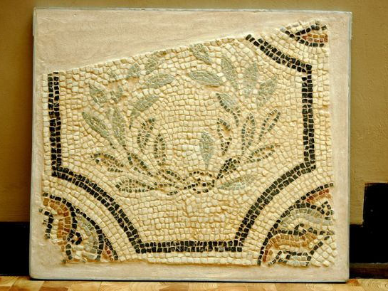

Slide 3
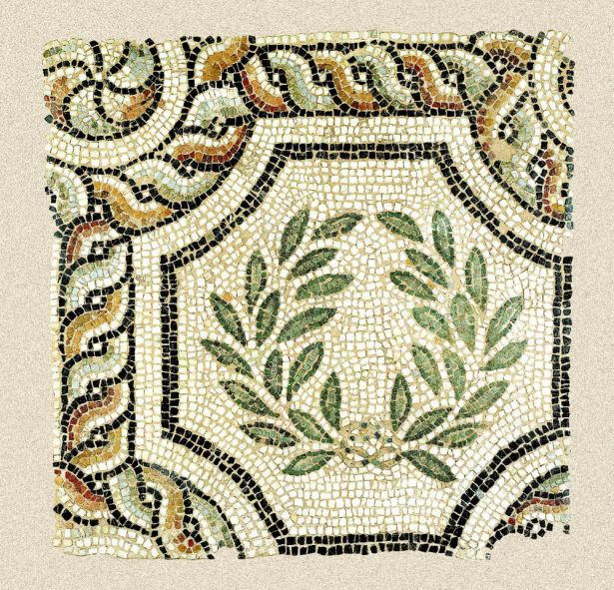

Slide 4
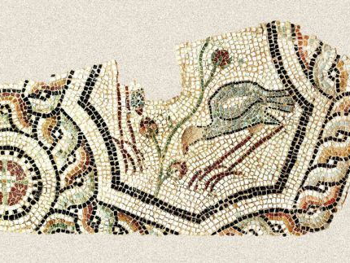

Slide 5
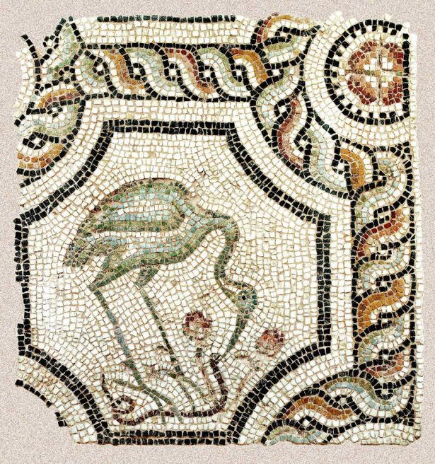

Slide 6
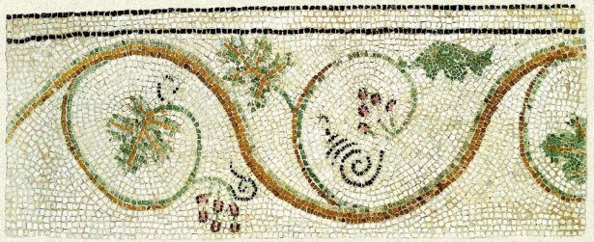
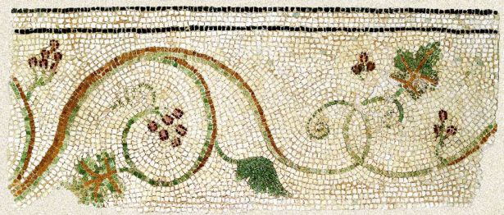

Slide 7
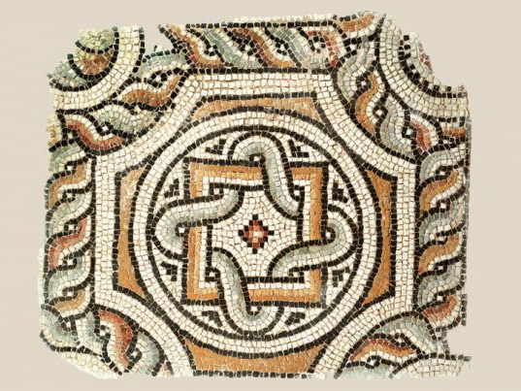

Slide 8
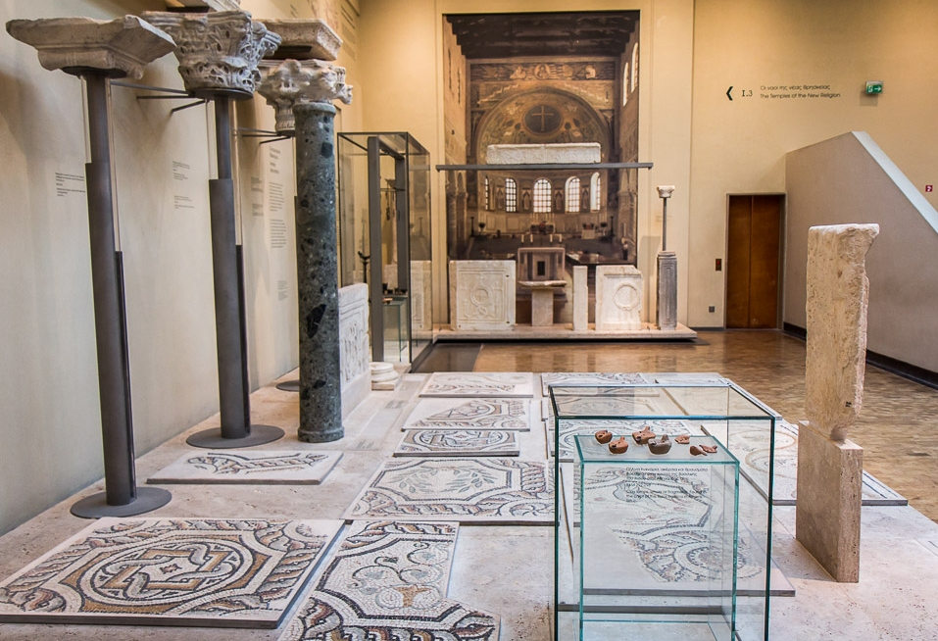

Slide 9
Slide 1
Introduction- Mosaics from the Ilissos Basilica in Athens
Slide 2
Fragment of a Mosaic depicting a Laurel Wreath, 5th century AD, Floor Mosaic, 98 x 97 cm, Byzantine and Christian Museum, Athens, Greece https://www.byzantinemuseum.gr/en/permanentexhibition/ancient_world_to_Byzantium/temples_of_the_new_religion/?bxm=175 3
Slide 3
Mosaic depicting a Laurel Wreath, 5th century AD, Floor Mosaic, 98 x 97 cm, Byzantine and Christian Museum, Athens, Greece https://www.byzantinemuseum.gr/en/permanentexhibition/ancient_world_to_Byzantium/temples_of_the_new_religion/?bxm=1755
Slide 4
Fragment of a Mosaic depicting a Bird, 5th century AD, Floor Mosaic, 77 x 155 cm, Byzantine and Christian Museum, Athens, Greece https://www.byzantinemuseum.gr/en/permanentexhibition/ancient_world_to_Byzantium/temples_of_the_new_religion/?bxm=1754
Slide 5
Mosaic depicting a Stork pecking at a Snake, 5th century AD, Floor Mosaic, 92 x 98 cm, Byzantine and Christian Museum, Athens, Greece https://www.byzantinemuseum.gr/en/permanentexhibition/ancient_world_to_Byzantium/temples_of_the_new_religion/?bxm=1756
Slide 6
Part of a Mosaic pavement decorated with a winding stem with leaves and grapes, 5th century AD, Floor Mosaic, 62 x 151 cm, Byzantine and Christian Museum, Athens, Greece https://www.byzantinemuseum.gr/en/permanentexhibition/ancient_world_to_Byzantium/temples_of_the_new_religion/?bxm=1758
Part of a Mosaic pavement decorated with a winding stem with leaves and grapes, 5th century AD, Floor Mosaic, 63 x 147 cm, Byzantine and Christian Museum, Athens, Greece https://www.byzantinemuseum.gr/en/permanentexhibition/ancient_world_to_Byzantium/temples_of_the_new_religion/?bxm=1759
Slide 7
Part of a Mosaic pavement with geometric decoration, 5th century AD, Floor Mosaic, 110 x 92 cm, Byzantine and Christian Museum, Athens, Greece https://www.byzantinemuseum.gr/en/permanentexhibition/ancient_world_to_Byzantium/temples_of_the_new_religion/?bxm=1762
Slide 8
Exhibition of Mosaics from the Ilissos Basilica in Athens, 5th century AD, Byzantine and Christian Museum, Athens, Greece http://www.byzantineathens.com/betaalphasigmaiotalambdaiotakappaeta-iotalambdaiotasigmasigmaomicronupsilon.html
Slide 9
Photo Credits
Slide 9
The End

Slide 10
The End

