Slide 1
Art, Revolution and the 1st President of the United States… George Washington

Slide 2
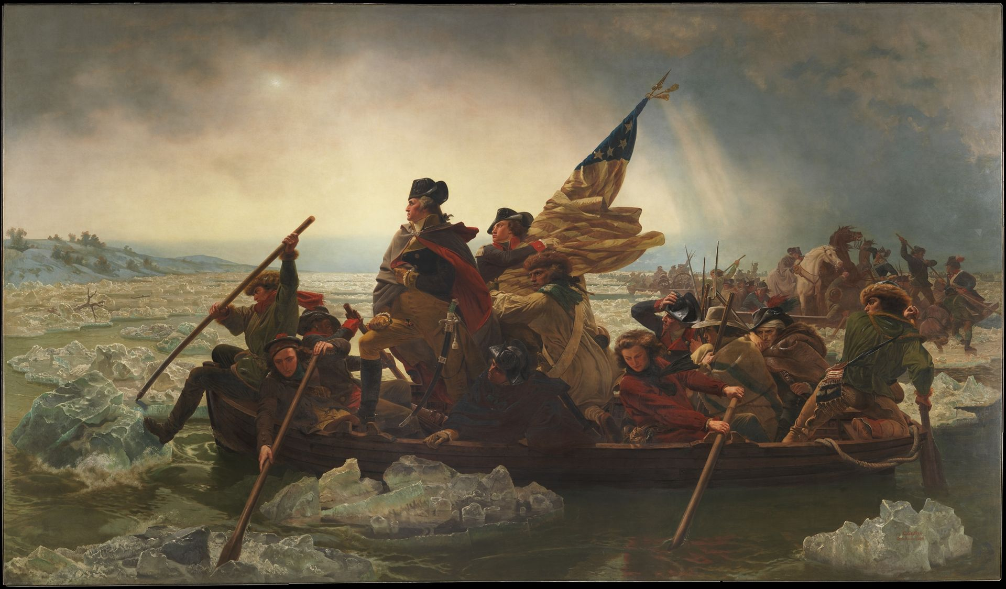
Emanuel Gottlieb Leutze, 1816–1868
Washington Crossing the Delaware, 1851, oil on canvas, 378.5 x 647.7 cm, the MET, NY

Slide 3
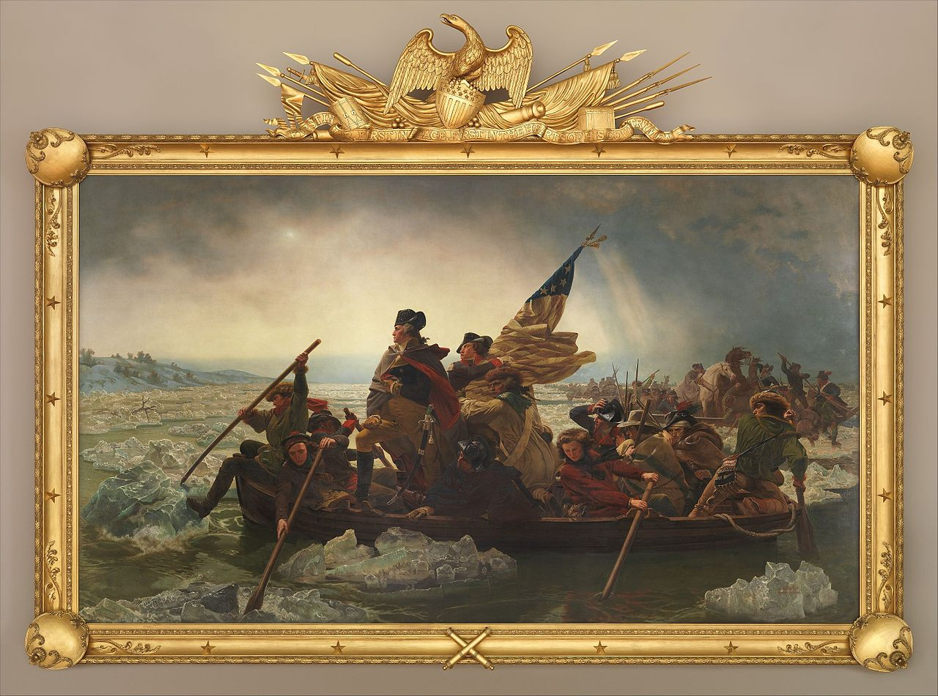

Slide 4
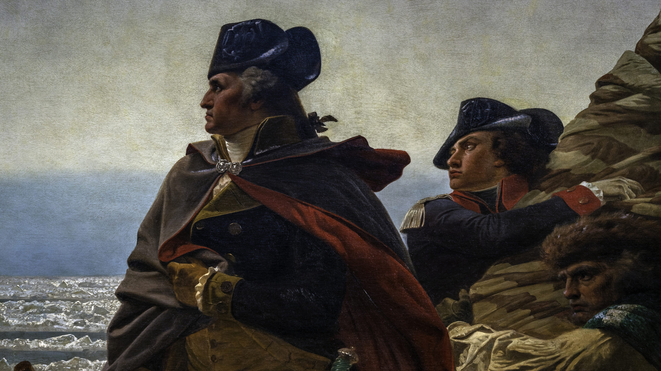

Slide 5
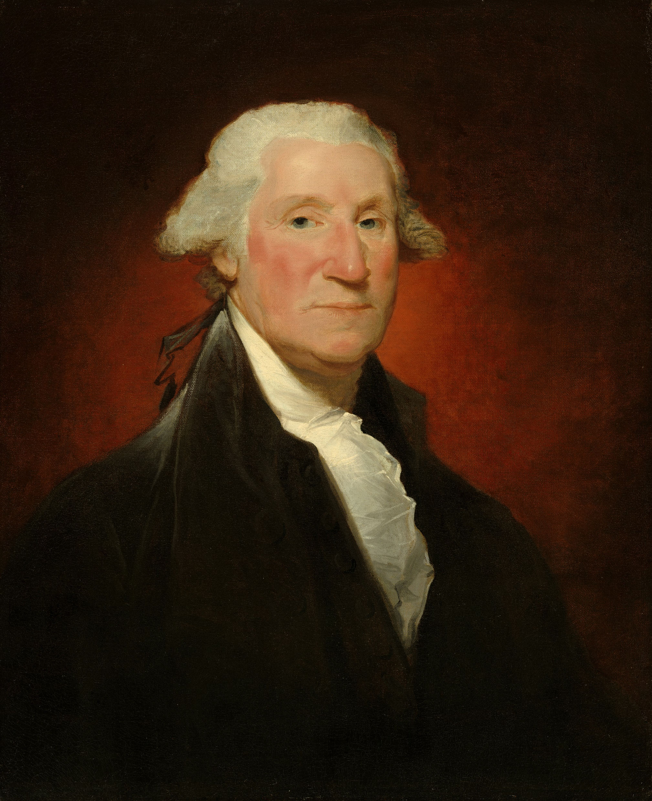
Gilbert Stuart, 1755–1828
Portrait of George Washington, the Vaughan Type, 1794, oil on canvas, 73.7 x 61.6 cm, the National Portrait Gallery, Washington, DC, USA

Slide 6
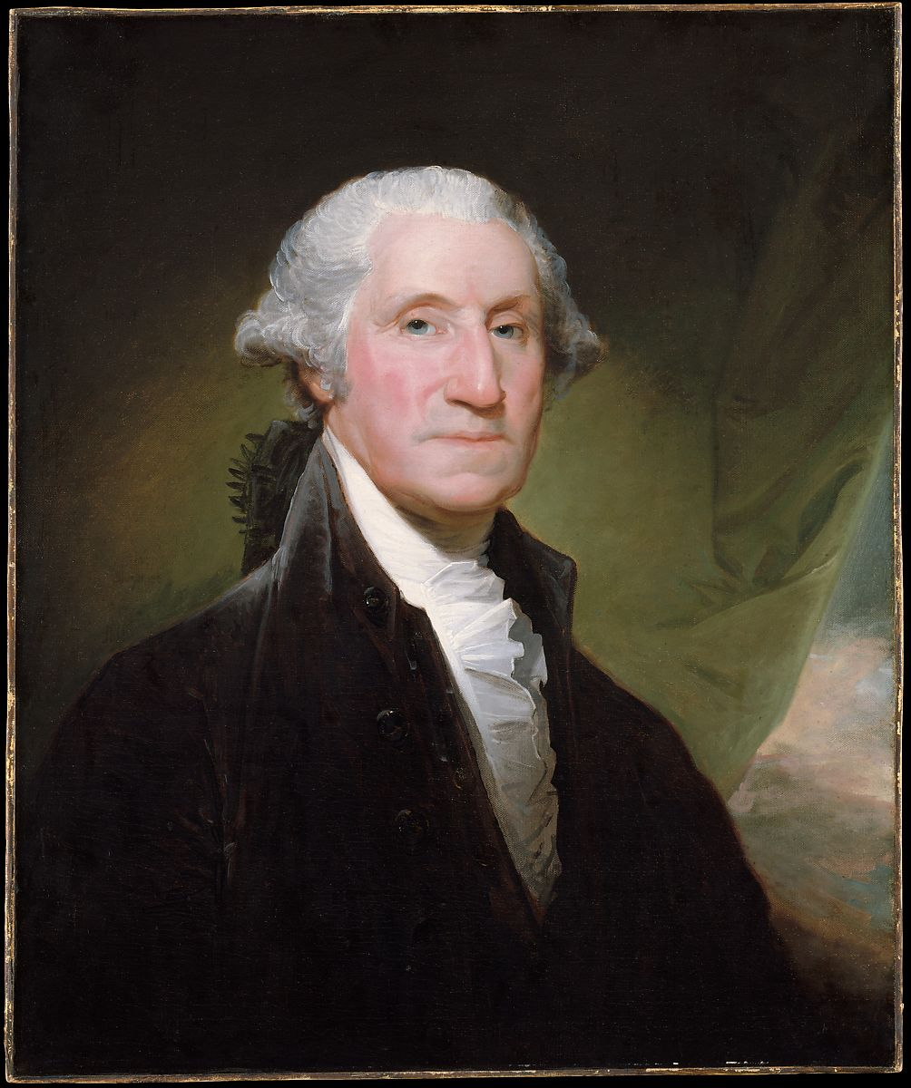
Gilbert Stuart, 1755–1828
Portrait of George Washington, the Vaughan Type, ca. 1795–96, oil on canvas, 76.8 x 64.1 cm, the MET, NY

Slide 7
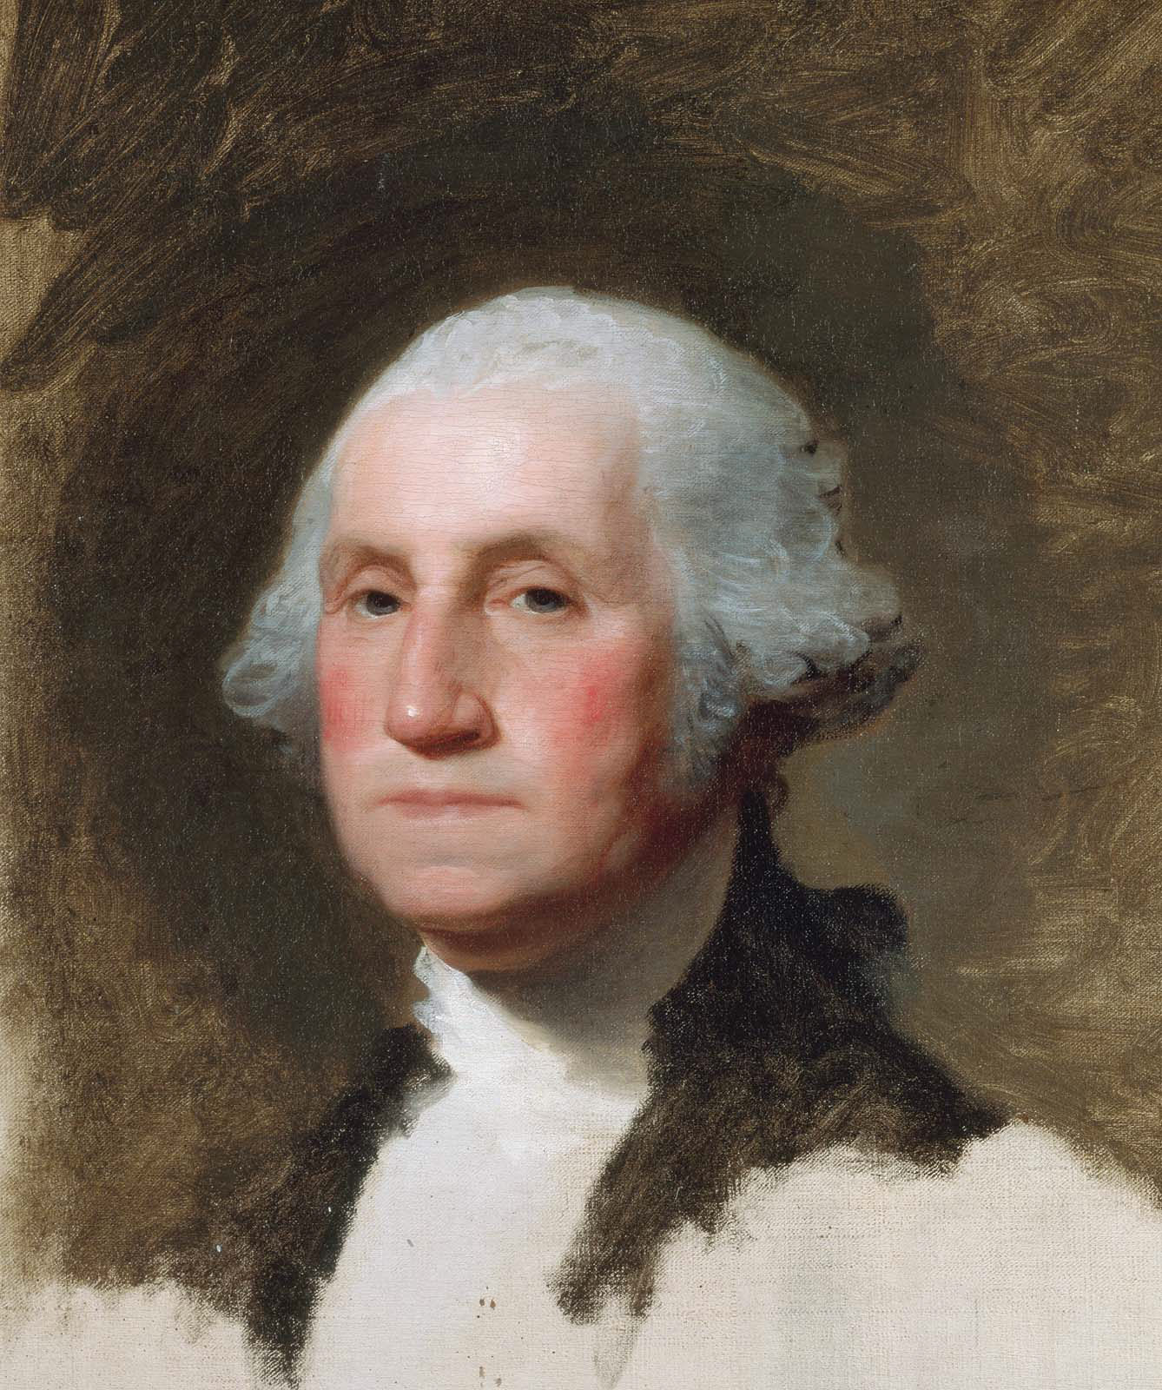
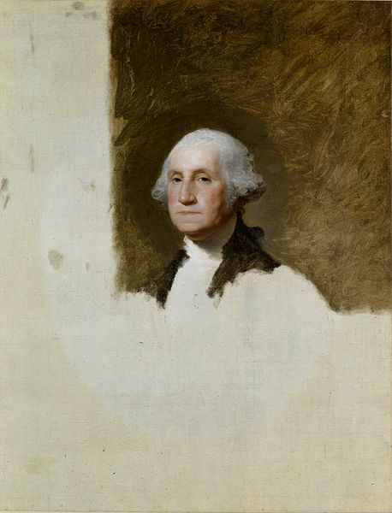
Gilbert Stuart, 1755–1828
Portrait of George Washington the Athenaeum Type, and detail, 1796, oil on canvas, 101 × 88 cm, Museum of Fine Arts, Boston

Slide 8
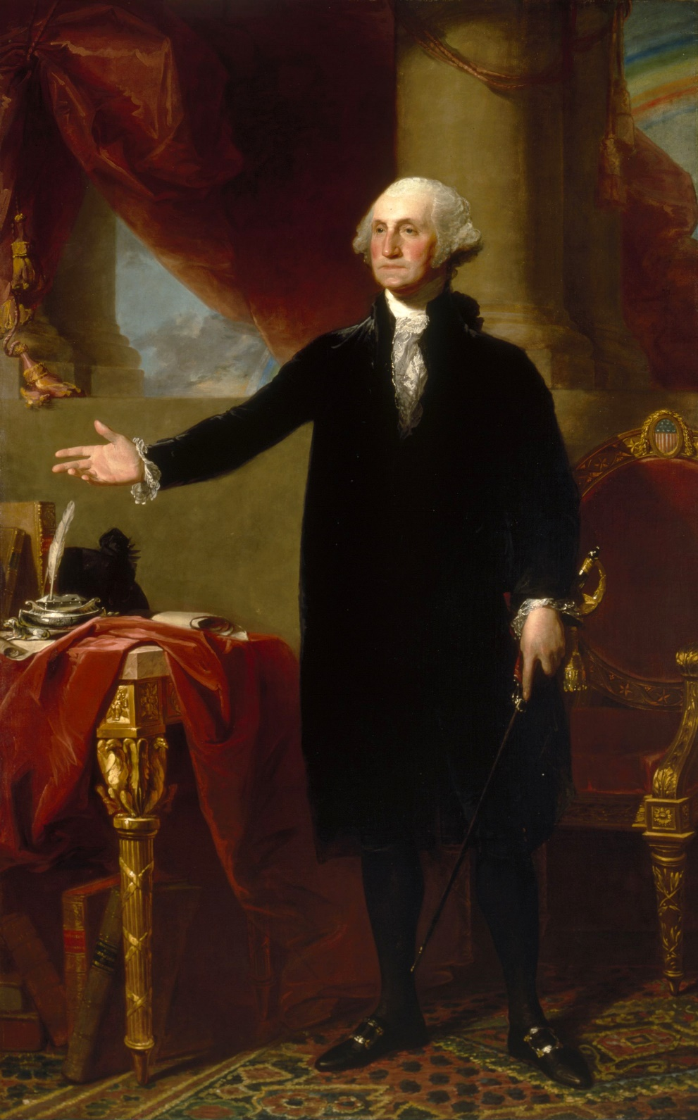
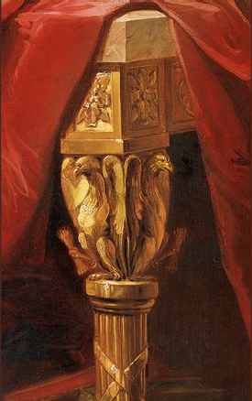
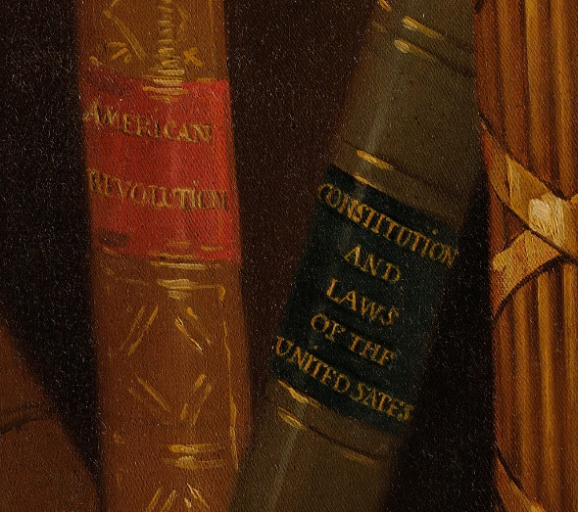
Gilbert Stuart, 1755–1828
Portrait of George Washington, the Lansdowne Type and details, 1796, oil on canvas, 243.8 cm × 152.4 cm, National Portrait Gallery , Washington, DC

Slide 9
Copyrights – Public Domain
Slides 1:
Introduction - Art, Revolution and the 1st President of the United States… George Washington
Slides 2, 3 and 4:
Emanuel Gottlieb Leutze, 1816–1868
Washington Crossing the Delaware, 1851, oil on canvas, 378.5 x 647.7 cm, the MET, NY https://commons.wikimedia.org/wiki/Category:Washington_Crossing_the_Delaware#/media/File:Washington_Crossing_the_Delaware_MET_DP215410.jpg https://upload.wikimedia.org/wikipedia/commons/d/d6/Washington_Crossing_the_Delaware_MET_DP249079.jpg https://smarthistory.org/leutze-washington-crossing-the-delaware/
Slide 5:
Gilbert Stuart, 1755–1828
Portrait of George Washington, the Vaughan Type, 1794, oil on canvas, 73.7 x 61.6 cm, the National Portrait Gallery, Washington, DC, USA https://upload.wikimedia.org/wikipedia/commons/2/27/George_Washington_%28Vaughan_portrait%29_A33850.jpg
Slide 6:
Gilbert Stuart, 1755–1828
Portrait of George Washington, the Vaughan Type, ca. 1795–96, oil on canvas, 76.8 x 64.1 cm, the MET, NY https://www.metmuseum.org/art/collection/search/16584
Slide 7:
Gilbert Stuart, 1755–1828
Portrait of George Washington the Athenaeum Type, and detail, 1796, oil on canvas, 101 × 88 cm, Museum of Fine Arts, Boston https://en.wikipedia.org/wiki/Athenaeum_Portrait#/media/File:Gilbert_Stuart_1796_portrait_of_WashingtonFXD.jpg https://www.artdocentprogram.com/wp-content/uploads/2015/07/mfa.org_.jpg
Slide 8:
Gilbert Stuart, 1755–1828
George Washington, the Lansdowne Type and details, 1796, oil on canvas, 243.8 cm × 152.4 cm, National Portrait Gallery , Washington, DC https://en.wikipedia.org/wiki/Lansdowne_portrait#/media/File:Gilbert_Stuart,_George_Washington_(Lansdowne_portrait,_1796).jpg

