Slide 1
John Singer Sargent, 1856-1925
Watercolours

Slide 2
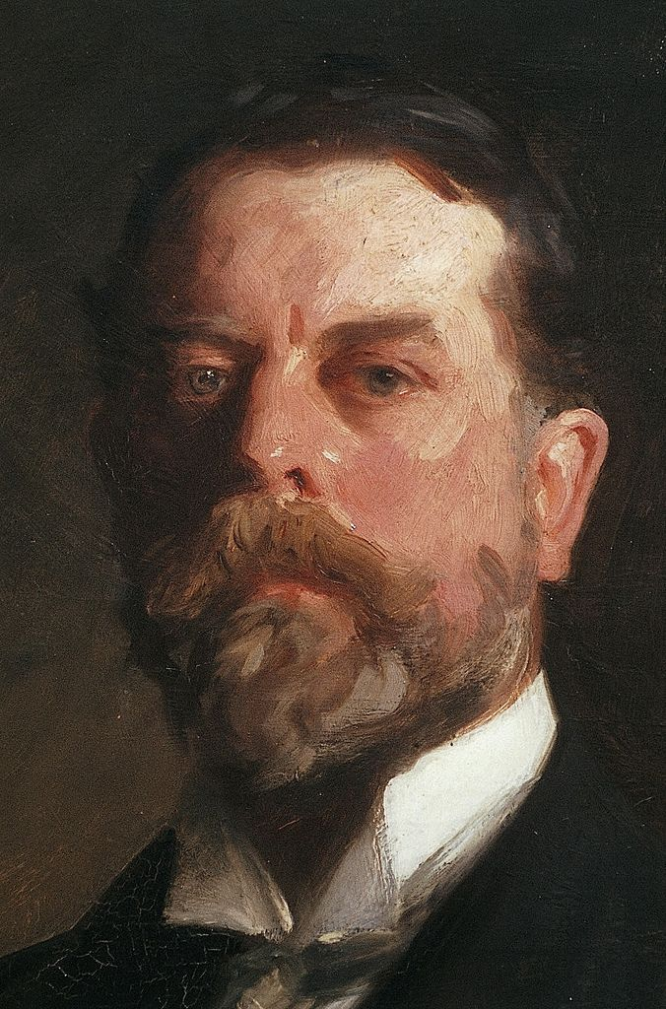
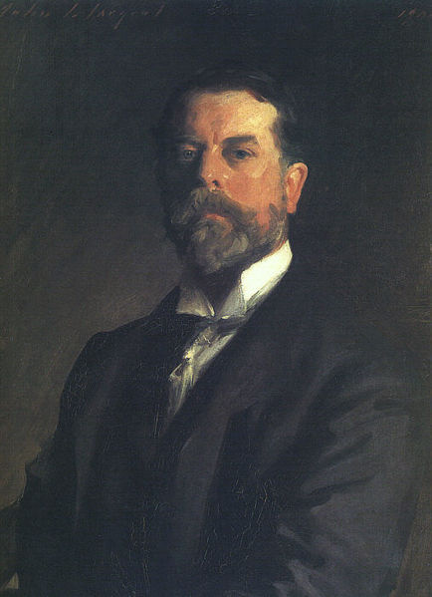
Self-Portrait, 1906, oil on canvas, 70x53 cm, the MET, NY, USA and detail… https://gr.pinterest.com/pin/384213411941243543/ https://commons.wikimedia.org/wiki/File:Sargent,_John_SInger_(1856-1925)_-_Self-Portrait_1907_b.jpg

Slide 3
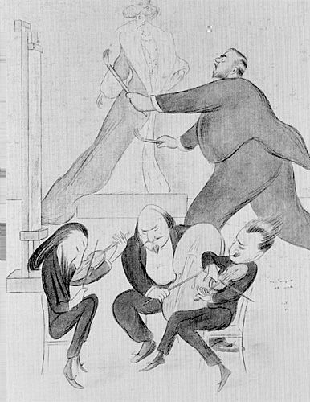
Mr. Sargent at Work by
Max Beerbohm, 1872-1956, frontispiece from "The Book of
Caricatures, London
In a letter to his future wife
Beerbohm wrote: 'I have just done a rather good "Mr Sargent at Work"-more or less suggested by a musical party he gave some nights ago. Two fiddlers and a cellist in the foreground, and a duchess on a flatform in the background, and he in between, dashing at a canvas, with a big and swilling brush in either hand. I wish I could make my living by drawing.’ https://core.ac.uk/download/pdf/219380507.pdf

Slide 4
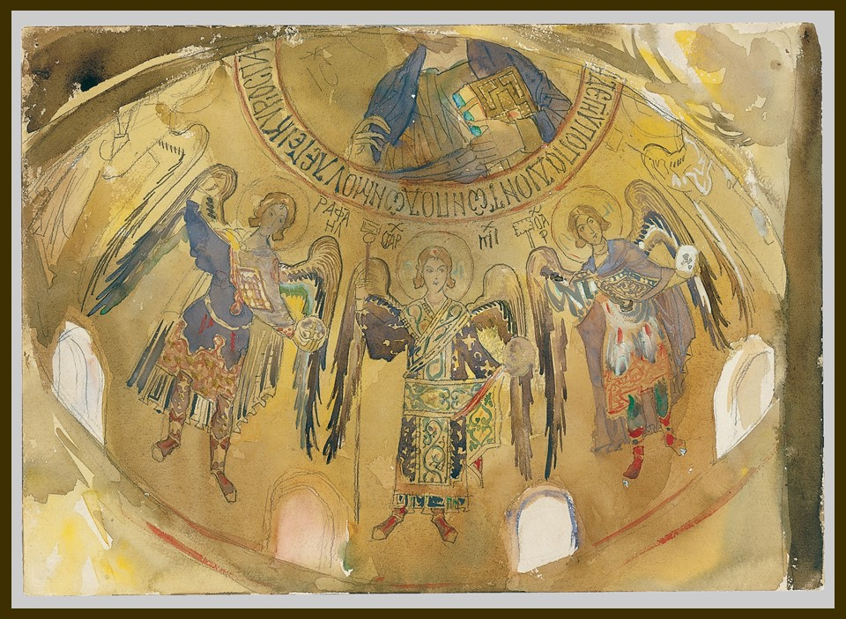
Angels, Mosaic, Palatine Chapel, Palermo, 1897 or 1901, watercolor gouache, and graphite on off-white wove paper, 25x35.5 cm, the MET, NY, USA https://upload.wikimedia.org/wikipedia/commons/d/df/Angels%2C_Mosaic%2C_Palatine_Chapel%2C_Palermo_MET_50.130.83f.jpg

Slide 5
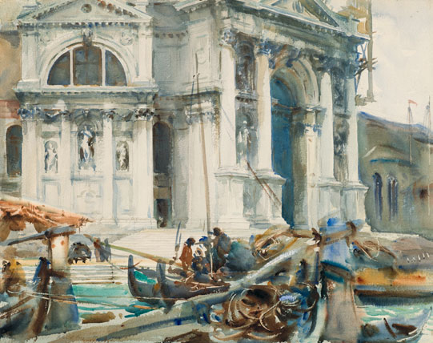
Santa Maria della Salute, 1904. Translucent and opaque watercolor and graphite with graphite underdrawing, 46.2 x 58.4 cm, Brooklyn Museum https://habituallychic.luxury/2013/04/john-singer-sargent-watercolors/

Slide 6
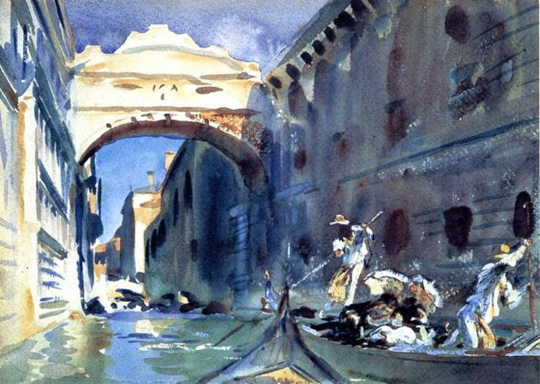
Bridge of Sights, 1903-04, Translucent and opaque watercolor with graphite and red-pigmented underdrawing, 25.4 x 35.6 cm, Brooklyn Museum https://www.wikiart.org/en/john-singer-sargent/the-bridge-of-sighs

Slide 7
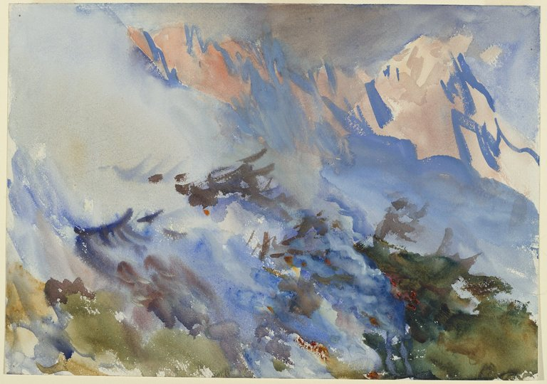
Mountain Fire, 1906-07, Opaque and translucent watercolour, 60.6 x 75.7 x 3.5 cm, Brooklyn Museum https://www.brooklynmuseum.org/opencollection/objects/20383

Slide 8
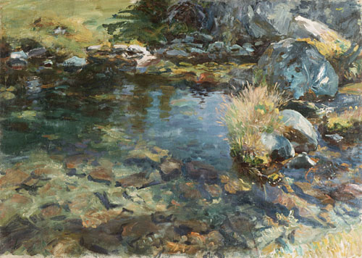
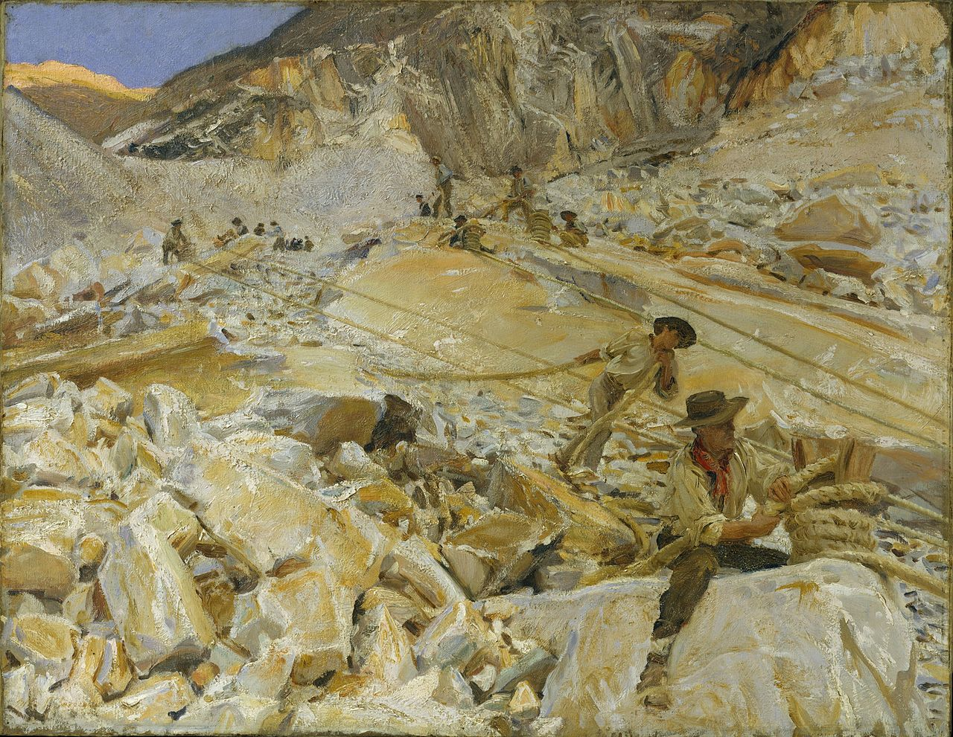
Alpine Pool, 1907, Oil on canvas,
69.9 x 96.5 cm, The MET, NY, USA https://www.jssgallery.org/Paintings/10026.html
Bringing down Marble from the Quarries to Carrara, 1911, Oil on canvas, 71.4 x 91.8 cm, The MET, NY, USA https://en.wikipedia.org/wiki/Bringing_Down_Marble_from_the_Quarries_to_Carrara

Slide 9
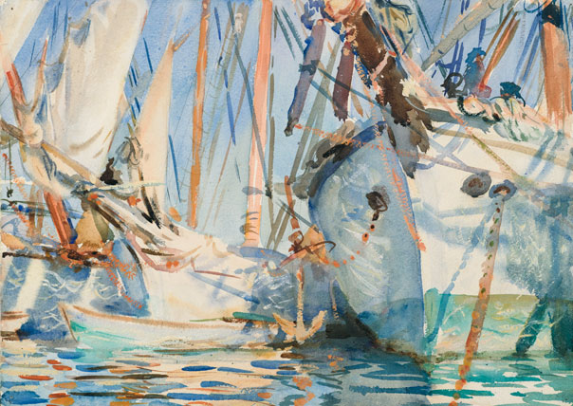
White Ships, circa 1908. Translucent and opaque watercolor and wax resist with graphite underdrawing, 35.6 x 49.2 cm, Brooklyn Museum https://www.brooklynmuseum.org/opencollection/objects/20397

Slide 10
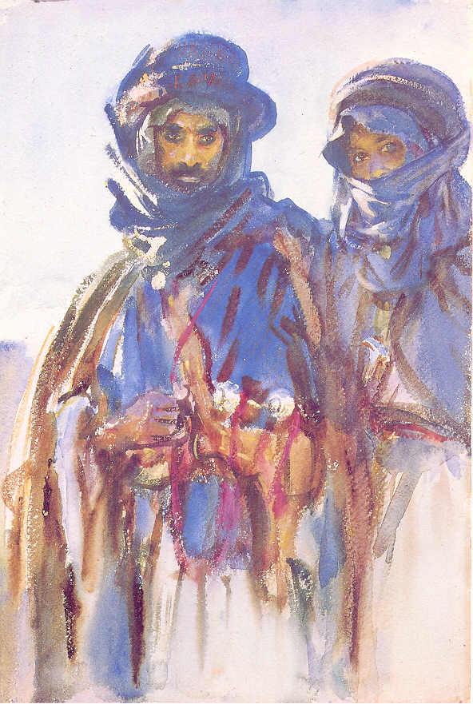
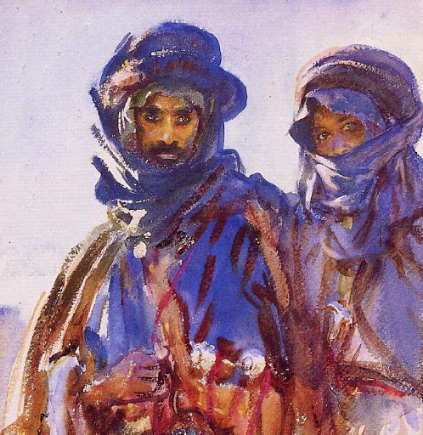
Bedouins, 1905, Transparent watercolor with touches of opaque watercolor on off-white, thick, rough-textured wove paper, 45.7 x 30.5 cm, The Brooklyn Museum, New York https://www.jssgallery.org/Paintings/Bedouins.htm and http://www.eurocles.com/arpoma/arpoma-musees2.php?action=rech4&rep=../data/peinture/&filename=sargent

Slide 11
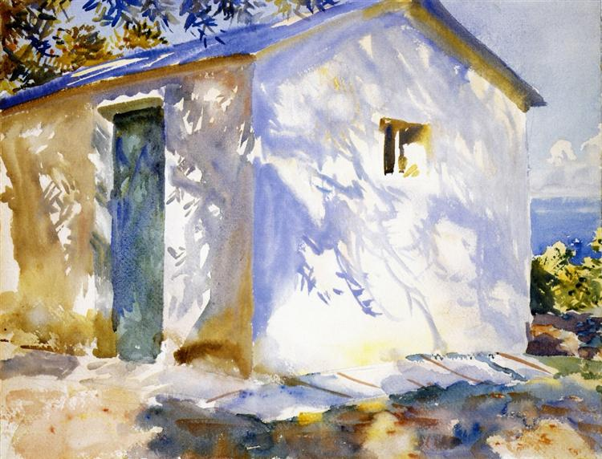
Corfu: Lights and Shadows, 1909. Translucent and opaque watercolor with graphite underdrawing, 40.3 x 53 cm, MFA, Boston https://www.wikiart.org/en/john-singer-sargent/corfu-lights-and-shadows-1909

Slide 12
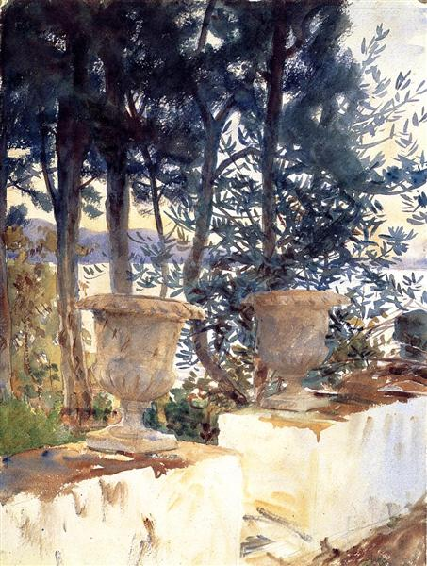
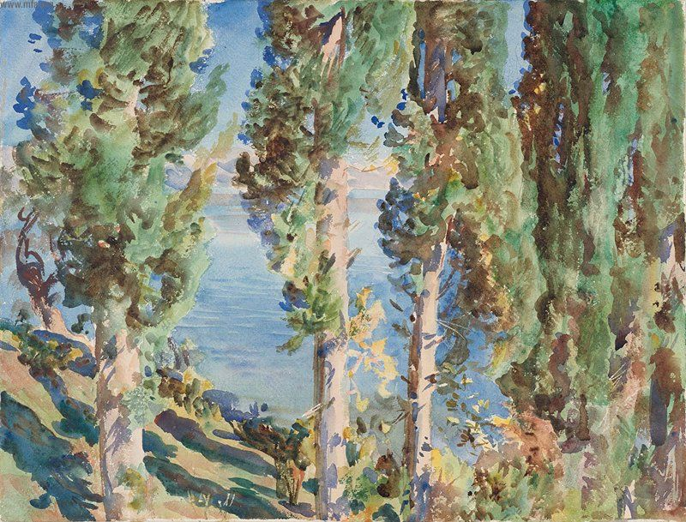
Corfu: The Terrace, 1909, Watercolor over graphite pencil on paper, 52 x 40 cm, MFA, Boston https://www.wikiart.org/en/john-singer-sargent/corfu-the-terrace-1909
Corfu: Cypresses, 1909, Watercolor over graphite pencil on paper, 40 x 52.1 cm, MFA, Boston https://commons.wikimedia.org/wiki/File:John_Singer_Sargent_-_Corfu-_Cypresses_-_Google_Art_Project.jpg

Slide 13
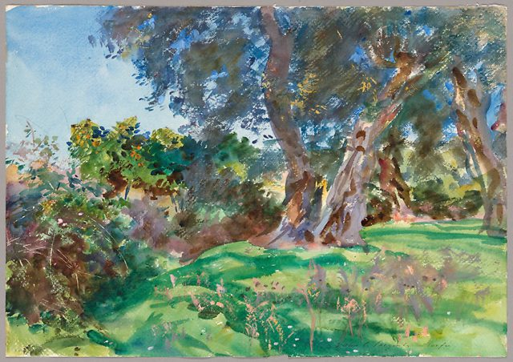
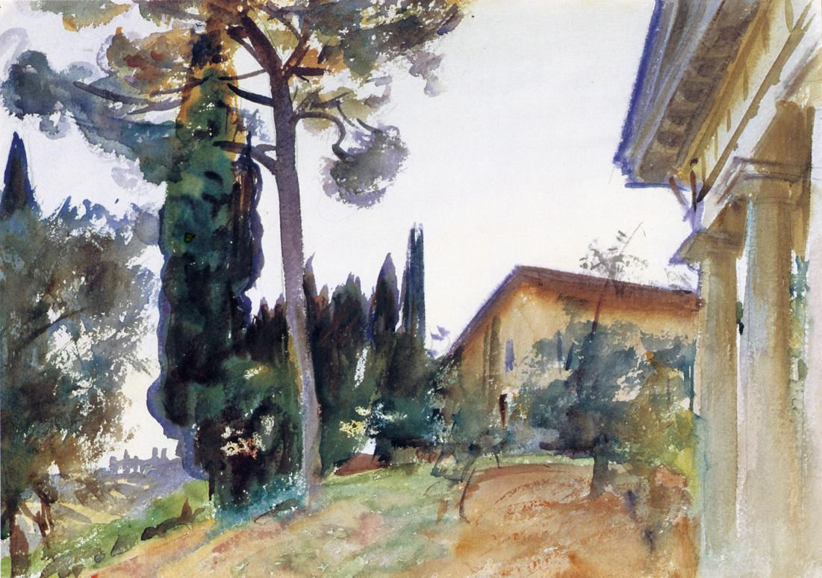
Olive Trees, Corfu, 1909, Watercolor and opaque watercolor with scraping and wax resist over graphite on ivory wove paper, 356 × 508 mm, The Art Institute of Chicago, USA https://www.thepassivevoice.com/olive-trees-corfu/
Corfu, 1909, Watercolour, 34.93 x 49.53 cm, Pennsylvania Academy of Fine Arts, USA http://www.hellenicaworld.com/Art/Paintings/en/PartJSSargent0172.html

Slide 14
THE END

