Slide 1
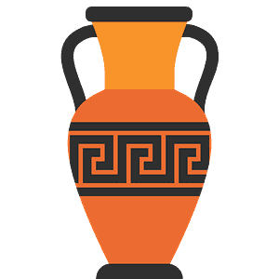
Berlin Painter…
Red-Figure
Amphoras

Slide 2
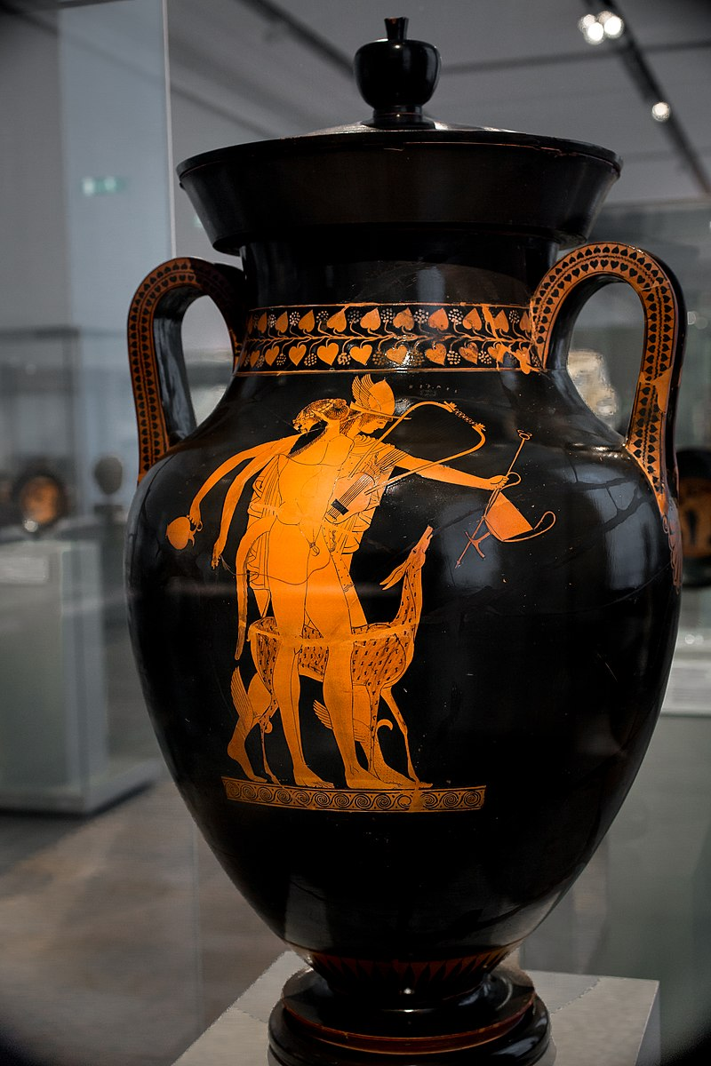

Slide 3
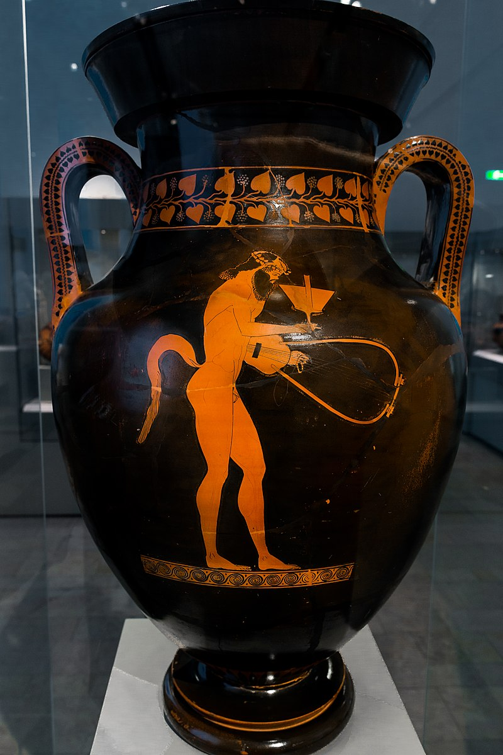

Slide 4
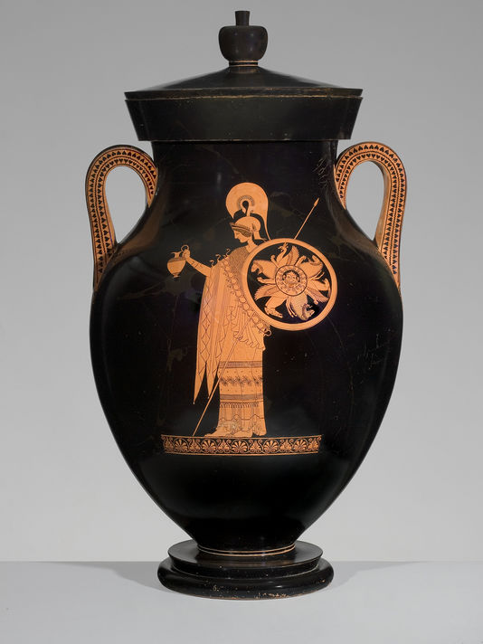

Slide 5
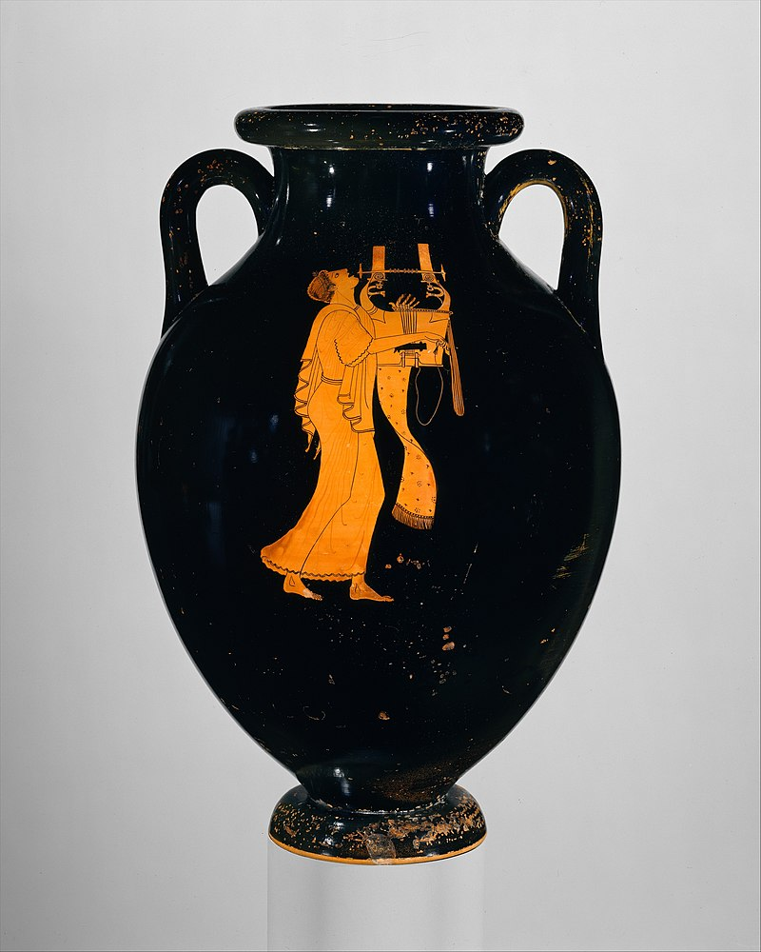

Slide 6
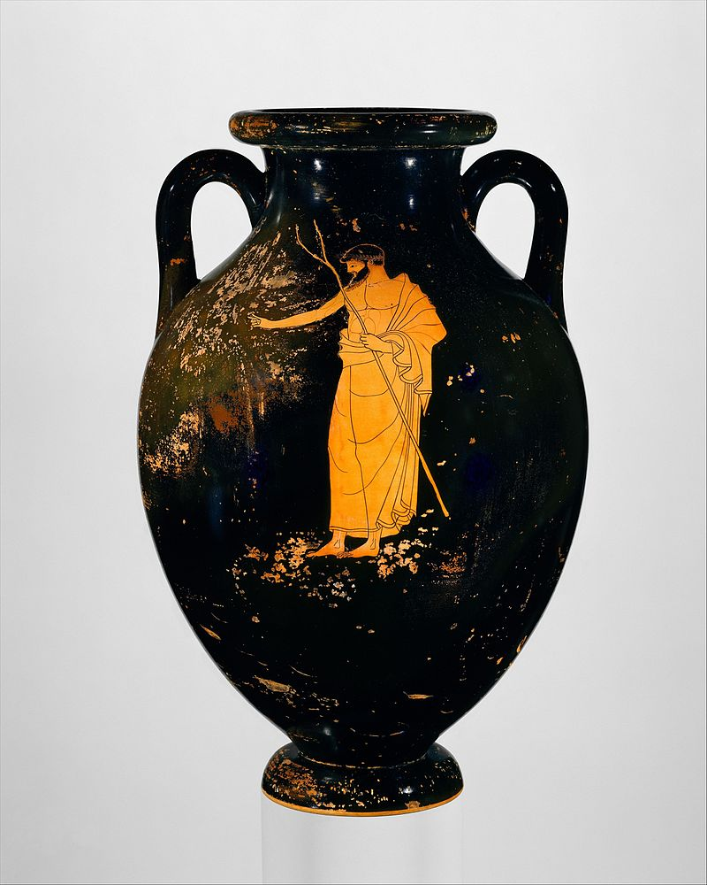

Slide 7
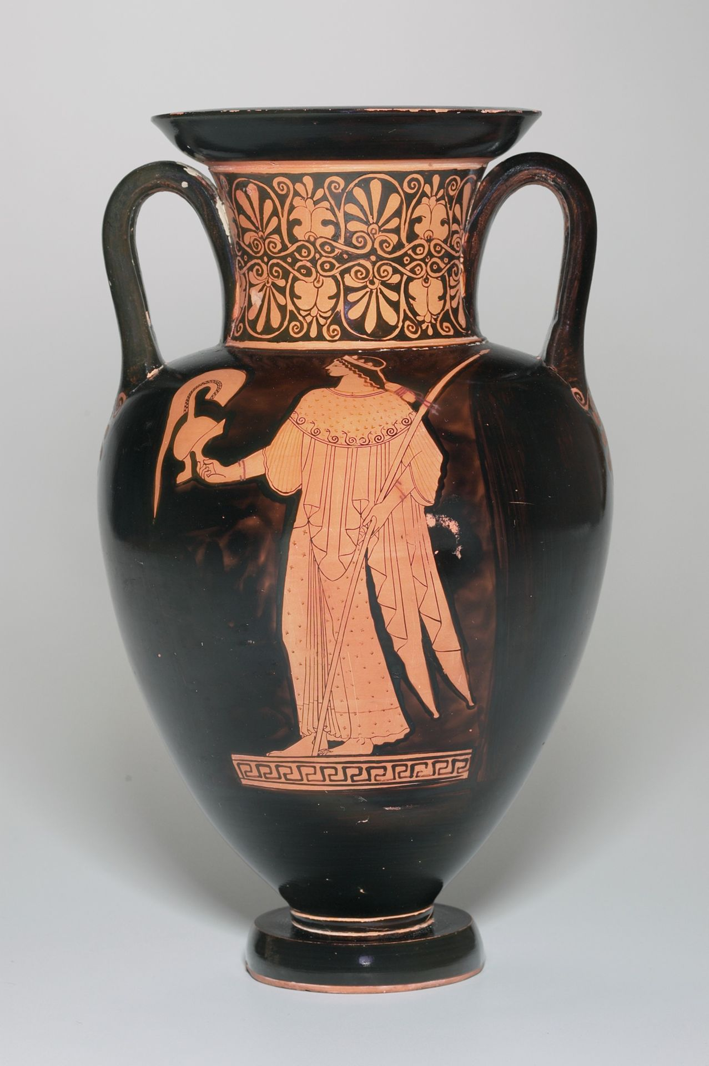

Slide 8
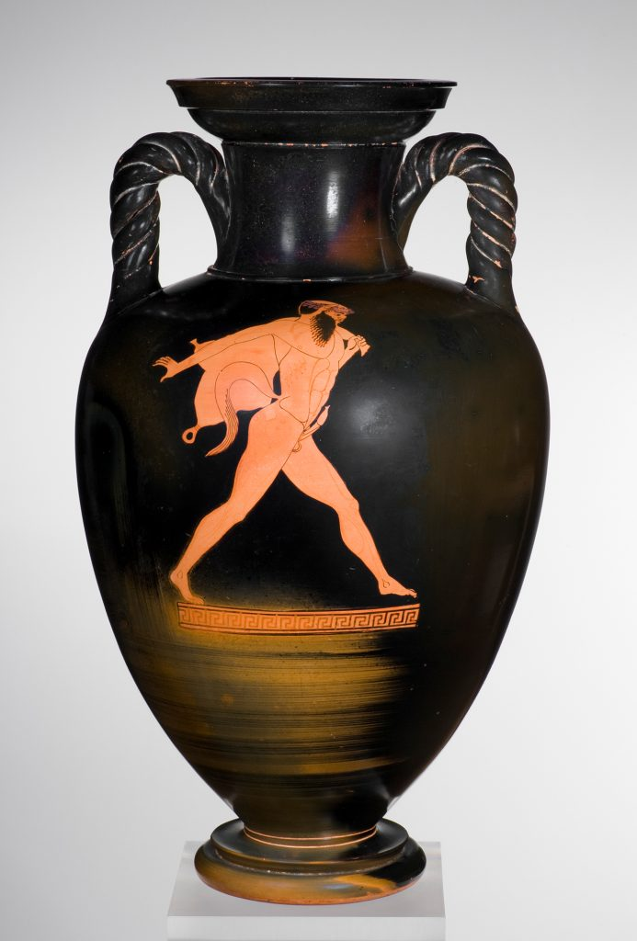

Slide 9
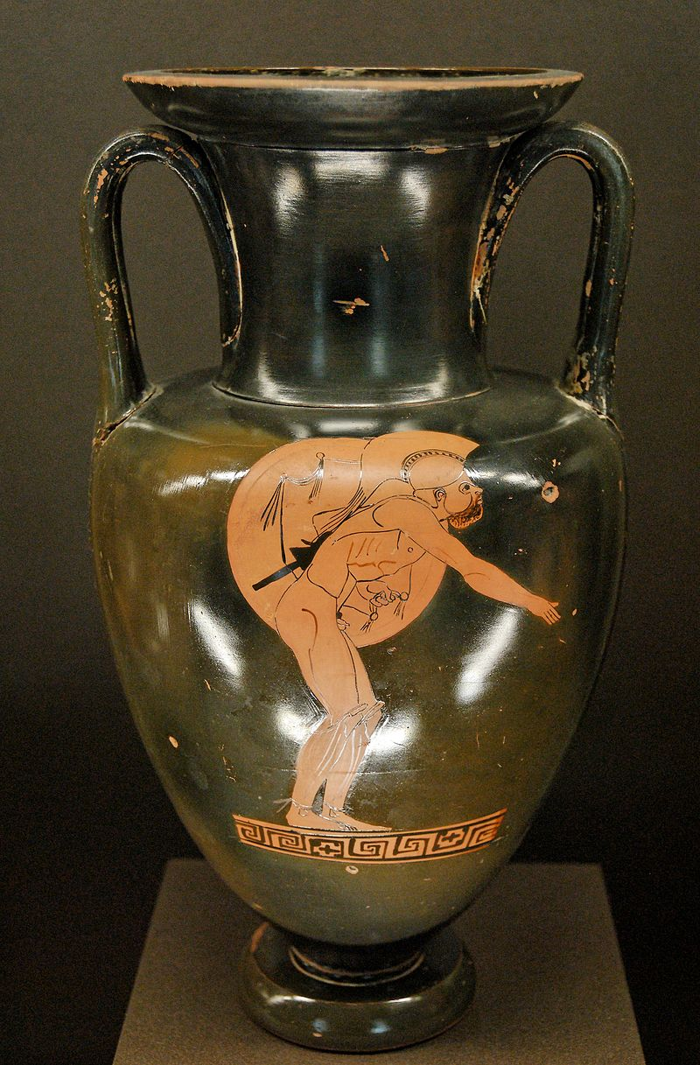

Slide 10
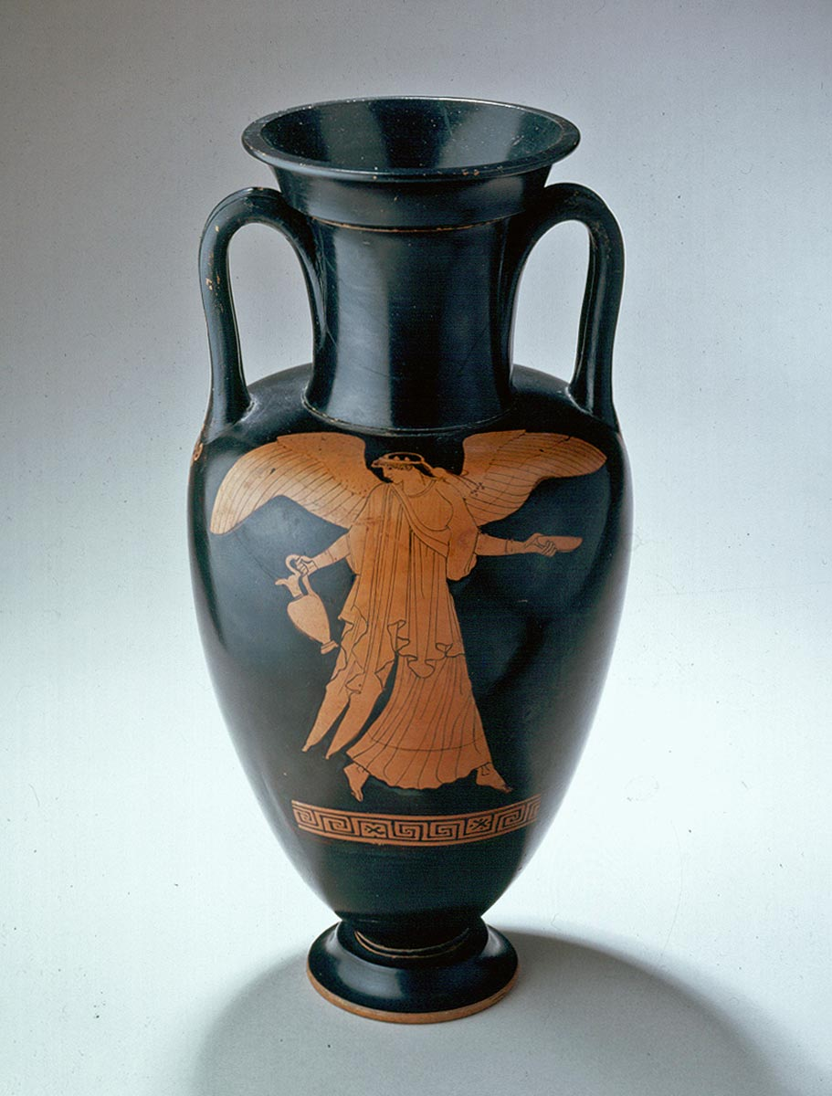

Slide 11
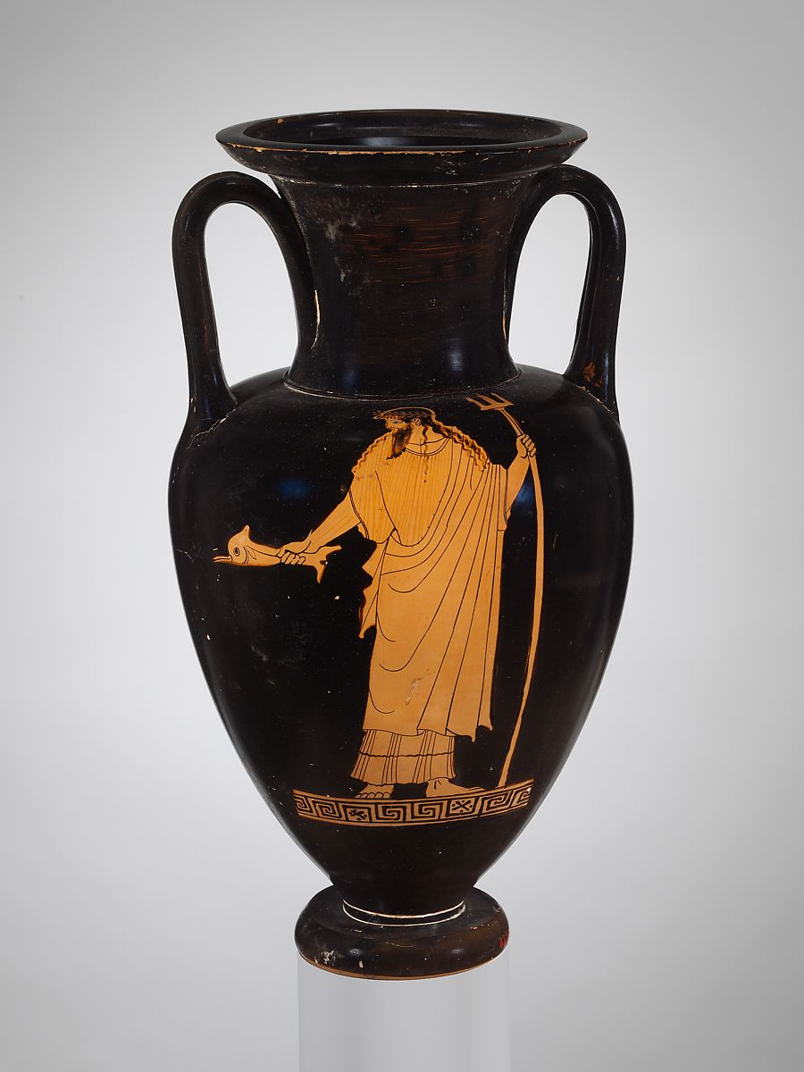

Slide 12
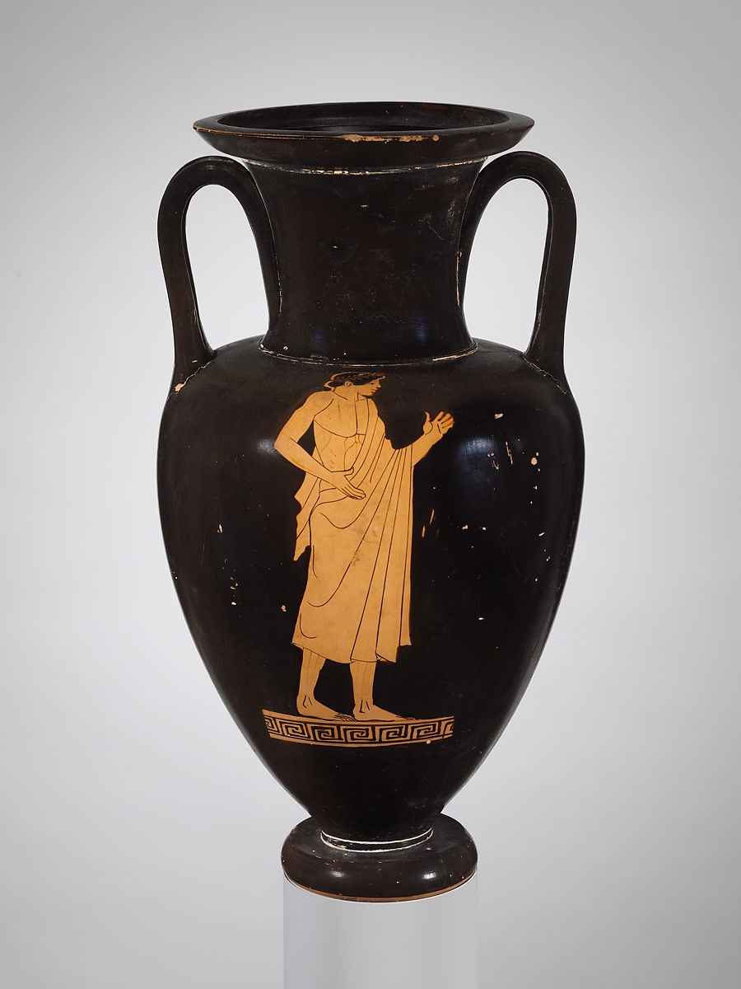

Slide 13
an
Slide 1
Introduction – Berlin Painter… Amphoras
Slides 2 and 3
Berlin Painter, ca. 500–ca. 460 BC
A: Satyr/ Silenos Oreimachos with lyra/barbitos, behind him Hermes with kerykeion, oinochoe and kantharos, deer looking up - B: Satyr/Silenos Orochares with lyra/barbitos and kantharos, c. 490 BC, Athenian Red-Figure Terracotta Amphora, Height: 81.5 cm, Altes Museum (Antikensammlung), Berlin, Germany https://commons.wikimedia.org/wiki/File:Berlin_Painter_ARV_196_1_satyr_Hermes_deer_-_satyr_(01).jpg and https://commons.wikimedia.org/wiki/Category:Satyr_and_Hermes_on_amphora_by_Berlin_Painter_(Berlin_F_2160)#/media/File:Berlin_Painter_ARV_196_1_satyr_Hermes_deer_-_satyr_(06).jpg
Slide 4
Berlin Painter, ca. 500–ca. 460 BC
A: Athena - B, Herakles, ca. 500–490 B.C. Athenian Red-Figure Terracotta Amphora, Height: 79 cm, Antikenmuseum Basel und Sammlung Ludwi, Basel, Switcherland https://artmuseum.princeton.edu/art/exhibitions/1656
Slides 5 and 6
Berlin Painter, ca. 500–ca. 460 BC
A: Young Man singing and playing the kithara – B: Judge, ca. 490 B.C. Athenian Red-Figure Terracotta Amphora, Height: 41.50 cm, the MET, N, USA https://www.metmuseum.org/art/collection/search/254896
Slide 7
Berlin Painter, ca. 500–ca. 460 BC
A: Athena – B: Hermes, ca. 480 B.C. Athenian Red-Figure Terracotta Amphora, Height: 33.20 cm, Yale University Art Galler, New Haven, CT, USA https://artgallery.yale.edu/collections/objects/1726
Slide 8
Berlin Painter, ca. 500–ca. 460 BC
A: Satyr running with Wineskin, ca. 480 B.C. Athenian Red-Figure Terracotta Amphora, Staatliche Antikensammlungen und Glyptothek, Munchen, Germany https://newyorkarts.net/wp-content/uploads/2017/06/Running-Satyr.jpg
ότι αγαπούσε

Slide 14
Slide 9
Berlin Painter, ca. 500–ca. 460 BC
A: Hoplitodromia (race in armour), B. Draped Man, ca. 480 BC, Athenian Red-Figure Terracotta Amphora, Height: 33.5 cm, Louvre Museum, Paris, France https://commons.wikimedia.org/wiki/File:Hoplitodromia_Louvre_CA214.jpg#/media/File:Hoplitodromia_Louvre_CA214.jpg
Slide 10
Berlin Painter, ca. 500–ca. 460 BC
A: Nike with Oinochoe and Phiale, B. Draped Youth, ca. 470 BC, Athenian Red-Figure Terracotta Amphora, Height: 36.80 cm, Collection of Middlebury College Museum of Art Middlebury, VT, USA http://museum.middlebury.edu/collections/antiquities
Slides 11 and 12
Berlin Painter, ca. 500–ca. 460 BC
A: God Poseidon, B. Youth, ca. 470-465 BC, Athenian Red-Figure Terracotta Amphora, Height: 35.70 cm, the MET, NY, https://www.metmuseum.org/art/collection/search/254184

