Slide 1
Antonello da Messina
1430-1479

Slide 2
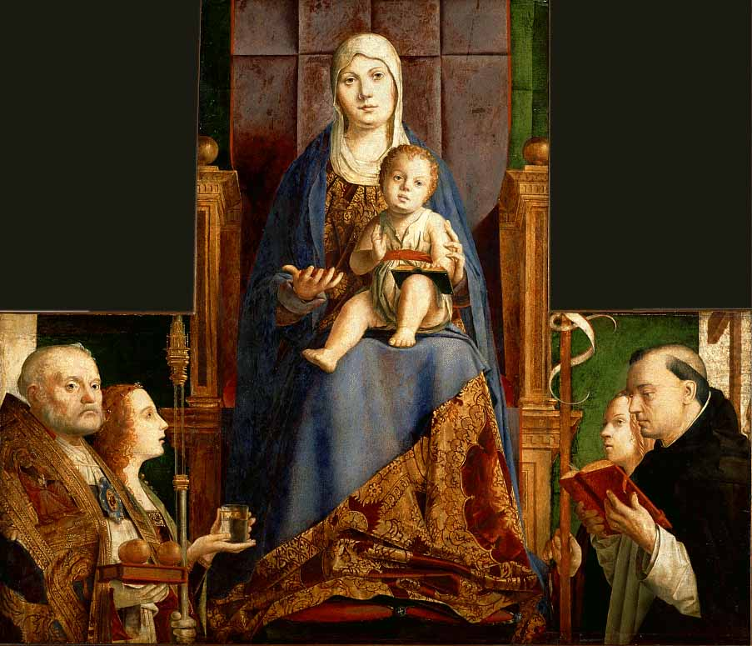

Slide 3
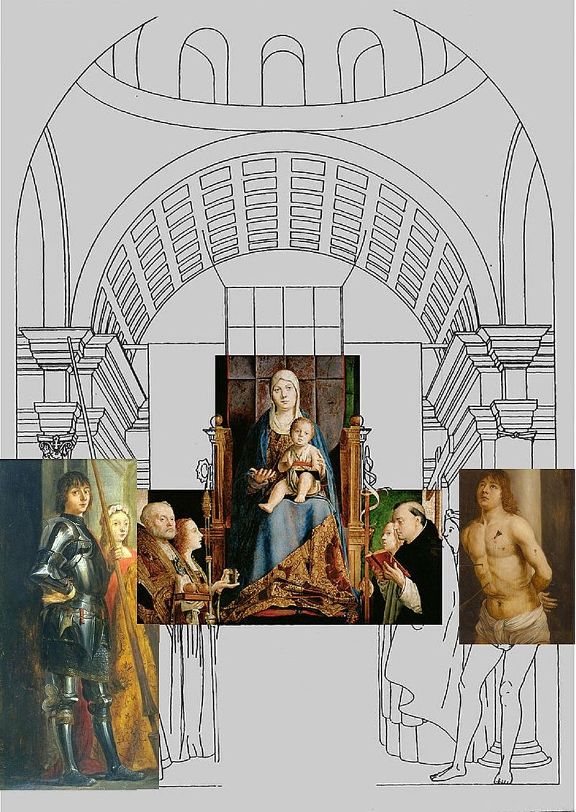
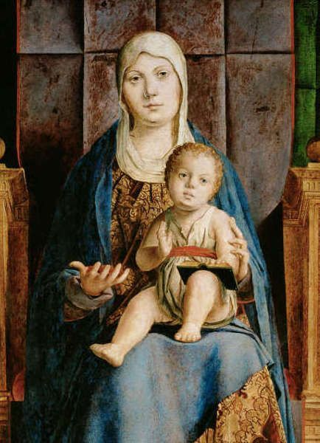

Slide 4
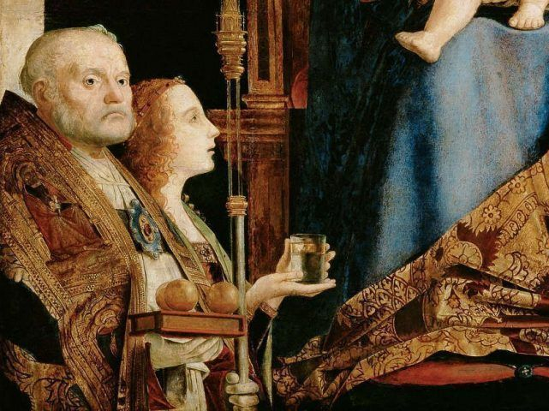

Slide 5
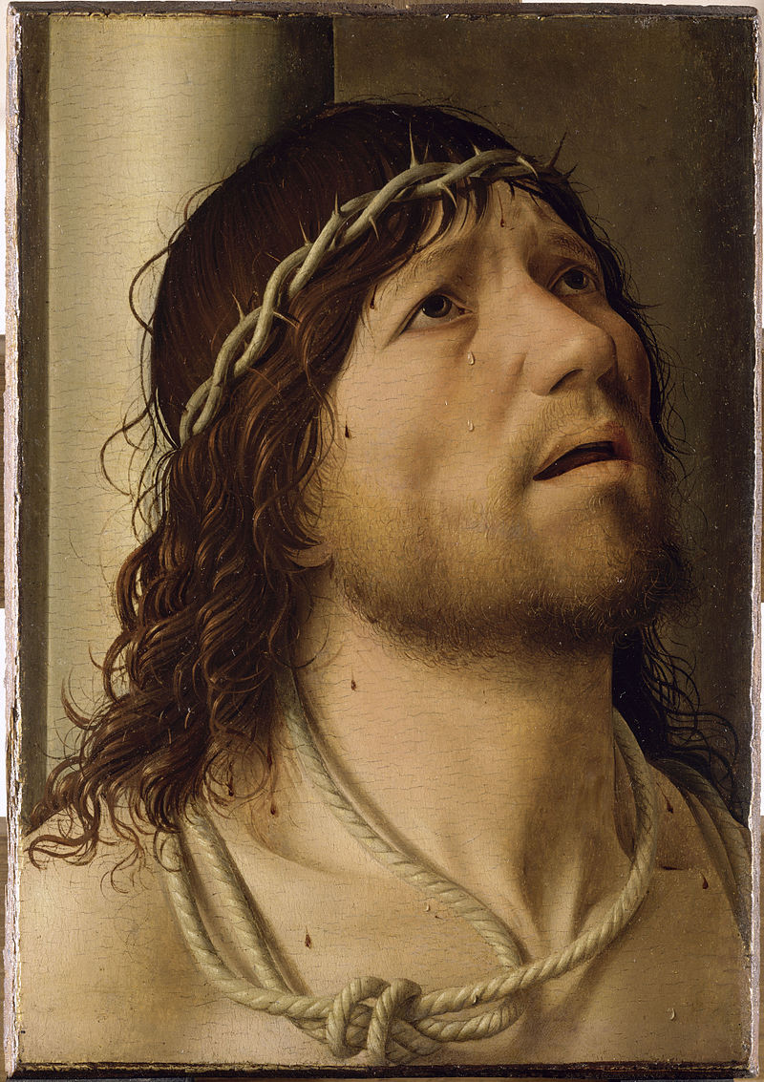

Slide 6
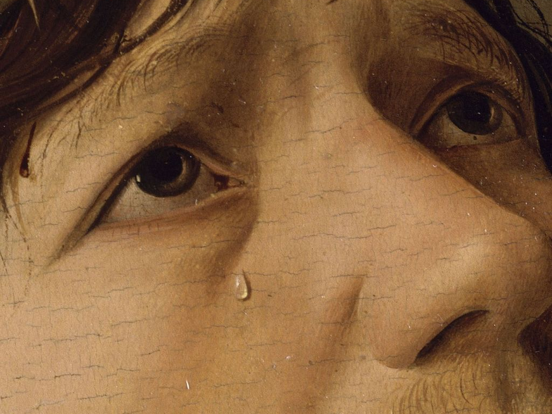

Slide 7
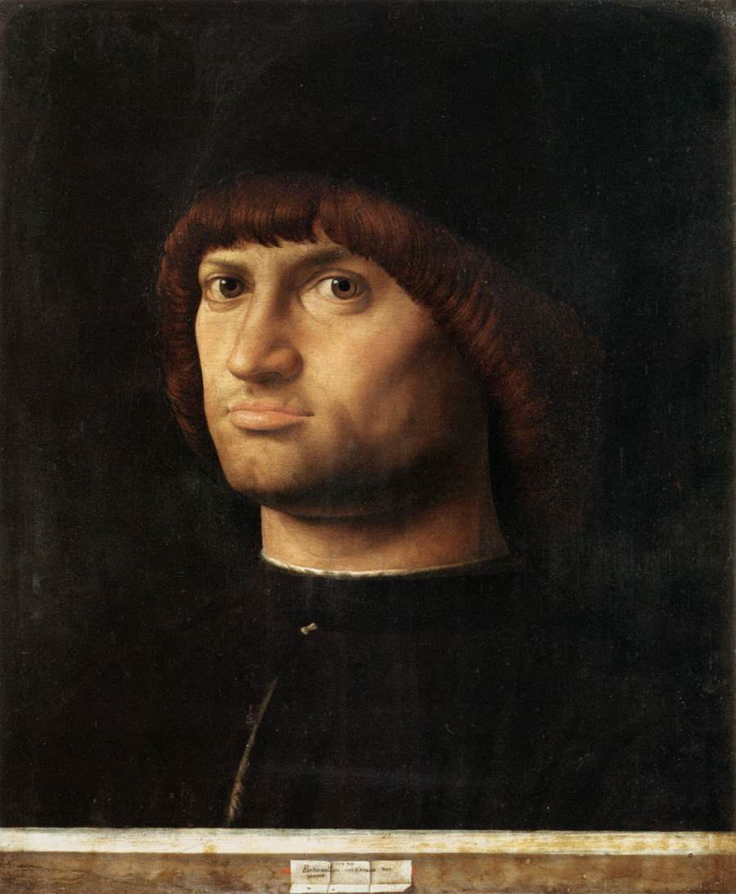

Slide 8
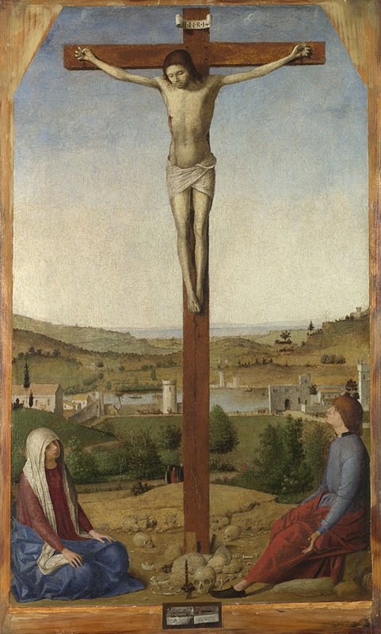

Slide 9
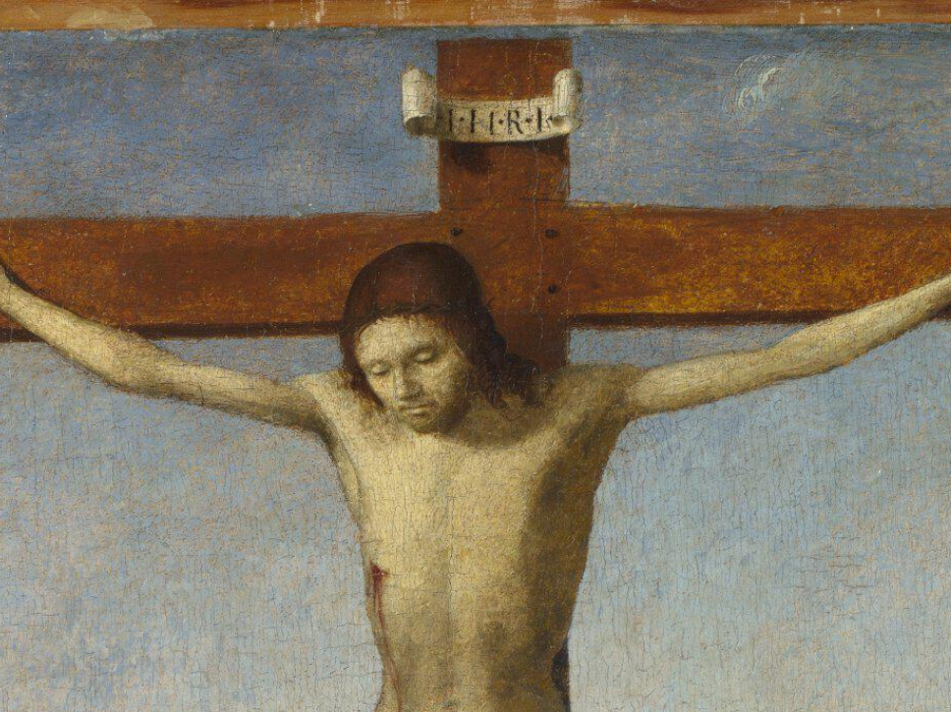

Slide 10
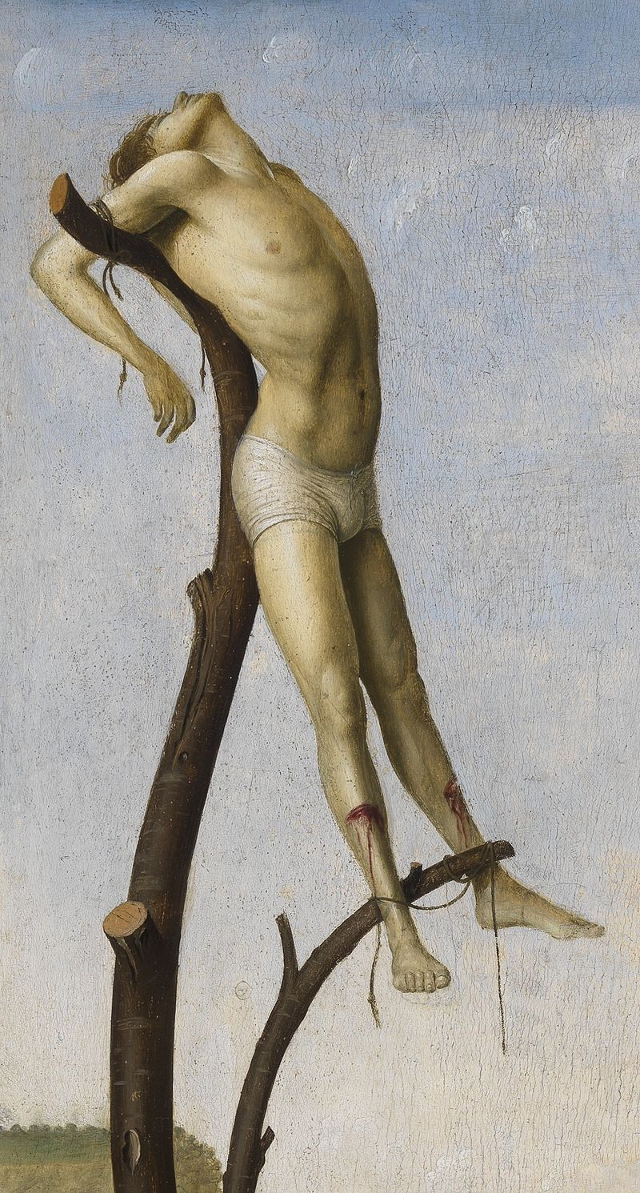
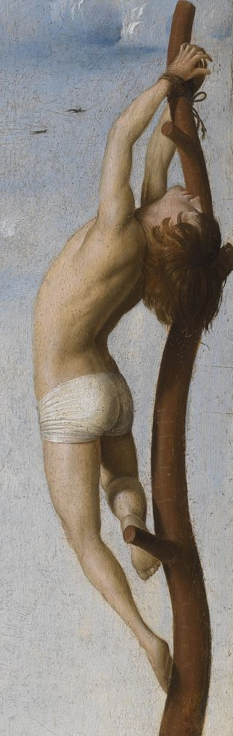
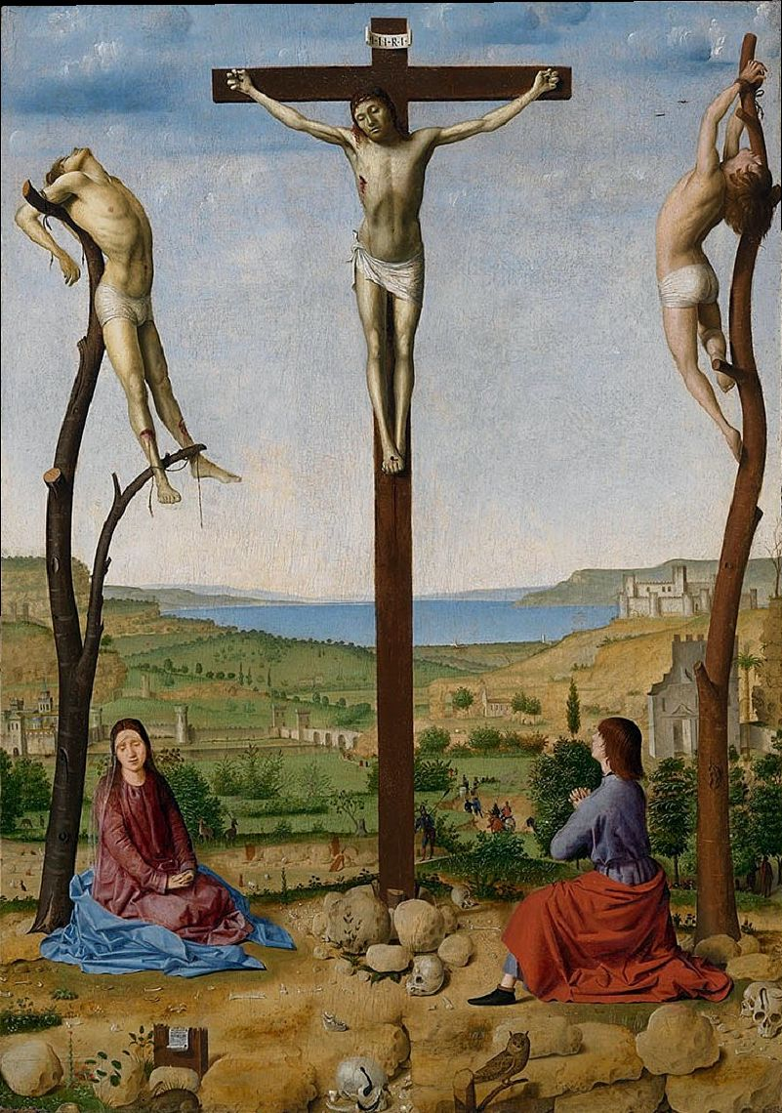

Slide 11
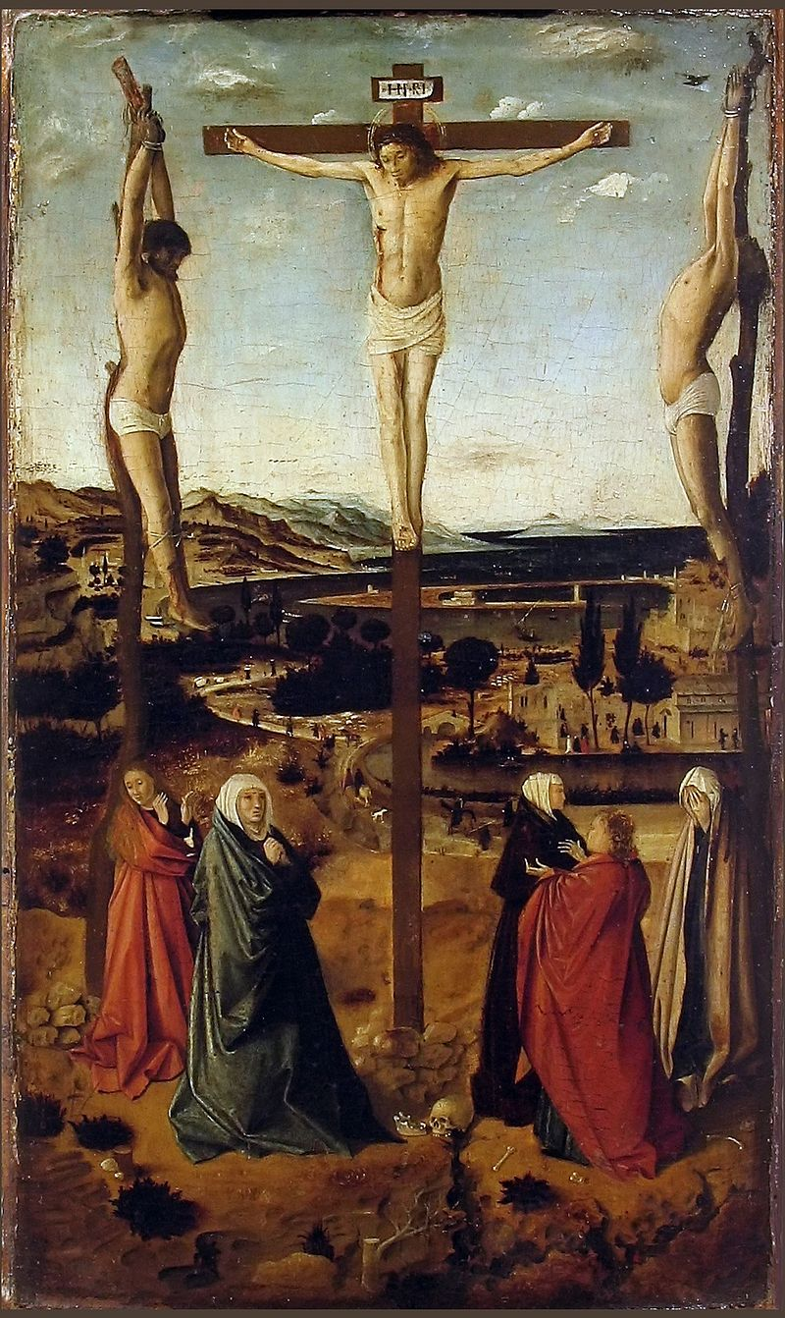

Slide 12
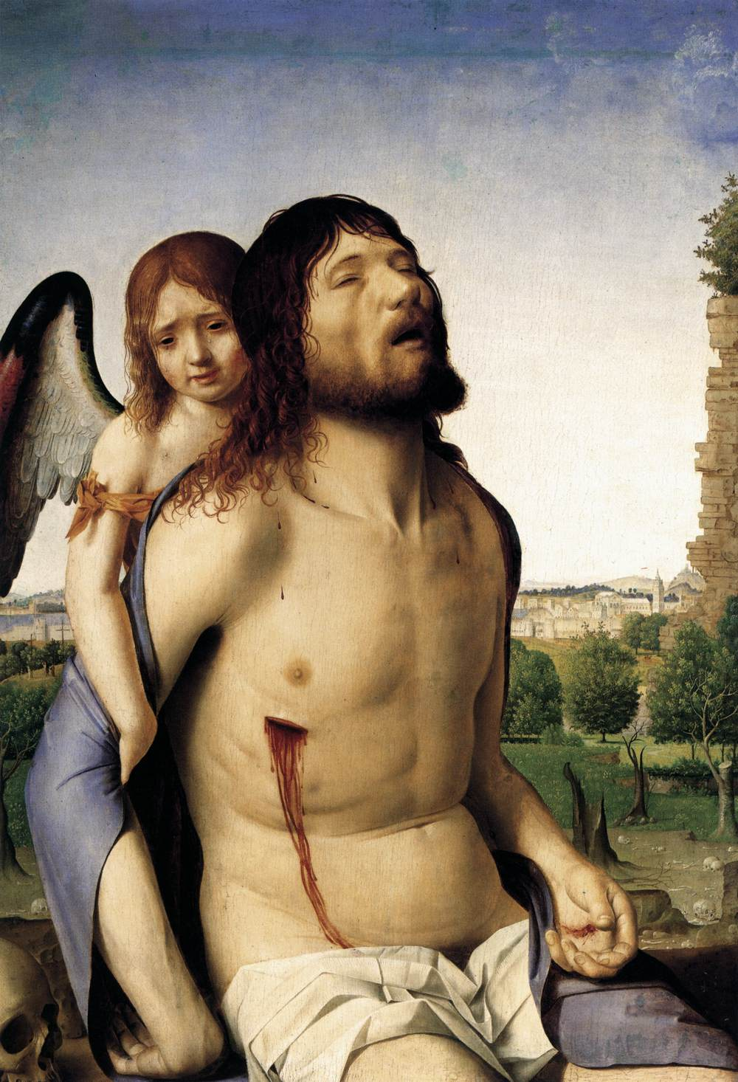
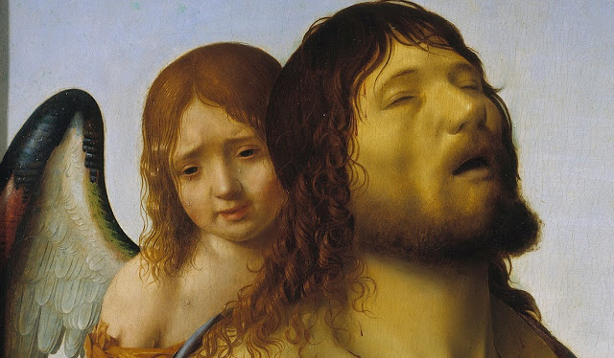

Slide 13
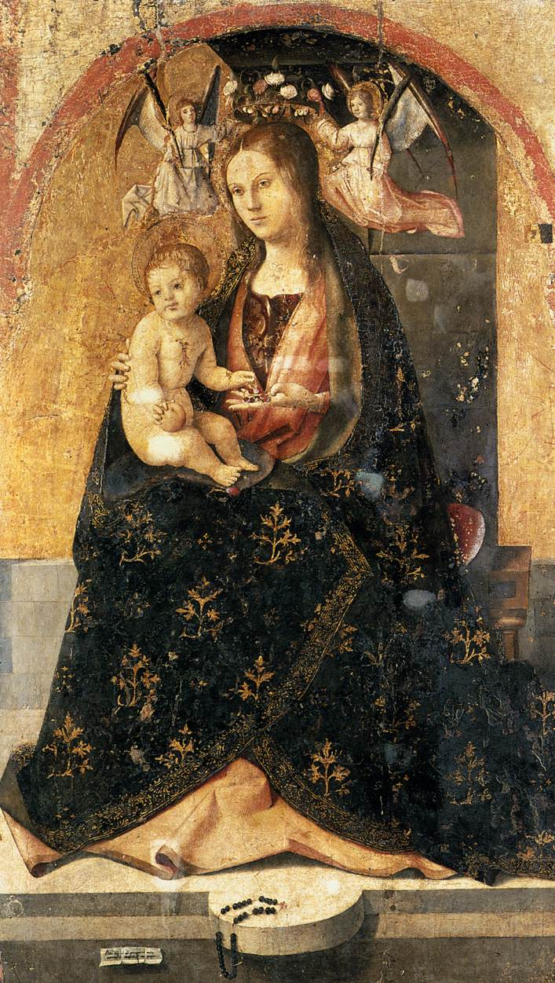
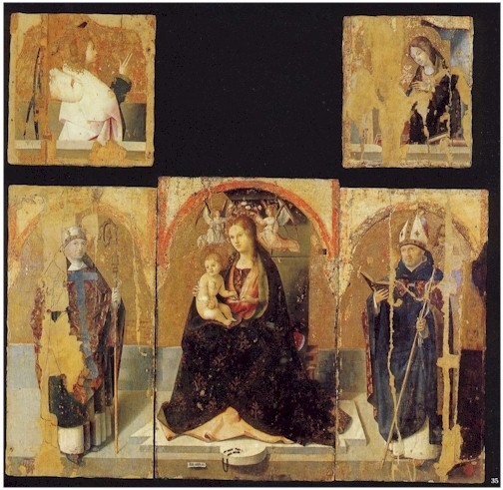

Slide 14
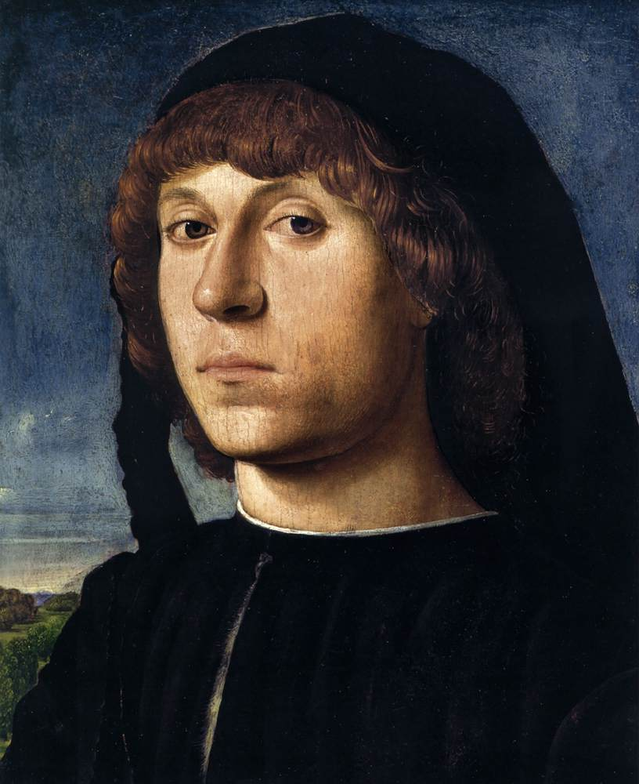
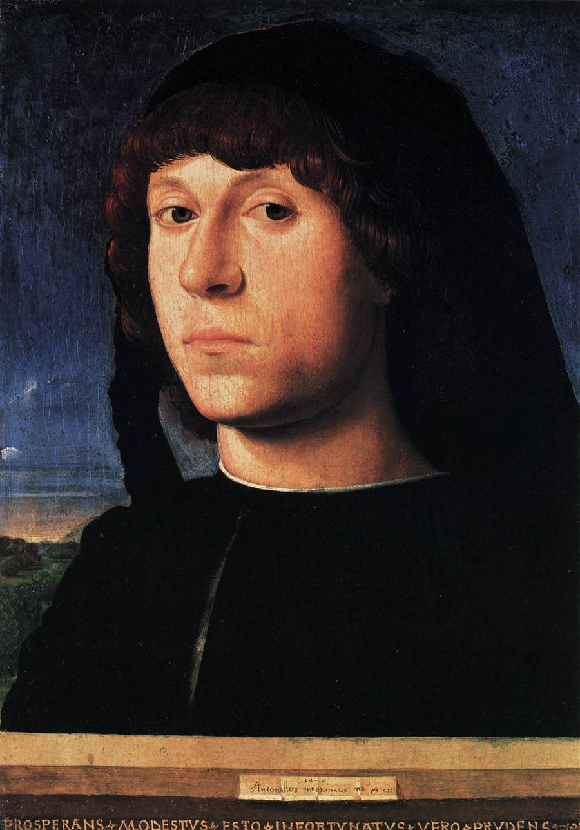

Slide 15
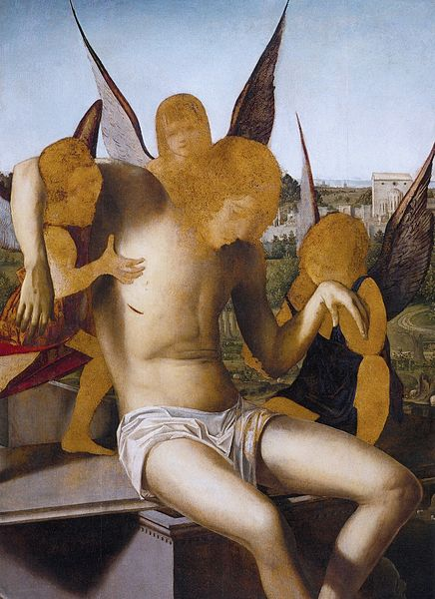

Slide 16
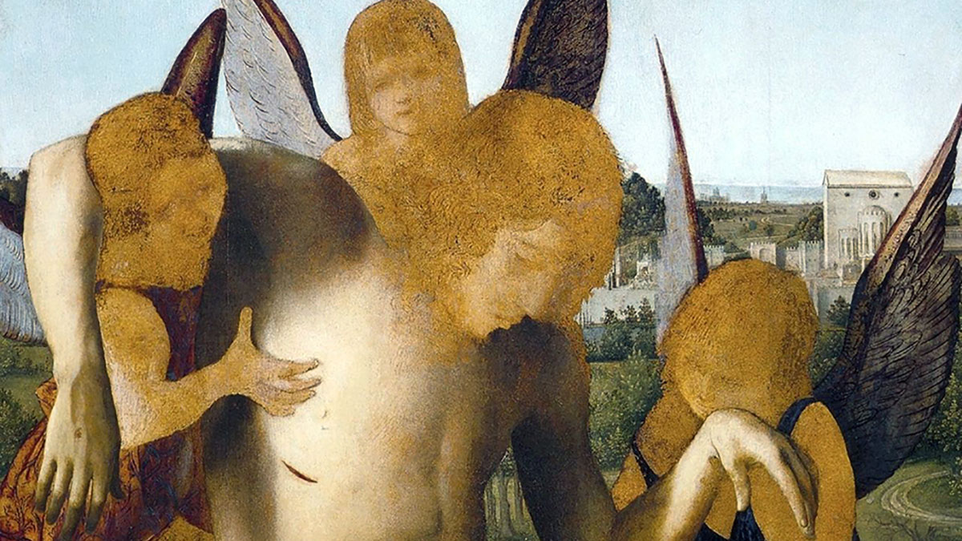

Slide 17
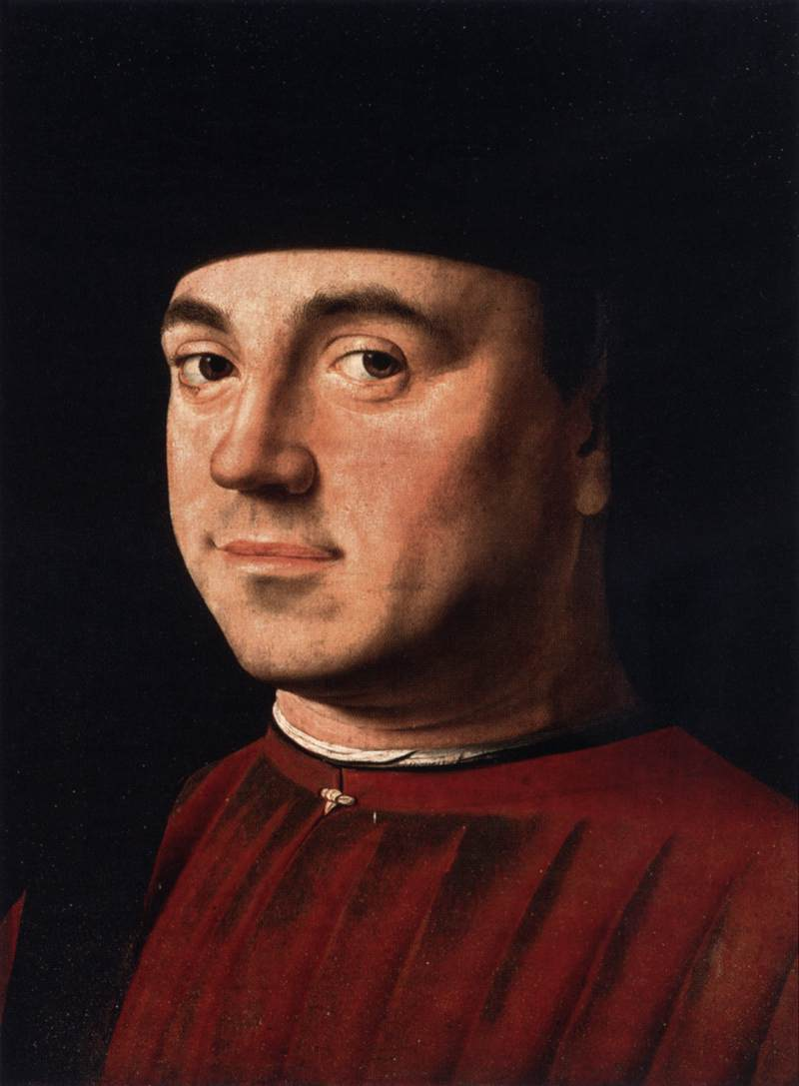

Slide 18
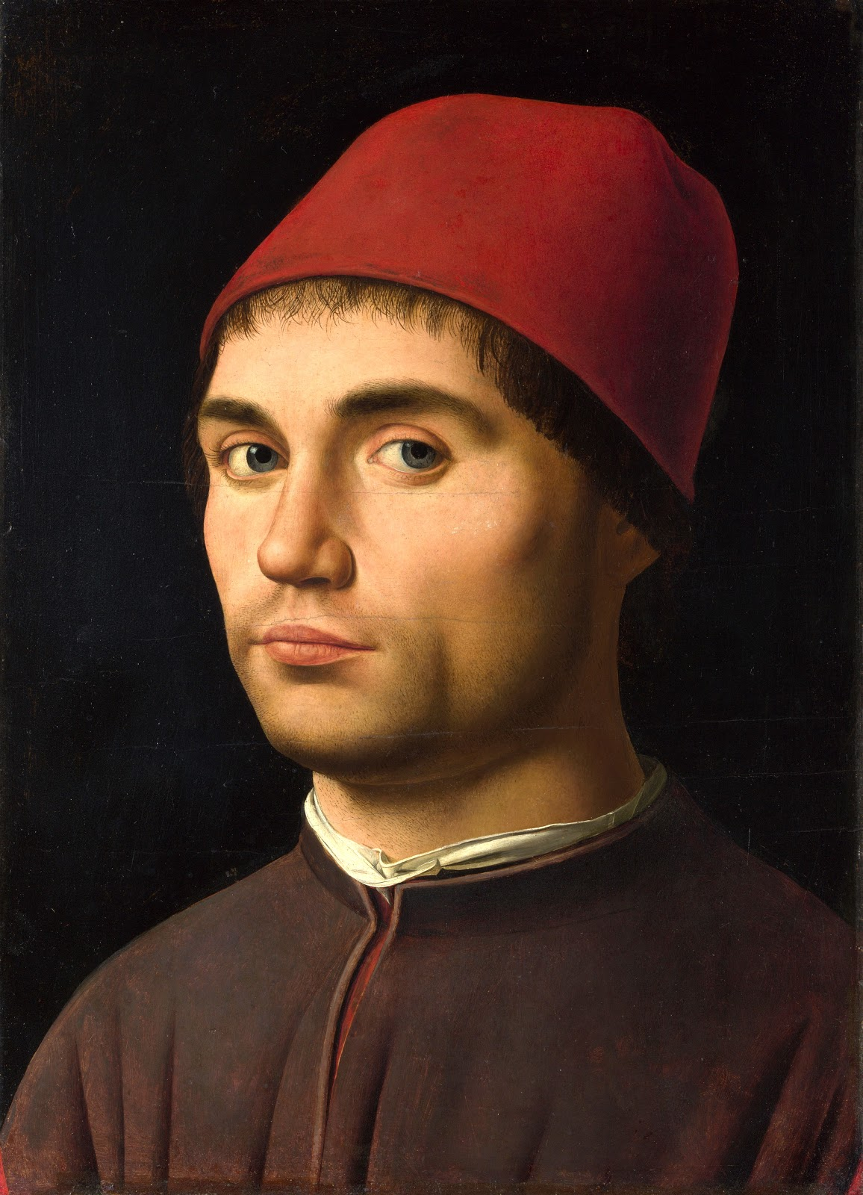

Slide 19
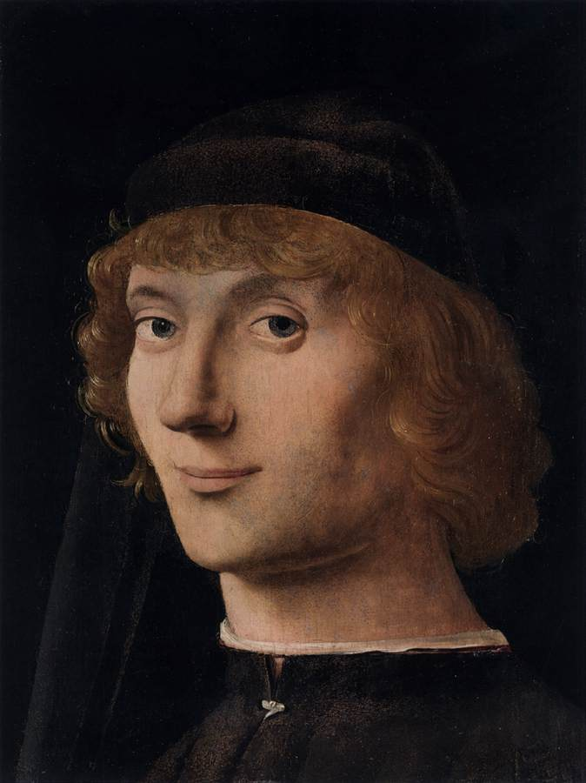

Slide 20
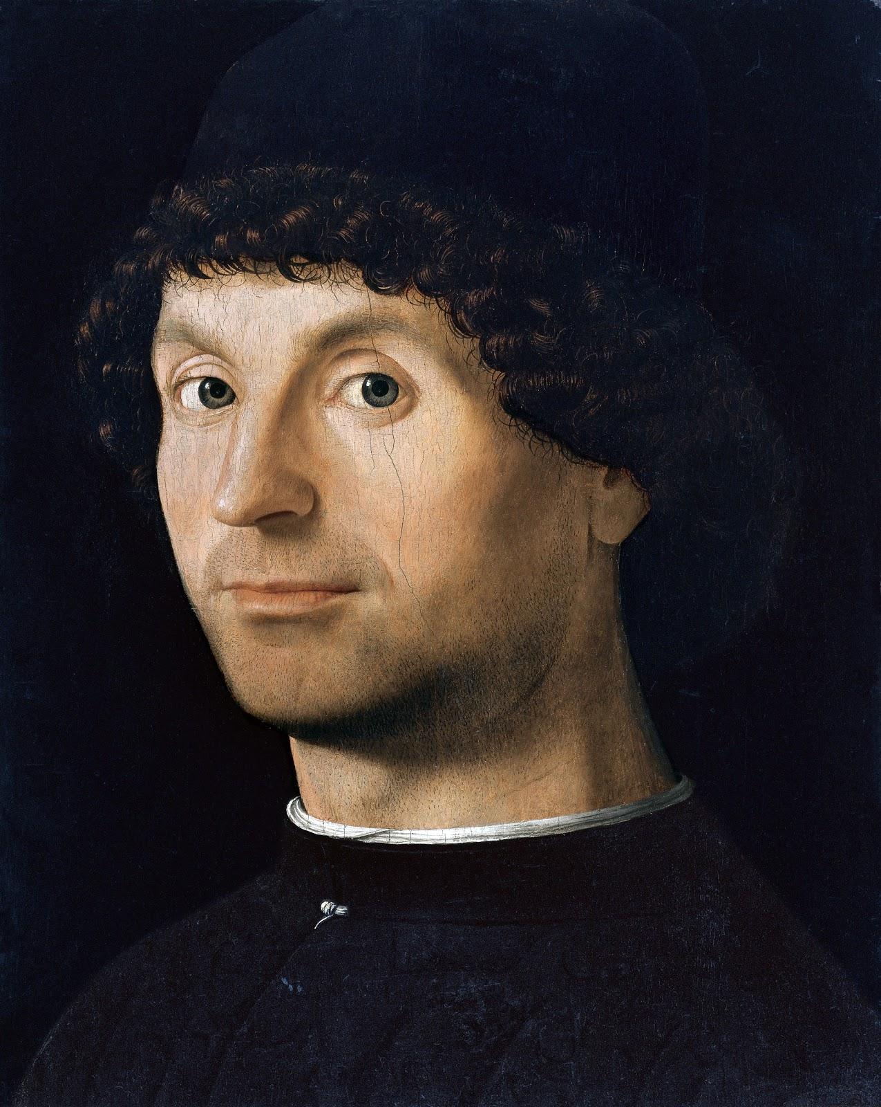

Slide 21
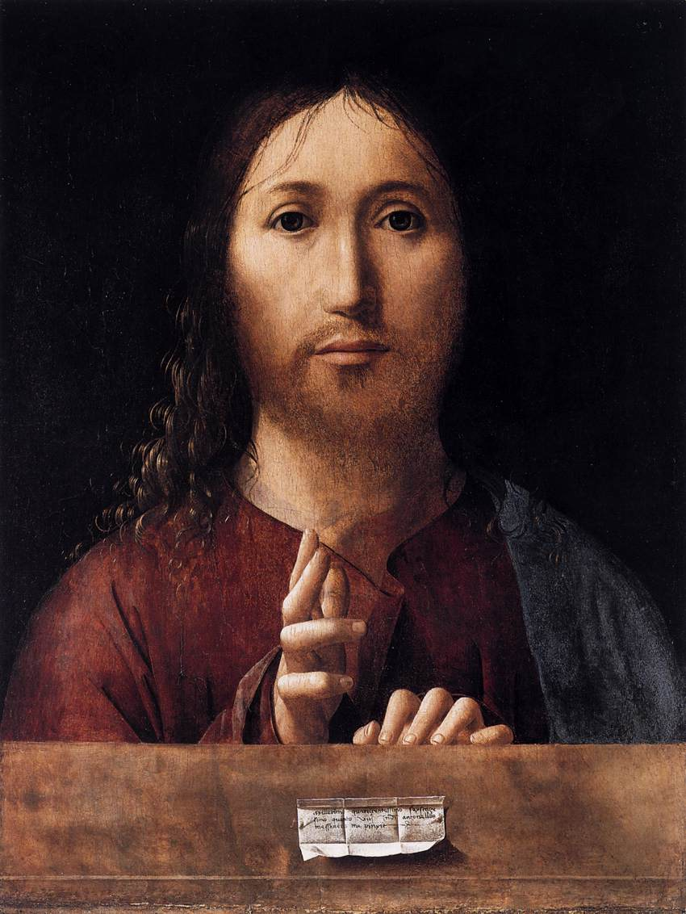

Slide 22
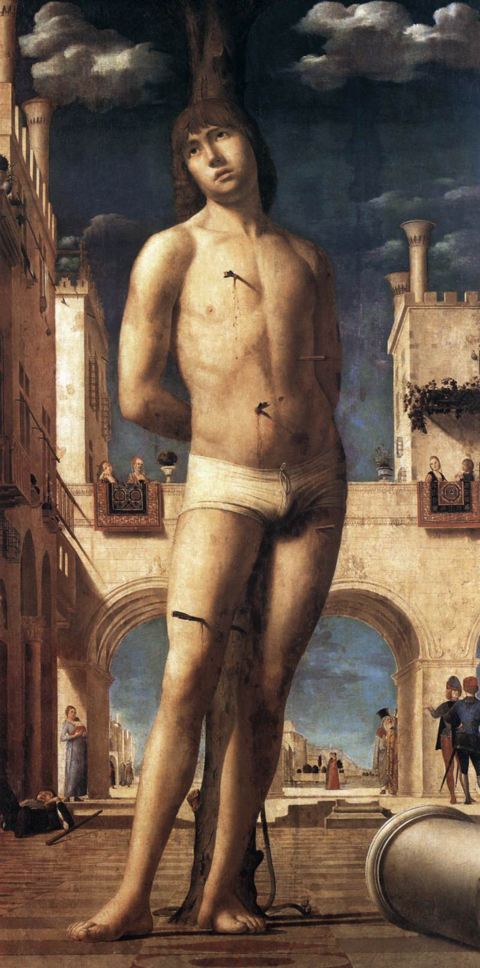
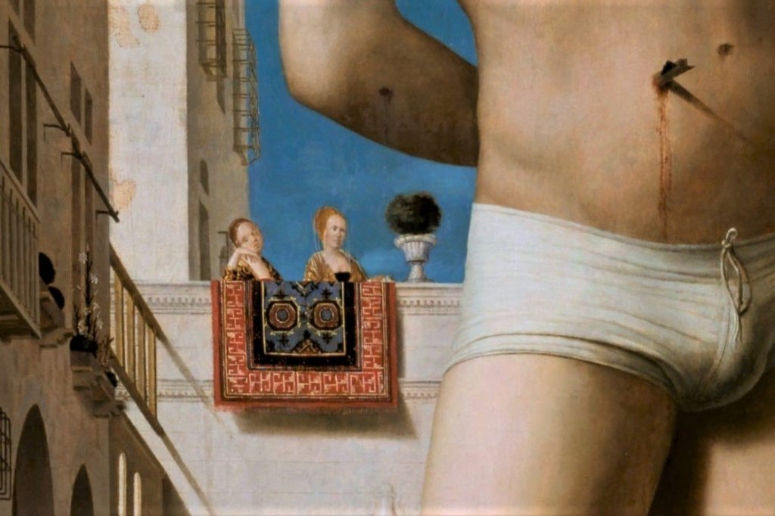
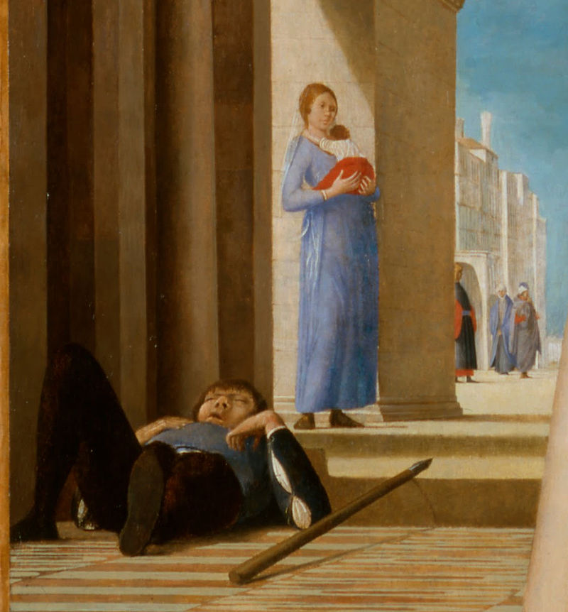
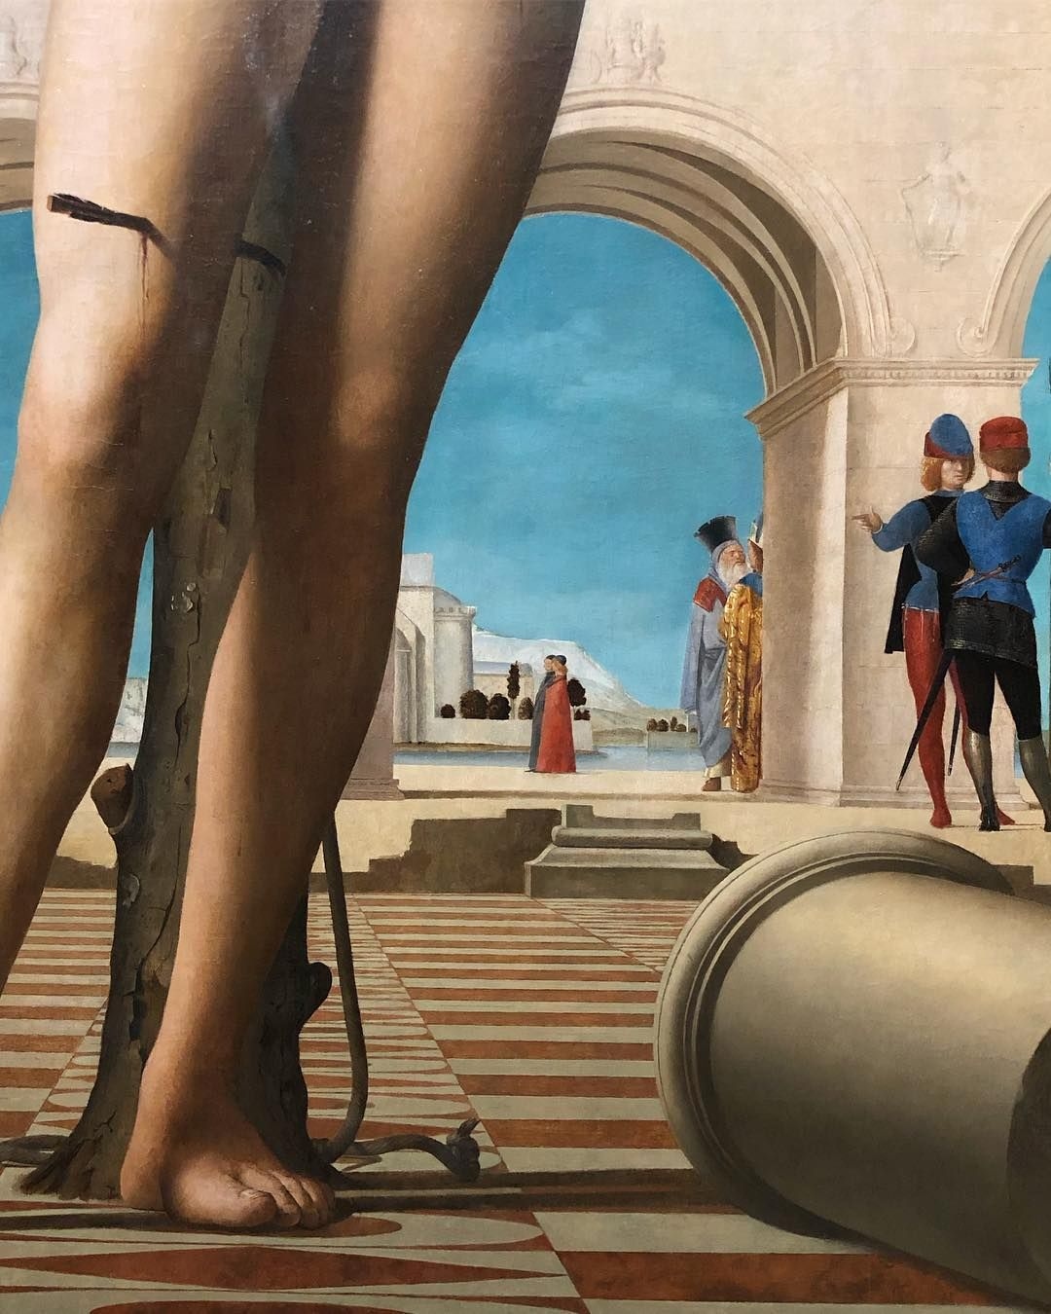

Slide 23
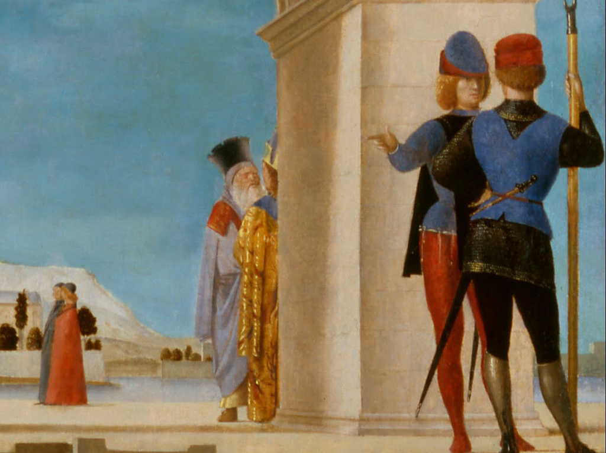

Slide 24
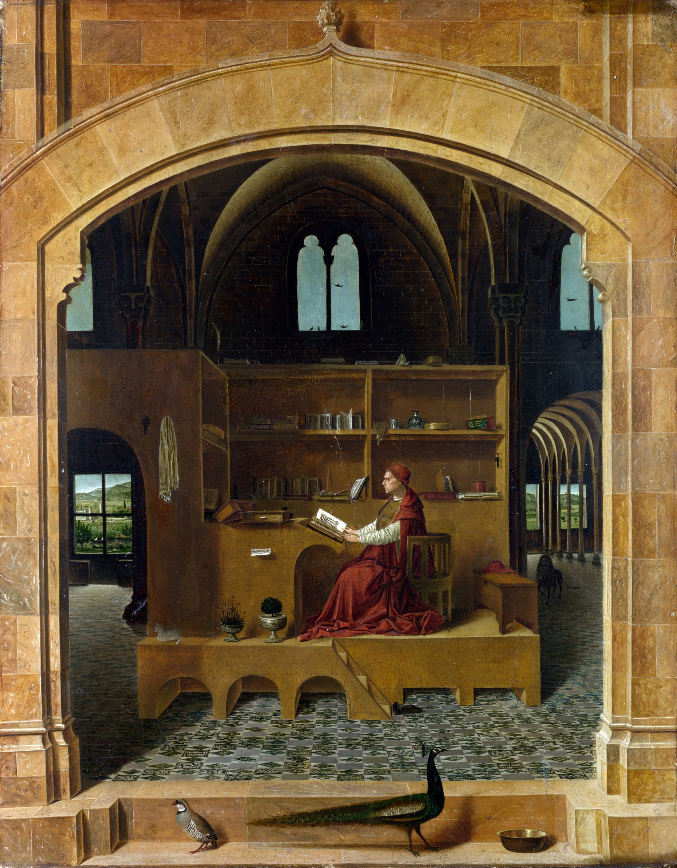
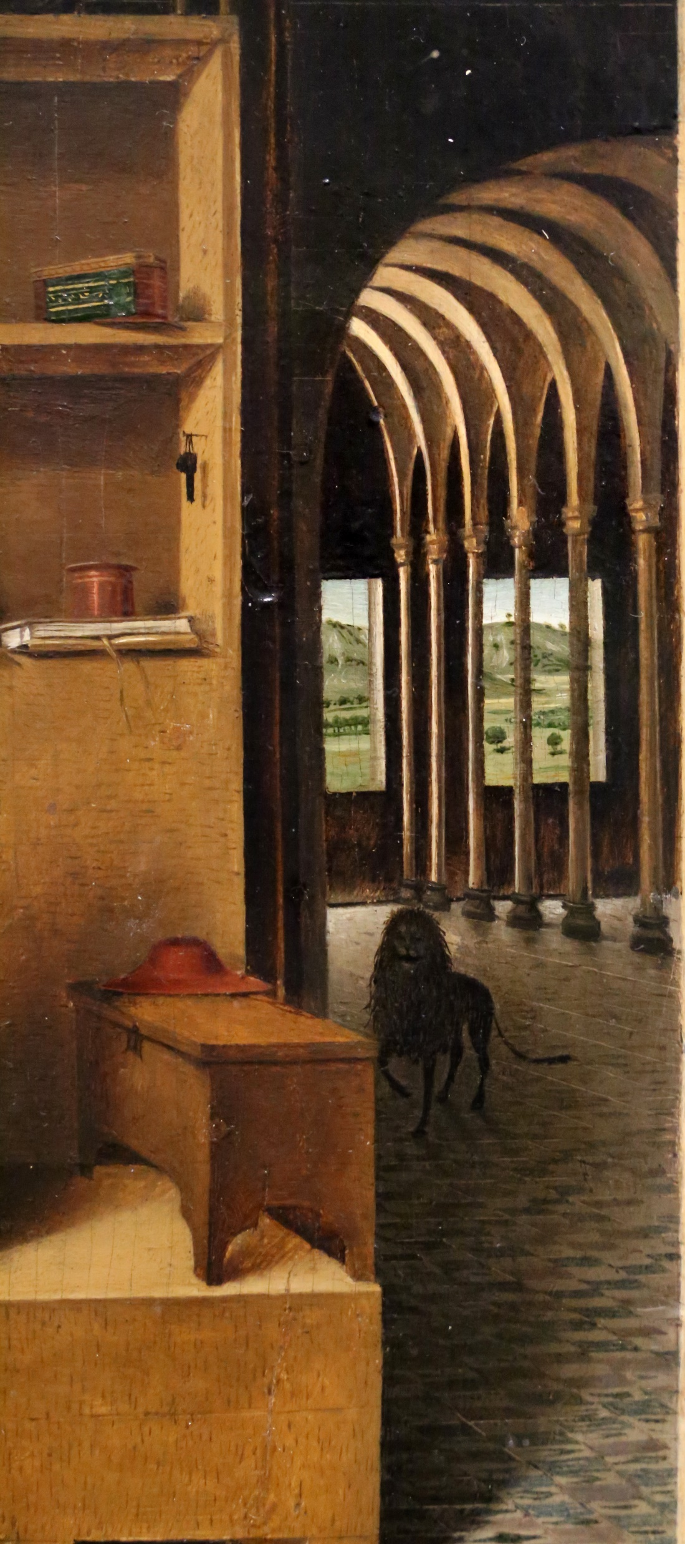

Slide 25
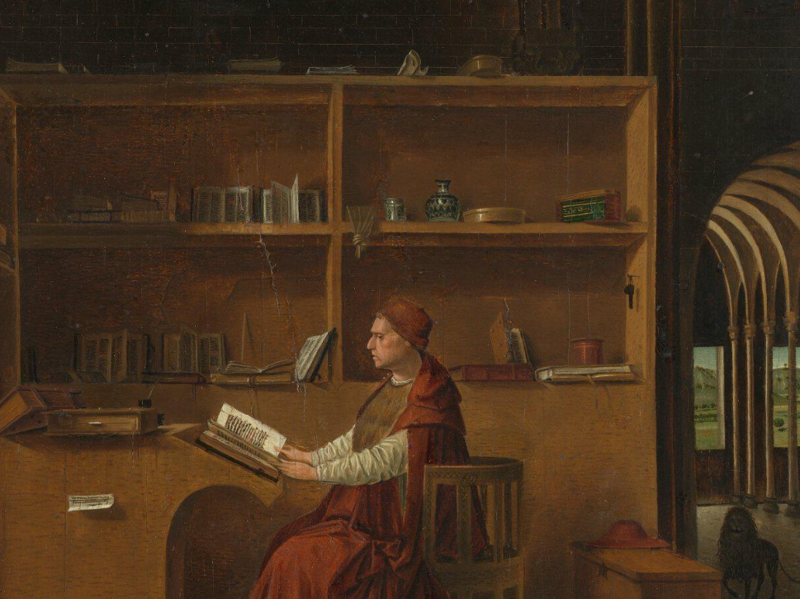

Slide 26
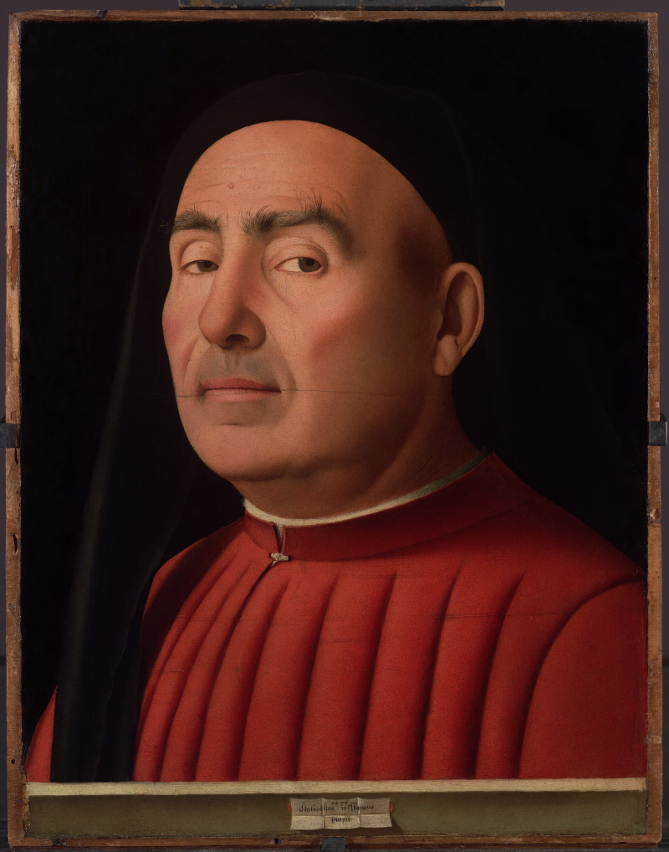

Slide 27
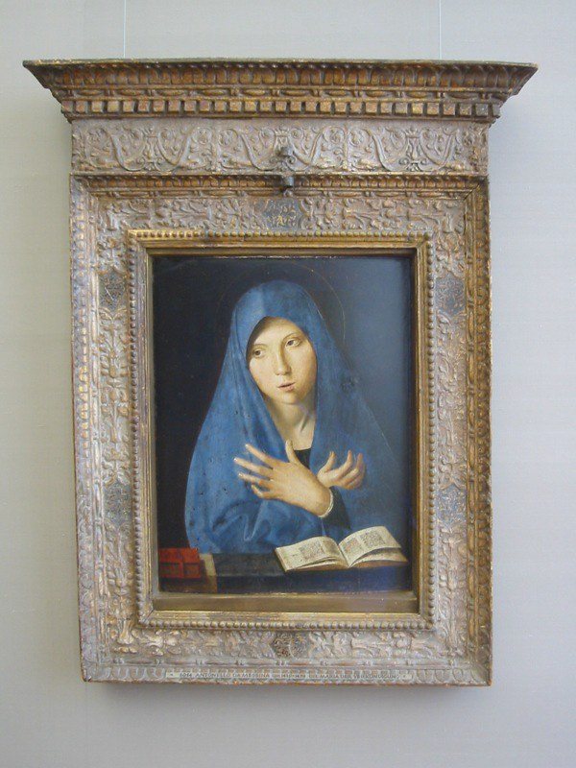

Slide 28
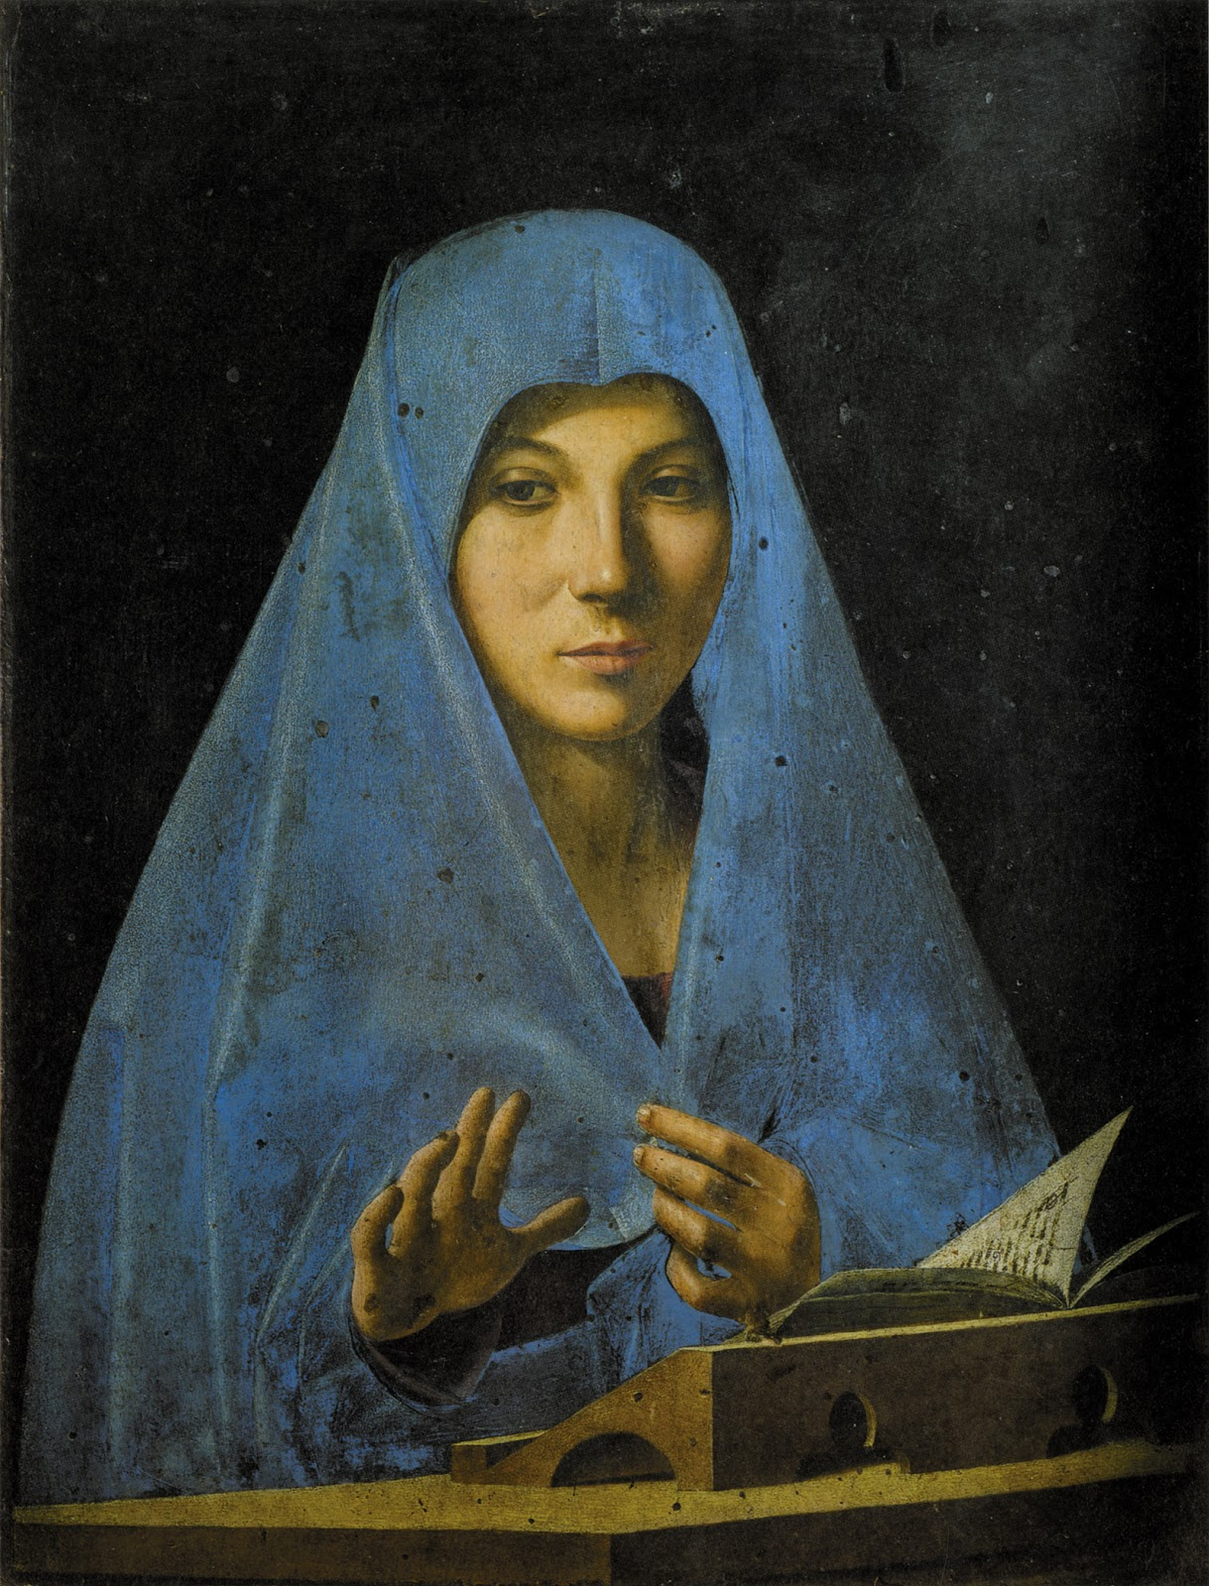
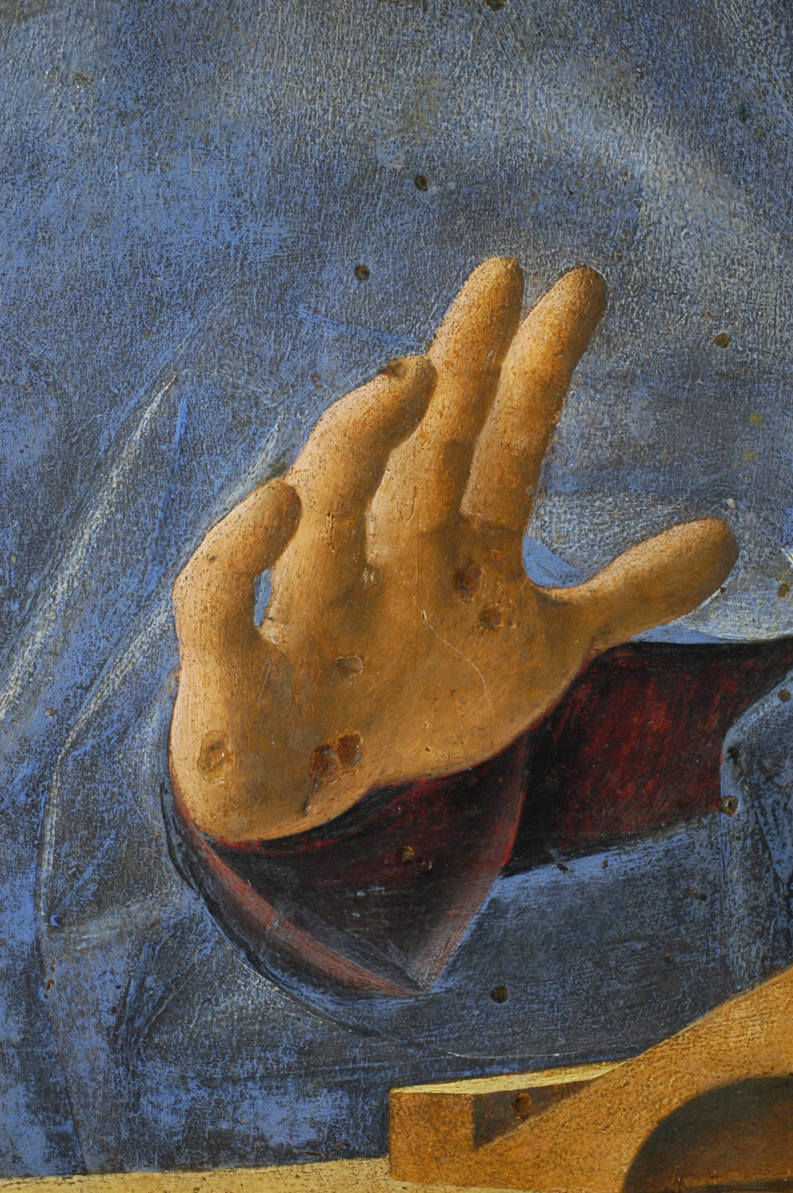

Slide 29
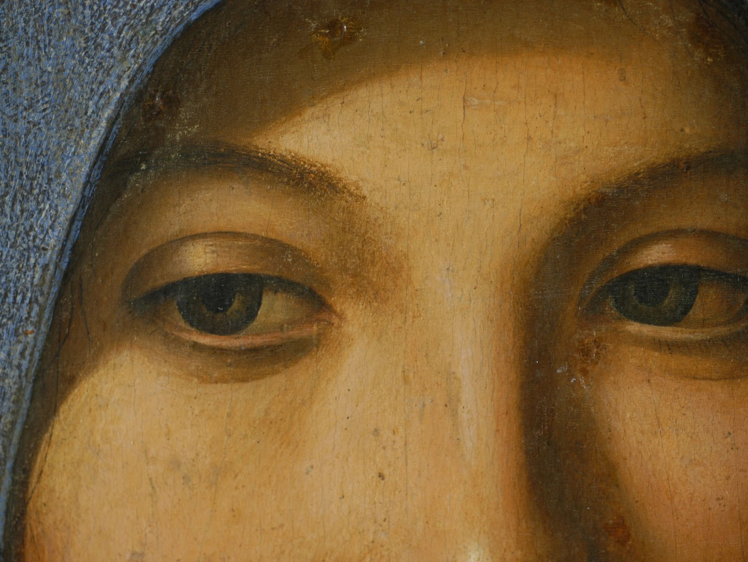

Slide 30
Slide 1
Introduction – Anonello da Messina, 1430-1479
Slide 2
San Cassiano Altar, 1475-76, Oil on panel, Kunsthistorisches Museum, Vienna https://www.wga.hu/frames-e.html?/html/a/antonell/index.html
Slide 3
Antonello da Messina, Pala di San Cassiano Attempted reconstruction with the added fragments by David Teniers the Younger, 1610-1690
San Cassiano Altar (Madonna detail), 1475-76, Oil on panel, Kunsthistorisches Museum, Vienna https://artinwords.de/antonello-da-messina-pala-di-san-cassiano-sacra-conversazione/
Slide 4
San Cassiano Altar (detail), 1475-76, Oil on panel, Kunsthistorisches Museum, Vienna https://artinwords.de/antonello-da-messina-pala-di-san-cassiano-sacra-conversazione/
Slide 5
Christ at the Column, c. 1476, Oil on wood, 30 x 21 cm, Musée du Louvre, Paris https://en.wikipedia.org/wiki/Christ_at_the_Column_(Antonello_da_Messina)#/media/File:Antonello_da_Messina_-_Christ_at_the_Column_-_WGA0744.jpg
Slide 6
Christ at the Column (detail), c. 1476, Oil on wood, 30 x 21 cm, Musée du Louvre, Paris https://eclecticlight.co/2019/08/07/the-first-italian-master-in-oil-antonello-da-messina-3/
Slide 7
Portrait of a Man (Il Condottiere), 1475, Oil on canvas, 36 x 30 cm, Musée du Louvre, Paris https://www.wga.hu/frames-e.html?/html/a/antonell/index.html
Slides 8 and 9
Crucifixion, 1475, Wood, 42 x 25,5 cm, National Gallery, London
Crucifixion (detail), 1475, Wood, 42 x 25,5 cm, National Gallery, London https://www.nationalgallery.org.uk/paintings/antonello-da-messina-christ-crucified

Slide 31
Slide 10
Crucifixion and two details, 1475, Oil on panel, 52.5 x 42.5 cm, Koninklijk Museum voor Schone Kunsten, Antwerp https://commons.wikimedia.org/wiki/Category:Antwerpen_Crucifixion_by_Antonello_da_Messina https://www.tuttartpitturasculturapoesiamusica.com/2019/11/Antonello-da-Messina.html
Slide 11
Crucifixion, 1467-69, Tempera and oil on panel, 39 x 23 cm, Muzeul National Brukenthal, Sibiu https://en.wikipedia.org/wiki/Crucifixion_(Antonello_da_Messina)#/media/File:Antonello_da_Messina_026.jpg
Slide 12
The Dead Christ Supported by and Angel and detail, 1475-78, Oil on panel, 74 x 51 cm, Museo del Prado, Madrid https://www.wga.hu/frames-e.html?/html/a/antonell/index.html http://theartgalleryintheworld.blogspot.com/2014/01/antonello-da-messina-cristo-morto.html
Slide 13
San Gregorio Polyptych and the Madonna and Child, 1473, Oil on panel, 129 x 76 cm, Museo Regionale, Messina https://upload.wikimedia.org/wikipedia/commons/4/44/Antonello_da_Messina_-_Madonna_and_Child_-_WGA00750.jpg
Slide 14
Portrait of a Young Man and detail, 1478, Oil on walnut panel, Staatliche Museen, Berlin https://www.wga.hu/frames-e.html?/html/a/antonell/index.html
Slides 15 and 16
Pietà and detail, c. 1475, Oil on panel, 115 x 86 cm, Museo Correr, Venice https://it.wikipedia.org/wiki/File:Antonello_da_Messina_038.jpg
Slide 17
Portrait of a Man, c. 1475, Oil on wood, 31 x 26 cm, Galleria Borghese, Rome https://www.wga.hu/frames-e.html?/html/a/antonell/index.html

Slide 32
Slide 18
Portrait of a Man, c. 1475, Oil on panel, 36 x 25 cm, National Gallery, London https://www.tuttartpitturasculturapoesiamusica.com/2019/11/Antonello-da-Messina.html
Slide 19
Portrait of a Young Man, 1470-72, Oil on wood, 27 x 21 cm, Metropolitan Museum of Art, New York https://www.wga.hu/frames-e.html?/html/a/antonell/index.html
Slide 20
Portrait of a Man, 1475-76, Oil on panel, 28 x 21 cm, Museo Thyssen-Bornemisza, Madrid https://www.tuttartpitturasculturapoesiamusica.com/2019/11/Antonello-da-Messina.html
Slide 21
Salvator Mundi, 1465, Oil on panel, 39 x 30 cm, National Gallery, London https://www.wga.hu/frames-e.html?/html/a/antonell/index.html
Slides 22 and 23
St Sebastian and four details, 1476-77, Oil on canvas transferred from panel, 171 x 86 cm, Gemäldegalerie, Dresden https://www.wga.hu/frames-e.html?/html/a/antonell/index.html https://en.wikipedia.org/wiki/St_Sebastian_(Antonello_da_Messina) https://www.pinterest.ca/pin/419045940325761422/
Slides 24 and 25
St Jerome in his Study and two details, c. 1460, Oil on wood, 46 x 36 cm, National Gallery, London https://upload.wikimedia.org/wikipedia/commons/b/b1/Antonello_da_Messina_-_St_Jerome_in_his_study_-_National_Gallery_London.jpg https://commons.wikimedia.org/wiki/File:Antonello_da_messina,_san_girolamo_nello_studio,_1475_ca._07.jpg https://www.nationalgallery.org.uk/paintings/antonello-da-messina-saint-jerome-in-his-study

Slide 33

Slide 26
Trivulzio Portrait, 1476, Oil on panel, 37 x 28 cm, Museo Civico d'Arte Antica, Turin https://commons.wikimedia.org/wiki/Category:Portrait_of_a_Man_(Trivulzio_portrait,_Antonello_Da_Messina)#/media/File:Antonello_Da_Messina_-_Ritratto_Trivulzio.png
Slide 27
Virgin of the Annunciation, 1473, Oil on panel, Alte Pinakothek, Munich https://www.flickr.com/photos/birdies-perch/408028926/
Slide 28 and 29
Virgin Annunciate and three details, c. 1476, Oil on wood, 45 x 34,5 cm, Galleria Regionale della Sicilia, Palermo https://www.tuttartpitturasculturapoesiamusica.com/2019/11/Antonello-da-Messina.html

Slide 34
The End

