Slide 1
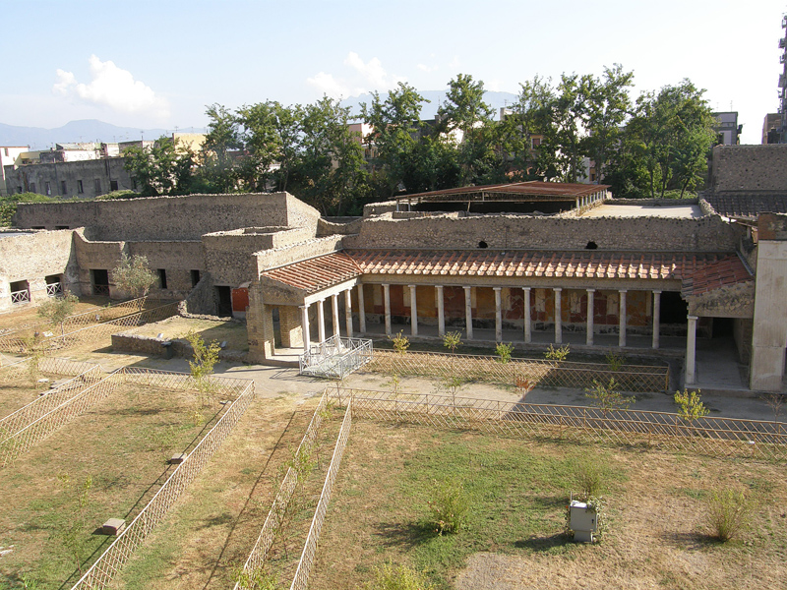
Oplontis Villa of Poppaea

Slide 2
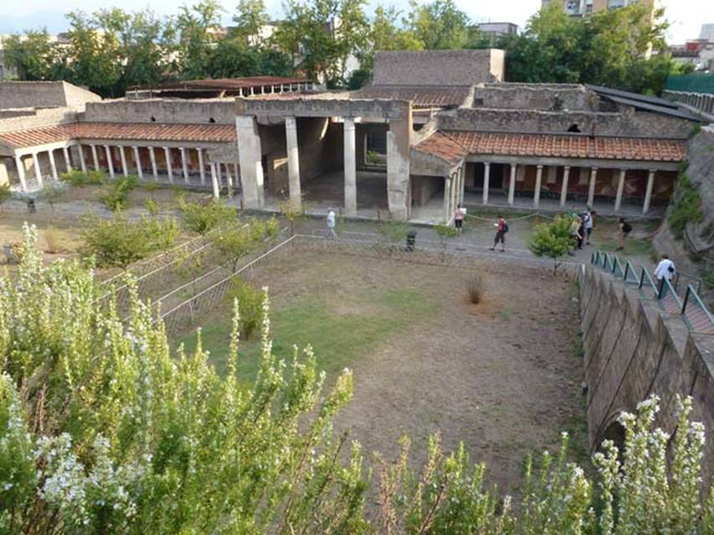

Slide 3
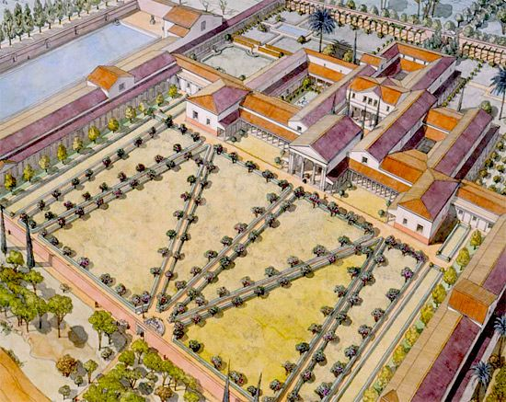

Slide 4
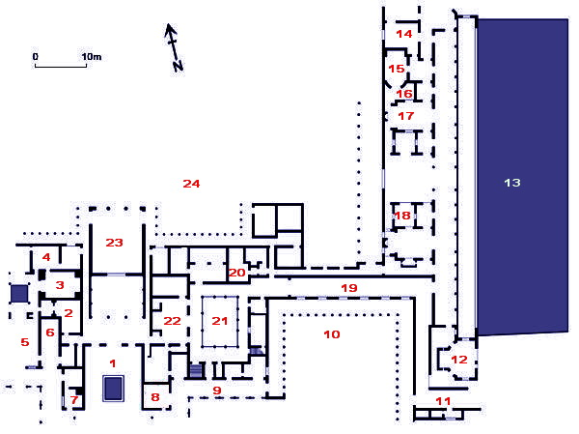
Plan of the Villa Poppaea: 01-Atrium, 03-Caldarium, 04-Tepidarium, 06-Triclinium, 07-Cubiculum, 10-Peristyle, 12-Oecus, 13-Piscina, 15-Viridarium, 20-Latrine, 21-Peristyle, 22-Lararium, 24-Garden

Slide 5
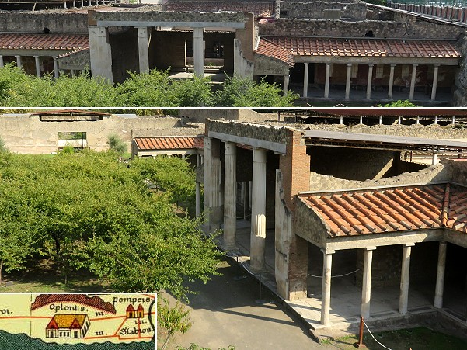
Photo credits: https://www.romeartlover.it/Hercula7.html

Slide 6
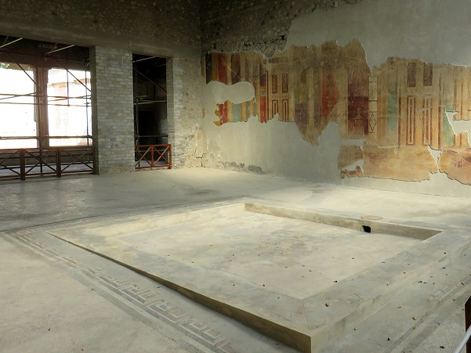
The Atrium – The following photo credits: https://www.romeartlover.it/Hercula7.html

Slide 7
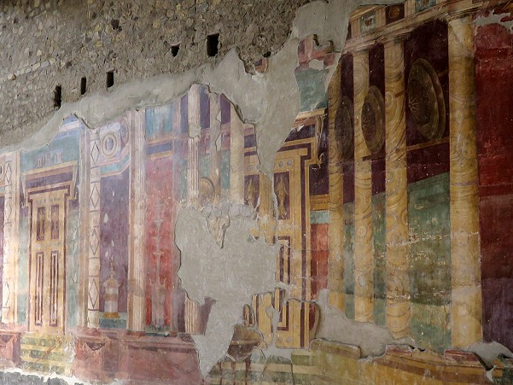
Atrium: fake architectures on one of the long sides

Slide 8
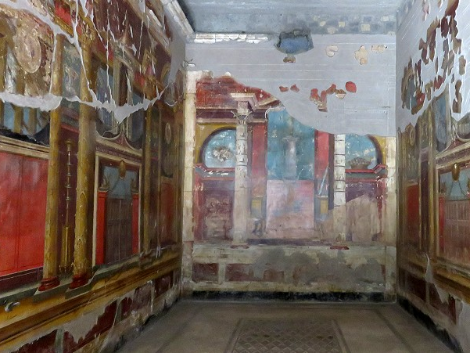
Main triclinium (dining room)

Slide 9
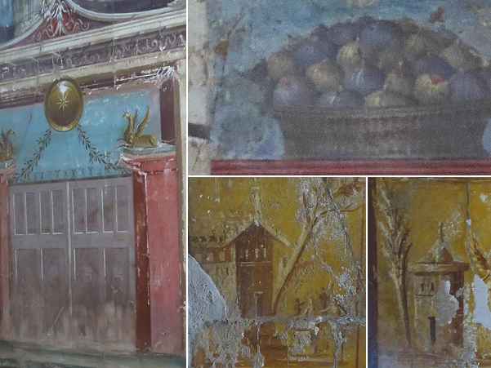
Main triclinium: details of the wall paintings

Slide 10
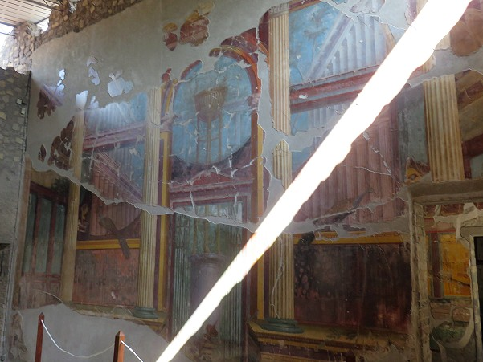
Hall of the Tripod (with a ray of sunshine)

Slide 11
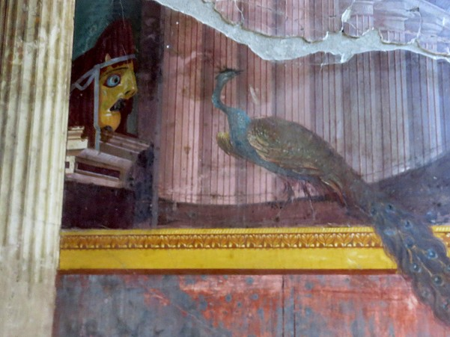
Detail of the Hall of the Tripod showing a theatrical mask and a peacock

Slide 12
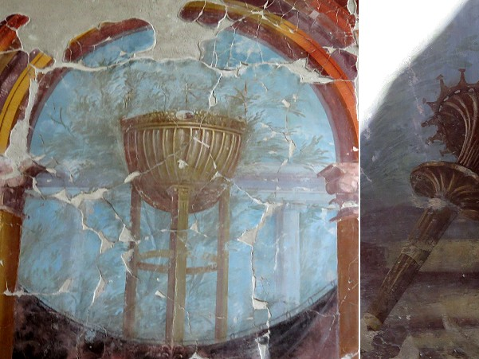
Other details of the decoration of the Hall of the Tripod: (left) upper part of the tripod; (right) bronze torch, of a design which is found in coins minted at Alexandria

Slide 13
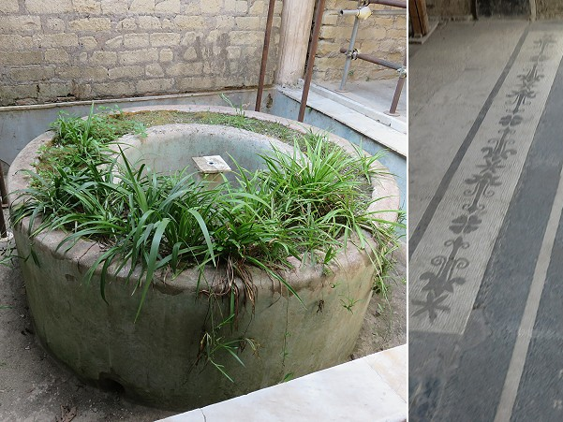
Fountain and mosaic floor of the baths

Slide 14
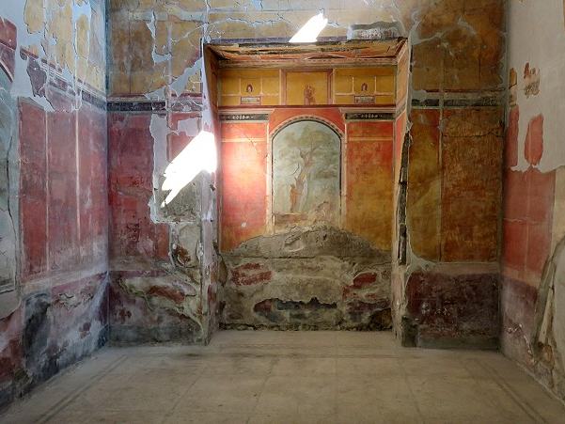
Calidarium

Slide 15
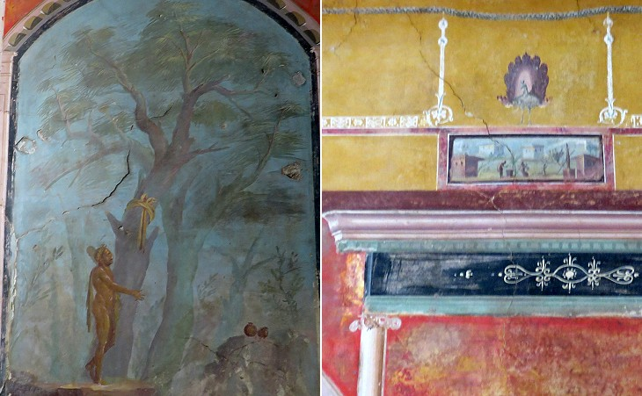
Calidarium: details of its wall paintings: (left) Hercules in the Garden of the Hesperides, a very popular subject throughout the whole Roman Empire; (right) other details

Slide 16
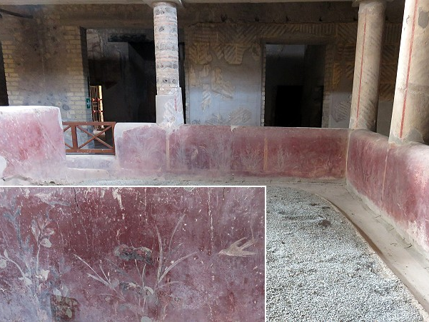
Inner peristyle; detail of its decoration

Slide 17
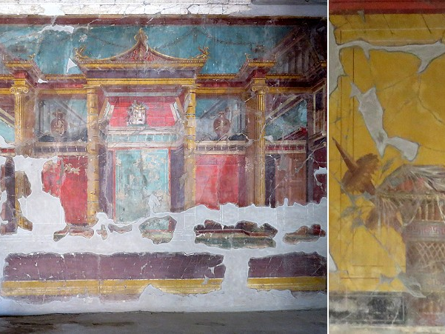
Small room between the atrium and the southern peristyle and a detail of its decoration; the roof at the centre of the fake architecture has a rather Chinese appearance

Slide 18
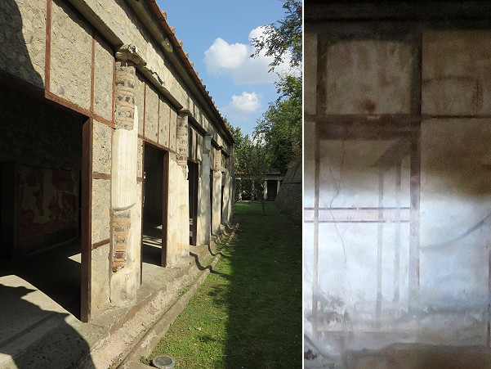
(left) Portico leading to the southern peristyle; (right) third style decoration of a "cubiculum" (sleeping room) along the portico

Slide 19
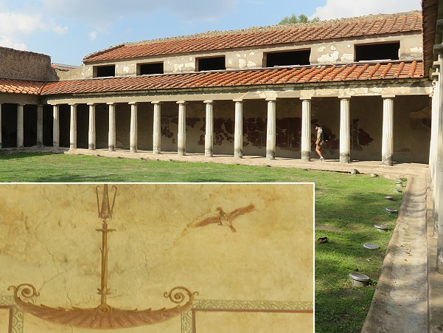
Southern peristyle; detail of its fourth style decoration

Slide 20
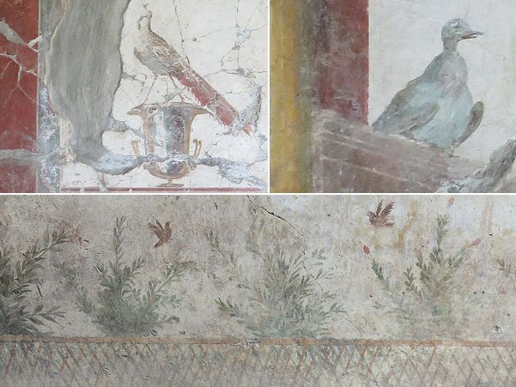
(above) Details of the fourth style decoration of halls between the southern peristyle and the pool area; (below) a detail depicting a garden

Slide 21
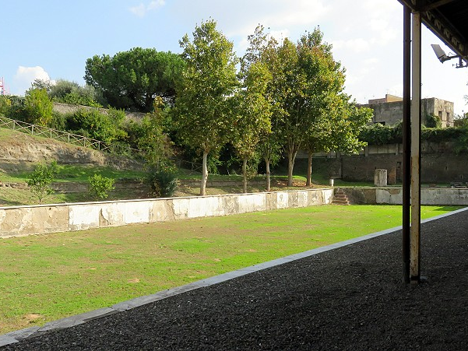
The Pool

Slide 22
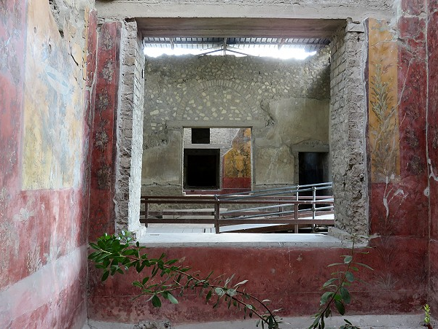
Small gardens (in the foreground and in the background) inside the wing of the villa alongside the pool

Slide 23
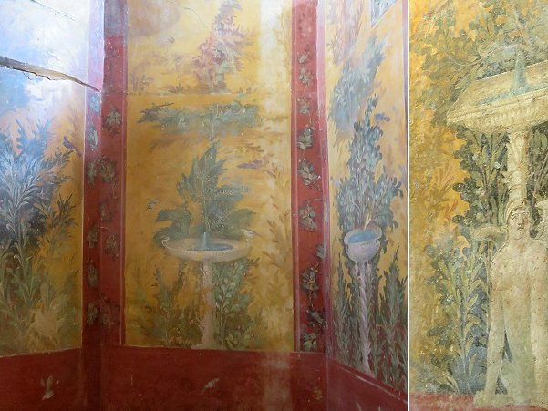
Second style paintings in the walls surrounding the small gardens

Slide 24
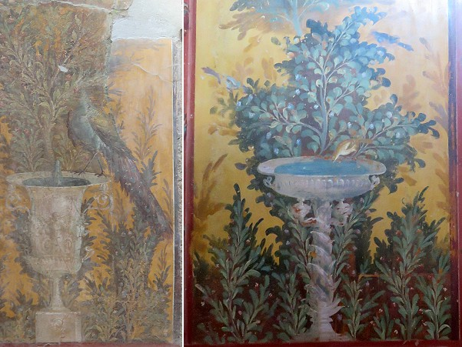
Second style paintings in the walls surrounding the small gardens

Slide 25
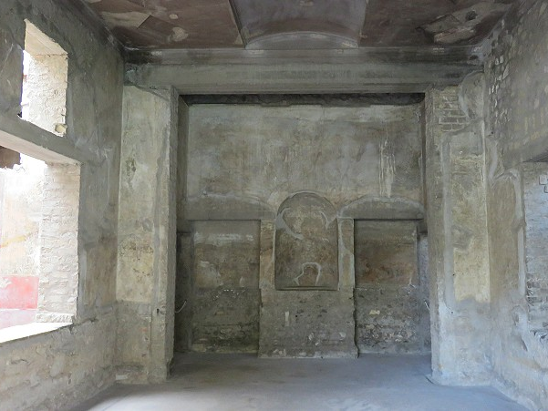
Hall in the wing of the villa alongside the pool

Slide 26
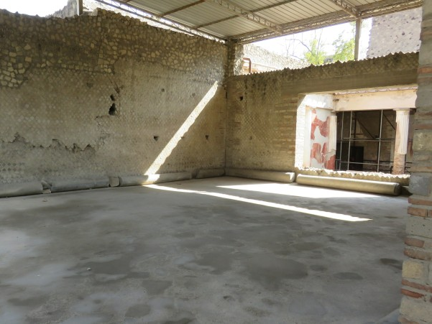
Great Rear Hall

Slide 27
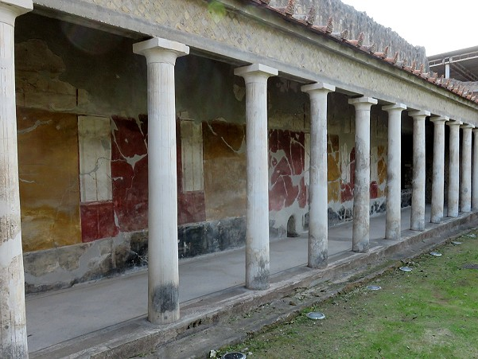
Portico at the side of the Great Rear Hall

Slide 28
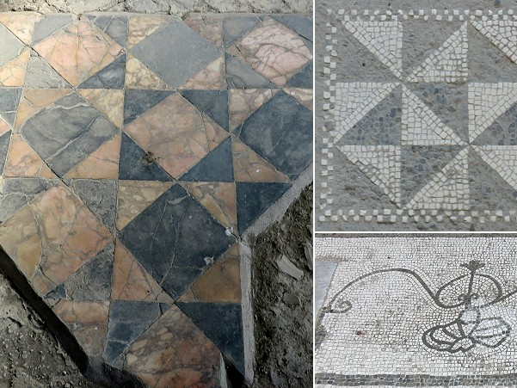
Details of the marble and mosaic floors

