Slide 1
Pandora

Slide 2
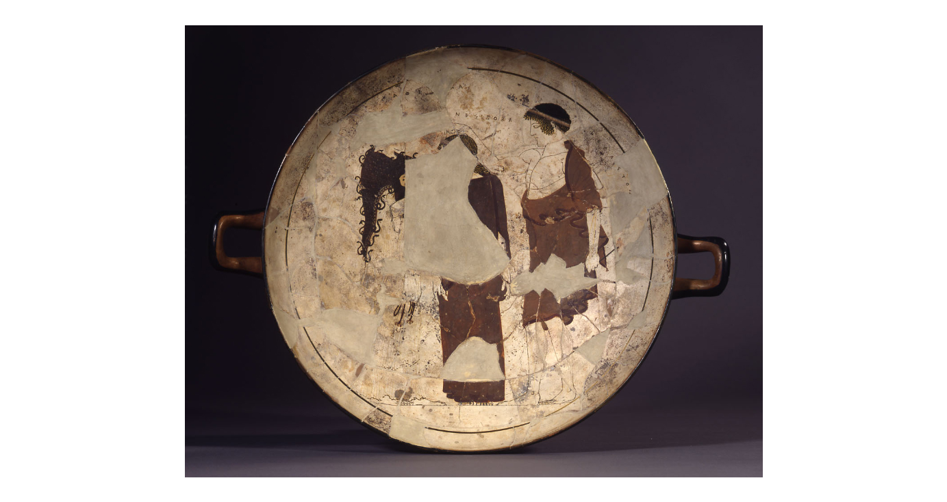
Attributed to:
The Tarquinia Painter
The making of Pandora, c. 470-460 BC, Red-Figured Cup with white ground, British Museum

Slide 3
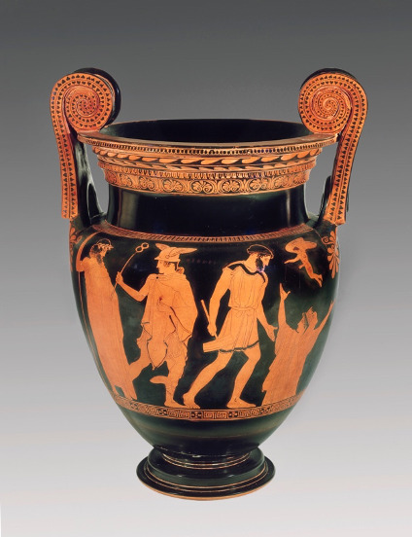
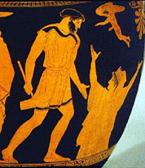
The Creation of Pandora, 475 - 425 BC, Attic Red Figure Volute Krater, attributed to Recalls Kensington Class, ca Ashmolean Museum, Oxford, United Kingdom

Slide 4
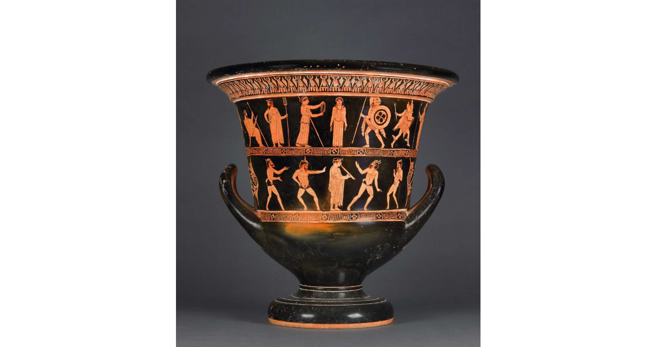
Painted by: The Niobid Painter
The Creation of Pandora, 460BC-450 BC, Attic Red Figure Calyx krater, attributed to the Niobid Painter, Archaic period, British Museum

Slide 5
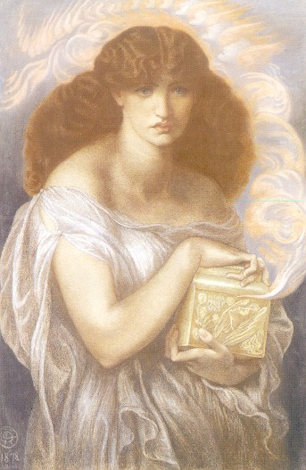
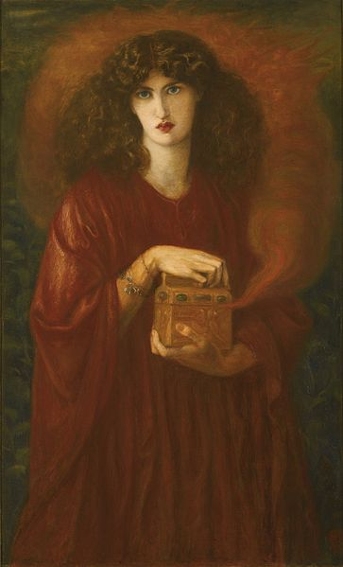
Dante Gabriel Rossetti, 1828-1882
Pandora, 1878, colouled chalks, Lady Lever Art Gallery, Liverpool
Dante Gabriel Rossetti, 1828-1882
Pandora, 1871, oil on canvas, 131 x 79 cm, Private Collection

Slide 6
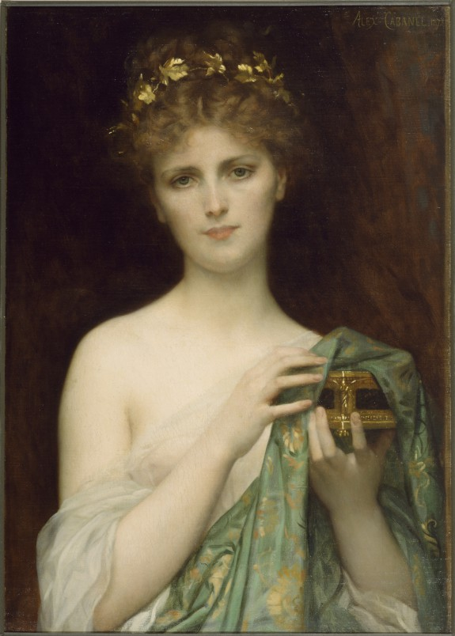
Alexandre Cabanel, 1823–1889
Swedish soprano Christine Nilsson as Pandora, 1873, oil on canvas, 70.2 x 49.2 cm, Walters Art Museum, Baltimore, MD

Slide 7
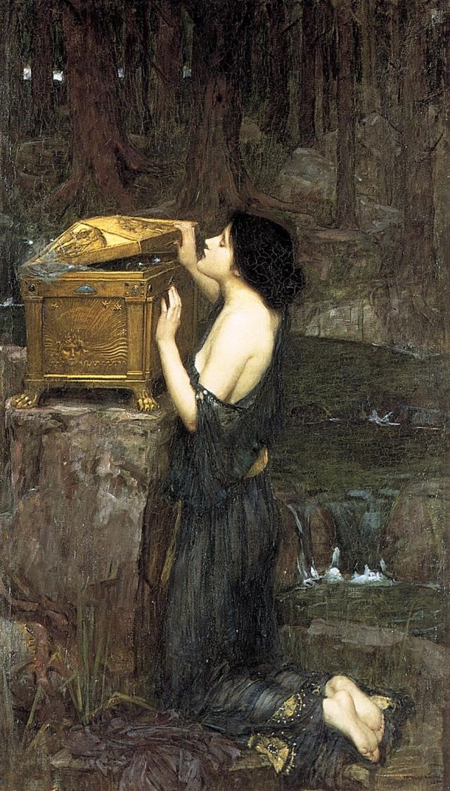
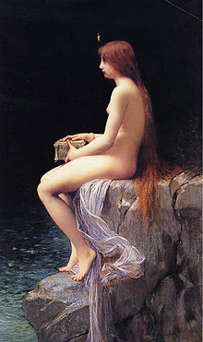
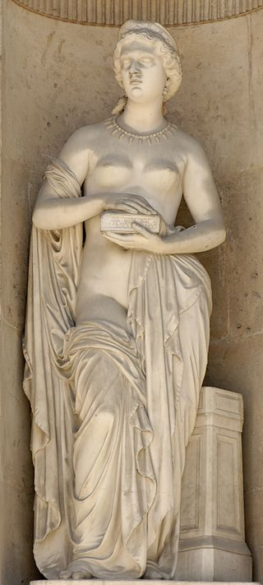
John William Waterhouse,
1849-1917
Pandora, 1896, oil on canvas, Private Collection
Jules Joseph Lefebvre, 1836–1911
Pandora, 1882, oil on canvas, Private Collection
Pierre Loison,
1816–1886
Pandora, 1861, East façade of the Cour Carrée in the Louvre Palace, Paris

Slide 8
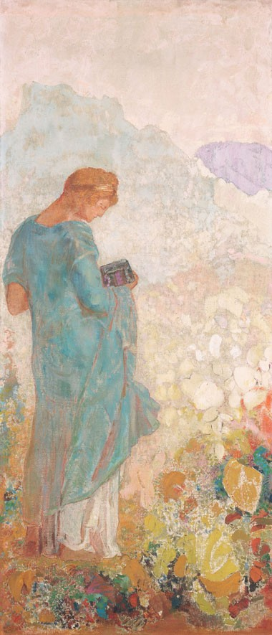
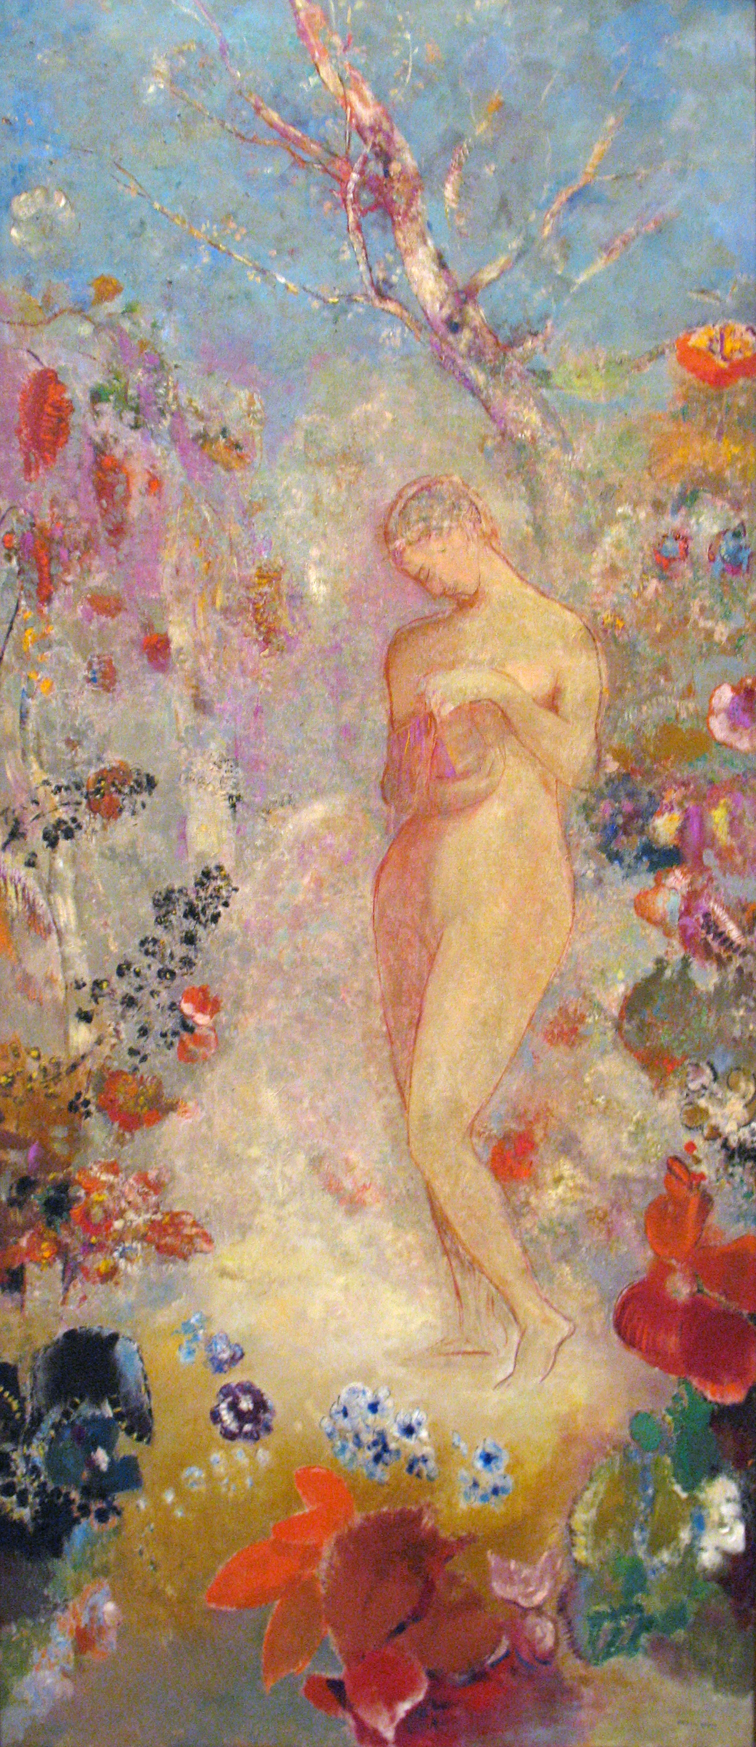
Odilon Redon, 1840–1916
Pandora, 1910/1912, oil on canvas,
143.5 x 62.9 cm, National Gallery of Art, Chester Dale Collection, Washington, DC
Odilon Redon, 1840–1916
Pandora, 1914, oil on canvas, 143.5 x 62.2 cm, the MET, NY

Slide 9
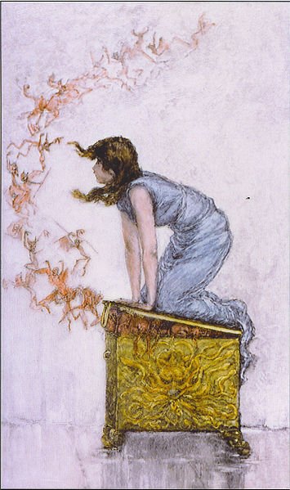
F.S. Church, 1842–1924
Pandora trying to close the box she has opened out of curiosity. At left, the evils of the world taunt her as they escape. (19th century engraving)

Slide 10
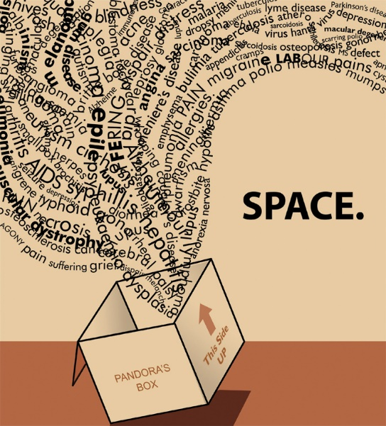
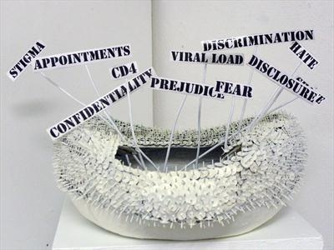
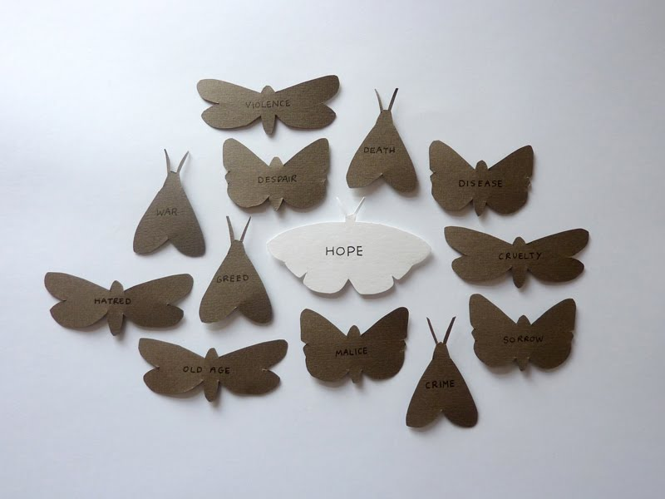
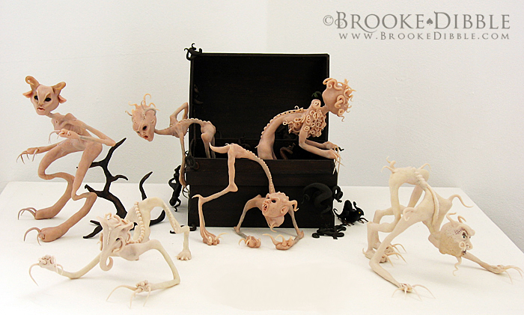
Pandora’s Box

Slide 11
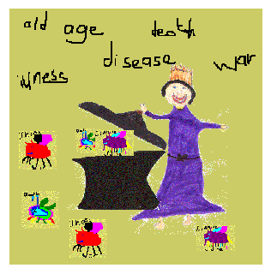

Slide 12
Photo Credits
Slide 1
Pandora – Title
Slide 2 https://www.britishmuseum.org/collection/object/G_1881-0528-1
Slide 3 https://www.worldhistory.biz/ancient-history/70903-changing-representations-of-pandora.html https://quatr.us/greeks/hesiod-greek-literature.htm
Slide 4 https://www.britishmuseum.org/collection/object/G_1856-1213-1
Slide 5 https://androom.home.xs4all.nl/biography/a000649.htm
Slide 5 https://androom.home.xs4all.nl/biography/a000649.htm https://commons.wikimedia.org/wiki/File:Dante_Gabriel_Rossetti_-_Pandora.jpg
Slide 6 https://art.thewalters.org/detail/19035/pandora/
Slide 7 https://commons.wikimedia.org/wiki/File:Pandora_-_John_William_Waterhouse.jpg https://commons.wikimedia.org/wiki/File:Pandora_Lefebvre.jpg http://www.hellenicaworld.com/Greece/Mythology/Sculpture/en/PandoraPierreLoison.html
Slide 8 https://commons.wikimedia.org/wiki/File:1914_Odilon_Redon_Pandora_anagoria.JPG https://www.nga.gov/collection/art-object-page.46531.html
Slide 9 https://commons.wikimedia.org/wiki/File:Opened_up_a_Pandora%27s_box.jpg

