Slide 1
Domenicos Theotokopoulos
El Greco
1541-1614
Paintings of the Annunciation

Slide 2
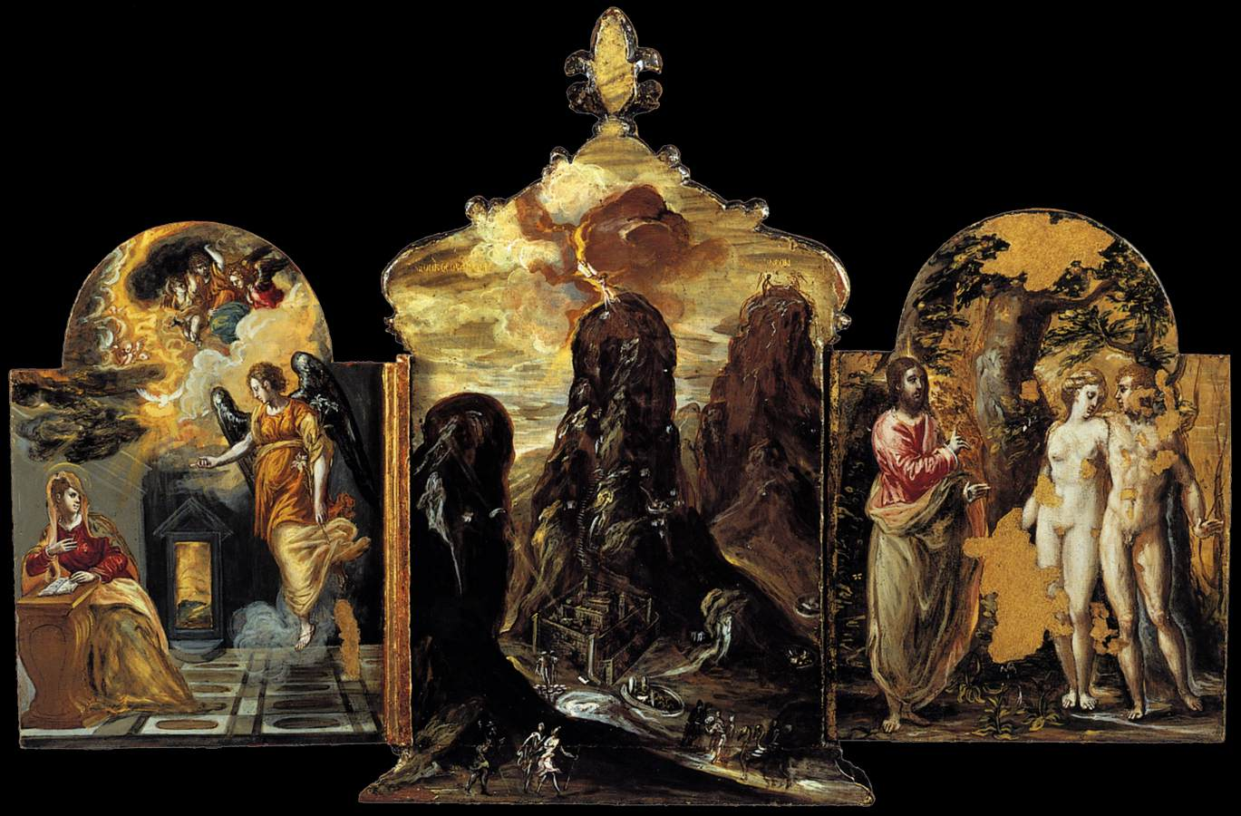
The Modena Triptych (front panels),
1568, Tempera on panel,
37 x 23,8 cm (central panel),
24 x 18 cm (side panels),
Galleria Estense, Modena, Italy

Slide 3
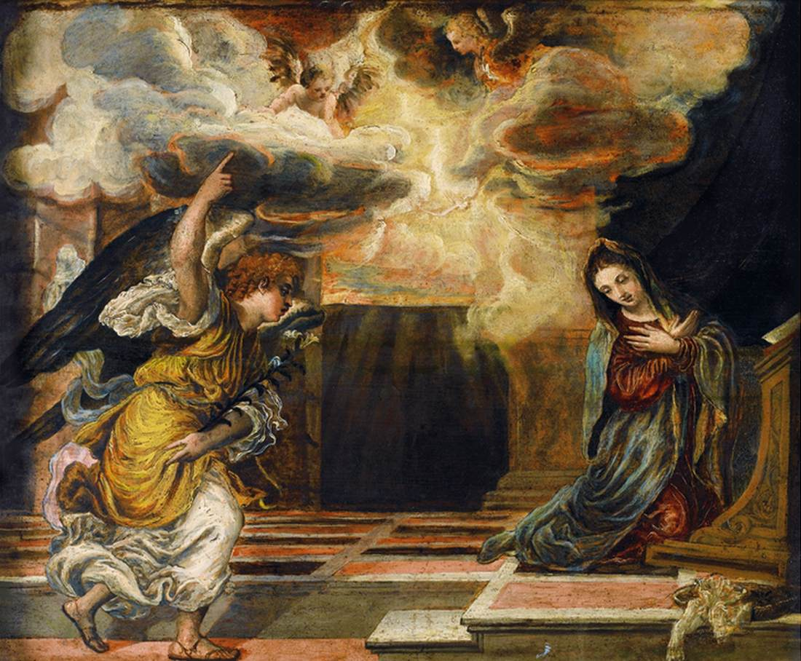
The Annunciation,
1568-70, Oil on panel,
63 x 76 cm,
Private collection

Slide 4
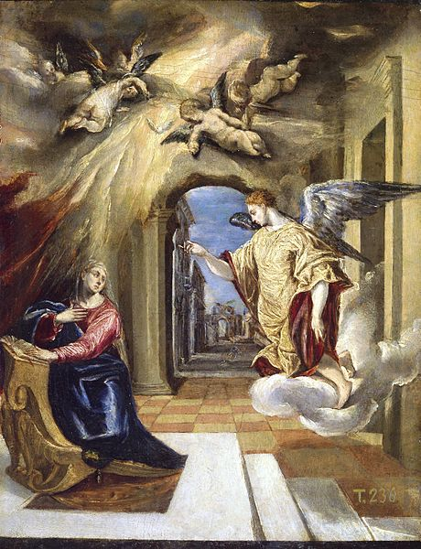
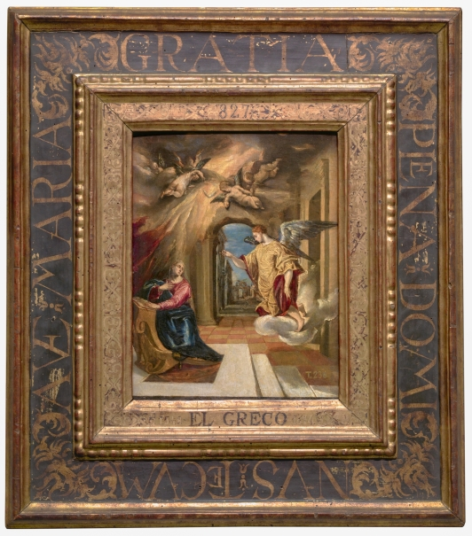
The Annunciation, from 1570 until 1572, Oil on Canvas mounted on panel, 26x20 cm, Museo del Prado, Madrid, Spain

Slide 5
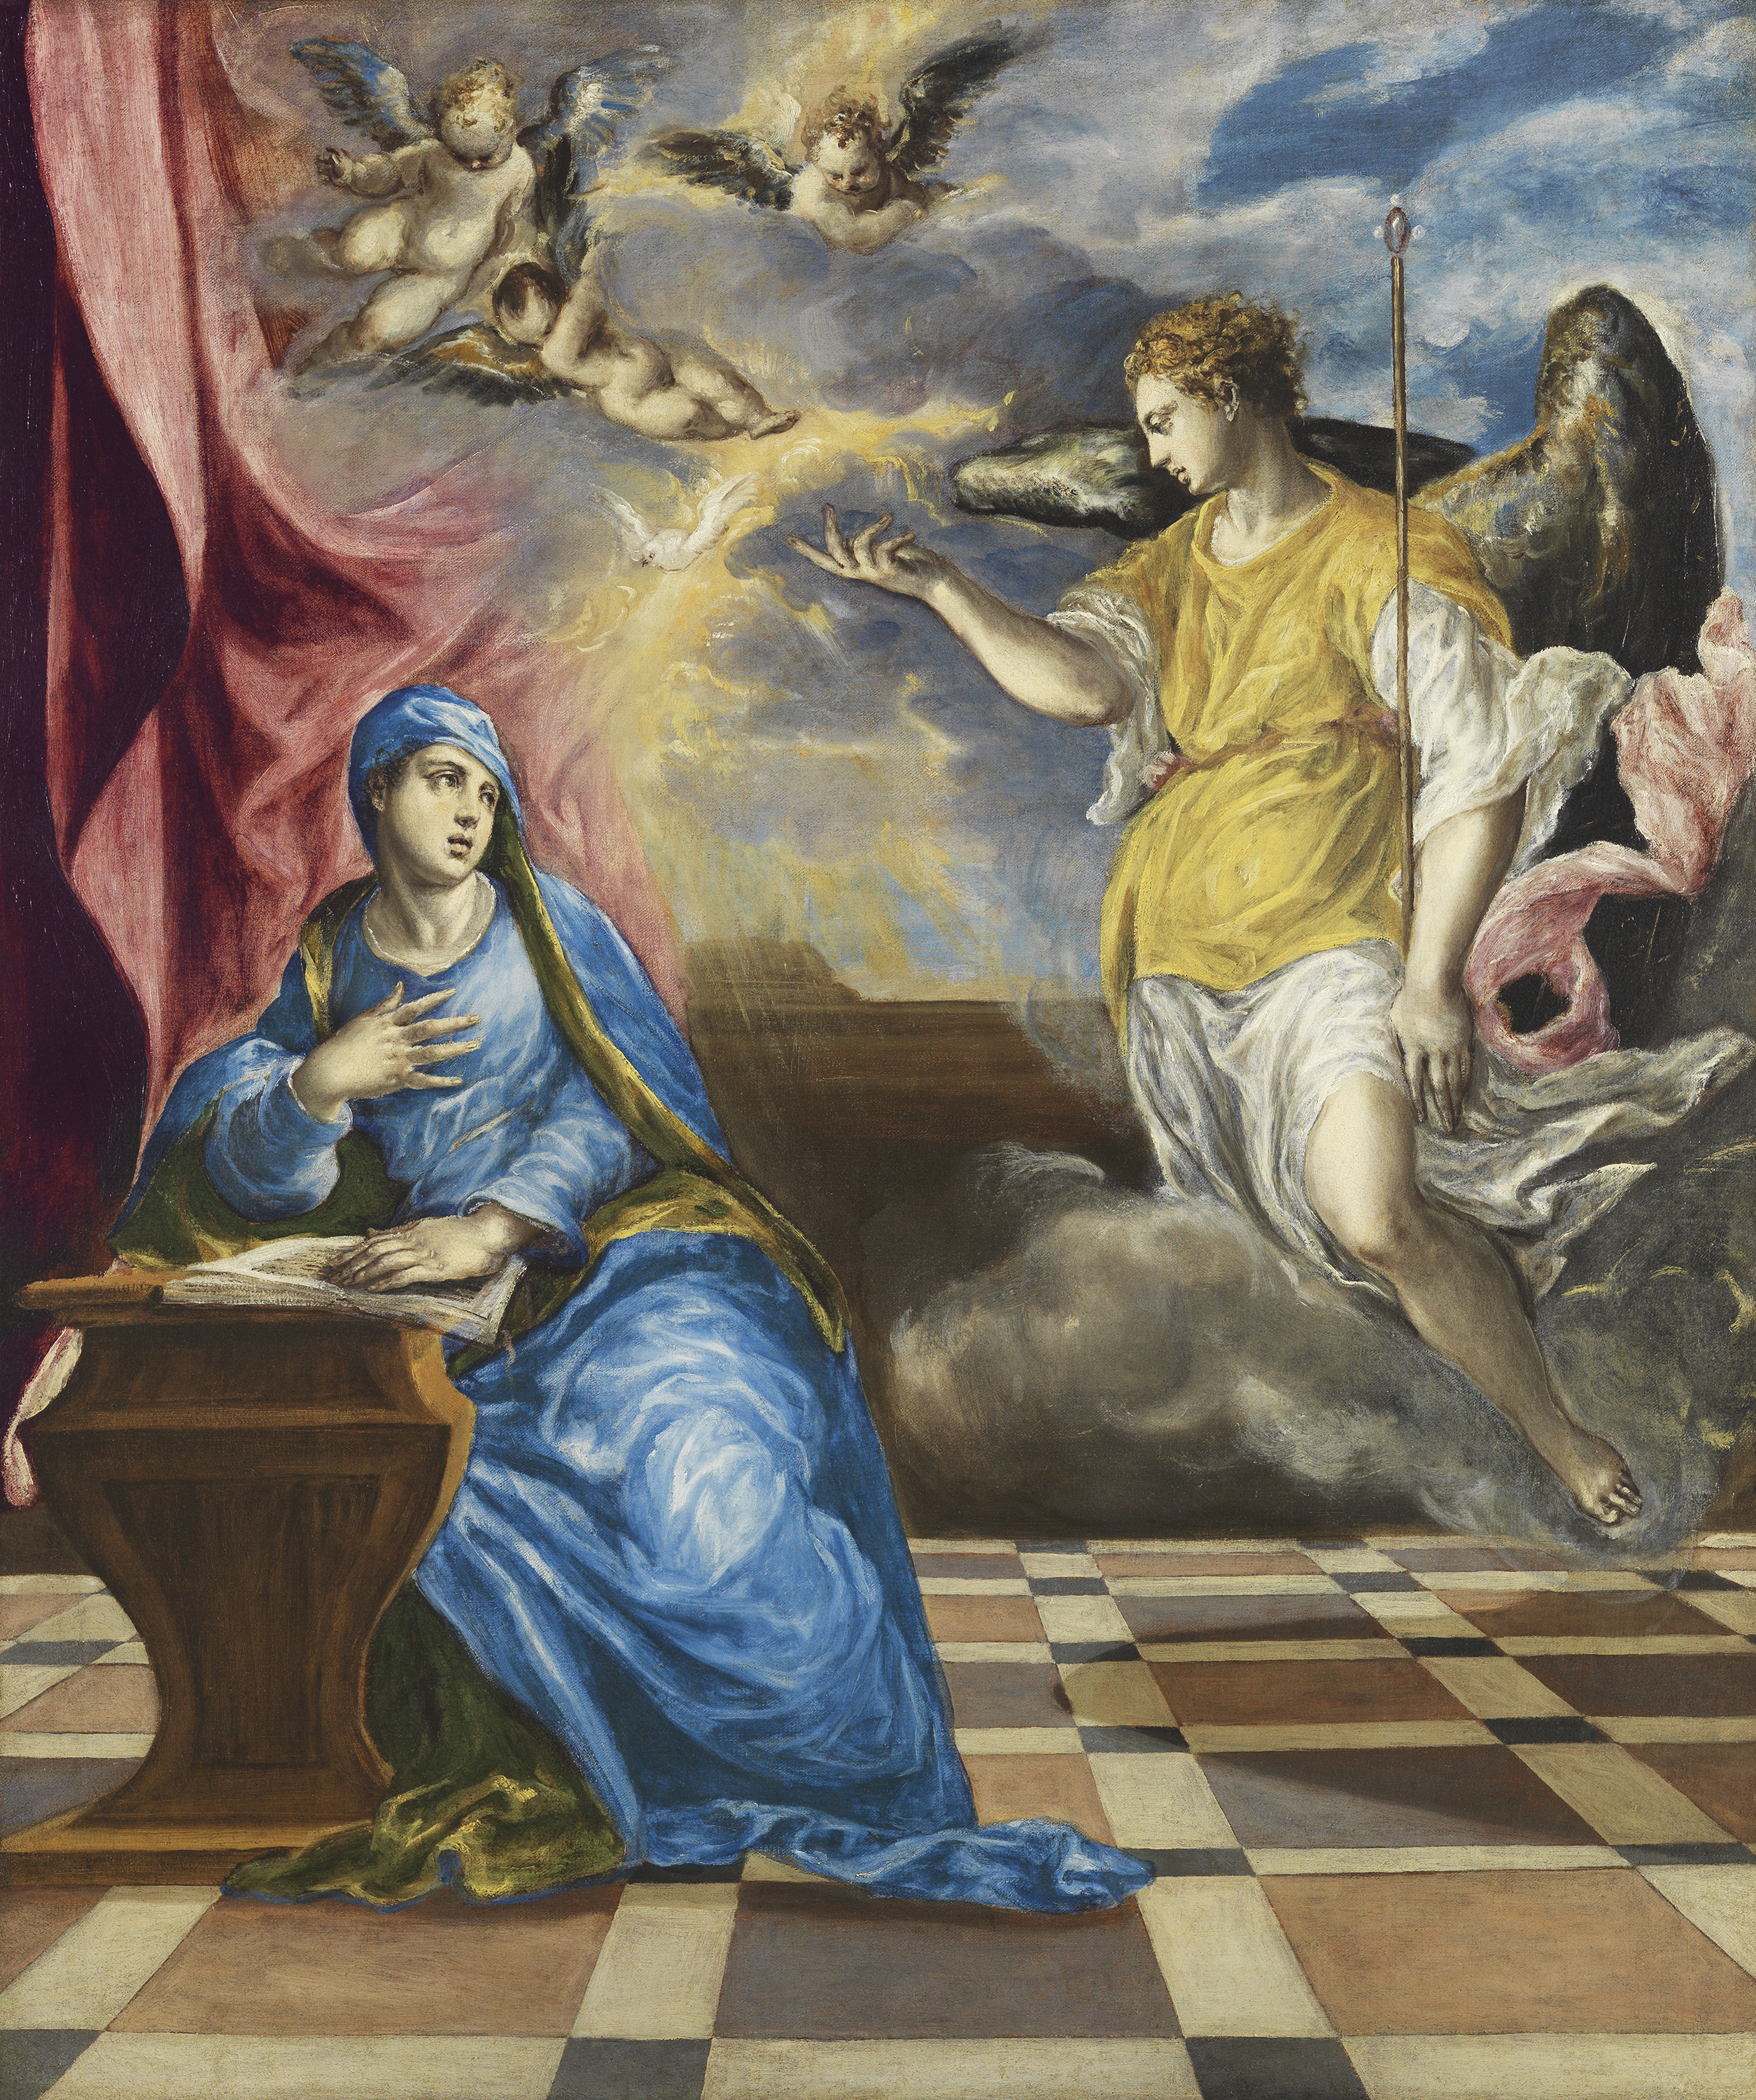
The Annunciation, ca. 1576,
Oil on canvas, 117 x 98 cm,
Museo Nacional Thyssen-Bornemisza, Madrid

Slide 6
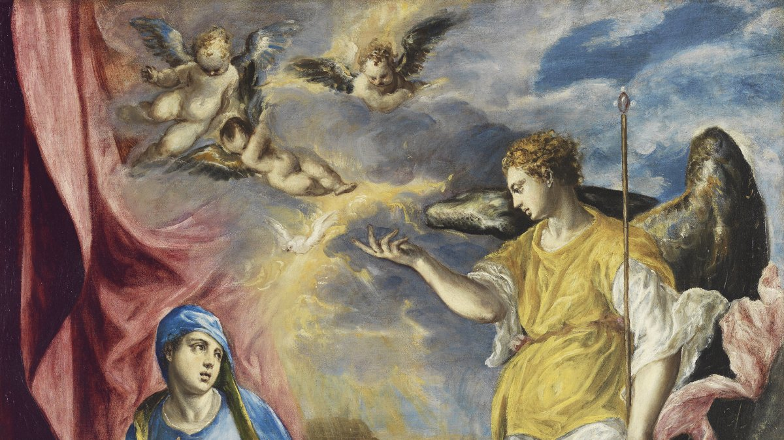

Slide 7
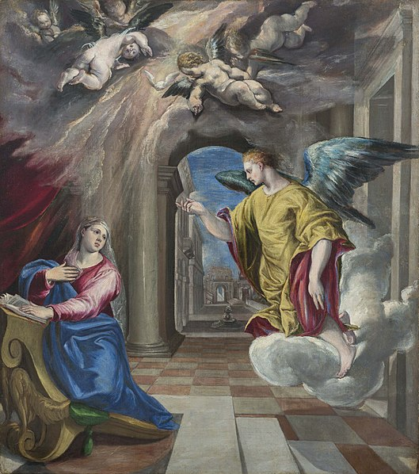
The Annunciation, 1577-1580, Oil on Canvas, 107 x 94 cm, Museu Nacional d'Art de Catalunya

Slide 8
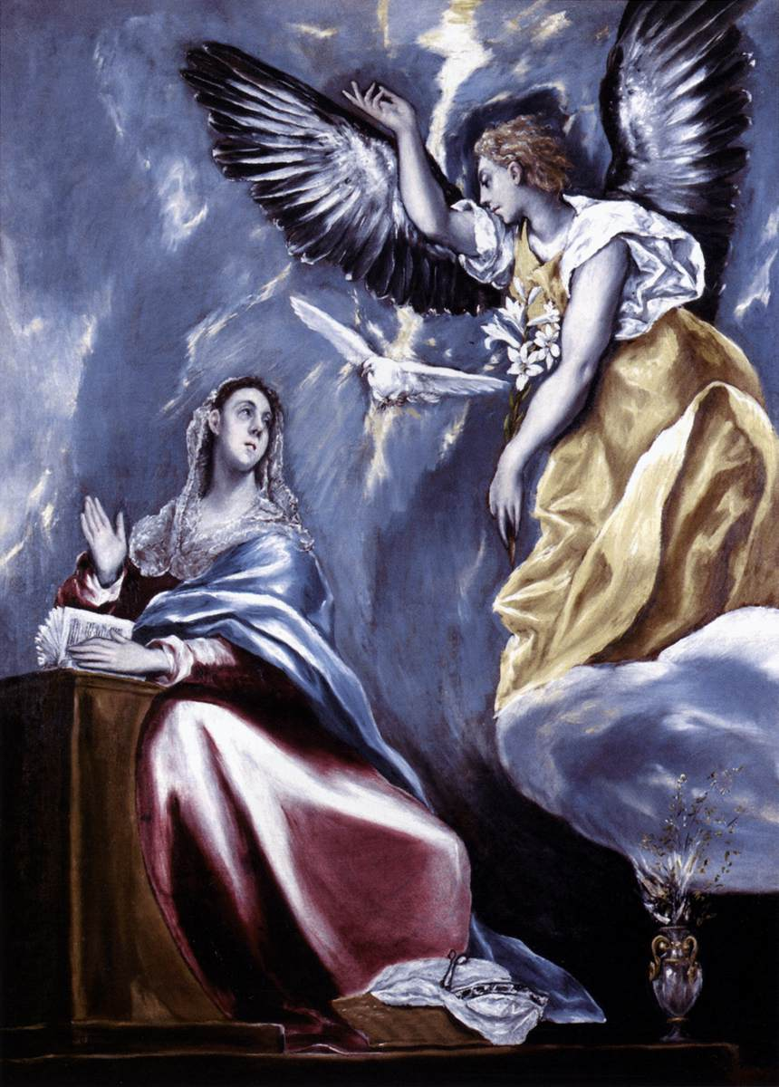
The Annunciation, 1595-1600,
Oil on Canvas, 91 x 66,5 cm,
Szépmûvészeti Múzeum, Budapest

Slide 9
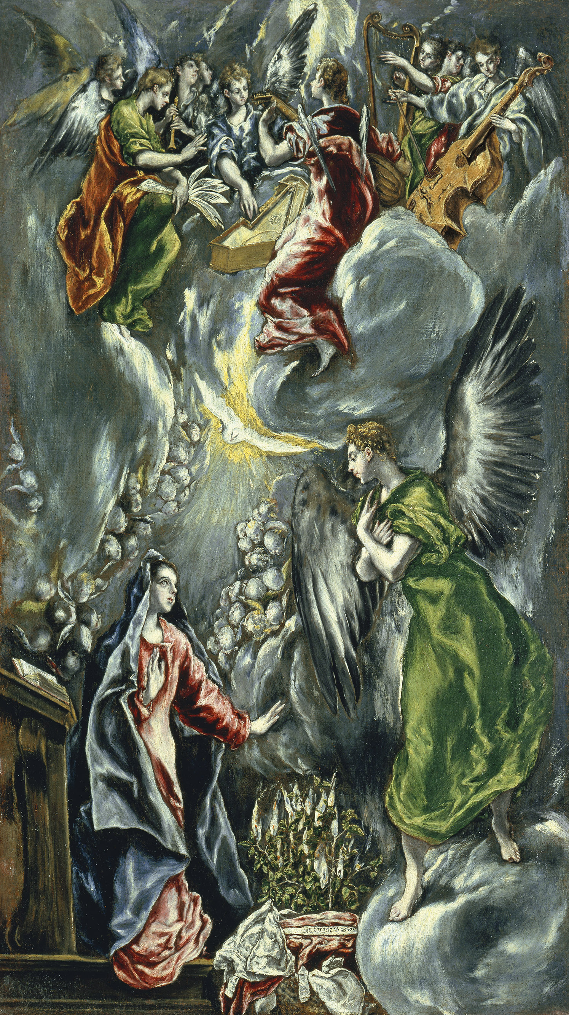
The Annunciation, ca. 1596 – 1600, Oil on canvas,
114 x 67 cm,
Museo Nacional
Thyssen-Bornemisza, Madrid

Slide 10
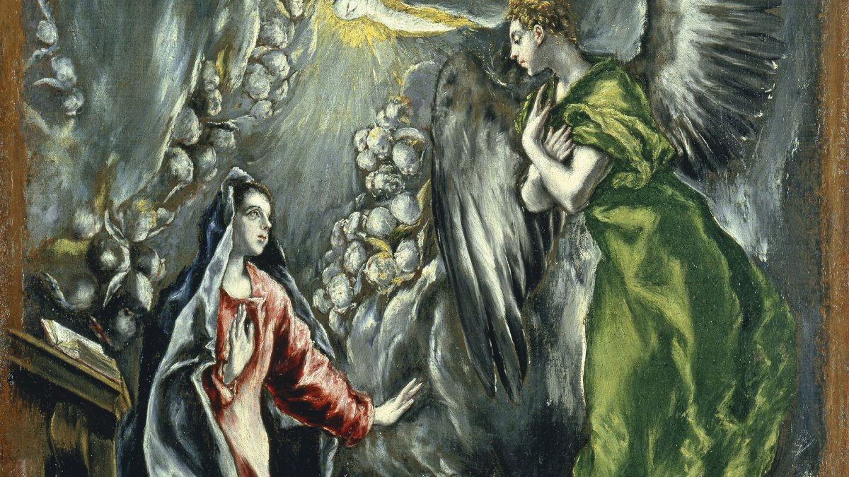

Slide 11
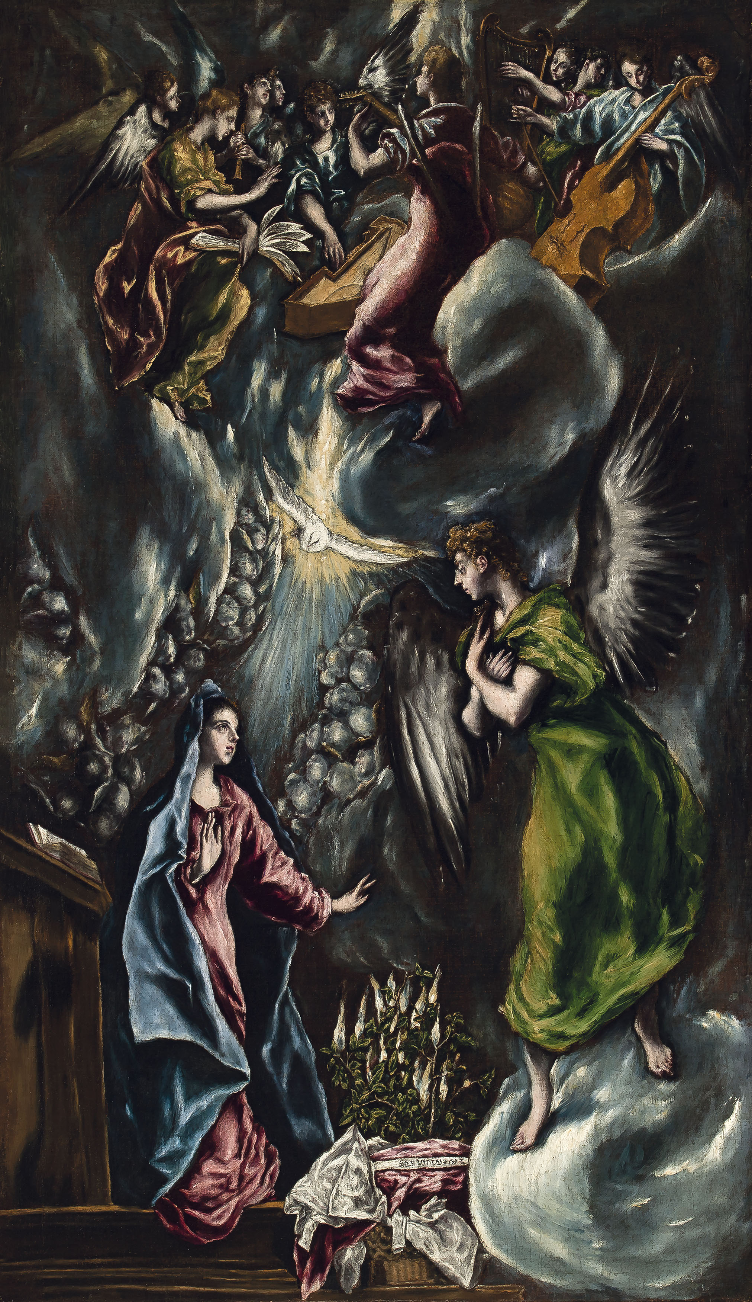
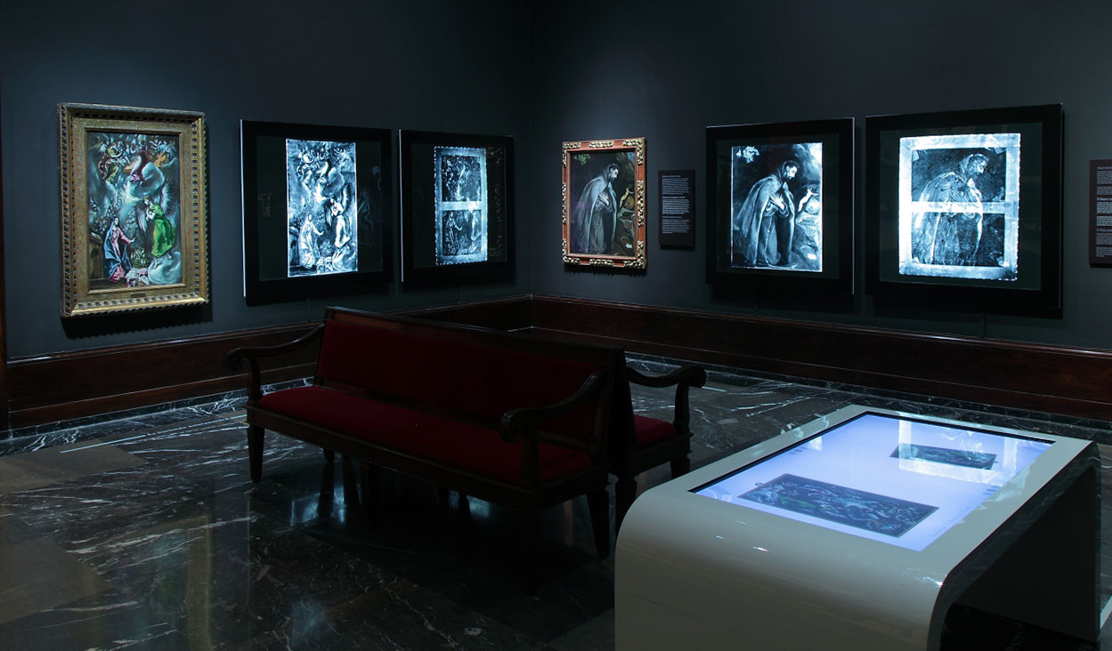
The Annunciation, ca. 1596-1600, Oil on Canvas, 113x65 cm, Bilbao Fine Arts Museum, Spain
The Grecos at the Bilbao Fine Arts Museum (30 April–25 August) is the Museum’s contribution to the events commemorating the fourth centenary of the death of
El Greco

Slide 12
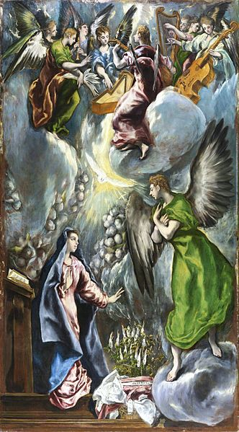
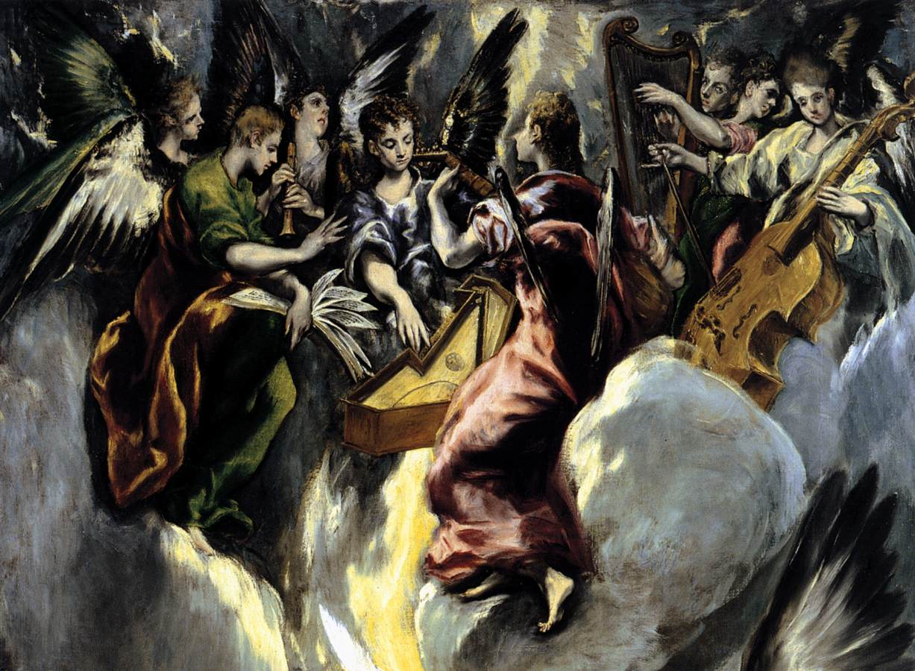
The Annunciation, ca. 1596-1600, Oil on Canvas, 315x174 cm, Museo del Prado, Spain

Slide 13
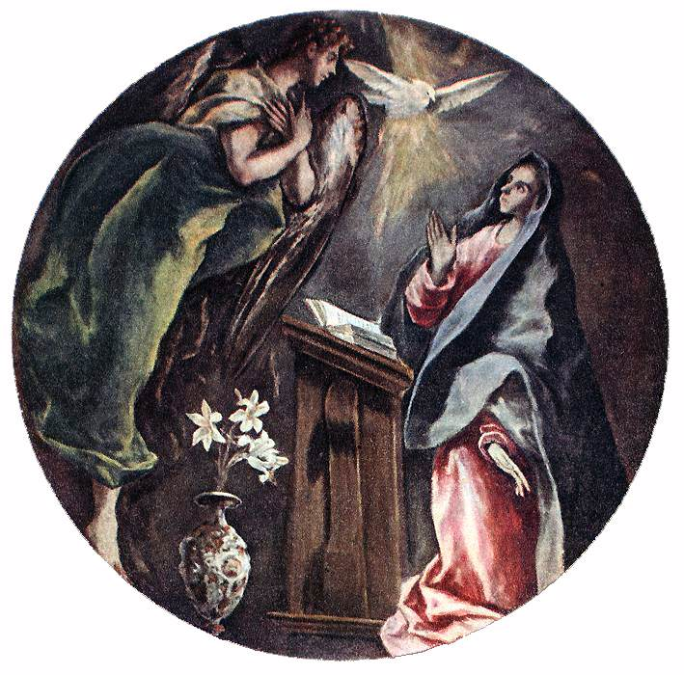
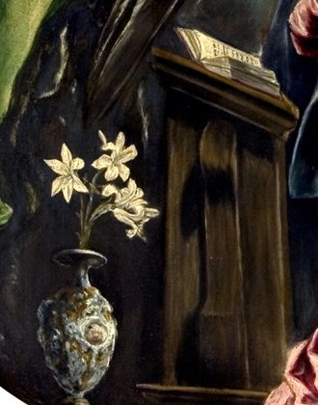
The Annunciation (and detail), 1603-05, Oil on canvas, Diameter: 128 cm, Hospital de la Caridad, Illescas

Slide 14
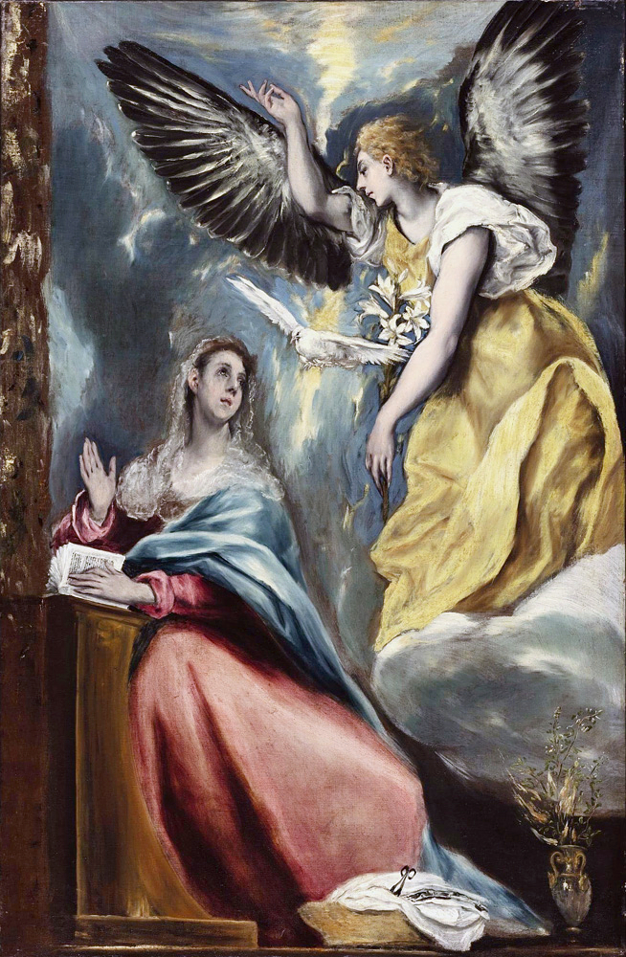
The Annunciation, 1600s, Oil on canvas, 128 x 83 cm, Toledo Museum of Art, Toledo, Ohio

Slide 15
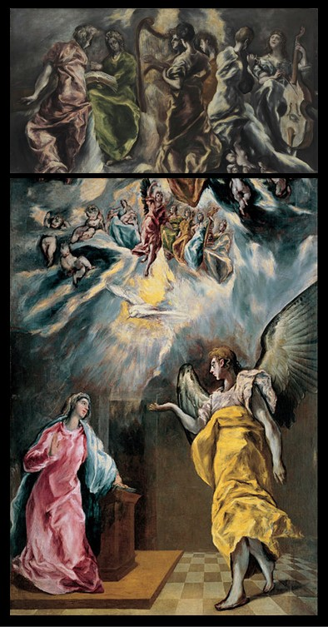
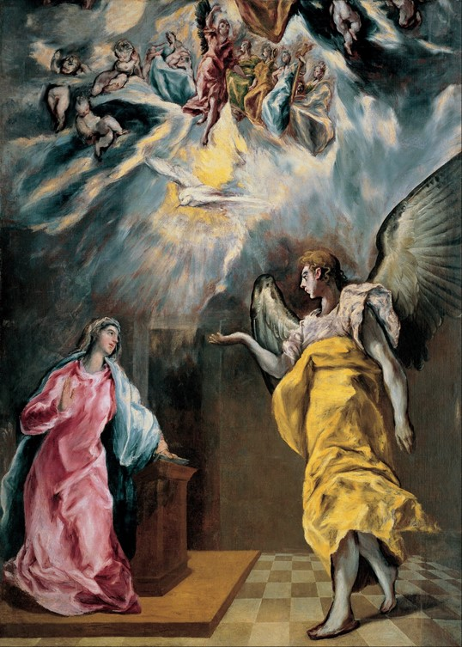
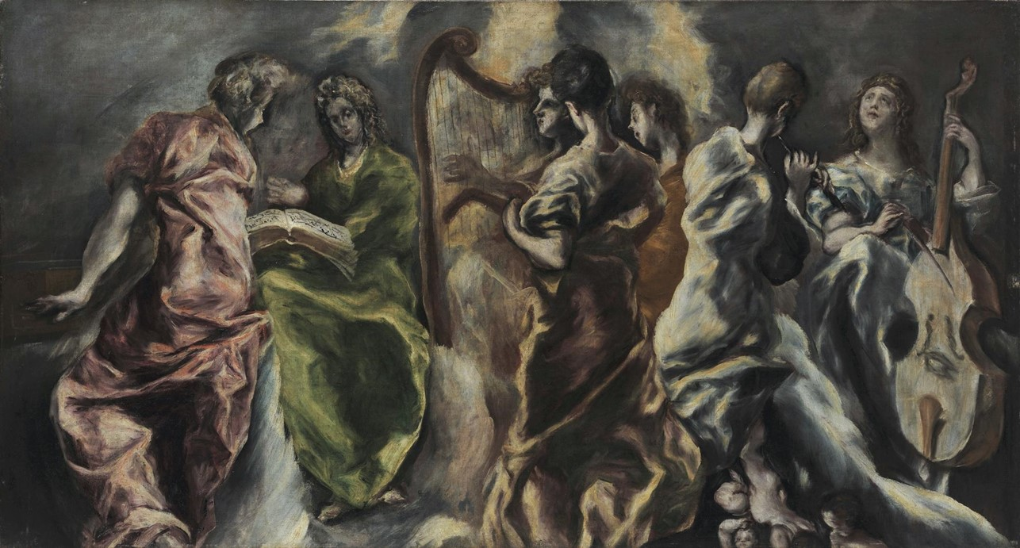
The Concert of the Angels, c. 1608-1614, Oil on Canvas,
115-217 cm, National Gallery - Alexandros Soutsos Museum - Evripidis Koutlidis Foundation, Athens
The Annunciation, 1614, Oil on
Canvas, 2.940,00x2.090,00 mm,
Banco Santander, Spain

Slide 16
Domenicos Theotokopoulos - Paintings of the Annunciation – Photo Credits
Slide 2
The Modena Triptych (front panels), 1568, Tempera on Panel, 37 x 23,8 cm (central panel), 24 x 18 cm (side panels), Galleria Estense, Modena https://www.wga.hu/frames-e.html?/html/g/greco_el/19/1901grec.html
Slide 3
The Annunciation, 1568-70, Oil on Panel, 63 x 76 cm, Private collection https://www.wga.hu/frames-e.html?/html/g/greco_el/19/1901grec.html
Slide 4
The Annunciation, from 1570 until 1572, Oil on Canvas mounted on panel, 26x20 cm, Museo del Prado, Madrid https://commons.wikimedia.org/wiki/File:Annunciation_by_El_Greco_(1570-1575,_Prado).jpg https://www.museodelprado.es/en/the-collection/art-work/the-annunciation/0e31a4de-bf19-4e4d-8977-f61ca8211dea
Slide 5
The Annunciation, ca. 1576, Oil on Canvas, 117 x 98 cm, Museo Nacional Thyssen-Bornemisza, Madrid https://www.museothyssen.org/en/collection/artists/greco-domenikos-theotokopoulos/annunciation-0
Slide 6
The Annunciation (detail), ca. 1576, Oil on Canvas, 117 x 98 cm, Museo Nacional Thyssen-Bornemisza, Madrid https://www.museothyssen.org/en/collection/artists/greco-domenikos-theotokopoulos/annunciation-0
Slide 7
The Annunciation, 1577-1580, Oil on Canvas, 107 x 94 cm, Museu Nacional d'Art de Catalunya https://commons.wikimedia.org/wiki/File:L%27Anunciaci%C3%B3,_Dom%C3%A9nikos_Theotok%C3%B3poulos_(El_Greco),_segle_XVI.jpg
Slide 8
The Annunciation, 1595-1600, Oil on Canvas, 91 x 66,5 cm, Szépmûvészeti Múzeum, Budapest https://www.wga.hu/frames-e.html?/html/g/greco_el/19/1901grec.html
Slide 9
The Annunciation, ca. 1596 – 1600, Oil on Canvas. 114 x 67 cm, Museo Nacional Thyssen-Bornemisza, Madrid https://upload.wikimedia.org/wikipedia/commons/3/3f/El_Greco_-_The_Annunciation_-_WGA10522.jpg
Slide 10
The Annunciation (detail), ca. 1596 – 1600, Oil on Canvas. 114 x 67 cm, Museo Nacional Thyssen-Bornemisza, Madrid https://www.museothyssen.org/en/collection/artists/greco-domenikos-theotokopoulos/annunciation

Slide 17
Domenicos Theotokopoulos - Paintings of the Annunciation – Photo Credits
Slide 11
The Annunciation, ca. 1596-1600, Oil on Canvas, 113.8 x 65.4 cm, Bilbao Fine Arts Museum, Spain https://www.museobilbao.com/in/obras-maestras/el-greco-domenikos-theotokopoulos https://www.museobilbao.com/in/exposiciones/the-grecos-at-the-bilbao-fine-arts-museum-223
Slide 12
The Annunciation, ca. 1596-1600, Oil on Canvas, 315x174 cm, Museo del Prado, Spain https://commons.wikimedia.org/wiki/File:Anunciacion_Prado(2).jpg https://www.wga.hu/frames-e.html?/html/g/greco_el/19/1901grec.html
Slide 13
The Annunciation, 1603-05, Oil on Canvas, 128 cm, Hospital de la Caridad, Illescas https://www.wga.hu/frames-e.html?/html/g/greco_el/19/1901grec.html https://commons.wikimedia.org/wiki/File:La_Anunciaci%C3%B3n,_de_El_Greco_(detalle_2).jpg
The Annunciation (detail), 1603-05, Oil on canvas, Diameter: 128 cm, Hospital de la Caridad, Illescas https://commons.wikimedia.org/wiki/File:La_Anunciaci%C3%B3n,_de_El_Greco_(detalle_2).jpg
Slide 14
The Annunciation, 1600s, Oil on Canvas, 128 x 83 cm, Toledo Museum of Art, Toledo, Ohio https://el.m.wikipedia.org/wiki/%CE%91%CF%81%CF%87%CE%B5%CE%AF%CE%BF:Anunciaci%C3%B3n_(El_Greco).jpg
Slide 15
The Concert of the Angels, c. 1608-1614, Oil on Canvas, 115-217 cm, National Gallery - Alexandros Soutsos Museum - Evripidis Koutlidis Foundation, Athens https://www.nationalgallery.gr/en/painting-permanent-exhibition/painting/domenicos-theotokopoulos-el-greco/the-concert-of-the-angels.html
The Annunciation, 1614, Oil on Canvas, 2.940,00x2.090,00 mm, Banco Santander, Spain https://el.m.wikipedia.org/wiki/%CE%91%CF%81%CF%87%CE%B5%CE%AF%CE%BF:Domenikos_Theotokopoulos,_El_Greco_-_The_Annunciation_-_Google_Art_Project.jpg

Slide 18
The End

