Slide 1
Teaching with Andrea Mantegna
1431-1506

Slide 2
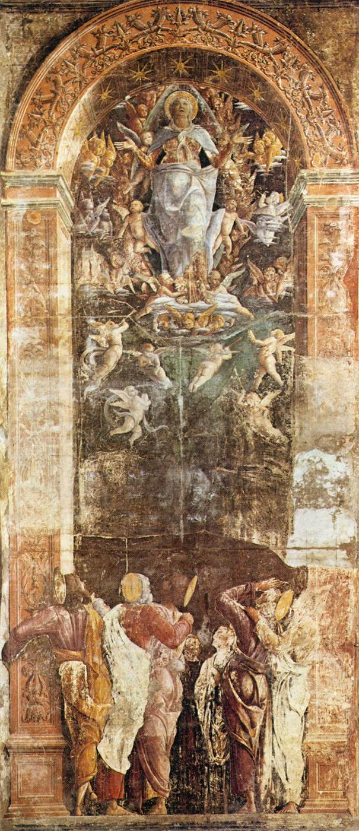
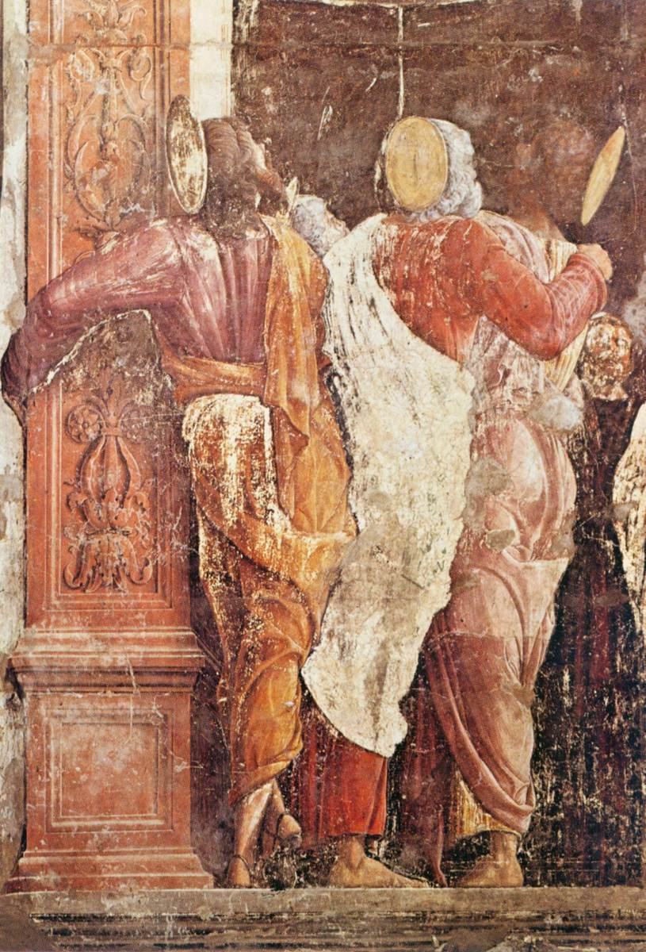
Assumption of the Virgin (and detail), (for the most part the work by Mantegna), 1454-57, Fresco, Cappella Ovetari, Chiesa degli Eremitani, Padua

Slide 3
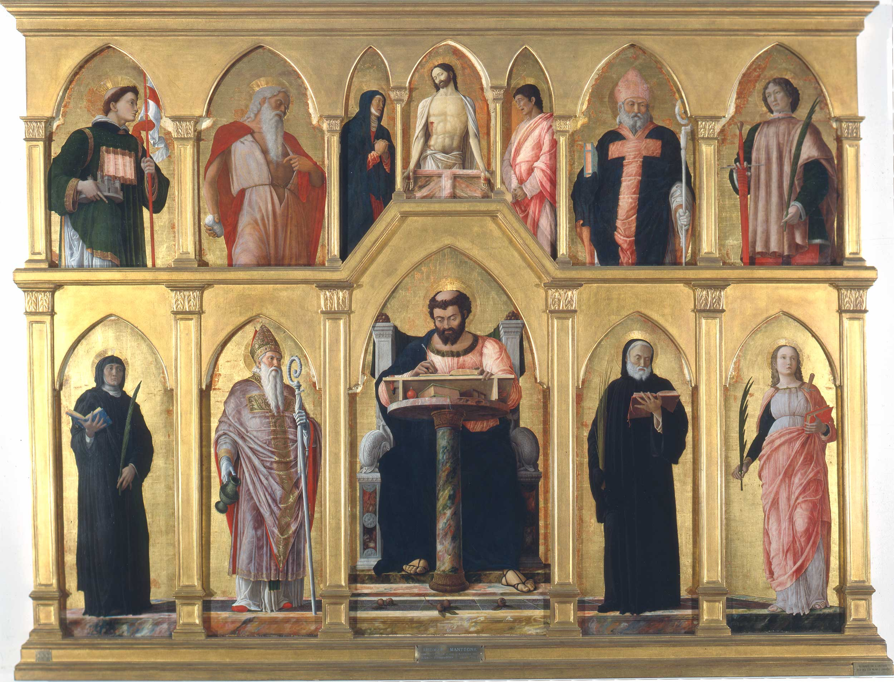
San Luca Polyptych, 1453, Tempera on panel, 177 x 230 cm, Pinacoteca di Brera, Milan

Slide 4
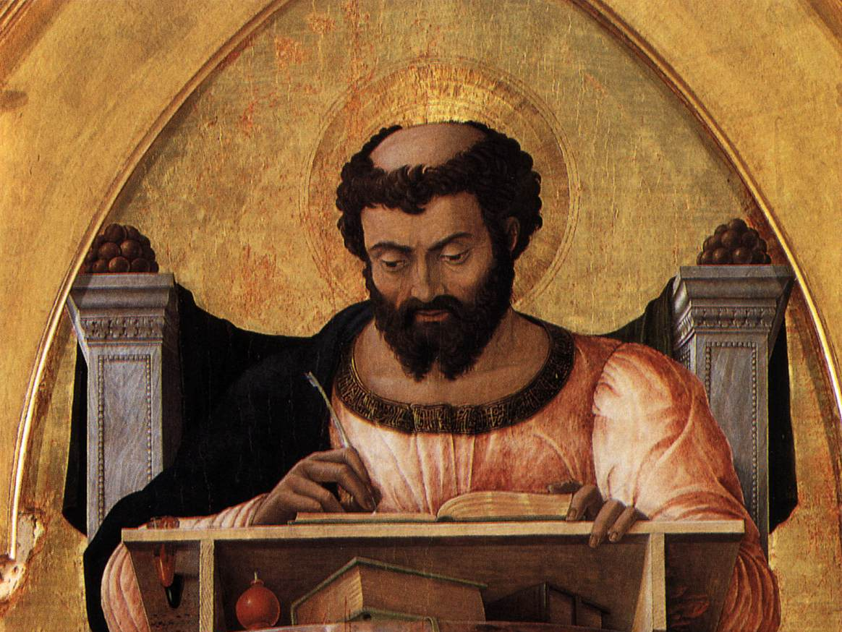

Slide 5
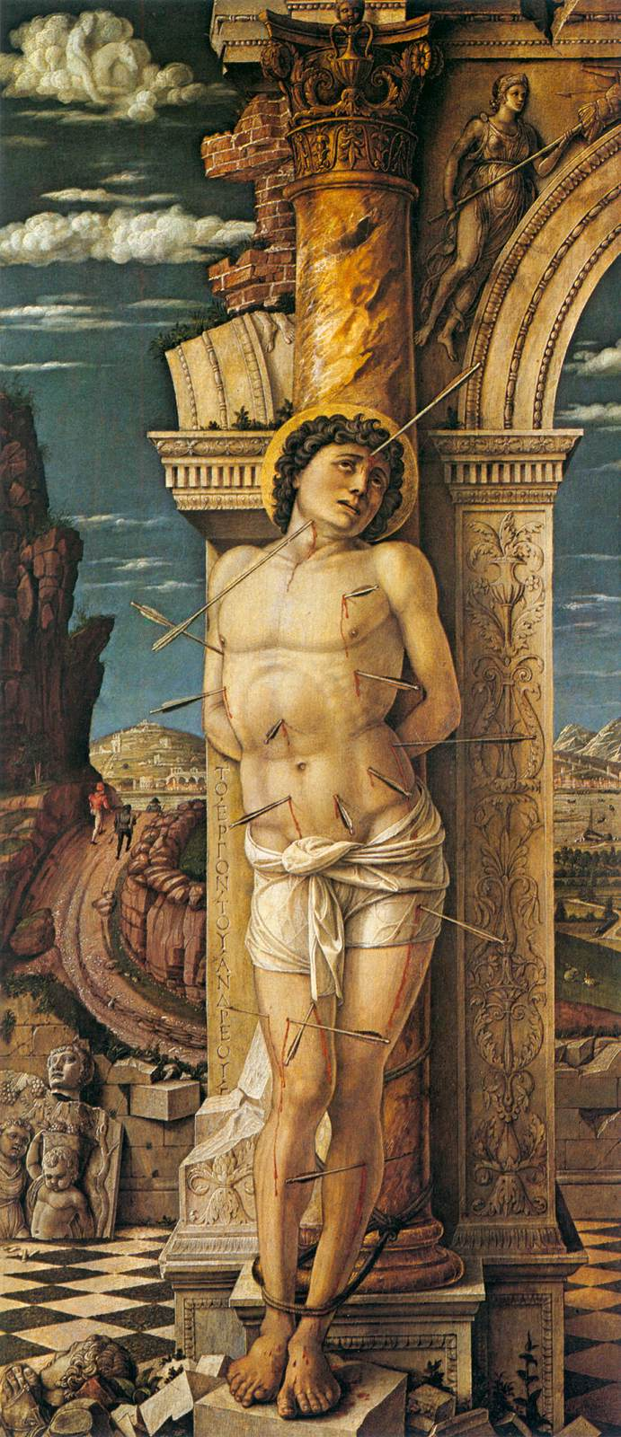
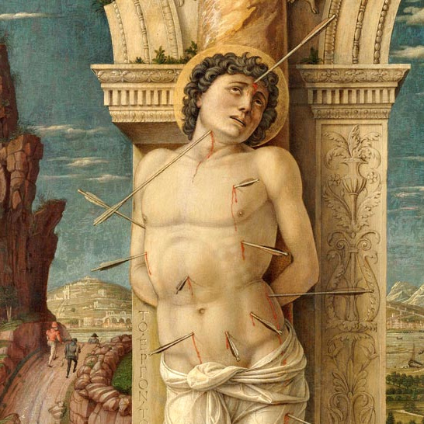
St Sebastian, (and detail) 1459, Tempera on wood, 68 x 30 cm, Kunsthistorisches Museum, Vienna

Slide 6
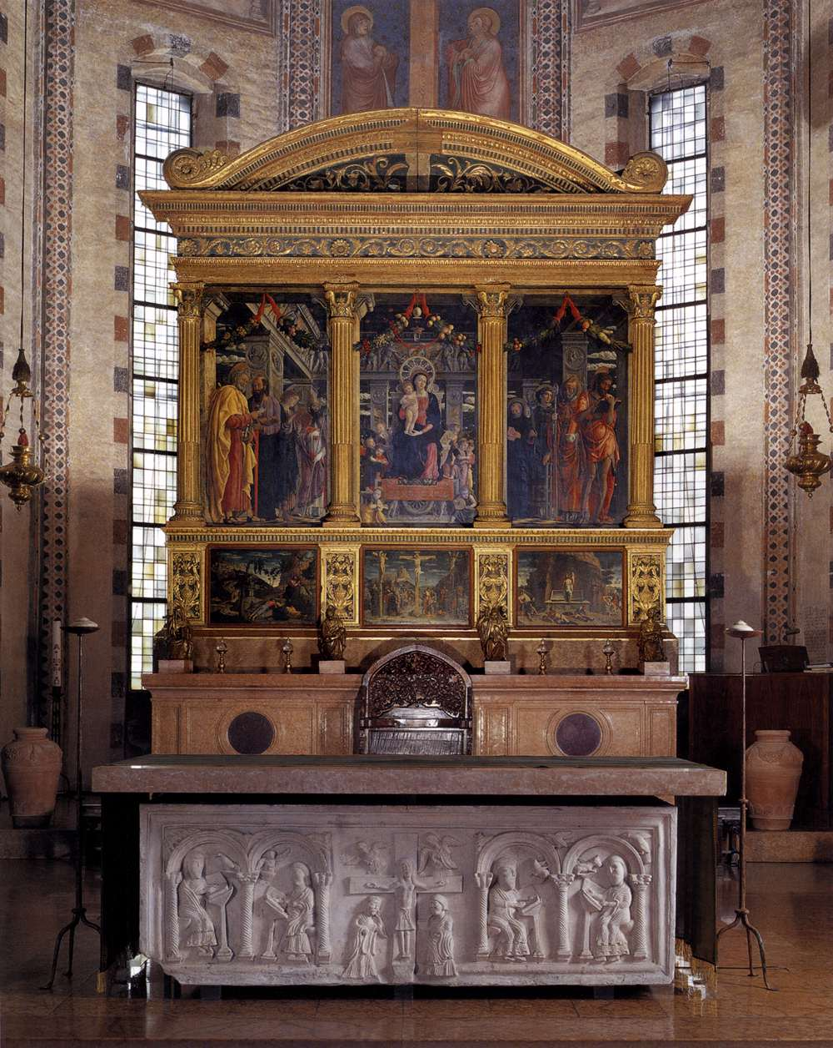
The San Zeno Polyptych
1457-60,
Tempera on panel,
480 x 450 cm,
San Zeno, Verona

Slide 7
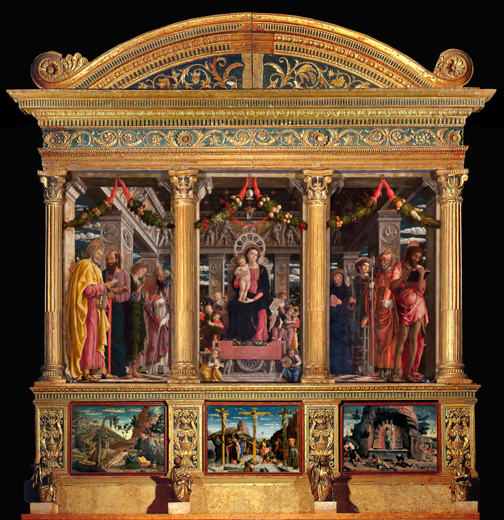

Slide 8
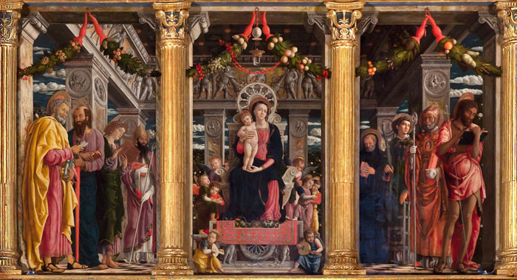
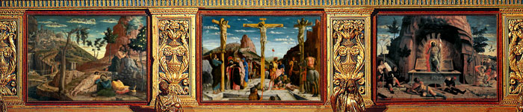

Slide 9
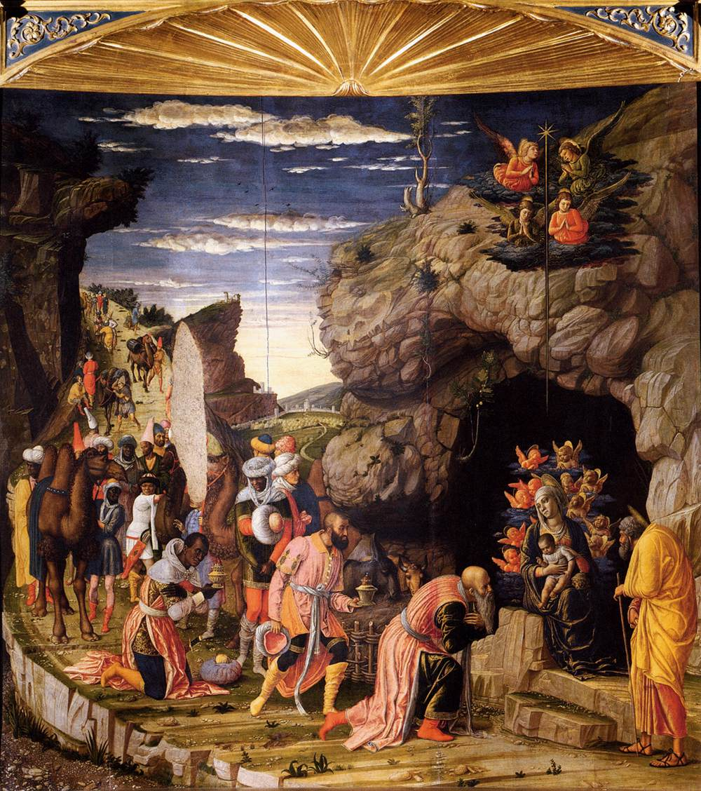
The Adoration of the Magi, 1460-64,
Tempera on wood,
76 x 77 cm,
Galleria degli Uffizi, Florence

Slide 10
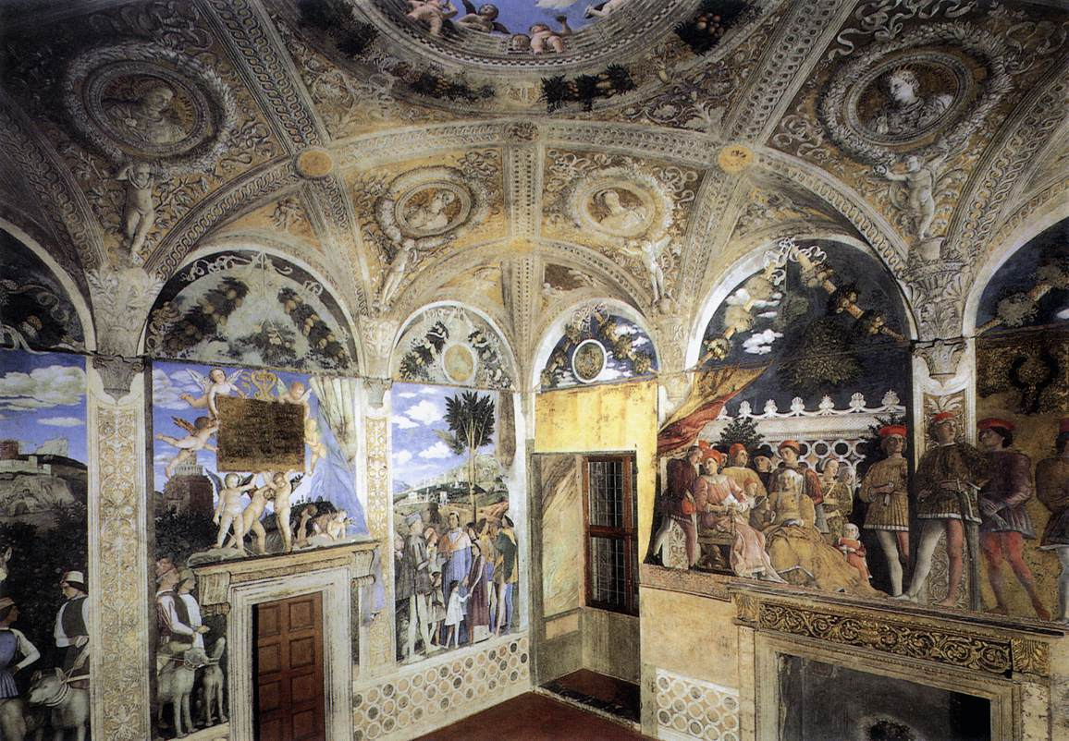
View of the west and north walls of the Camera degli Sposi,
1465-74, Walnut oil on plaster, Camera degli Sposi, Palazzo Ducale, Mantua

Slide 11
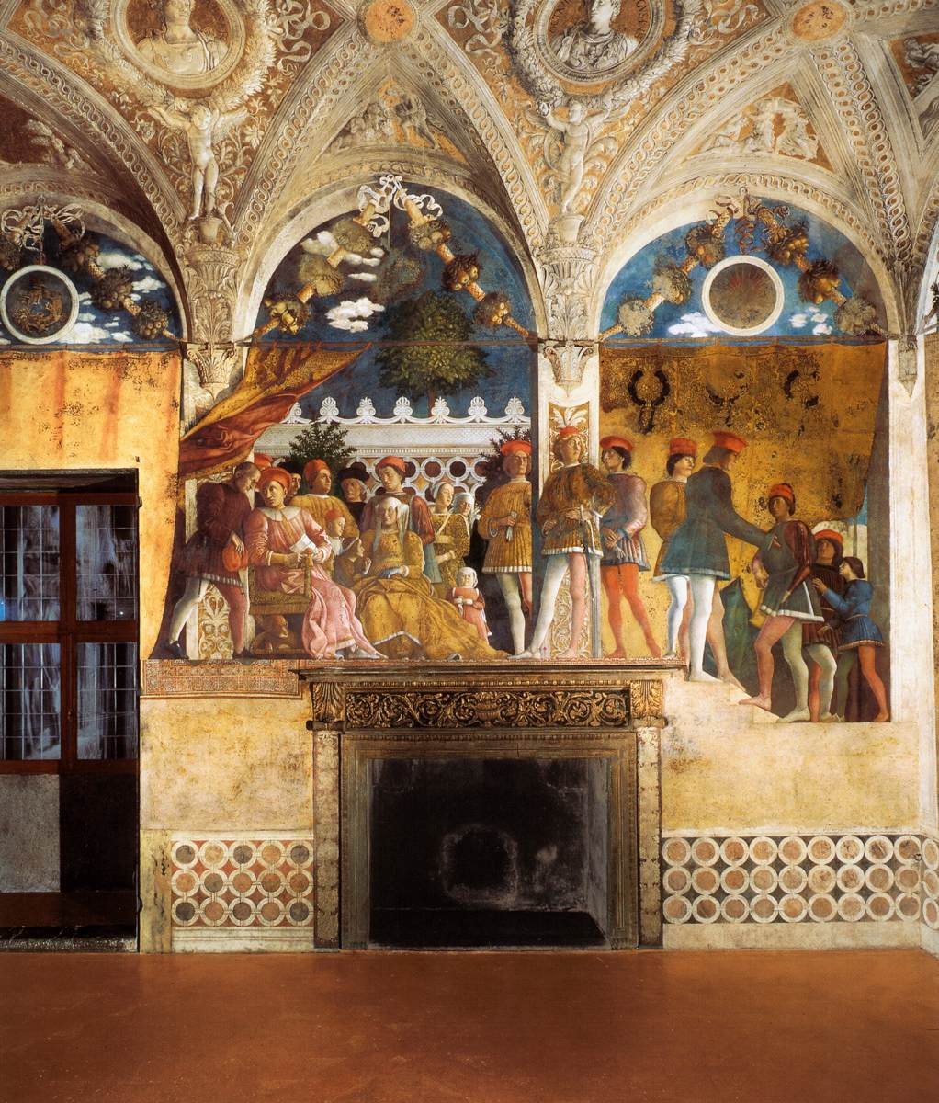
The north wall:
The Court of Gonzaga, 1465-74,
Walnut oil on plaster,
Camera degli Sposi, Palazzo Ducale, Mantua

Slide 12
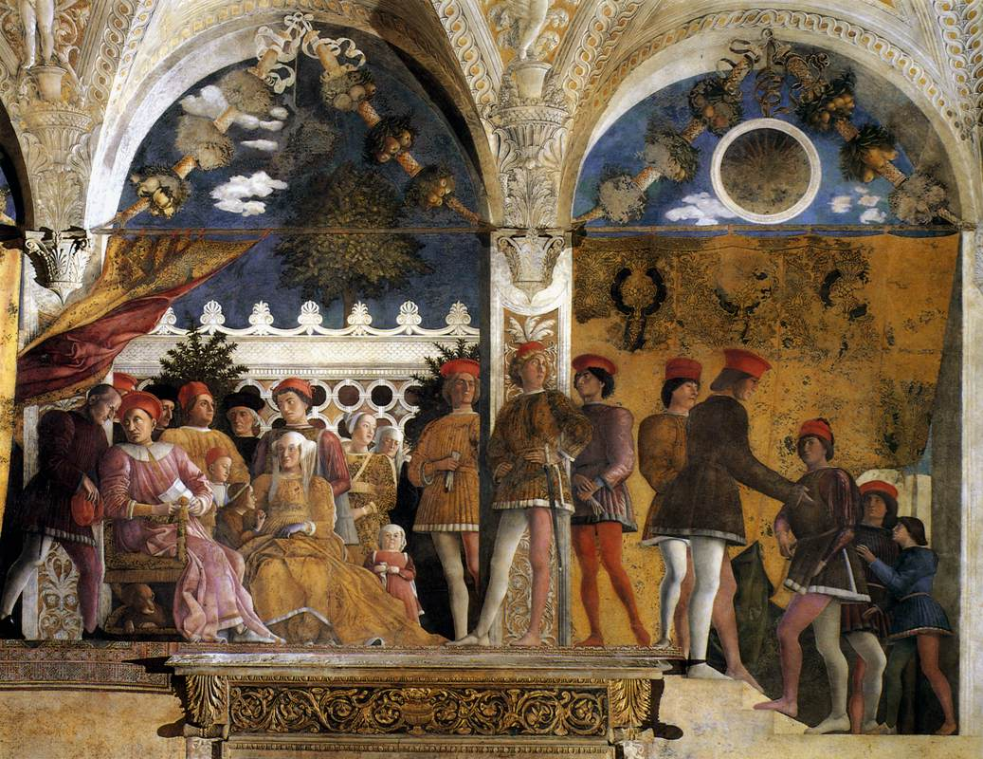

Slide 13
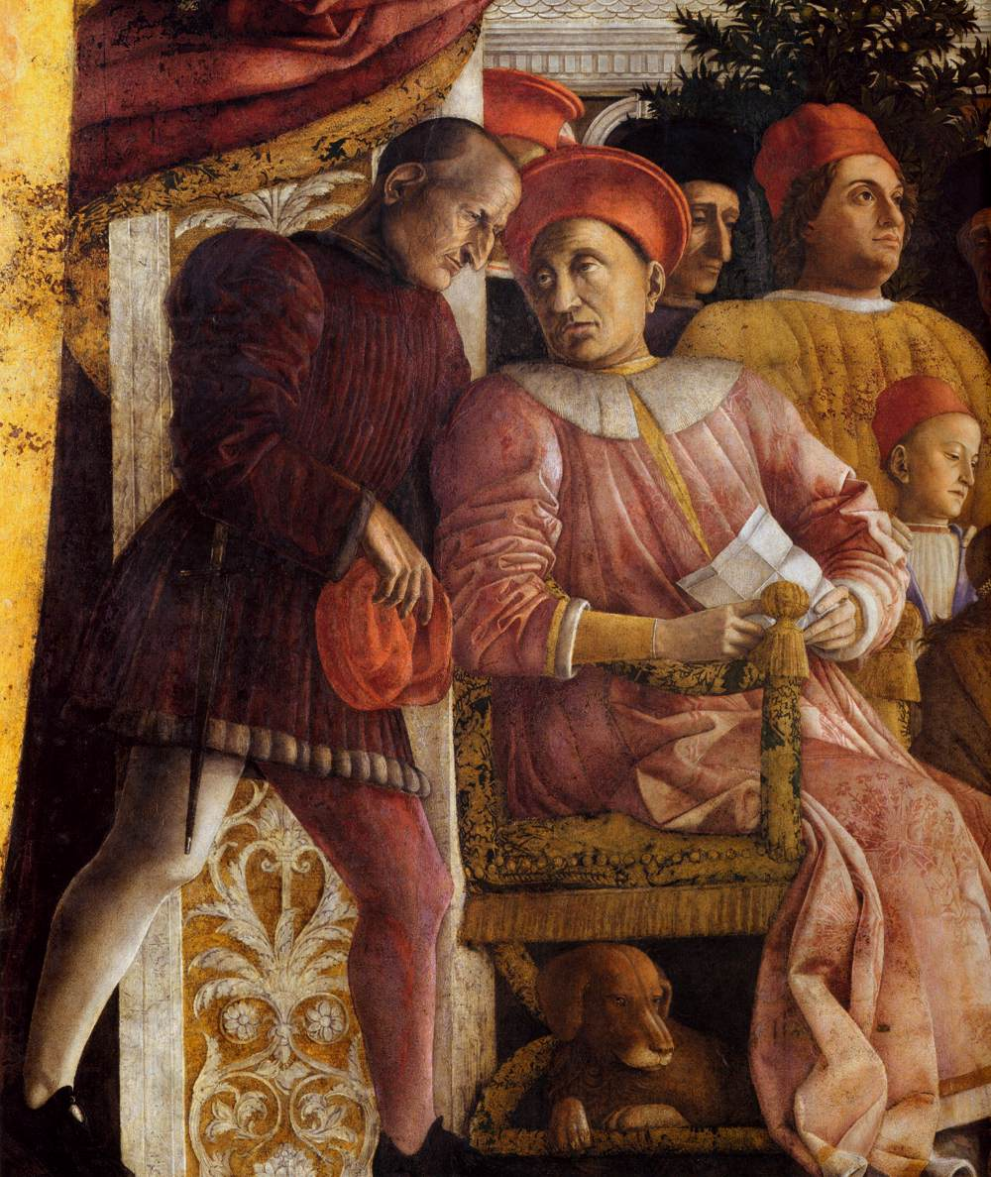
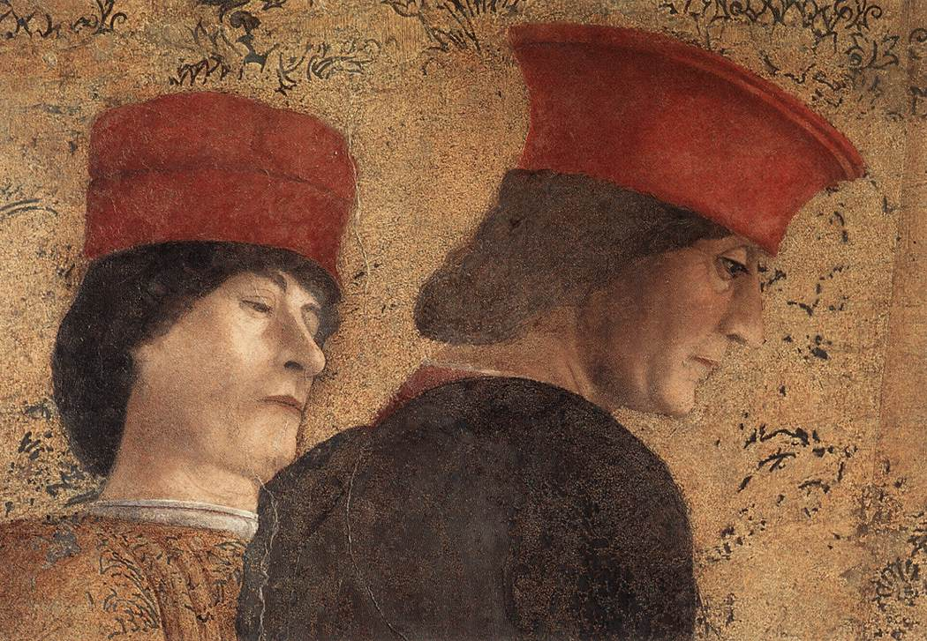
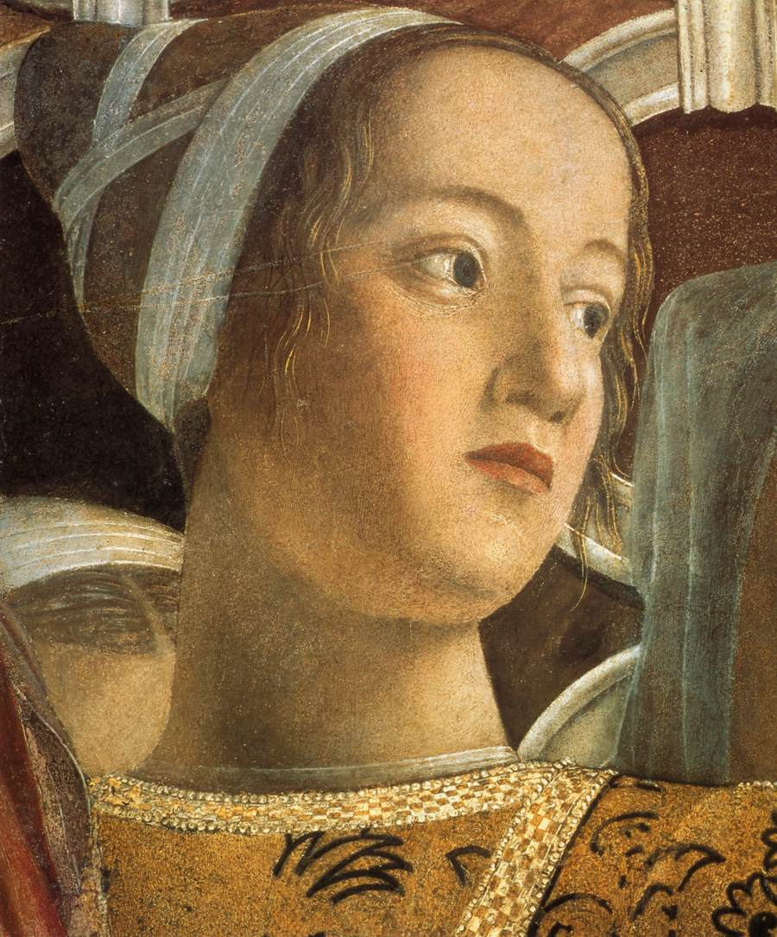

Slide 14
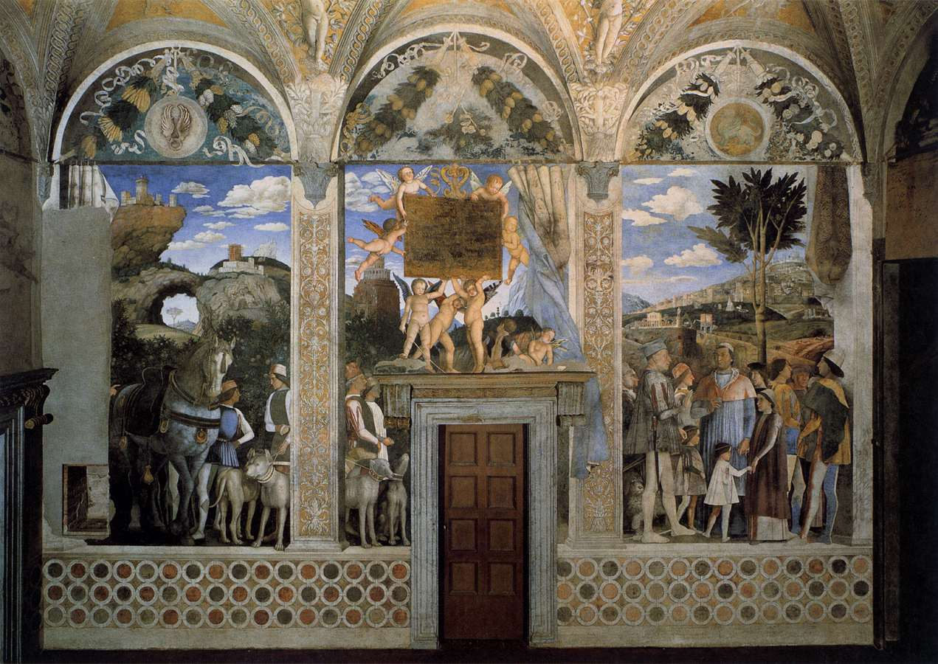
The west wall: The Meeting, 1465-74, Walnut oil on plaster
Camera degli Sposi, Palazzo Ducale, Mantua

Slide 15
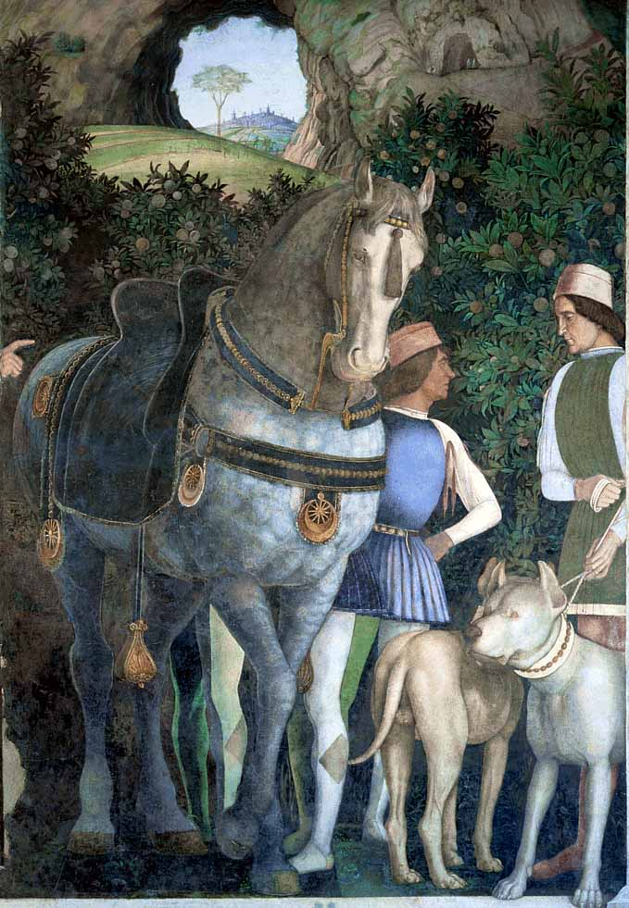
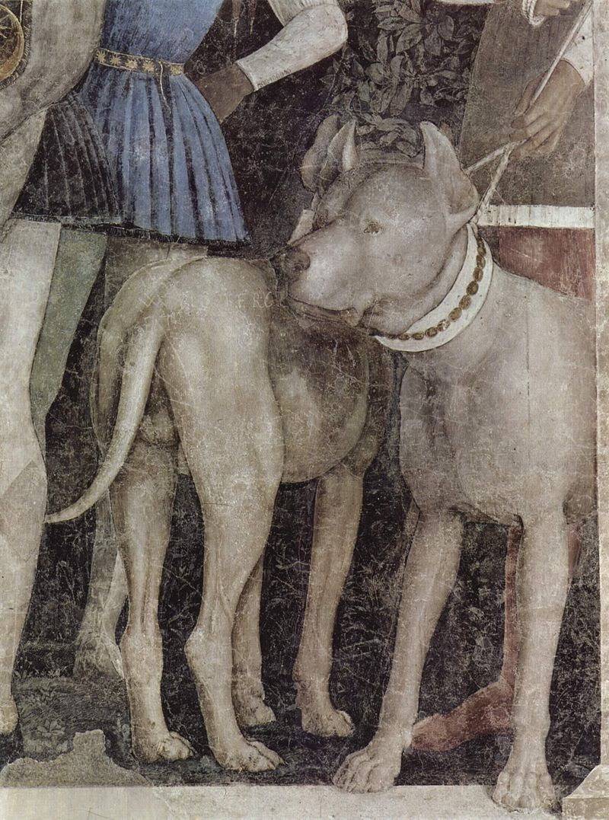

Slide 16
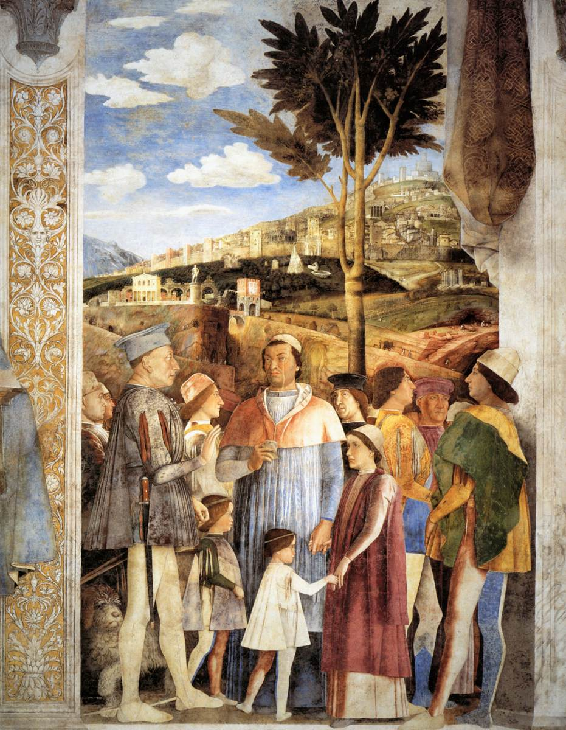
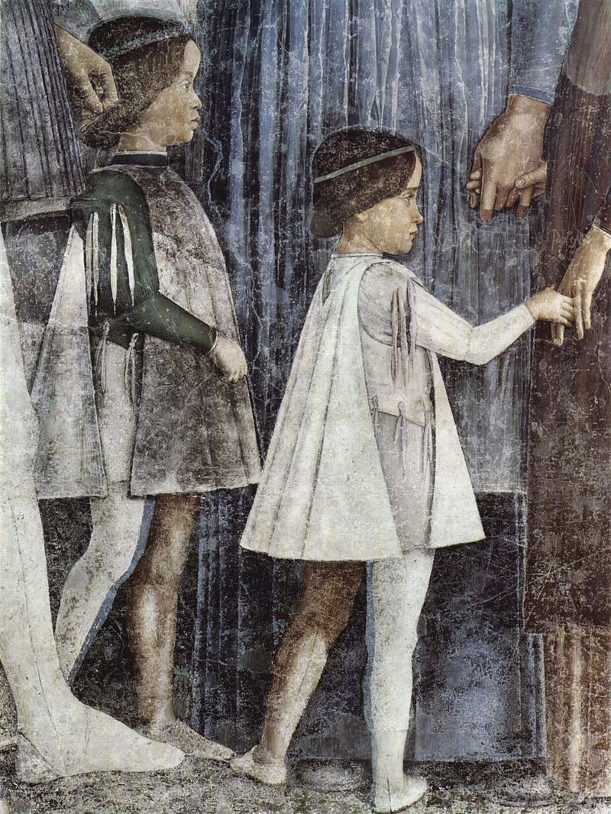

Slide 17
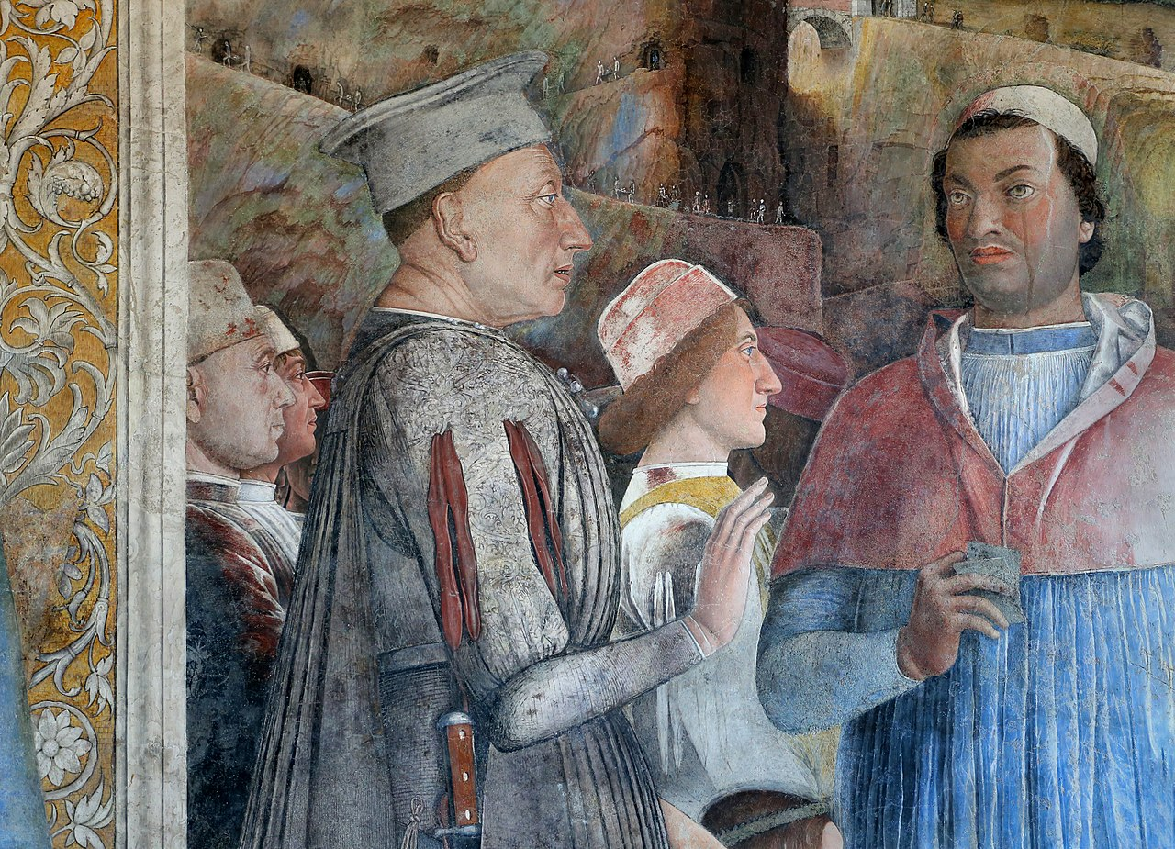

Slide 18
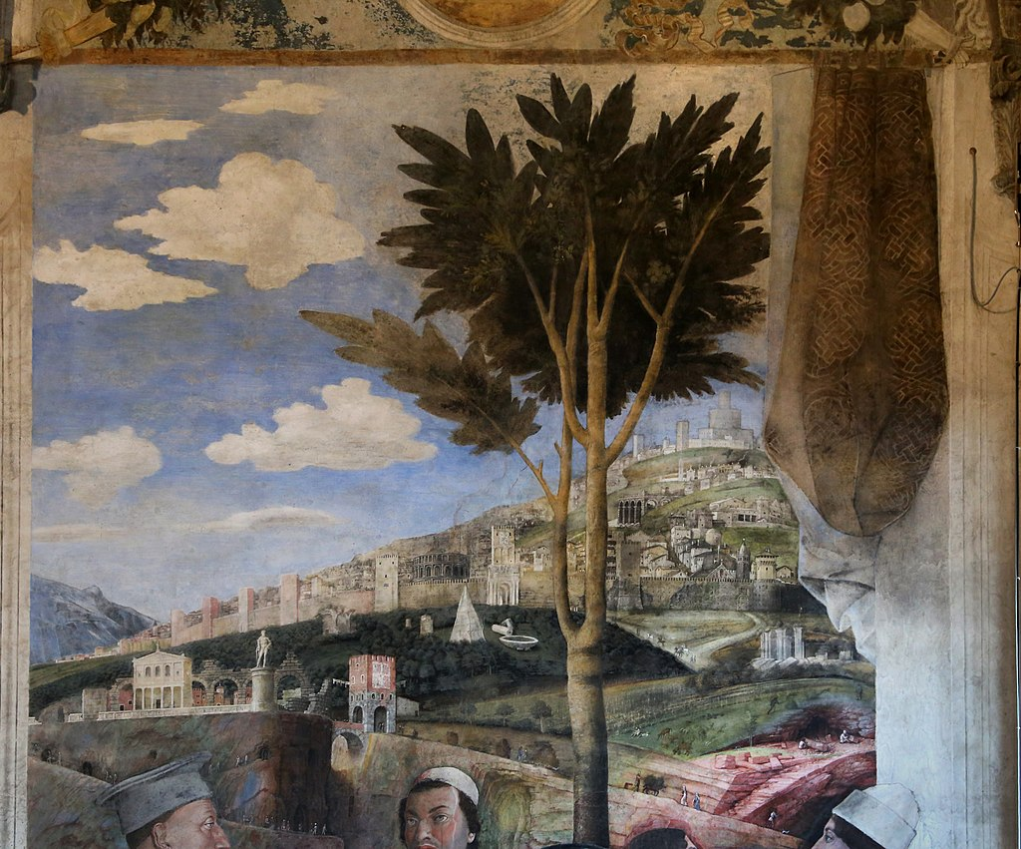

Slide 19
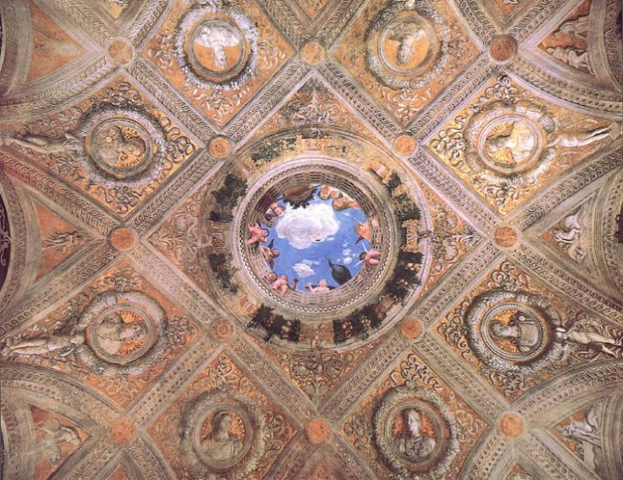
Ceiling decoration of the Camera degli Sposi, 1465-74, Walnut oil on plaster and fresco, Camera degli Sposi, Palazzo Ducale, Mantua

Slide 20
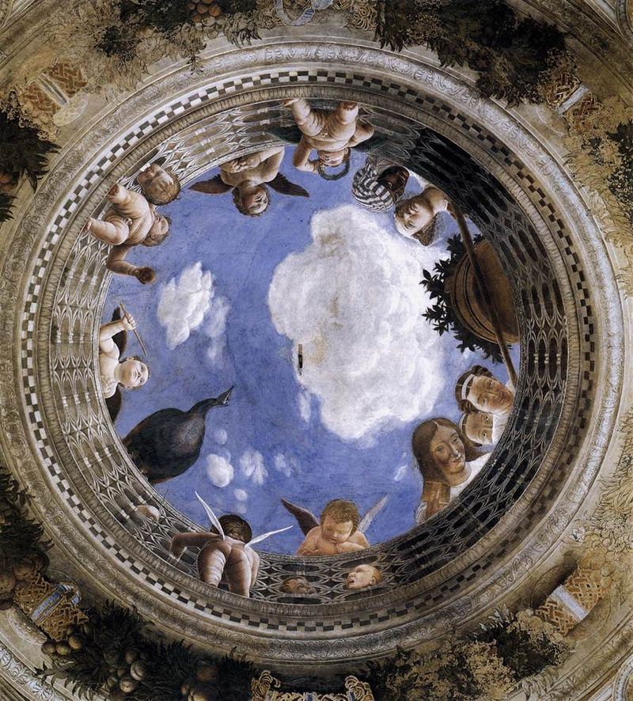

Slide 21
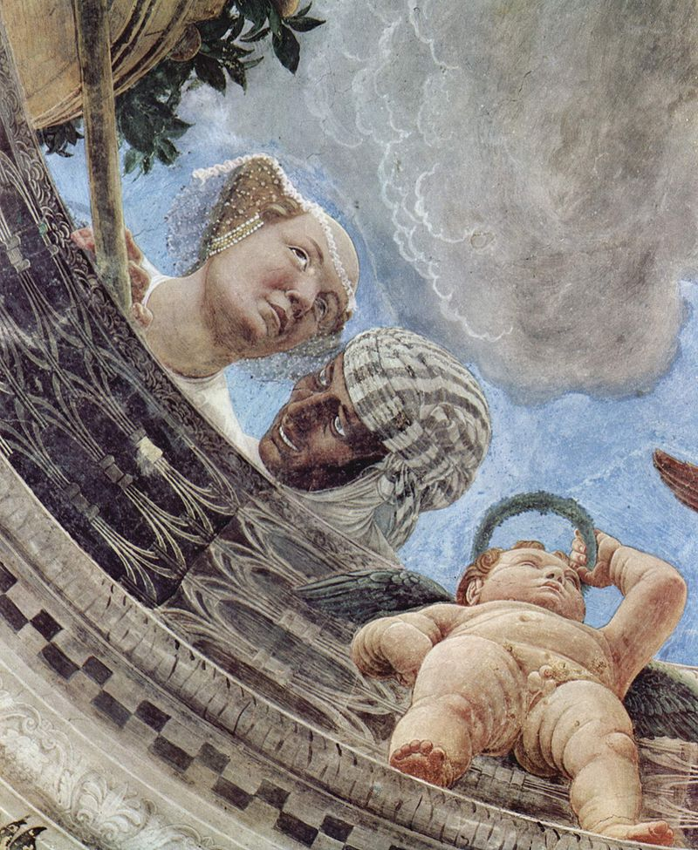
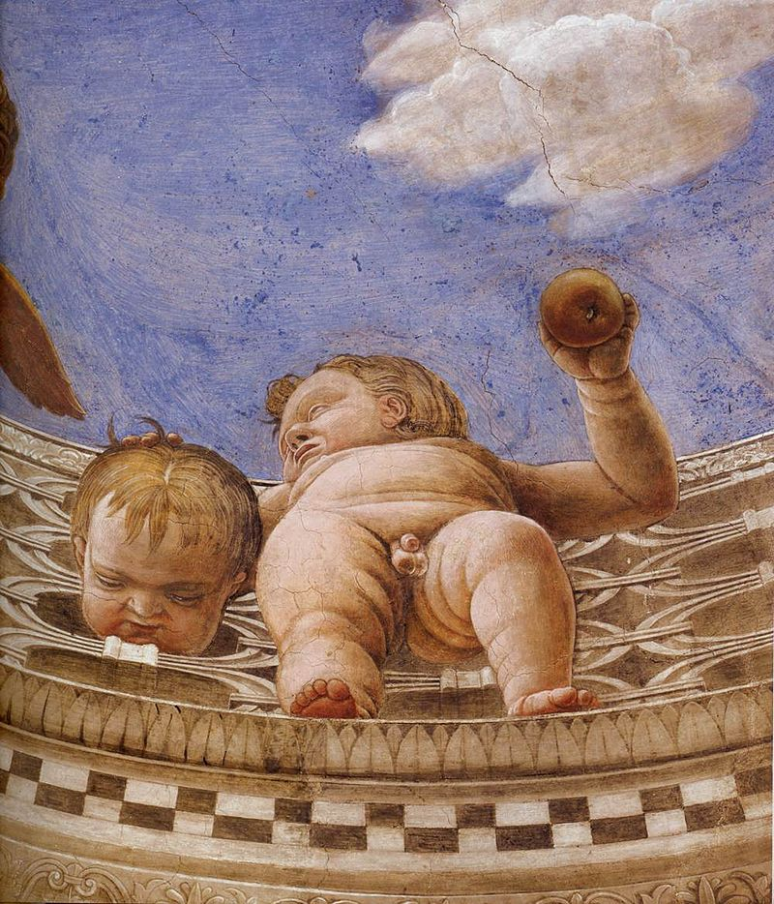

Slide 22
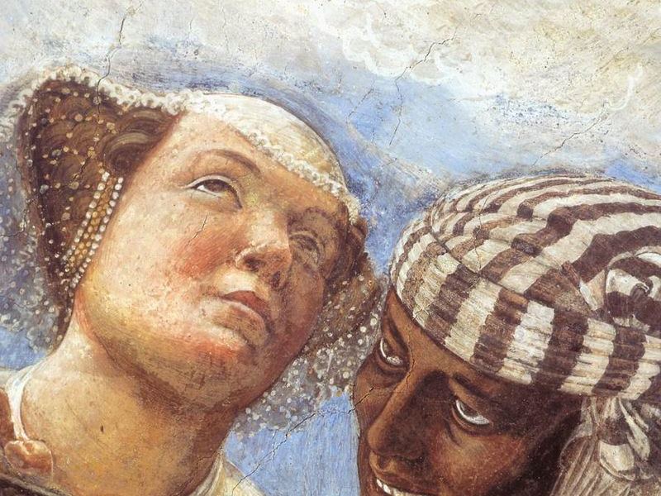

Slide 23
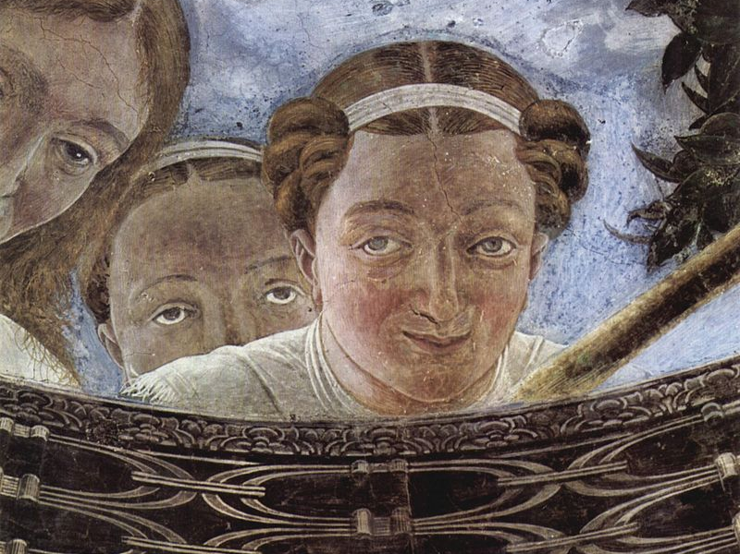

Slide 24
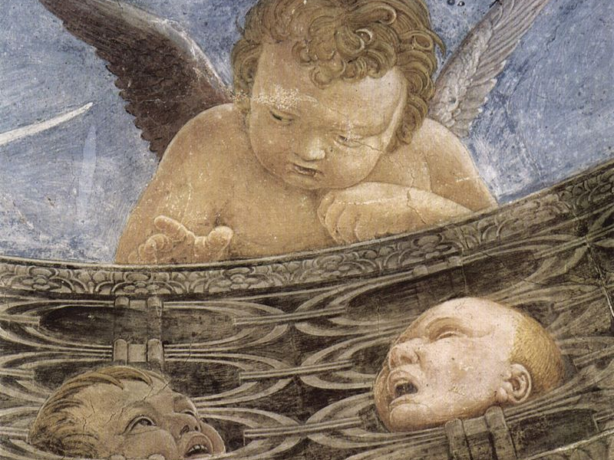

Slide 25
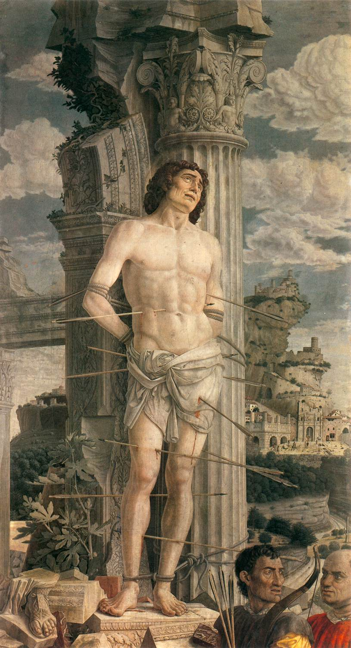
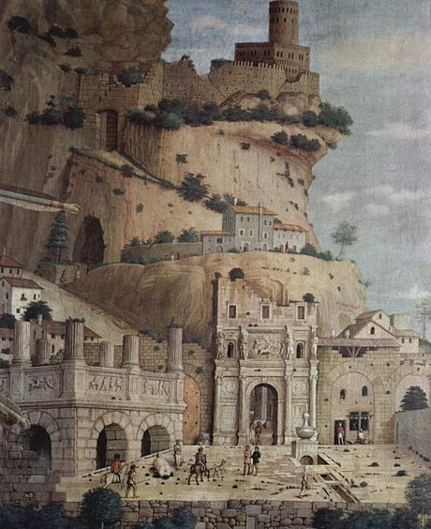
St Sebastian (and detail), c. 1480, Tempera on canvas, 255 x 140 cm, Musée du Louvre, Paris

Slide 26
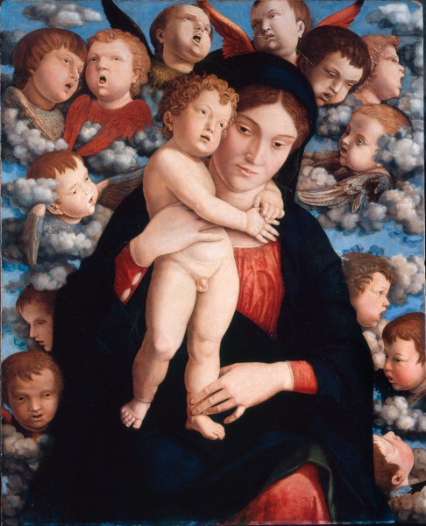
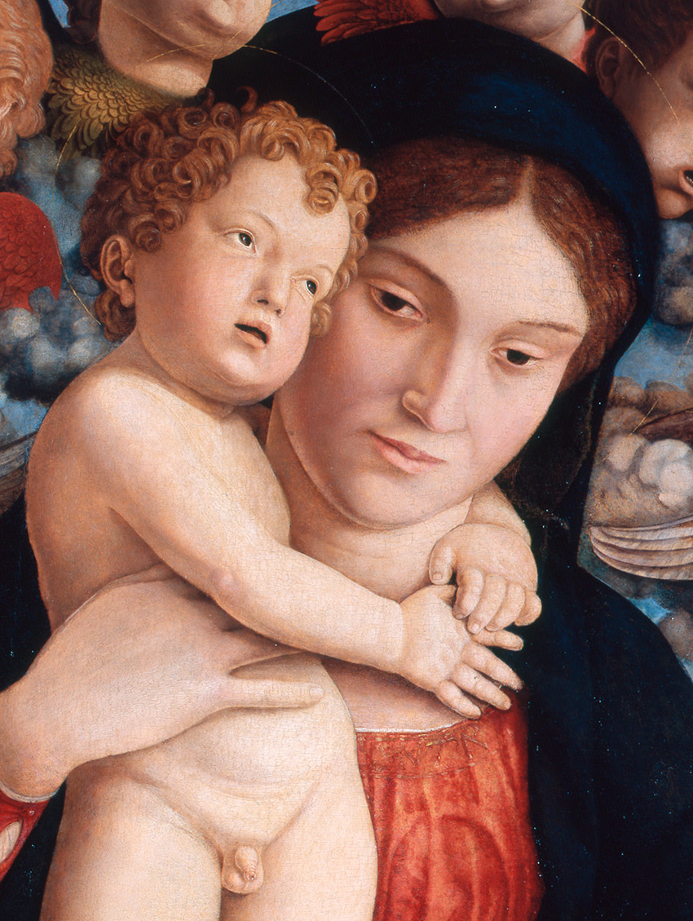
Madonna of the Cherubim (and detail), c. 1485, Panel, 88 x 70 cm,
Pinacoteca di Brera, Milan

Slide 27
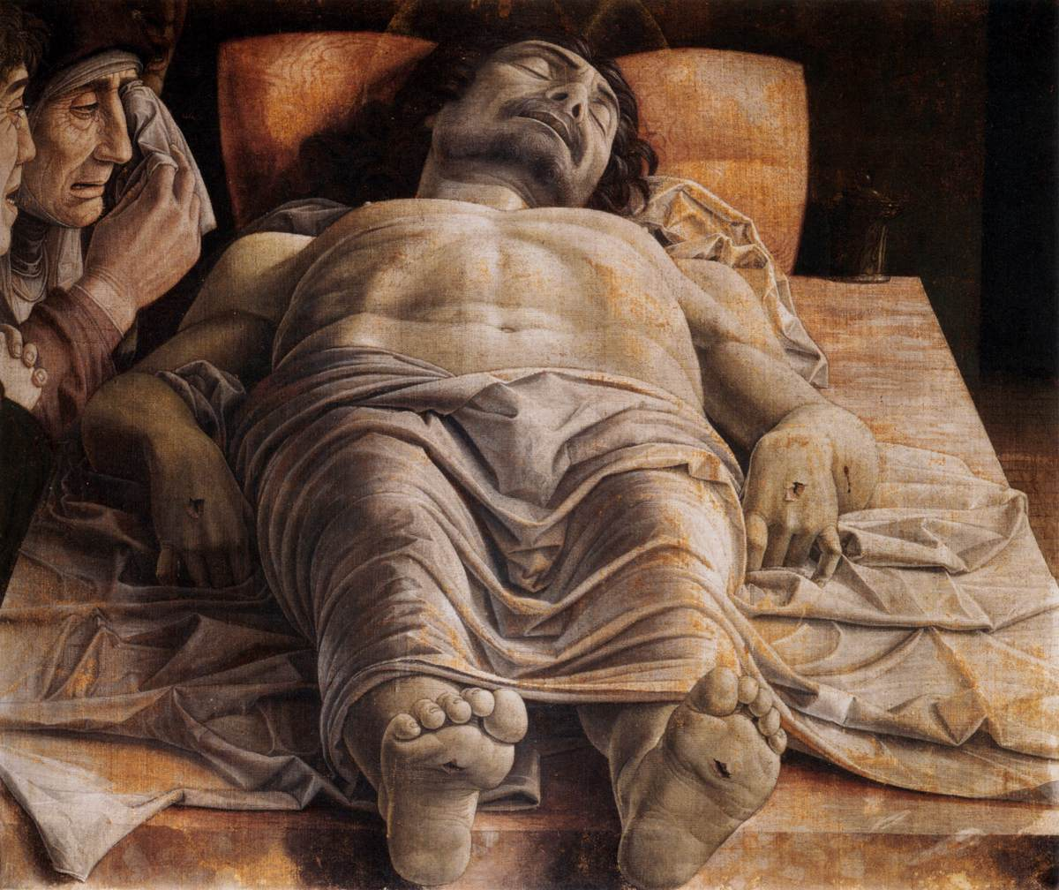
The Lamentation over the Dead Christ, c. 1490, Tempera on canvas,
68 x 81 cm, Pinacoteca di Brera, Milan

Slide 28
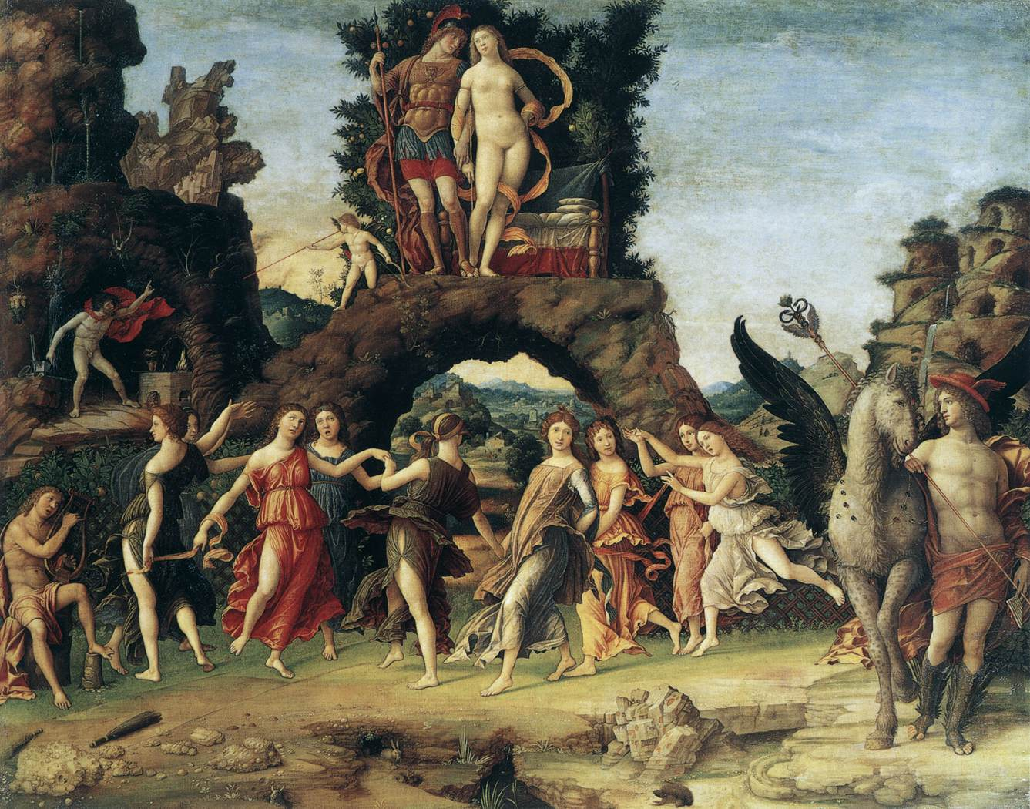
Parnassus, 1497, Tempera on canvas, 160 x 192 cm, Musée du Louvre, Paris

Slide 29
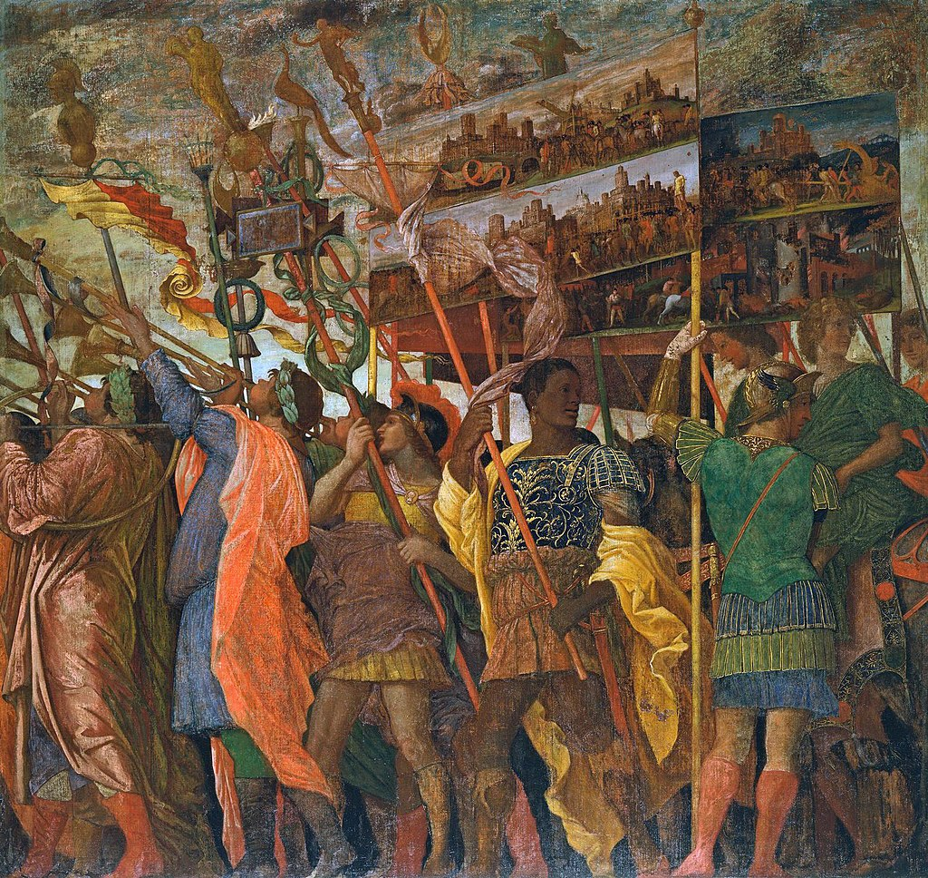
Triumphs of Caesar (scene 1), 1485-95, Tempera on canvas, 267 x 278 cm,
Royal Collection, Hampton Court

Slide 30
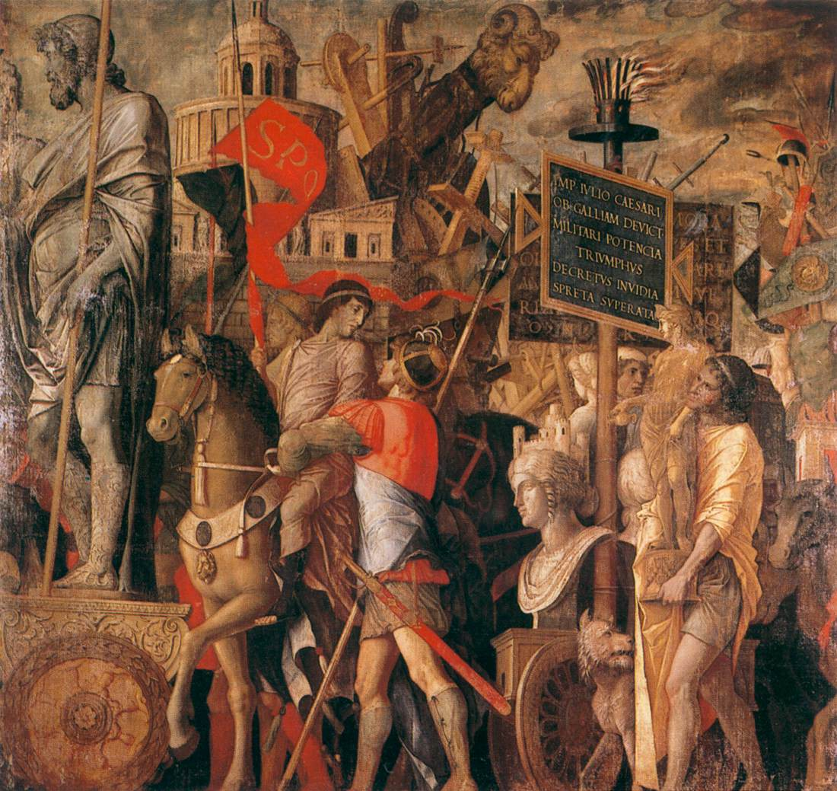
Triumphs of Caesar
(scene 2),
1485-95,
Tempera on canvas,
267 x 278 cm,
Royal Collection, Hampton Court

Slide 31
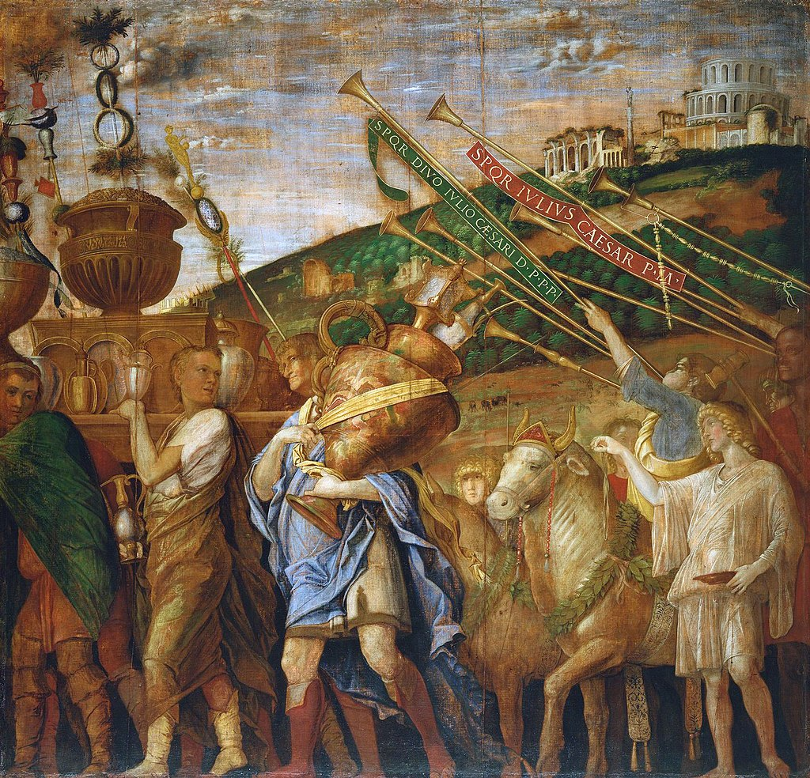
Triumphs of Caesar (scene 4), 1485-95, Tempera on canvas,
267 x 278 cm, Royal Collection, Hampton Court

Slide 32
Photo Credits
Slide 1
Introduction - Teaching with Andrea Mantegna, 1431-1506
Slide 2
Assumption of the Virgin, (for the most part the work by Mantegna),1454-57, Fresco, Cappella Ovetari, Chiesa degli Eremitani, Padua
Assumption of the Virgin (detail), (for the most part the work by Mantegna),1454-57, Fresco, Cappella Ovetari, Chiesa degli Eremitani, Padua https://www.wga.hu/frames-e.html?/html/m/mantegna/index.html
Slide 3
San Luca Polyptych, 1453, Tempera on panel, 177 x 230 cm, Pinacoteca di Brera, Milan https://pinacotecabrera.org/en/collezione-online/opere/saint-luke-polyptych/
Slide 4
San Luca Polyptych (detail), 1453, Tempera on panel, 177 x 230 cm, Pinacoteca di Brera, Milan https://www.wga.hu/frames-e.html?/html/m/mantegna/index.html
Slide 5
St Sebastian, 1459, Tempera on wood, 68 x 30 cm, Kunsthistorisches Museum, Vienna https://www.wga.hu/frames-e.html?/html/m/mantegna/index.html
St Sebastian (detail), 1459, Tempera on wood, 68 x 30 cm, Kunsthistorisches Museum, Vienna https://secretimages.org/2019/10/19/andrea-mantegna-st-sebastian-c-1459/
Slide 6
The San Zeno Polyptych, 1457-60, Tempera on panel, 480 x 450 cm, San Zeno, Verona https://www.wga.hu/frames-e.html?/html/m/mantegna/index.html
Slide 7
The San Zeno Polyptych, 1457-60, Tempera on panel, 480 x 450 cm, San Zeno, Verona https://www.italianways.com/the-classical-beauty-of-mantegnas-san-zeno-altarpiece/
Slide 8
The San Zeno Polyptych (Sacra Conversazione), 1457-60, Tempera on panel, 480 x 450 cm, San Zeno, Verona
The San Zeno Polyptych (Predela Paintings), 1457-60, Tempera on panel, 480 x 450 cm, San Zeno, Verona https://www.italianways.com/the-classical-beauty-of-mantegnas-san-zeno-altarpiece/
Slide 9
The Adoration of the Magi, 1460-64, Tempera on wood, 76 x 77 cm, Galleria degli Uffizi, Florence https://www.wga.hu/frames-e.html?/html/m/mantegna/index.html
Slide 10
View of the west and north walls of the Camera degli Sposi, 1465-74, Walnut oil on plaster, Camera degli Sposi, Palazzo Ducale, Mantua https://www.wga.hu/frames-e.html?/html/m/mantegna/index.html
Slide 11
The north wall: The Court of Gonzaga, 1465-74, Walnut oil on plaster, Camera degli Sposi, Palazzo Ducale, Mantua https://www.wga.hu/frames-e.html?/html/m/mantegna/index.html
Slide 12
The north wall: The Court of Gonzaga, 1465-74, Walnut oil on plaster, Camera degli Sposi, Palazzo Ducale, Mantua https://www.wga.hu/frames-e.html?/html/m/mantegna/index.html

Slide 33
Slide 13
The north wall: The Court of Gonzaga (3 details), 1465-74, Walnut oil on plaster, Camera degli Sposi, Palazzo Ducale, Mantua https://www.wga.hu/frames-e.html?/html/m/mantegna/index.html
Slide 14
The west wall: The Meeting, 1465-74, Walnut oil on plaster, Camera degli Sposi, Palazzo Ducale, Mantua https://www.wga.hu/frames-e.html?/html/m/mantegna/index.html
Slide 15
The west wall: The Meeting (left panel), 1465-74, Walnut oil on plaster, Camera degli Sposi, Palazzo Ducale, Mantua https://commons.wikimedia.org/wiki/Category:Camera_picta_-_West_Wall_-_The_Meeting#/media/File:Camera_picta,_l'incontro_02.1.jpg
The west wall: The Meeting (detail), 1465-74, Walnut oil on plaster, Camera degli Sposi, Palazzo Ducale, Mantua https://commons.wikimedia.org/wiki/Category:Camera_picta_-_West_Wall_-_The_Meeting#/media/File:Andrea_Mantegna_070.jpg
Slide 16
The west wall: The Meeting (right panel), 1465-74, Walnut oil on plaster, Camera degli Sposi, Palazzo Ducale, Mantua https://www.wga.hu/frames-e.html?/html/m/mantegna/index.html
The west wall: The Meeting (detail), 1465-74, Walnut oil on plaster, Camera degli Sposi, Palazzo Ducale, Mantua https://commons.wikimedia.org/wiki/Category:Camera_picta_-_West_Wall_-_The_Meeting#/media/File:Andrea_Mantegna_083.jpg
Slide 17
The west wall: The Meeting, 1465-74, Walnut oil on plaster, Camera degli Sposi, Palazzo Ducale, Mantua https://commons.wikimedia.org/wiki/Category:Camera_picta_-_West_Wall_-_The_Meeting#/media/File:Andrea_mantegna,_camera_degli_sposi,_1465-74,_parete_ovest,_detta_dell'incontro,_04_corte_gonzaga_all'aperto_07_ludovico_gonzaga.jpg
Slide 18
The west wall: The Meeting, 1465-74, Walnut oil on plaster, Camera degli Sposi, Palazzo Ducale, Mantua https://commons.wikimedia.org/wiki/Category:Camera_picta_-_West_Wall_-_The_Meeting#/media/File:Andrea_mantegna,_camera_degli_sposi,_1465-74,_parete_ovest,_detta_dell'incontro,_04_corte_gonzaga_all'aperto_03,2.jpg
Slide 19
Ceiling decoration, 1465-74, Walnut oil on plaster and fresco, Camera degli Sposi, Palazzo Ducale, Mantua https://commons.wikimedia.org/wiki/Category:Camera_picta_-_Ceiling#/media/File:Andrea_Mantegna_064_big.jpg
Slide 20
Ceiling decoration, 1465-74, Walnut oil on plaster and fresco, Camera degli Sposi, Palazzo Ducale, Mantua https://commons.wikimedia.org/wiki/Category:Camera_picta_-_Ceiling#/media/File:Andrea_Mantegna_-_Ceiling_Oculus_-_WGA14022.jpg
Slide 21
Ceiling decoration Detail), 1465-74, Walnut oil on plaster and fresco, Camera degli Sposi, Palazzo Ducale, Mantua https://commons.wikimedia.org/wiki/Category:Camera_picta_-_Ceiling#/media/File:Andrea_Mantegna_053.jpg
Ceiling decoration Detail), 1465-74, Walnut oil on plaster and fresco, Camera degli Sposi, Palazzo Ducale, Mantua https://commons.wikimedia.org/wiki/Category:Camera_picta_-_Ceiling#/media/File:Andrea_Mantegna_-_Ceiling_Oculus_(detail)_-_WGA14024.jpg

Slide 34
Slide 22
Ceiling decoration, 1465-74, Walnut oil on plaster and fresco, Camera degli Sposi, Palazzo Ducale, Mantua https://commons.wikimedia.org/wiki/Category:Camera_picta_-_Ceiling#/media/File:Andrea_Mantegna_-_Ceiling_Oculus_(detail)_-_WGA14025.jpg
Slide 23
Ceiling decoration, 1465-74, Walnut oil on plaster and fresco, Camera degli Sposi, Palazzo Ducale, Mantua https://commons.wikimedia.org/wiki/Category:Camera_picta_-_Ceiling#/media/File:Andrea_Mantegna_065.jpg
Slide 24
Ceiling decoration, 1465-74, Walnut oil on plaster and fresco, Camera degli Sposi, Palazzo Ducale, Mantua https://commons.wikimedia.org/wiki/Category:Camera_picta_-_Ceiling#/media/File:Andrea_Mantegna_066.jpg
Slide 25
St Sebastian, c. 1480, Tempera on canvas, 255 x 140 cm, Musée du Louvre, Paris https://www.wga.hu/frames-e.html?/html/m/mantegna/index.html
St Sebastian (detail), c. 1480, Tempera on canvas, 255 x 140 cm, Musée du Louvre, Paris https://www.wikiwand.com/en/St._Sebastian_(Mantegna)
Slide 26
Madonna of the Cherubim, c. 1485, Panel, 88 x 70 cm, Pinacoteca di Brera, Milan https://pinacotecabrera.org/en/collezione-online/opere/madonna-and-child-with-a-choir-of-cherubs/
Madonna of the Cherubim (detail), c. 1485, Panel, 88 x 70 cm, Pinacoteca di Brera, Milan https://patrons.org.es/andrea-mantegna/
Slide 27
The Lamentation over the Dead Christ, c. 1490, Tempera on canvas, 68 x 81 cm, Pinacoteca di Brera, Milan https://www.wga.hu/frames-e.html?/html/m/mantegna/index.html
Slide 28
Parnassus, 1497, Tempera on canvas, 160 x 192 cm, Musée du Louvre, Paris https://www.wga.hu/frames-e.html?/bio/m/mantegna/biograph.html
Slide 29
Triumphs of Caesar (scene 1), 1485-95, Tempera on canvas, 267 x 278 cm,
Royal Collection, Hampton Court https://en.wikipedia.org/wiki/Triumphs_of_Caesar_(Mantegna)#/media/File:Triumph1-Mantegna-picture-bearers.jpg
Slide 30
Triumphs of Caesar (scene 2), 1485-95, Tempera on canvas, 267 x 278 cm, Royal Collection, Hampton Court https://www.wga.hu/frames-e.html?/html/m/mantegna/index.html
Slide 31
Triumphs of Caesar (scene 4), 1485-95, Tempera on canvas, 267 x 278 cm, Royal Collection, Hampton Court https://en.wikipedia.org/wiki/Triumphs_of_Caesar_(Mantegna)#/media/File:Triumph4-Mantegna-vase-bearers.jpg
Slides 32,33,34
Photo credits
Slide 35
The End

Slide 35
The End

