Slide 1
Funerary Altar of an Actor,
170-200 AD, Archaeological Museum of Thessaloniki
Photos by Kostas Papantoniou

Slide 2
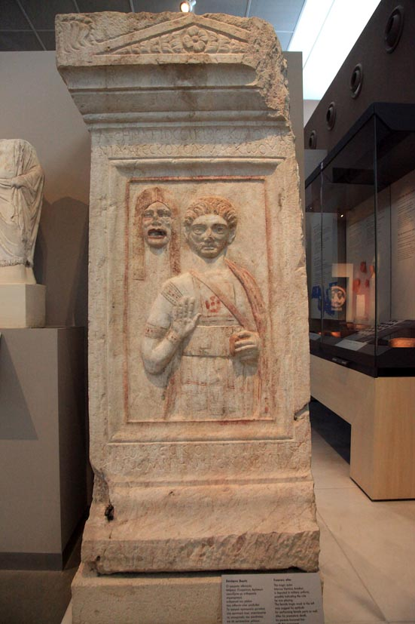

Slide 3
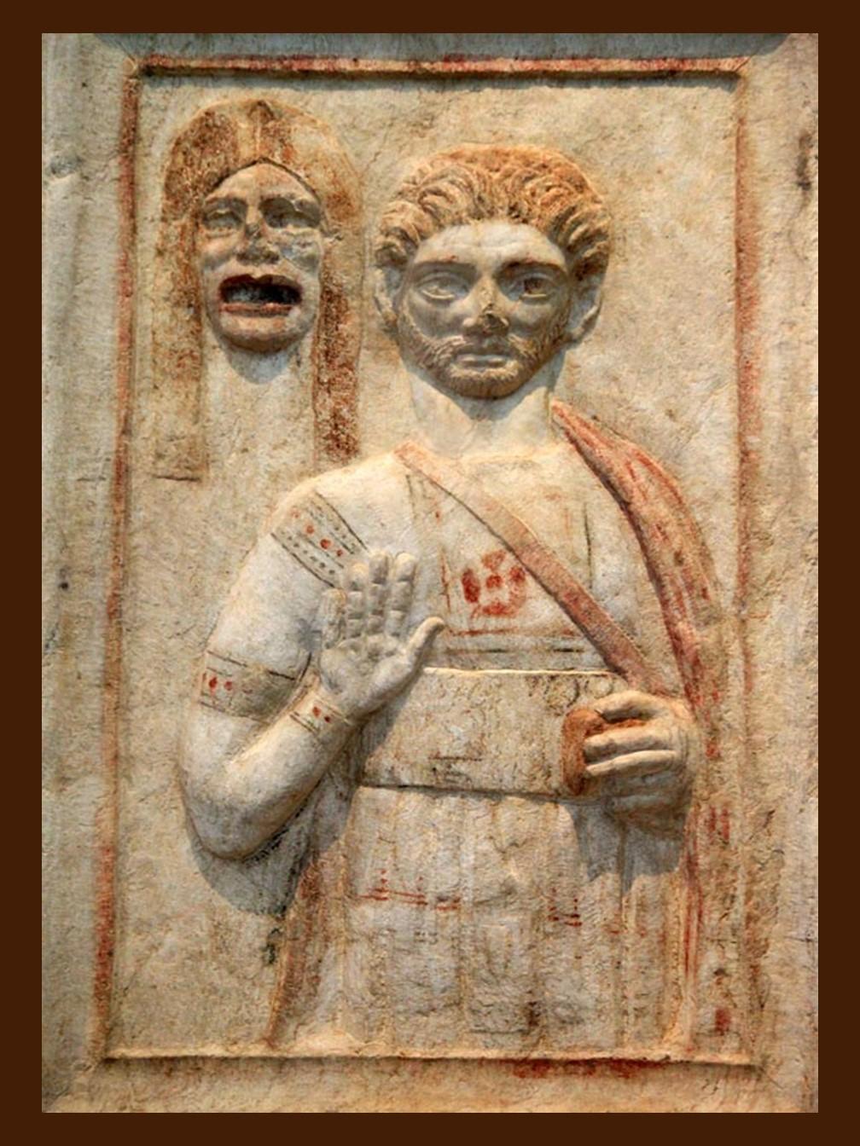

Slide 4
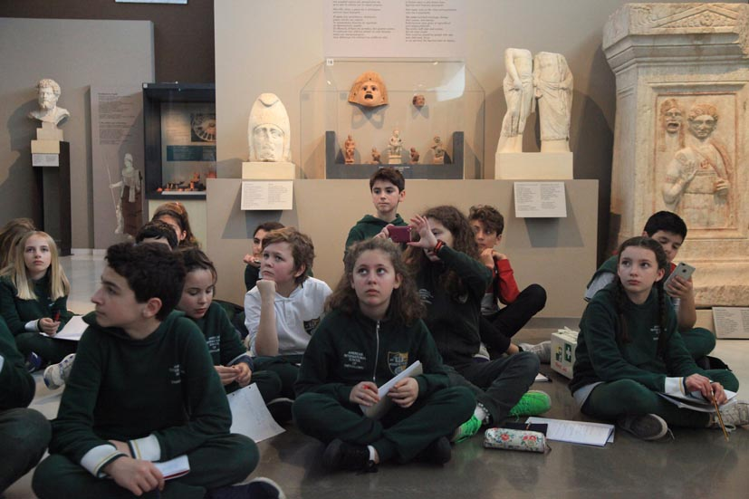




Slide 5
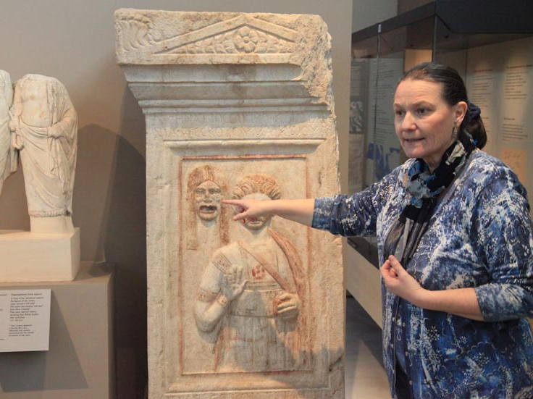

Slide 6
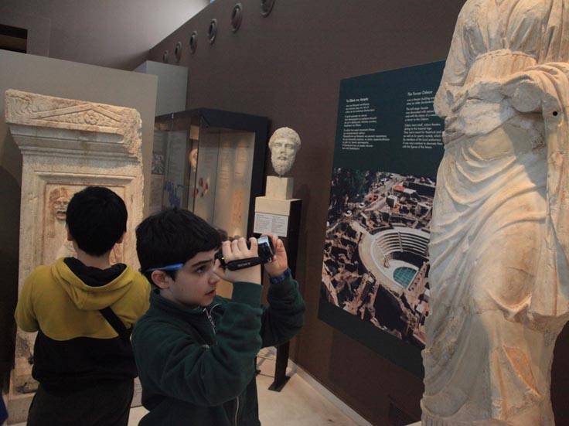

Slide 7
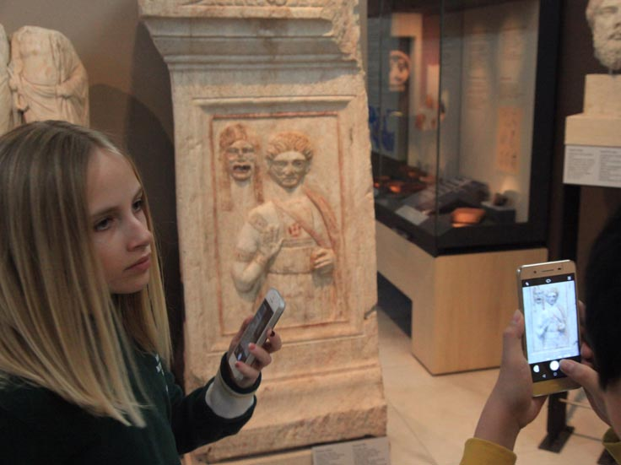

Slide 8
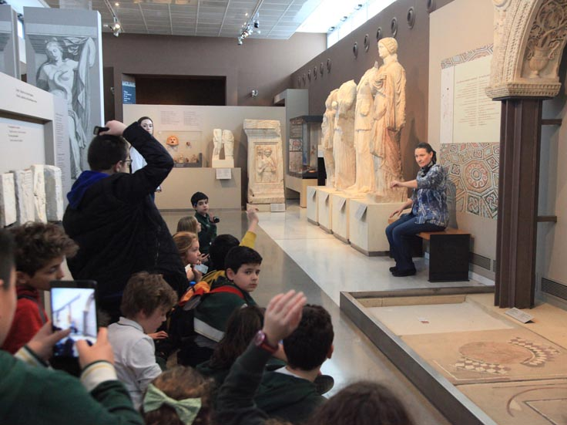

Slide 9
