Slide 1
PRINCESS FRESCO
The idyllic life of the daughters of Pharaoh Akhenaton and Nefertiti
Ashmolean Museum

Slide 2
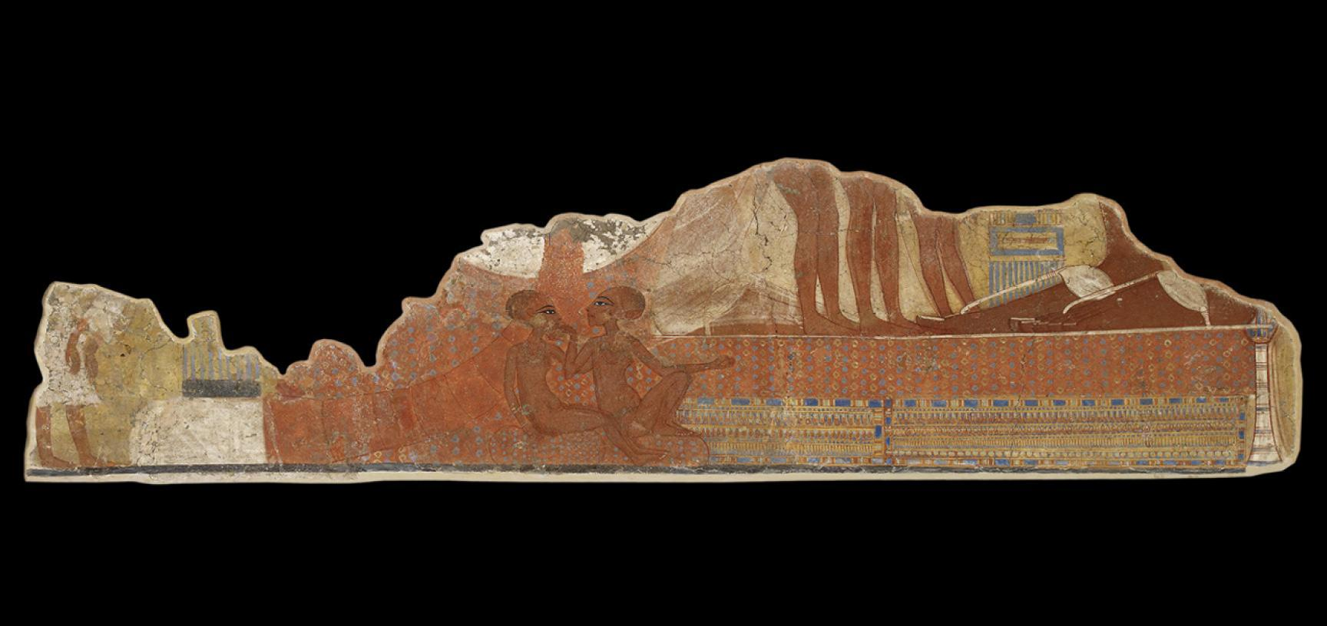

Slide 3
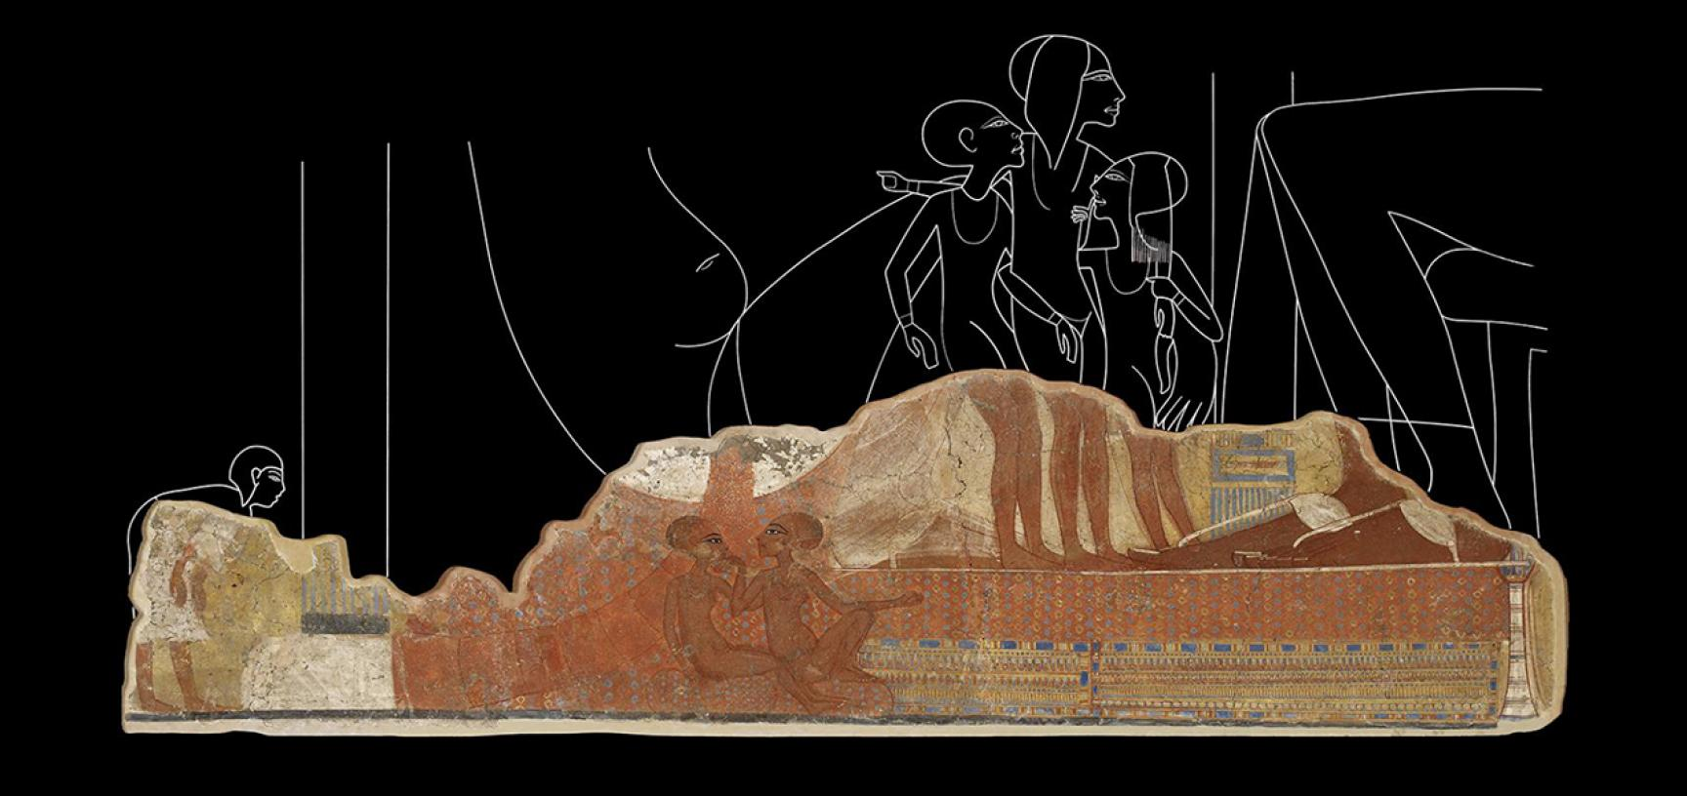

Slide 4
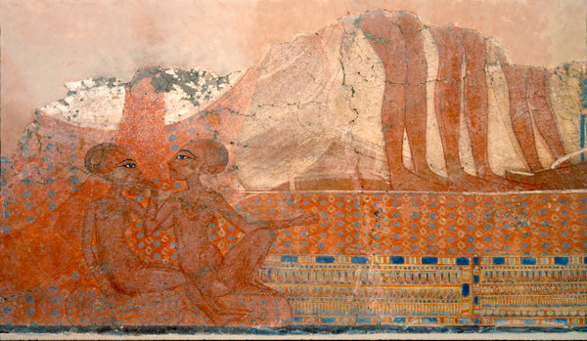

Slide 5
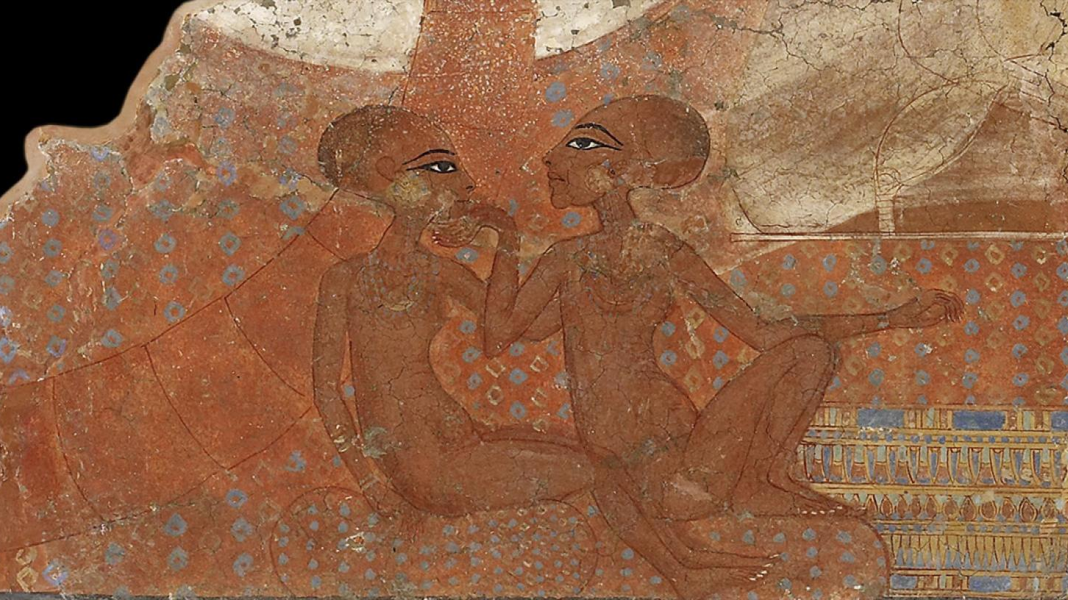

Slide 6
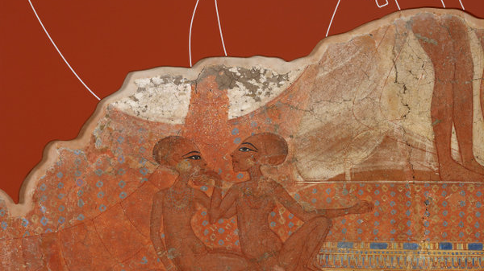

Slide 7
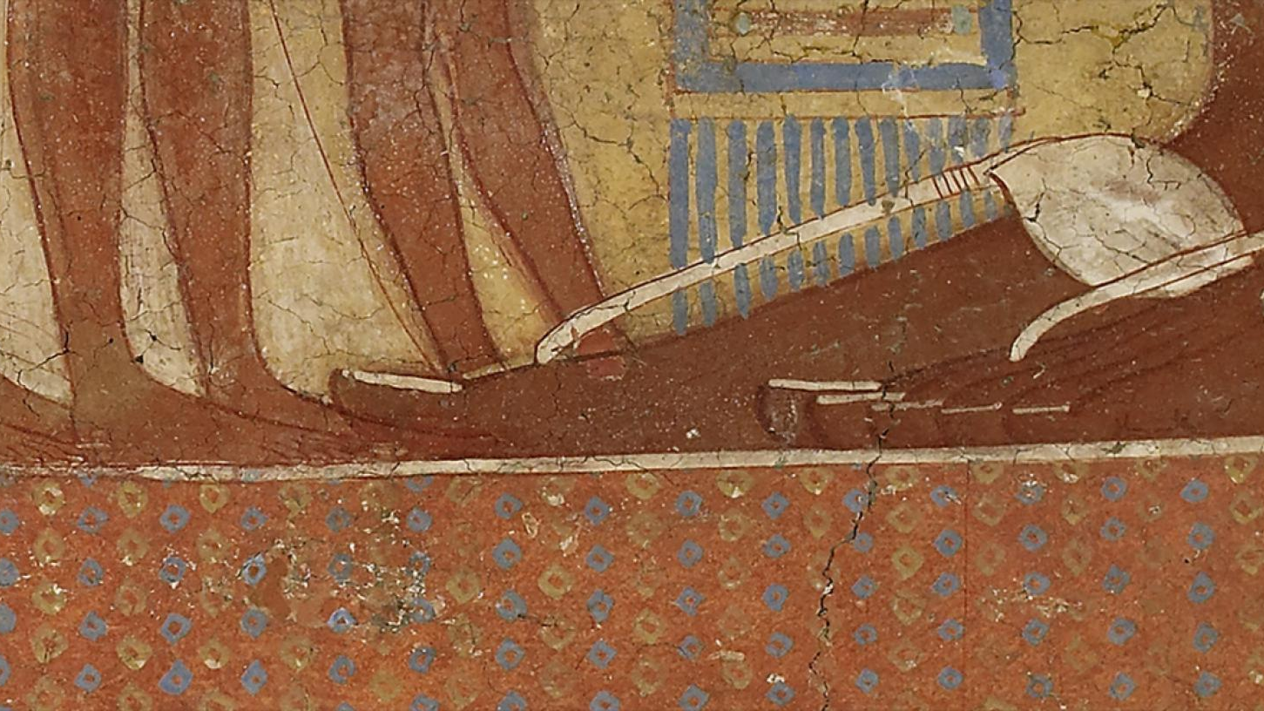

Slide 8
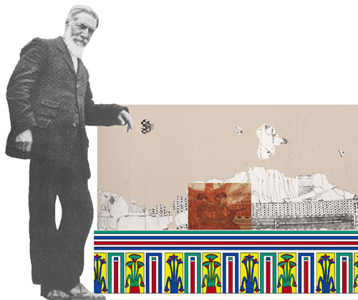
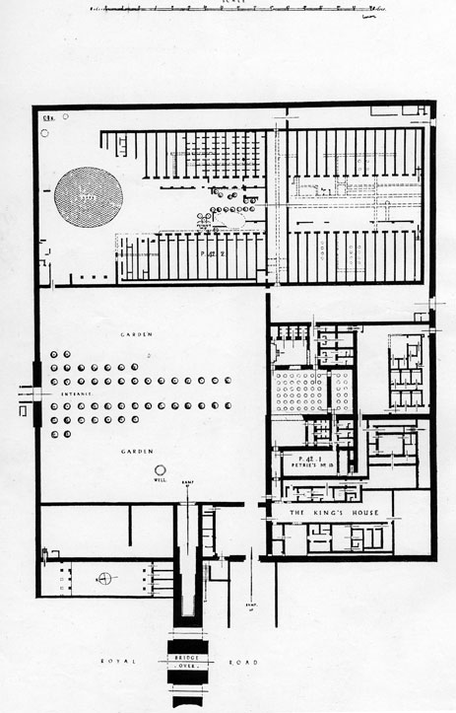
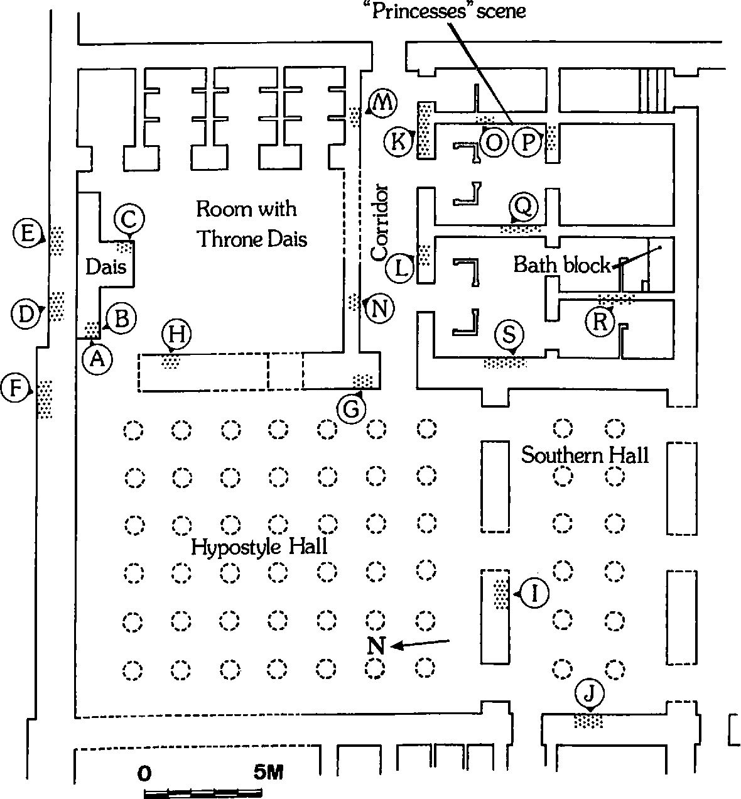
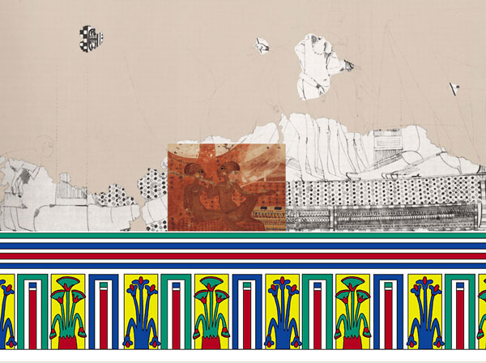
Plans of the King’s House in Amarna and the area where the fresco of the two Proncesses was located. The discussed fresco, with the figure of the discoverer (F. Petrie) added to give scale. The scene of princesses (Ashmolean Museum) as it was originally located on a wall in the King’s House, with the painted dado restored https://www.amarnaproject.com/pages/amarna_the_place/central_city/index.shtml https://www.semanticscholar.org/paper/Wall-Paintings-from-the-King%27s-House-at-Amarna-*-Weatherhead/6939baf93dc88d6774e539c9cda0f3e920d54515/figure/2

Slide 9

Photo Credits
Ashmolean Image Library https://www.ashmolean.org/princess-fresco https://images.ashmolean.org/search/?searchQuery=755002 and https://www.amarnaproject.com/pages/amarna_the_place/central_city/index.shtml https://www.semanticscholar.org/paper/Wall-Paintings-from-the-King%27s-House-at-Amarna-*-Weatherhead/6939baf93dc88d6774e539c9cda0f3e920d54515/figure/2

