Slide 1
Domenico Ghirlandaio,
1449-1494

Slide 2
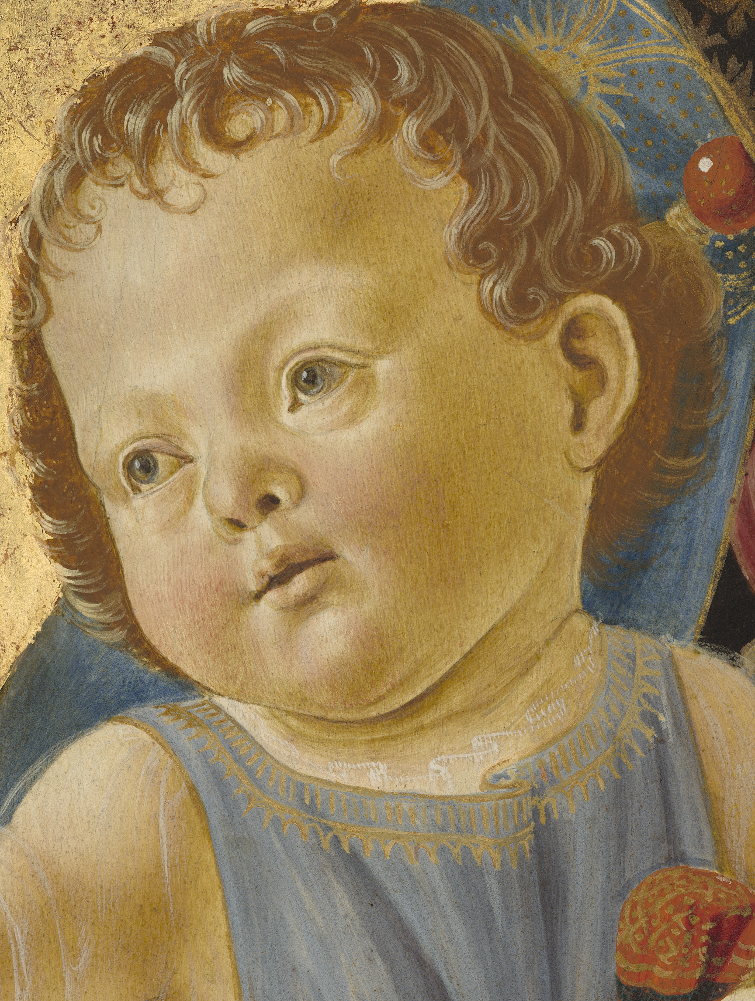
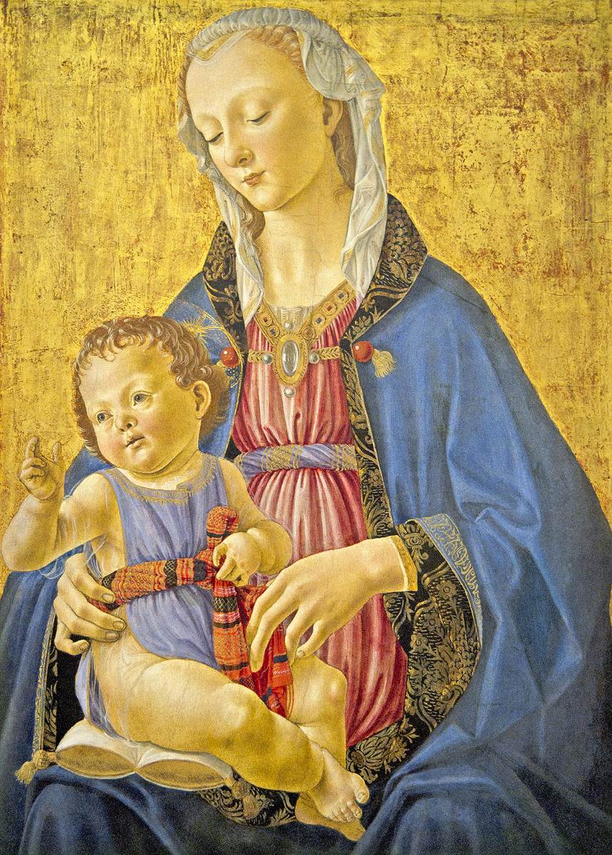
Madonna and Child, 1470-75
Tempera on panel, 71 x 49 cm, National Gallery of Art, Washington

Slide 3
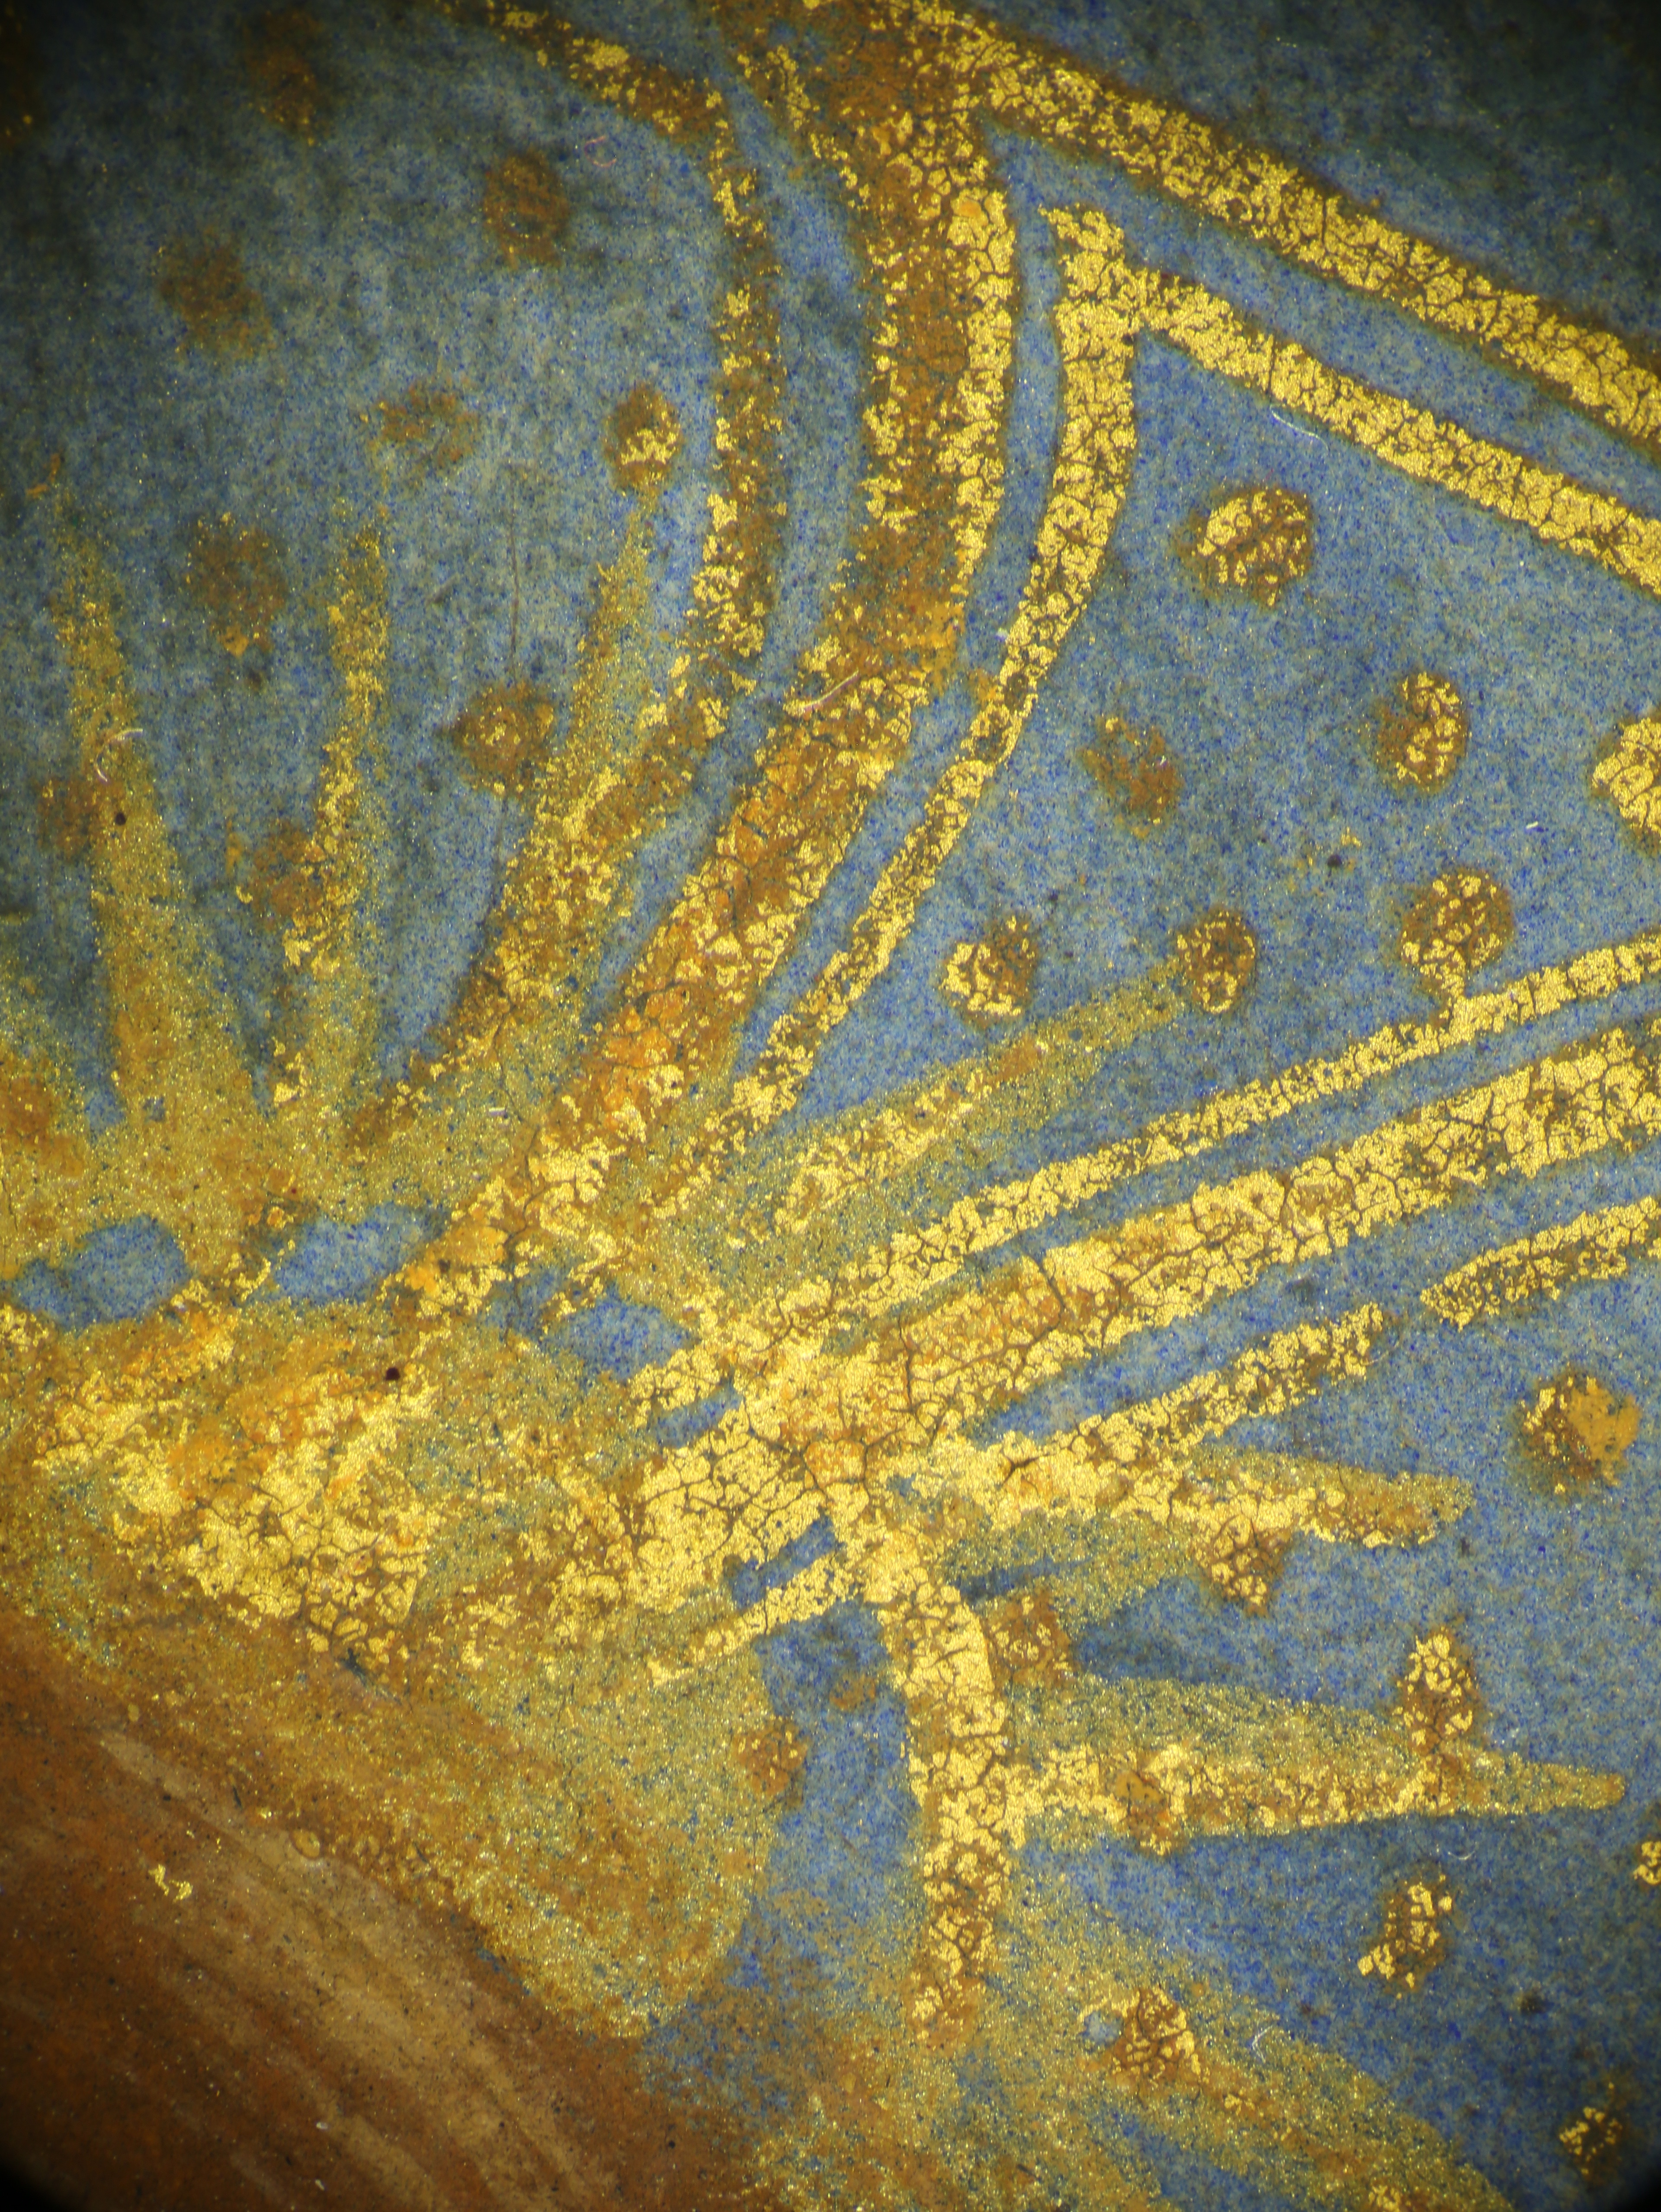
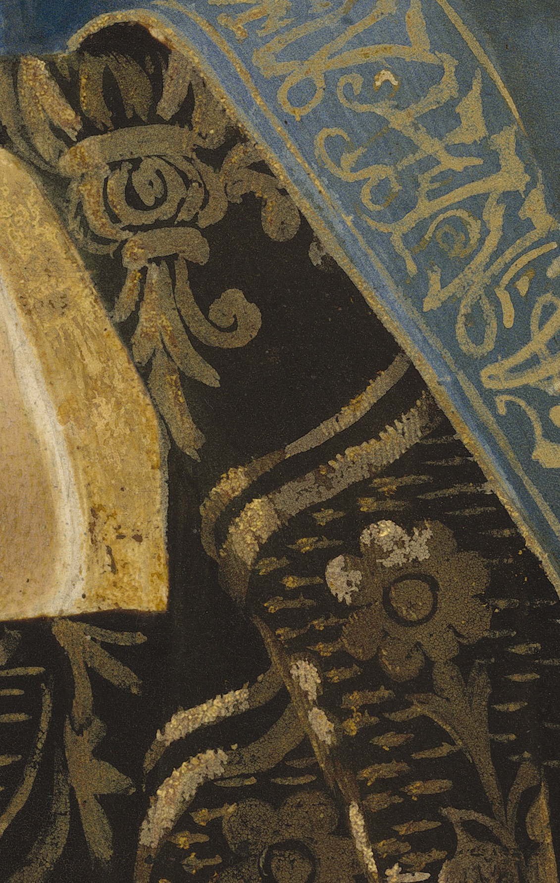
Detail of the Christ Child’s halo…
Detail of Mary’s cloak…

Slide 4
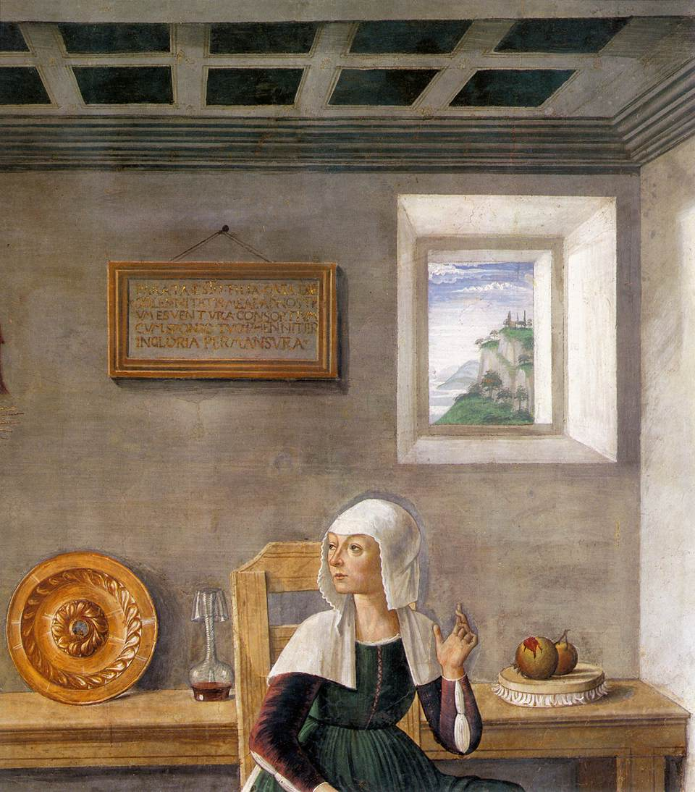
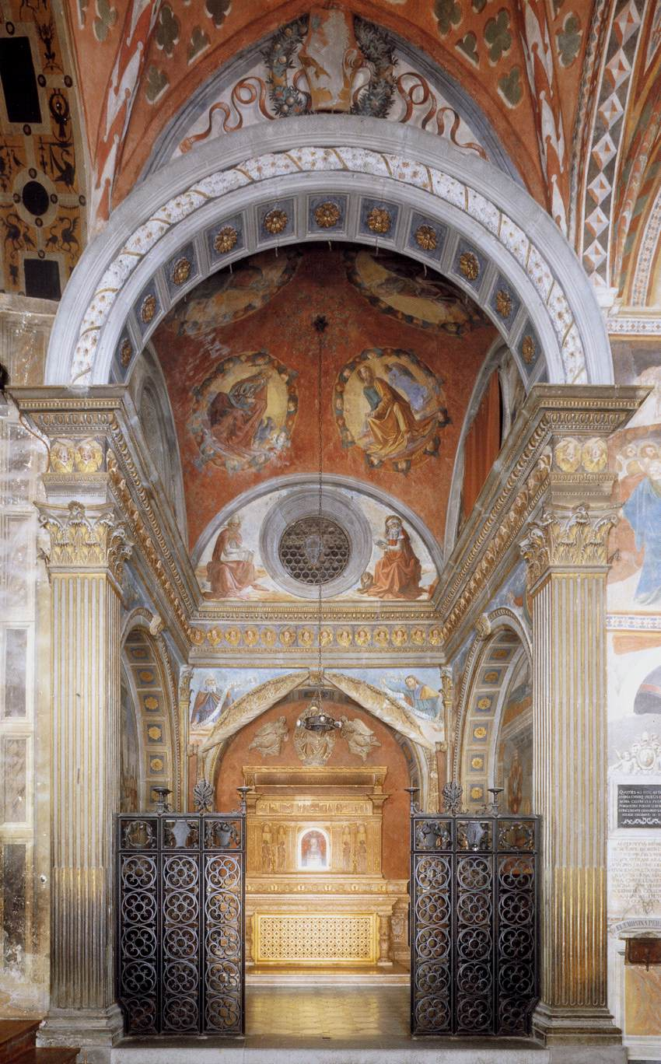
Announcement of Death to St Fina (detail),
1473-75, Fresco,
Collegiata, San Gimignano
View of the Chapel St Fina, 1473-75, Fresco,
Collegiata, San Gimignano

Slide 5
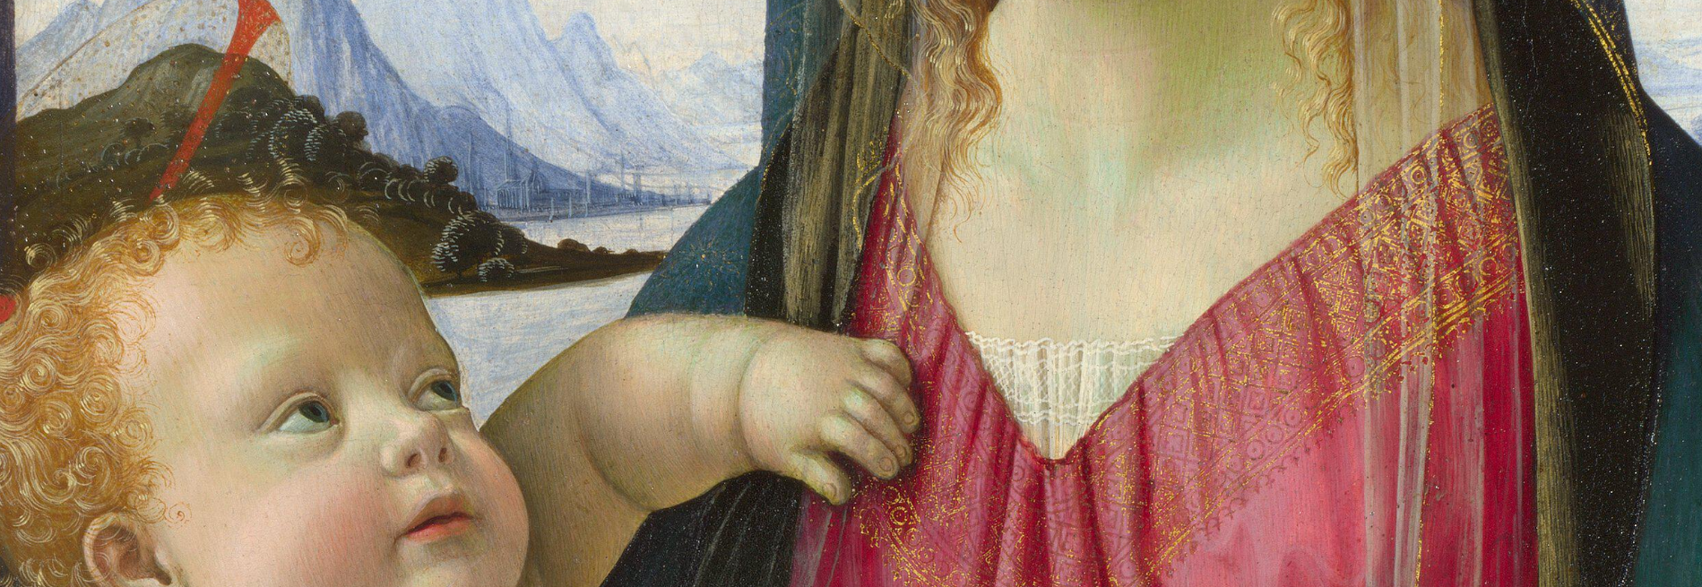
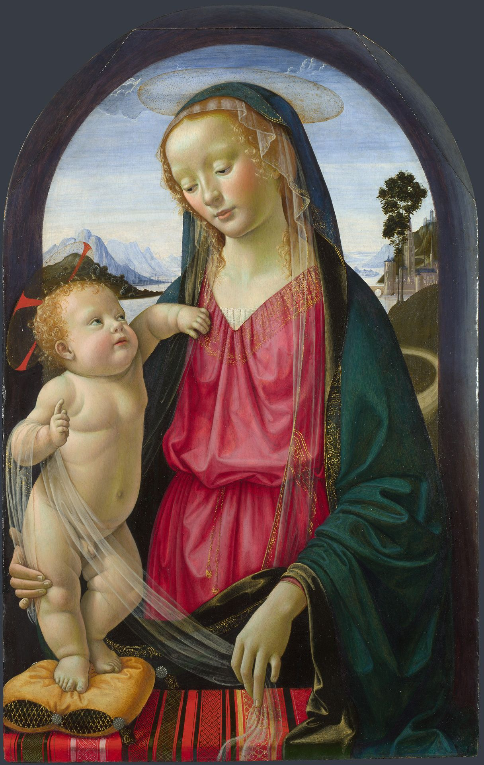
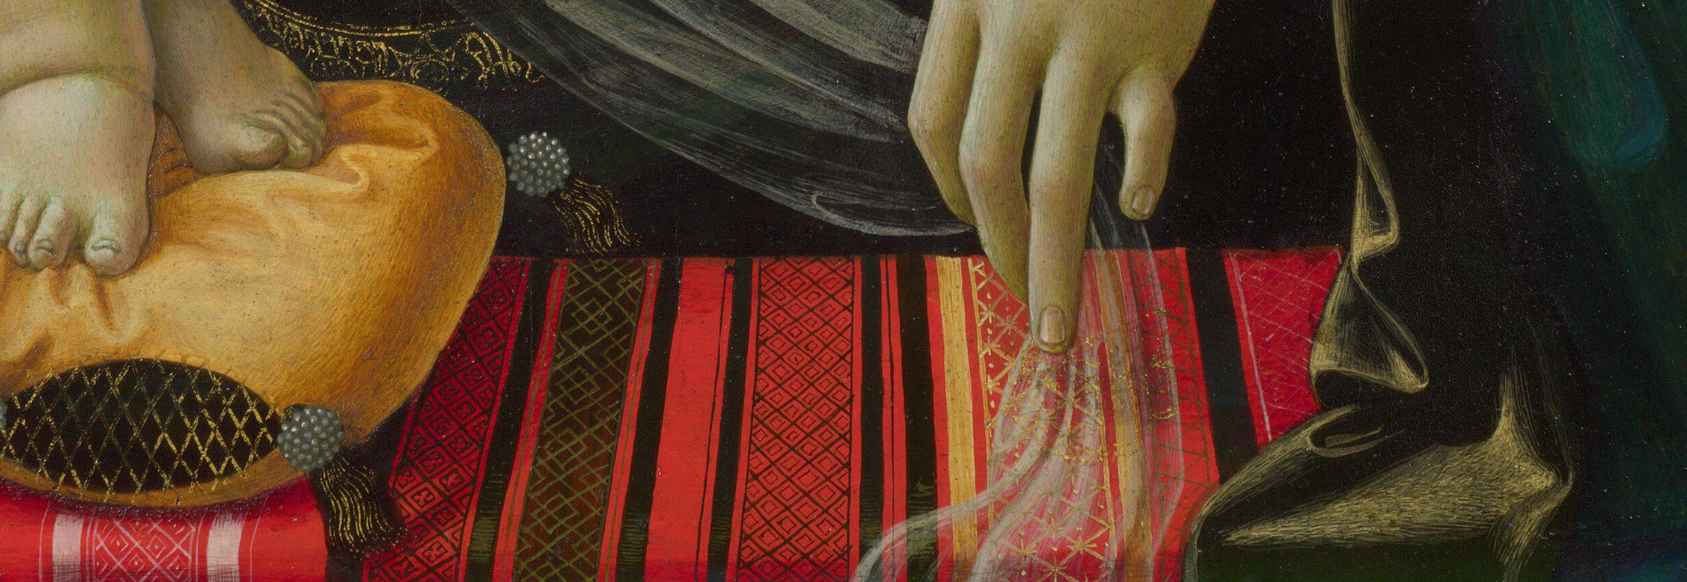
The Virgin and Child, 1480-90, Tempera on poplar, 88.9 x 57.8 cm, The National Gallery, London

Slide 6
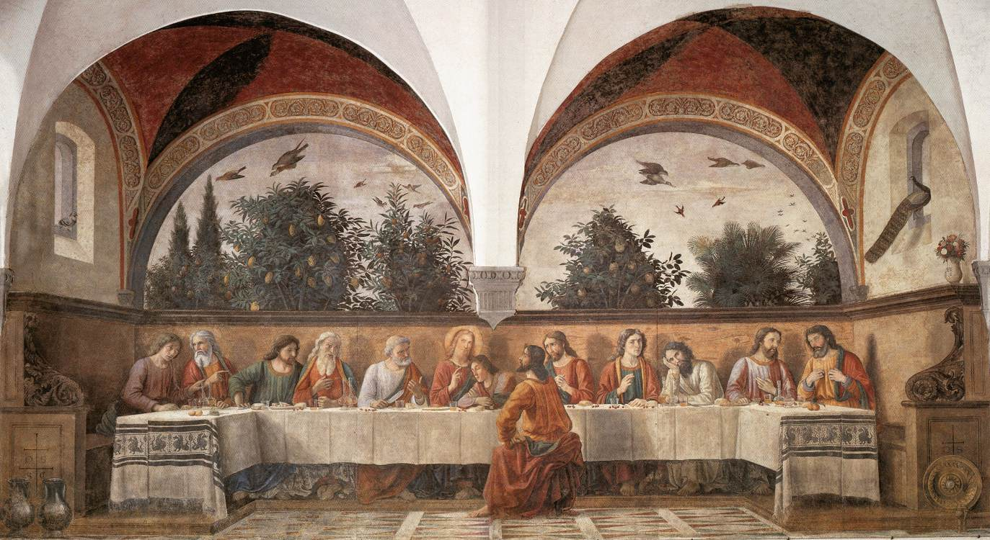
Last Supper,
1480,
Fresco, 400 x 880 cm,
Ognissanti, Florence

Slide 7
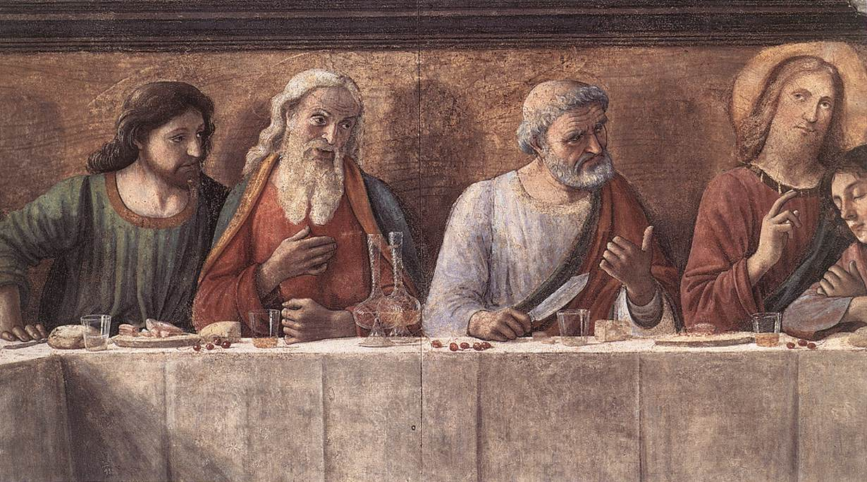

Slide 8
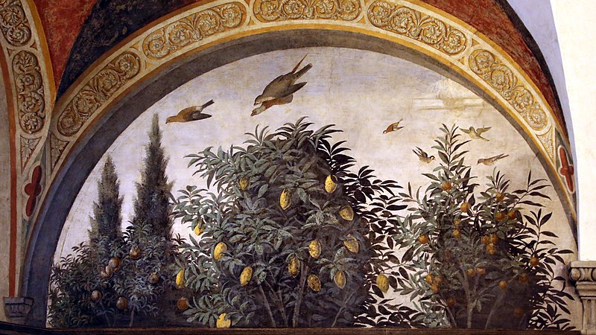

Slide 9
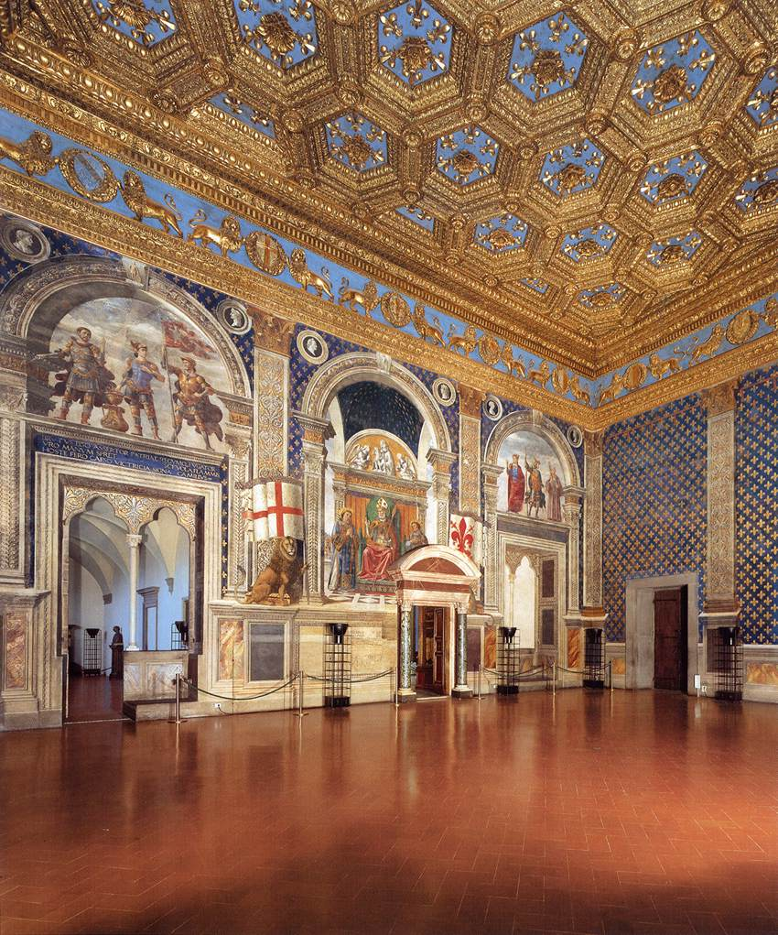
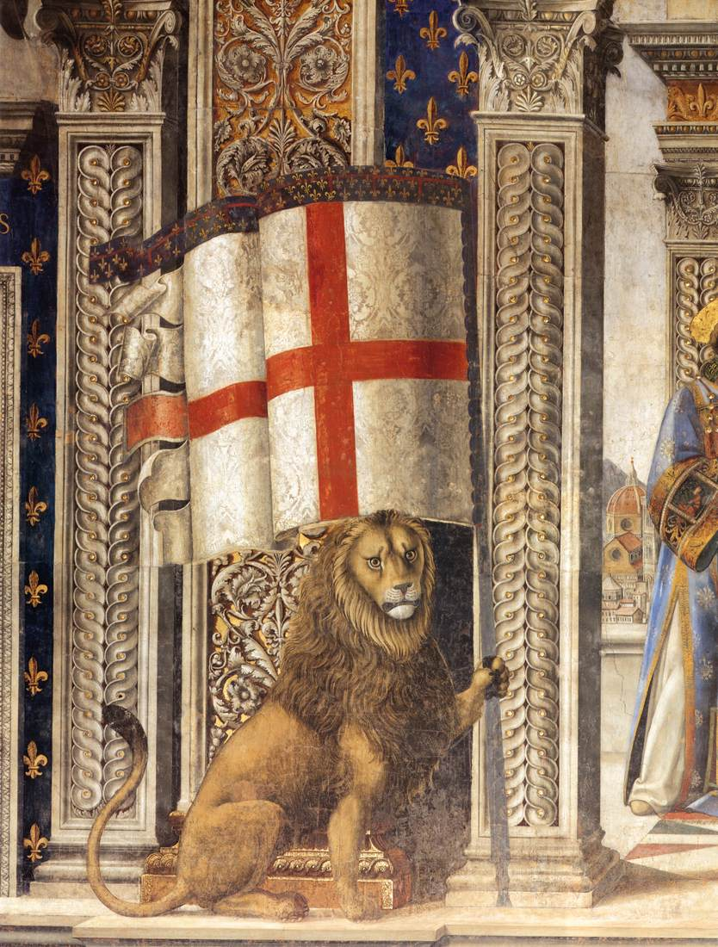
View of the Sala del Gigli, 1482-84, Fresco, Palazzo Vecchio, Florence
Decoration of the Sala del Gigli (detail),
1482-84,
Fresco,
Palazzo Vecchio, Florence

Slide 10
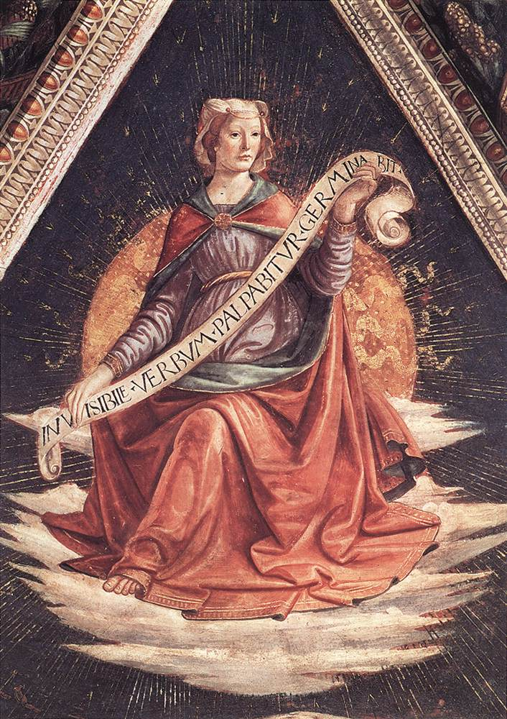
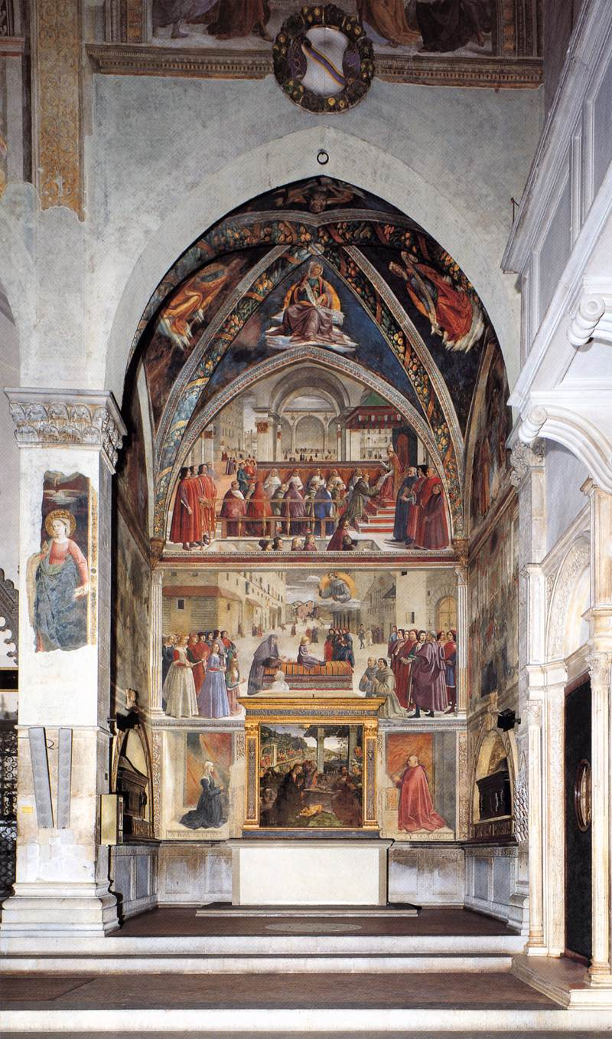
Sibyl, 1483-85, Fresco,
Santa Trinita, Florence
View of the Sassetti Chapel, 1483-85, Fresco, Santa Trinita, Florence

Slide 11
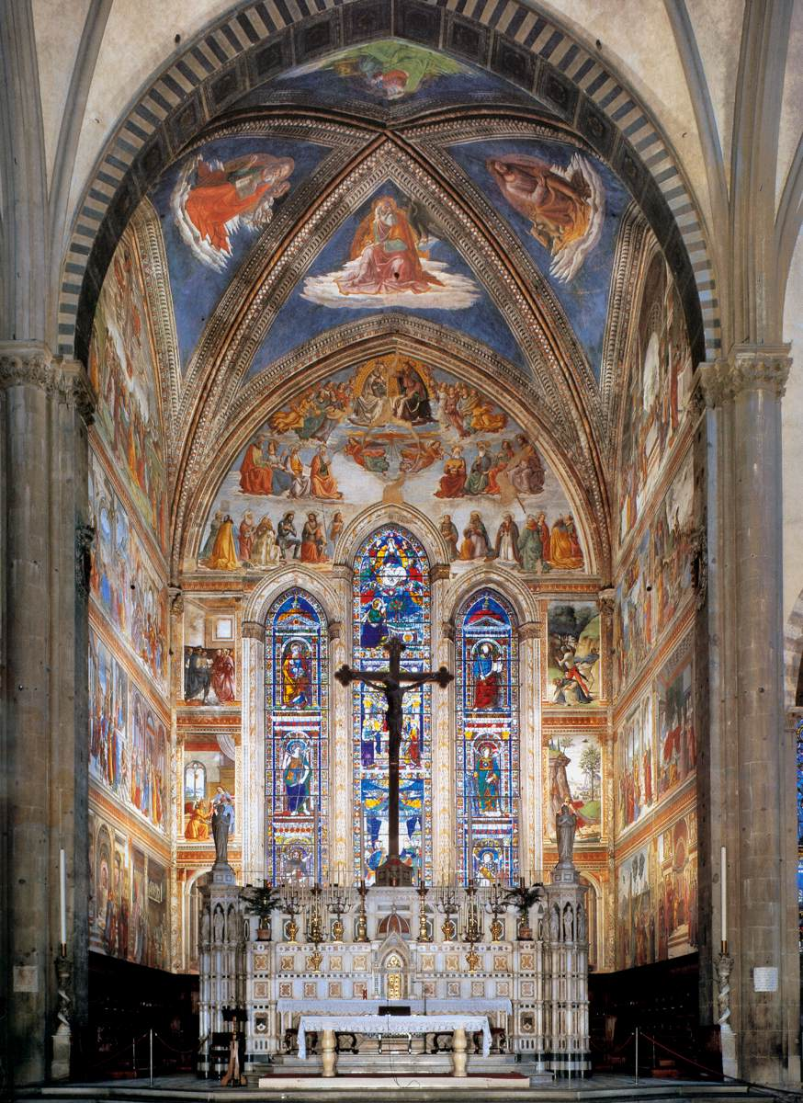
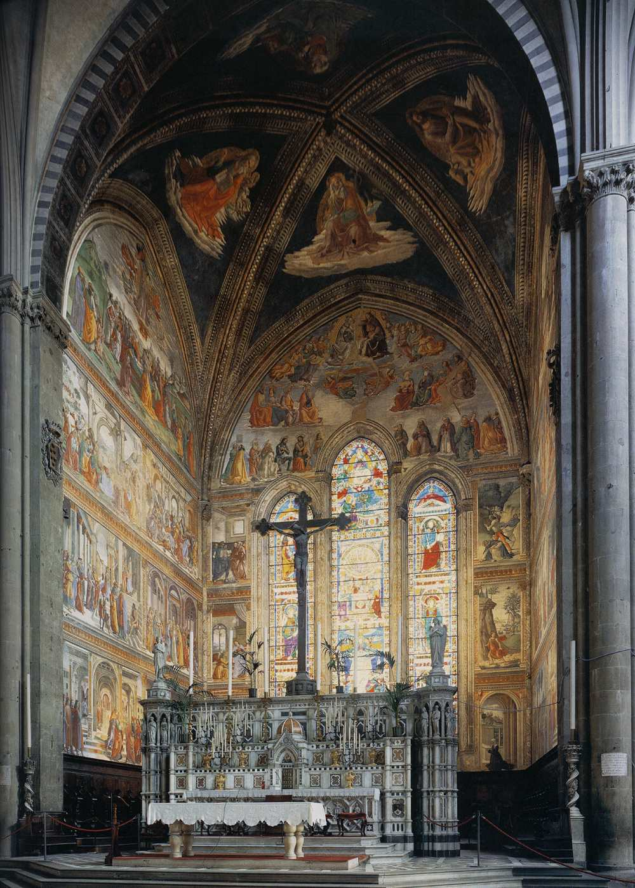
View of the Tornabuoni Chapel,
1485-90, Fresco,
Santa Maria Novella, Florence

Slide 12
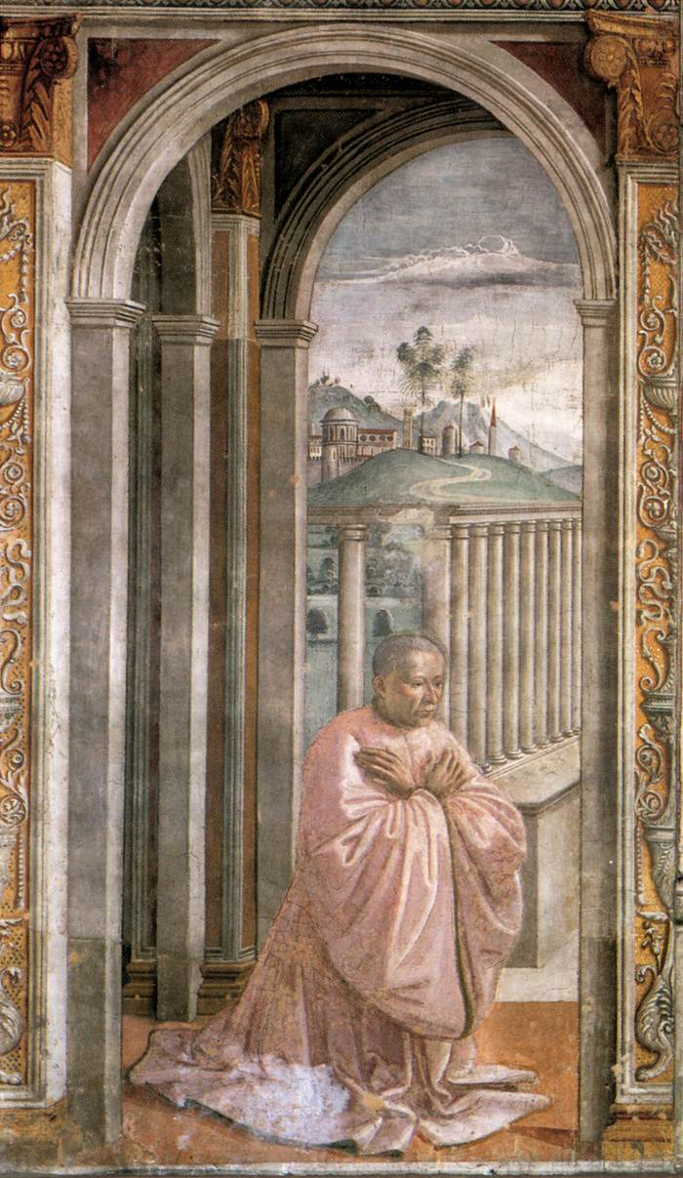
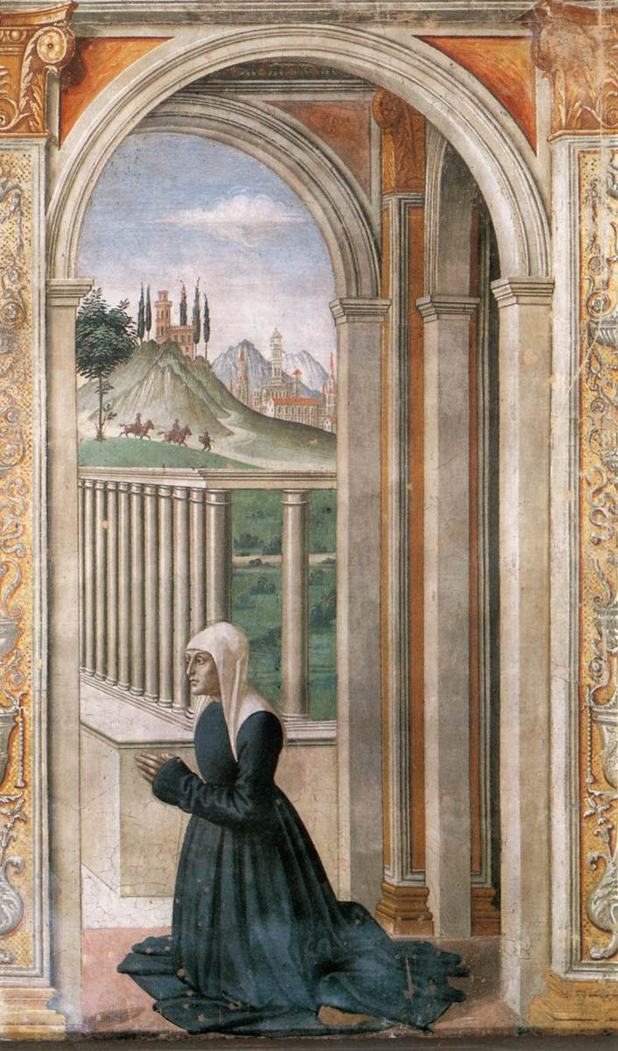
Portrait of the Donor Giovanni Tornabuoni, 1486-90, Fresco,
Cappella Tornabuoni, Santa Maria Novella, Florence
Portrait of the Donor Francesca Pitti-Tornabuoni, 1486-90
Fresco, Cappella Tornabuoni, Santa Maria Novella, Florence

Slide 13
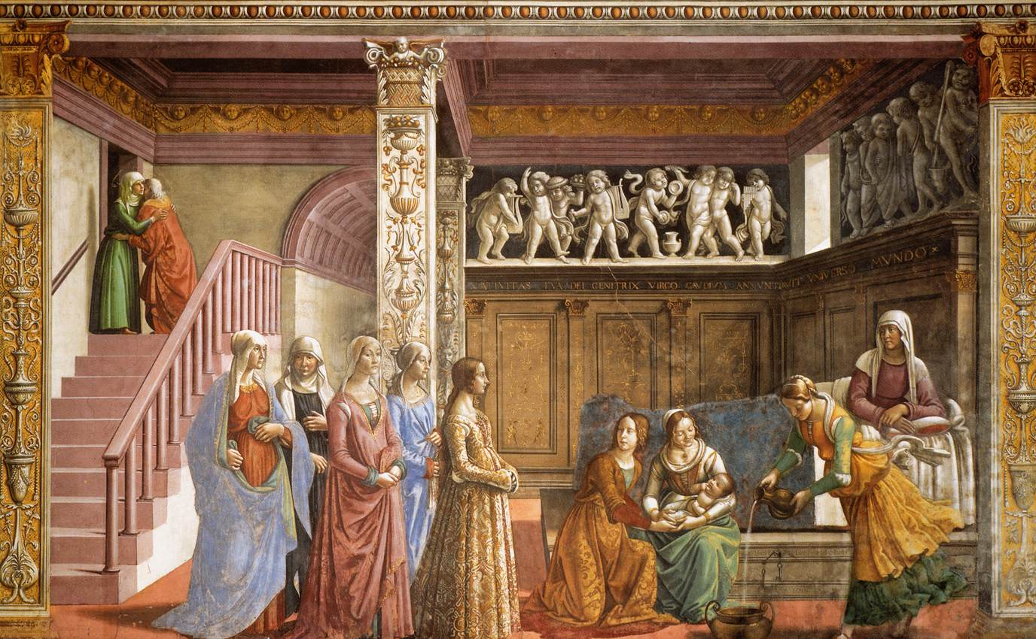
Birth of Mary, Frescoes on the left wall: Stories of the Virgin,
W. 450 cm,
Cappella Tornabuoni, Santa Maria Novella, Florence

Slide 14
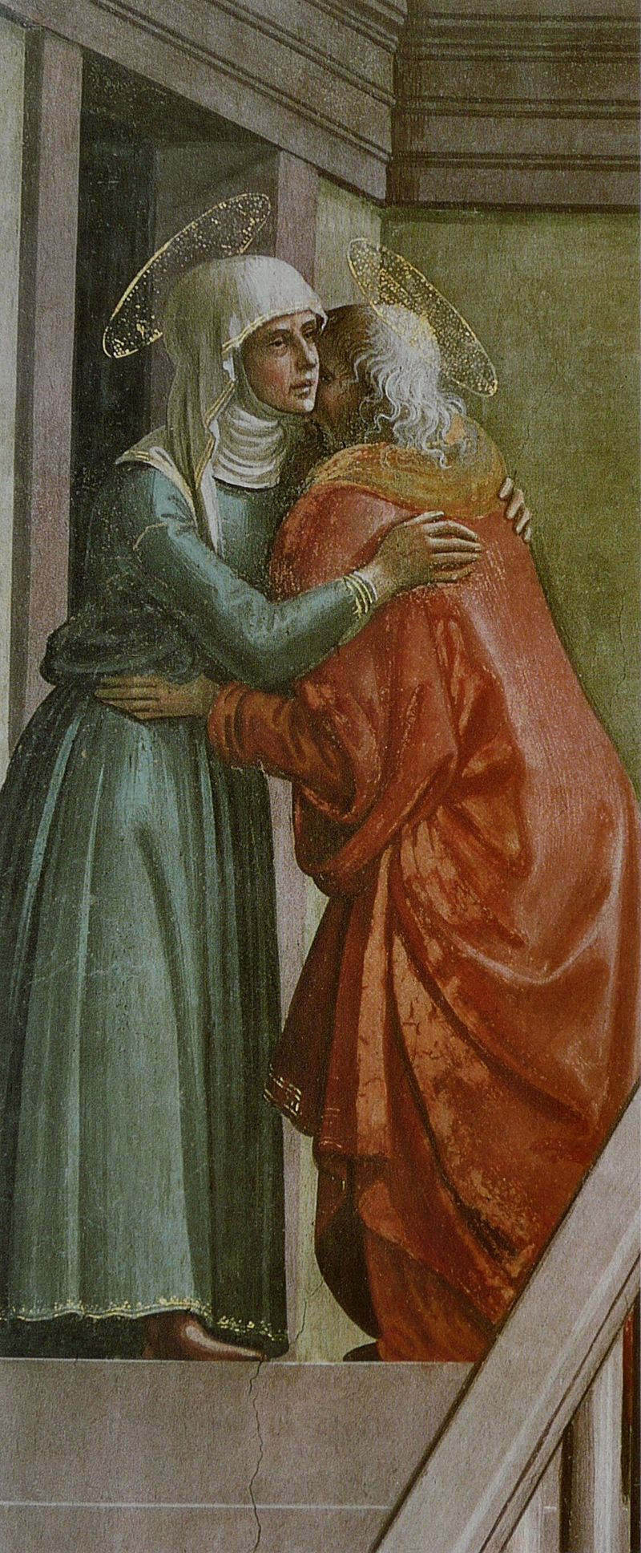
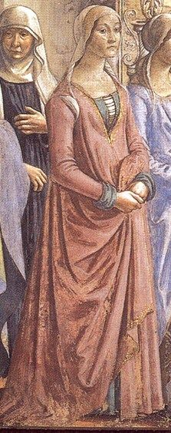
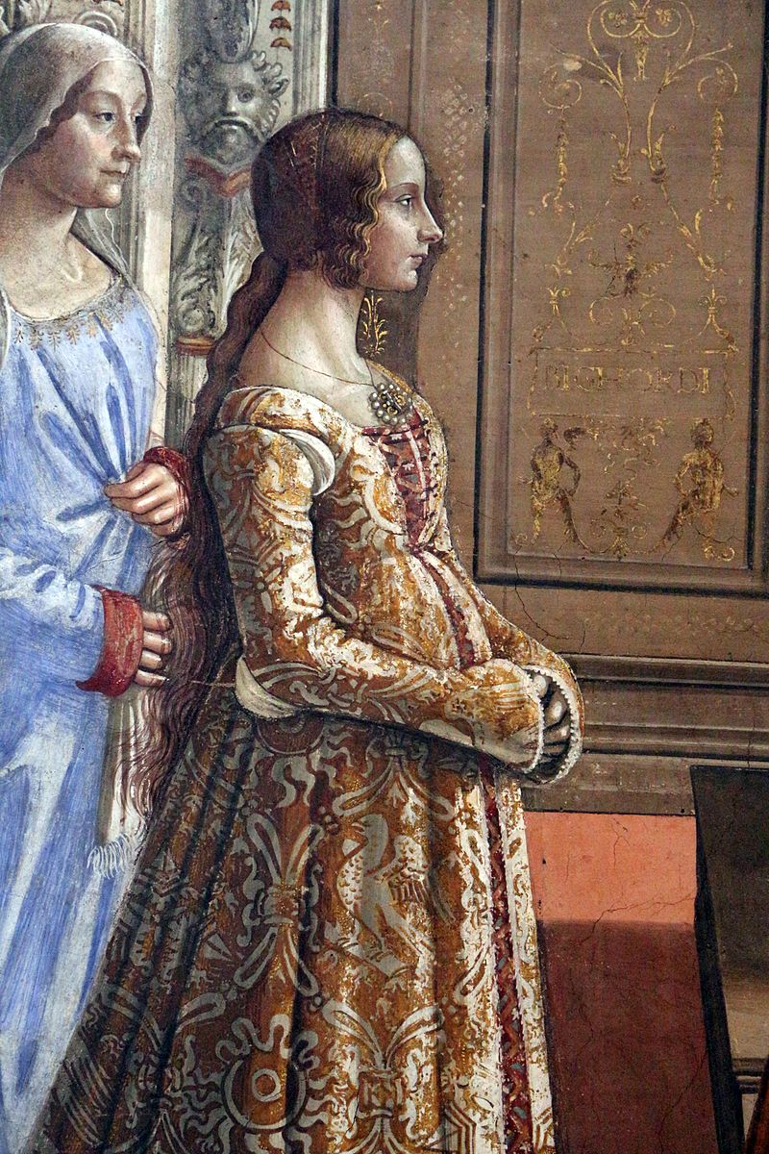
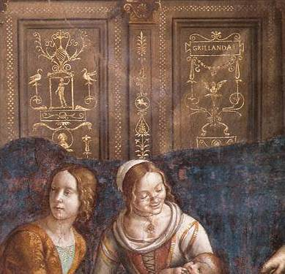

Slide 15
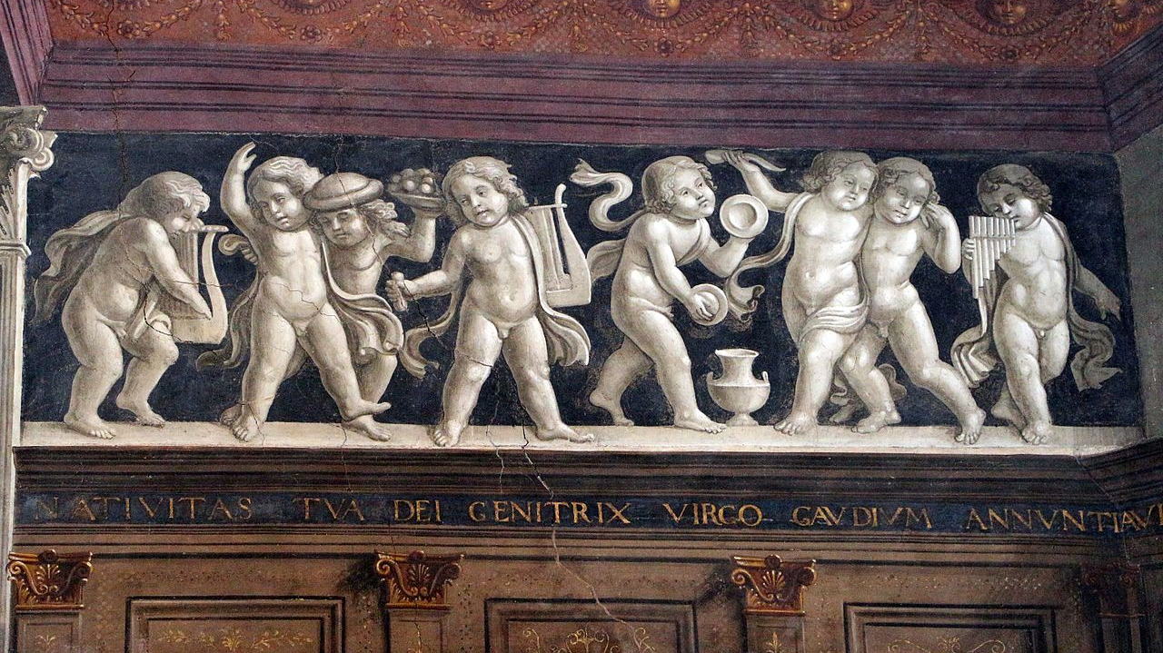

Slide 16
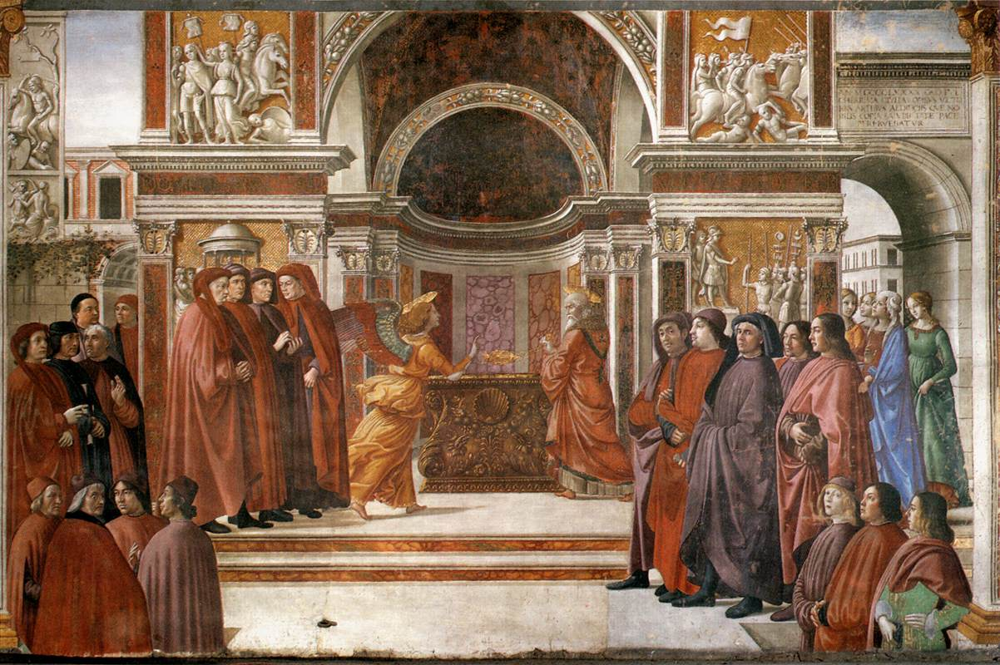
Angel Appearing to Zacharias, 1486-90,
Frescoes on the right wall: Stories of St John the Baptist,
W. 450 cm, Cappella Tornabuoni, Santa Maria Novella, Florence

Slide 17
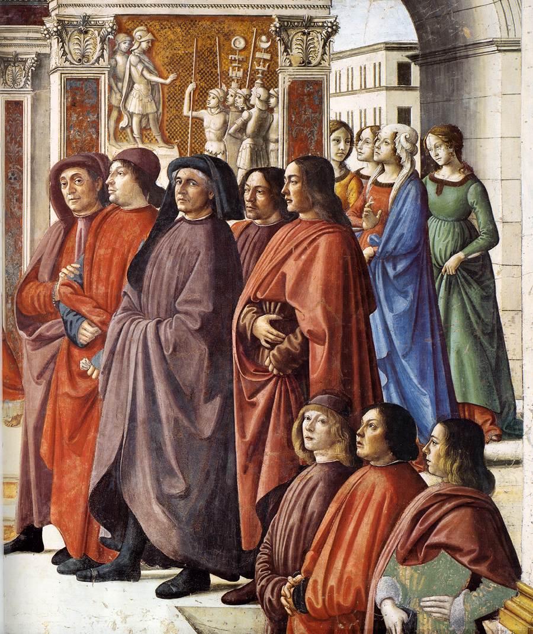
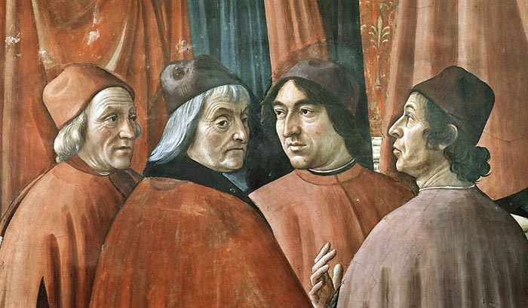
Four humanist philosophers under the patronage of the Medici: Marsilio Ficino, Cristoforo Landino, Angelo Poliziano and Demetrios Chalkondyles
The figures standing on the right are relatives of the patron; behind them is a self-portrait of Ghirlandaio (the second from right, next to a youngster with long hair, probably his son or brother

Slide 18
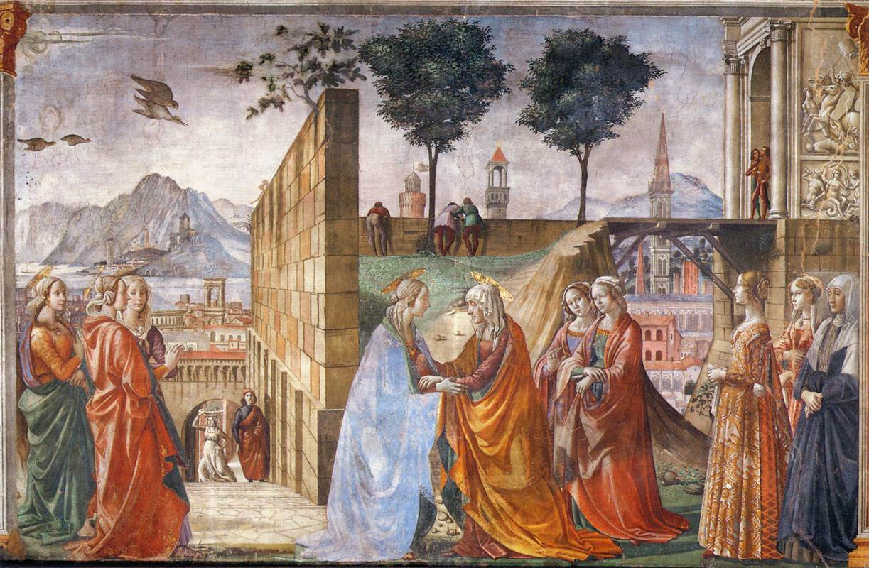
Visitation,
1486-90,
Fresco,
W. 450 cm
Cappella Tornabuoni, Santa Maria Novella, Florence

Slide 19
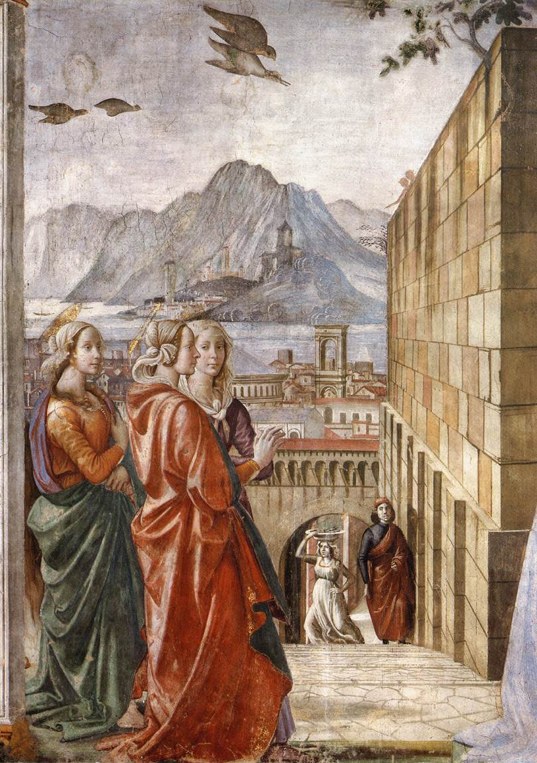
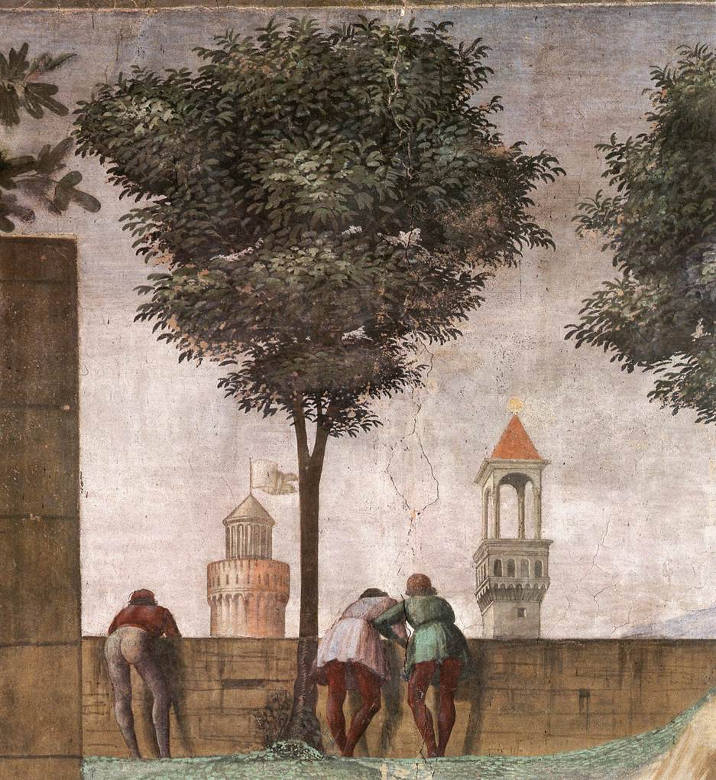

Slide 20
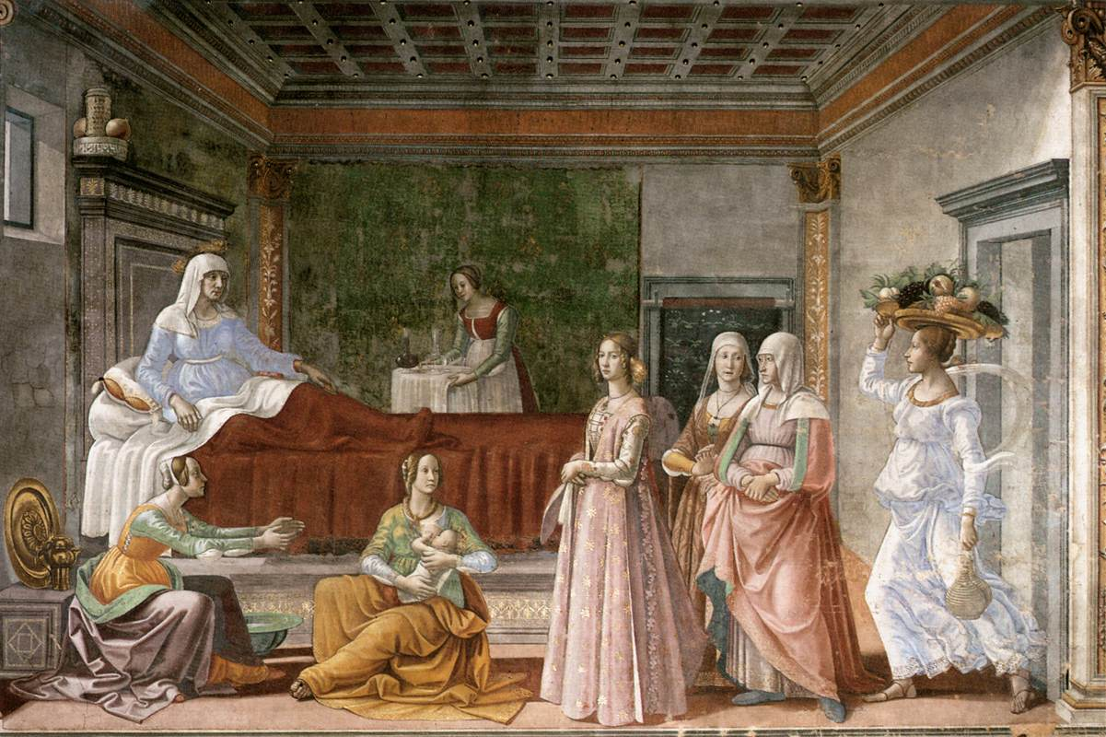
Birth of St John the Baptist,
1486-90,
Frescoes on the right wall: Stories of St John the Baptist,
W. 450 cm,
Cappella Tornabuoni, Santa Maria Novella, Florence

Slide 21
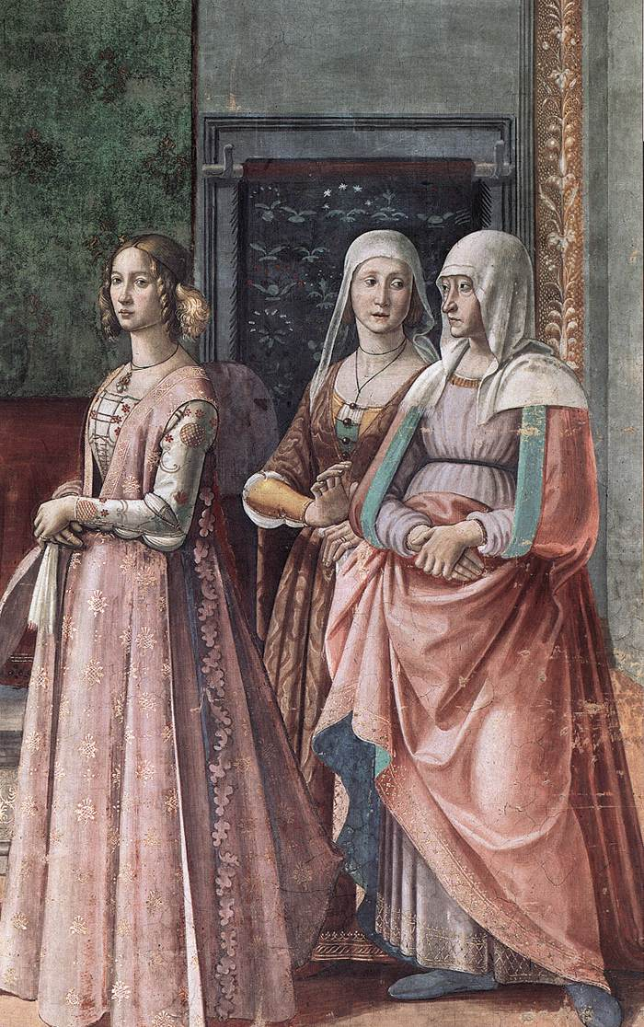
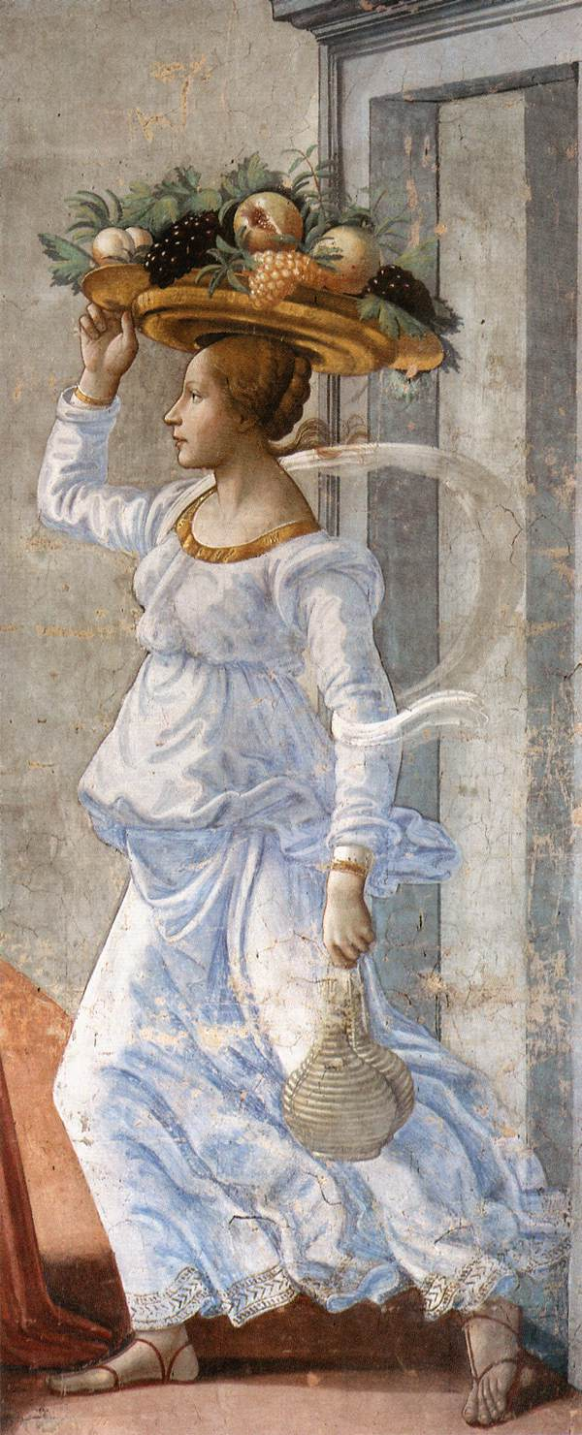
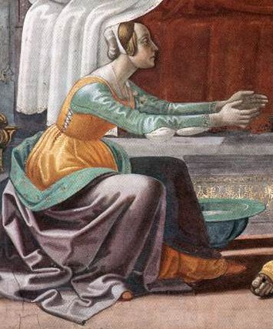

Slide 22
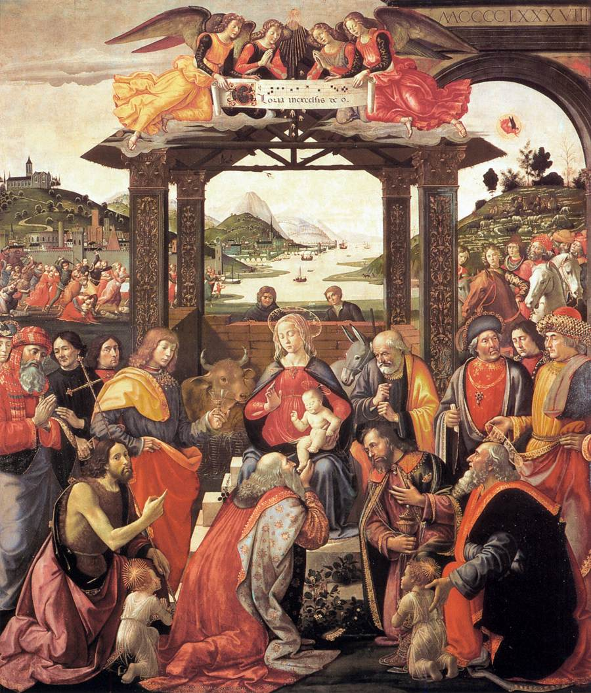
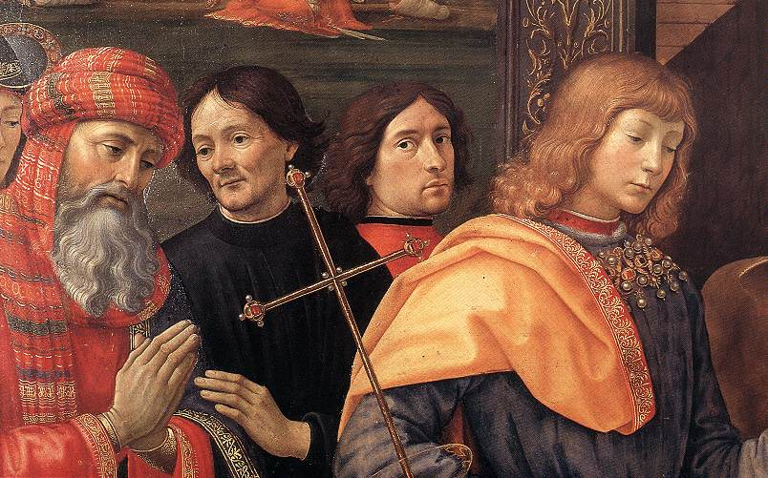
Adoration of the Magi, 1488,
Tempera on wood, 285 x 240 cm,
Spedale degli Innocenti, Florence

Slide 23
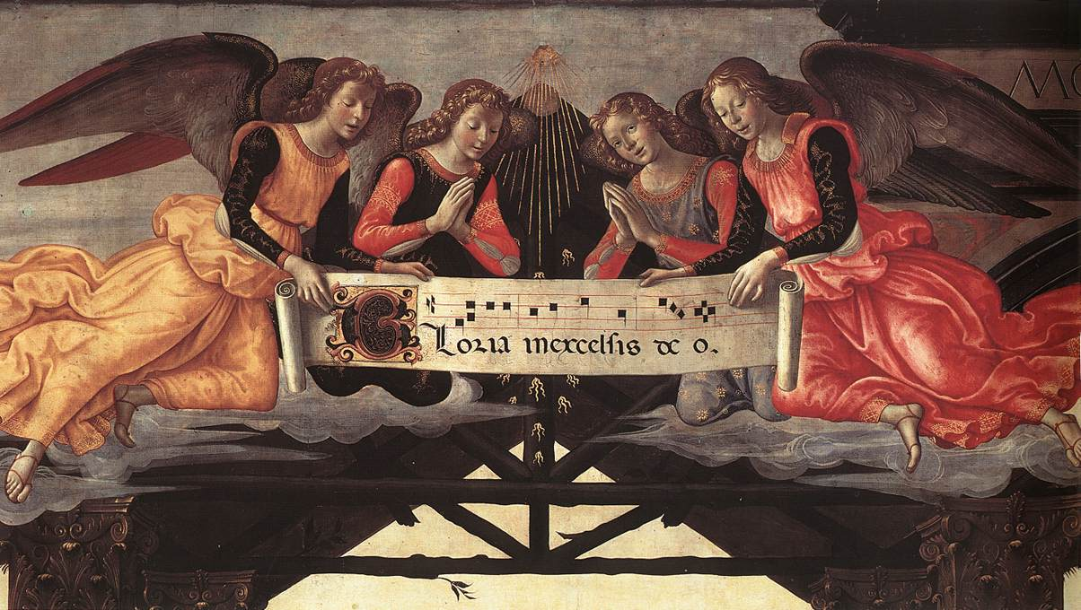

Slide 24
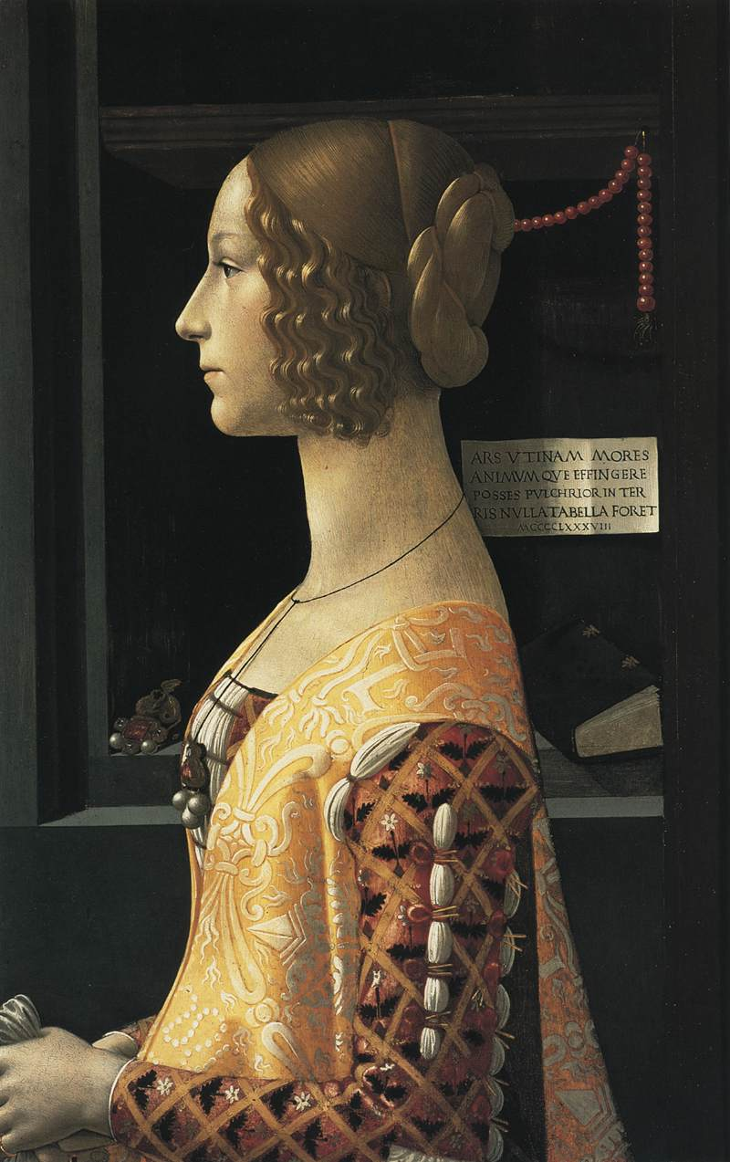
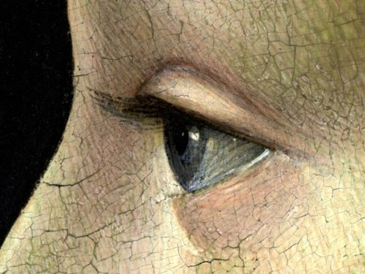
Portrait of Giovanna degli Albizzi Tornabuoni
1489 – 1490, Mixed media on panel. 77 x 49 cm
Museo Nacional Thyssen-Bornemisza, Madrid

Slide 25
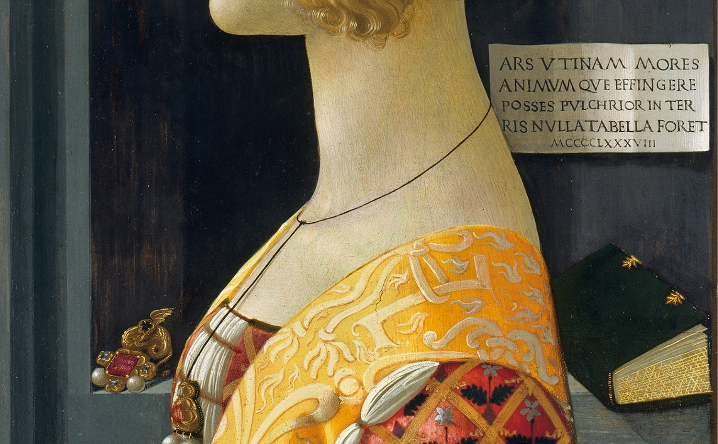

Slide 26
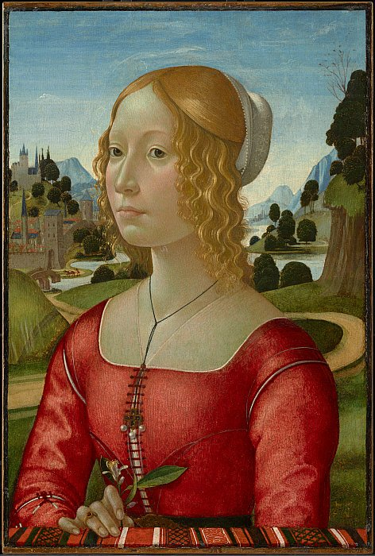
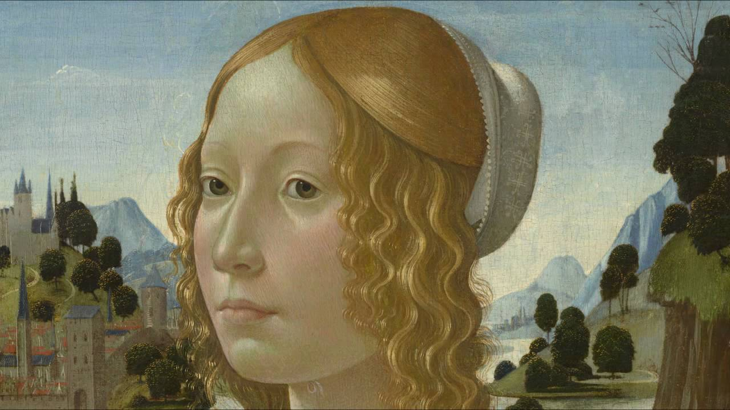
Portrait of a Lady, c. 1490, Tempera, oil, and gold on panel, 56.1 x 37.7 cm, The Clark Art Institute, Williamstown, MA, USA

Slide 27
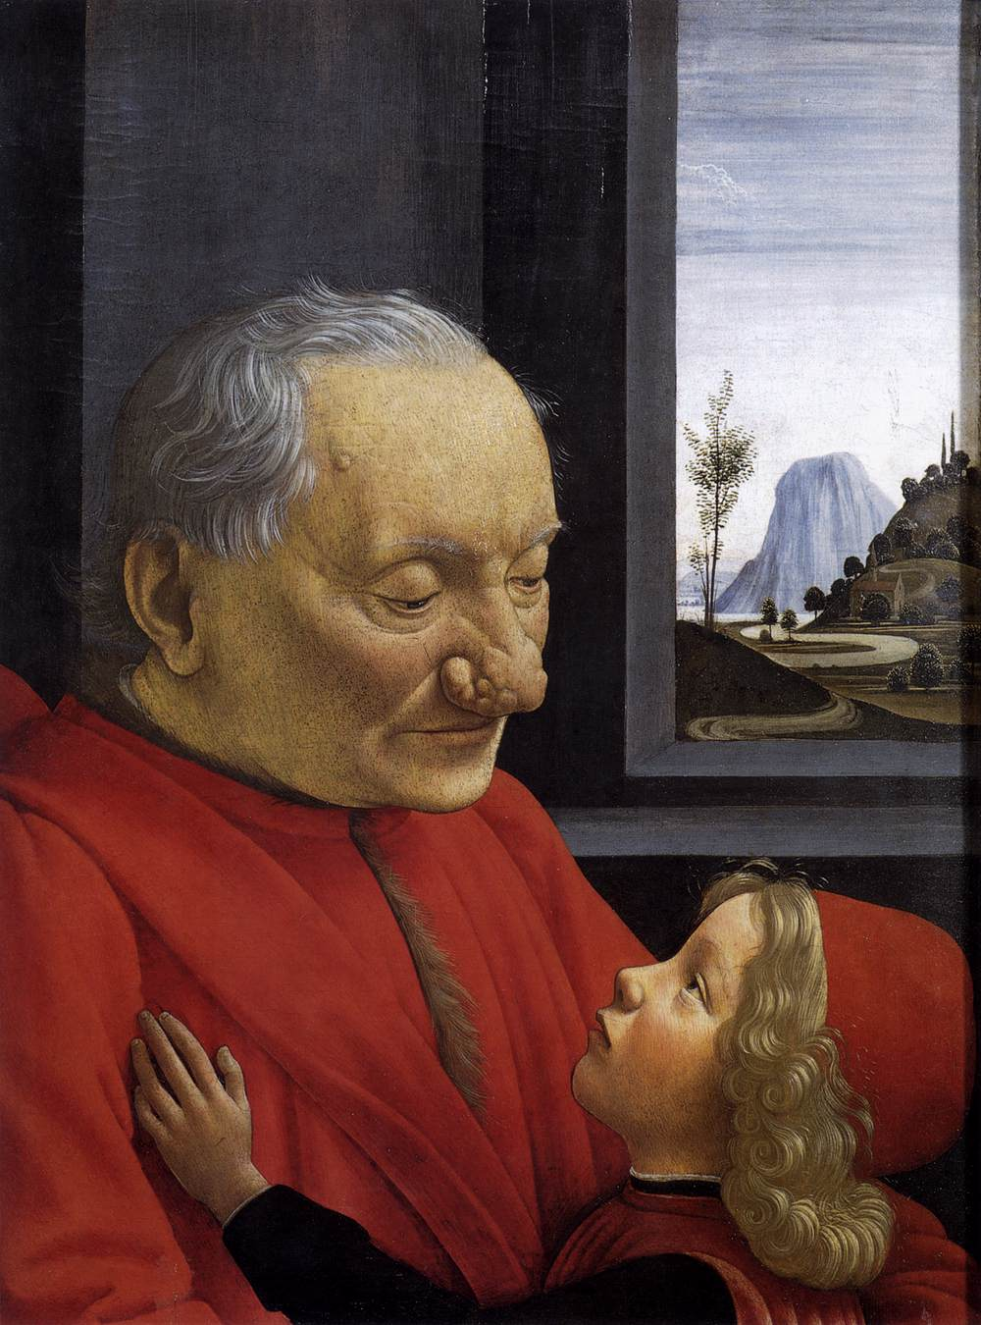
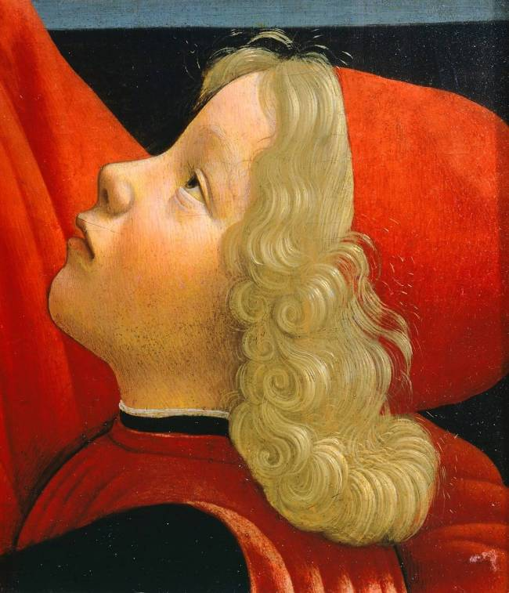
An Old Man and his Grandson, c. 1490, Tempera on wood, 62 x 46 cm, Musée du Louvre, Paris

Slide 28
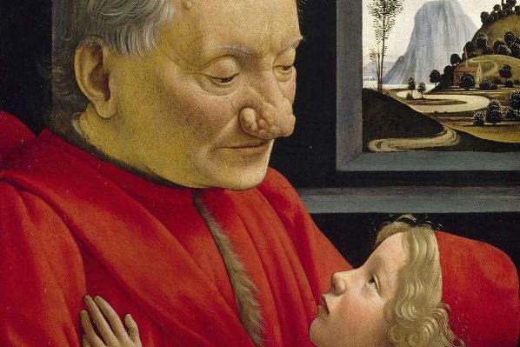

Slide 29
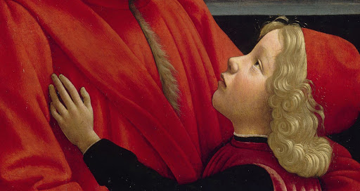

Slide 30
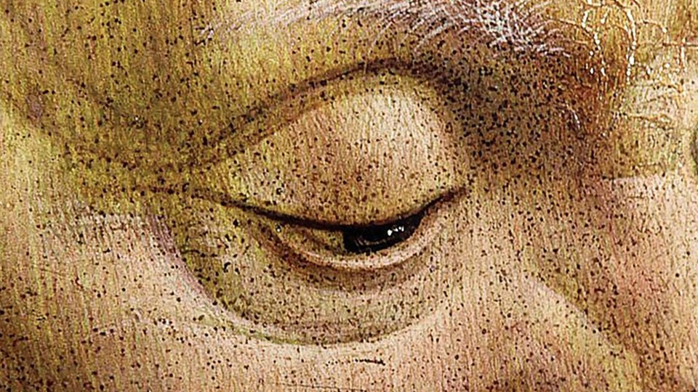

Slide 31
Thank you,
Domenico Ghirlandaio

