Slide 1
From the
Church of the
Holy Martyr Polyeuktos
in Constantinople…
to Venice
the Pilastri Acritani
In Western Art

Slide 2
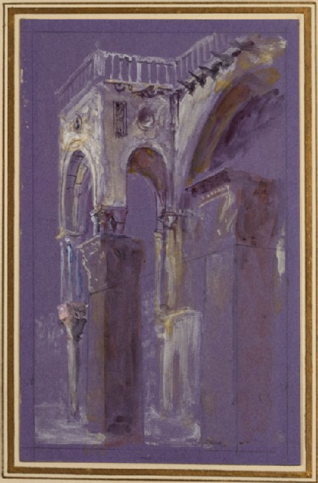

Slide 3
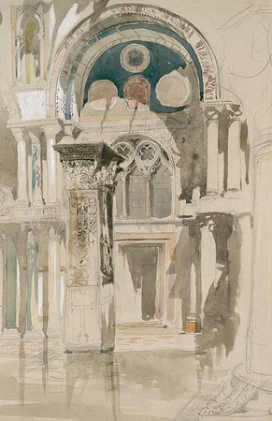

Slide 4
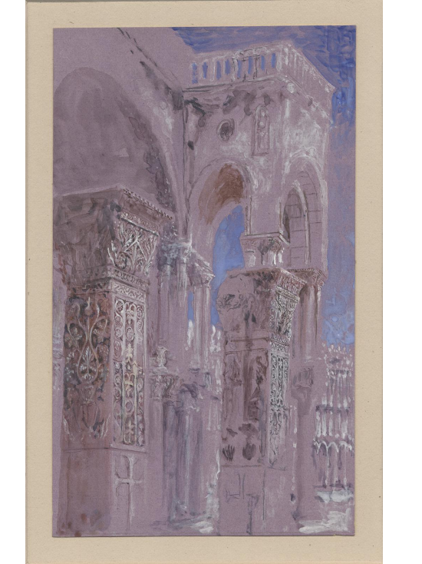

Slide 5
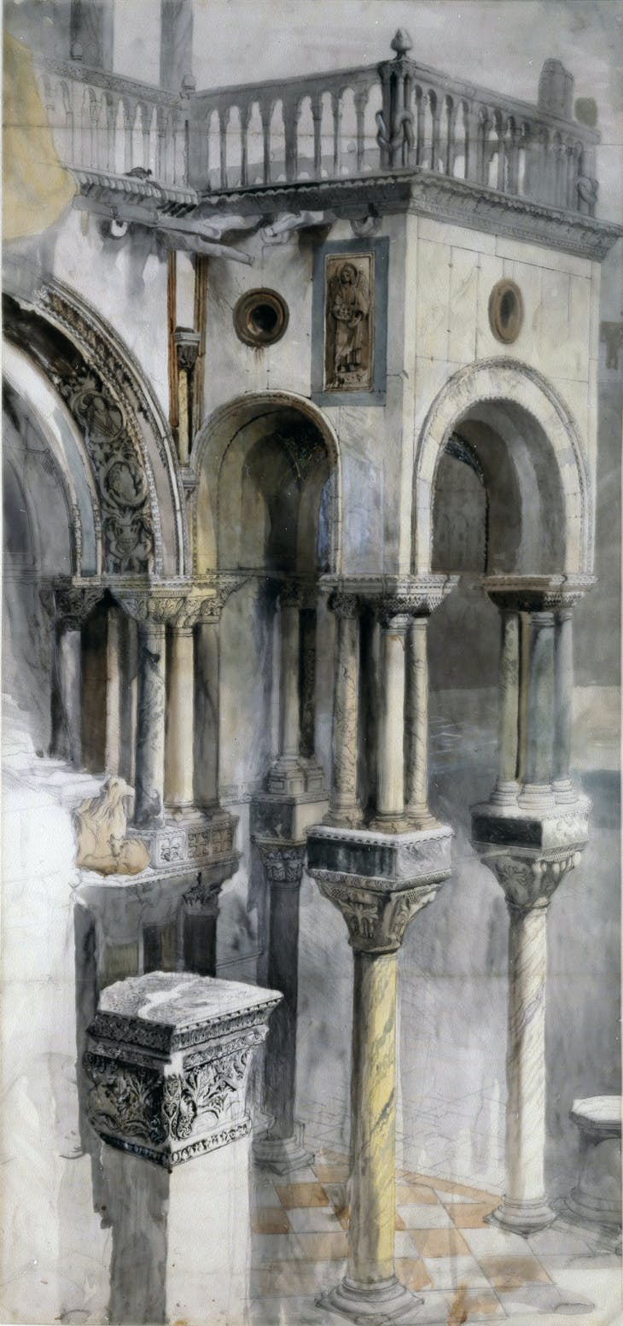

Slide 6
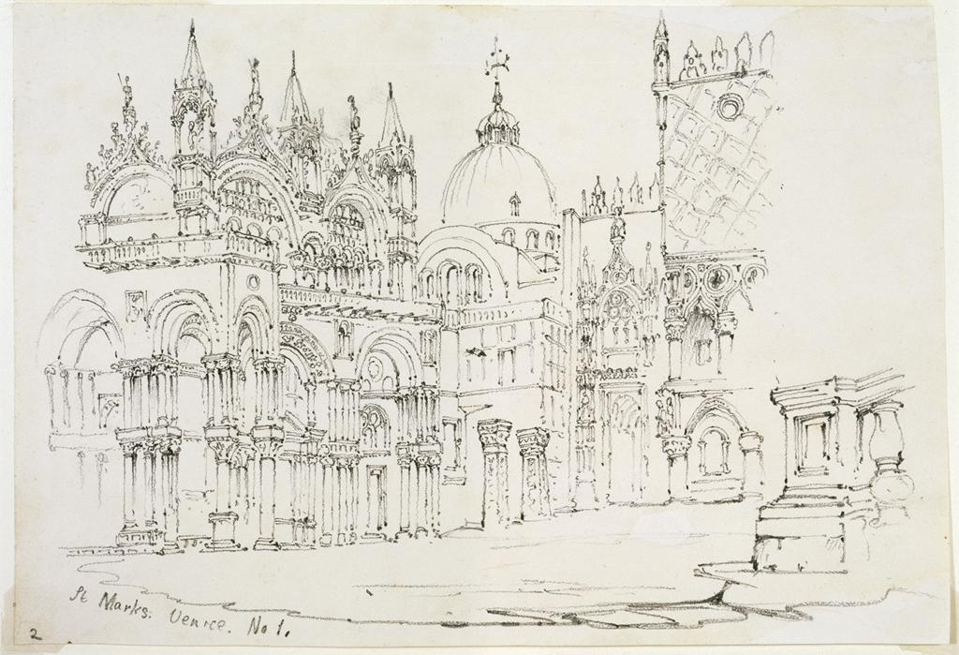

Slide 7
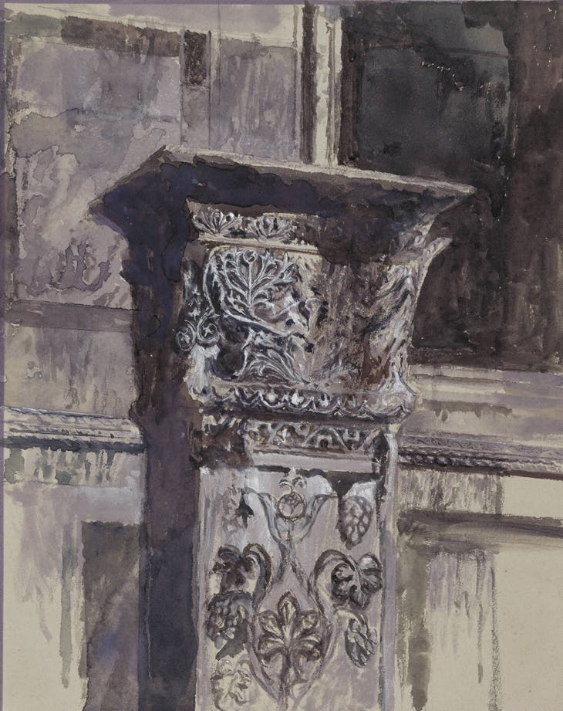

Slide 8
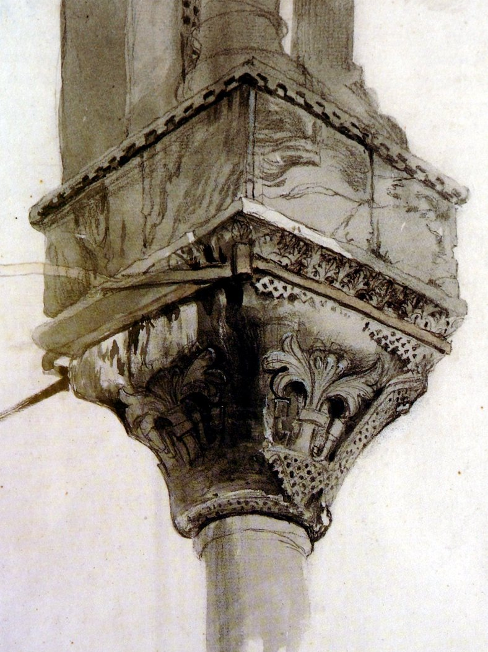

Slide 9
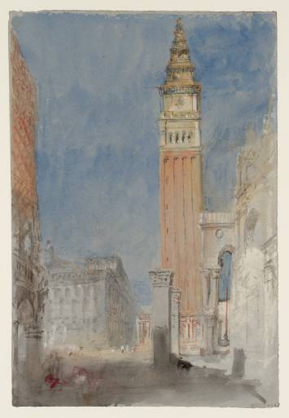

Slide 10
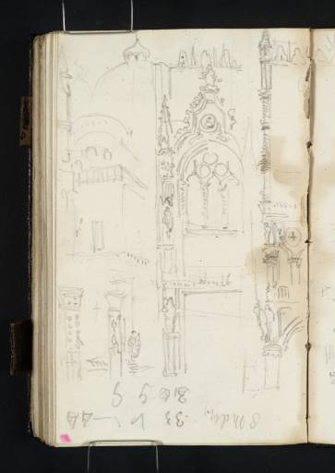

Slide 11
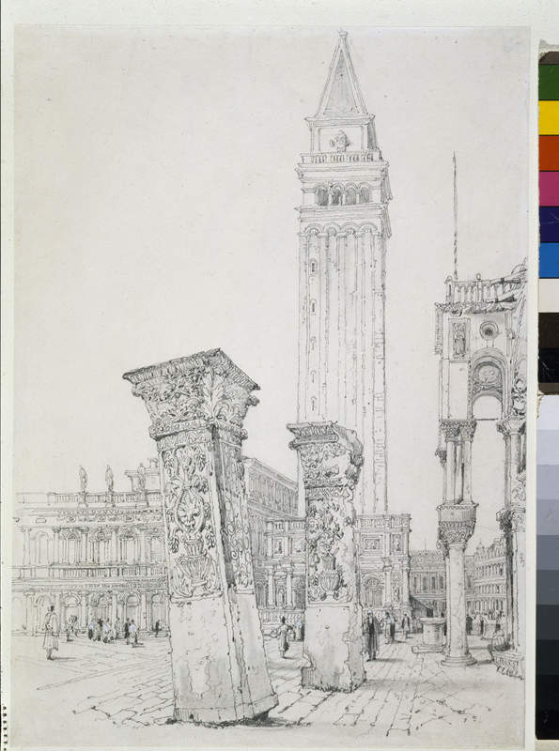

Slide 12
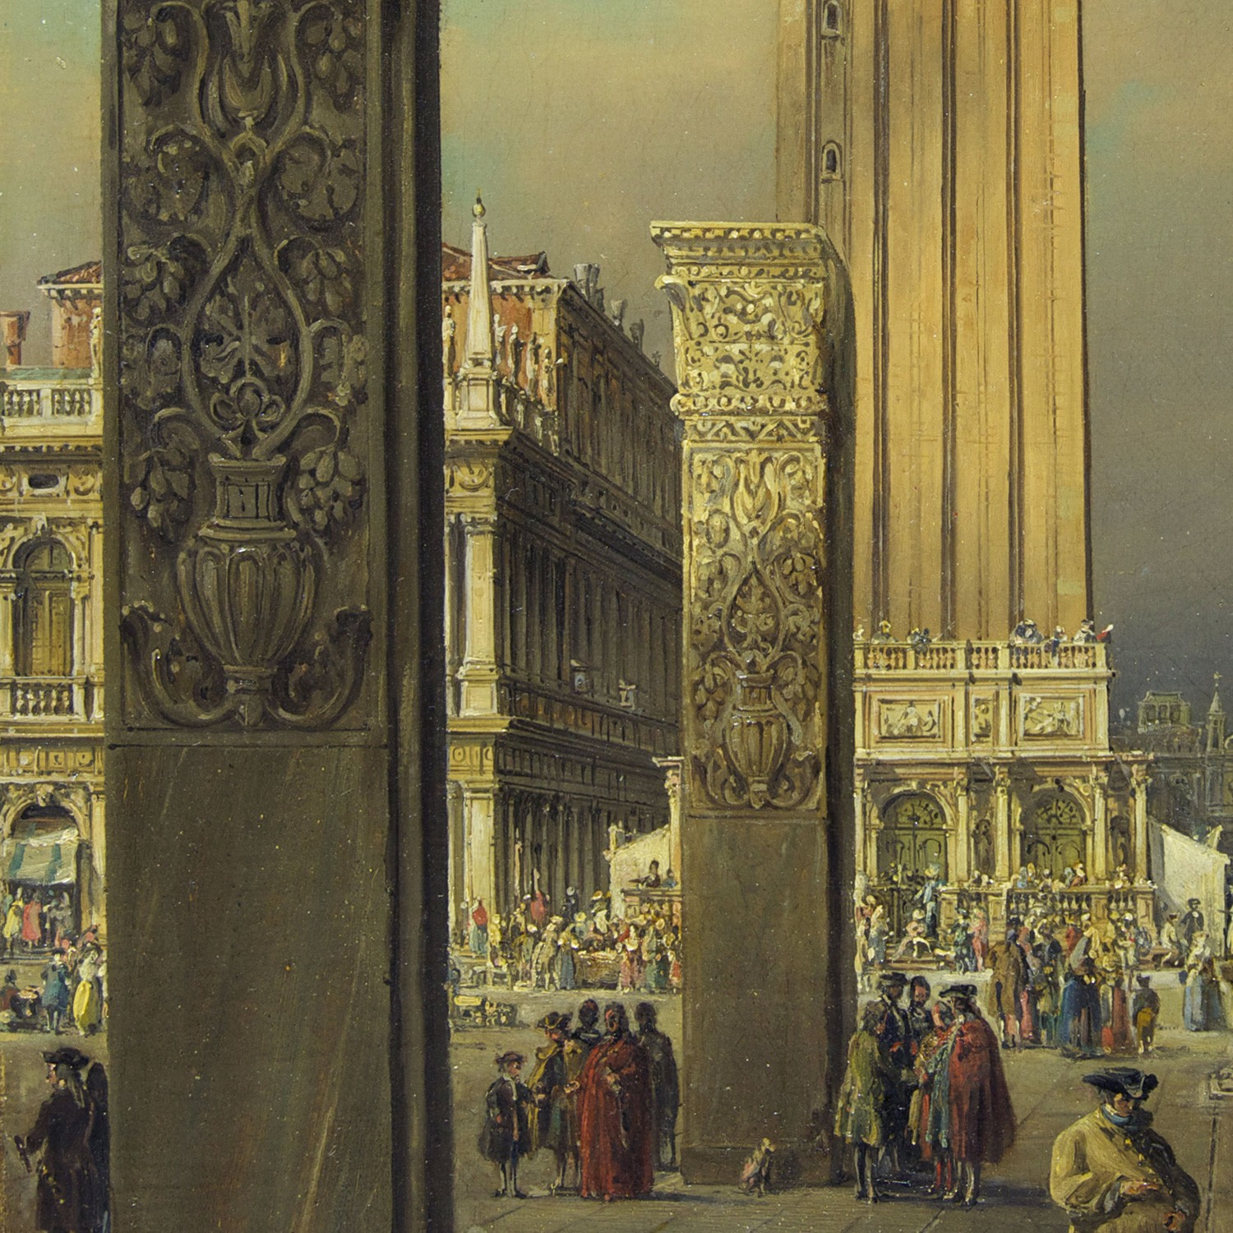
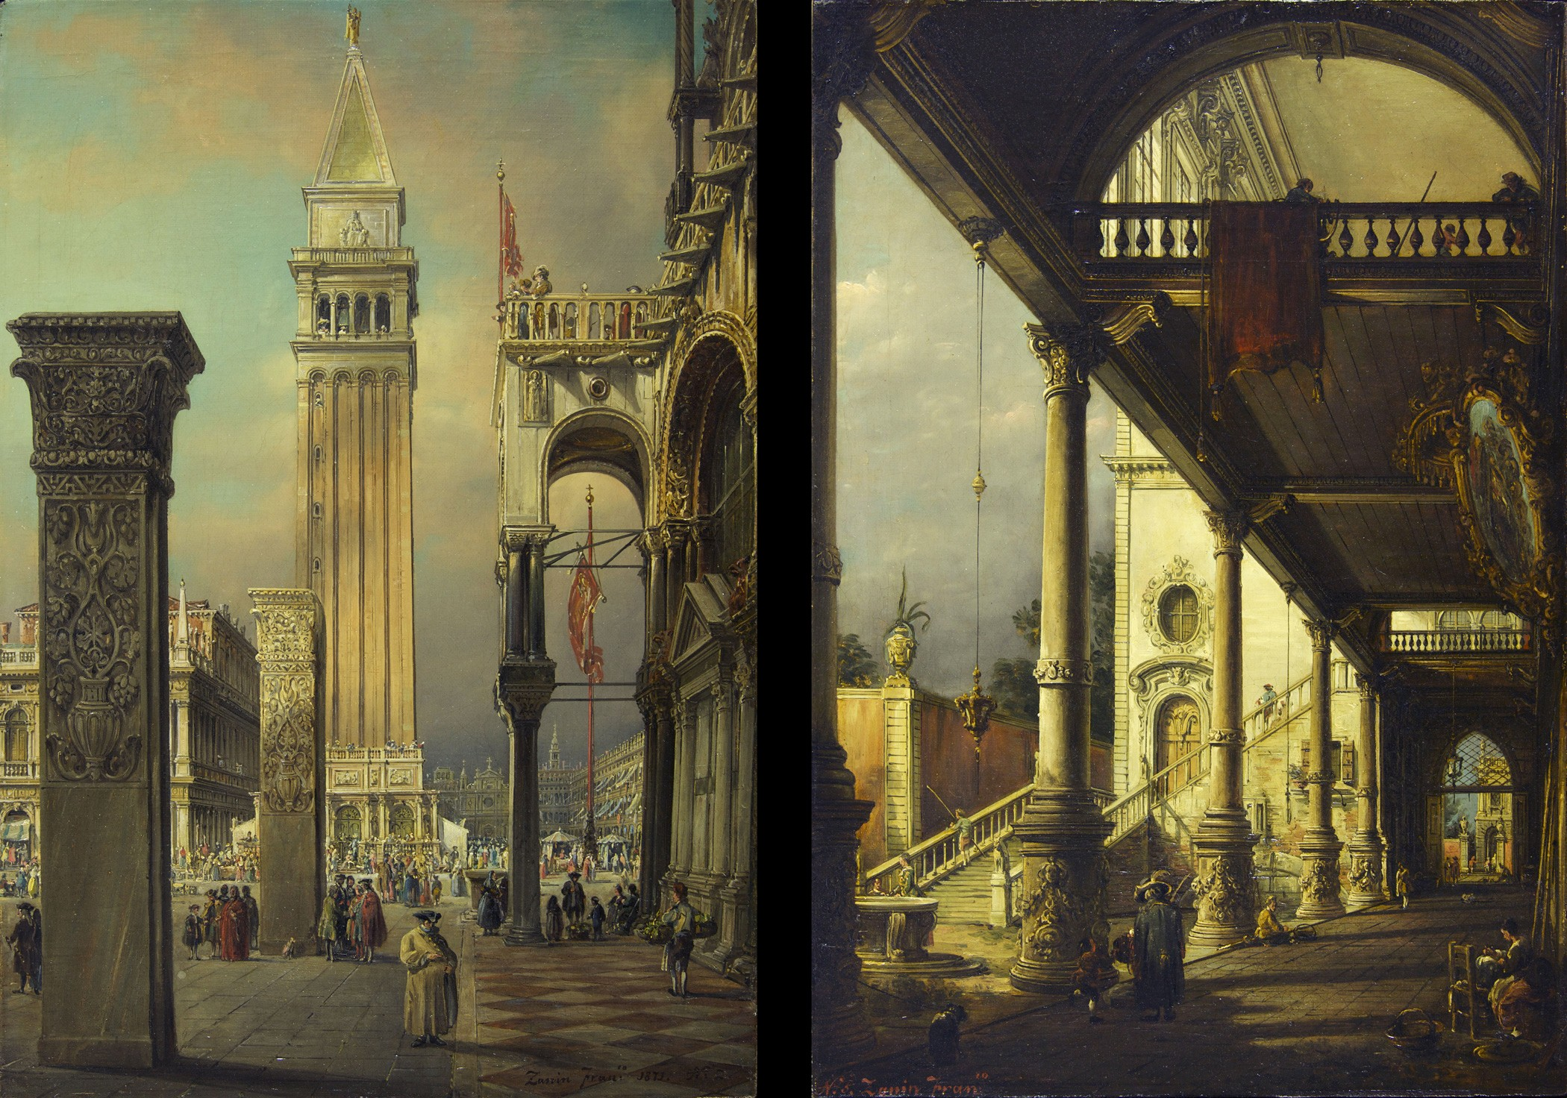

Slide 13
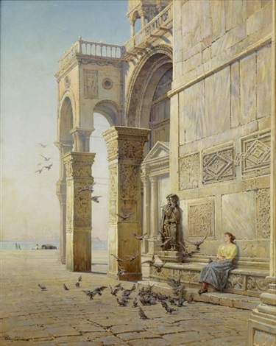

Slide 14
1. Title
2. John Ruskin, 1819 – 1900
The Saint Jean d'Acre Pillars and the south-west Corner of Saint Mark's Basilica, Venice, 1846, drawing, watercolour and bodycolour over graphite on purple wove paper, 164 x 103 mm, © University of Oxford - Ashmolean Museum http://ruskin.ashmolean.org/collection/8995/per_page/100/offset/200/sort_by/relevance/object/14539
3. John Ruskin, 1819 – 1900
Part of Saint Mark's Basilica, Venice: Sketch after Rain, 1846, drawing, watercolour and bodycolour and ink over graphite on grey wove paper, 421 x 286 mm, © University of Oxford - Ashmolean Museum https://www.tripadvisor.ca/LocationPhotoDirectLink-g187801-d9990291-i310401485-Colombo_Group-Bologna_Province_of_Bologna_Emilia_Romagna.html
4. John Ruskin, 1819 – 1900
The St Jean d'Acre columns with the south side of St Mark's, Venice; two detached columns, covered with sculptured ornament, standing in front of St Mark's, with portico behind, copied from a daguerrotype which reversed the image. 1879, watercolour, heightened with white, on purple paper, 150x90 millimetres, The British Museum https://www.britishmuseum.org/collection/object/P_1901-0516-2
5. John Ruskin, 1819 – 1900
Southern front of the Basilica di San Marco, from the loggia of the Palazzo Ducale, 1851, Private collection, Courtesy of the Trustees of the British Museum https://www.apollo-magazine.com/john-ruskins-visions-of-venice/

Slide 15
6. John Ruskin, 1819 – 1900
Venice, Piazza di San Marco and Basilica, 1835, Drawing, graphite on cream wove paper, 16.8275 x 24.765 cm, Smith College Museum of Art, Northampton, MA https://museums.fivecolleges.edu/detail.php?museum=sc&t=objects&type=ext&f=&s=&record=53&object_type=drawing&earliest_year=1750&op-earliest_year=%3E%3D&latest_year=1900&op-latest_year=%3C%3D
7. John Ruskin, 1819 – 1900
St Jean d’Acre pillar on the southern side of the Basilica di San Marco, 1879, British Museum, London https://www.apollo-magazine.com/john-ruskins-visions-of-venice/
8. John Ruskin, 1819 – 1900
Study of a basket and lily capital, Basilica di San Marco, Venice pencil and grey wash, heightened with touches of white, 3.5 x 16.5 cm, private collection https://www.thebyzantinelegacy.com/pilastri-acritani
9. Joseph Mallord William Turner, 1775–1851
The Campanile and Piazza of San Marco (St Mark’s Square), Venice, with the Pilastri Acritani beside the Basilica, from the Porta della Carta of the Palazzo Ducale (Doge’s Palace), 1840, Gouache, pencil and watercolour on grey wove paper, 282 x 191 mm, TATE, London https://www.tate.org.uk/art/research-publications/jmw-turner/joseph-mallord-william-turner-the-campanile-and-piazza-of-san-marco-st-marks-square-venice-r1197042

Slide 16
10. Joseph Mallord William Turner, 1775–1851
The Porta della Carta of the Palazzo Ducale (Doge's Palace), Venice, with the Basilica of San Marco (St Mark's) and the Pilastri Acritani, 1840, Pencil on white wove paper, 149 x 89 mm, TATE, London https://www.tate.org.uk/art/research-publications/jmw-turner/joseph-mallord-william-turner-the-porta-della-carta-of-the-palazzo-ducale-doges-palace-r1196668
11. Samuel Prout, 1783-1852
The Pilastri Acritani in the Piazetta, with the Campanile, 1824, Pencil And Stump On Paper, Birmingham Museums and Art Gallery https://www.birminghammuseums.org.uk/explore-art/items/1931P32/piazza-di-san-marco-venice
12. Francesco Zanin, 1824-1884
Venice, St. Mark Square with the Acritani's Pillars, oil on canvas, 65,5 x 45,5 cm, Salamon Gallery, Milan https://www.salamongallery.com/dipinti_opera.php?codice=66
13. Jean-Baptiste-Arthur Calame, 1843-1919
Bei den Pilastri Acritani vor dem Markusdom in Venedig , 1896, oil on canvas, 80 x 64 cm, Private Collection http://www.artnet.com/artists/jean-baptiste-arthur-calame/bei-den-pilastri-acritani-vor-dem-markusdom-in-nKJd5rV_do5keVtG2P_L-w2

Slide 17
THE END…

