Slide 1
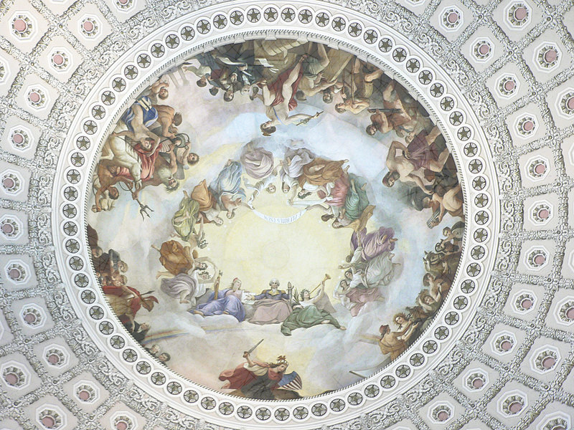
Constantino Brumidi, 1805–1880
Apotheosis of Washington, 1865, fresco, 4,664 square feet, the U.S. Capitol Building's Rotunda, Washington, DC

Slide 2
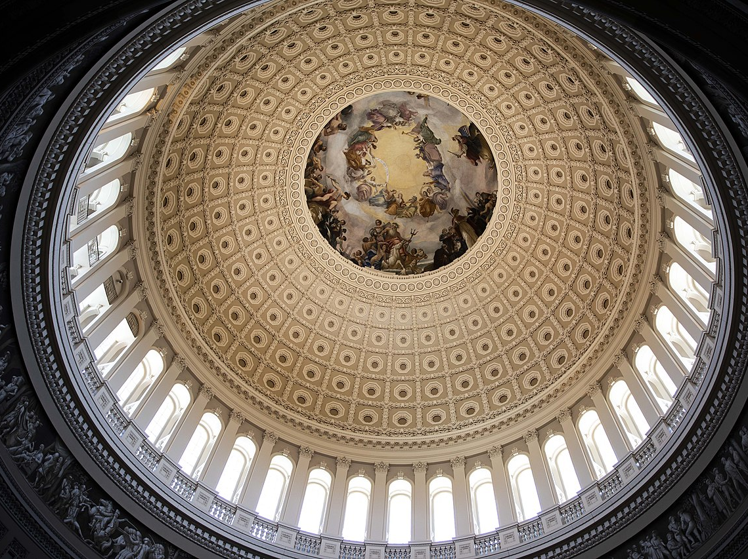

Slide 3
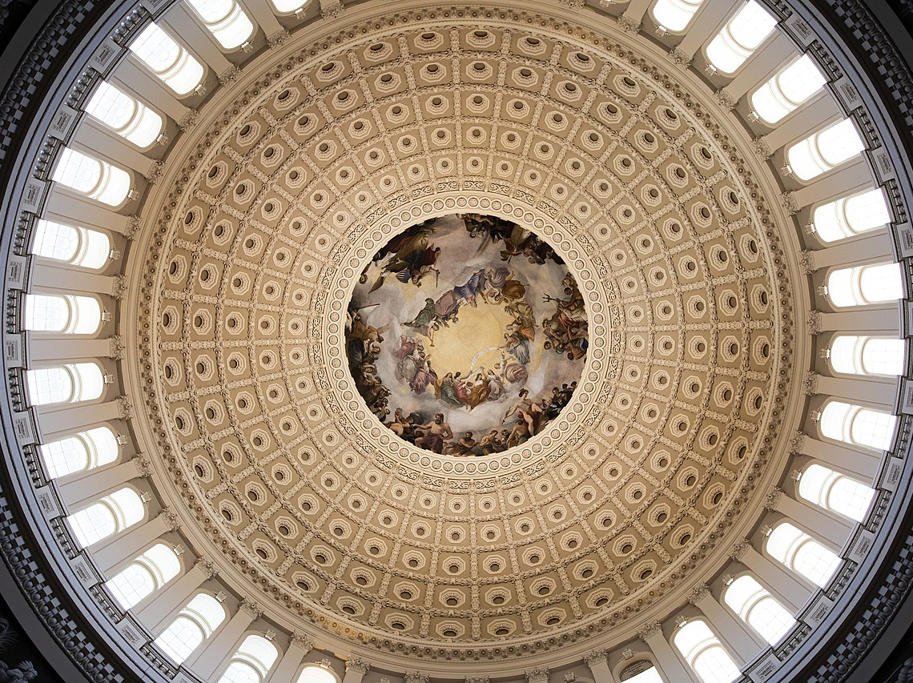

Slide 4
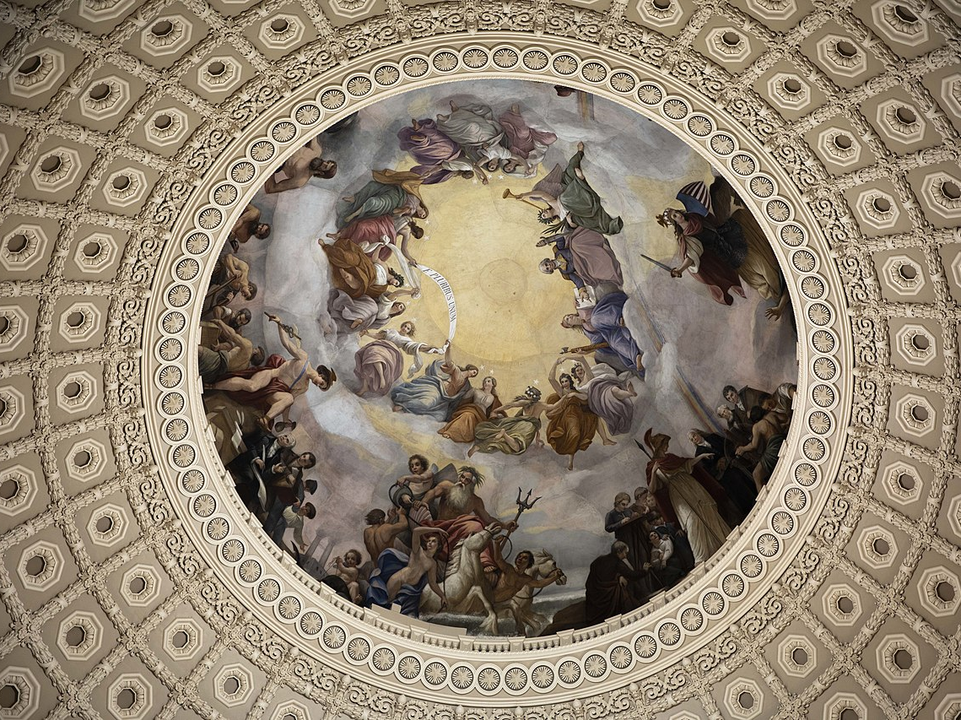

Slide 5
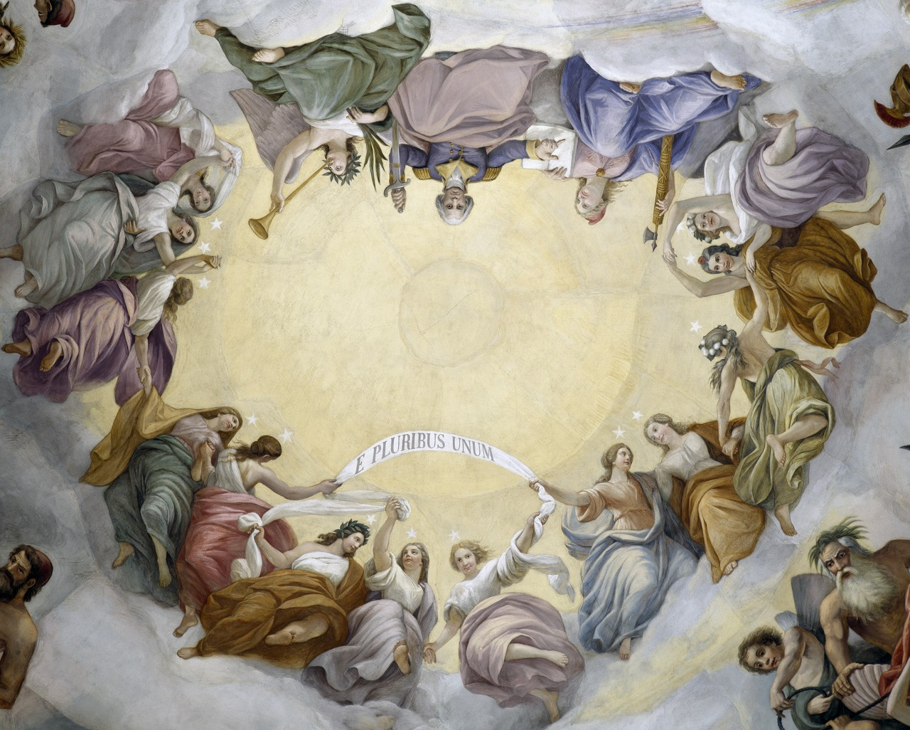

Slide 6
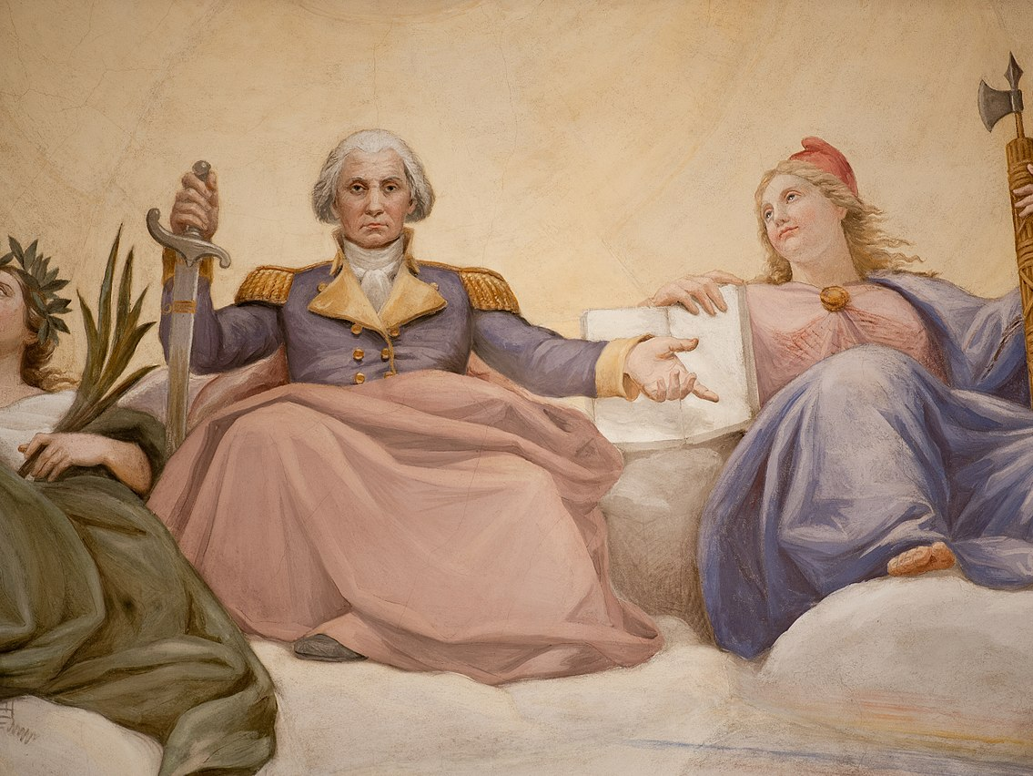

Slide 7
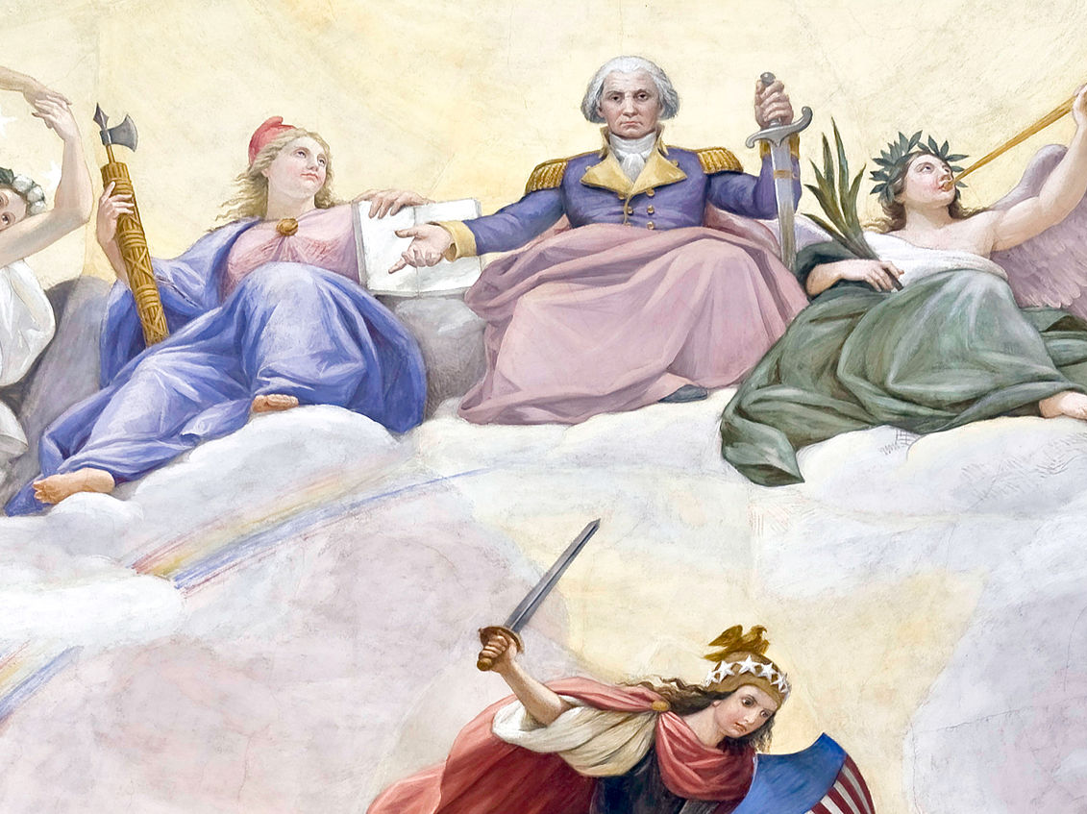

Slide 8
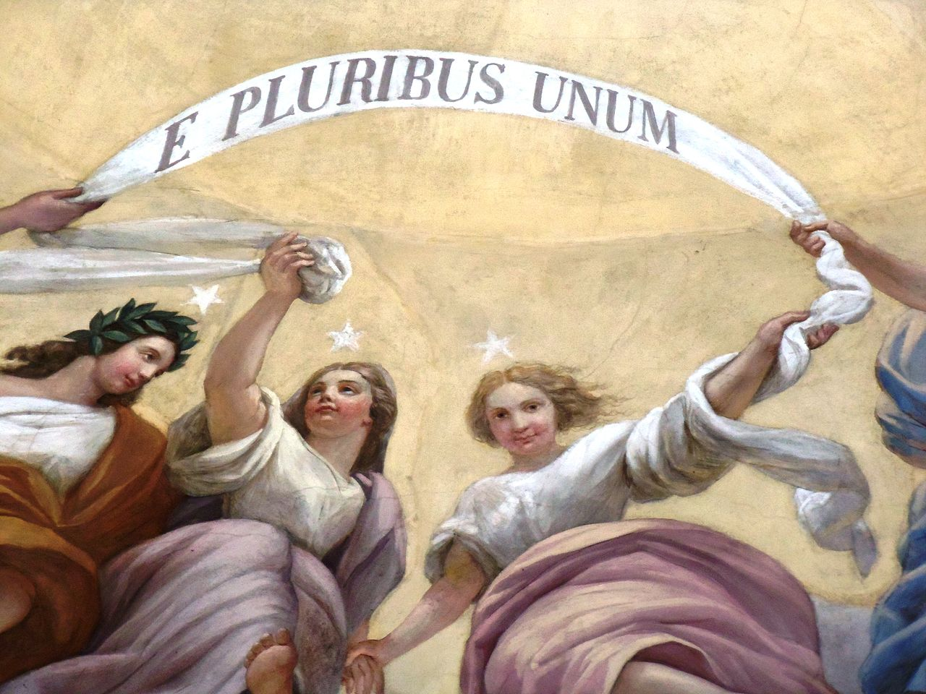

Slide 9
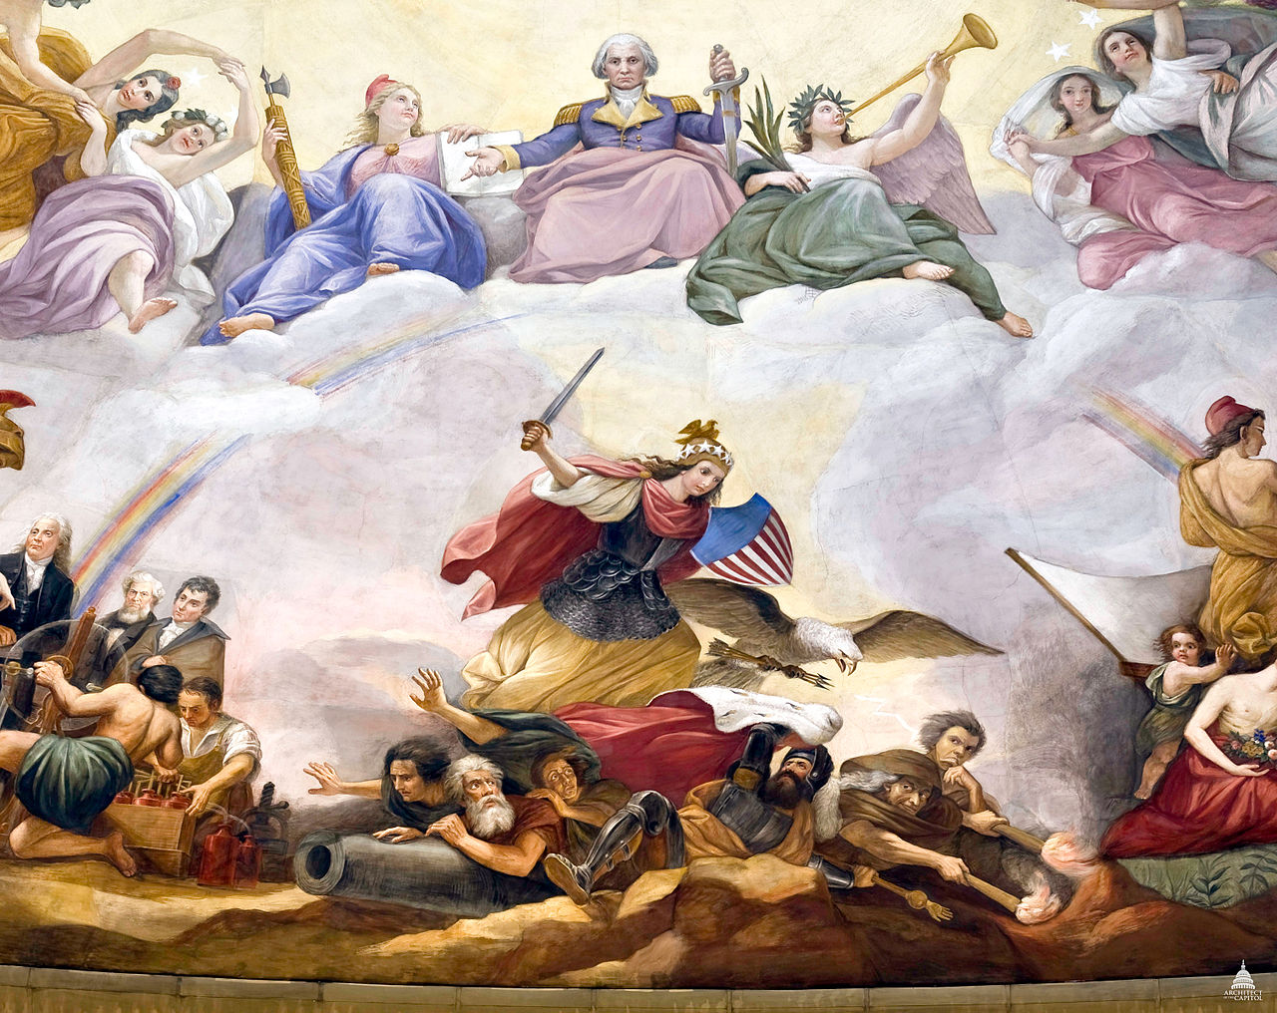
War, with Armed Freedom and the eagle defeating Tyranny and Kingly Power

Slide 10
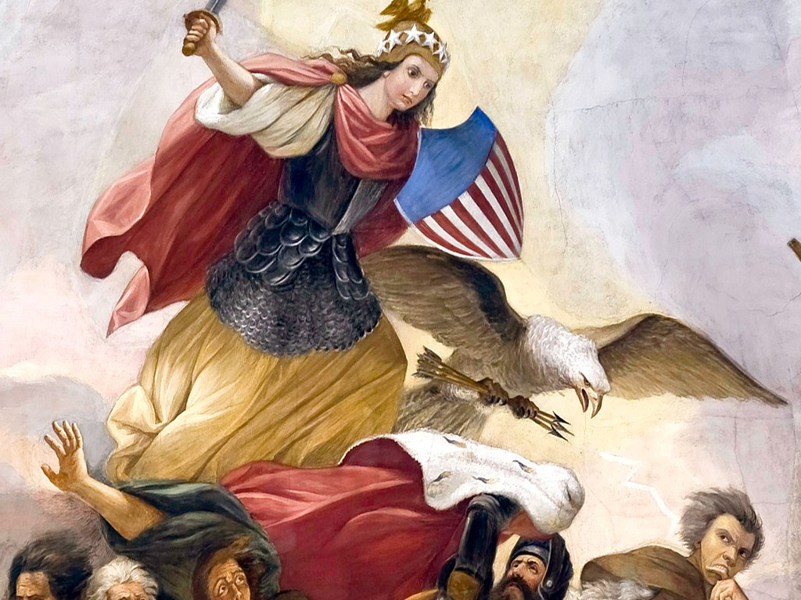

Slide 11
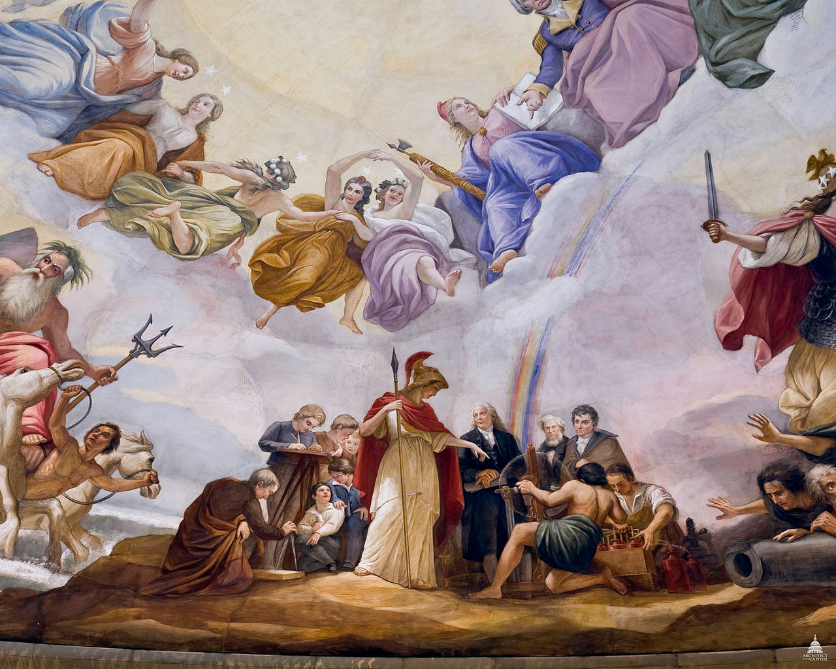
Science, with Minerva teaching Benjamin Franklin, Robert Fulton, and Samuel F.B. Morse

Slide 12
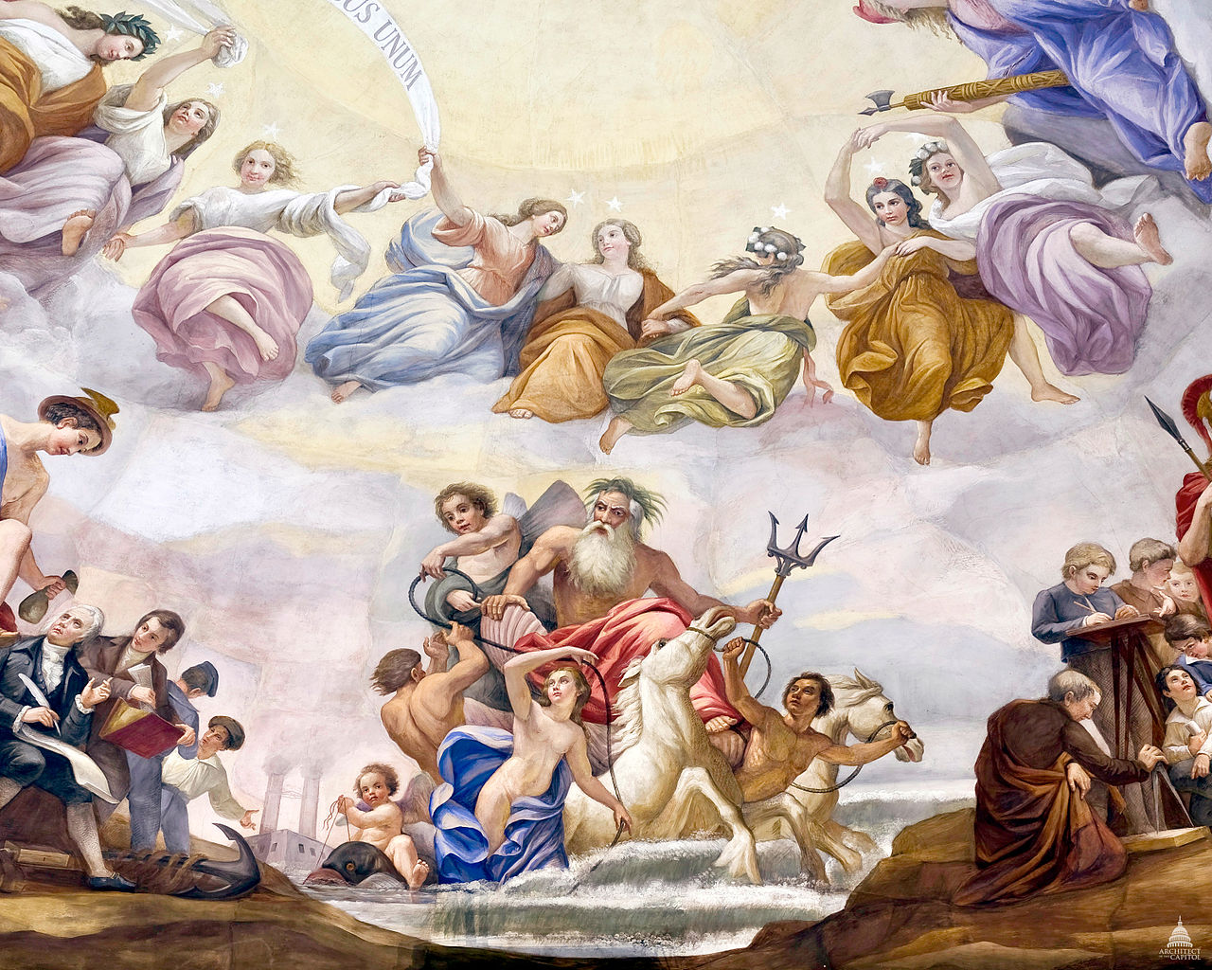
Marine, with Neptune holding his trident and Venus holding the transatlantic cable

Slide 13
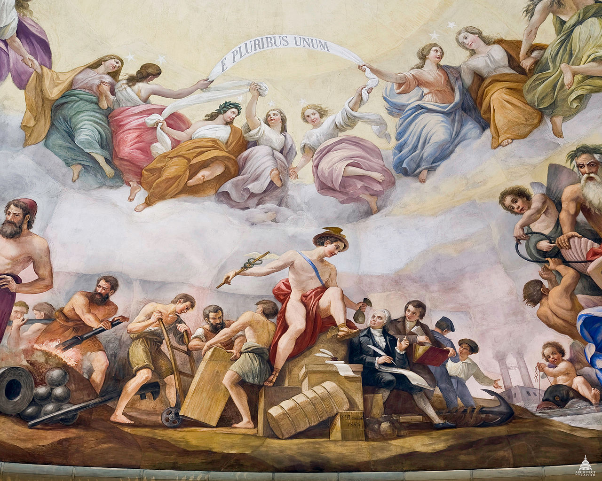
Commerce, with Mercury handing a bag of money to Robert Morris, financier of the American Revolution

Slide 14
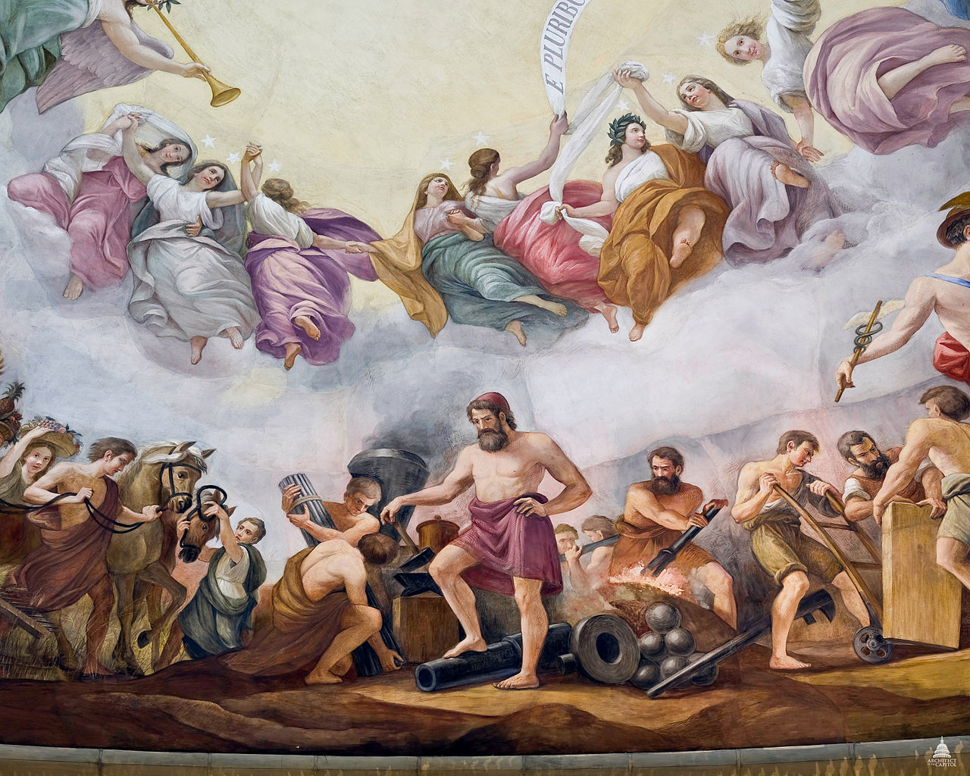
Mechanics, with Vulcan at the anvil and forge, producing a cannon and a steam engine

Slide 15
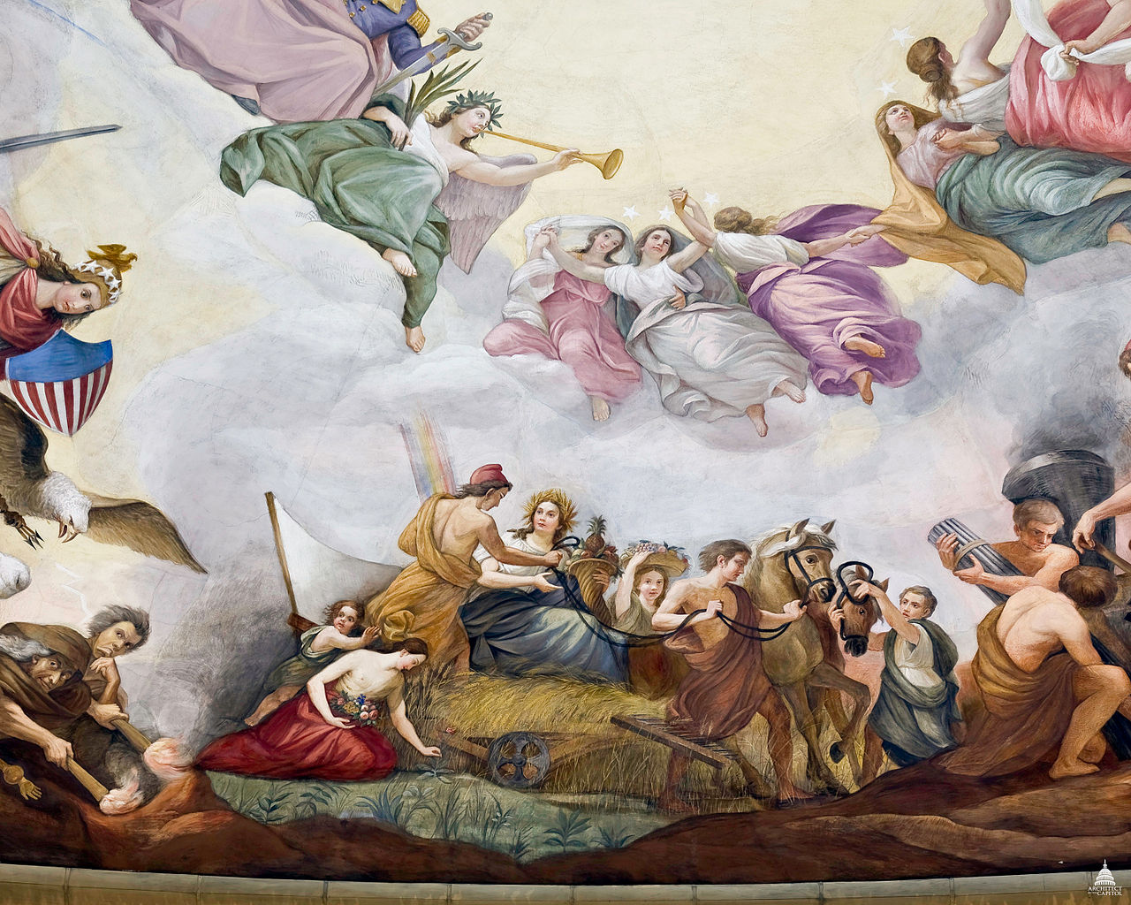
Agriculture, with Ceres seated on the McCormick Reaper, accompanied by America in a red liberty cap and Flora picking flowers

Slide 16
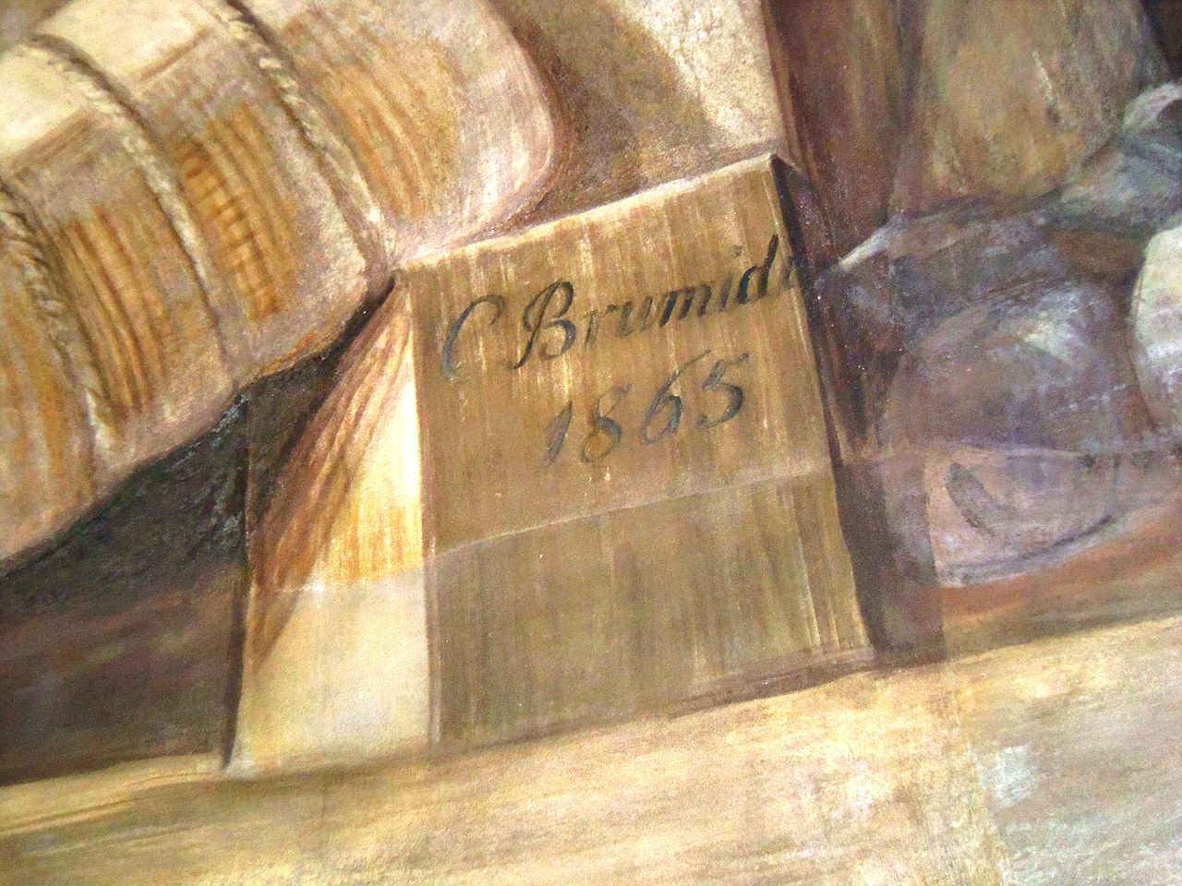

Slide 17
Constantino Brumidi, 1805–1880
Apotheosis of Washington, 1865, fresco, 4,664 square feet, the U.S. Capitol Building's Rotunda, Washington, DC
Copyrights for all pictures: https://commons.wikimedia.org/wiki/Category:The_Apotheosis_of_Washington

