Slide 1
Domenico Veneziano,
c. 1410-1461

Slide 2
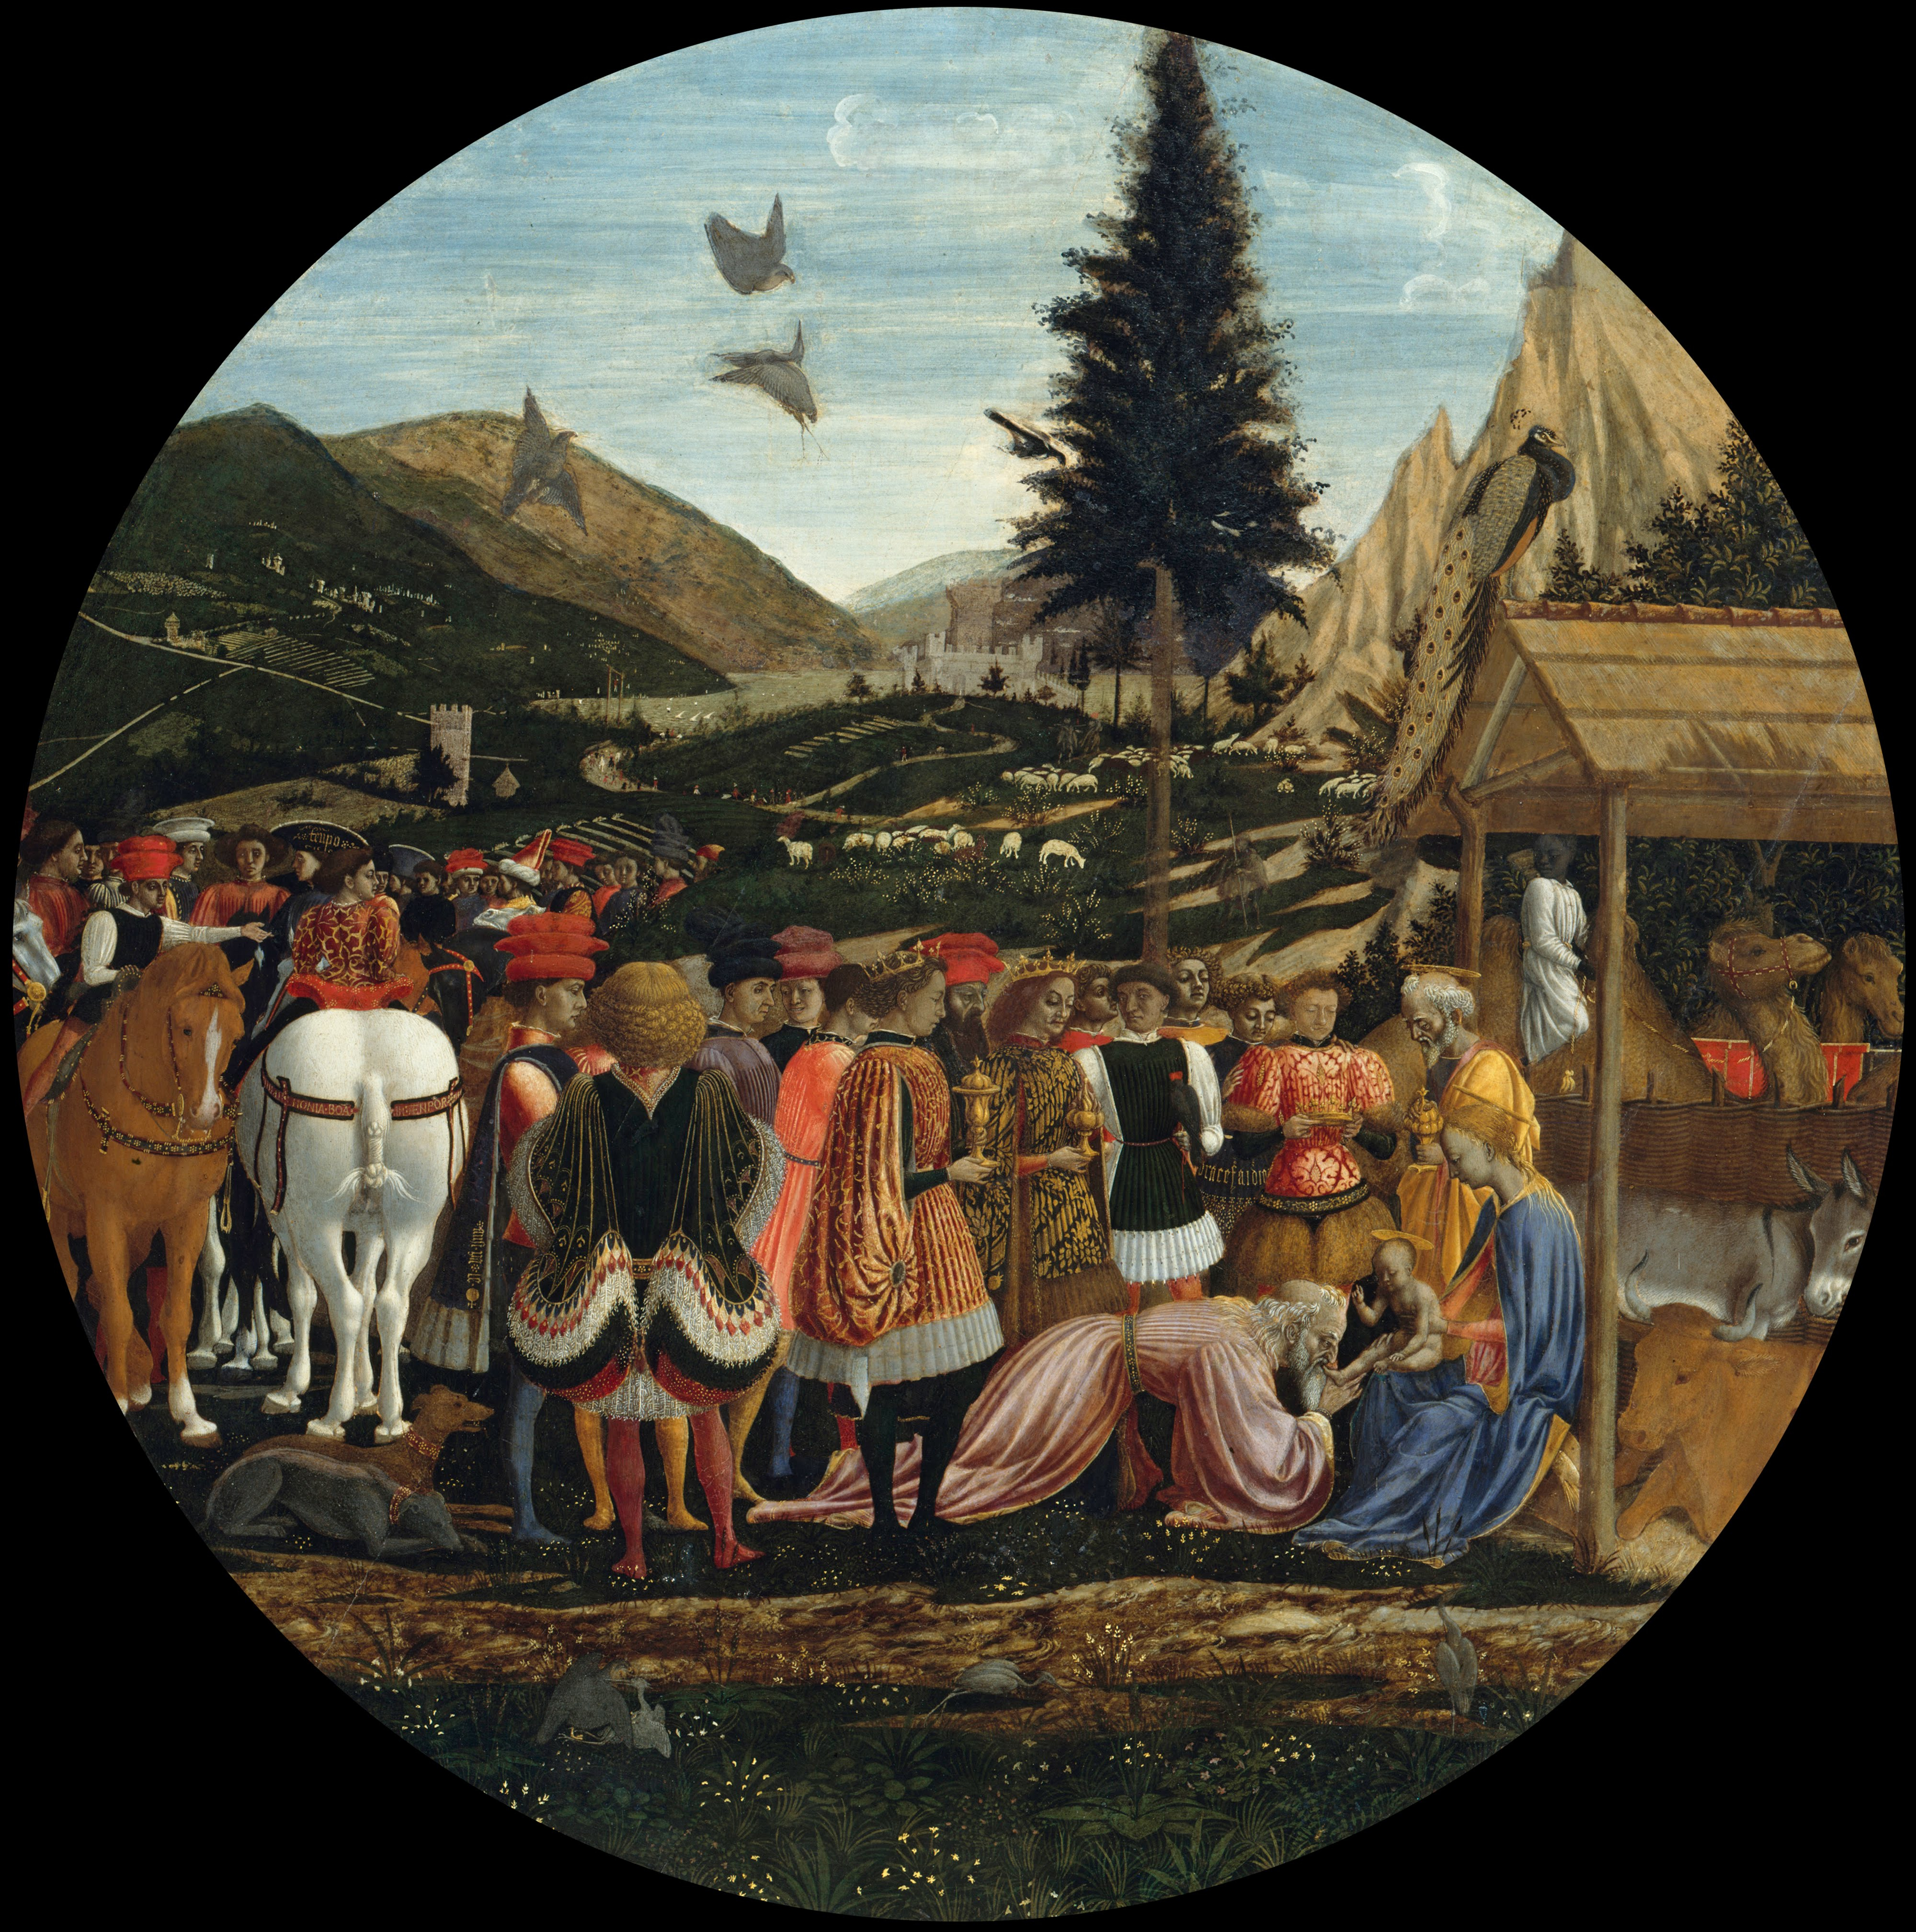
Domenico Veneziano, c. 1410-1461
The Adoration of the Magi, 1435, tempera on panel,
90 cm diameter, Gemäldegalerie, Berlin

Slide 3
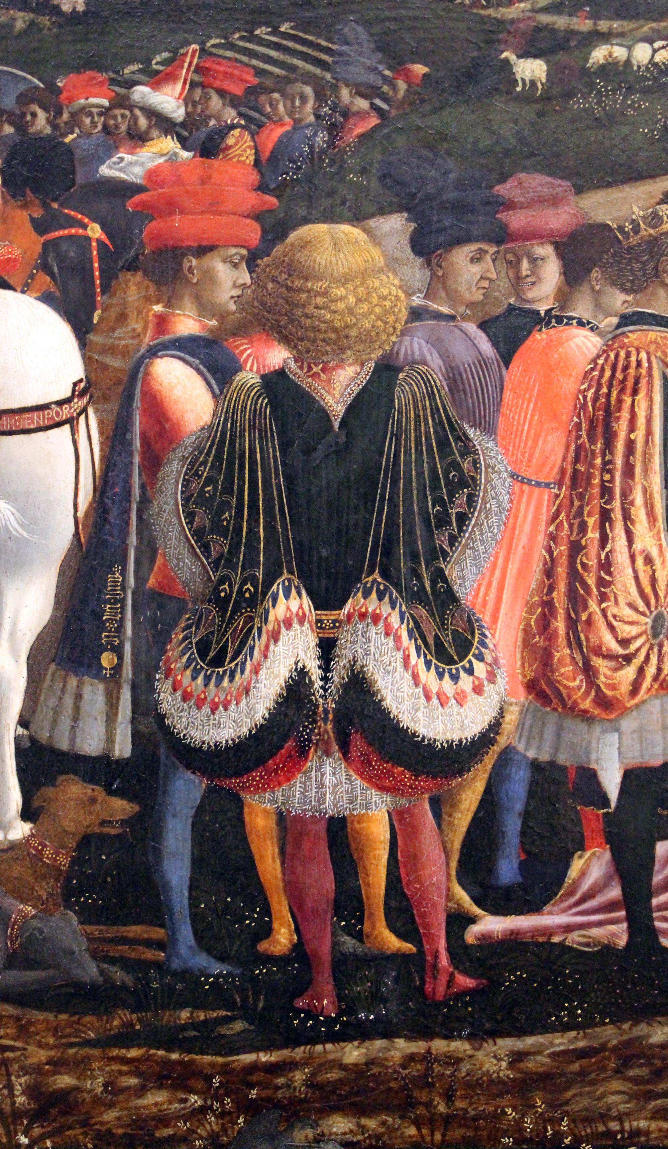
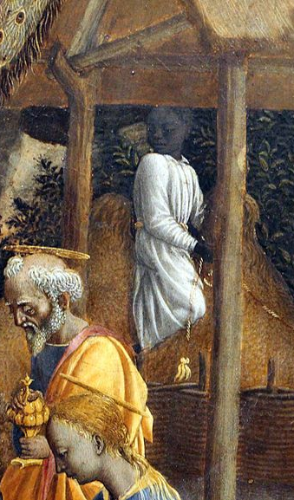
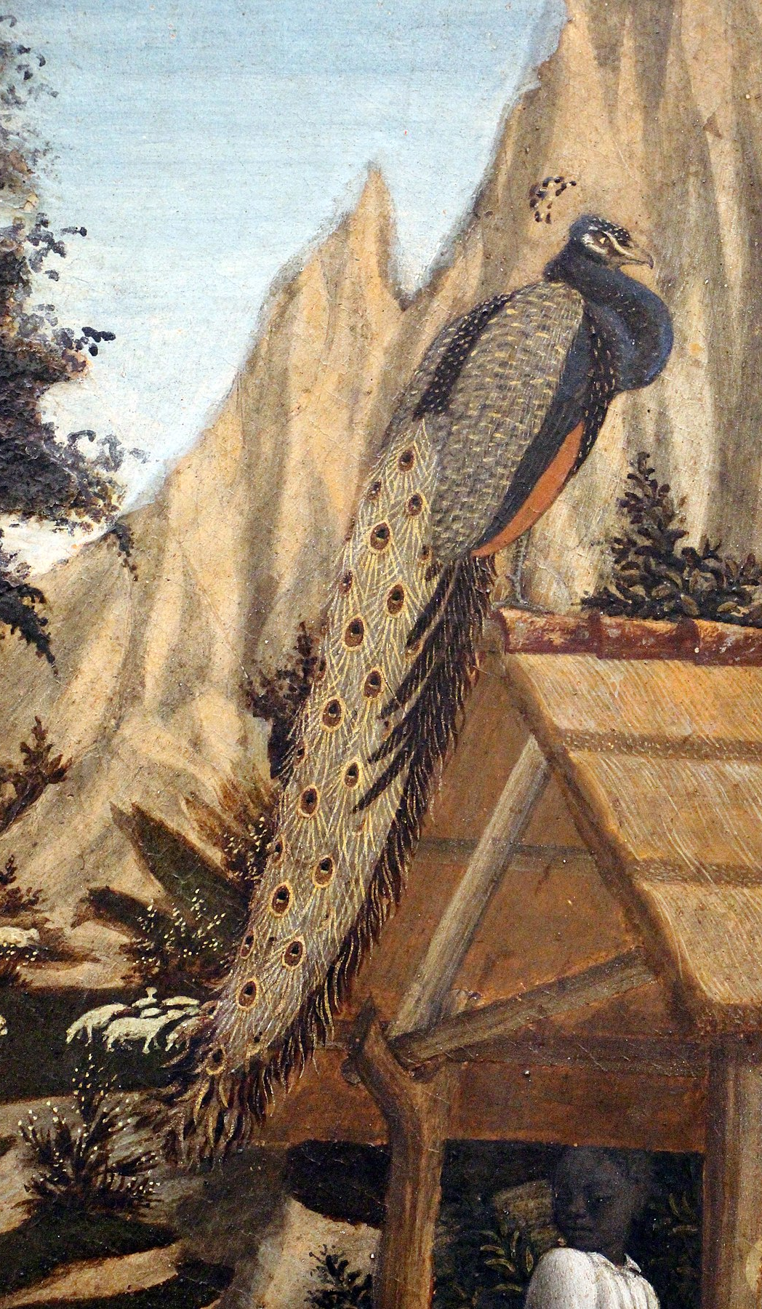

Slide 4
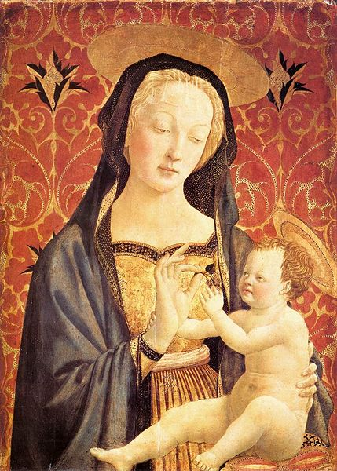
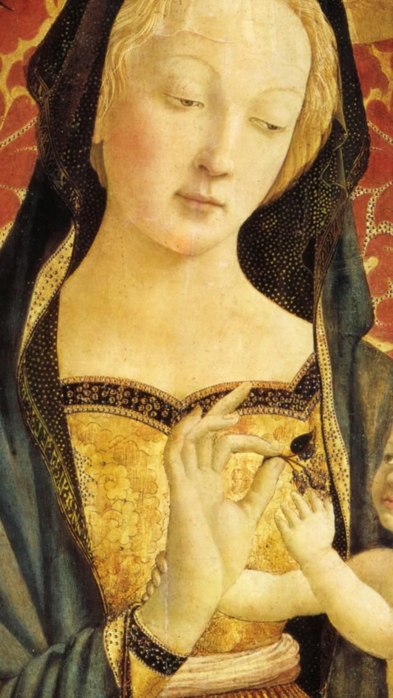
Madonna and Child, 1435-37, tempera on panel, 86x61 cm, Harvard University Center for Italian Renaissance Studies

Slide 5
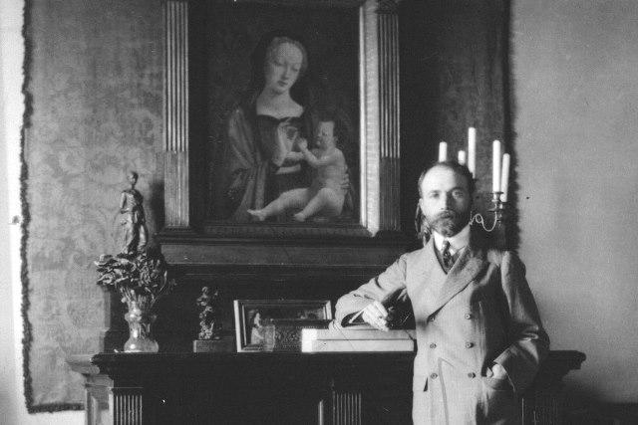
Bernard Berenson was one of the most famous and influential connoisseurs of Italian Renaissance paintings and drawings. The Photograph shows him standing in front of Domenico Veneziano’s painting of the Madonna and Child, in his Villa I Tatti, near Florence - http://itatti.harvard.edu/berensons

Slide 6
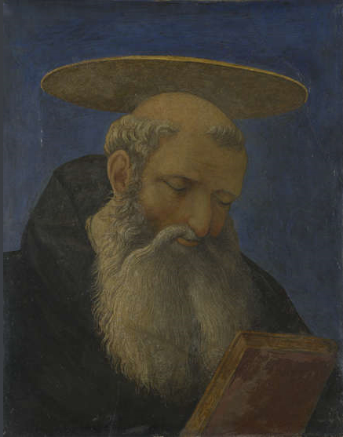
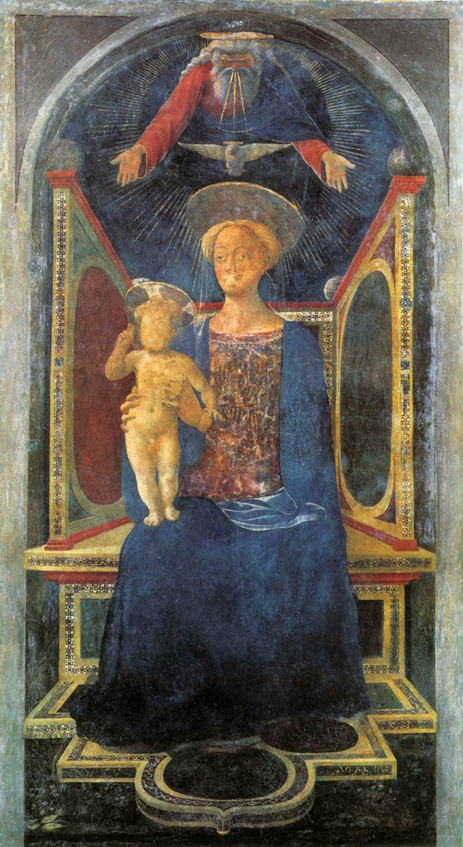
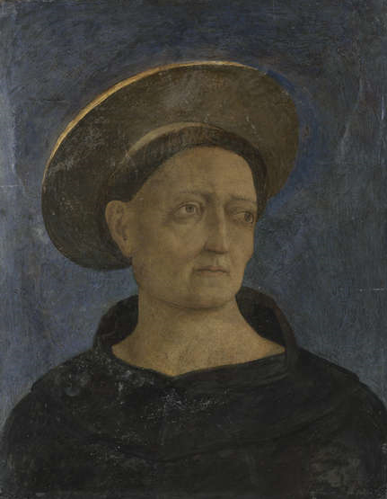
Tabernacolo Carnesecchi, c. 1440-1444, Fresco, transferred to canvas, 241 x 120.5 cm, National Gallery, London

Slide 7
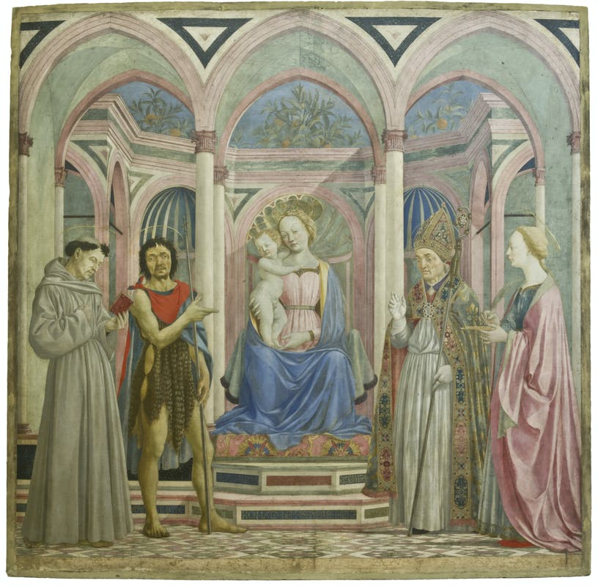
Domenico Veneziano, c. 1410-1461
Madonna and Child enthroned with St. Francis, John the Baptist, St. Zenobius and St. Lucy, c. 1445, tempera on panel, 209 x 216 cm, Galleria degli Uffizi, Florence

Slide 8
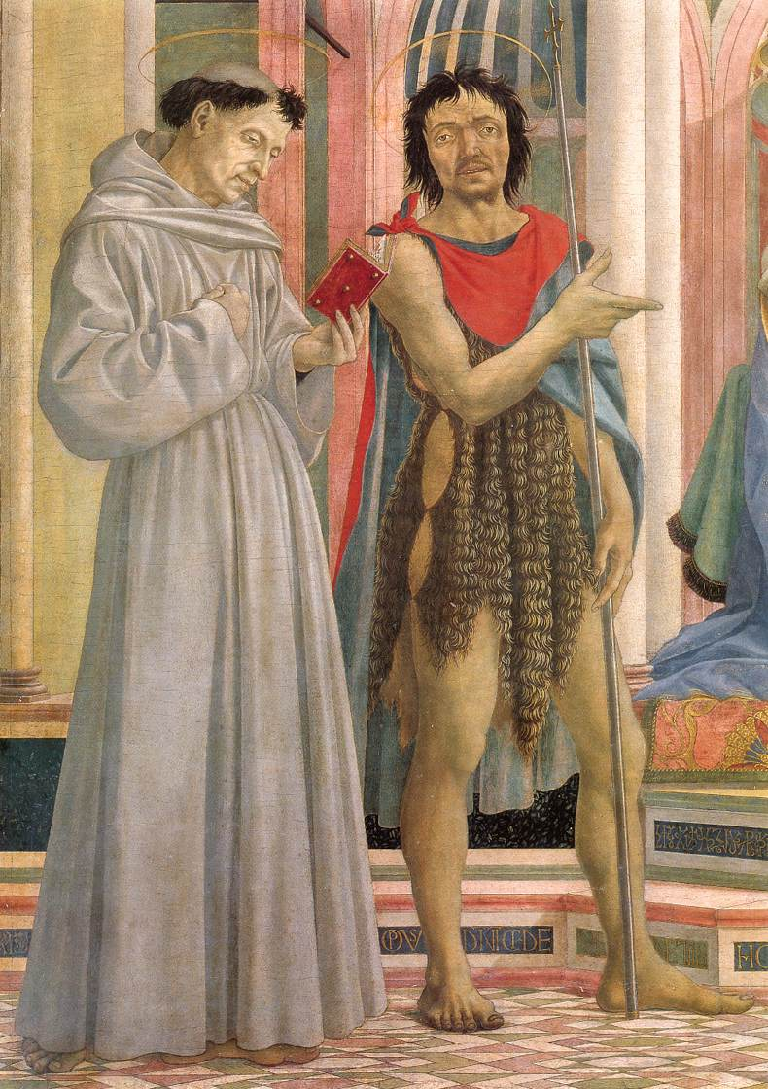
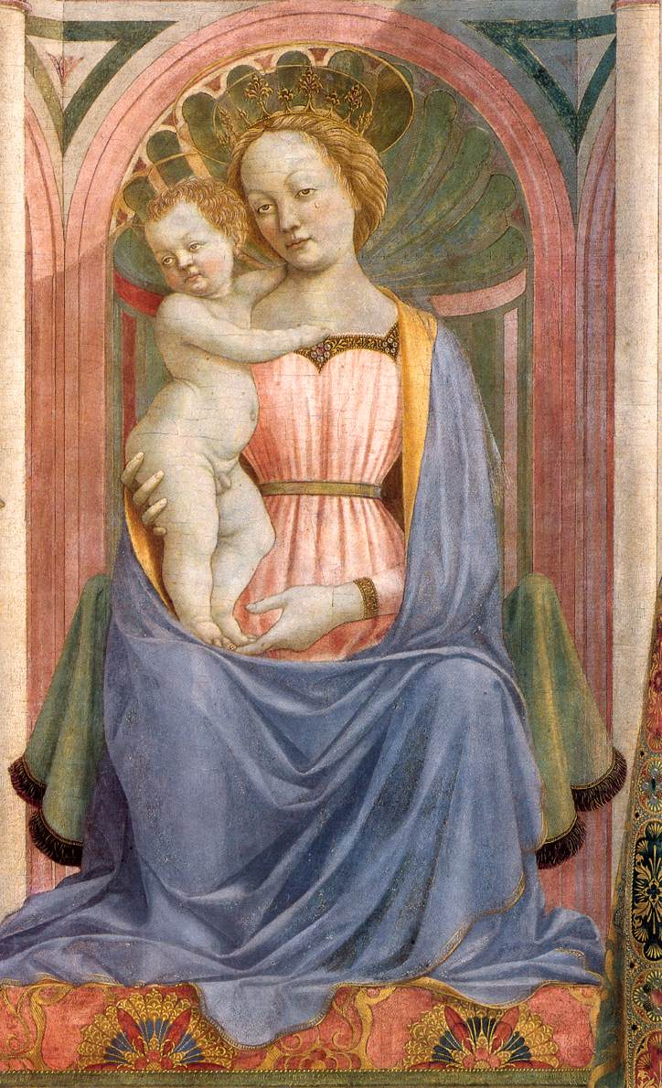
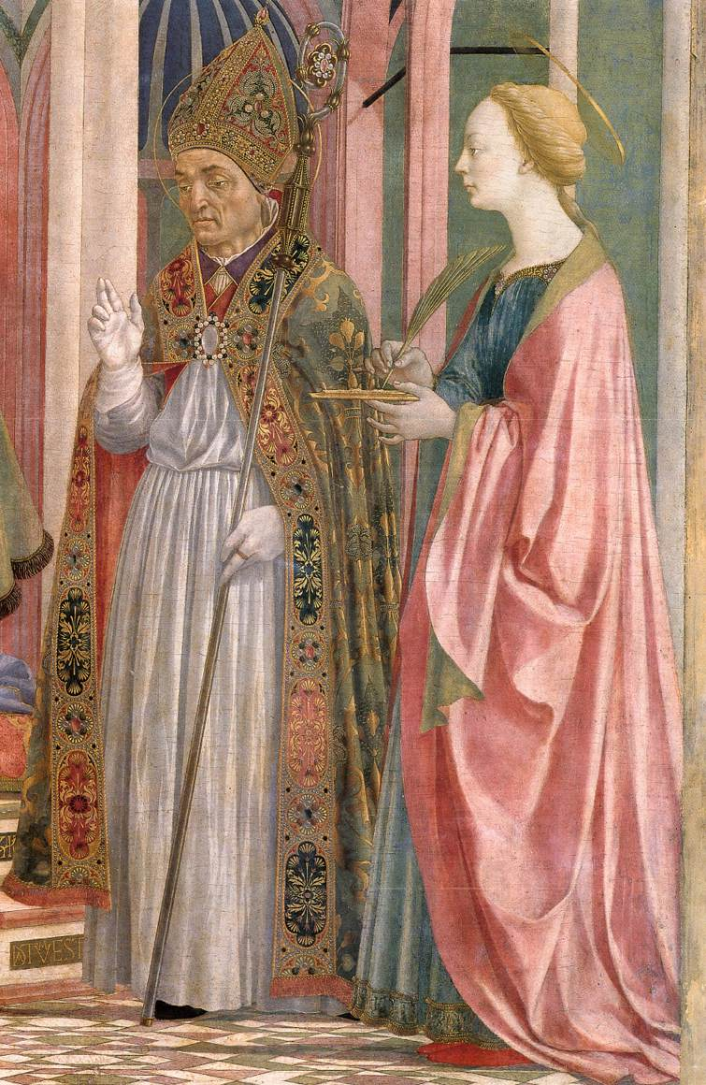

Slide 9
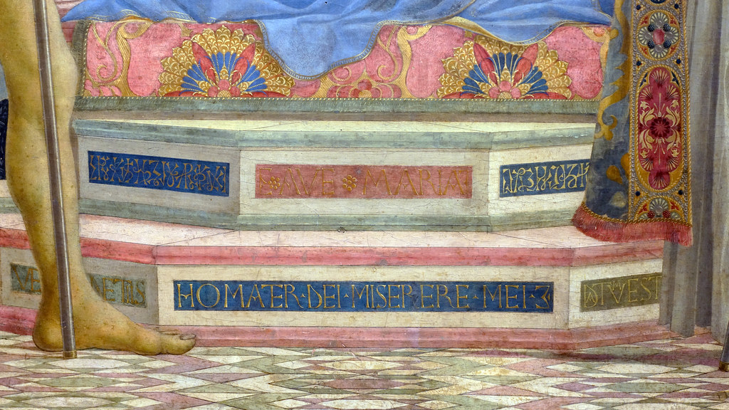

Slide 10
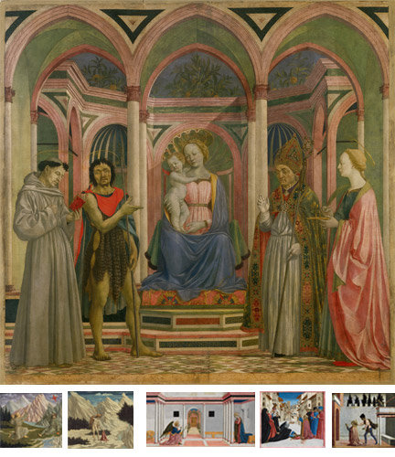
Domenico Veneziano, 'Saint Lucy Altarpiece' reconstruction.
‘Madonna and Child’, Galleria degli Uffizi, Florence. © Photo Scala, Florence - courtesy of the Ministero Beni e Att. Culturali; ‘Saint Francis’. © National Gallery of Art, Washington D.C.; ‘Saint John’. © National Gallery of Art, Washington D.C.; ‘Annunciation’. © The Fitzwilliam Museum, Cambridge / Photo Scala, Florence; 'A Miracle of Saint Zenobius.' © The Fitzwilliam Museum, Cambridge. ‘The Martyrdom of Saint Lucy’, Berlin, Staatliche Museen Preussischer Kulturbesitz, Gemäldegalerie. © Photo Scala, Florence / BPK, Bildagentur für Kunst, Kultur und Geschichte, Berlin. https://www.nationalgallery.org.uk/research/research-resources/exhibition-catalogues/building-the-picture/place-making/place-making-2

Slide 11

Saint Francis Receiving the Stigmata, c. 1445/1450, tempera on panel,
27.5 x 30.5 cm, National Gallery of Art, Washington DC

Slide 12
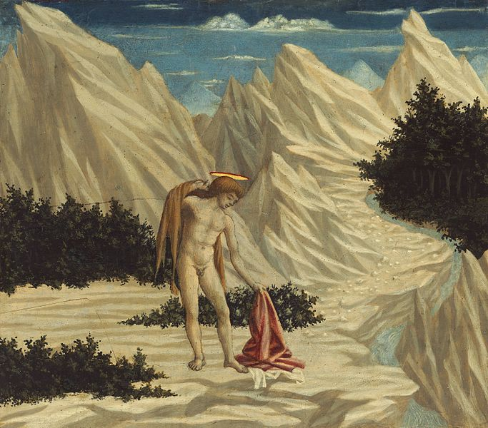
Saint John in the Dessert, c. 1445/1450, tempera on panel,
28.4 x 31.8 cm,
National Gallery of Art, Washington DC

Slide 13
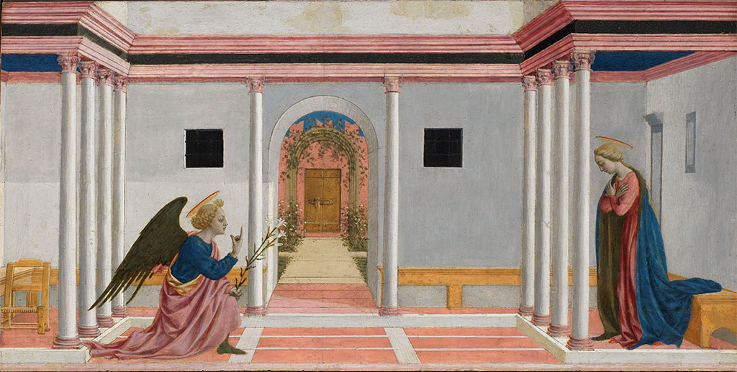
The Annunciation, c. 1445/1448, tempera on panel, 27.3 x 54 cm, The Fitzwilliam Museum, Cambridge

Slide 14
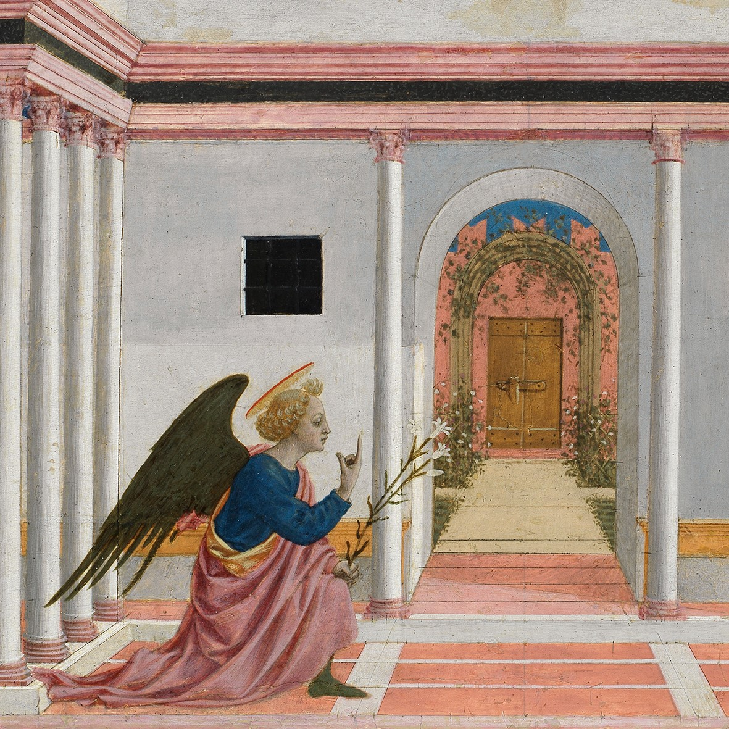

Slide 15
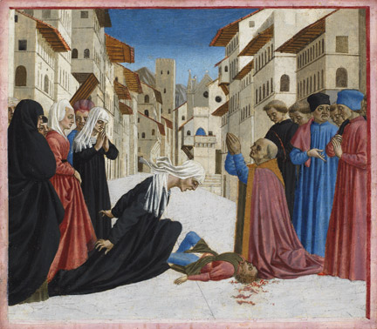
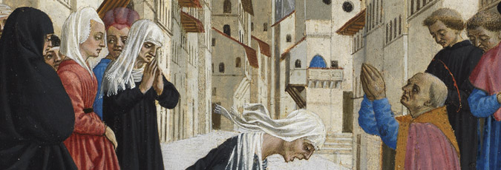
A Miracle of Saint Zenobius’, c. 1445/1450, tempera on panel,
28.6 x 32.5 cm,
The Fitzwilliam Museum, Cambridge

Slide 16
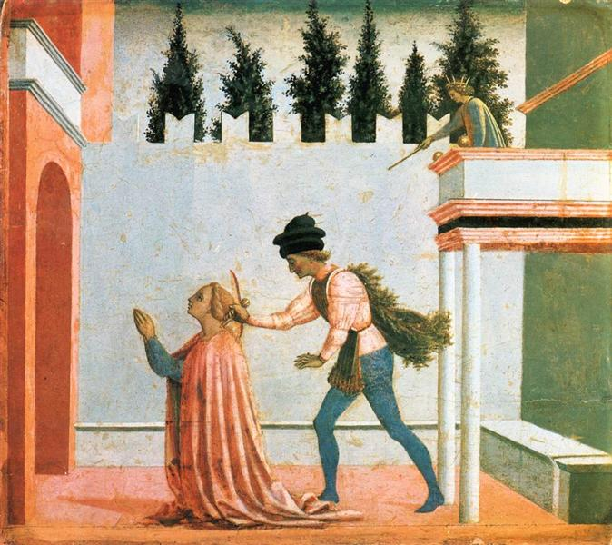
Martyrdom of St Lucy, c. 1445/1450, tempera on panel,
25 x 29 cm,
Staatliche Museen, Berlin

Slide 17
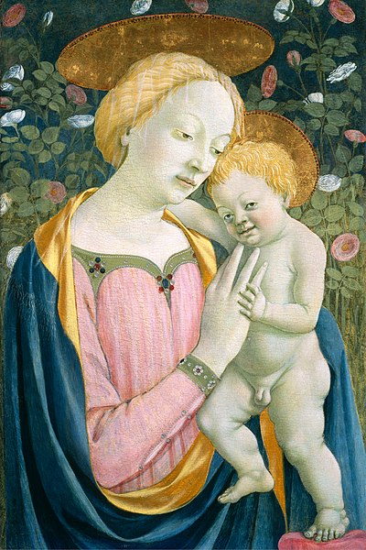
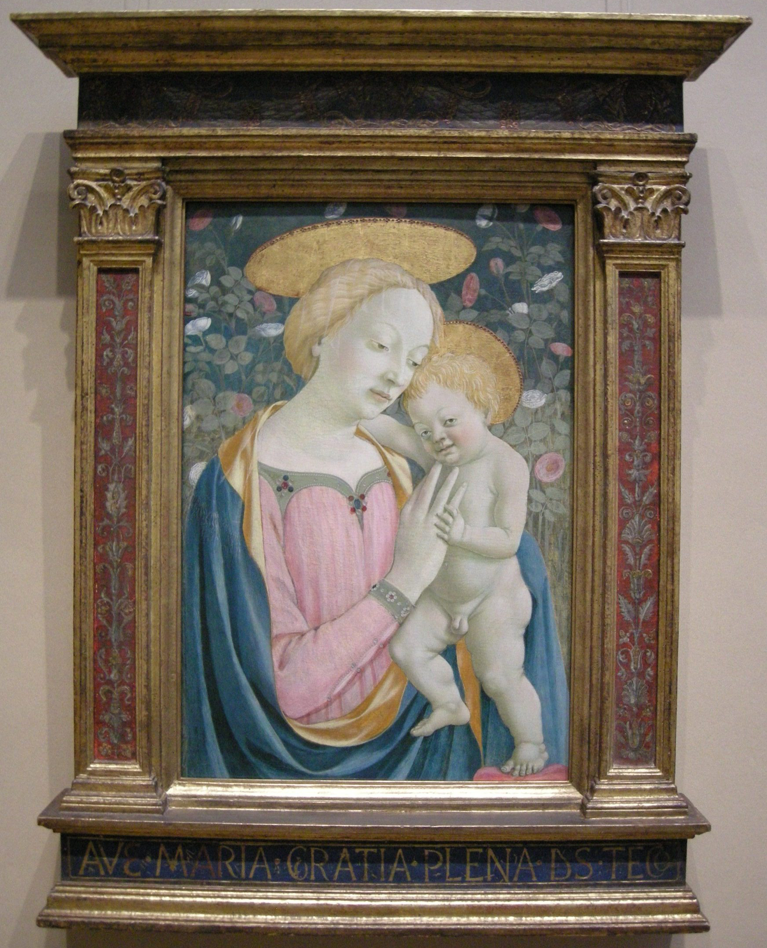
Madonna and Child, 1447, tempera on panel,
83x57 cm, National Gallery of Art, Washington, DC

Slide 18
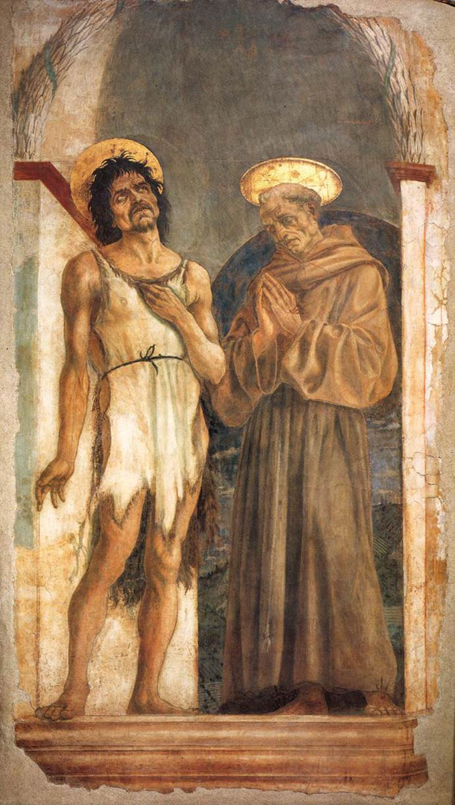
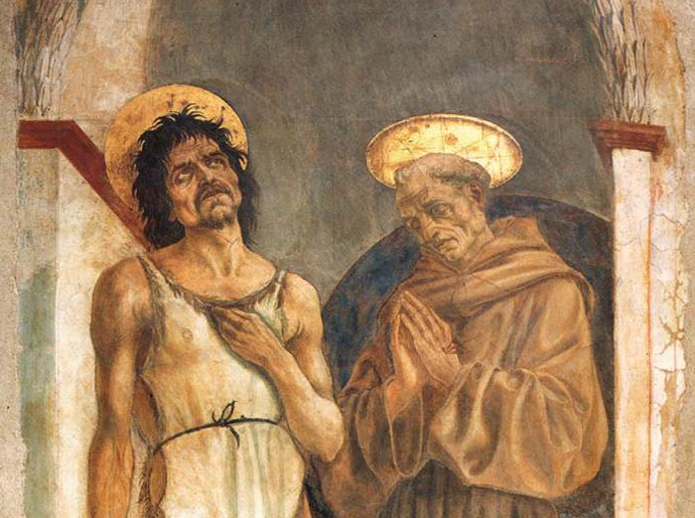
St John the Baptist and St Francis, 1454, detached fresco, 190 x 115 cm, Museo dell’ Opera di Santa Croce, Florence

Slide 19
The End…

