Slide 1
The Shield of Achilles Inspires my Grade 3 Students!

Slide 2
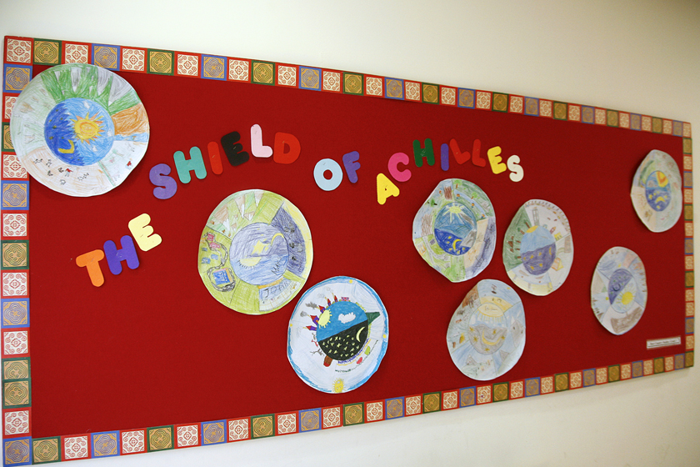

Slide 3
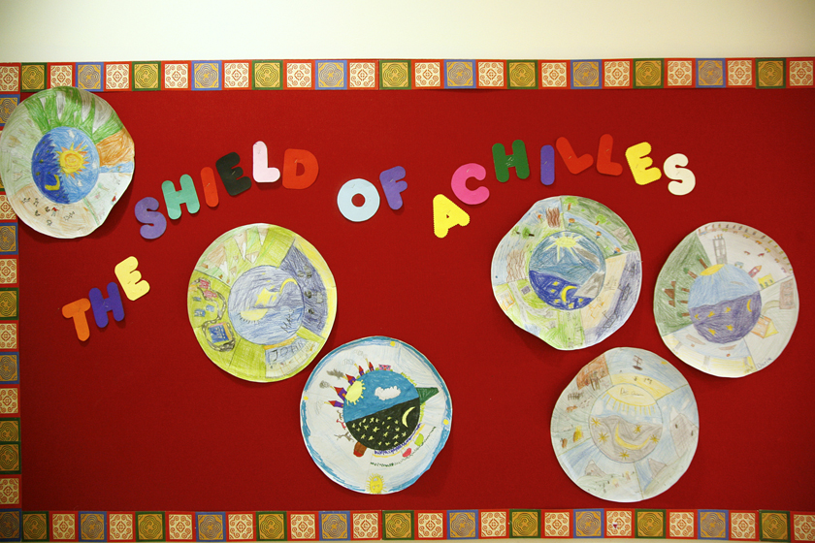

Slide 4
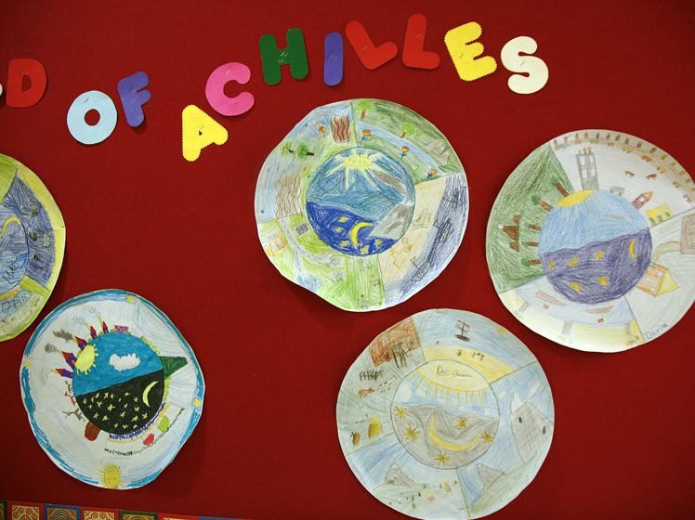

Slide 5
