Slide 1
The Shield of Achilles

Slide 2
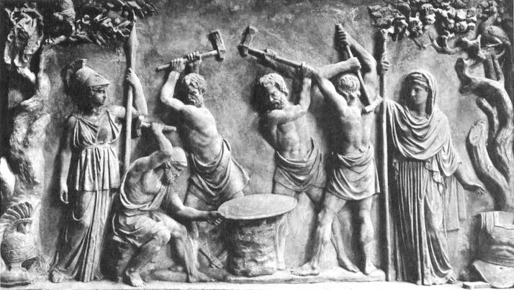
Hephaestus and the Cyclopes forging the shield of Achilles, to the left, Athena, to the right, Hera, date unknown, Greco-Roman bas-relief marble, Pinacoteca Capitolina, Palazzo Conservatori, Rome

Slide 3
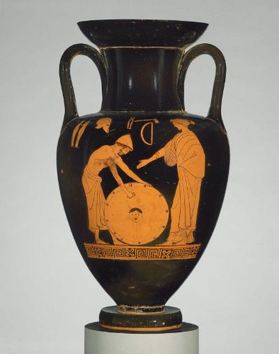
Hephaistos polishing the shield of Achilles, attributed to the Dutuit Painter, ca 470 BC, Red Figure Attic Amphora, 34.2 cm, MFA, Boston

Slide 4
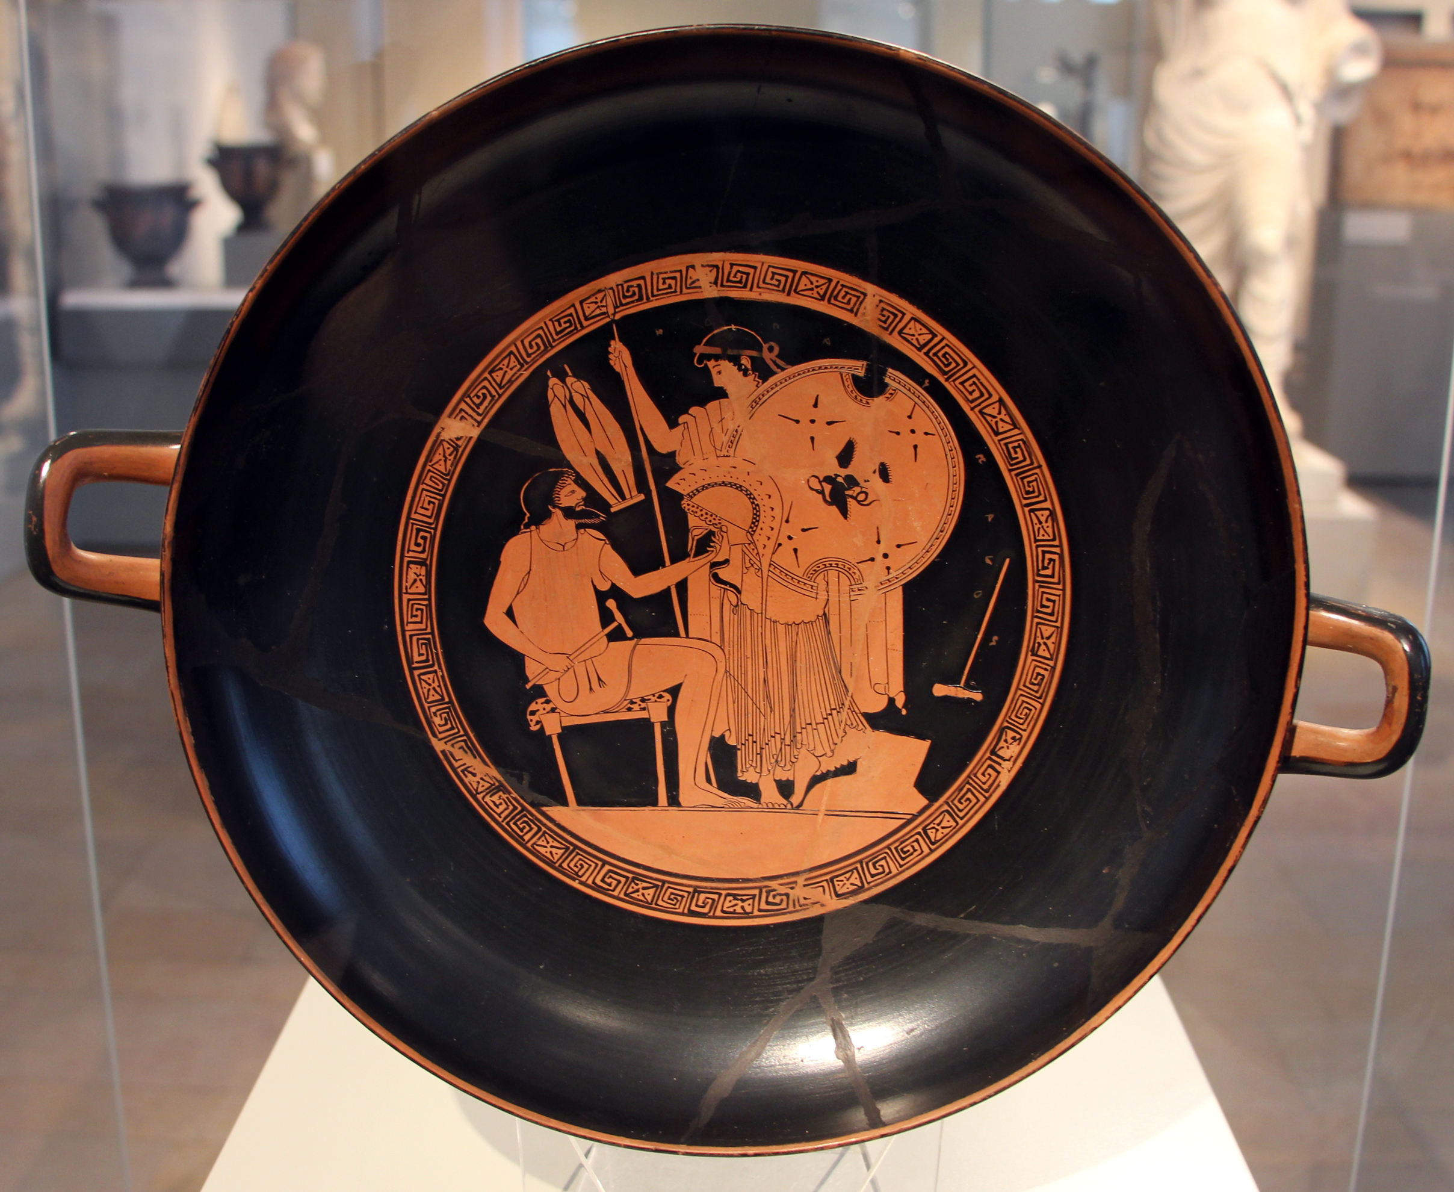
The Armour of Achilles, c. 480 BC, attributed to the Foundry painter, Red Figure Attic Kylix, Antikensammlung, Berlin, Germany

Slide 5
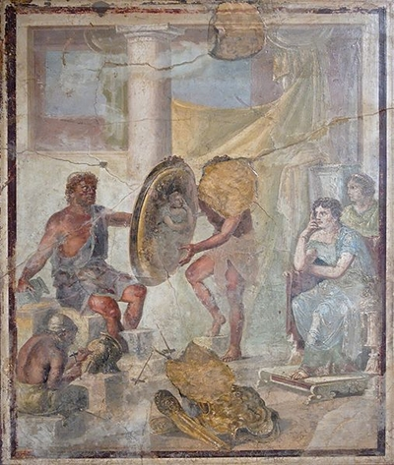
Hephaestus and Thetis with the Shield of Achilles, 1st cent. AD, Roman fresco from the House of Paccius Alexander in Pompeii, National Archaeological Museum, Naples

Slide 6
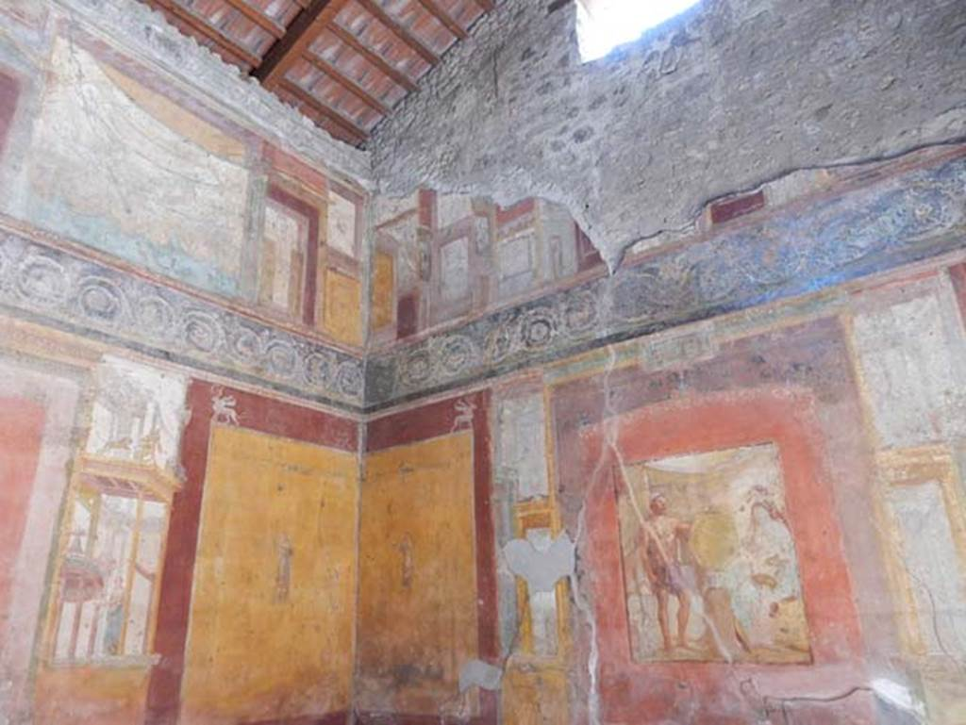
Hephaestus and Thetis with the Shield of Achilles, 1st cent. AD, Roman fresco from the House of Vedius Siricus and Vedius Nummianus, Pompeii

Slide 7
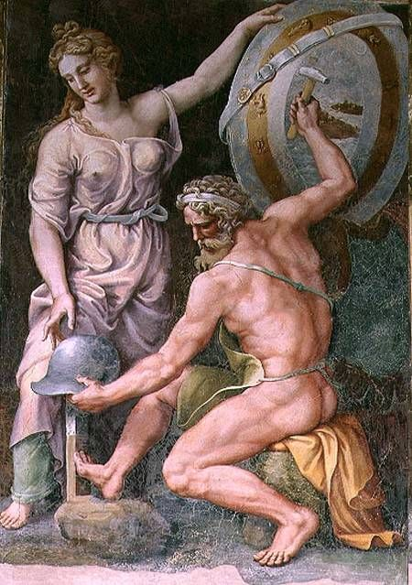
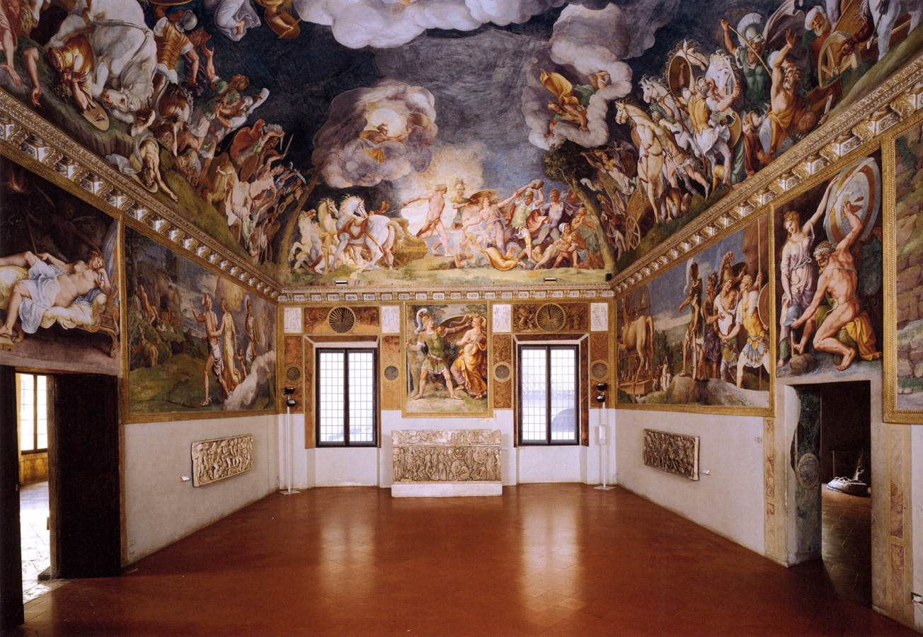
Julio Romano, 1499-1546
Vulcan forging the armour of Achilles, c. 1525, fresco, Sala di Troia, Palazzo Ducale, Mantua

Slide 8
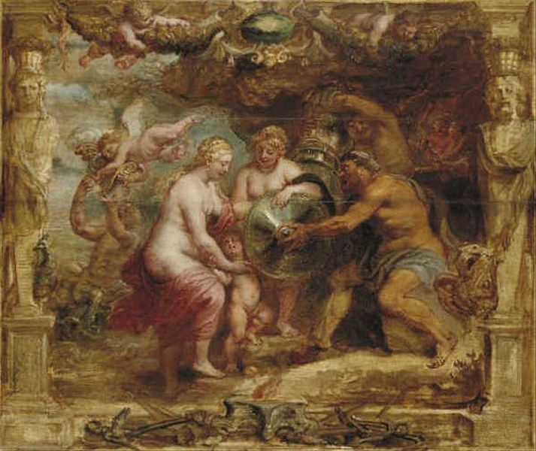
Peter Paul Rubens,
1577-1640
Thetis receiving the arms of Achilles from Vulcanus, c. 1630, oil on panel,
44.6x53.4 cm, Museum Boijmans Van Beuningen

Slide 9
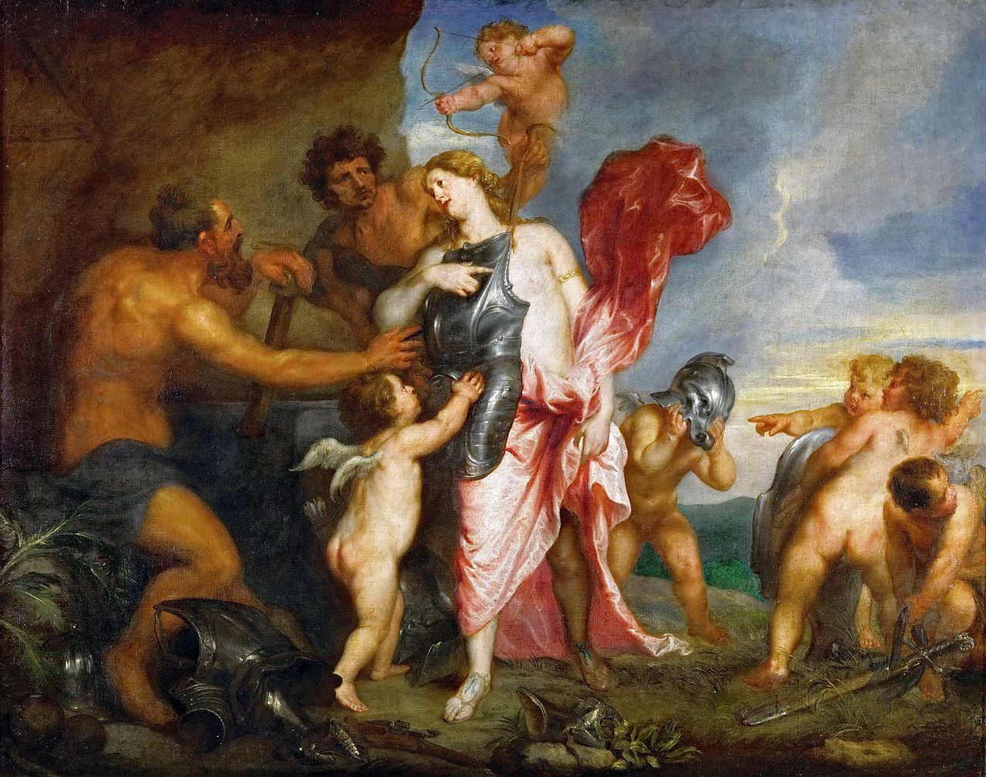
Anthony van Dyck, 1599 – 1641
Venus receiving the arms of Aeneas from Vulcan, 1630-32, oil on canvas, 112x142 cm, Kunsthistorisches Museum, Vienna

Slide 10
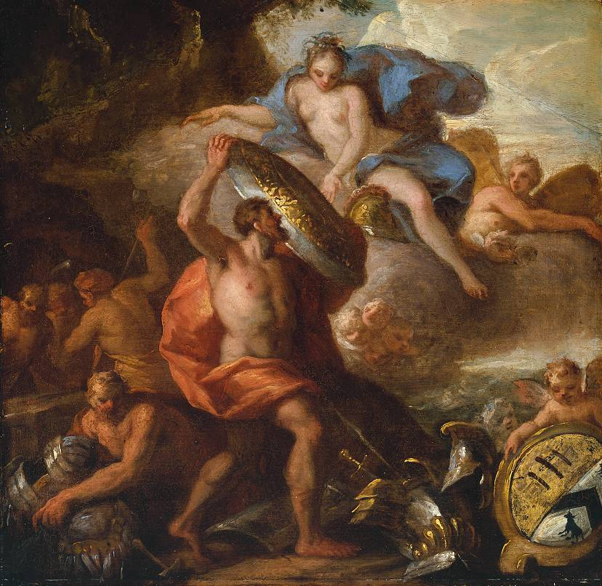
Sir James Thornhill, 1675 or 76–173
Thetis Accepting the Shield of Achilles from Vulcan, c.1710, oil on Wood, 489 × 498 mm, TATE, London

Slide 11
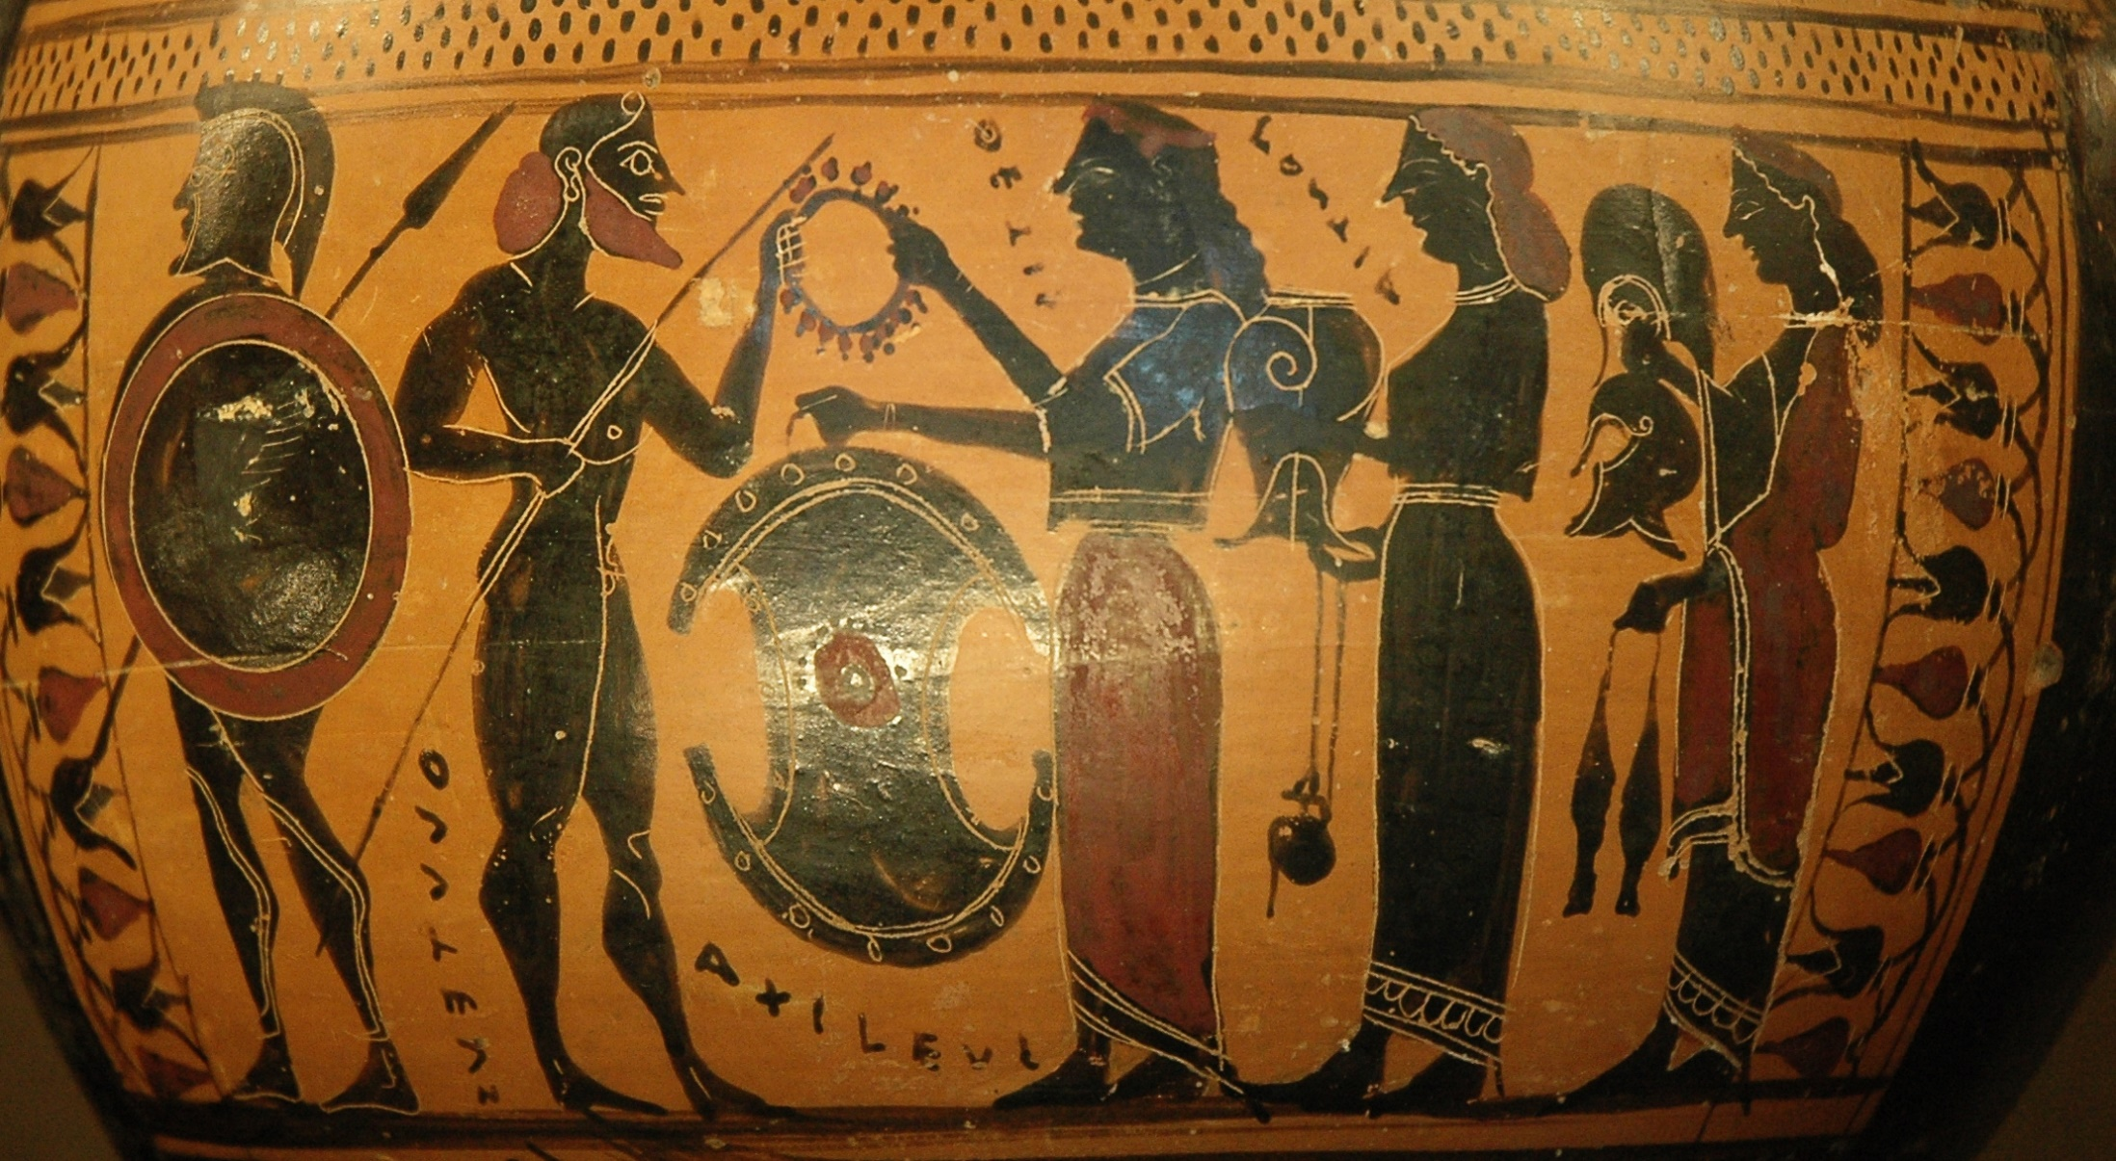
Thetis and attendants bring armour she had prepared for him to Achilles, c. 575–550 BC, Attic black-figure hydria, the Louvre

Slide 12
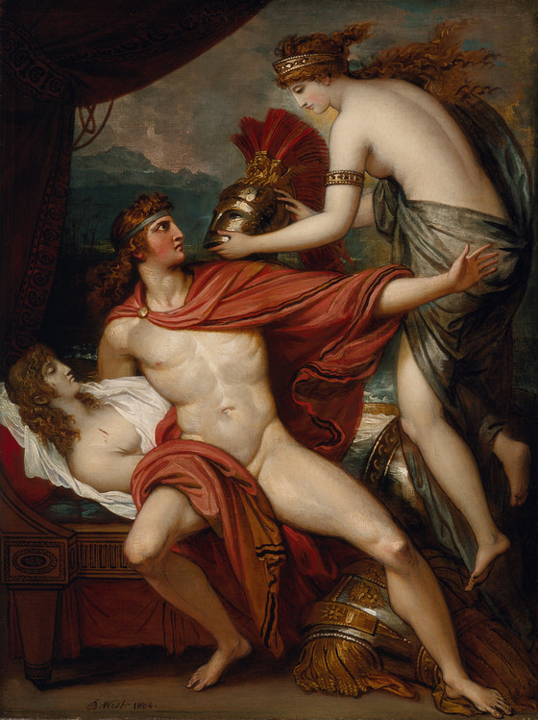
Benjamin West, 1738–1820
Thetis Bringing the Armor to Achilles, 1804, oil on canvas, 68.6 x 50.8 cm, Los Angeles County Museum of Art

Slide 13
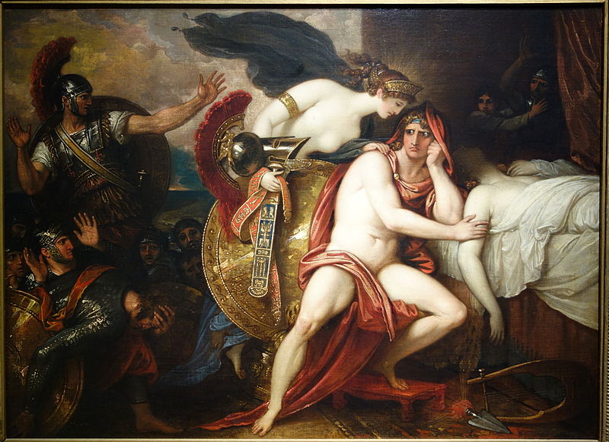
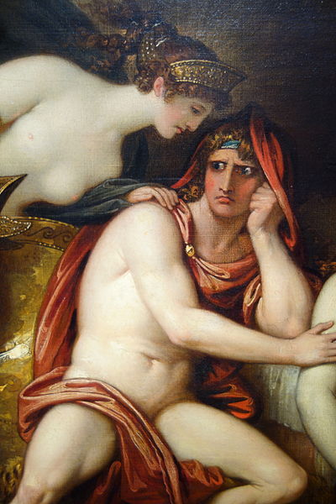
Benjamin West,
1738-1820
Thetis Bringing Armour to Achilles, 1806, oil on canvas, 50.8x69.22 cm, New Britain Museum of American Art, CT

Slide 14
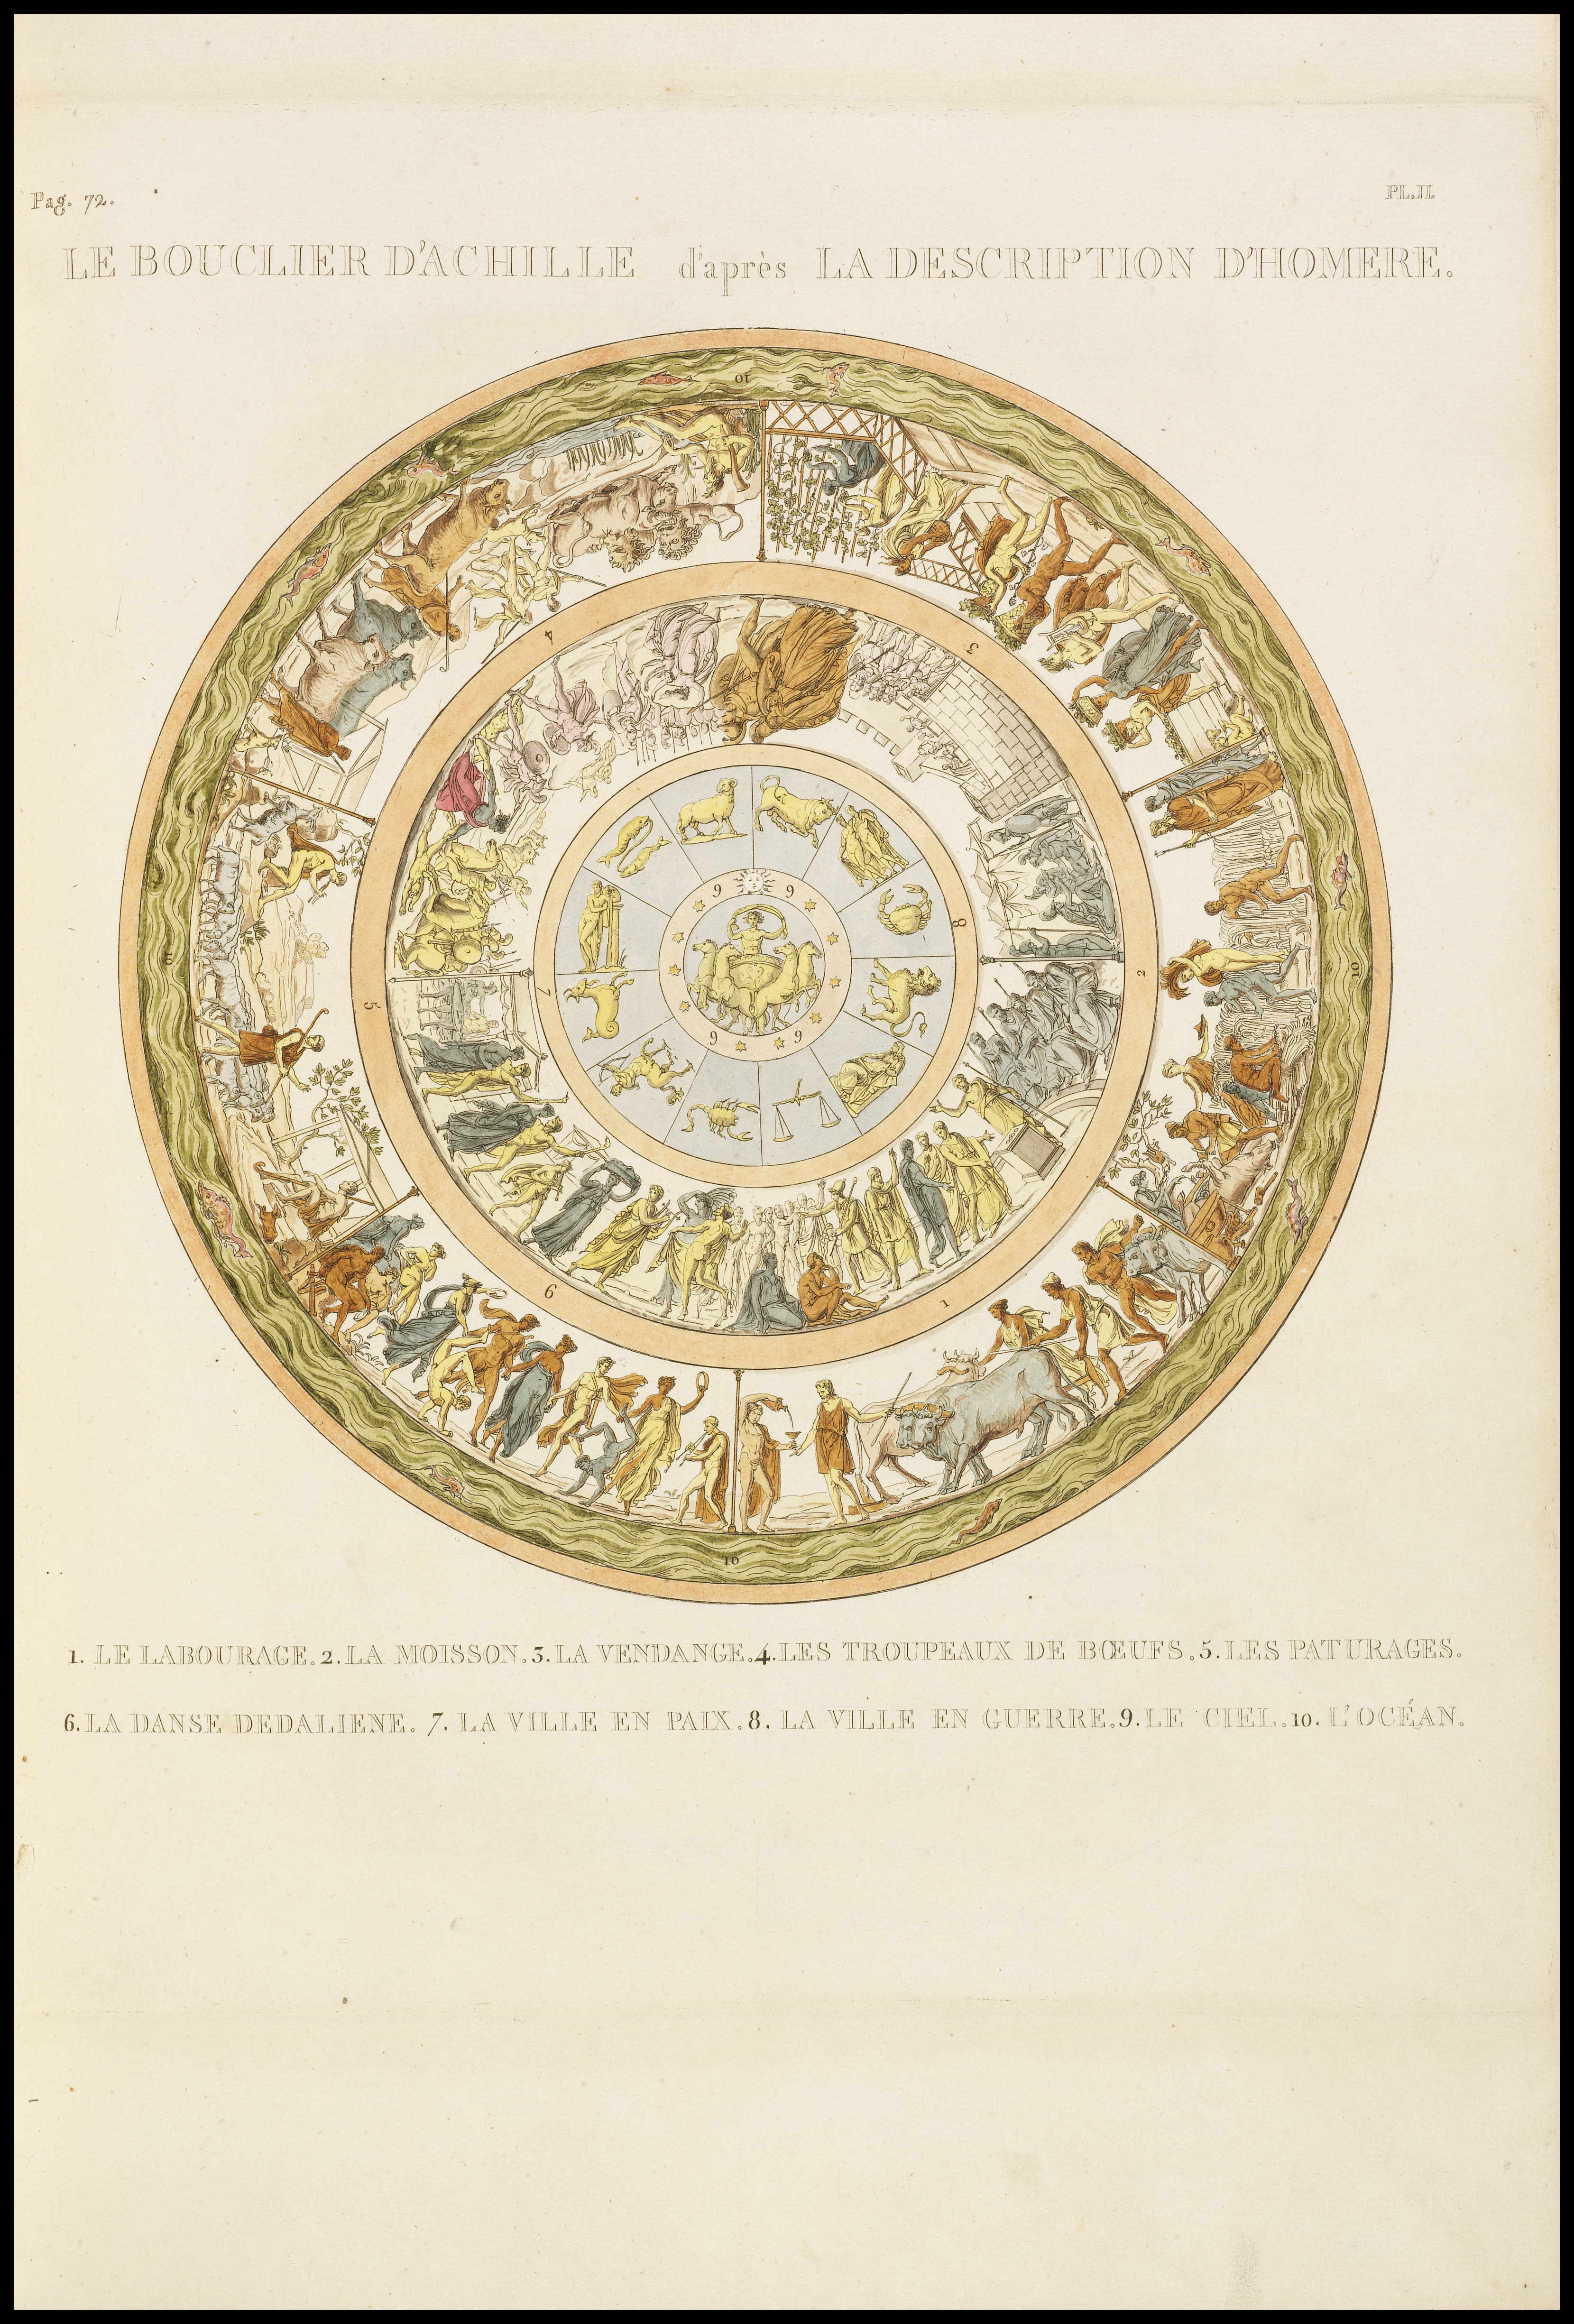
The shield of Achilles according to the description of Homer - a hand-colored etching by Quatremere de Quincy, (Antoine-Chrysostome 1755-1849) ca. 1814.
Published in The Jupiter Olympian, Paris, Didot, 1814.
This image was uploaded from the Getty Open Content online collection

Slide 15
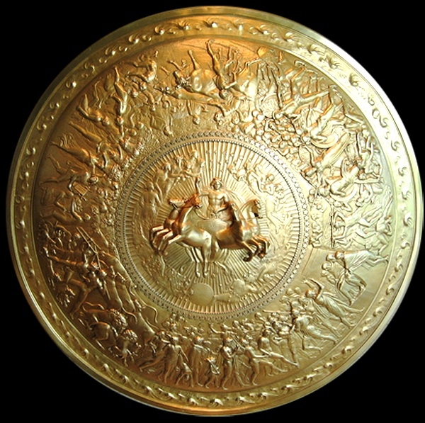
Philip Rundell, 1746-1827
Shield of Achilles, 1821-22, Silver gilt, 90.5 x 90.5 x 18.0 cm (whole object), Royal Collection Trust

Slide 16
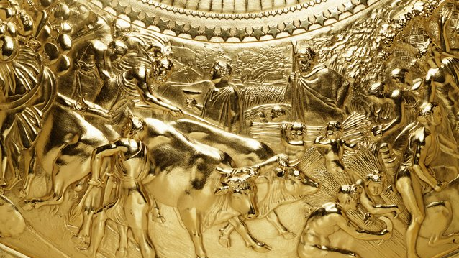

Slide 17
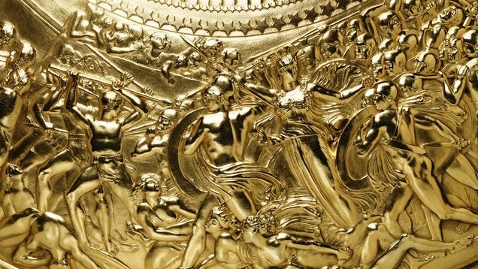

Slide 18
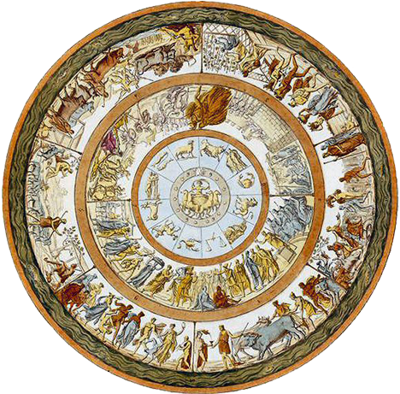
Angelo Monticelli,
1778-1837
An interpretation of the Shield of Achilles design described in Book 18 of the Iliad.
Handcoloured copperplate engraving by Angelo Monticelli from Giulio Ferrario’s Costumes Ancient and Modern of the Peoples of the World, Il Costume Antico e Moderno, Florence, 1842

Slide 19
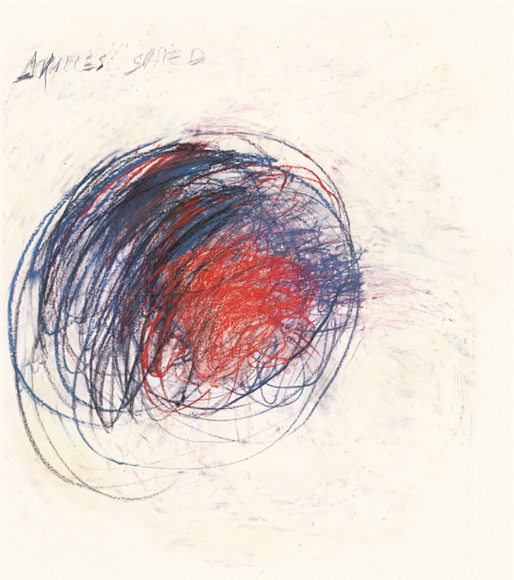
Cy Twombly, American, 1928 - 2011
Fifty Days at Iliam: Shield of Achilles, 1978, oil, oil crayon, and graphite on canvas, 191.8 x 170.2 cm, Philadelphia Museum of Art

Slide 20
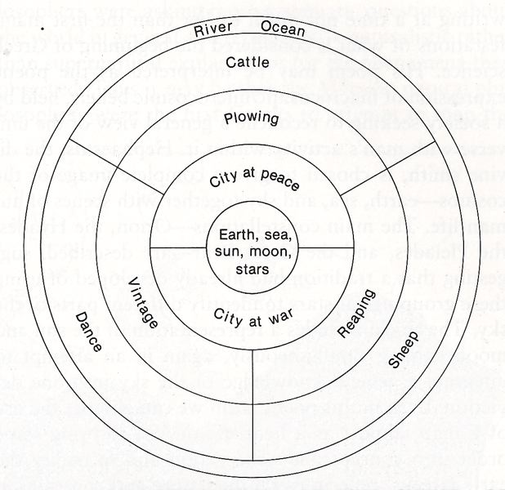
Diagram of the Shield from
“A Companion to the Iliad” (Wilcock)

Slide 21
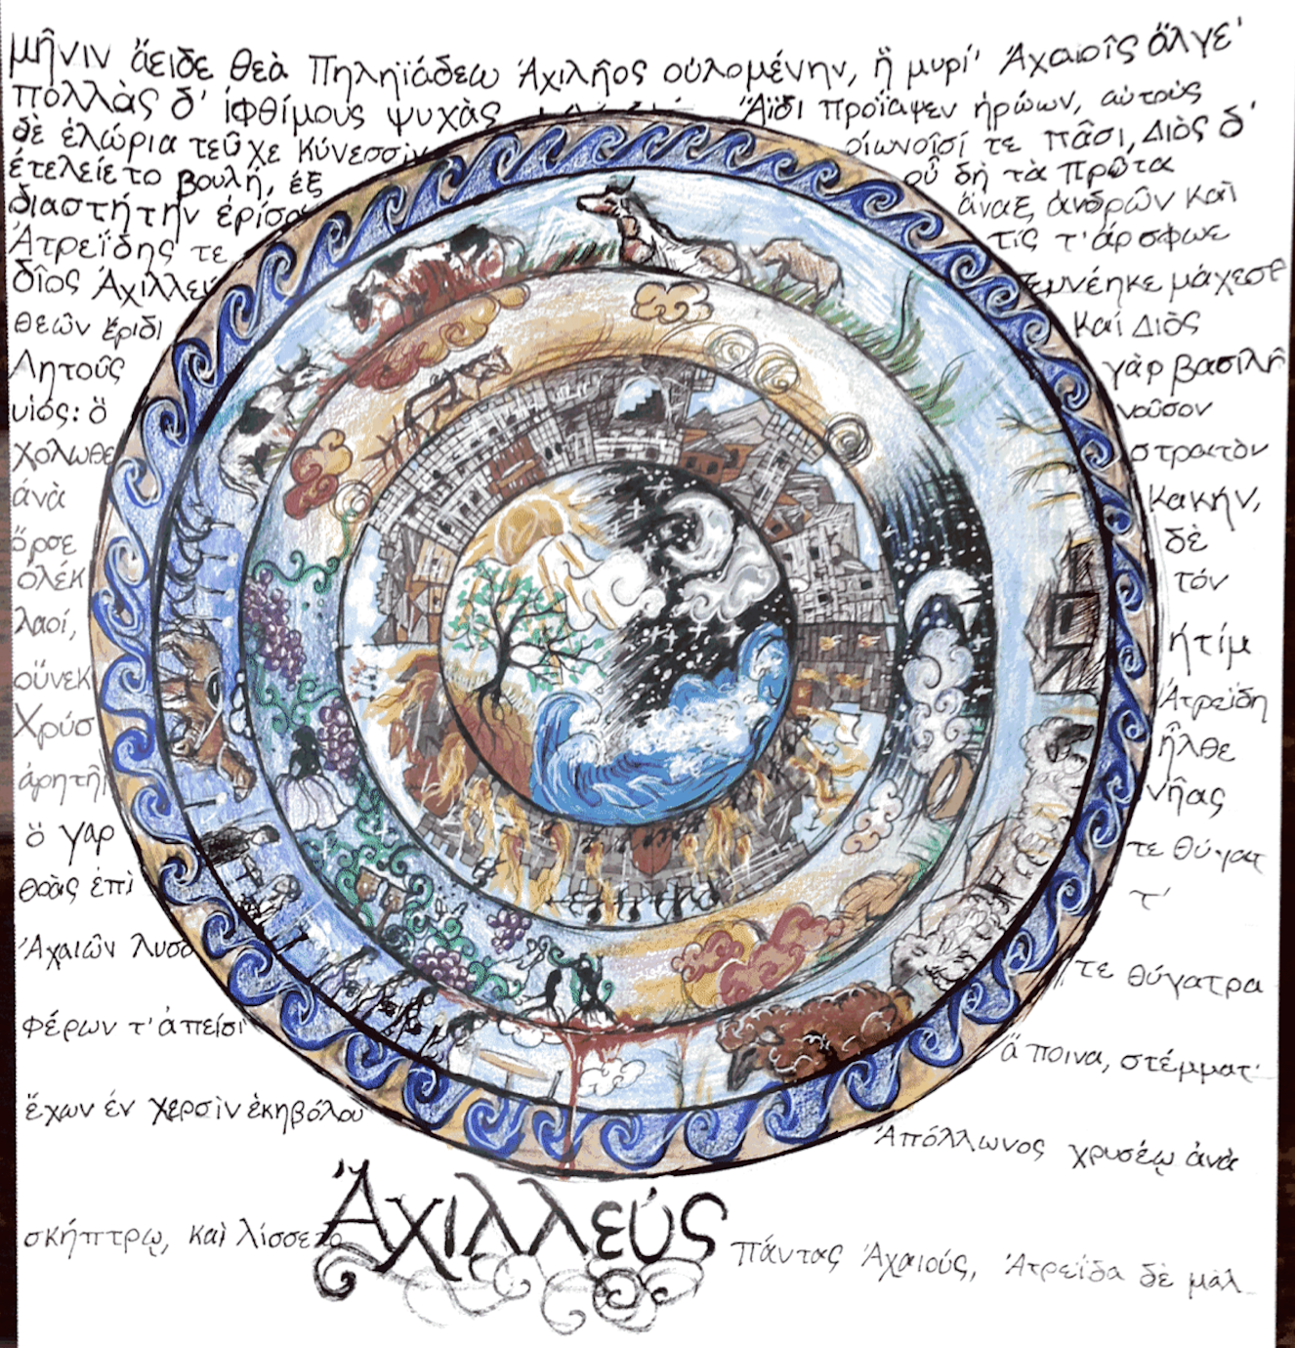
Drawing of the shield by a student: https://iris.haverford.edu/troy18/2018/09/20/shields-of-achilles/

Slide 22

A Bulletin Board display of my Grade 3 students’ work on the The Shield of Achilles Activity

