Slide 1
Henri Matisse
JAZZ 1947

Slide 2


Slide 3
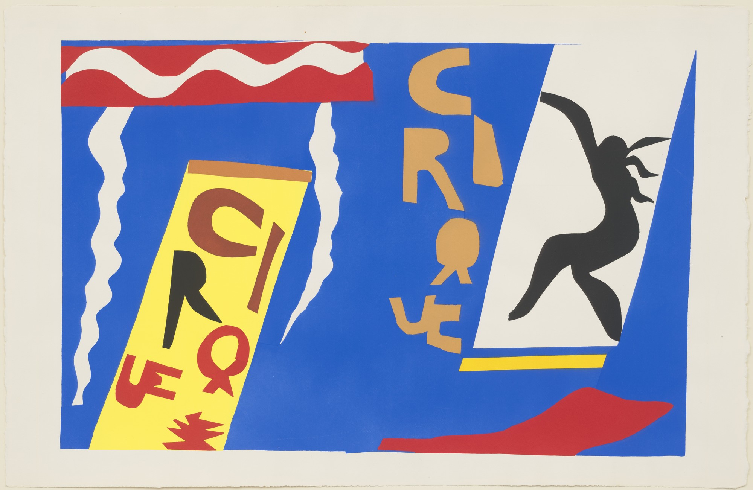

Slide 4


Slide 5
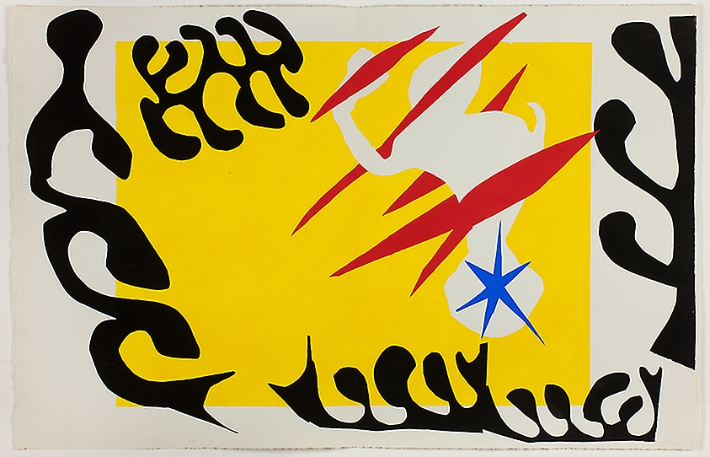

Slide 6
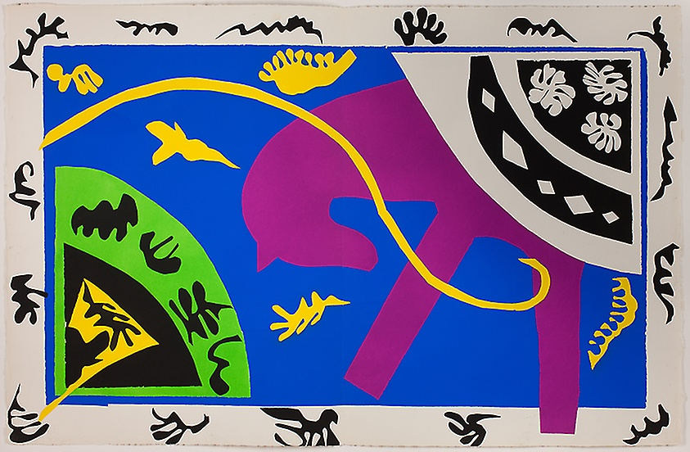

Slide 7
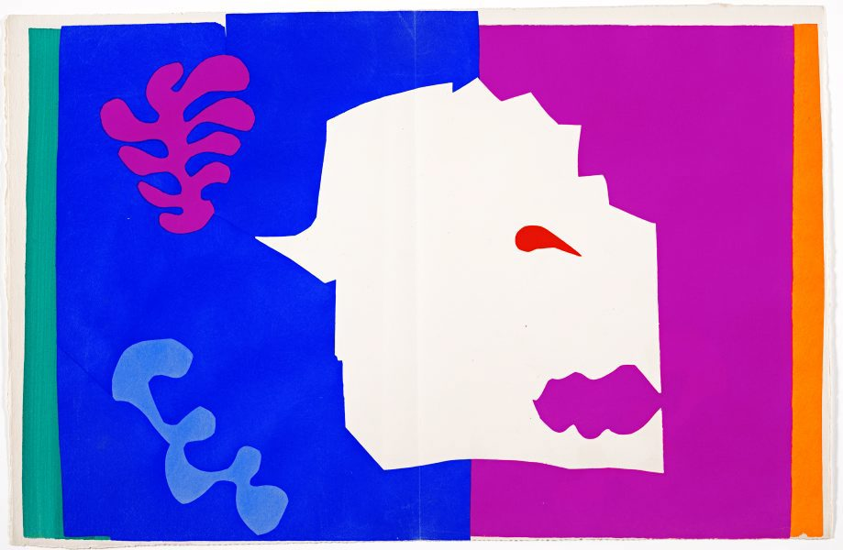

Slide 8
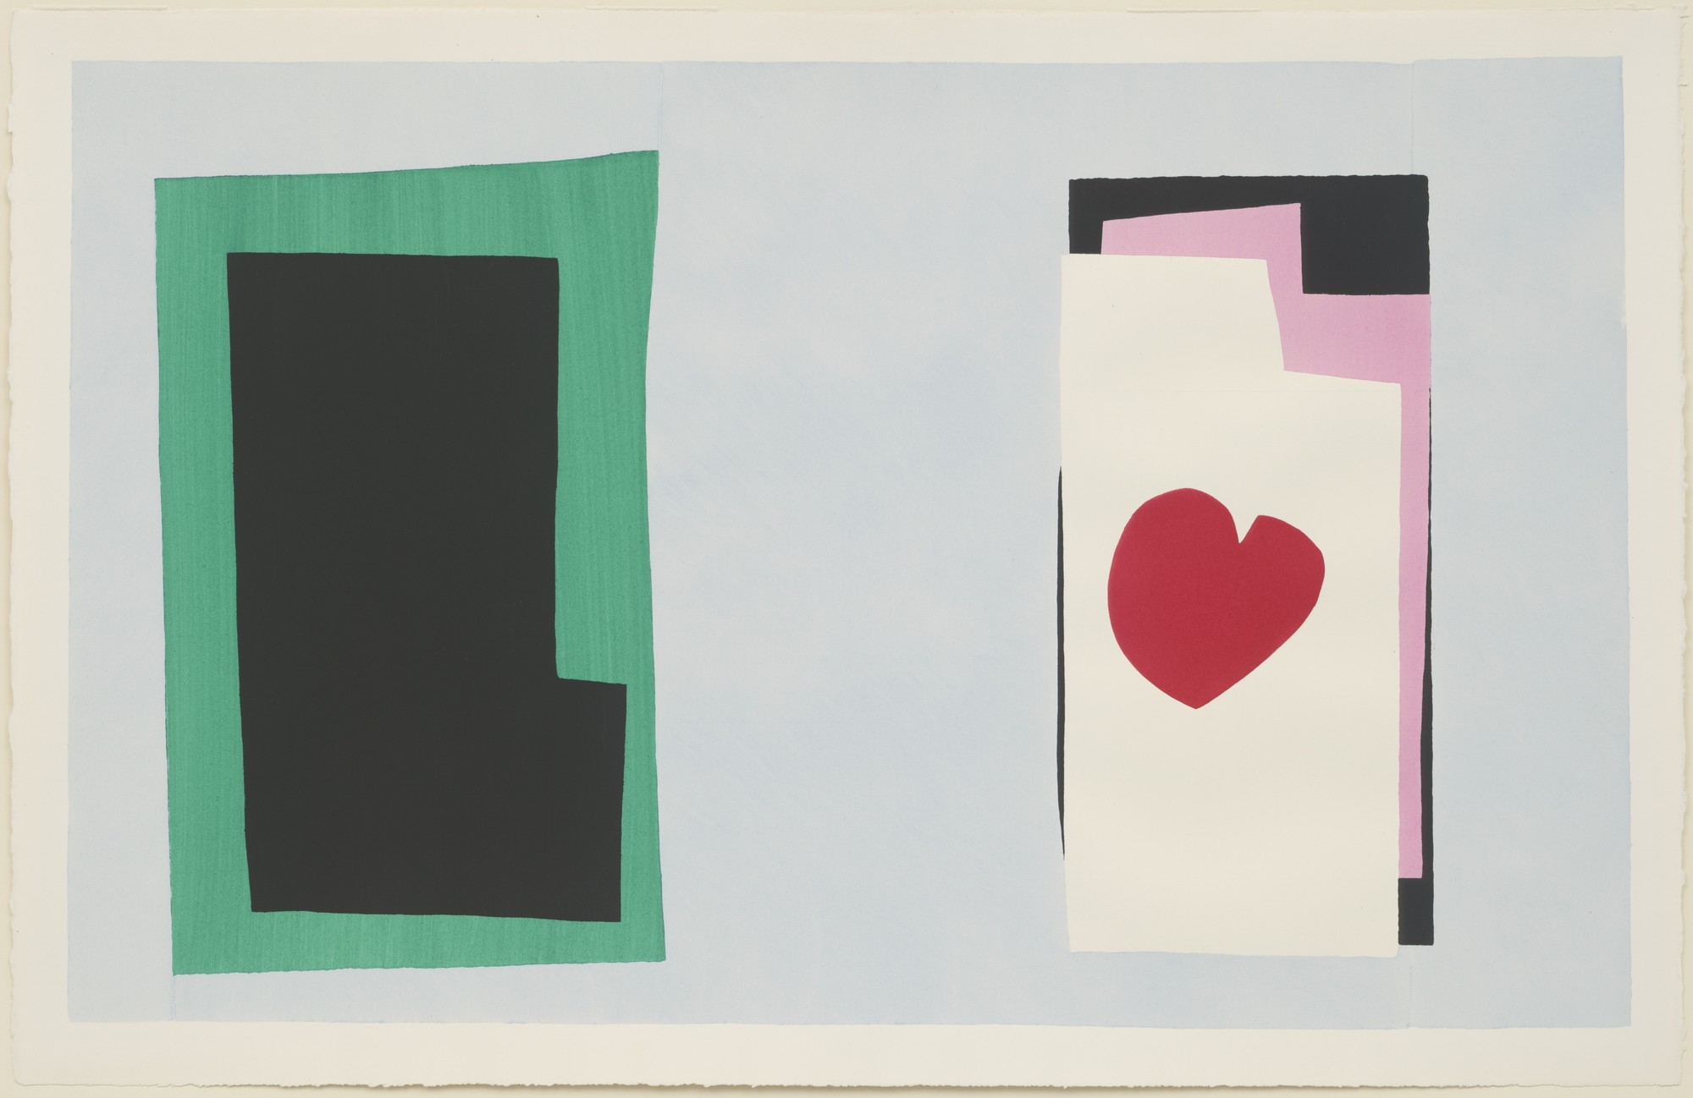

Slide 9
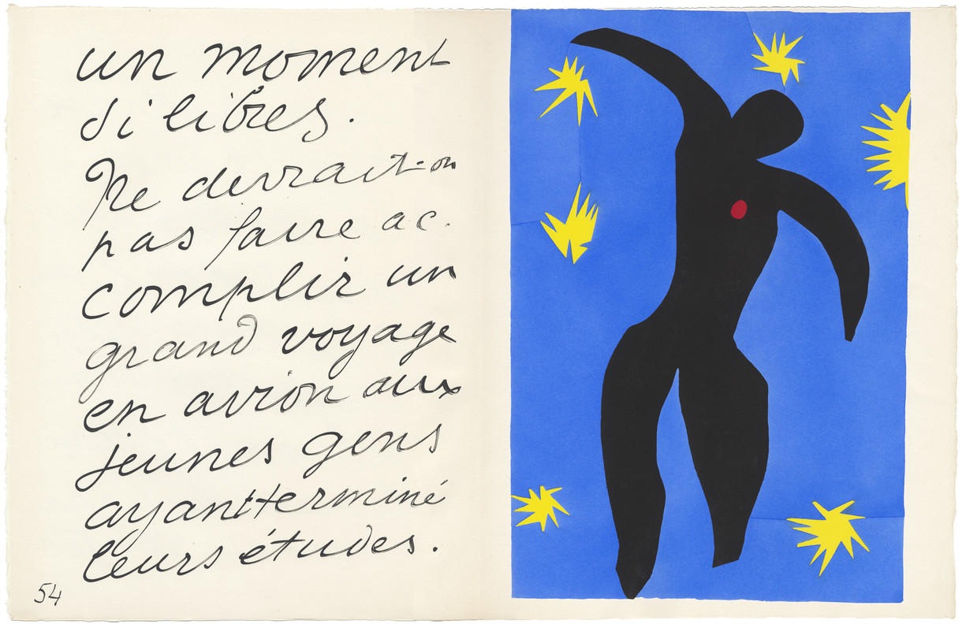

Slide 10
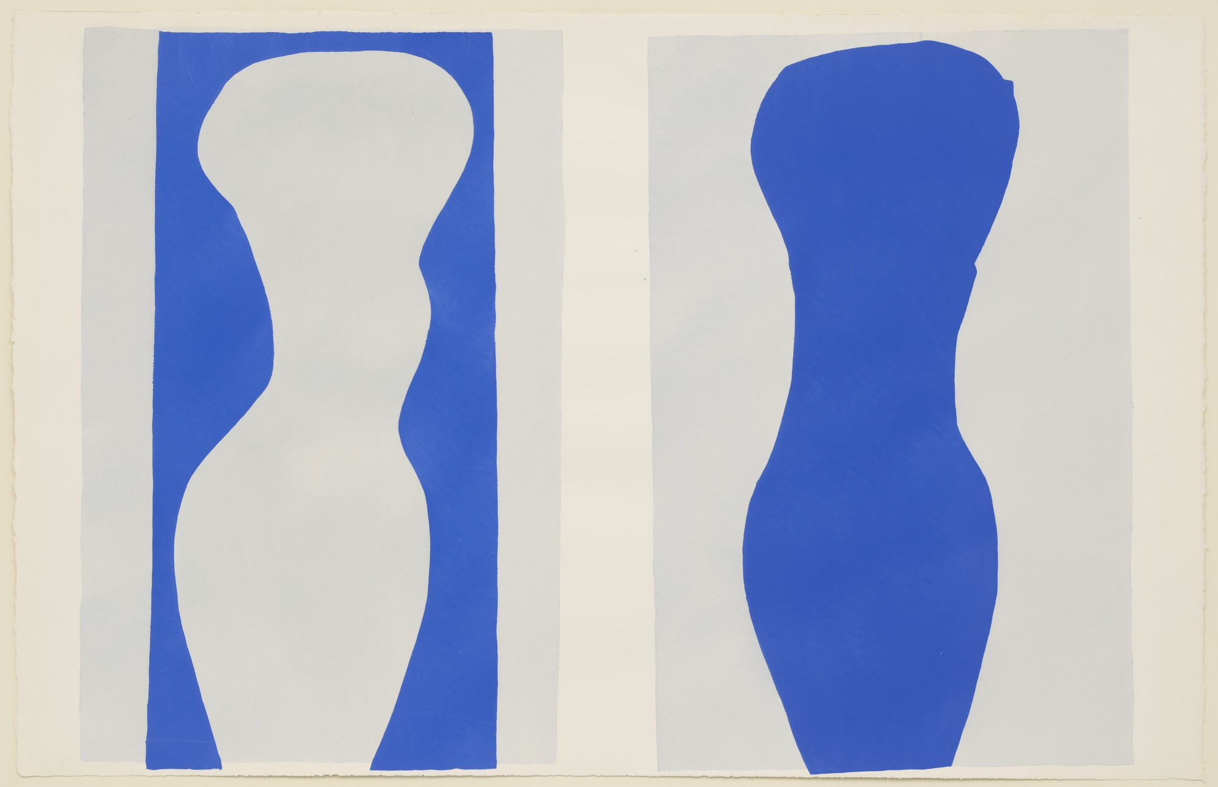

Slide 11
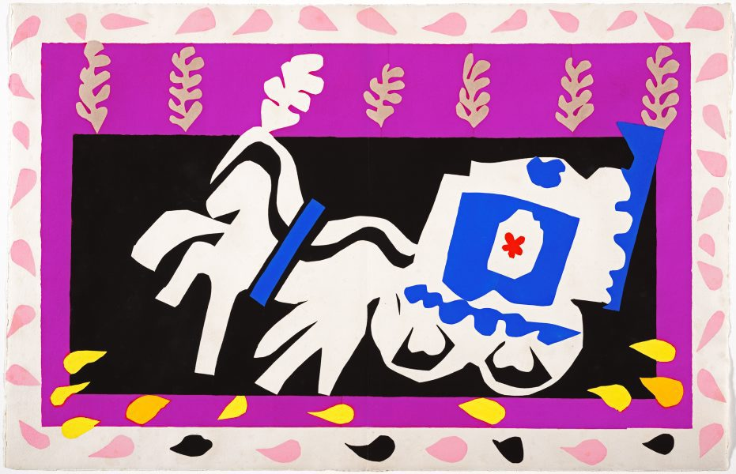

Slide 12
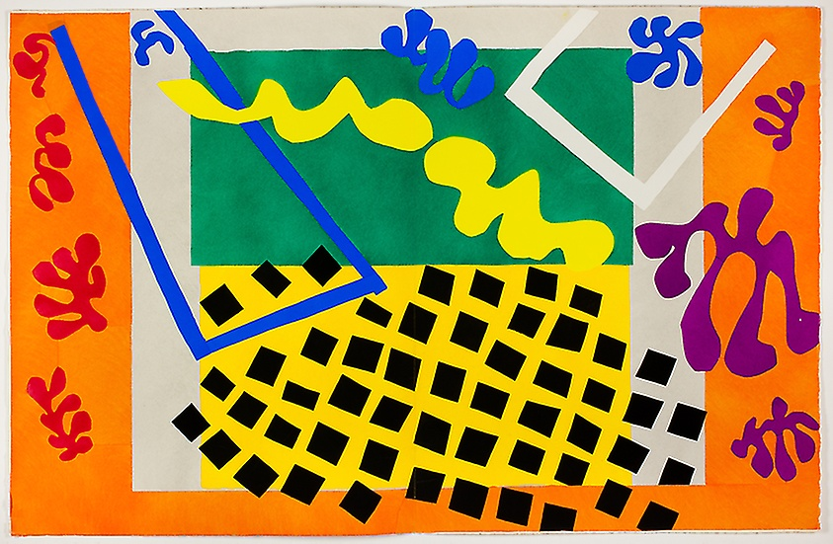

Slide 13
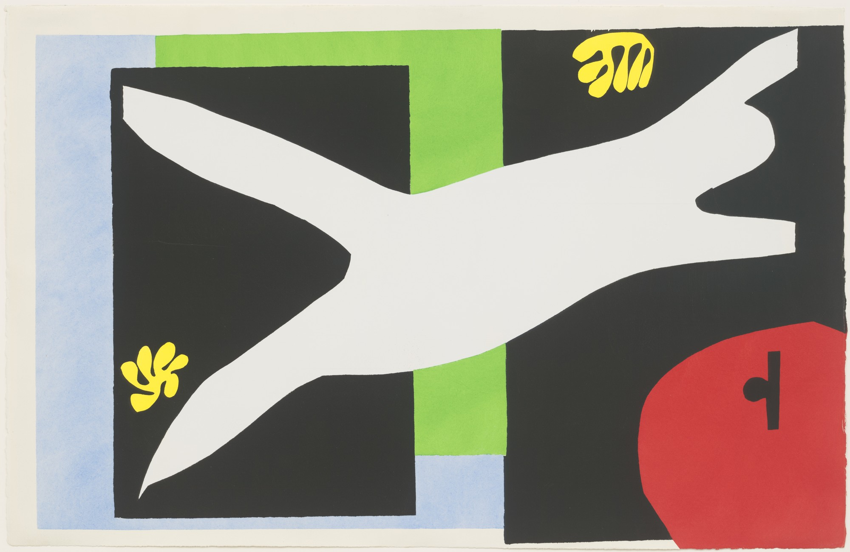

Slide 14
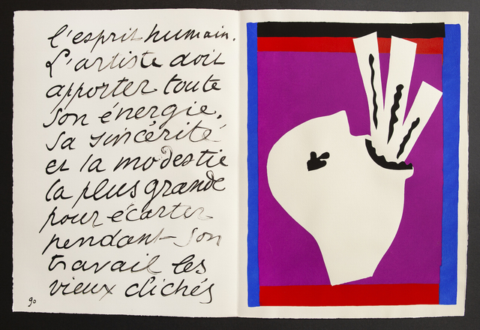

Slide 15
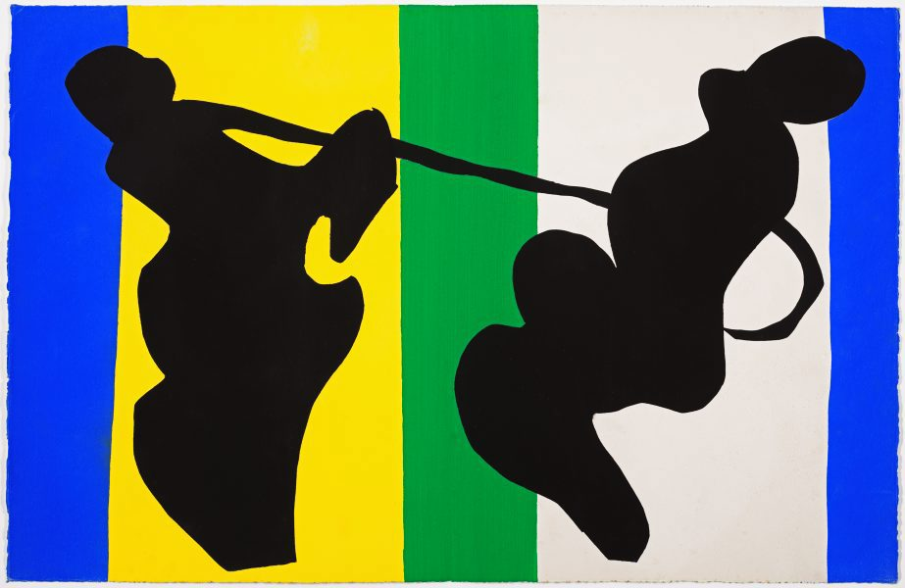

Slide 16
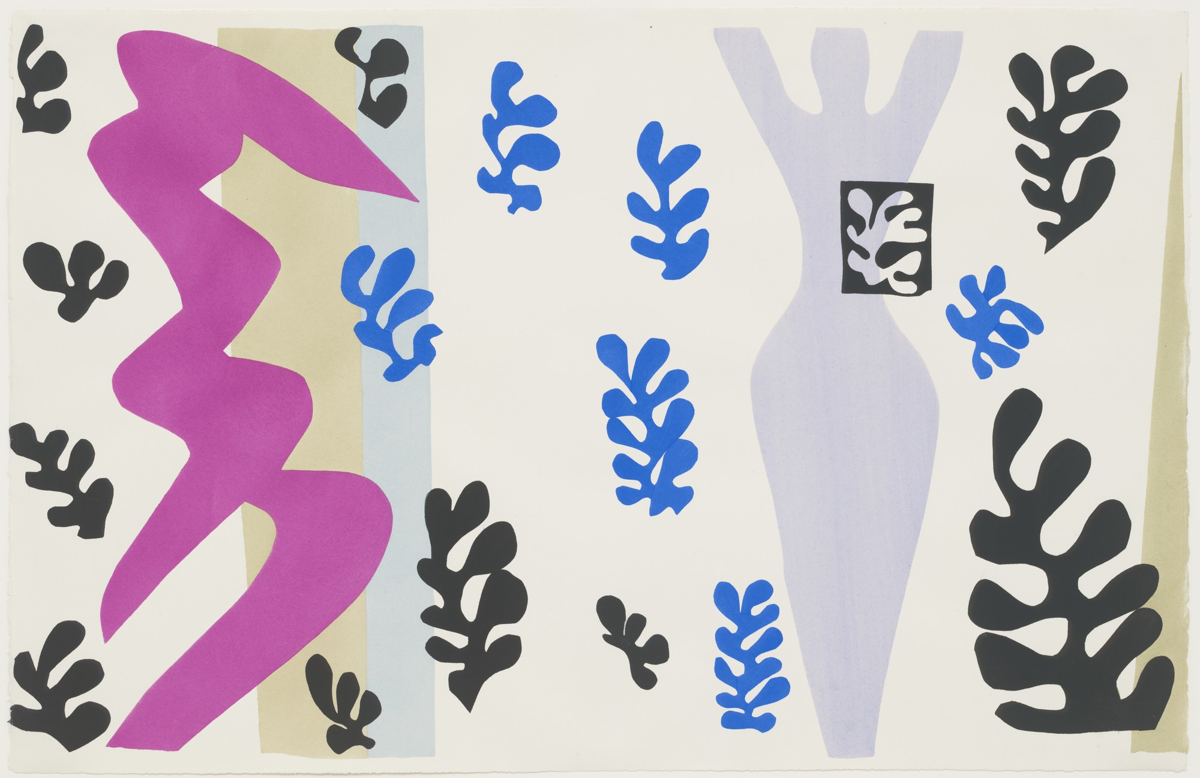

Slide 17
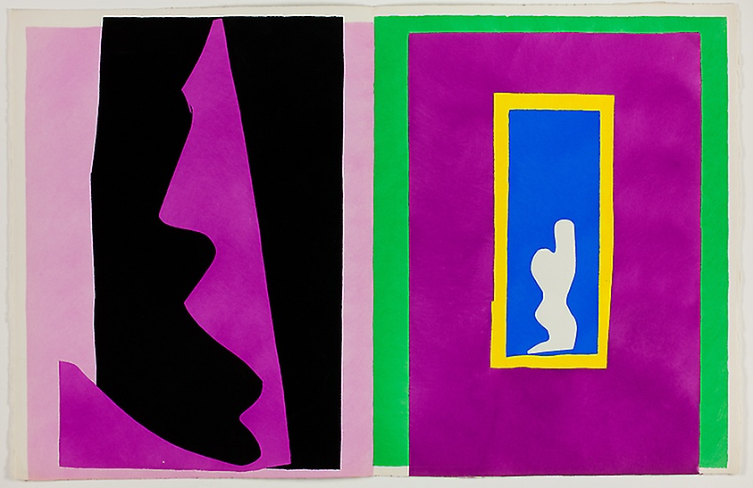

Slide 18
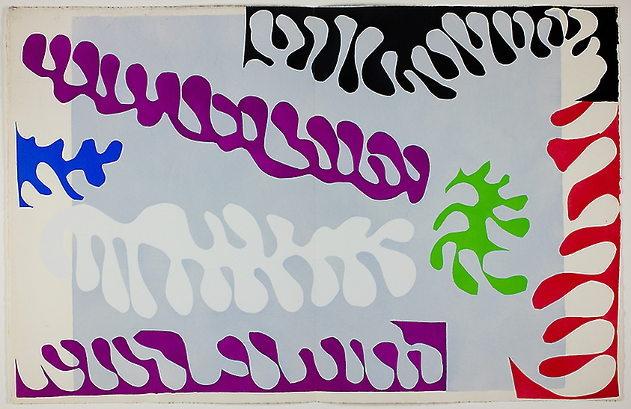

Slide 19
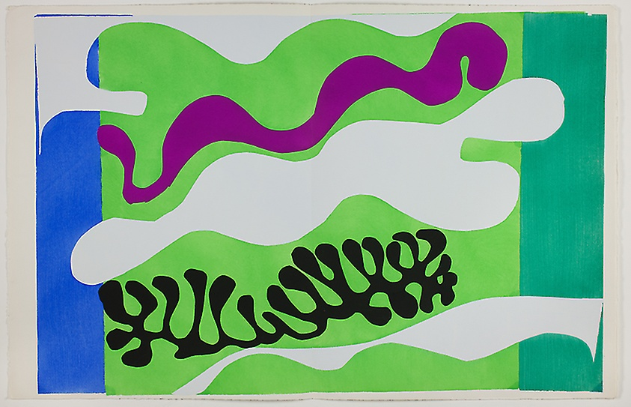

Slide 20
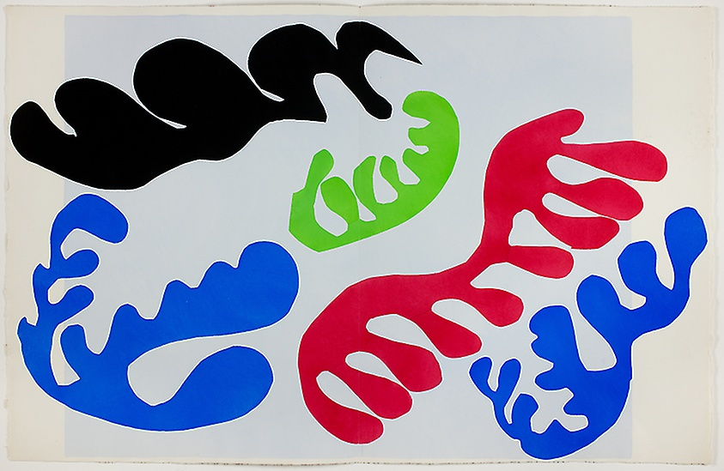

Slide 21
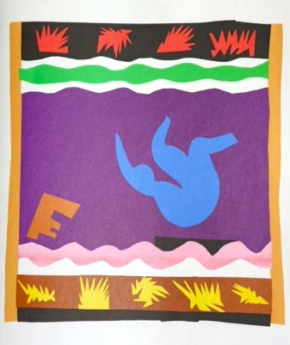

Slide 22
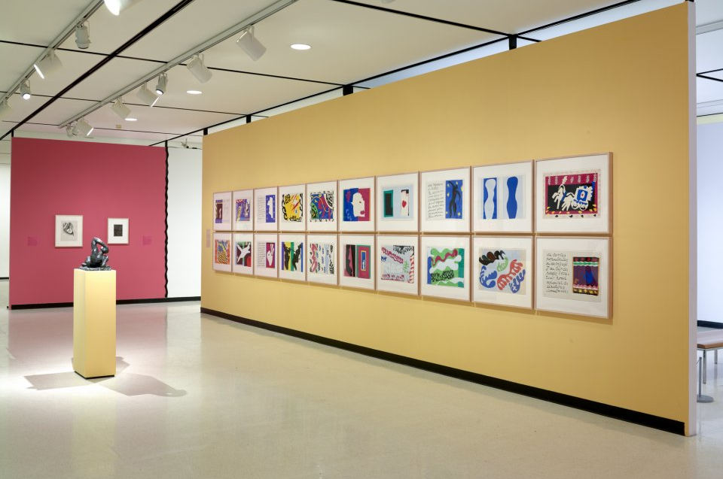
Installation view of Matisse and the Art of Jazz. Photograph by Tom Loonan.
Matisse and the Art of Jazz, January 20 - July 1, 2018 – Albright-Knox https://www.albrightknox.org/art/exhibitions/matisse-and-art-jazz

Slide 23
The titles of the individual sheets, together with supplementary explanations by his assistant Lydia Delectorskaya, in English translation, are:
"The Clown“ - "The Circus“ - "Monsieur Loyal" (a well-known Parisian circus director in the nineteenth century) –
"The Nightmare of the White Elephant“ - "The Horse, the Rider and Clown“ - "The Wolf" (the wolf from Red Riding Hood, the fairy tale by Charles Perrault. It is also an allusion to Hitler, contemporary history) - "The Heart“ - "Icarus“ - "Forms“ - "Pierrot's Funeral“ - "The Codomas" (two famous trapeze artists) - "The Swimmer in the Tank" (a memory of a performance Matisse saw in the aquarium of the Folies-Bergère) - "The Sword Swallower“ - "The Cowboy“ - "The Knife Thrower“ - "Destiny“ - "Lagoon I“ - "Lagoon II“ - "Lagoon III“ - "Toboggan" https://en.wikipedia.org/wiki/Jazz_(Henri_Matisse)

