Slide 1
15th cent. Renaissance Art
Donatello, 1386-1466

Slide 2
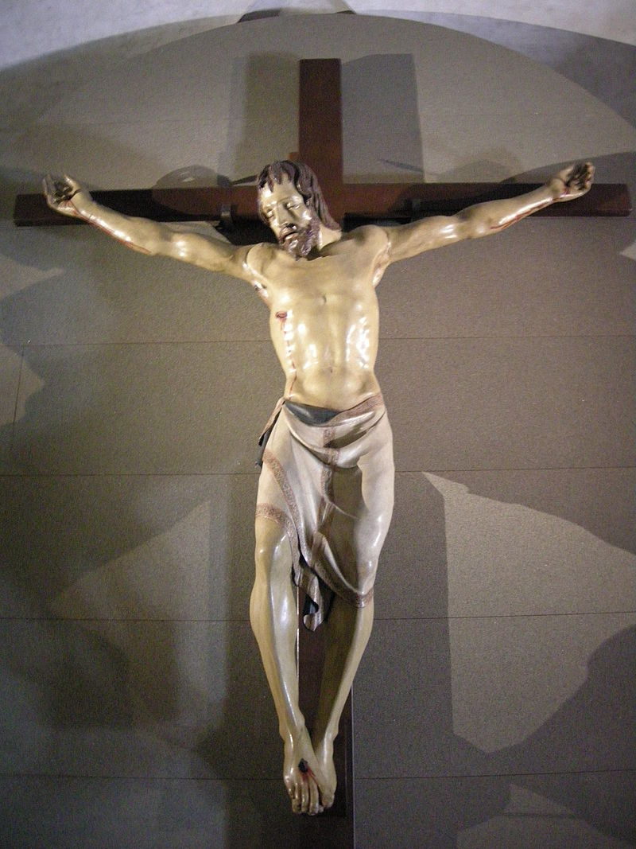
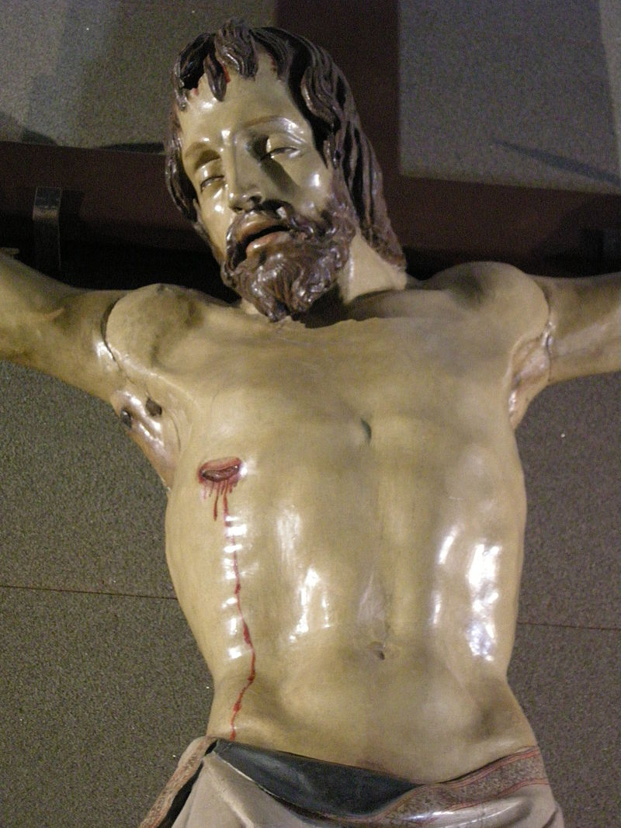
Santa Croce Crucifix, c.1406-1408, Polychrome Wood, Height: 165 cm, Cappella Bardi di Vernio, Santa Croce, Florence

Slide 3
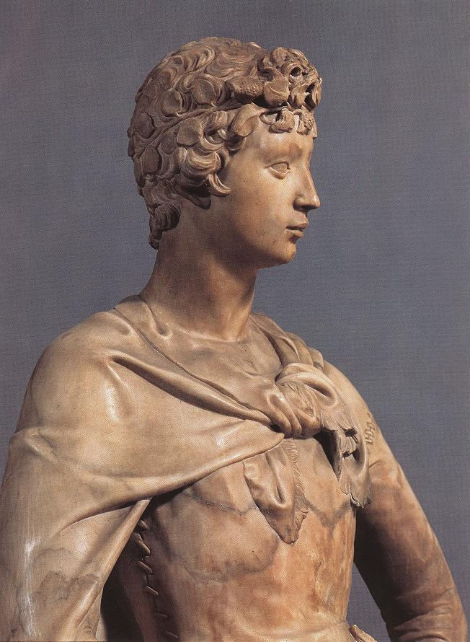
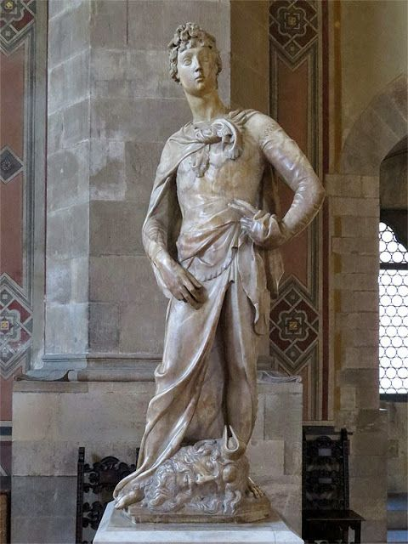
David, 1409,
Marble, Height:
191 cm,
Museo Nazionale del Bargello, Florence

Slide 4
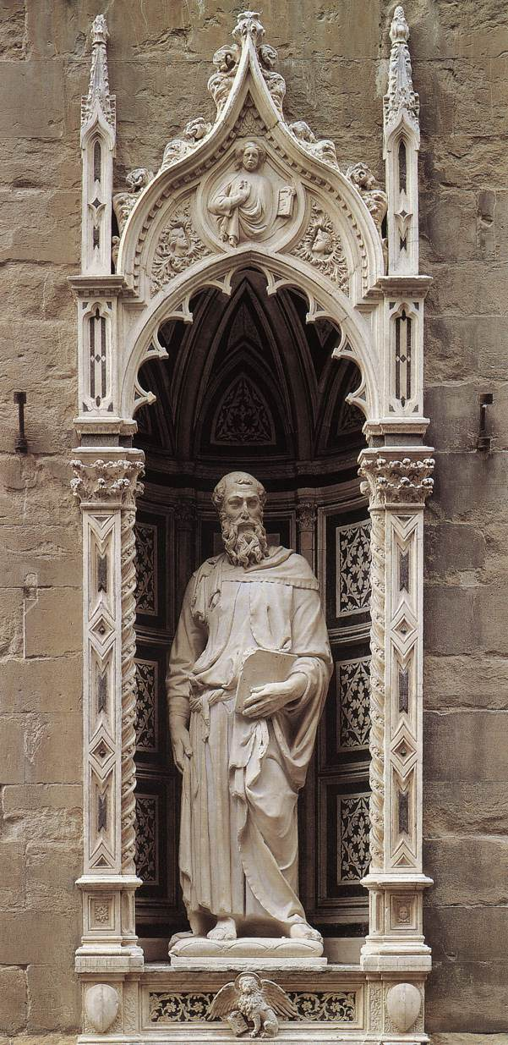
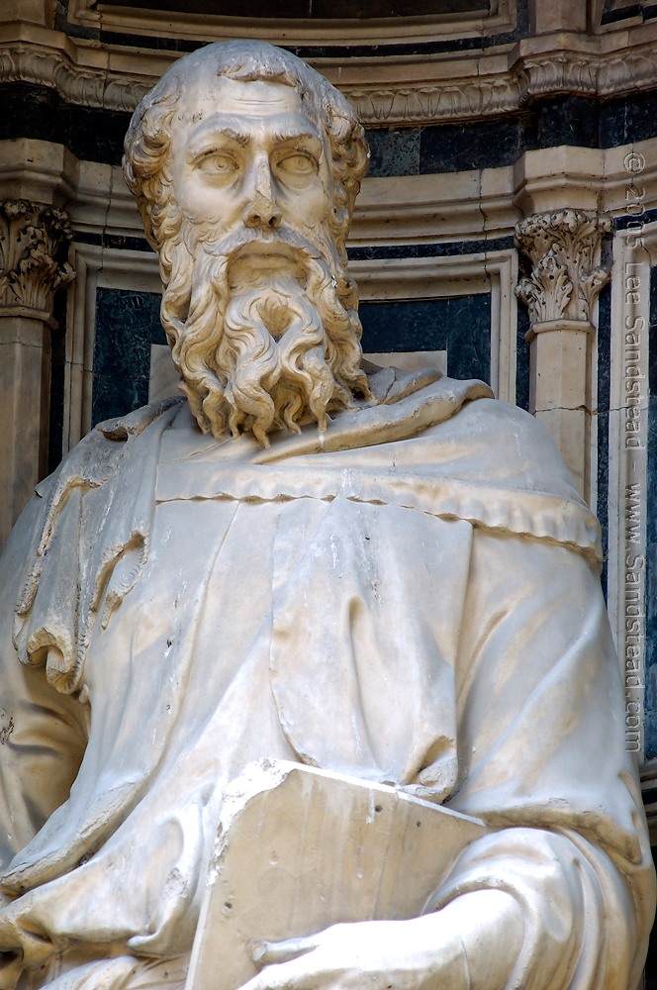
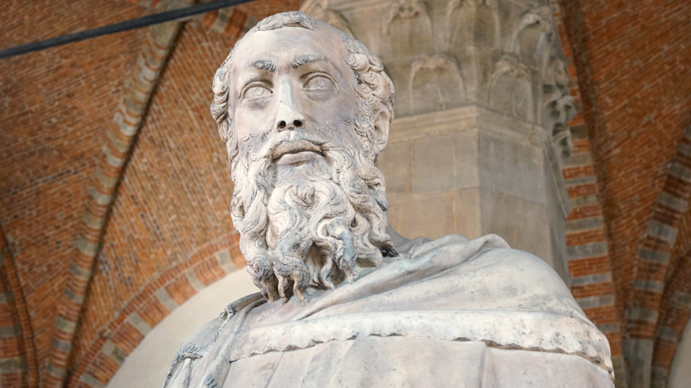
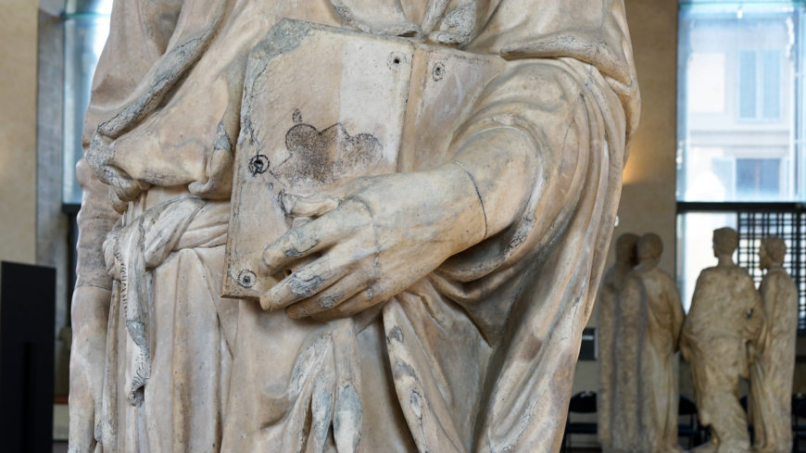
Saint Mark, 1411-1413, Marble, Height: 236 cm,
Orsanmichele, Florence

Slide 5
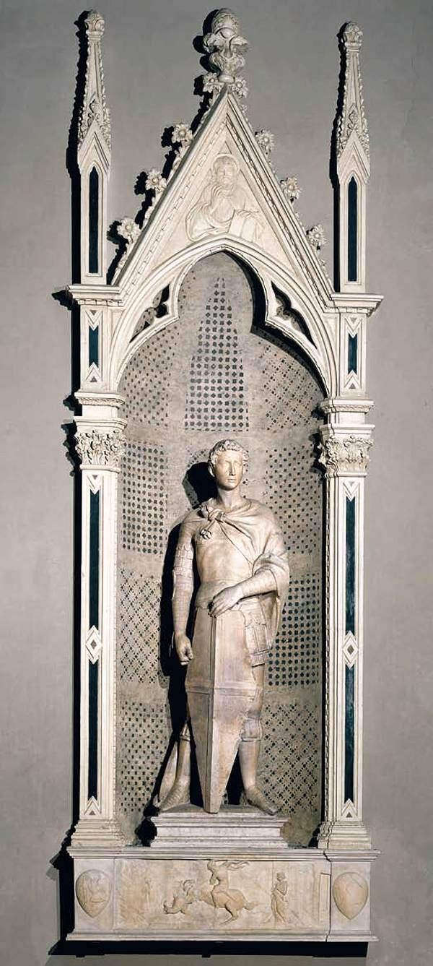
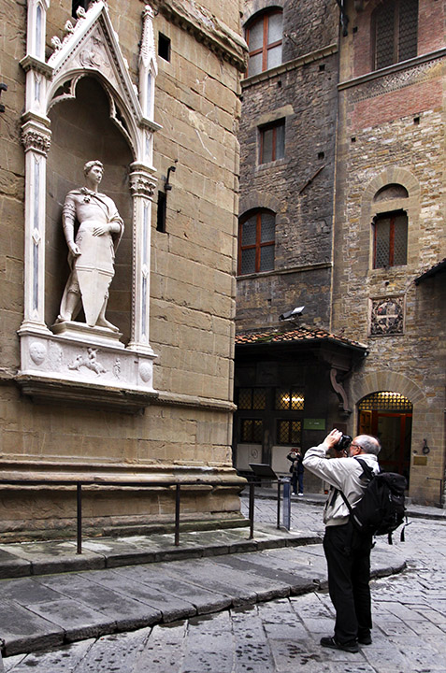
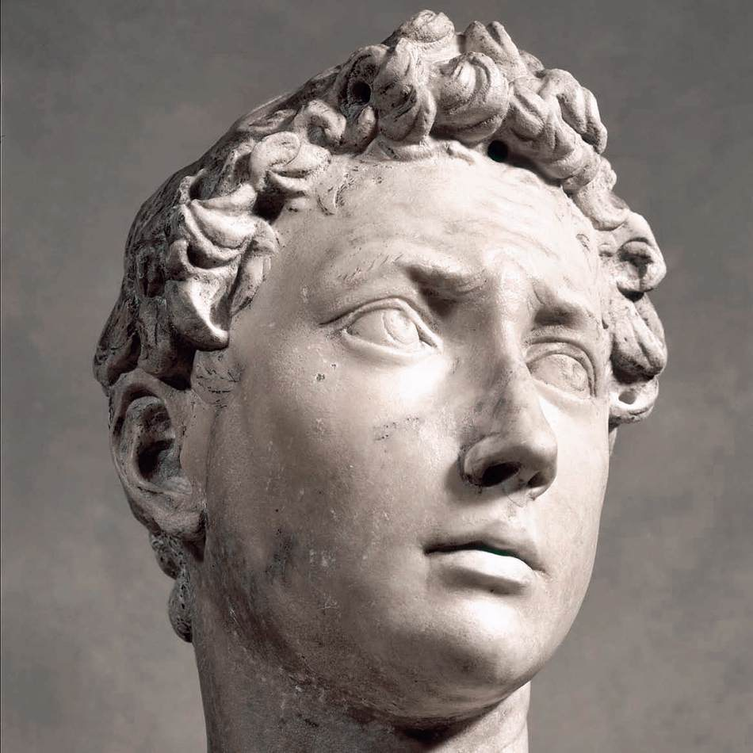
Saint George, c. 1416, Marble, Height: 214 cm, Museo Nazionale del Bargello, Florence

Slide 6
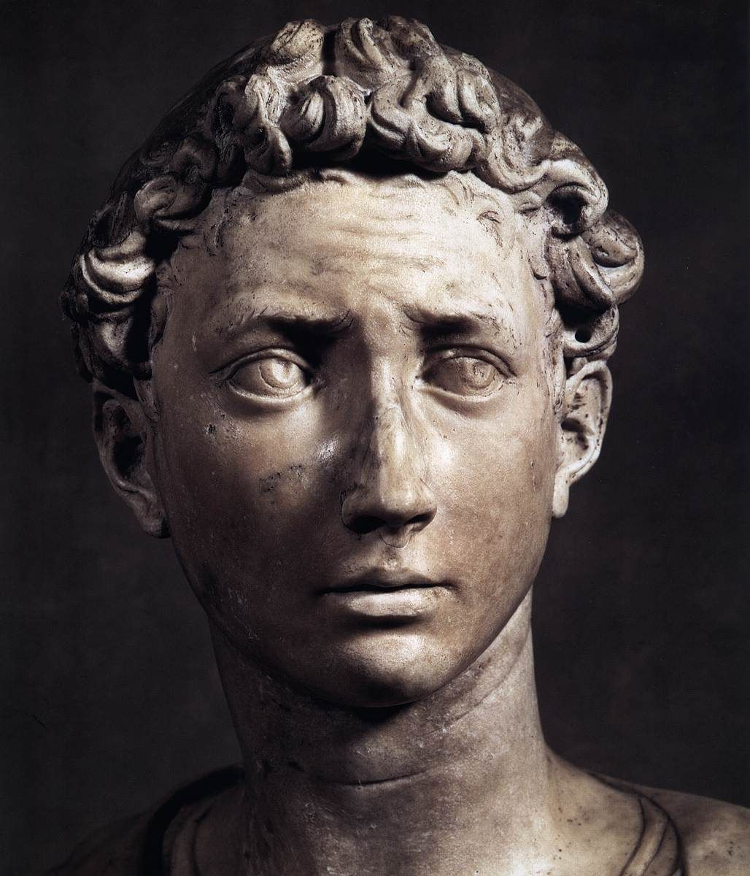
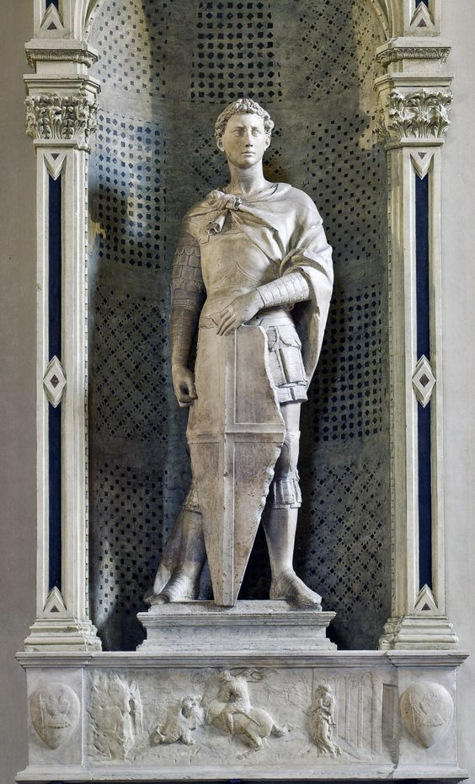

Slide 7
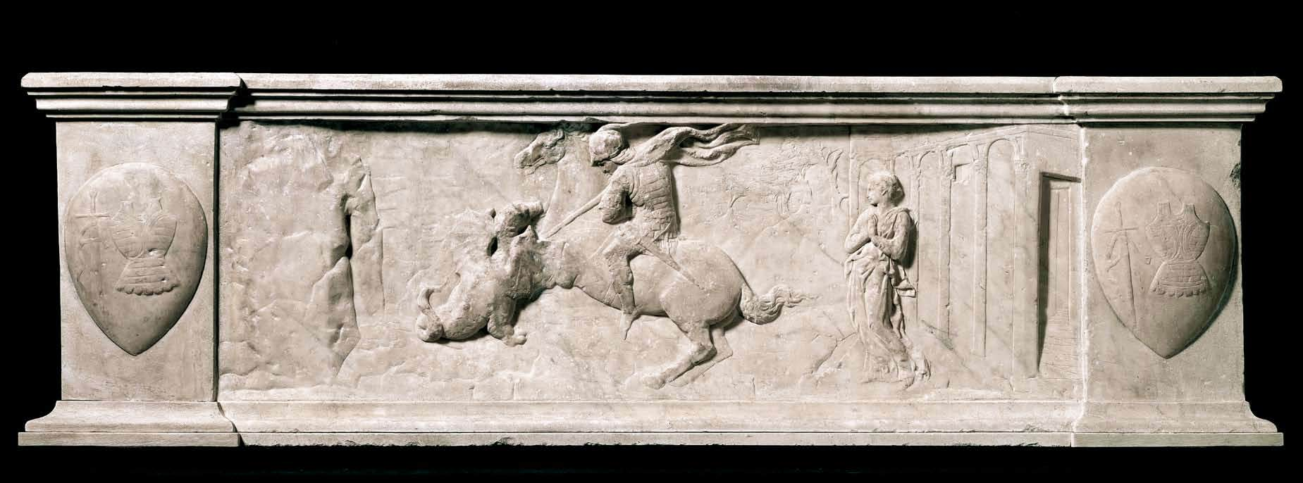

Slide 8
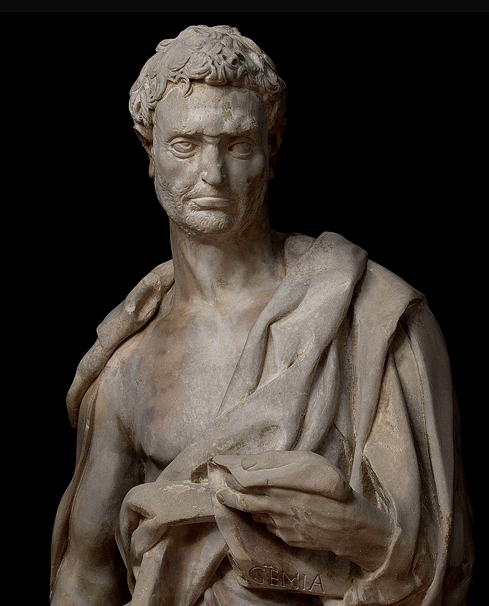
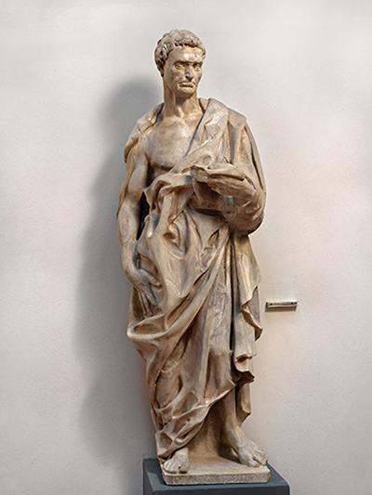
Prophet Jeremiah
1423-26, Marble, Height: 191 cm, Museo dell'Opera del Duomo, Florence

Slide 9
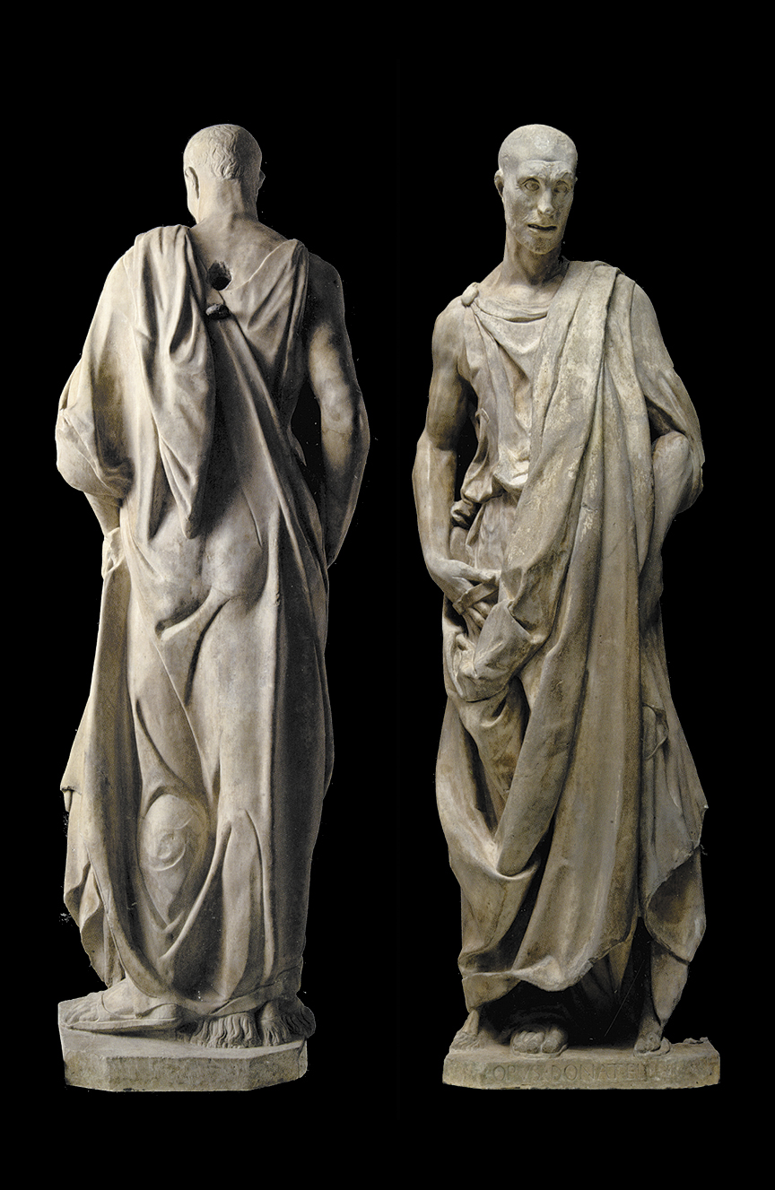
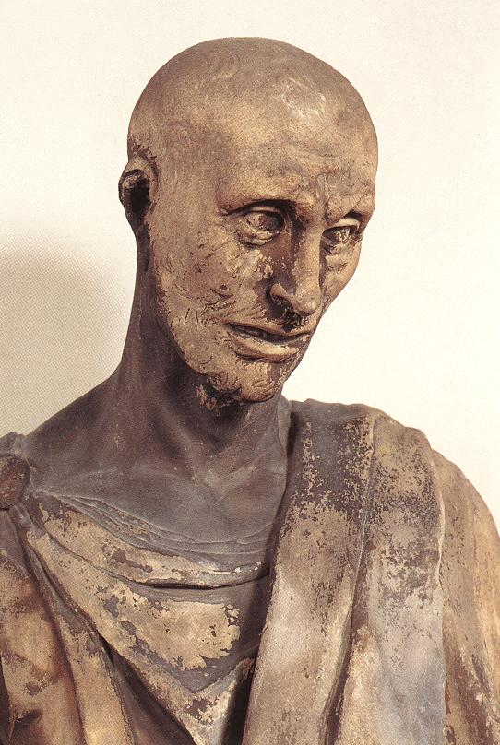
Prophet Habakkuk,
1427-36, Marble, Height: 196 cm, Museo dell'Opera del Duomo, Florence

Slide 10
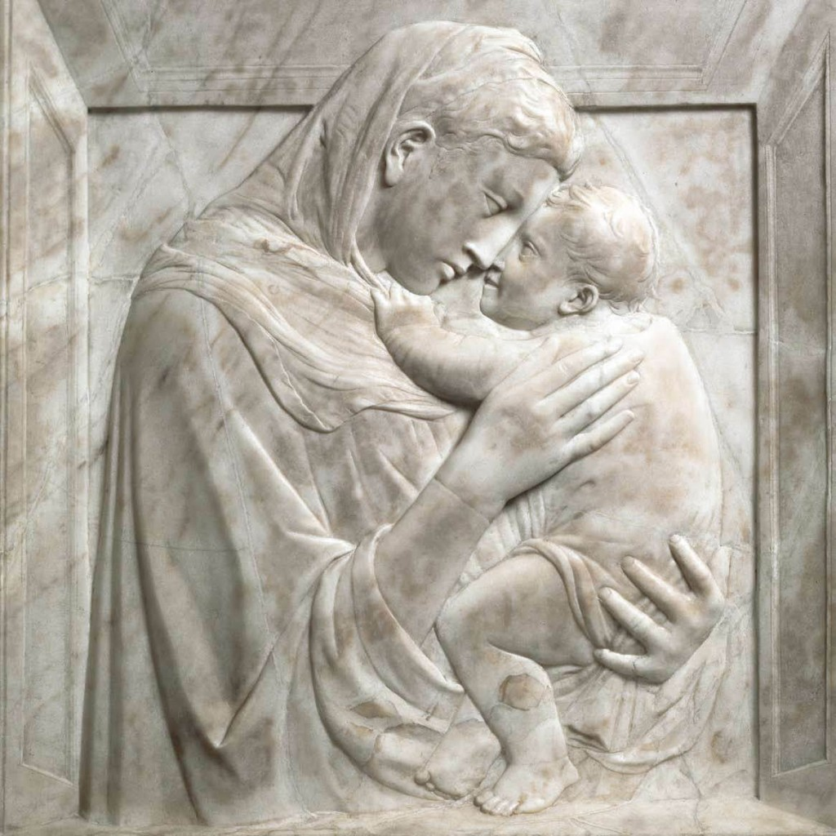
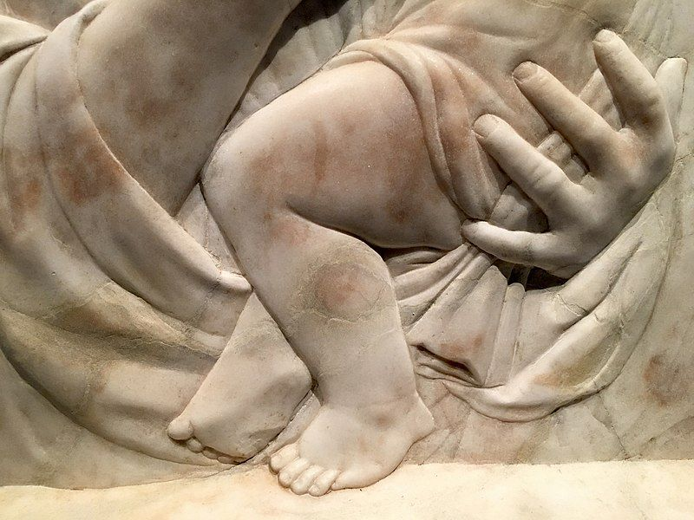
Pazzi Madonna,
1420-30,
Marble, 75 x 70 cm, the Bode-Museum, Berlin

Slide 11
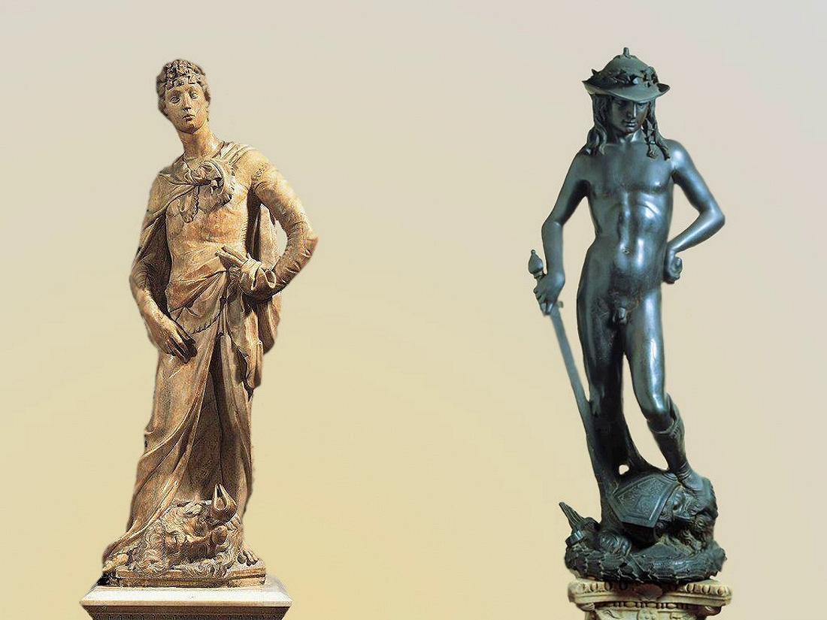
Comparison between Donatello’s David of 1409 and that of 1430

Slide 12
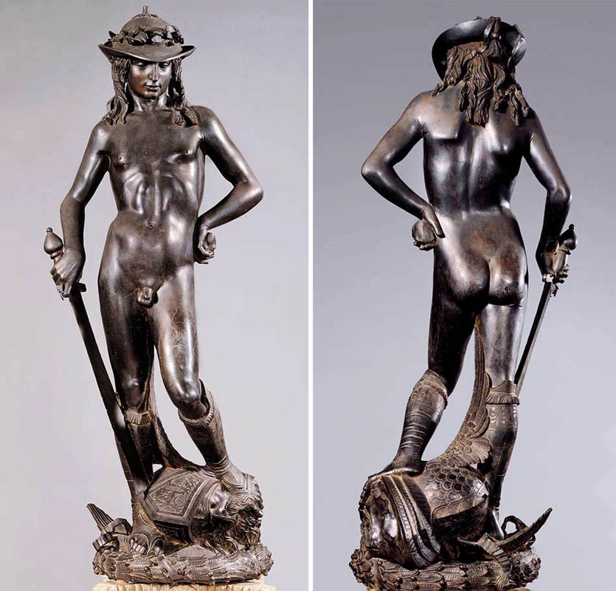
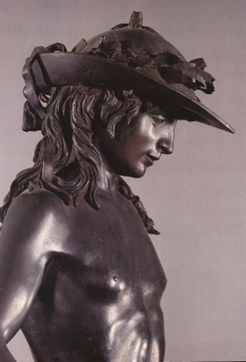
David, c. 1430
Bronze, Height: 158 cm, Museo Nazionale del Bargello, Florence

Slide 13
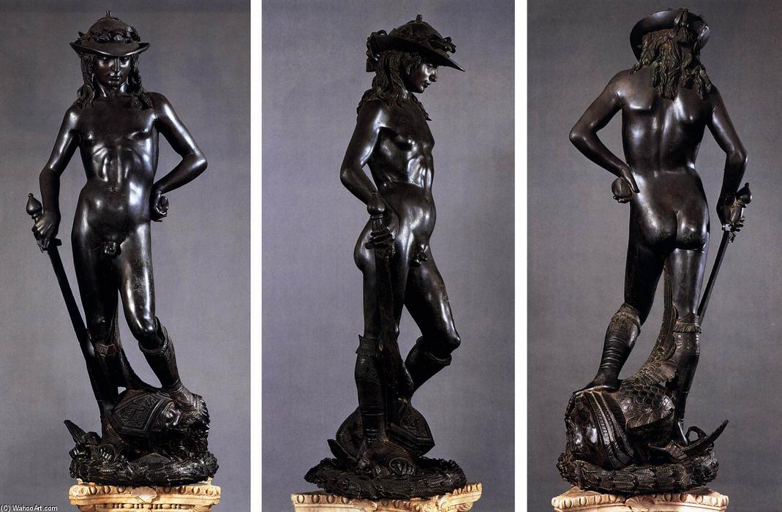

Slide 14
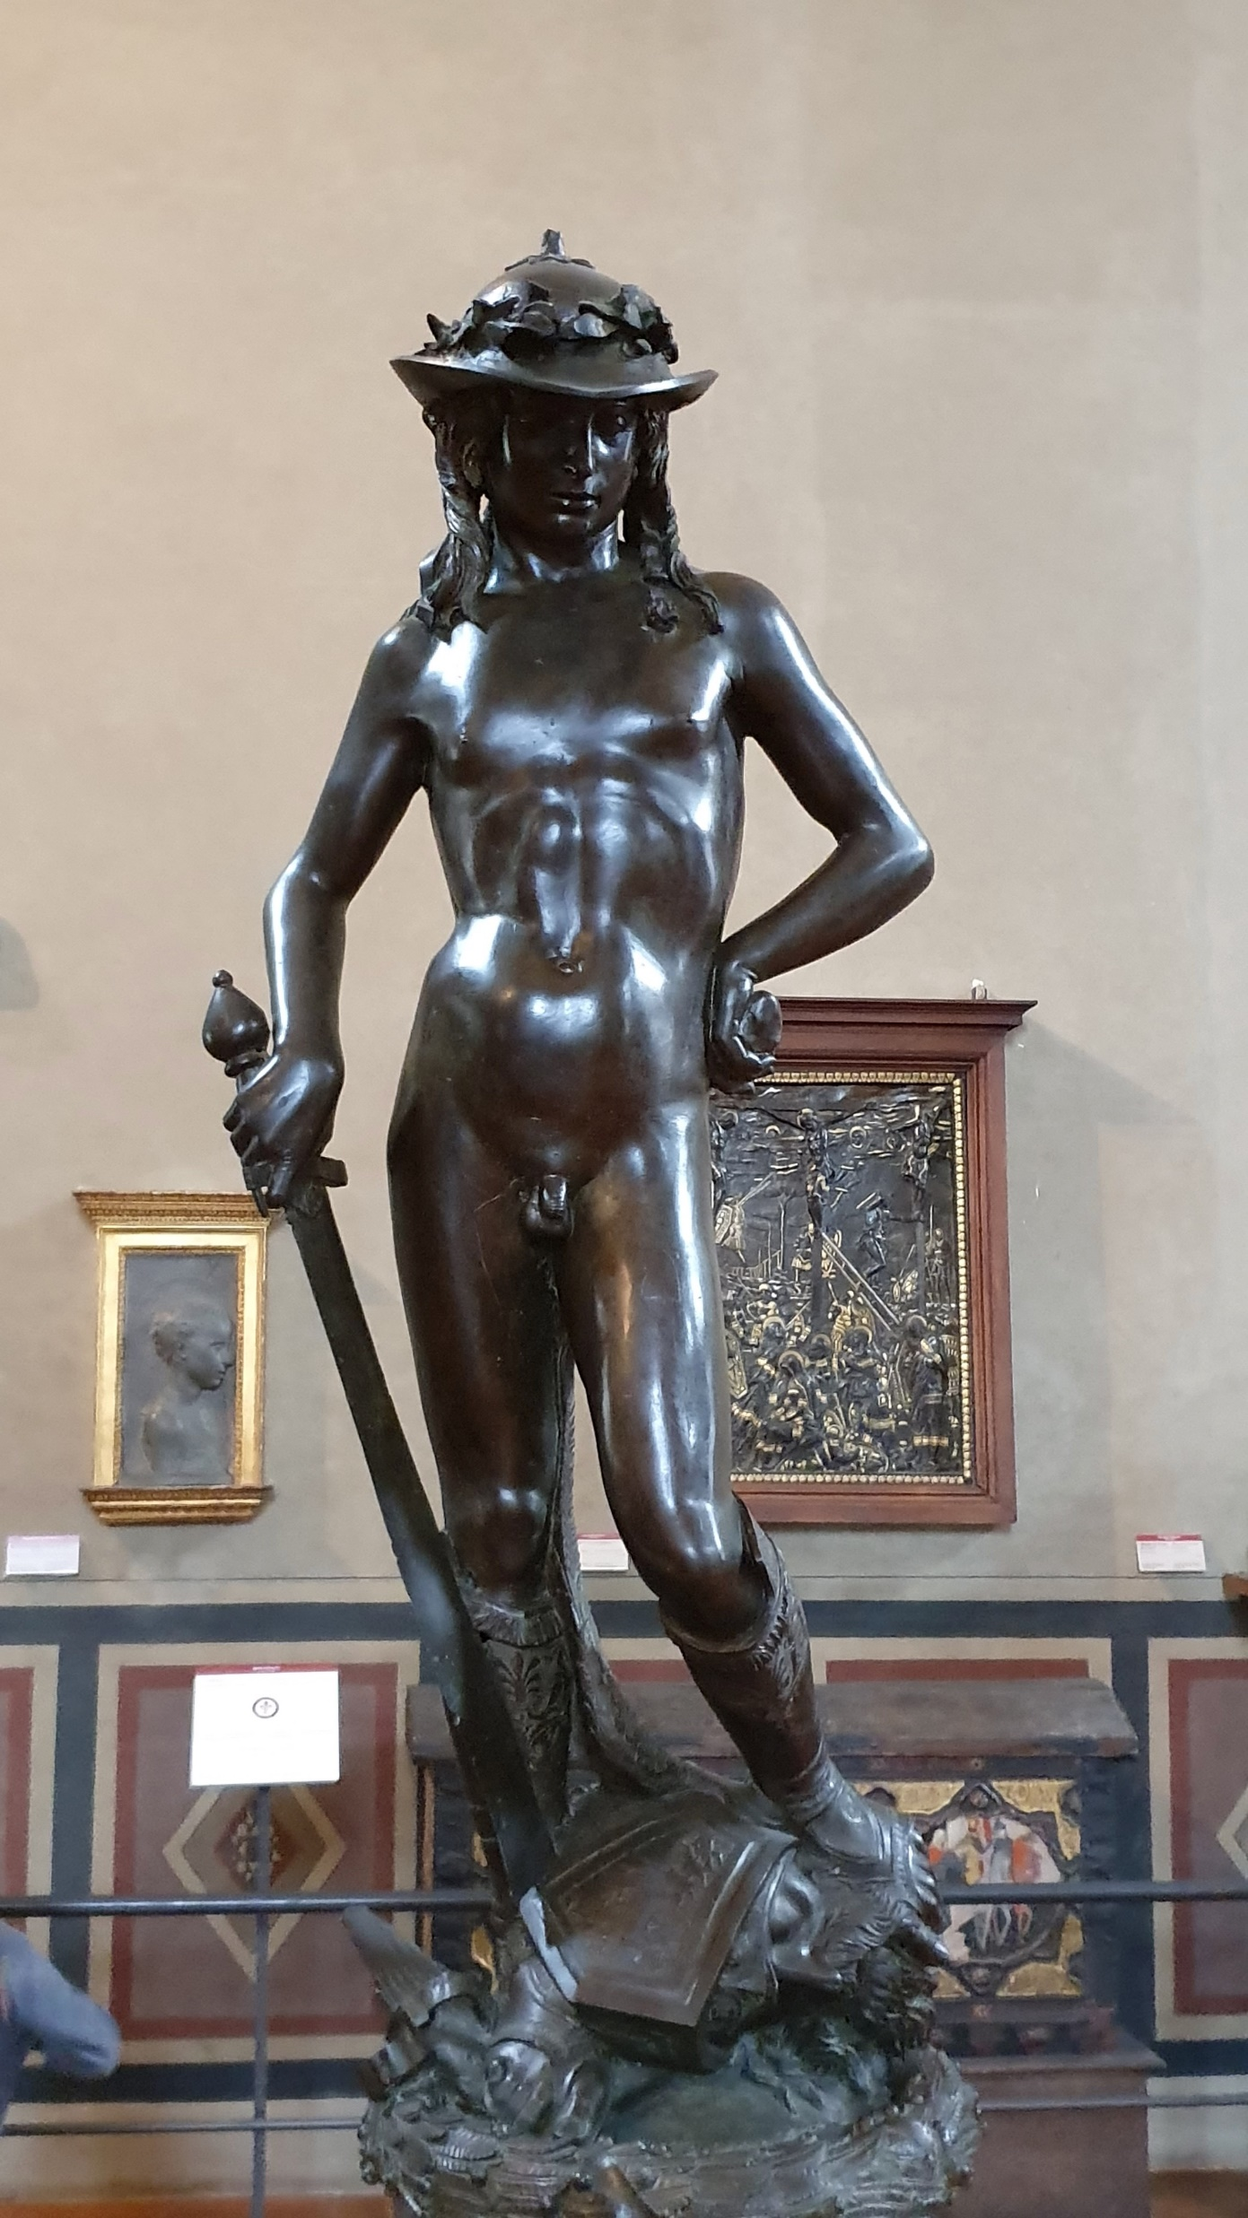
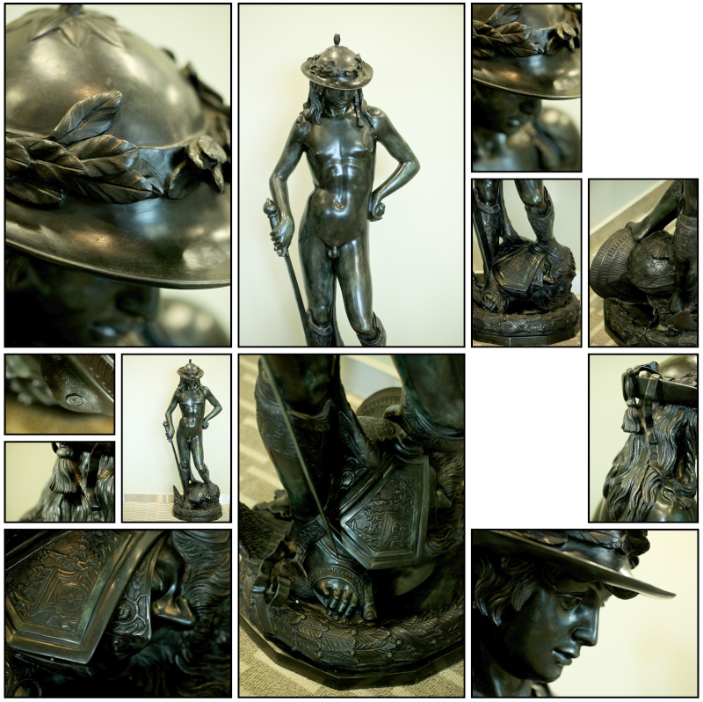

Slide 15
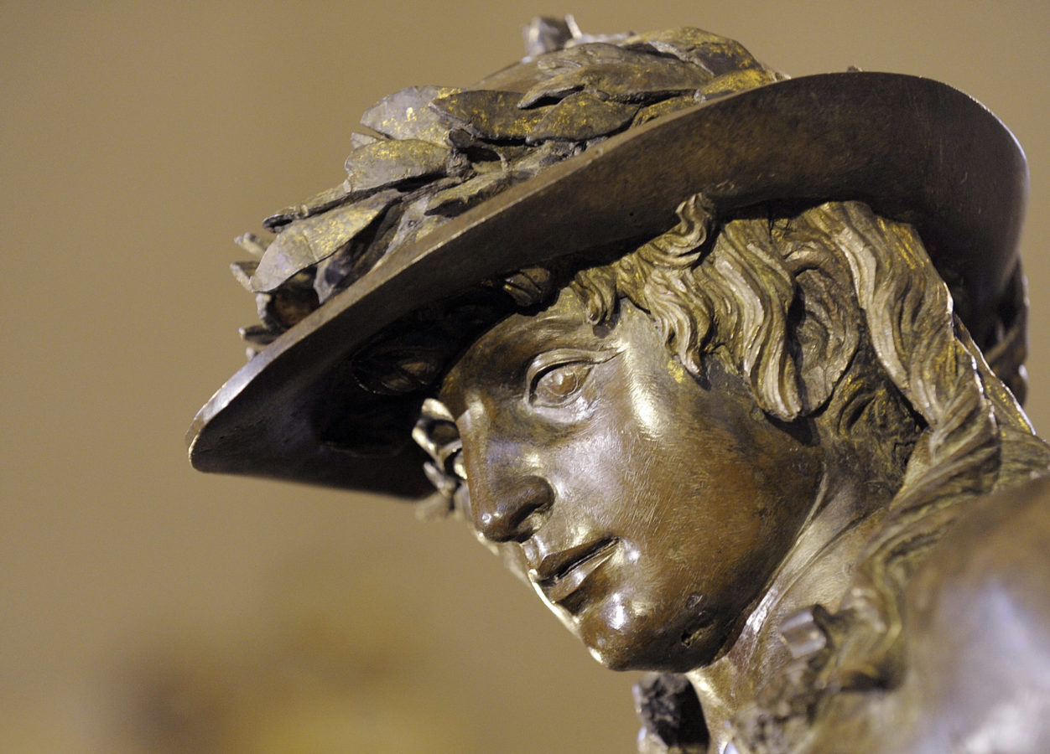

Slide 16
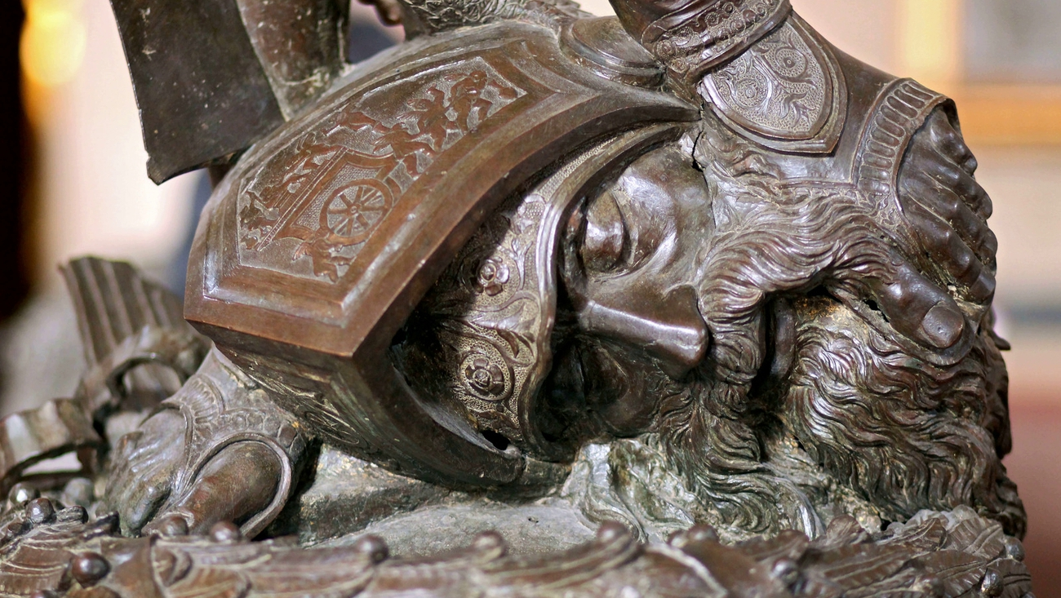

Slide 17
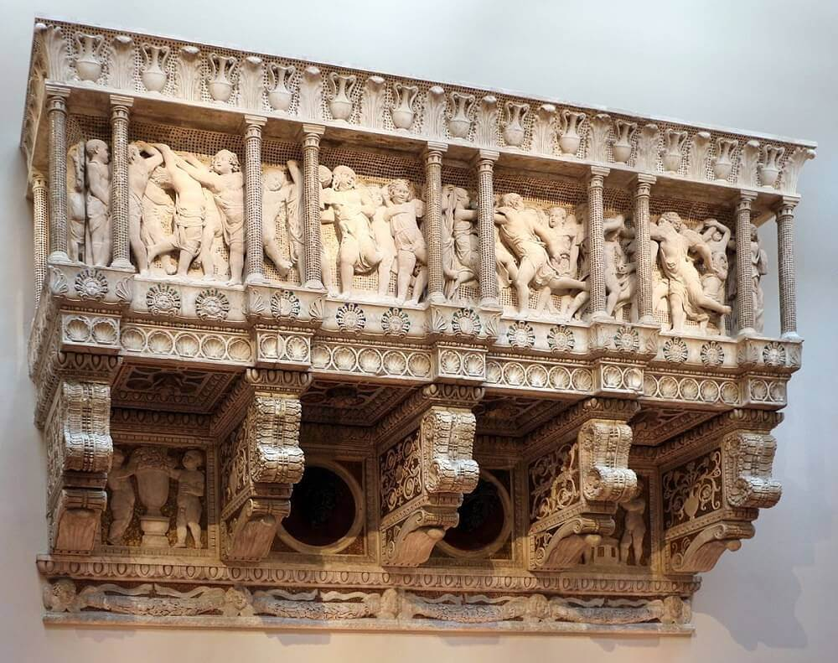
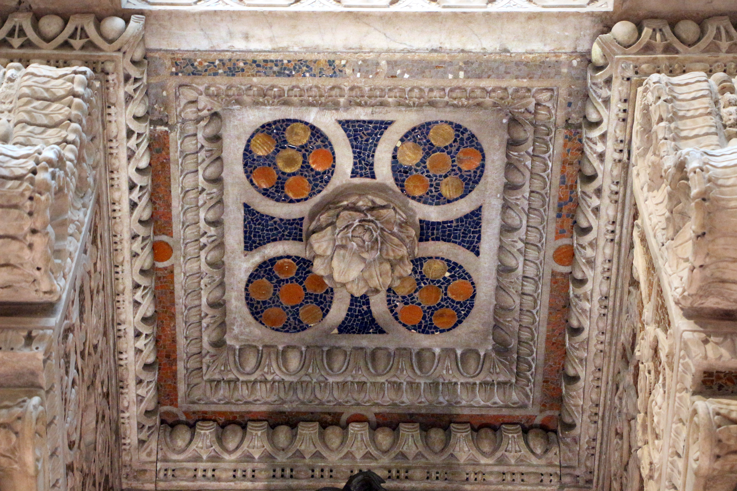
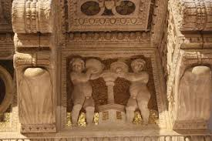
Cantoria, 1431-39
Marble, 348 x 570 cm
Museo dell'Opera del Duomo, Florence

Slide 18
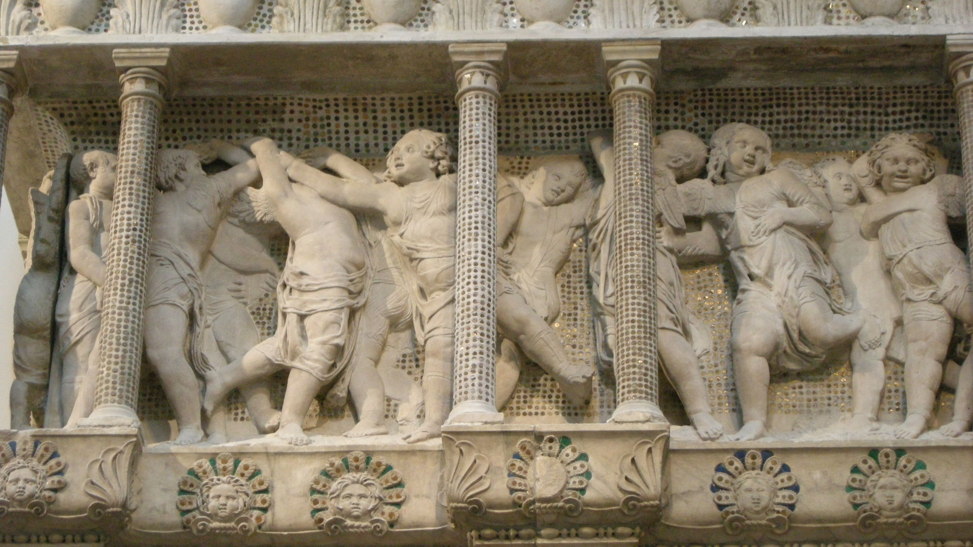

Slide 19
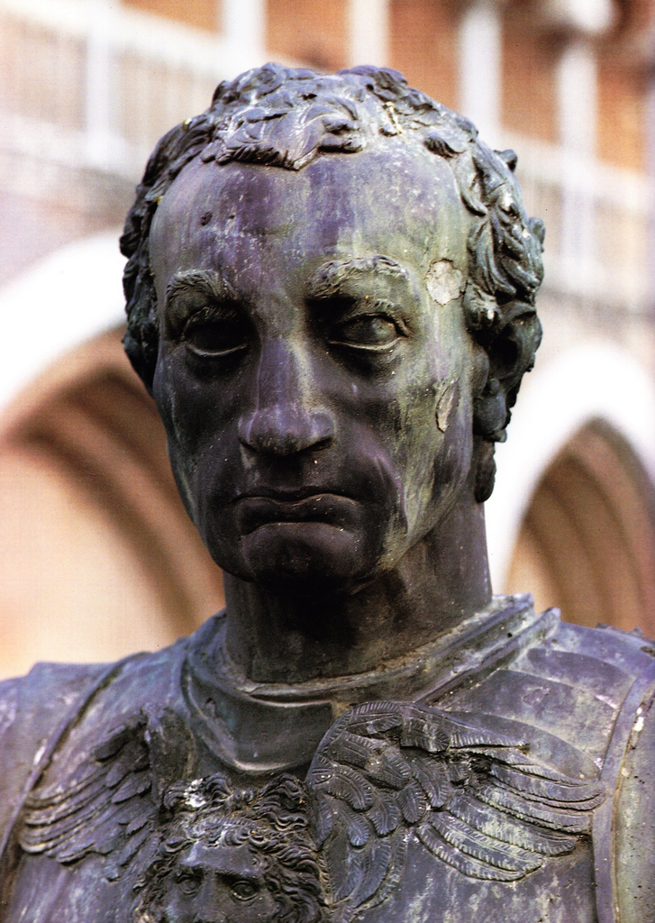
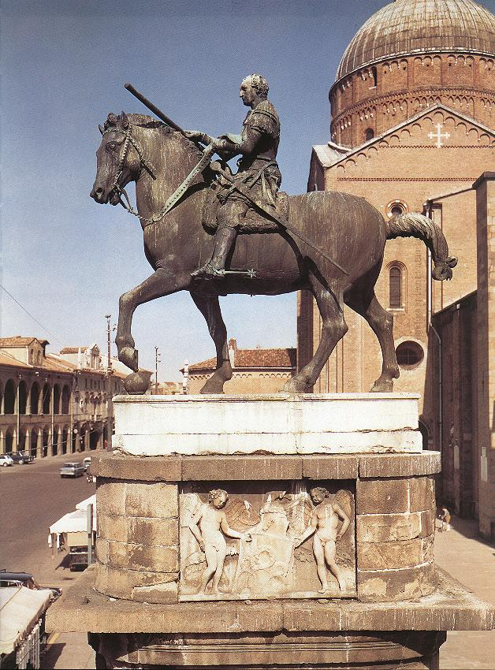
Equestrian
Statue of Gattamelata
1447-50, Bronze,
340x390 cm, Piazza del Santo, Padua

Slide 20
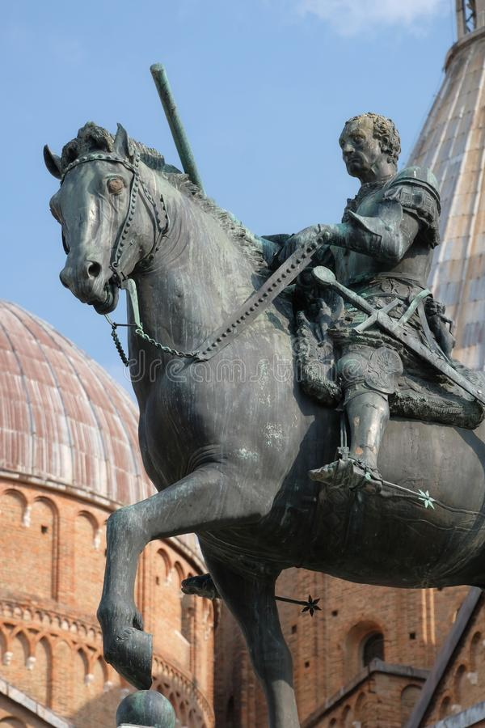
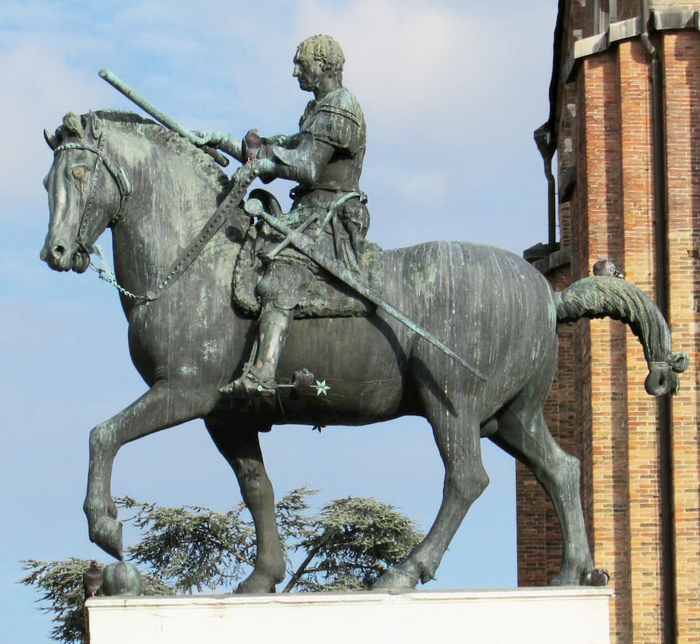

Slide 21
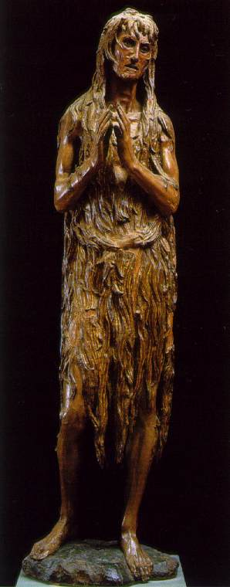
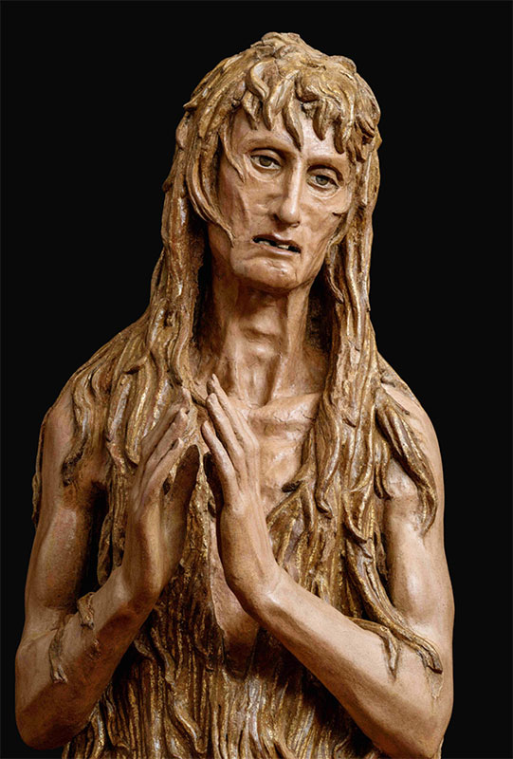
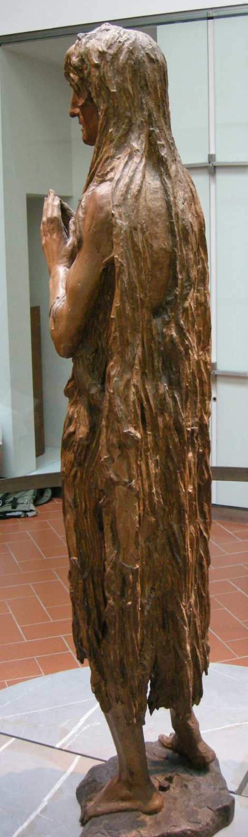
Saint Mary Magdalen, c. 1457, Wood, Height:
188 cm, Museo dell'Opera del Duomo, Florence

Slide 22
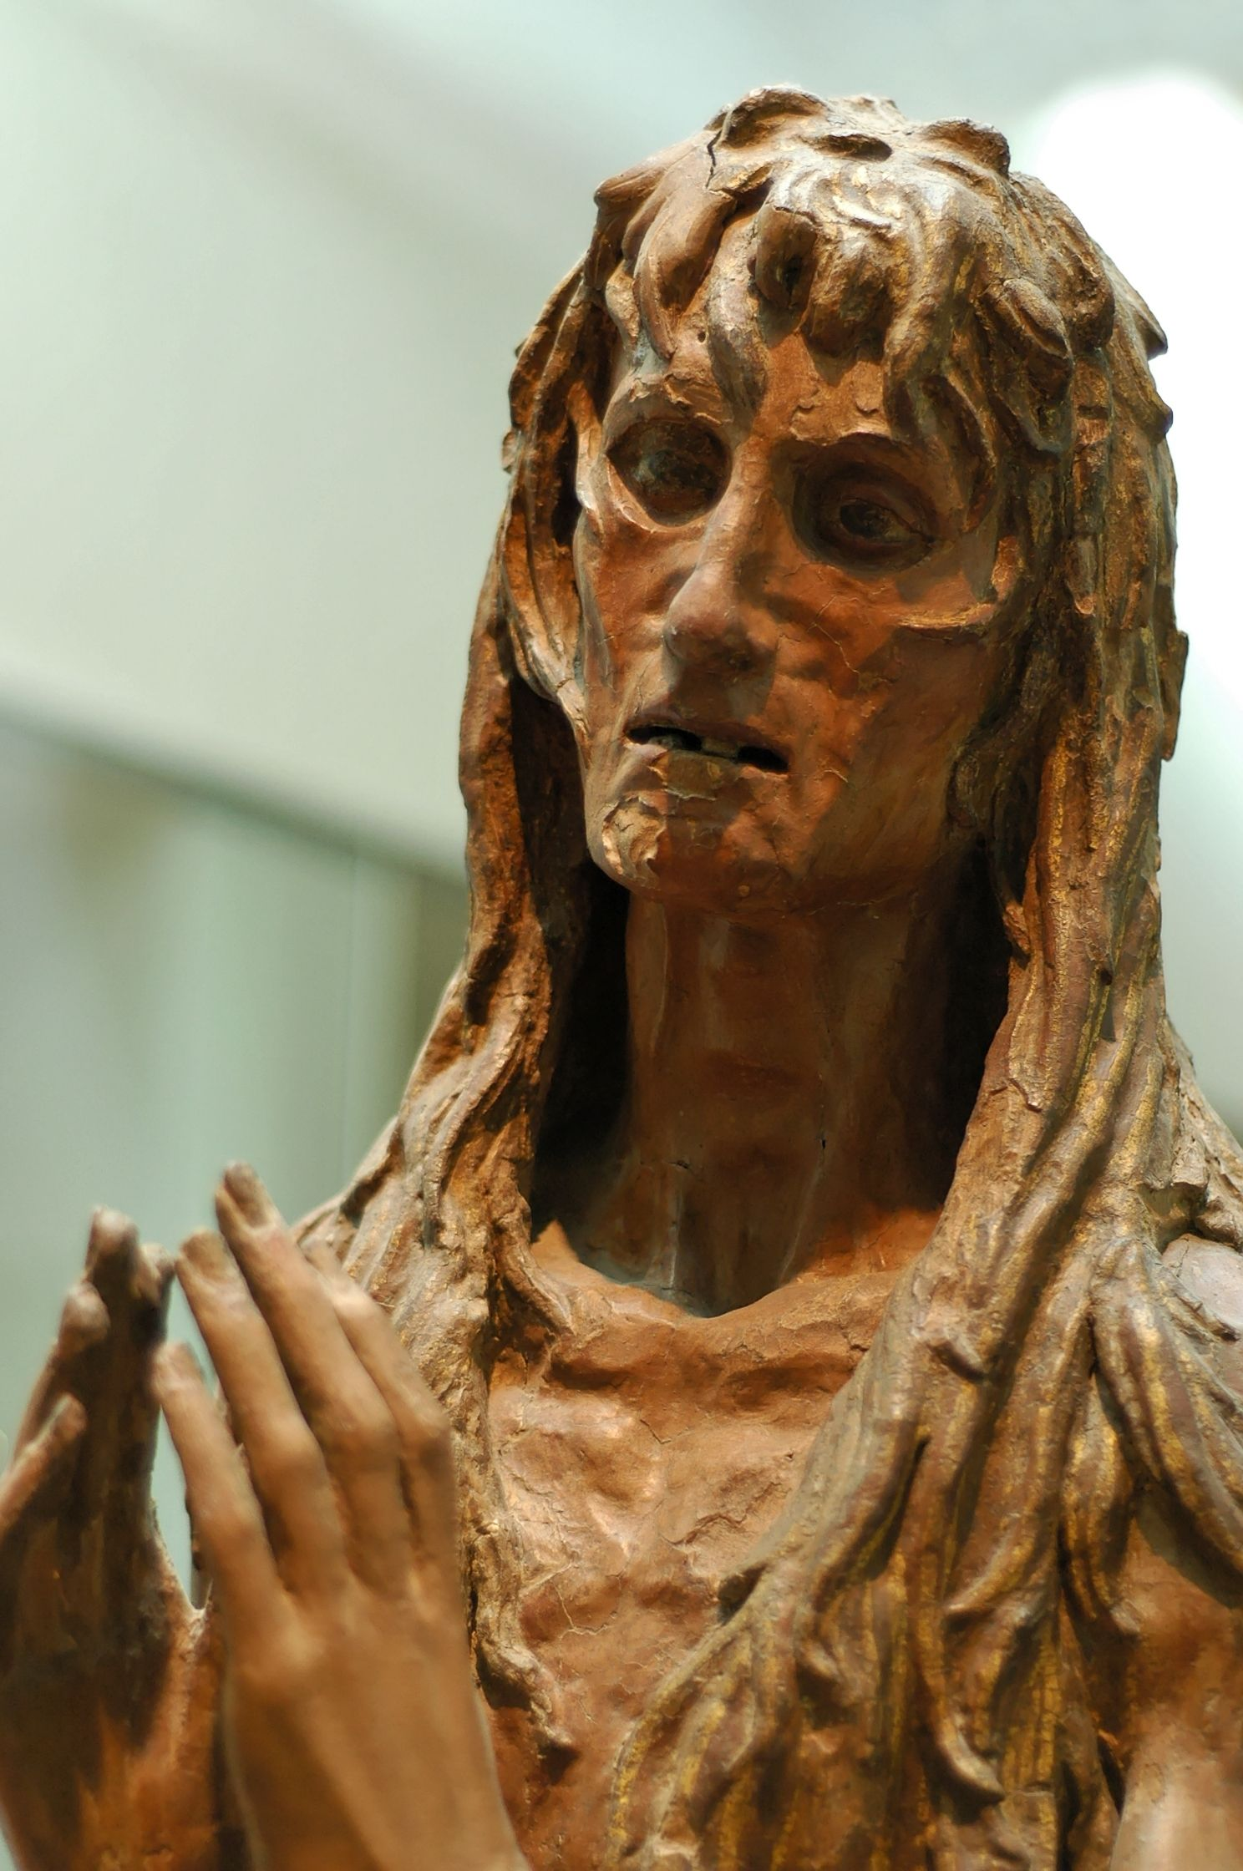
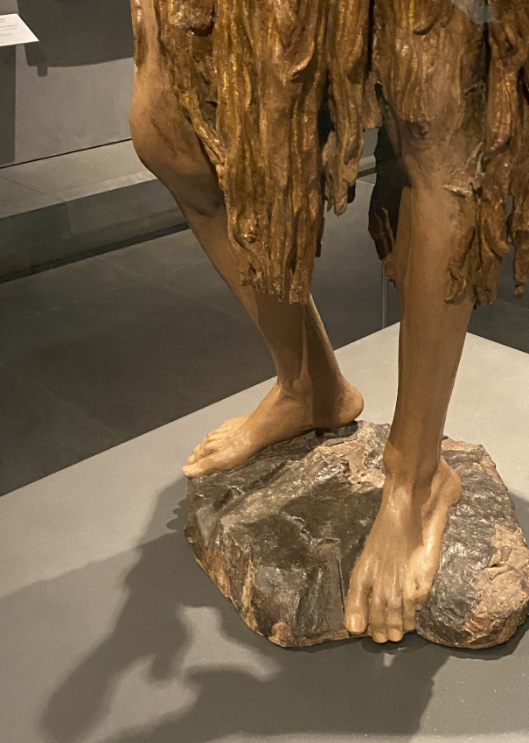

Slide 23
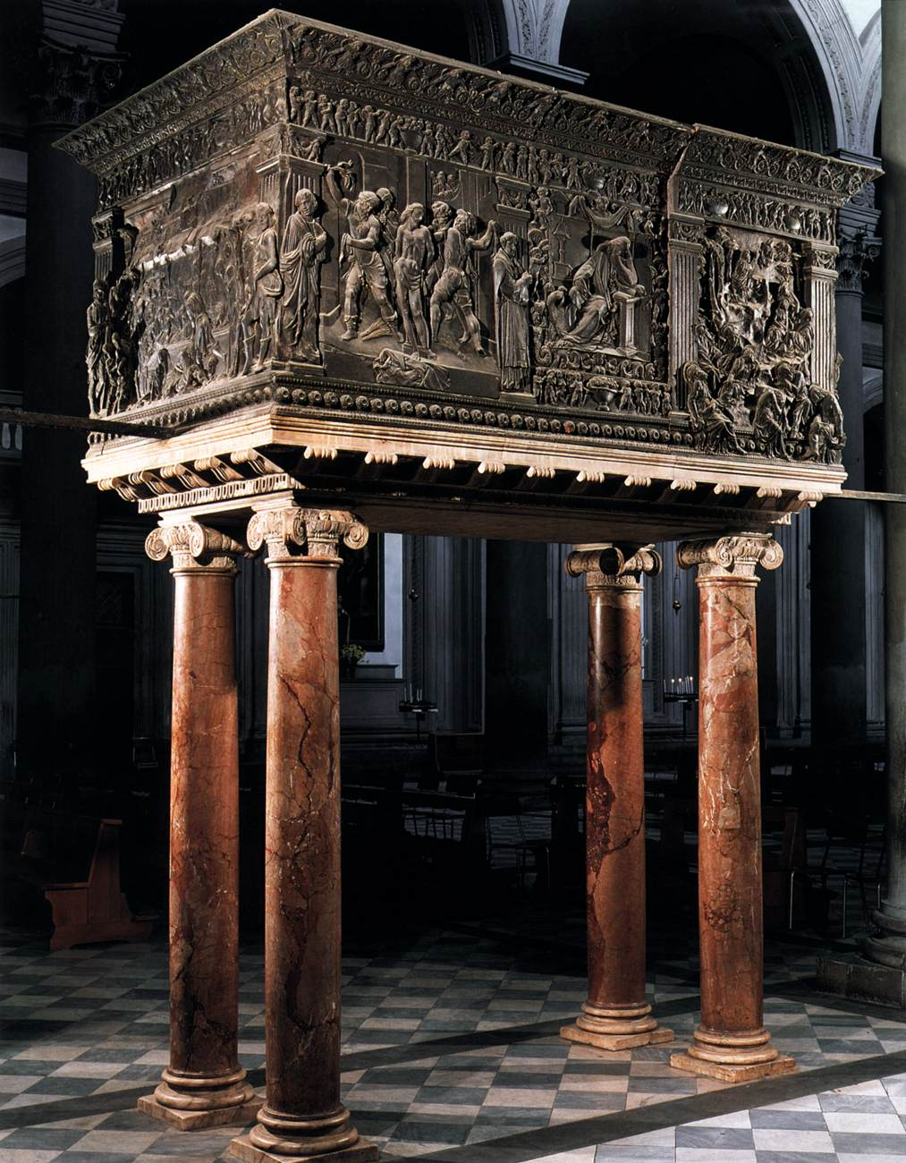
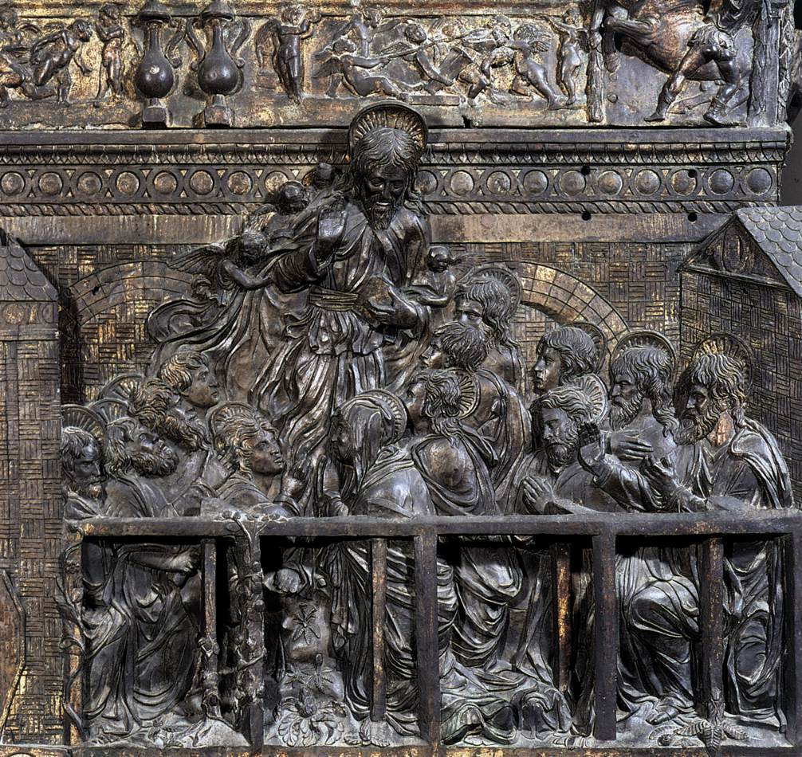
The Resurrection Pulpit, 1465, Marble and Bronze, 123 x 292 cm, San Lorenzo, Florence

Slide 24


