Slide 1
Pedanius Dioscurides
Vienna Dioscurides

Slide 2
Vienna Dioscurides, about 515 AD, Byzantine Greek Illuminated Manuscript of De Materia Medica by Pedanius Dioscurides, vellum folios measure 37 by 30 cm, Österreichischen Nationalbibliothek, Vienna

Slide 3
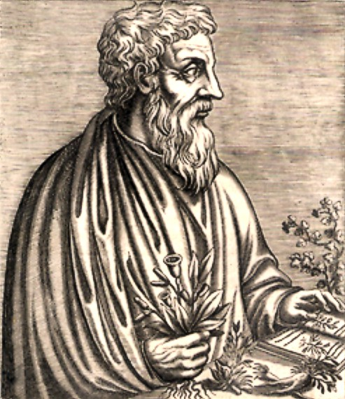
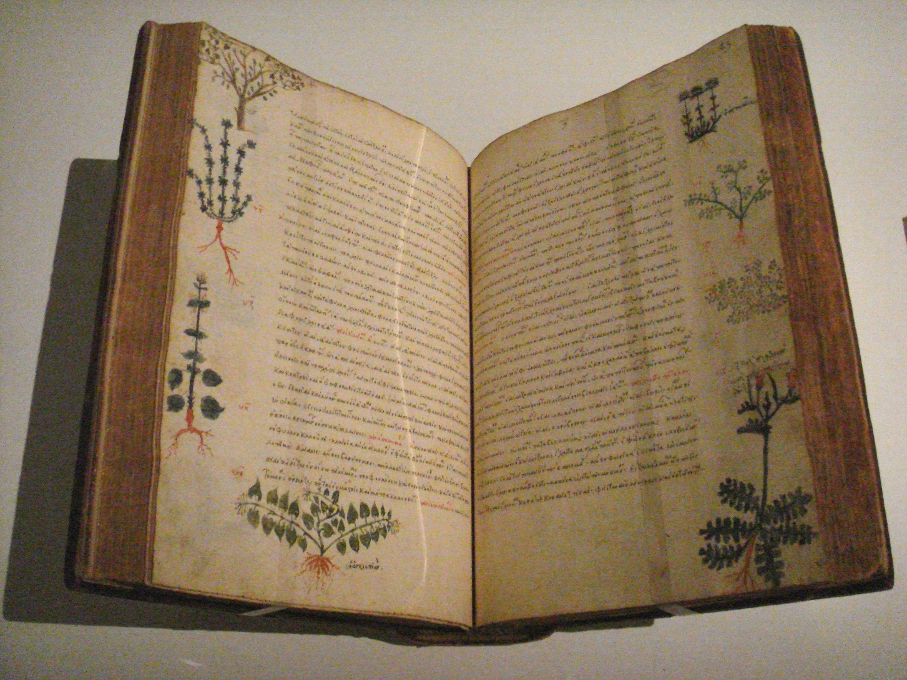
Pedanius Dioscurides
Pedanius Dioscurides was born in Anazarbos (Asia Minor) in the 1st century AD, during the time of Emperor Nero. He was a Greek physician, a pharmacologist and a military surgeon. As he travelled with the Roman Army, he had the opportunity to study the medicinal properties of nearly 600 plants. Around 77 AD, Dioscurides wrote “De materia medica,” a five-volume encyclopedia that deals with approximately 1,000 simple drugs. “De materia medica,” written originally in Greek, was translated in 7 different languages and is considered to be the foundation of European botany.

Slide 4
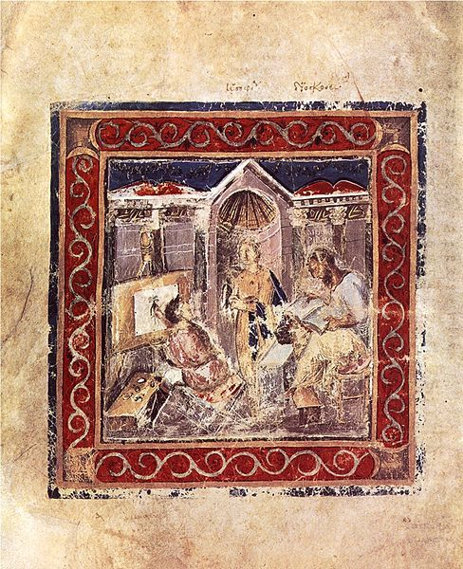
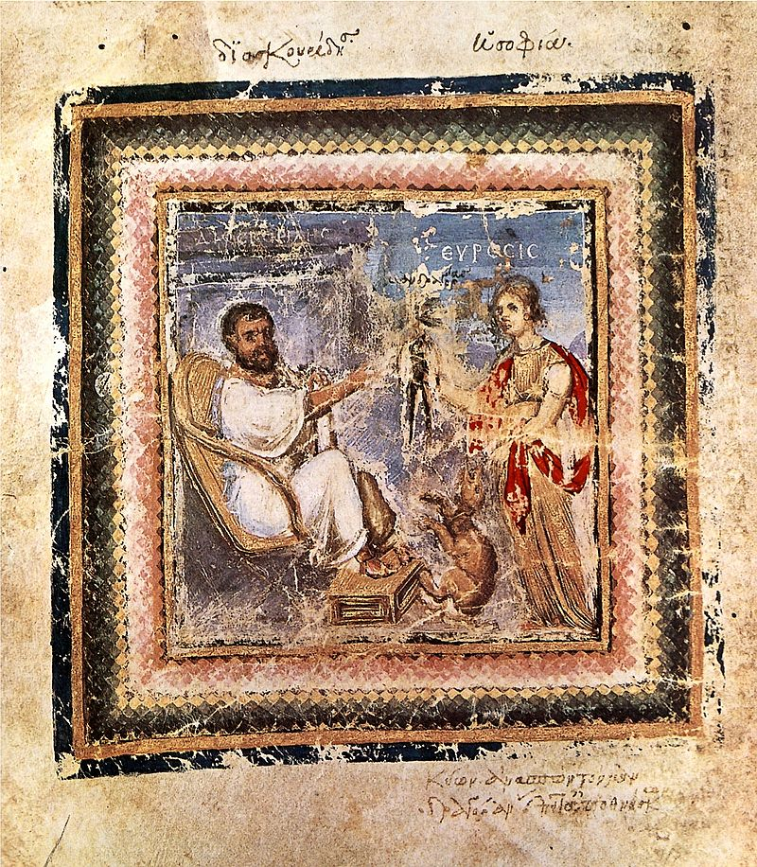
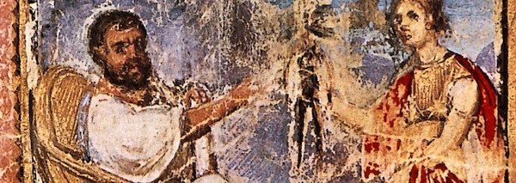
Vienna Dioscurides is an early 6th-century illuminated manuscript of De Materia Medica by Pandanius Dioscorides in Greek. It is an important and rare example of a late antique scientific text. The 491 vellum folios contain more than 400 pictures of animals and plants, most done in a naturalistic style.
Portraits of Dioskorides:
1. Dioscurides with the Mandrake Plant and
Euresis, the Personification of Invention.
2. Dioscorides reads from his text on the
Mandrake, while Epinoia (Idea-Muse) holds the mandrake to ensure the artist records it correctly. The unknown artist looks at
Epinoia as he paints the plant.

Slide 5
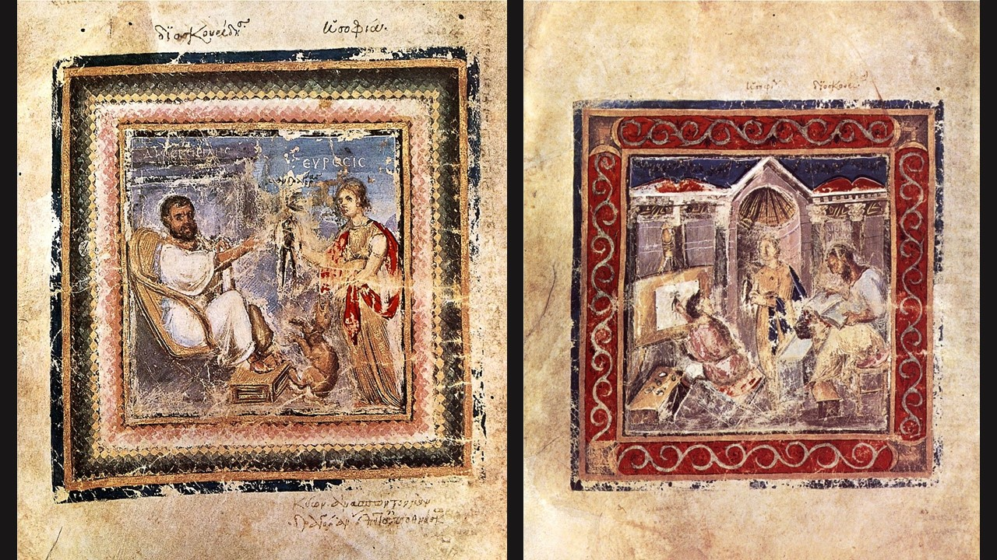

Slide 6
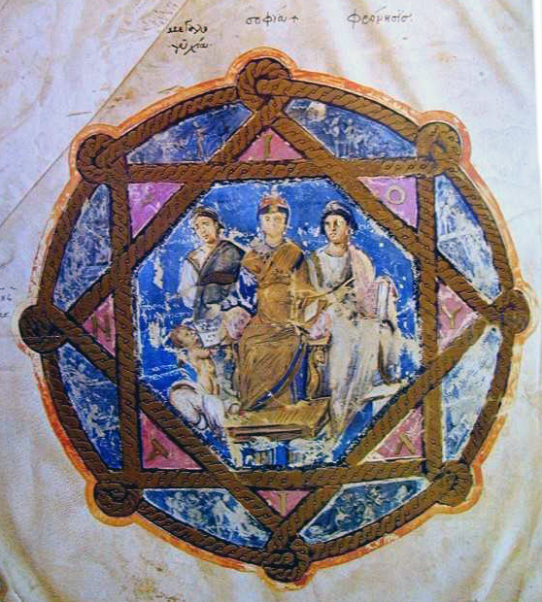
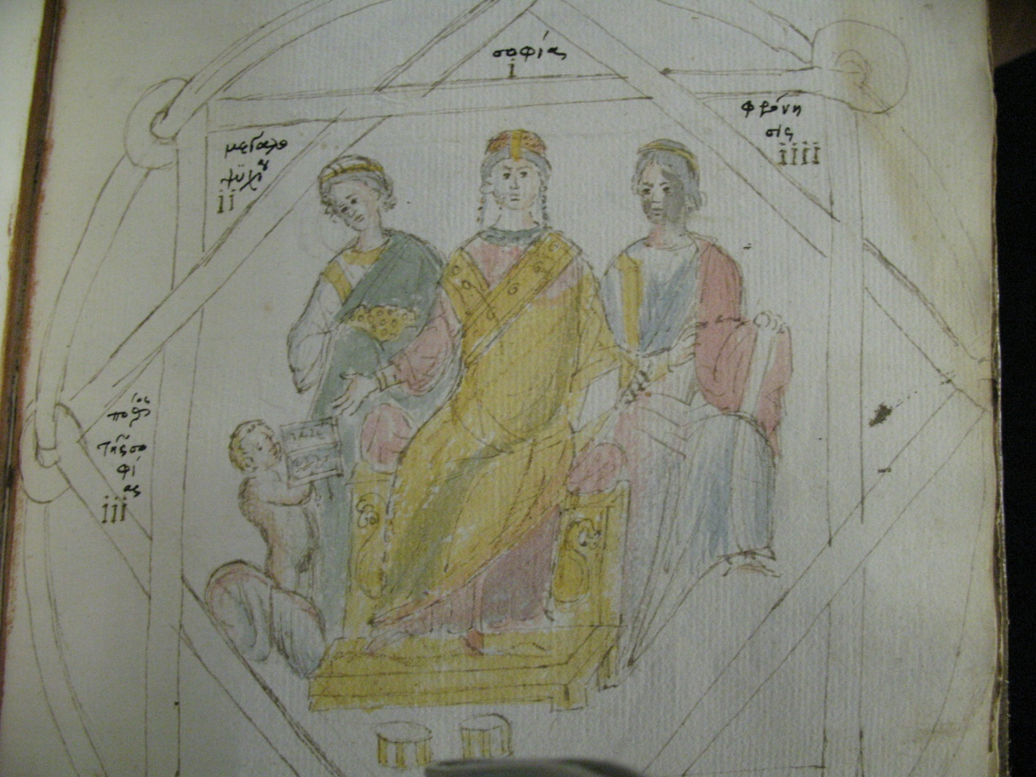
The manuscript was created in Constantinople just before 515 AD, commissioned as a gift, for the Imperial Princess Juliana Anicia. Although it was originally created as a luxury item, there is some indication that in later centuries it was used daily as a hospital textbook.

Slide 7
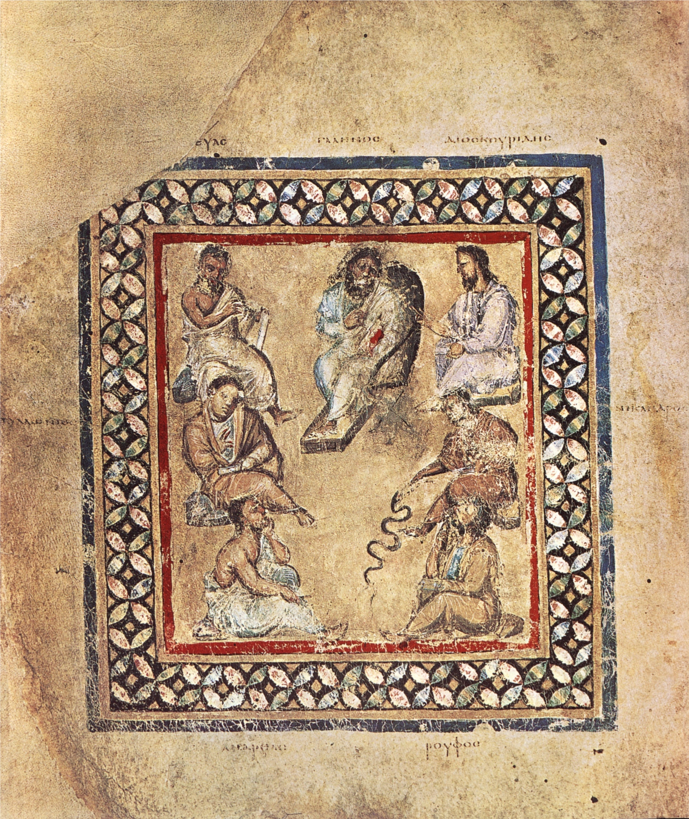
Seven noted Physicians and Botanists presented in the Vienna Dioscurides,
Galen,c. 131 - 200 AD is the figure in the middle. He is flanked by Krateuas, c. 2nd Century BC on his left and Dioscurides on his right. In the second row, from left to right, are Apollonius Mus, c. 1st Century BC and Nicander, c. 2nd Century BC. In the third row, from left to right, are Andreas, c. 4th Century AD and Rufus of Ephesus c. late 1st Century AD - c. early 2nd Century AD.

Slide 8
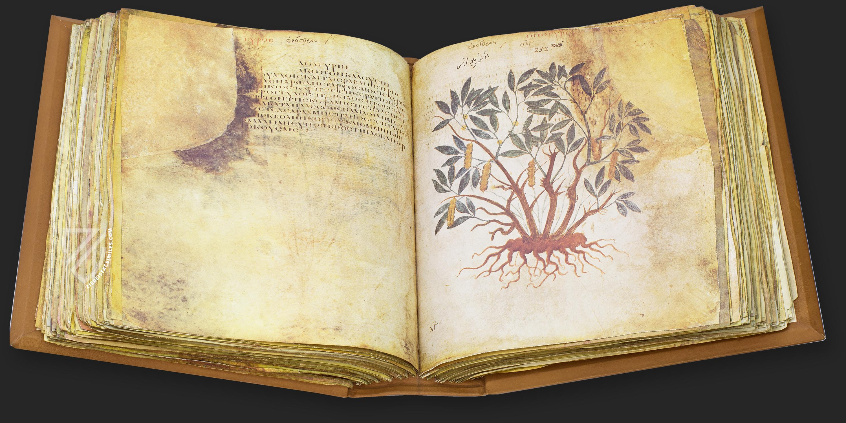
The Vienna Dioscurides comprises 491 folios (or almost a thousand pages) and almost four hundred color illustrations, each occupying a full page facing a description of the plant's pharmacological properties. . . . Handwritten notations in Greek, Latin, Persian, Turkish, Arabic and Hebrew give evidence of the work’s broad appeal. (photo of a facsimile copy of the original manuscript)

Slide 9
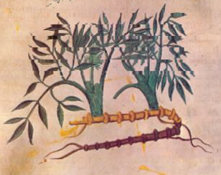
Vienna Dioscurides, early 6th-century illuminated manuscript of De Materia Medica, page on Krithamo

Slide 10
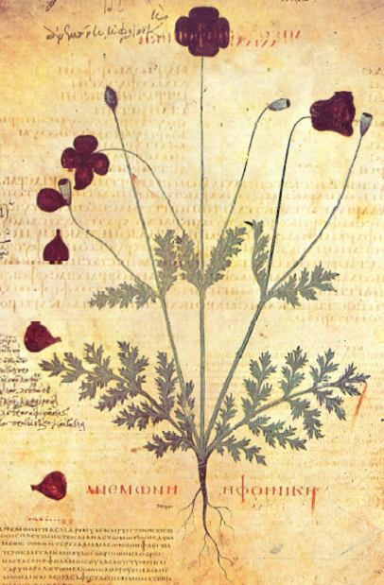
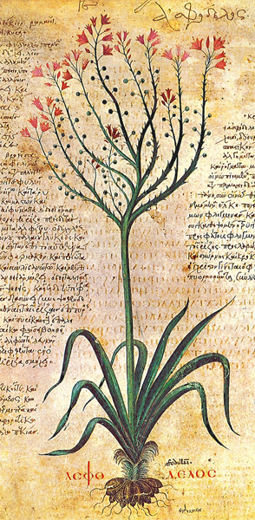
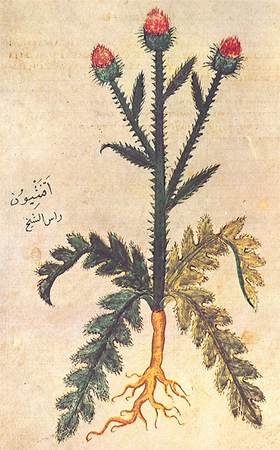
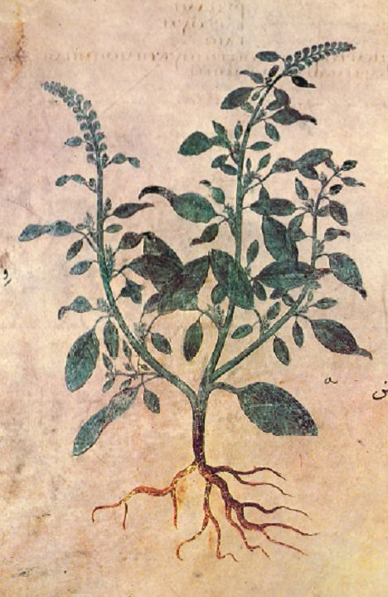
Vienna Dioscurides
Poppy Anemone, Asfodelos, Akanthio, Bliton

Slide 11
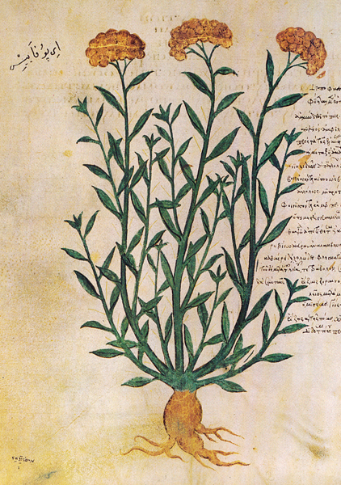
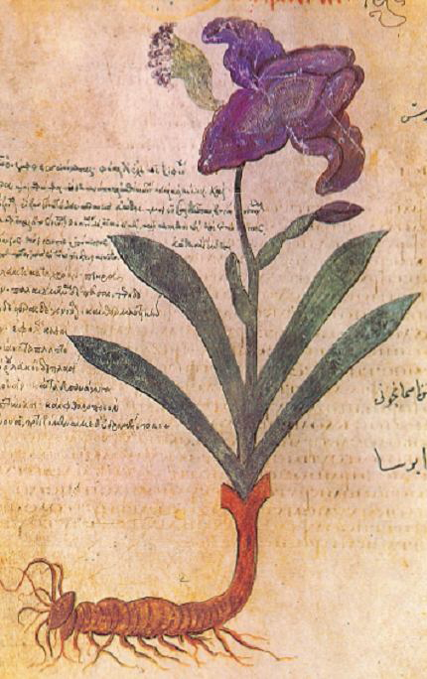
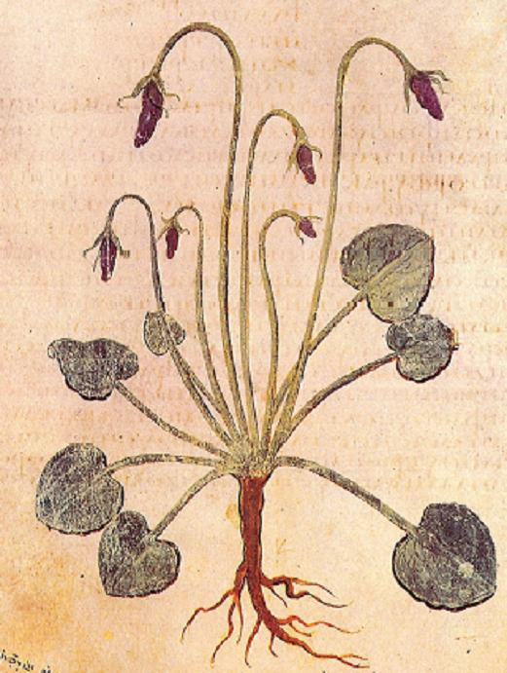
Ippofaes, Iris, Sweet Violet

Slide 12
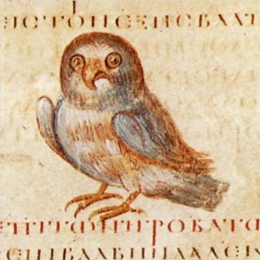
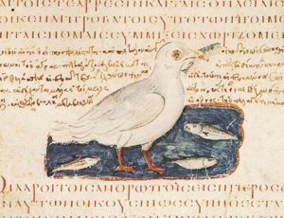
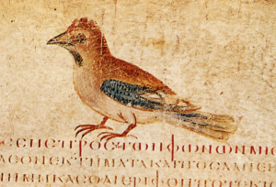
The Vienna Dioscurides also contains the earliest illustrated treatise on ornithology.

Slide 13
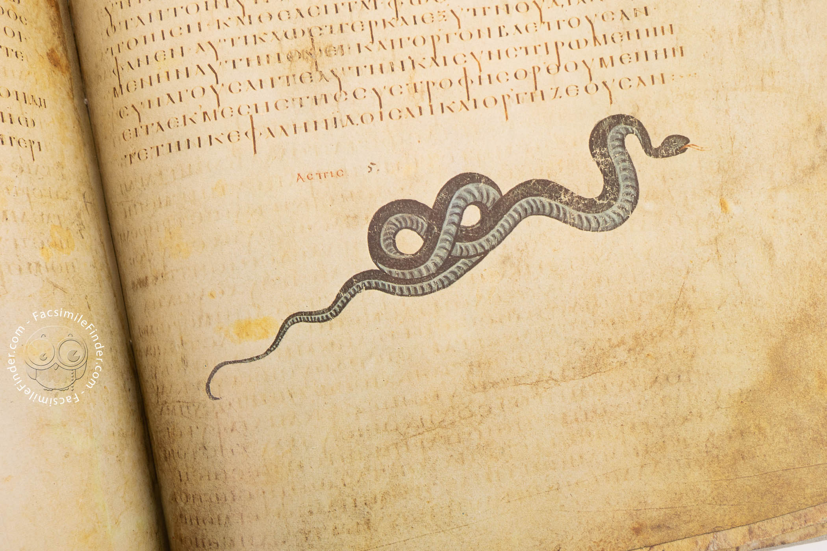
In addition to the text by Dioscurides, the famous Vienna manuscript has an appendix of the Carmen de Herbis attributed to Rufus, a paraphrase of an ornithological treatise by a certain Dionysius, usually identified with Dionysius of Philadelphia, and a paraphrase of Nicander's treatise on the treatment of snake bites. (detail photo of a Facsimile Edition)

Slide 14
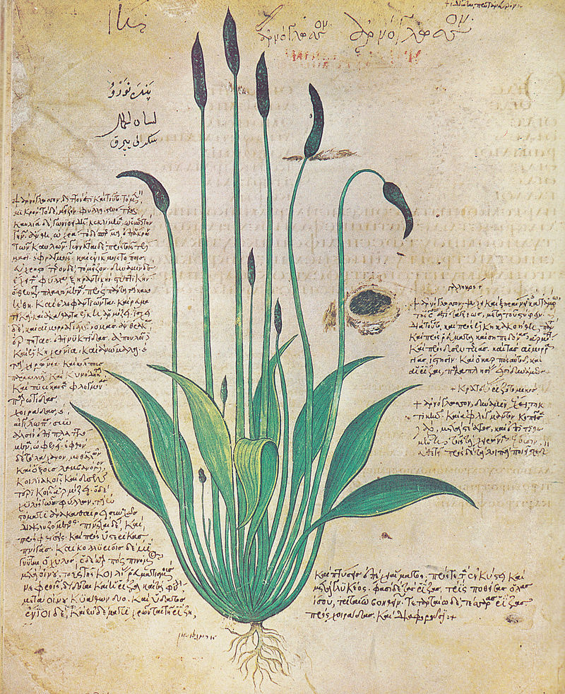
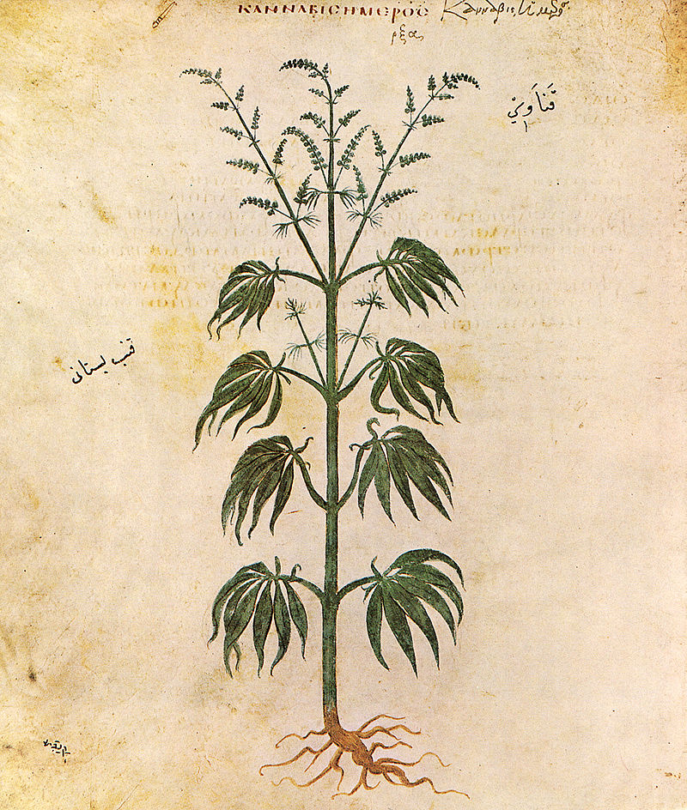
The Manuscript bears the traces, in script, of continuous use by Greek, Latin, Turkish, Oriental and Jewish physicians, thus proving an ongoing esteem for classical pharmacology from the 6th to the 15th centuries. (Folio 29v, Plantago lanceolata - lamb's tongue and Folio 167v, Cannabis sativa - hemp)

