Slide 1
Pella Archaeological Museum
The Lion Hunt

Slide 2
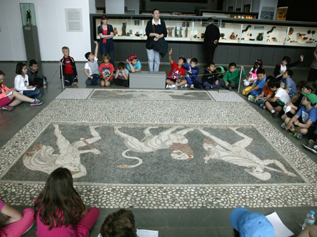

Slide 3
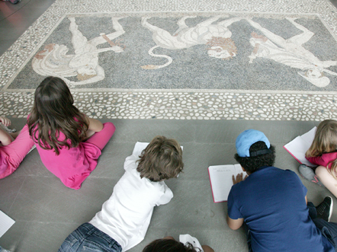

Slide 4
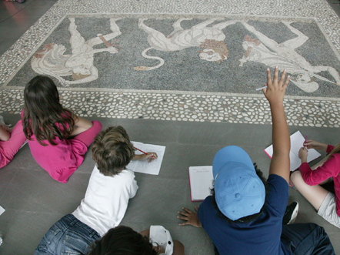

Slide 5
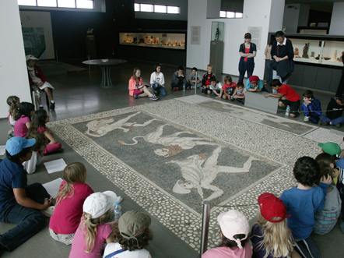

Slide 6
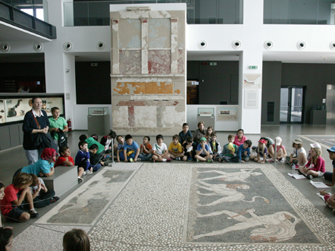

Slide 7
Guiding my students…
Photos by Kostas Papantoniou

