Slide 1
Unidentified Byzantine Church in Constantinople known today as Vefa Kilise Camii

Slide 2
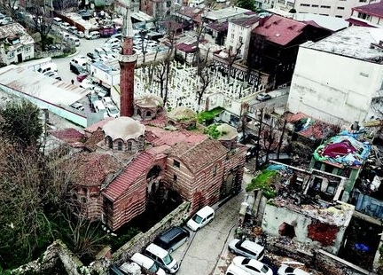

Slide 3
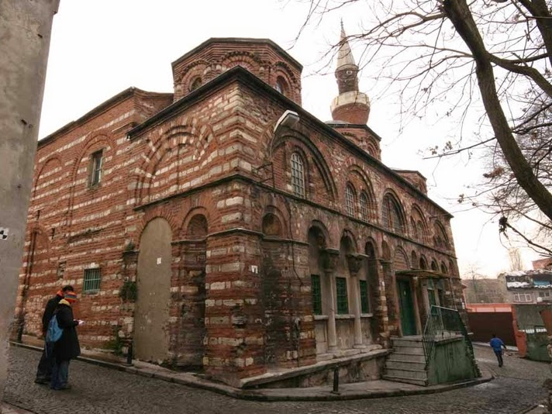

Slide 4
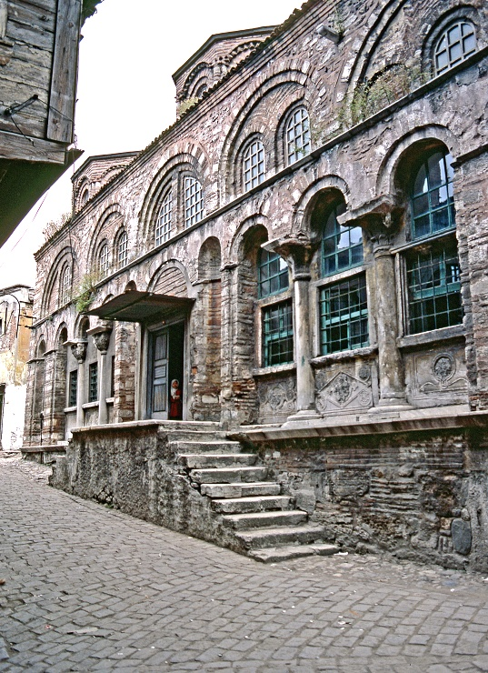
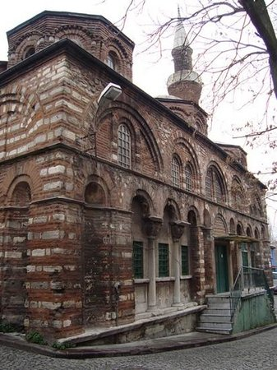

Slide 5
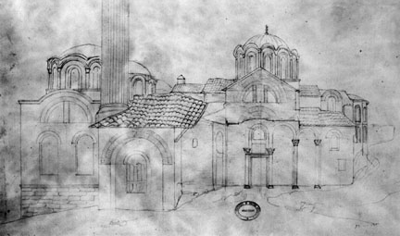
The south flank of the church as drawn by Texier, c. 1835. Photo Royal Institute of British Architects.

Slide 6
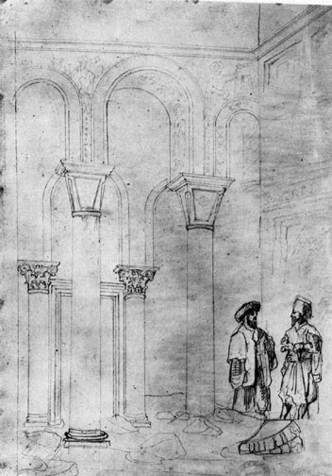
The arcade in the south wall opening into the parekklesion, as drawn by Texier, c. 1835. Photo Royal Institute of British Architects

Slide 7
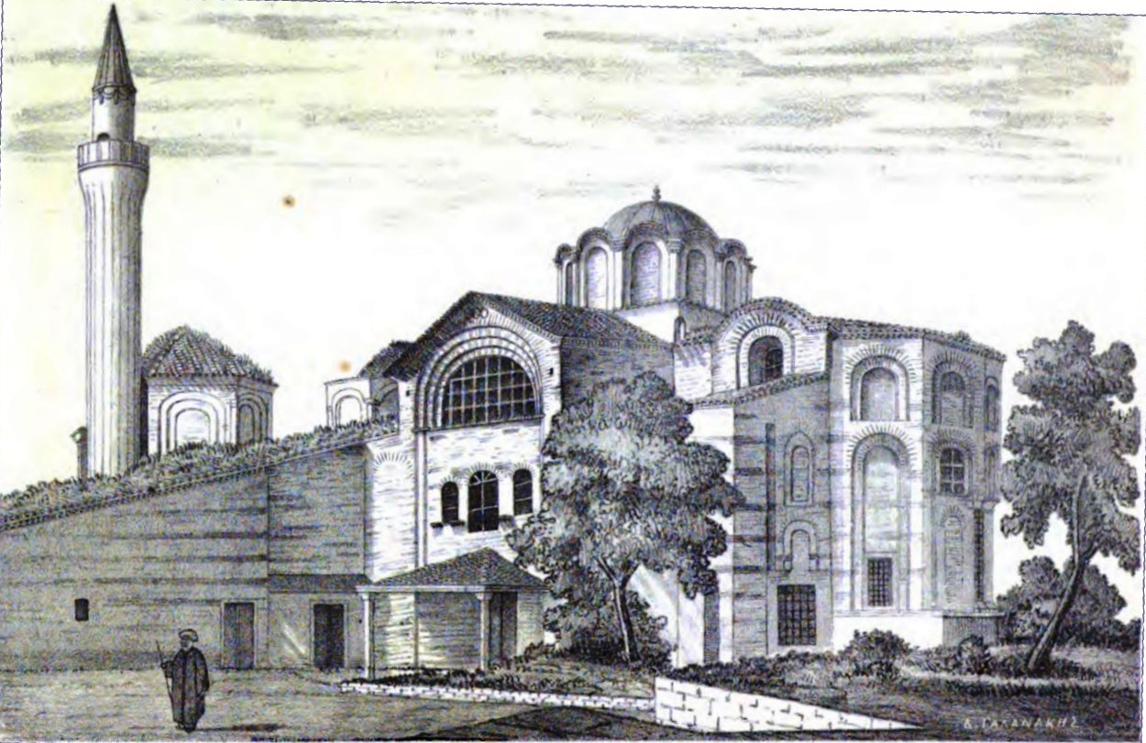
From Byzantine Studies by Paspates (1877)

Slide 8
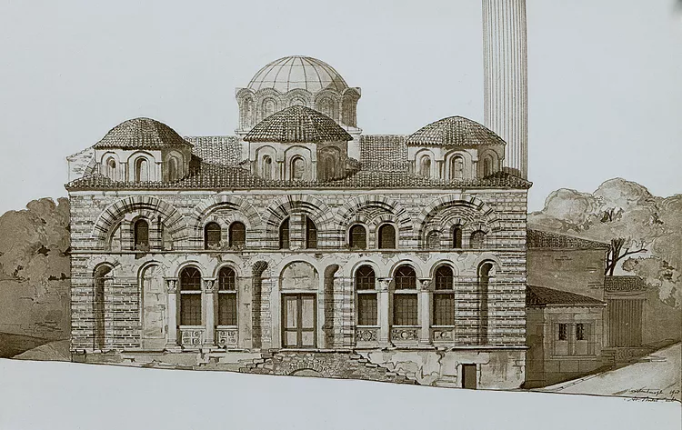
Ebersolt & Thiers (1910)

Slide 9
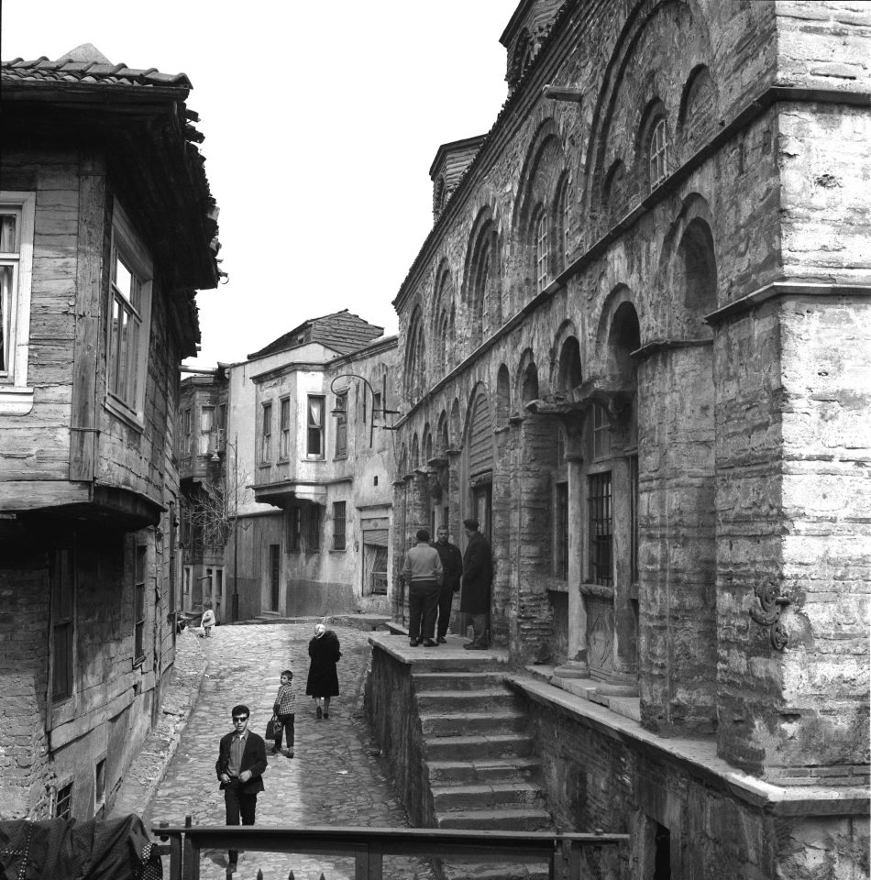

Slide 10
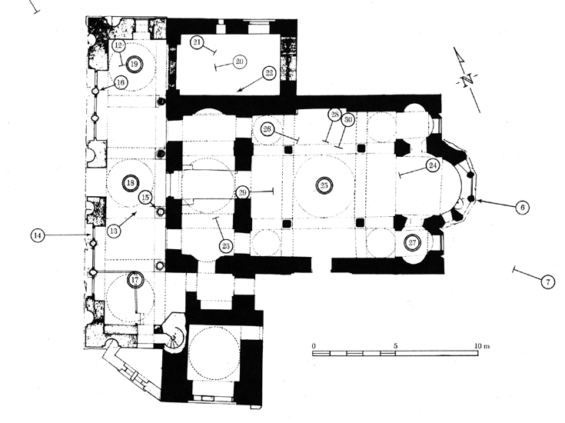

Slide 11
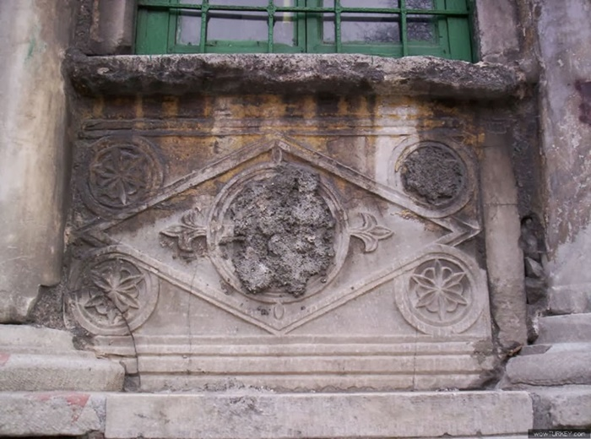

Slide 12
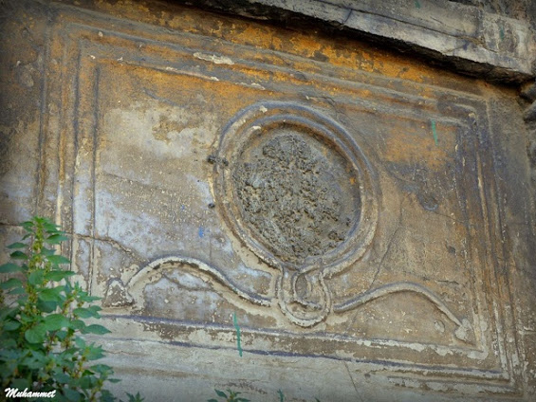

Slide 13
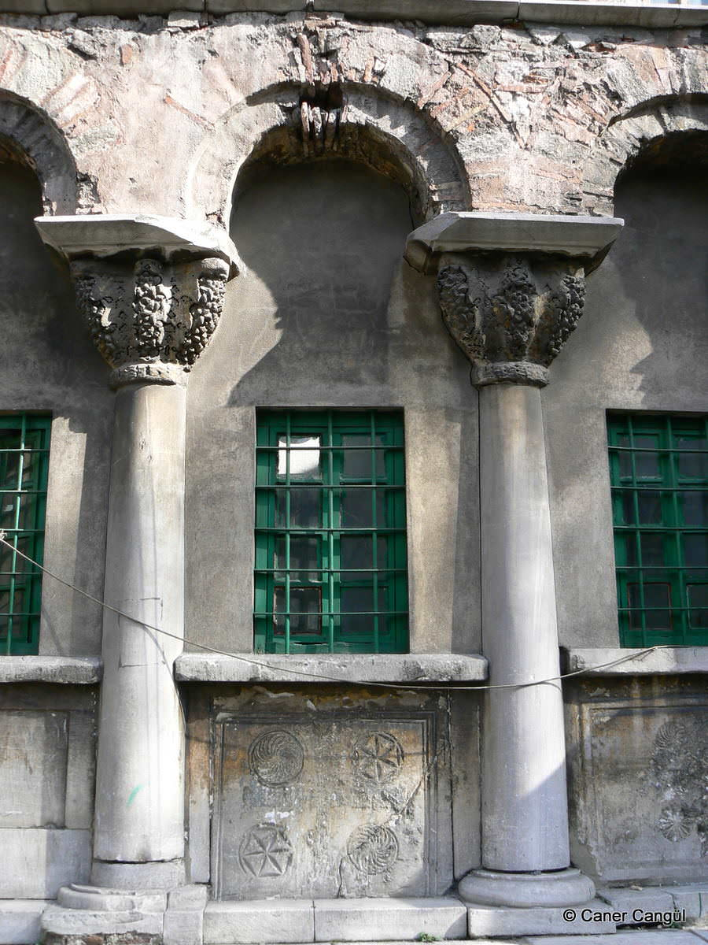

Slide 14
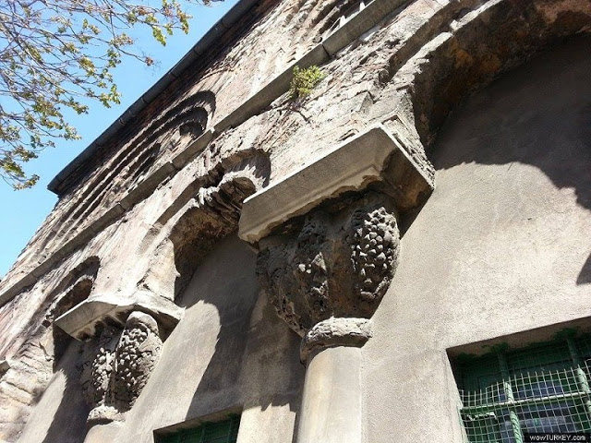

Slide 15
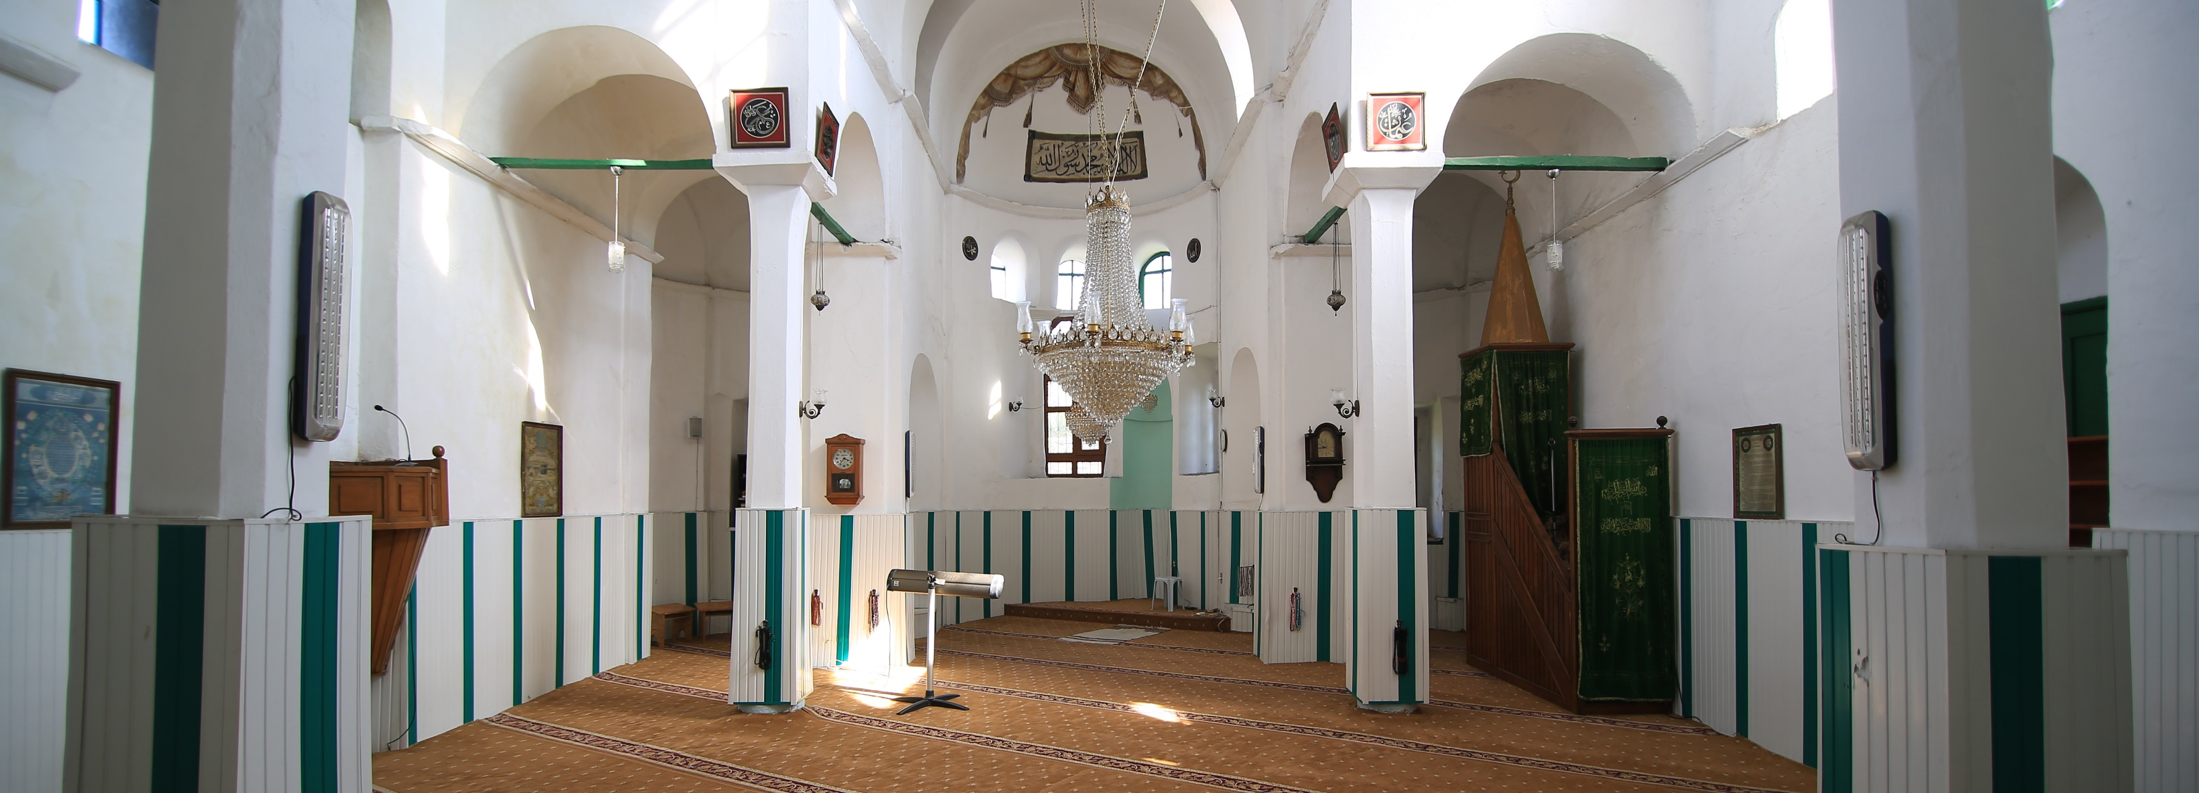

Slide 16
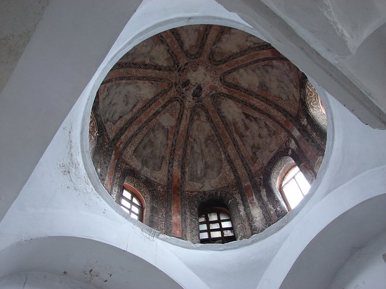

Slide 17
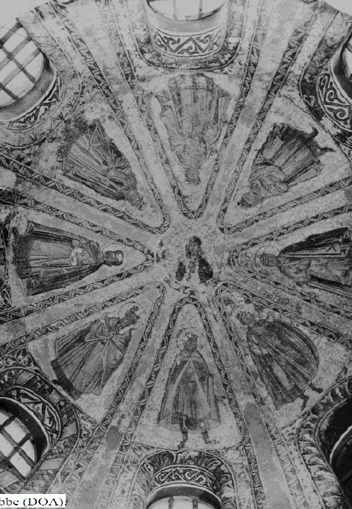
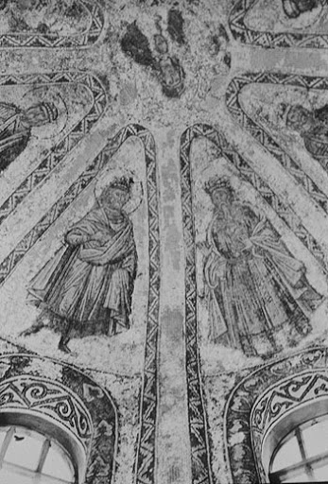

Slide 18
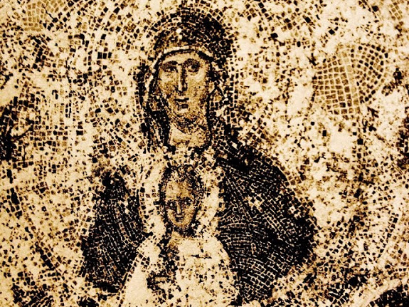

Slide 19
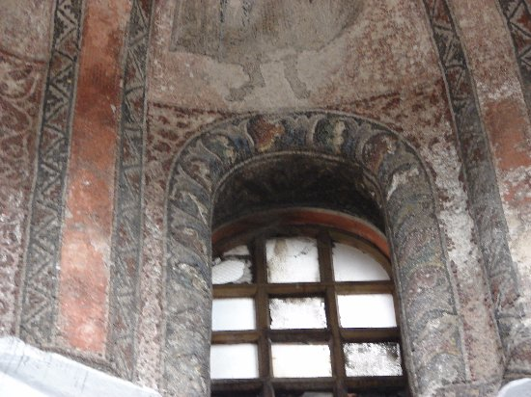

Slide 20
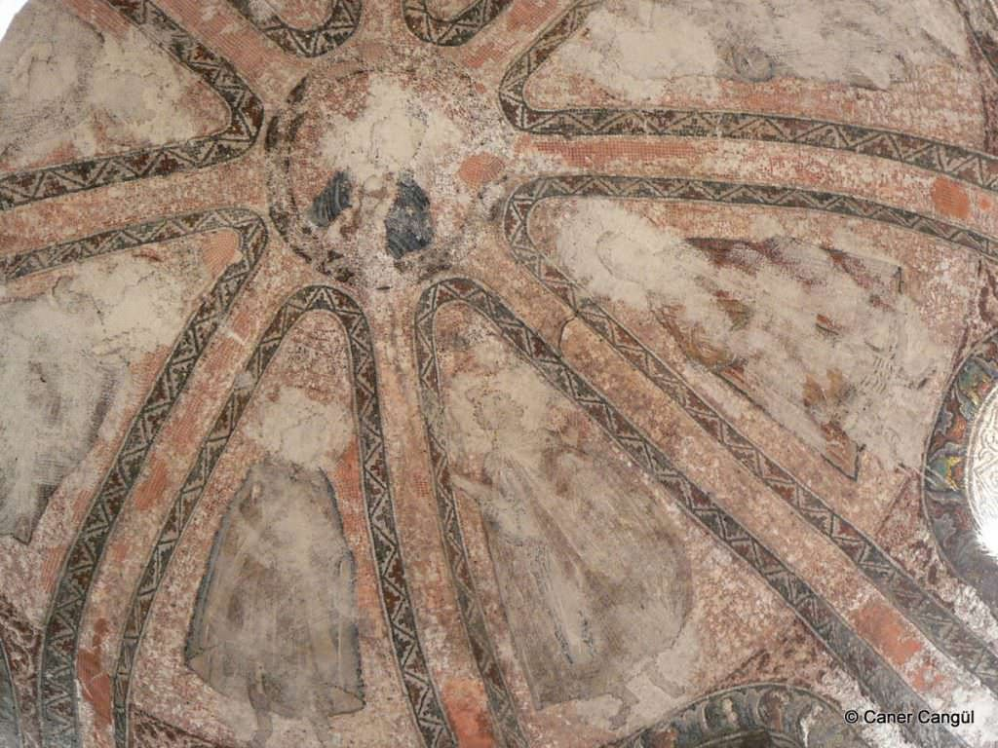

Slide 21
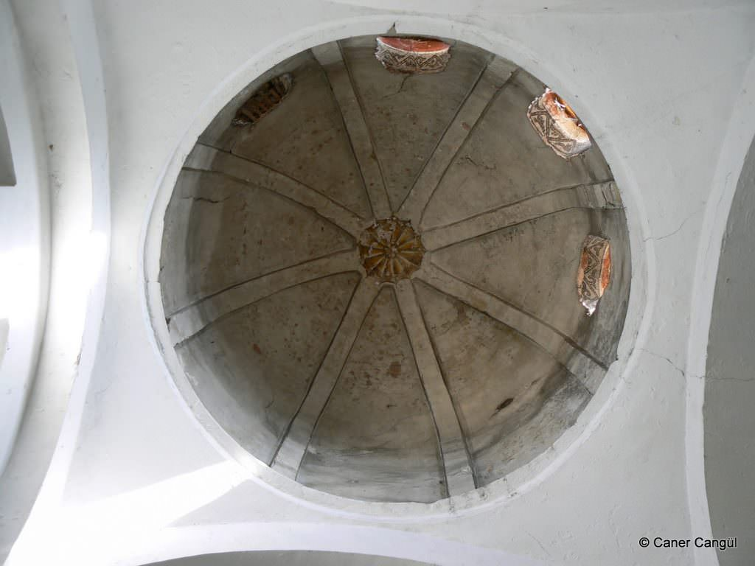

Slide 22
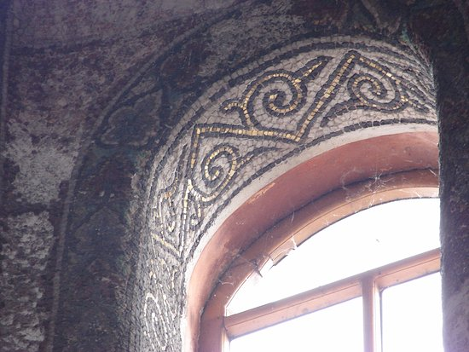

Slide 23
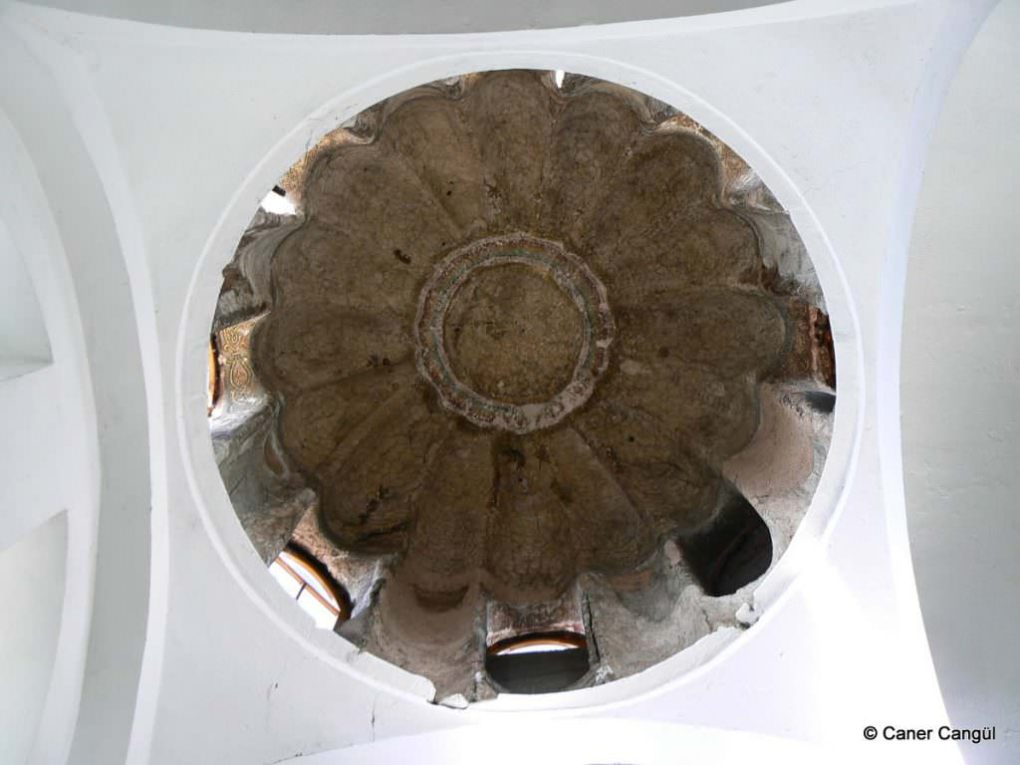

Slide 24
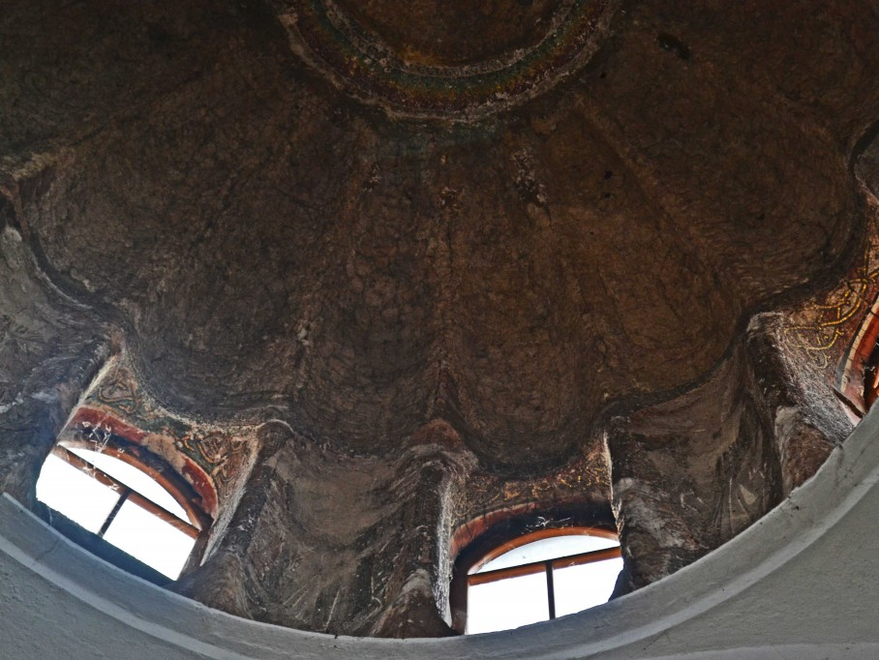

Slide 25
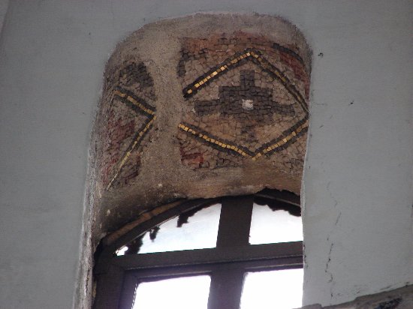

Slide 26
Photo Credits: https://tarihivefa.blogspot.com/2019/02/vefa-molla-semsettin-gurani-kilise-cami_18.html http://www.enormousfish.co.uk/?p=8242\ https://arsizsanat.com/simetri-ile-barisin-imzasi-vefa-kilise-cami/ https://www.nyu.edu/gsas/dept/fineart/html/Byzantine/index.htm?https&&&www.nyu.edu/gsas/dept/fineart/html/Byzantine/home.htm https://www.tripadvisor.in/Attraction_Review-g293974-d6220064-Reviews-Vefa_Kilise_Camii-Istanbul.html https://www.wikiwand.com/tr/Vefa_Kilise_Camii https://archive.org/details/vyzantinaimelet00unkngoog/page/n156/mode/2up https://serifyenen.com.tr/vefa-kilise-camii-molla-gurani-camii/ http://tarihivefa.blogspot.com/2019/02/vefa-molla-semsettin-gurani-kilise-cami_18.html https://www.canercangul.com/1450/vefa-kilise-camii-kubbe-icleri/ https://www.thebyzantinelegacy.com/vefa

