Slide 1
Teaching… with Giotto di Bondone, 1266/7 – 1337

Slide 2
Teaching… with Giotto
Panels

Slide 3
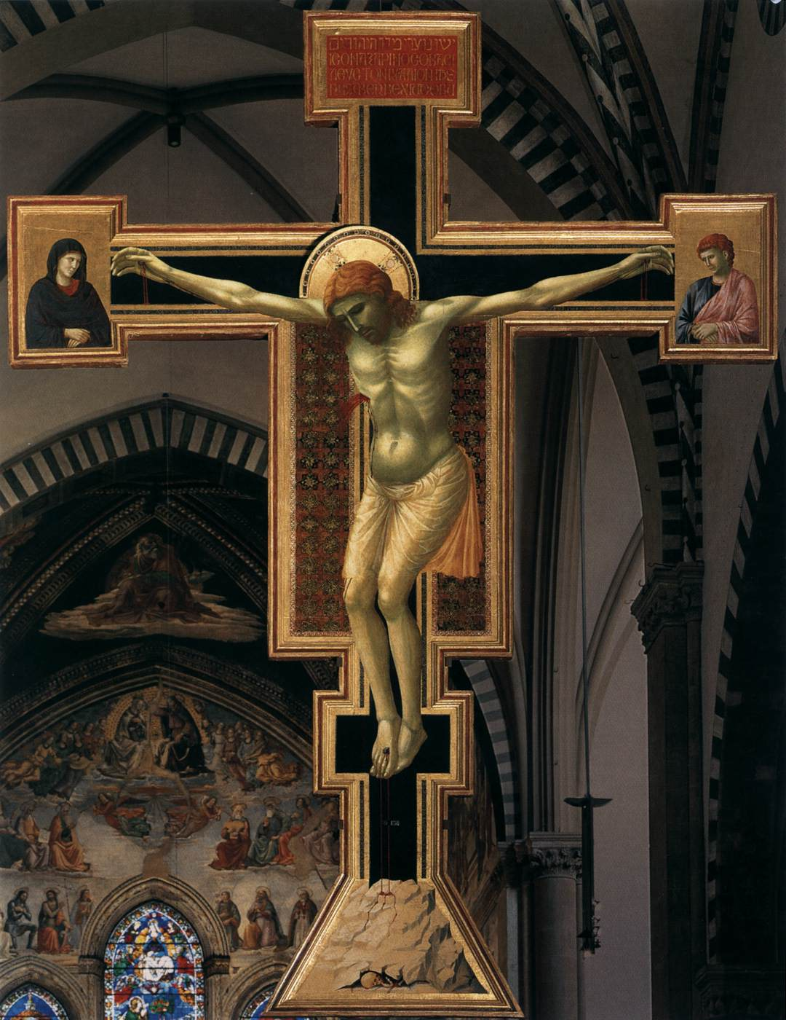
Crucifix, 1290-1300
Tempera on wood,
578 x 406 cm
Santa Maria Novella, Florence

Slide 4
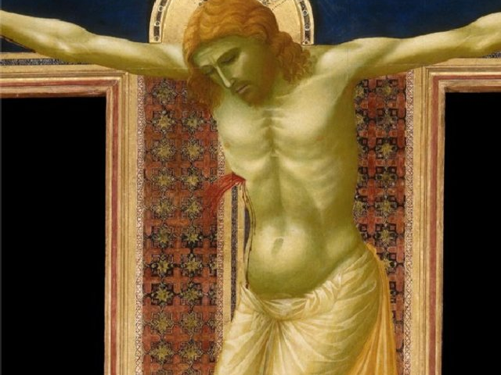

Slide 5
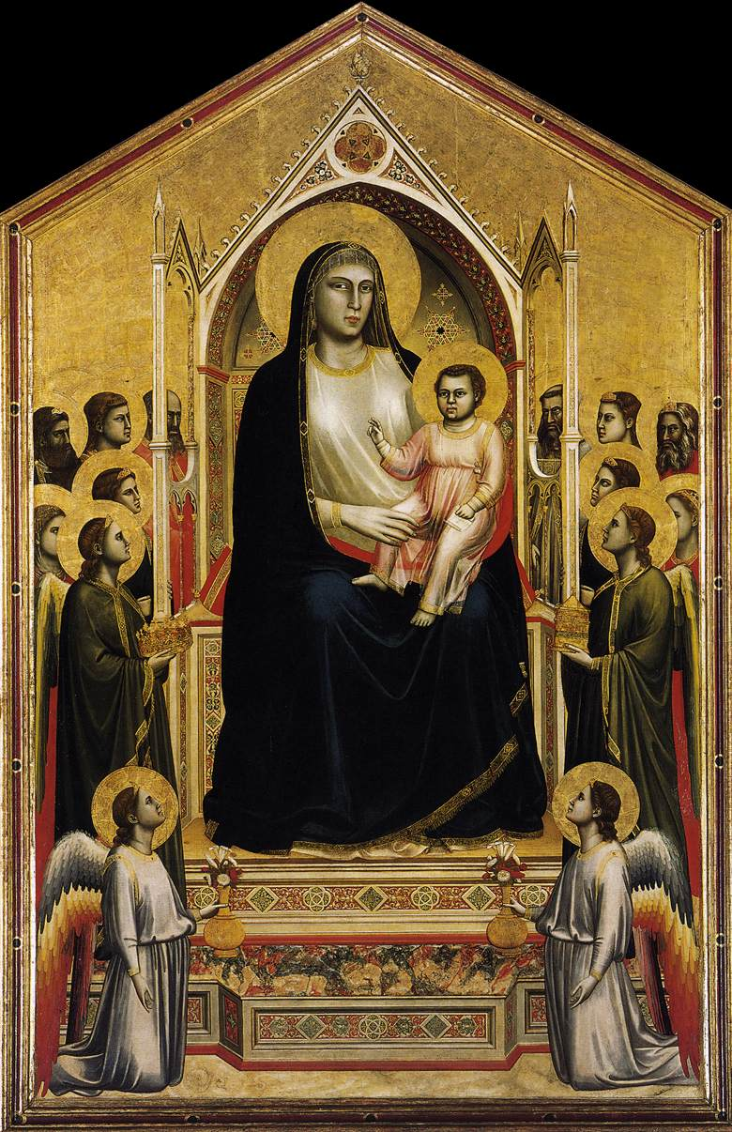
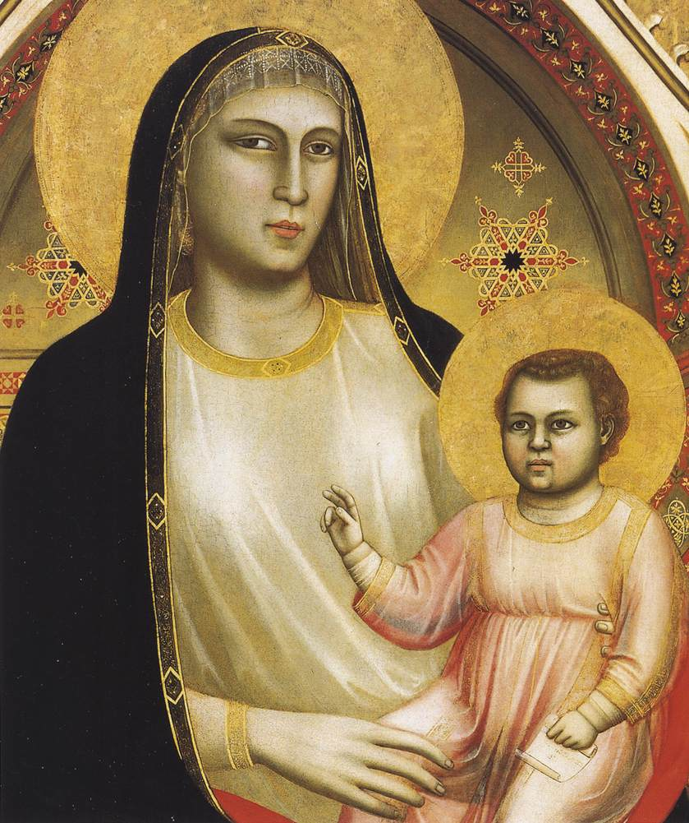
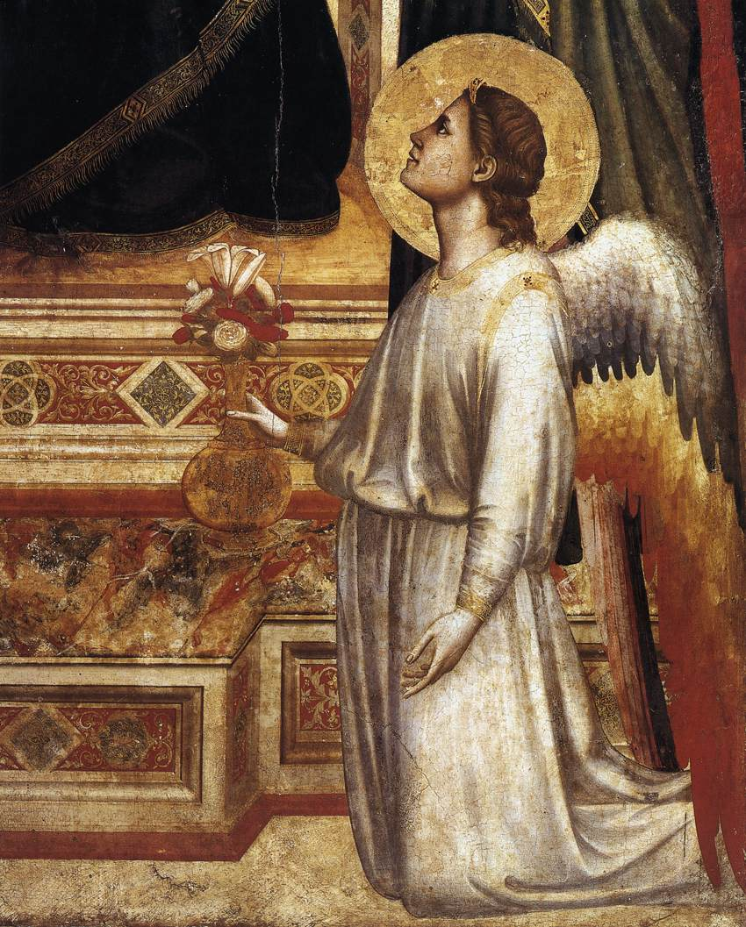
Ognissanti Madonna, 1310, tempera on panel, 325 × 204 cm, Uffizi Gallery, Florence https://www.youtube.com/watch?v=P9s3YA-glNk

Slide 6
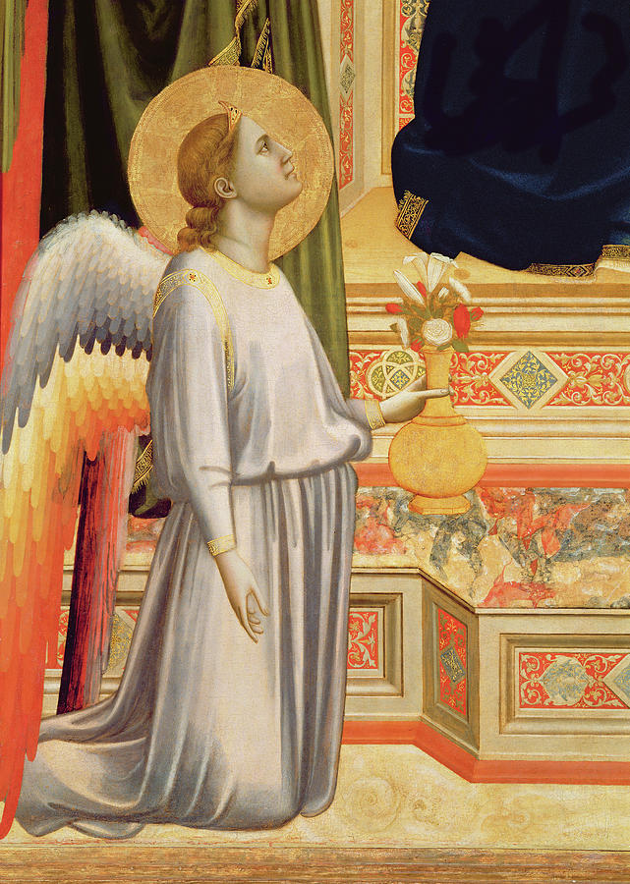
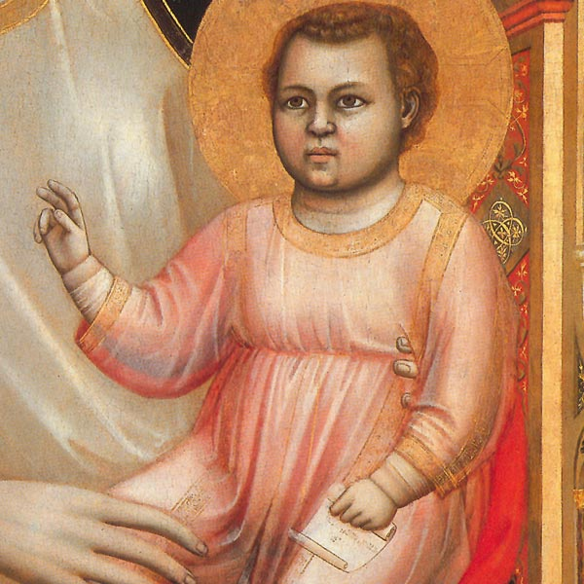

Slide 7
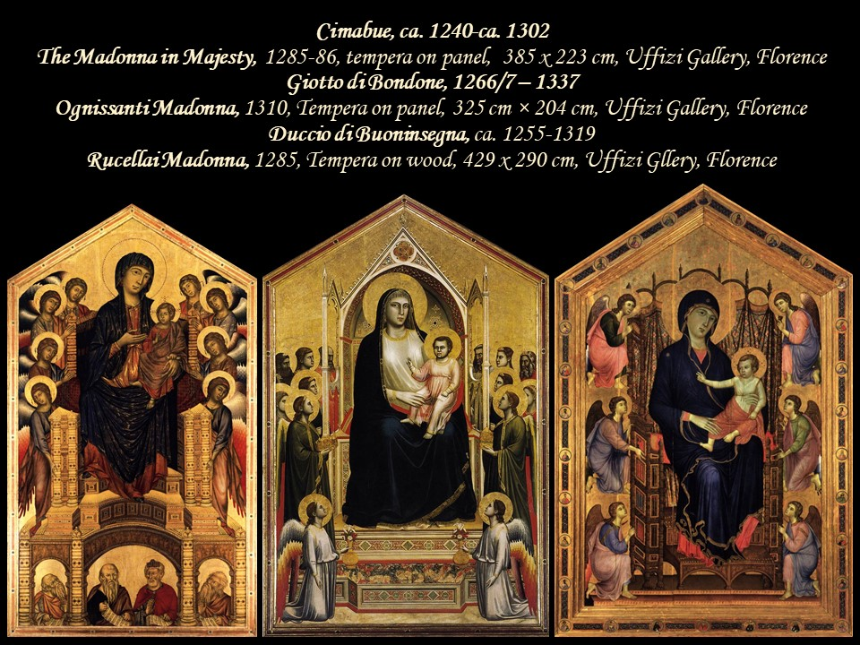

Slide 8
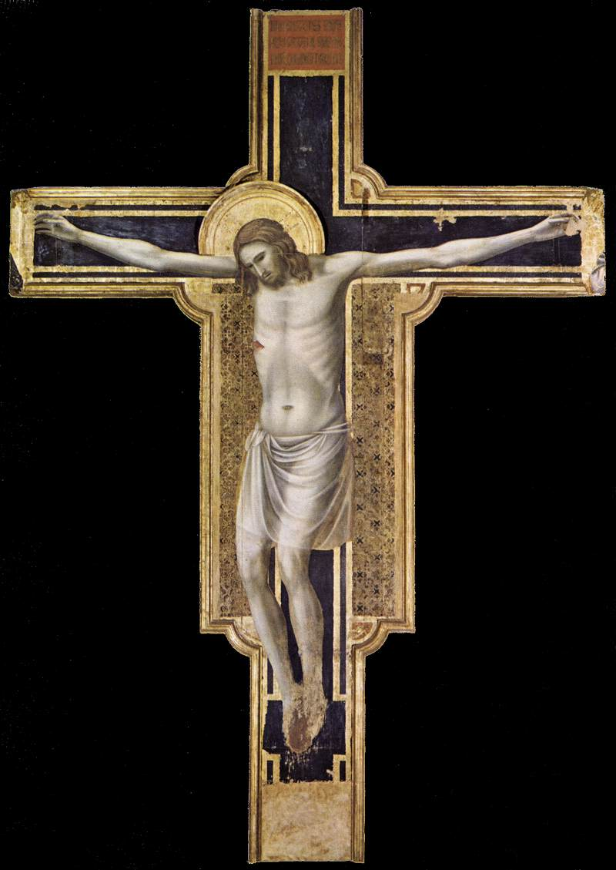
Crucifix, 1310-17
Tempera on wood, 430 x 303 cm
Tempio Malatestiano, Rimini

Slide 9
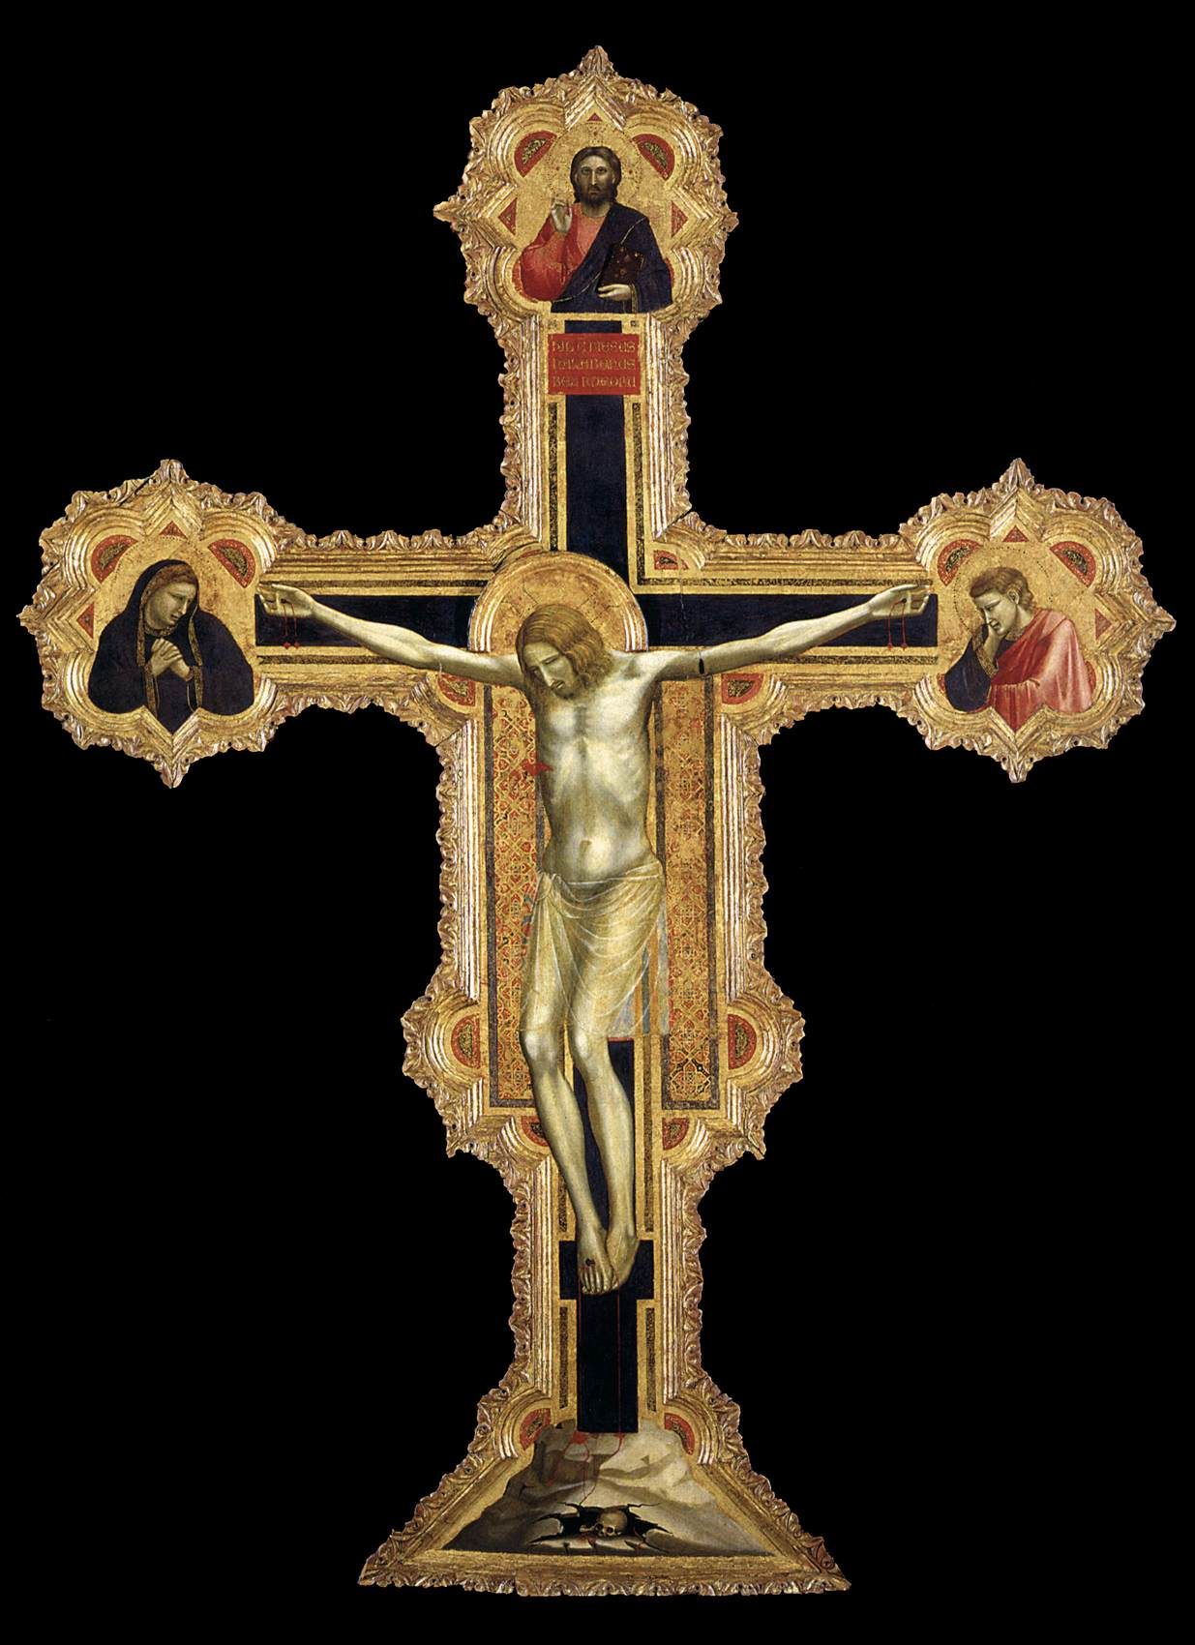
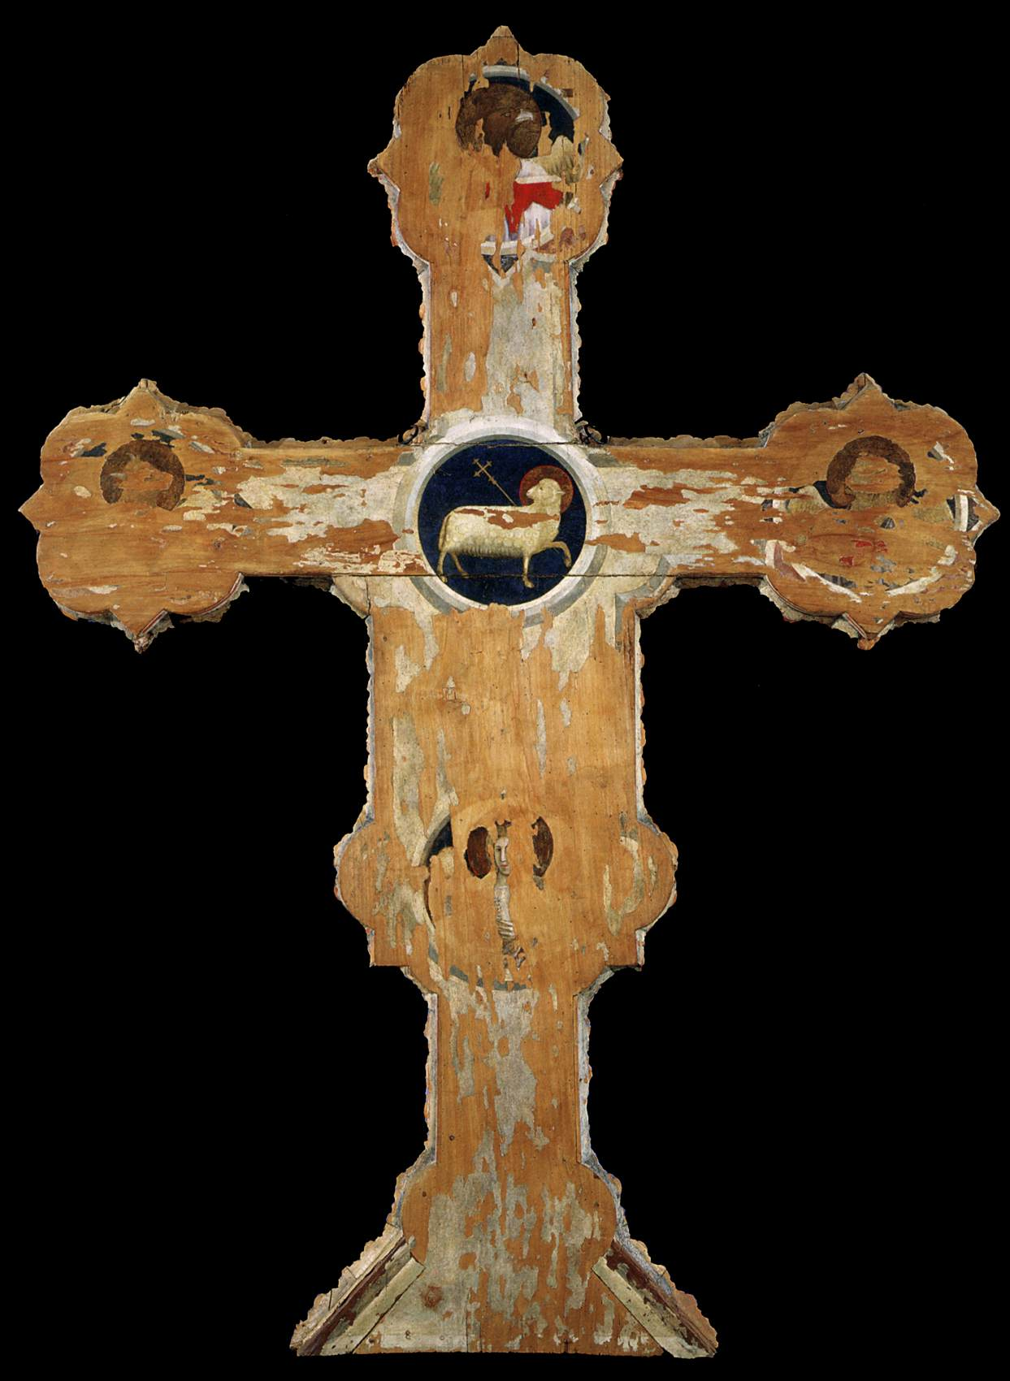
Crucifix (front and back), 1317
Tempera on wood, 223 x 164 cm
Museo Civico, Padua

Slide 10
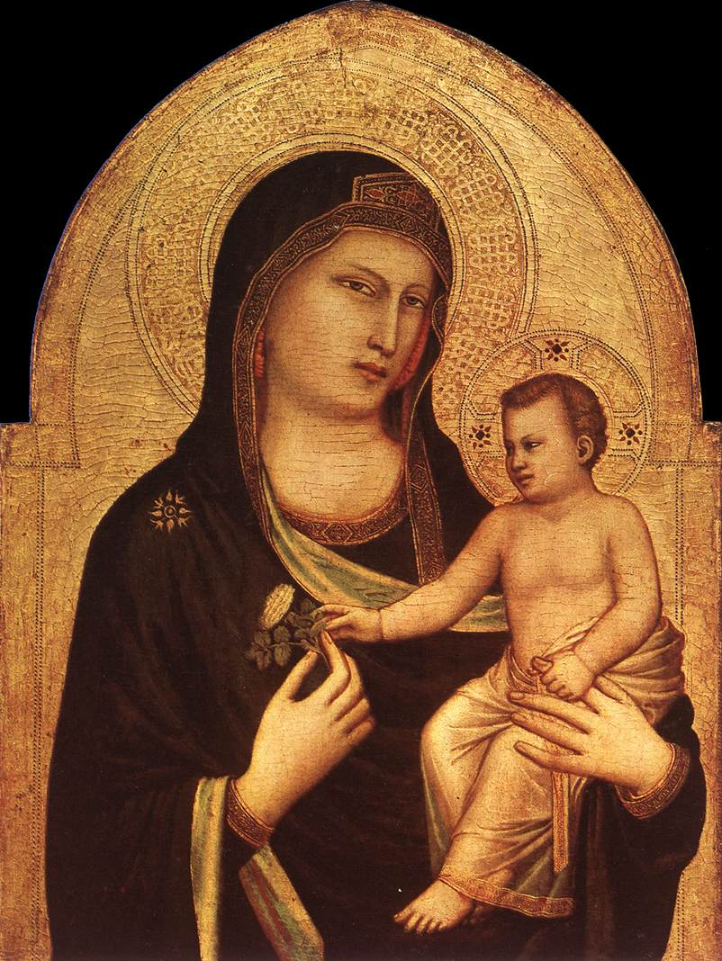
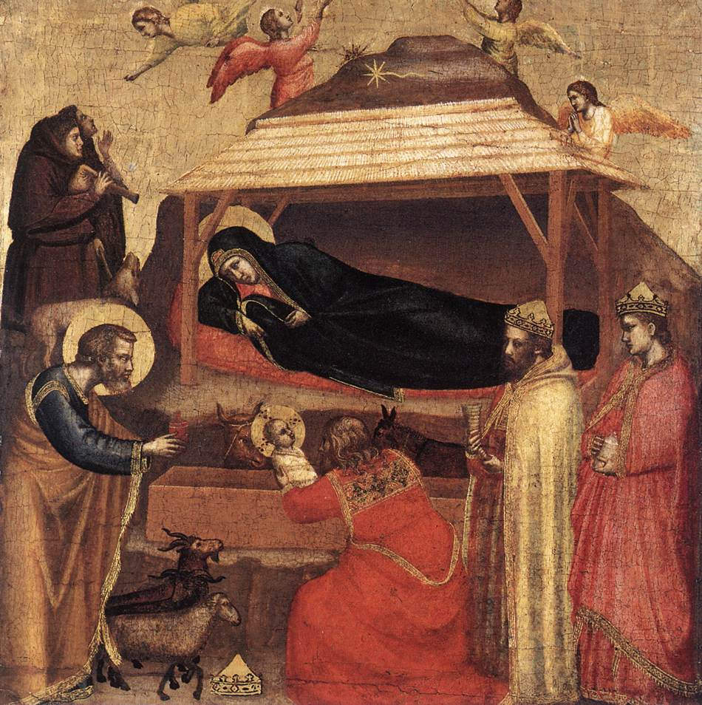
Panels of a dismembered Polyptych, 1320-1330, tempera on panel
Madonna and Child, 85,5 x 62 cm, NGA, Washington
The Epiphany, 45,1 x 43,8 cm, the MET, NY

Slide 11
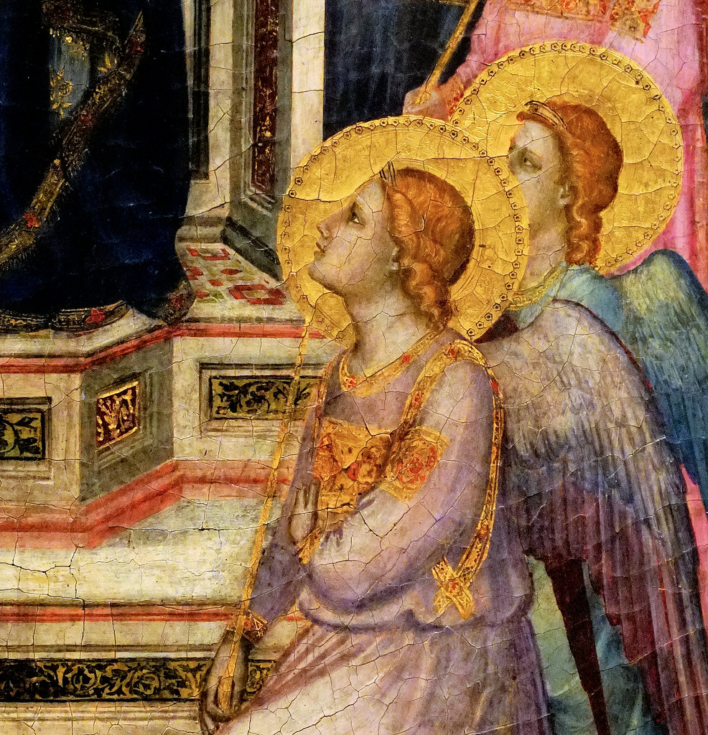
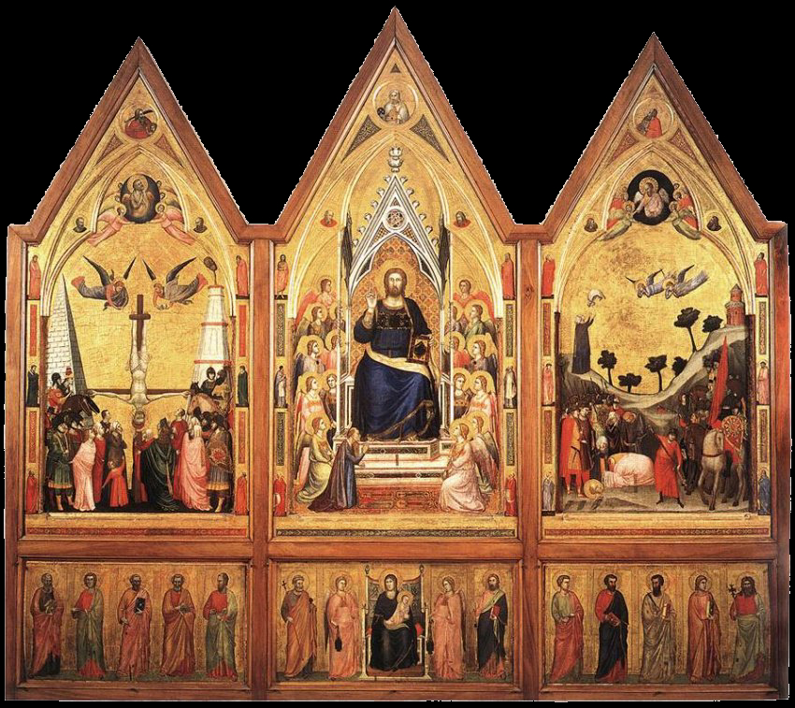
The Stefaneschi Triptych (recto), c. 1330, tempera on panel,
220 x 245 cm, Pinacoteca, Vatican

Slide 12
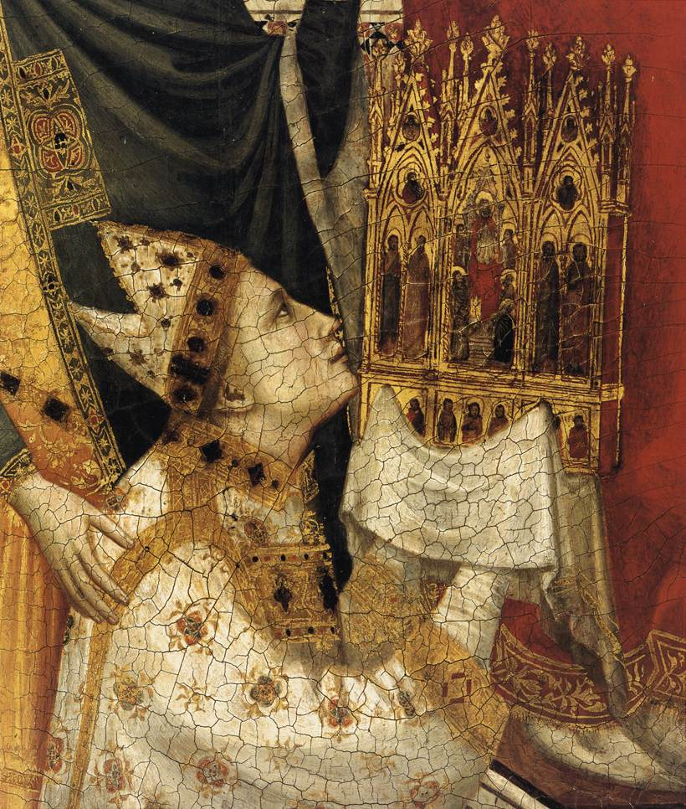
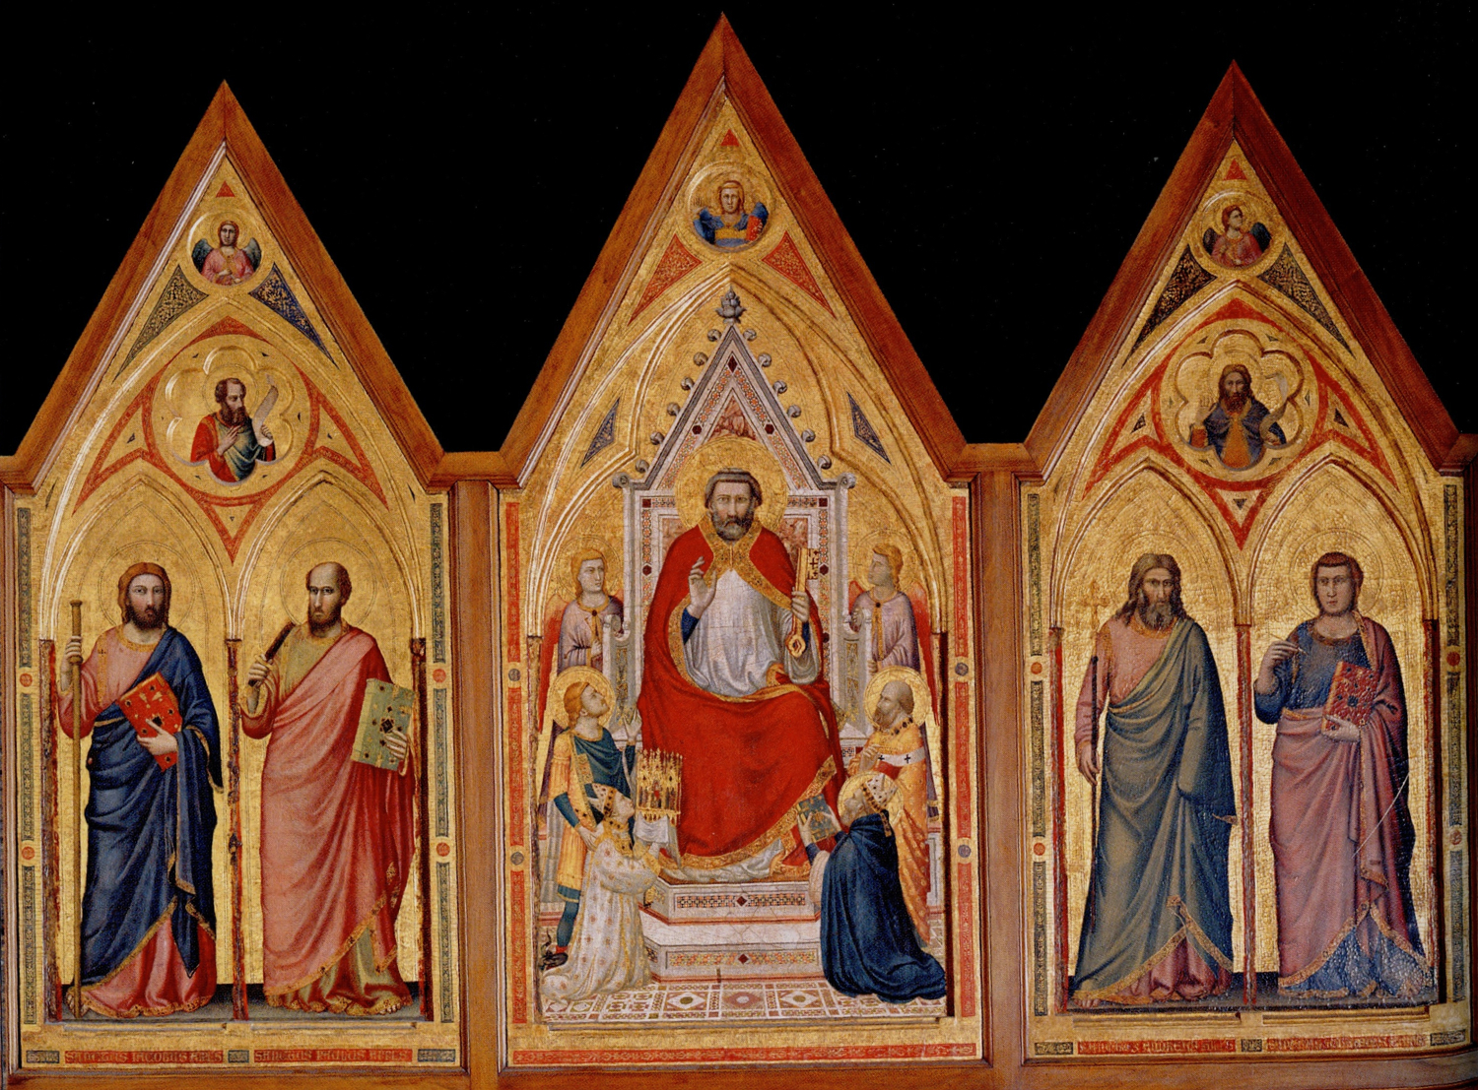
The Stefaneschi Triptych (verso), c. 1330, tempera on panel,
220 x 245 cm, Pinacoteca, Vatican

Slide 13
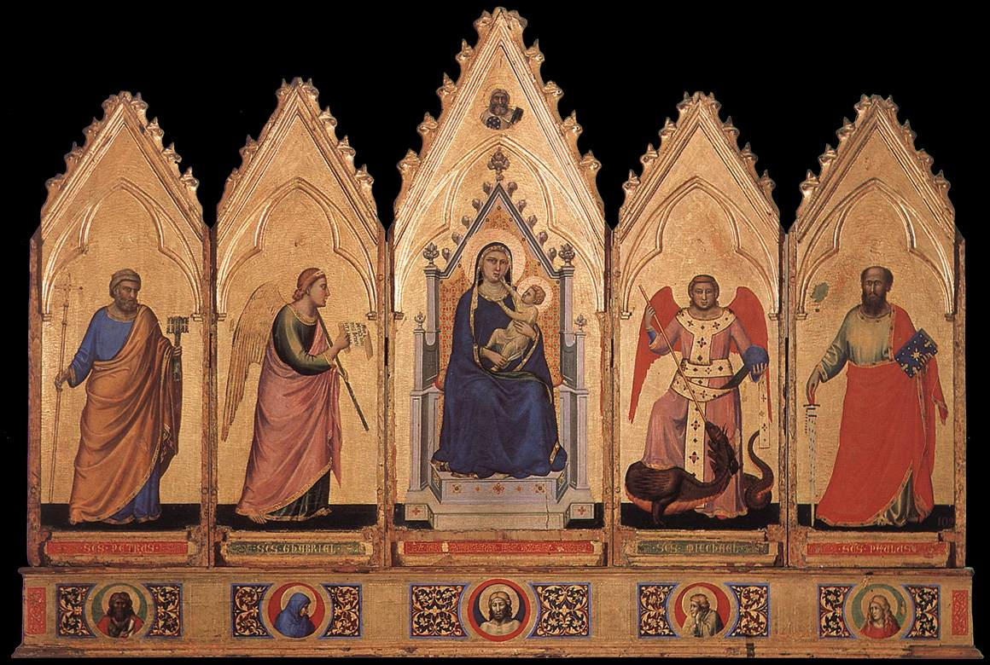
Polyptych, 1330-35, Tempera on wood, 91 x 340 cm, Pinacoteca Nazionale, Bologna

Slide 14
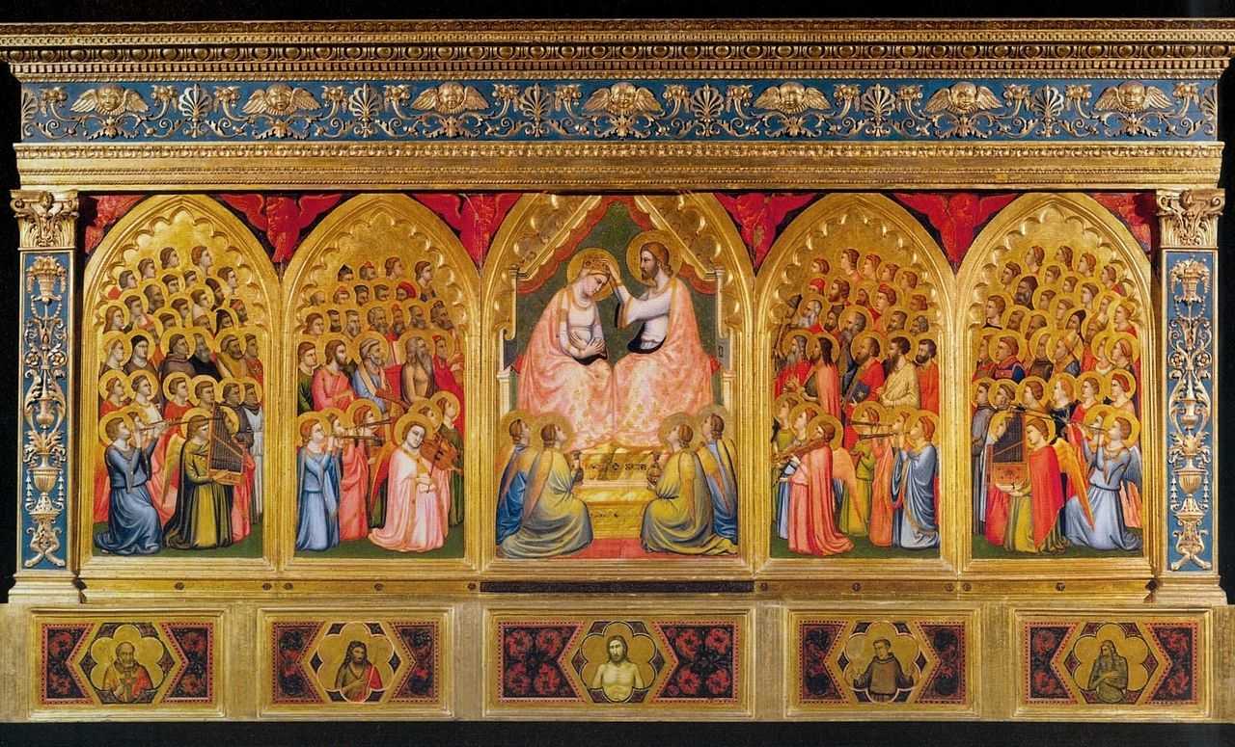
Baroncelli Polyptych, c. 1334, tempera on wood, 185 x 323 cm, Baroncelli Chapel, Santa Croce, Florence

Slide 15
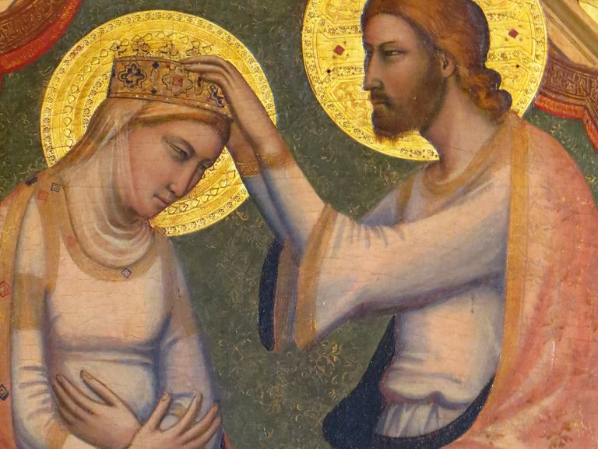

Slide 16
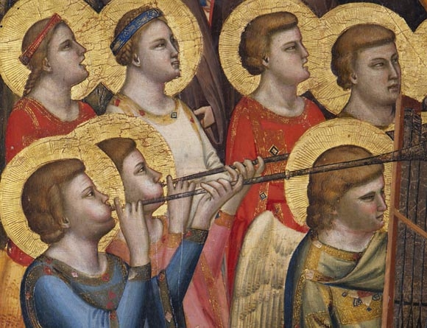

Slide 17
Teaching… with Giotto
Frescoes

Slide 18
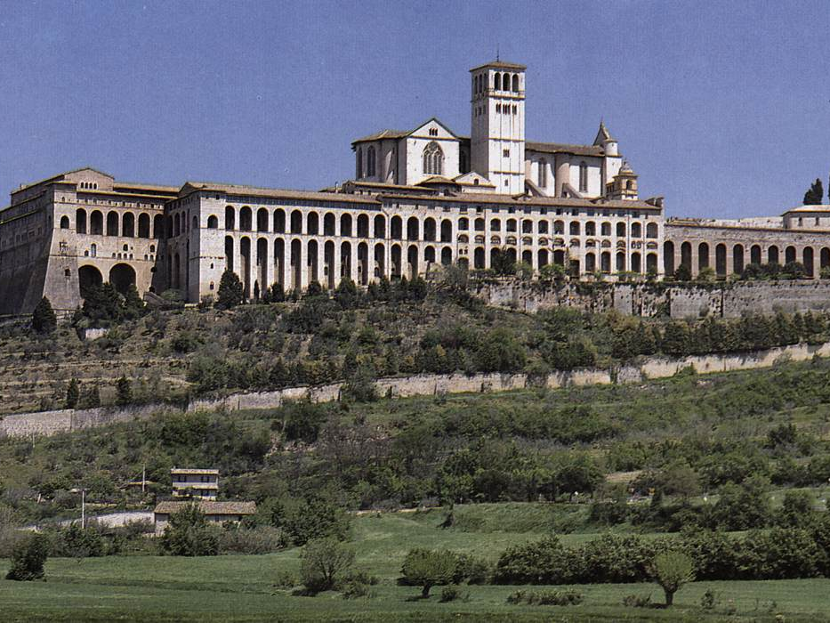
Church of San Francesco, Assisi
Giotto designed frescoes for the Upper and Lower Church

Slide 19
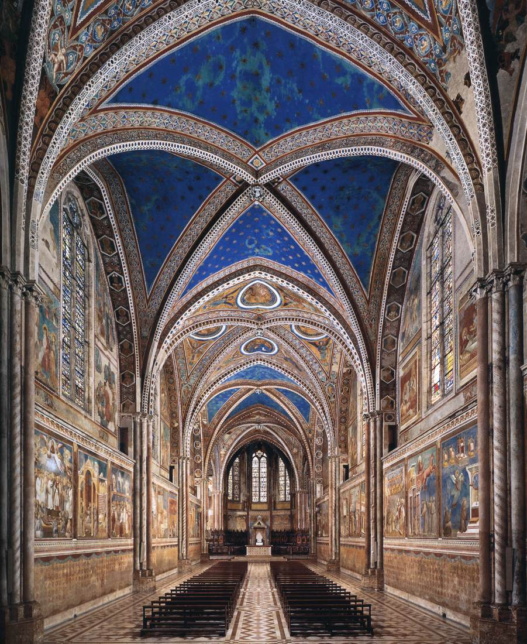
Upper Church, San Francesco, Assisi
View of the nave from the east
The frescoes illustrate episodes from the life of St. Francis, c. 1296

Slide 20
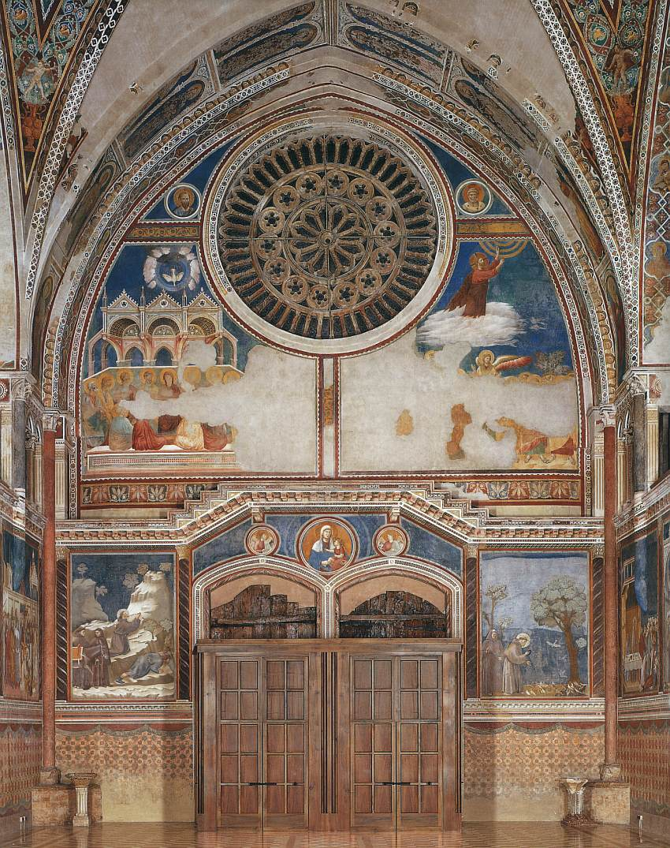
Legend of St Francis,
1297-99,
Upper Church, San Francesco, Assisi

Slide 21
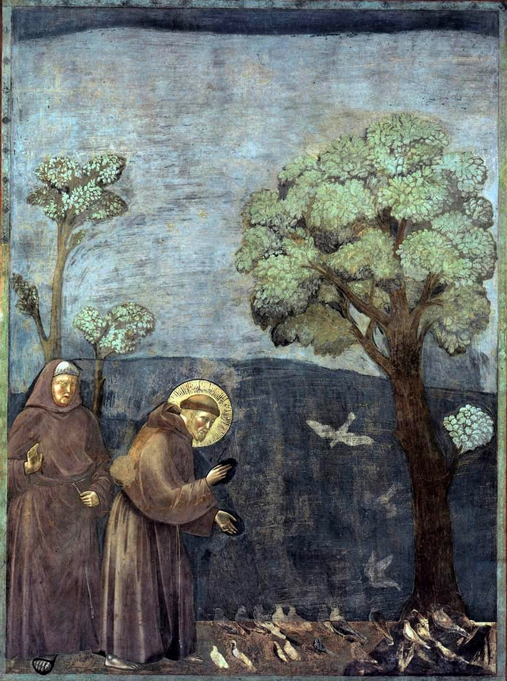
St. Francis' Sermon to the Birds, 1297-99,
Upper Church, San Francesco, Assisi

Slide 22
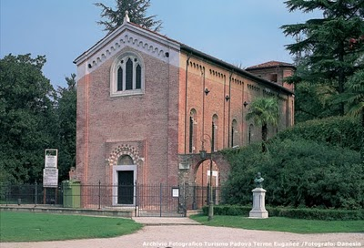
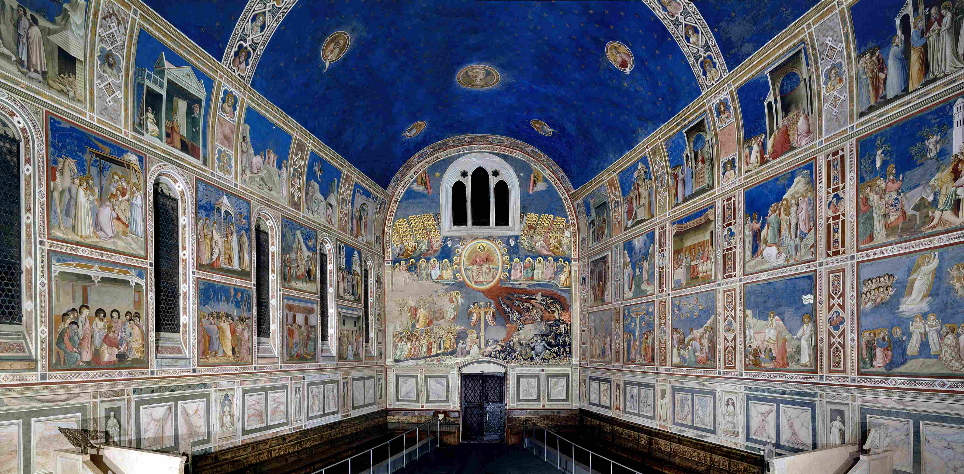
Cappella degli Scrovegni (Arena Chapel), 1303-06, Padua https://www.khanacademy.org/humanities/renaissance-reformation/late-gothic-italy/modal/v/giotto-arena-scrovegni-chapel-padua-c-1305-part-1-of-4 https://www.khanacademy.org/humanities/renaissance-reformation/late-gothic-italy/modal/v/giotto-arena-scrovegni-chapel-part-2-of-4

Slide 23
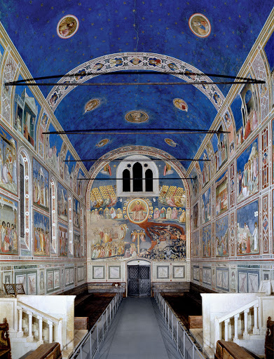
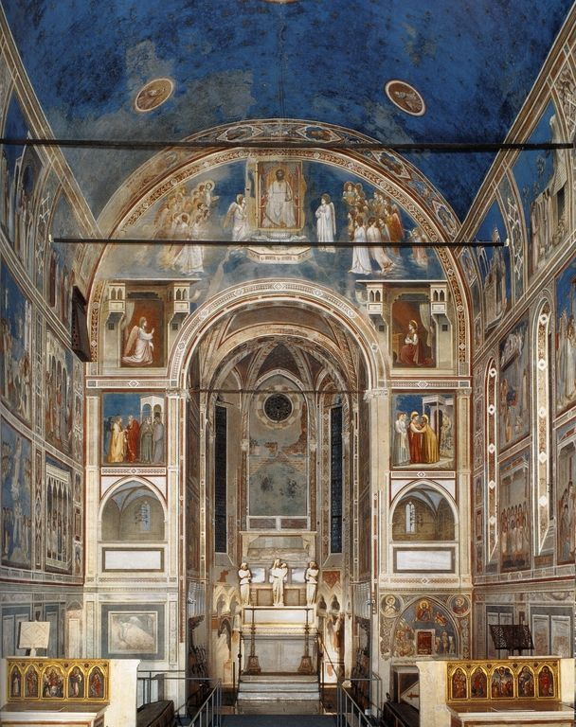
Cappella degli Scrovegni (Arena Chapel), 1303-06, Padua https://www.khanacademy.org/humanities/renaissance-reformation/late-gothic-italy/modal/v/giotto-arena-scrovegni-chapel-part-3-of-4 https://www.khanacademy.org/humanities/renaissance-reformation/late-gothic-italy/modal/v/giotto-arena-scrovegni-chapel-part-4-of-4

Slide 24
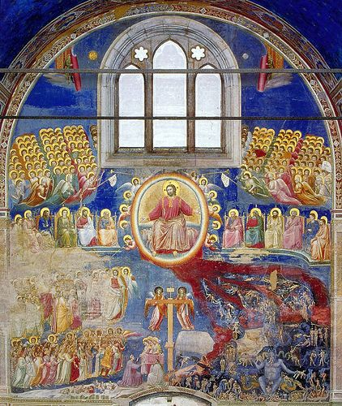
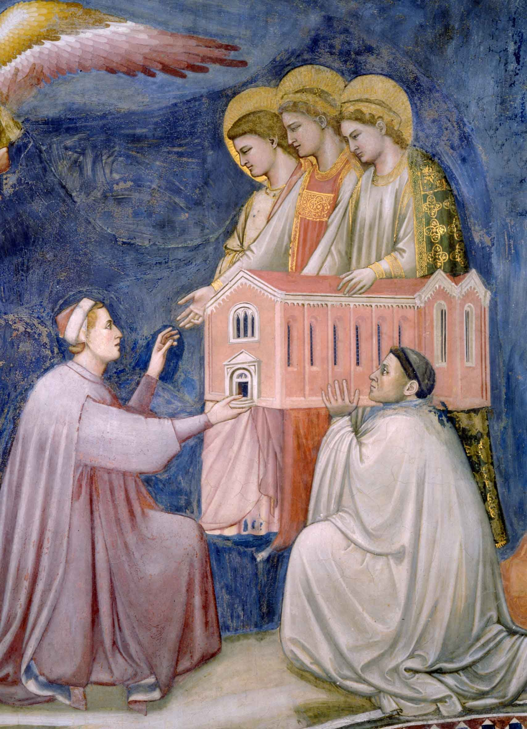
Model of the Chapel offered up to the Virgin Mary by Enrico Scrovegni

Slide 25
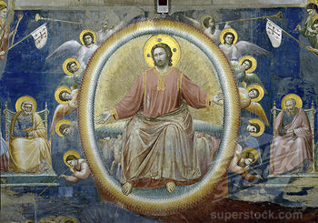
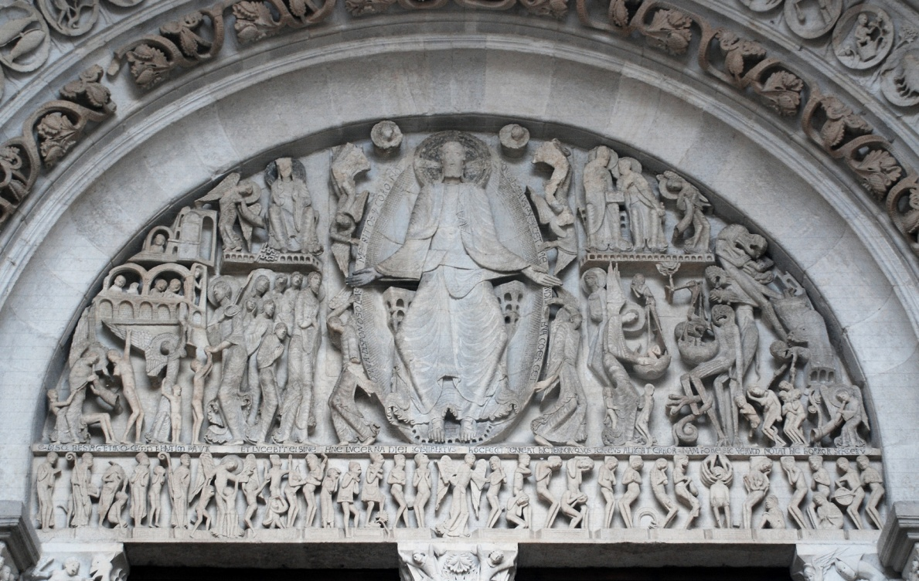
Detail of the
Triumphant Christ from the
Last Judgment Scene in the Arena Chapel and
The Last Judgment Scene in
St. Lazare, Autun Cathedral by Gislebertus, 12th century

Slide 26
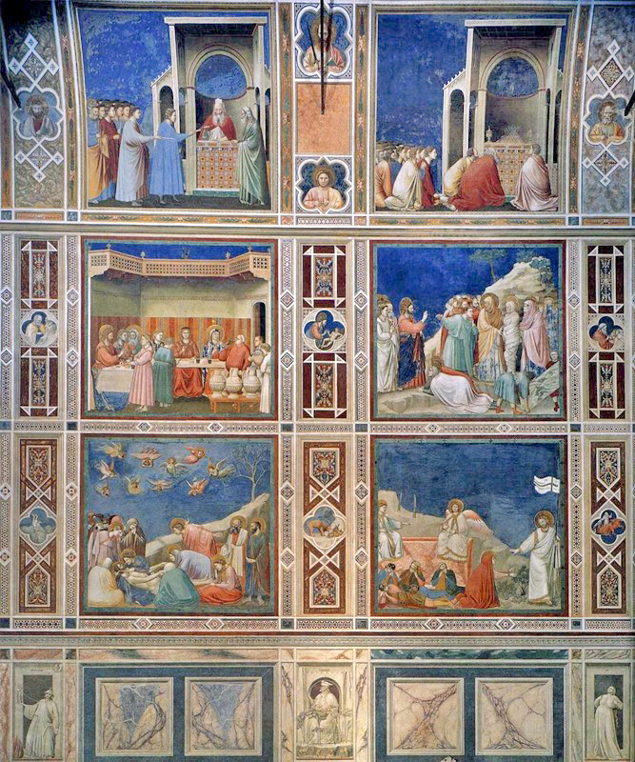

Slide 27
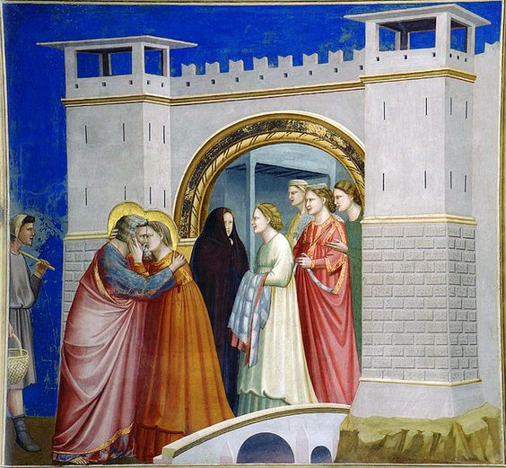
Joachim meets Anna at the
Golden Gate

Slide 28
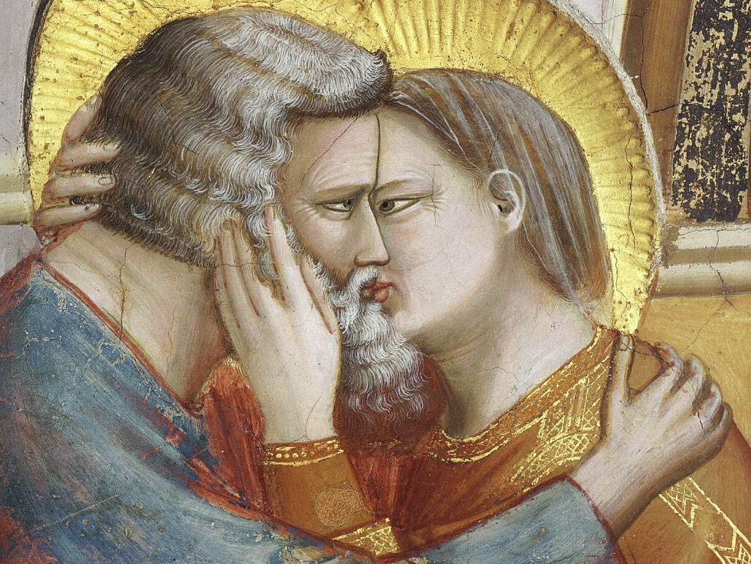

Slide 29
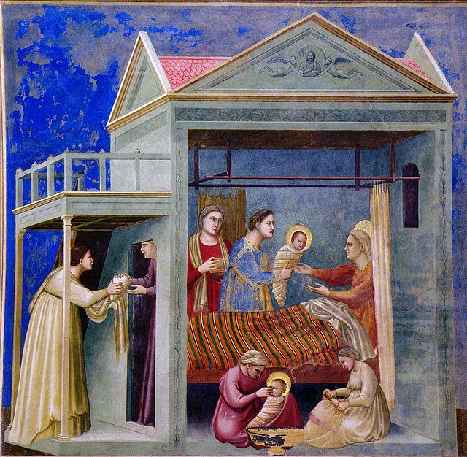
The Birth of the Virgin
Mary

Slide 30
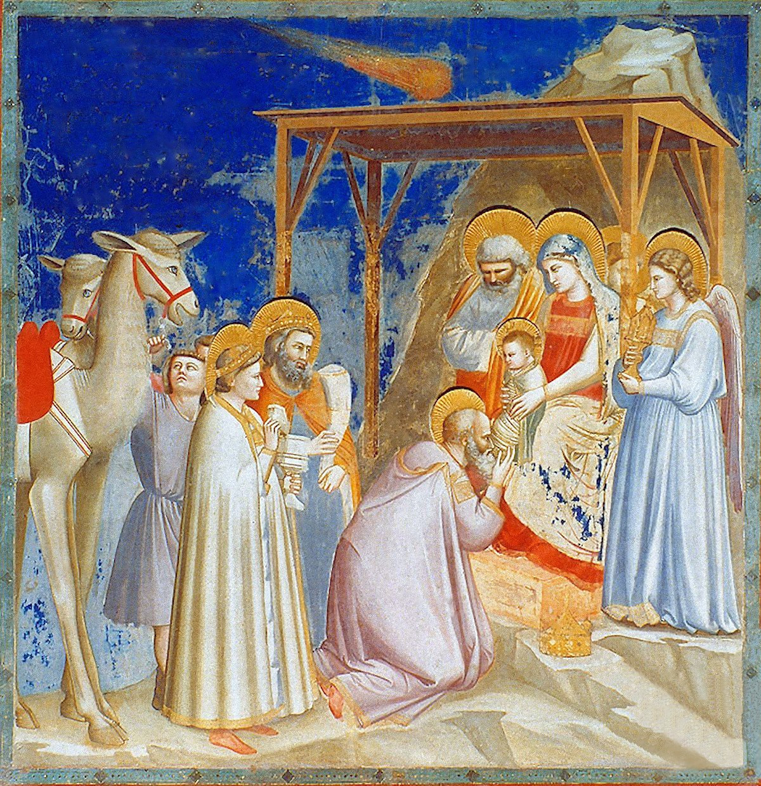
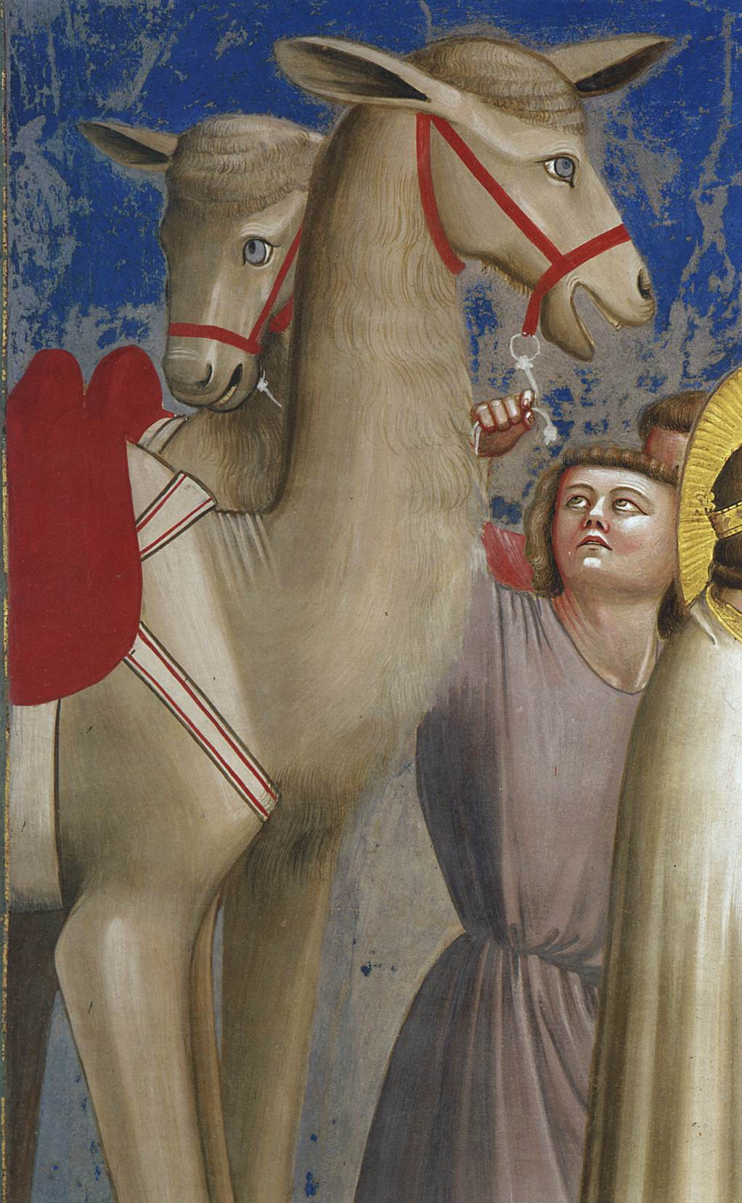
The Adoration of the Magi

Slide 31
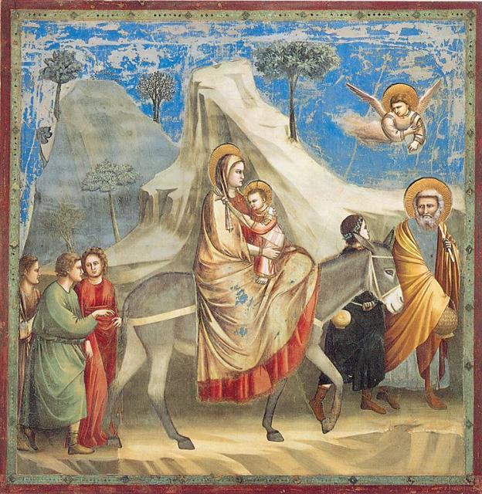
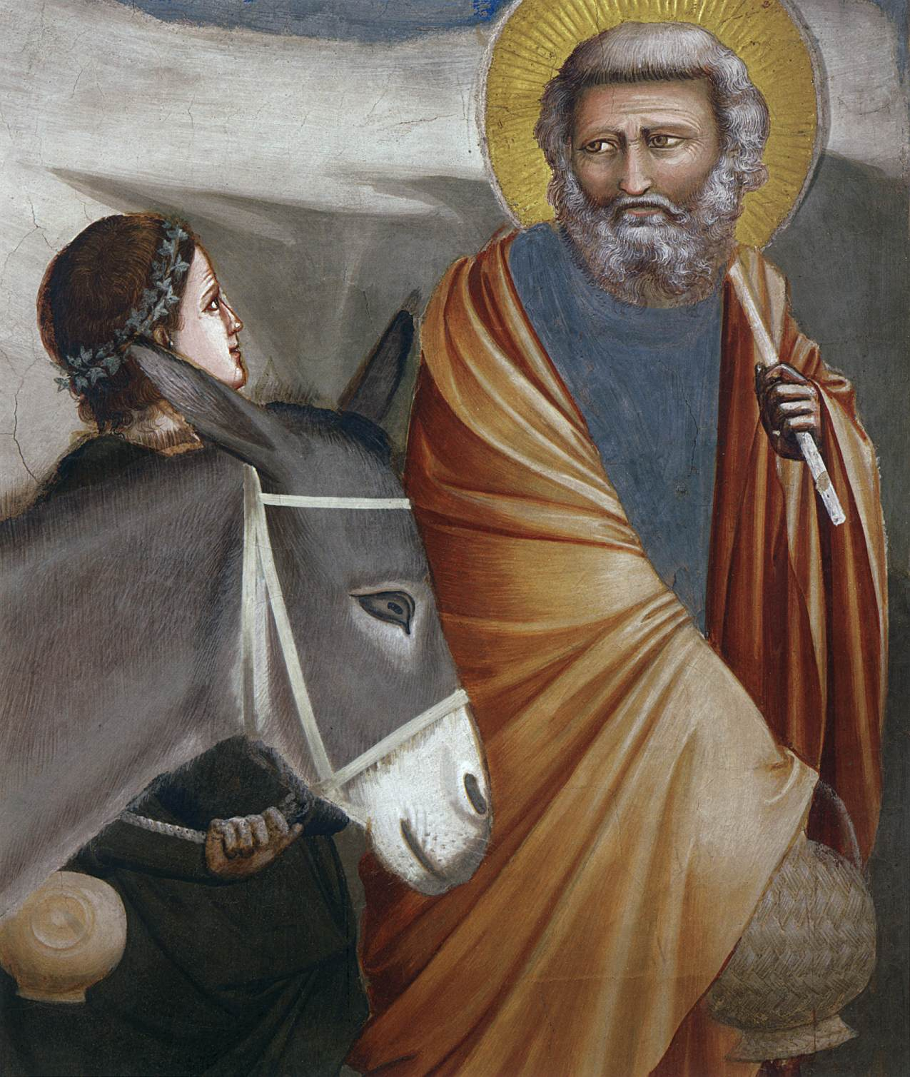
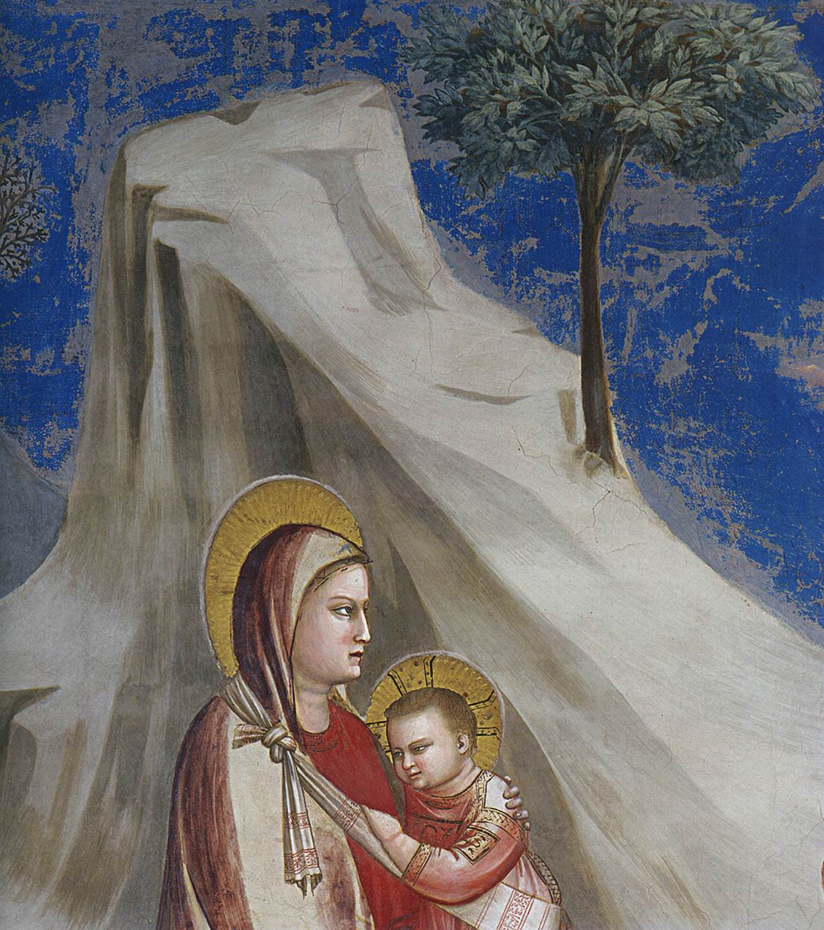
Flight into Egypt

Slide 32
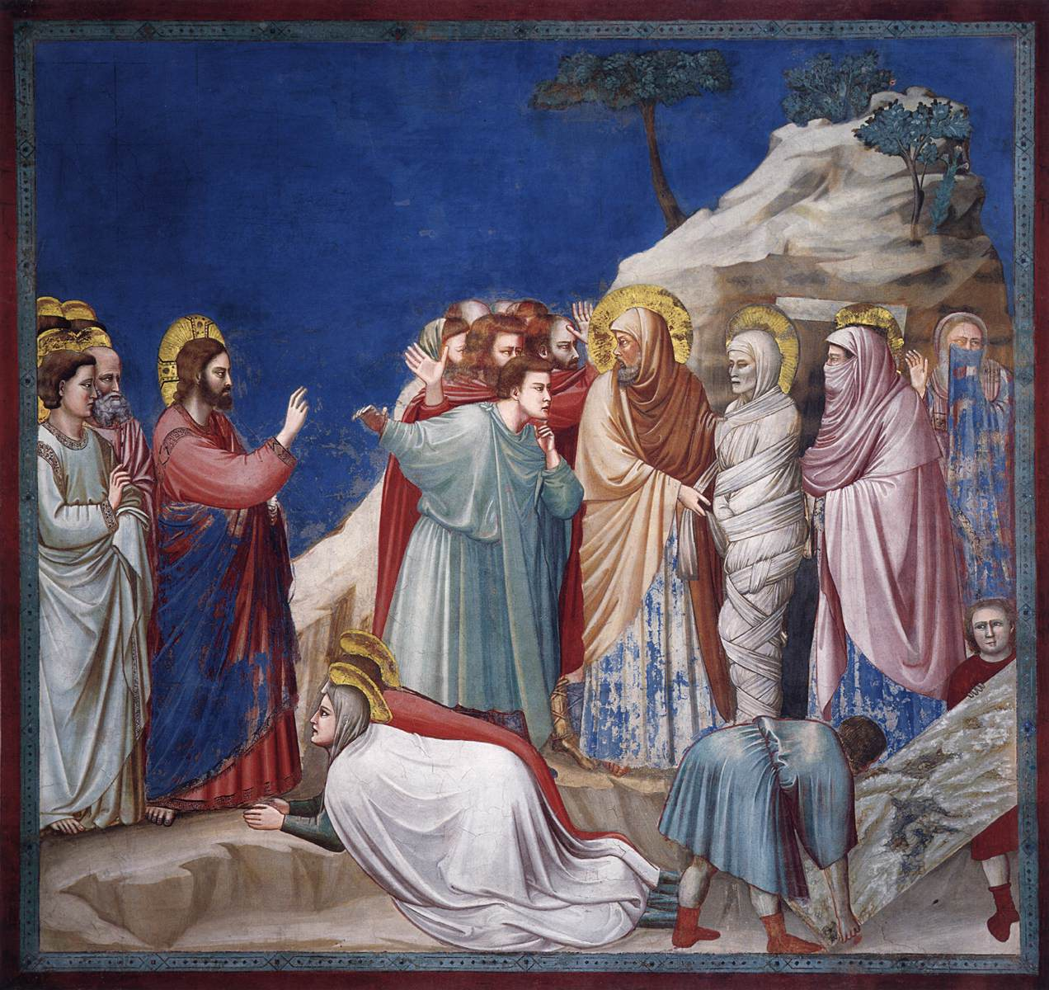
Raising of Lazarus

Slide 33
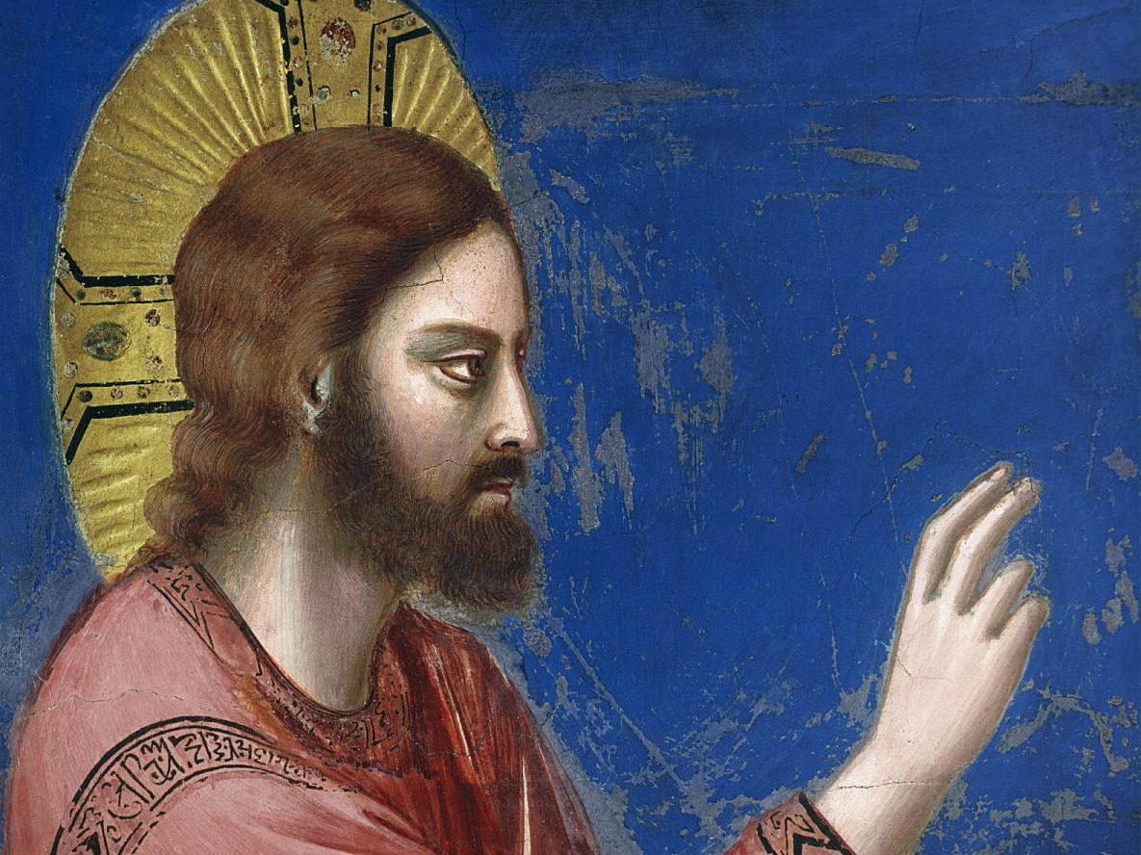

Slide 34
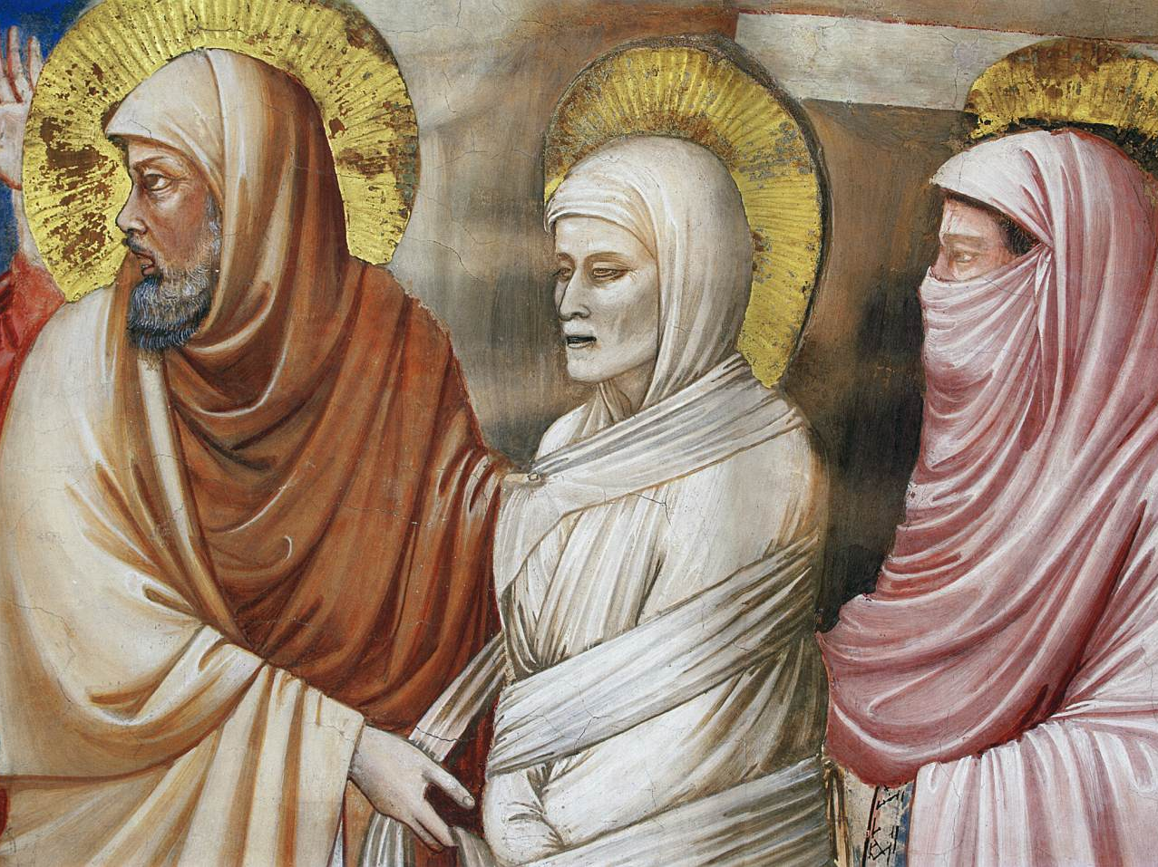

Slide 35
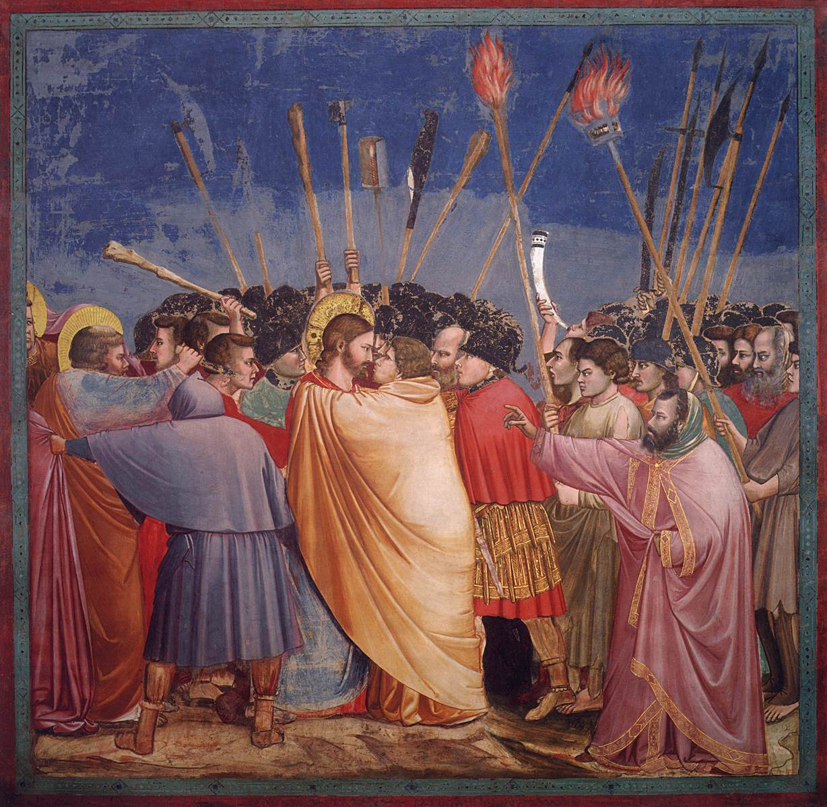
T
The Arrest of Christ (Kiss of Judas)

Slide 36
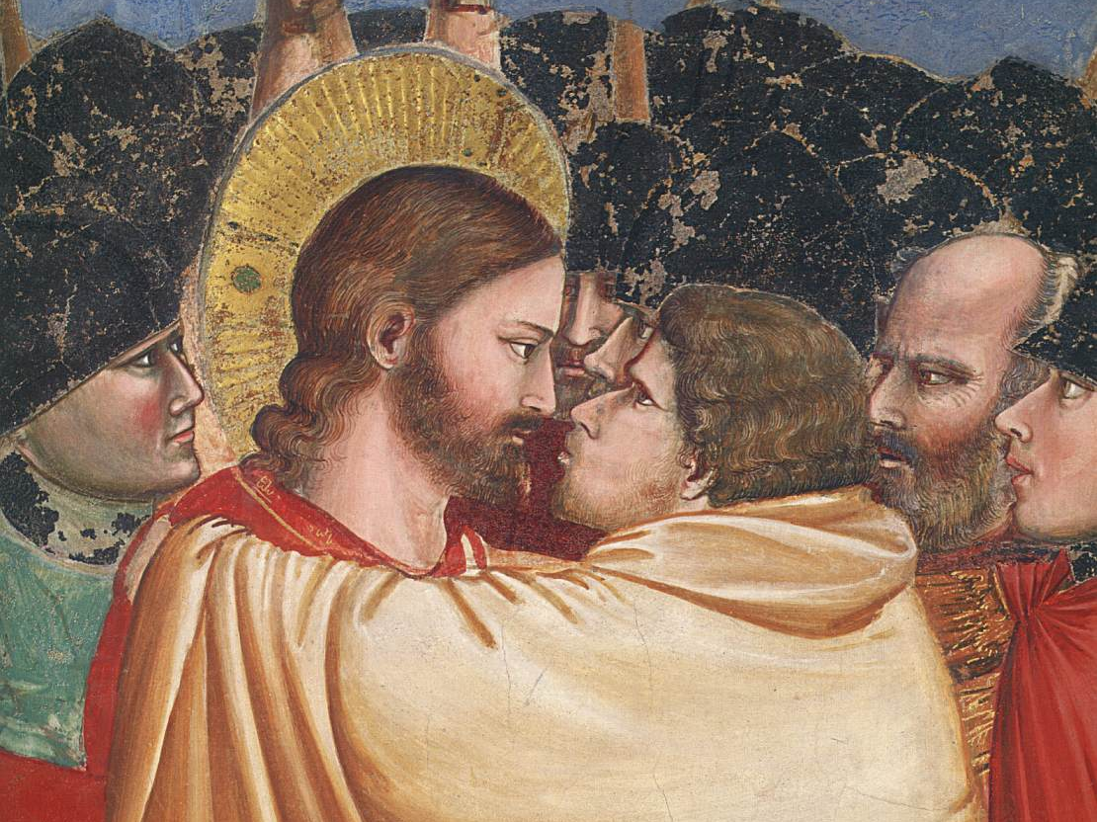

Slide 37
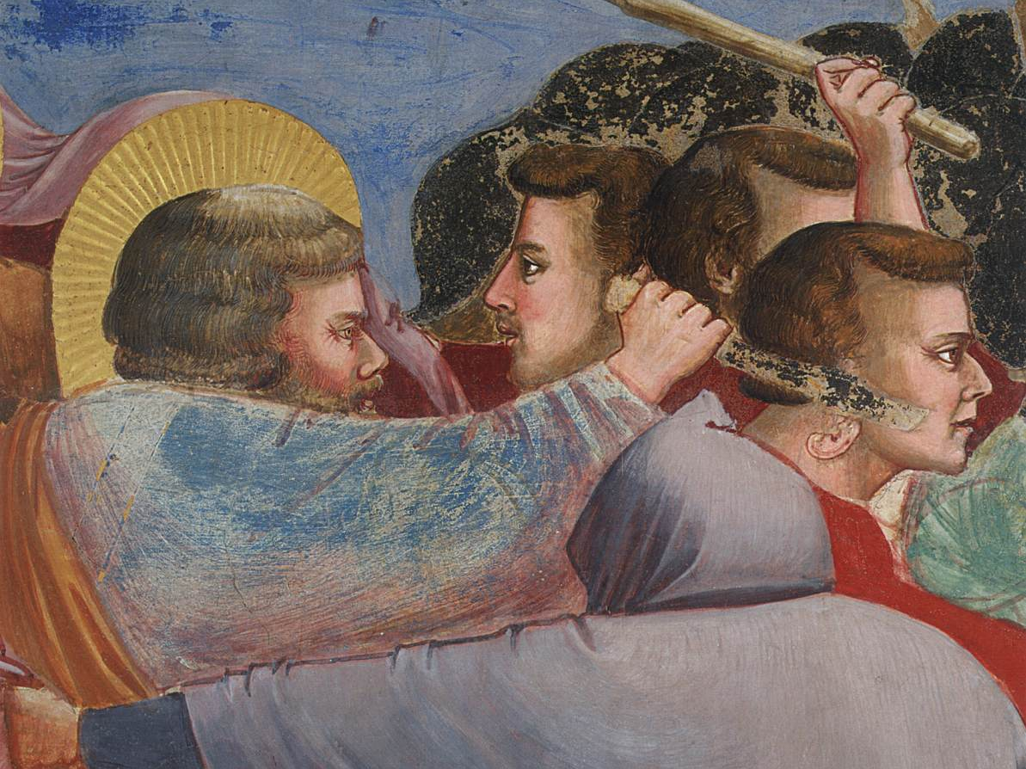

Slide 38
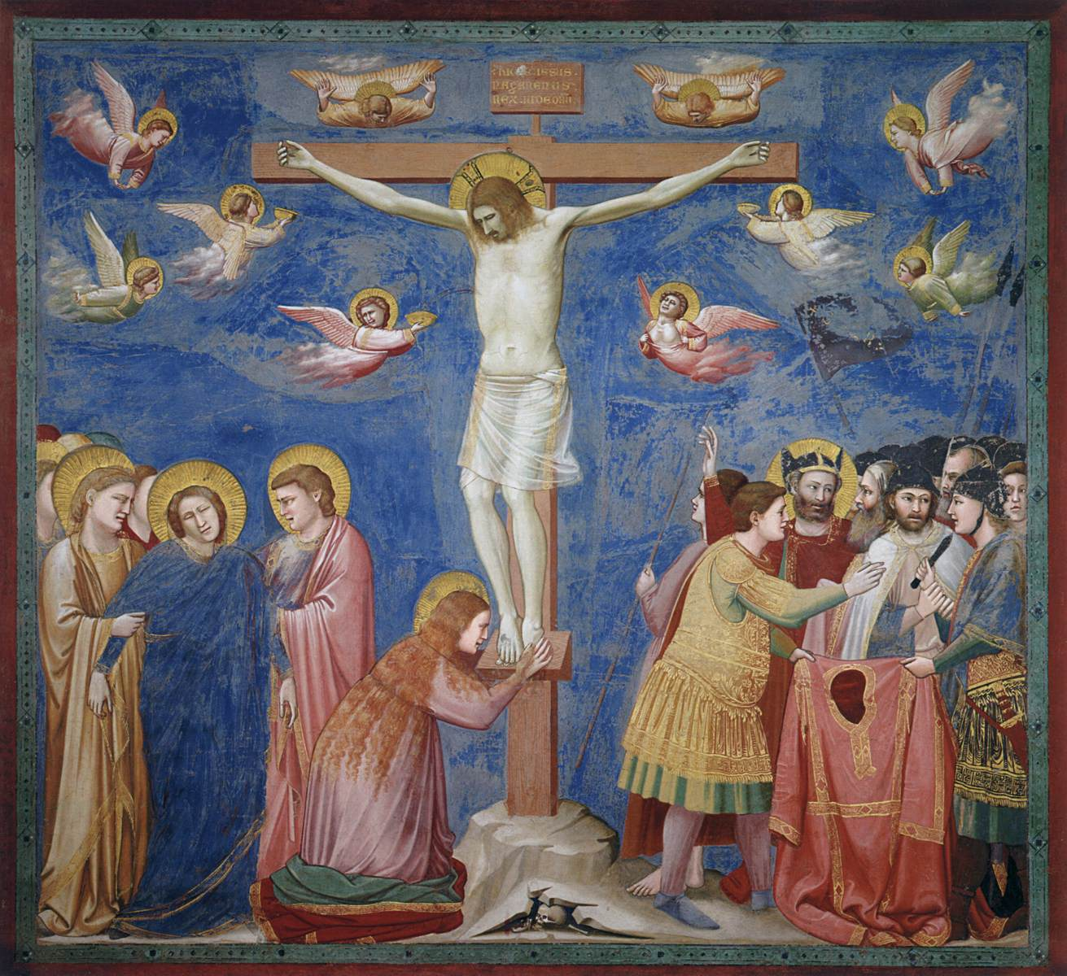
Crucifixion

Slide 39
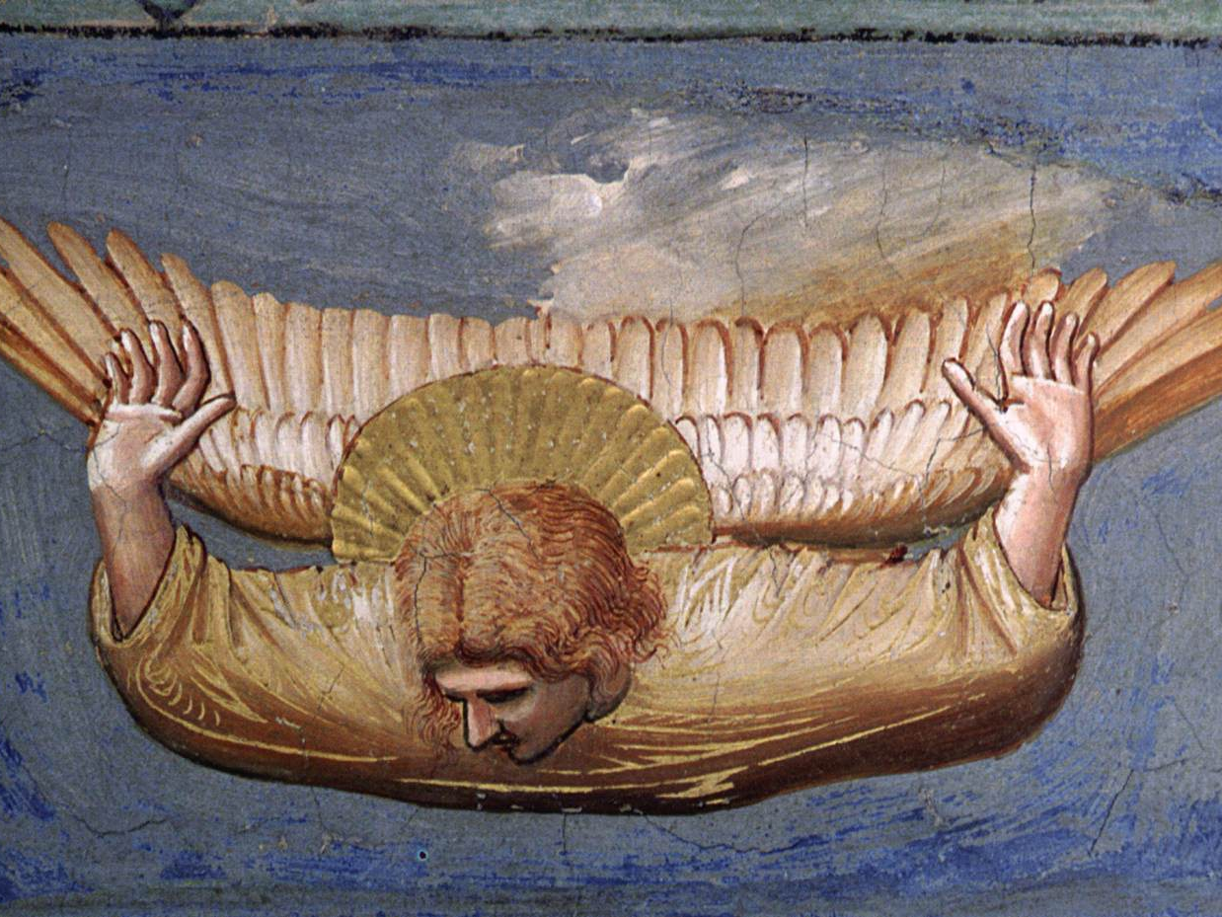

Slide 40


Slide 41


Lamentation (The Mourning of Christ)
Lamentation, Church of Saint Panteleimon, Nerezi, 12th century

Slide 42


Slide 43


Slide 44

Panoramic view of the frescoes in the Lower Church of San Francesco, Assisi, 1320-40

Slide 45

Frescoes in the crossing vault of the Lower Church
Franciscan Allegories, c. 1320, Lower Church, San Francesco, Assisi

Slide 46

Allegory of Poverty

Slide 47

Frescoes on the ceiling of the north transept of the Lower Church
Vault of the north transept, 1315-20, Lower Church, San Francesco, Assisi
Probably executed by Giotto's workshop under the direction of the master.

Slide 48

Return of Christ to Jerusalem, 1315-20,
North transept, Lower Church, San Francesco, Assisi

Slide 49

Frescoes in the Magdalen Chapel of the Lower Church, Scenes from the Life of Mary Magdalen: Mary Magdalen's Voyage to Marseilles
1320s - executed with a contribution of Giotto

Slide 50

View of the Peruzzi and Bardi Chapels
Santa Croce, Florence

Slide 51


View of the Peruzzi and Bardi Chapels (from right)
View of the Peruzzi and Bardi Chapels (from left)

Slide 52

Scene from the Life of St John the Evangelist: Ascension of the Evangelist
1320, Fresco, 280 x 450 cm, Peruzzi Chapel, Santa Croce, Florence

Slide 53

Scene from the Life of Saint Francis: Death and Ascension of St Francis c. 1325, Fresco, Bardi Chapel, Santa Croce, Florence

Slide 54


Slide 55
Teaching… with Giotto
Campanile

Slide 56

Giotto's bell tower seen from the top of the Duomo
The slender structure is square in plan with 14.45 m. sides. It is 84.7 m. tall and has polygonal buttresses at each corner. The tower is divided into five stages.

Slide 57


Design sketch for the Campanile, 1334,
Parchment, Museo dell'Opera del Duomo,
Florence

