Slide 1
Lady of Auxerre, c. 640-630 BC, from Crete, limestone statuette, height 0.63 m, the Louvre, Paris
and
Daughter of Eleutherna, 7th century BC, limestone statuette, surviving height of 60 cm, so a total of about one meter, Museum of Ancient Eleutherna

Slide 2
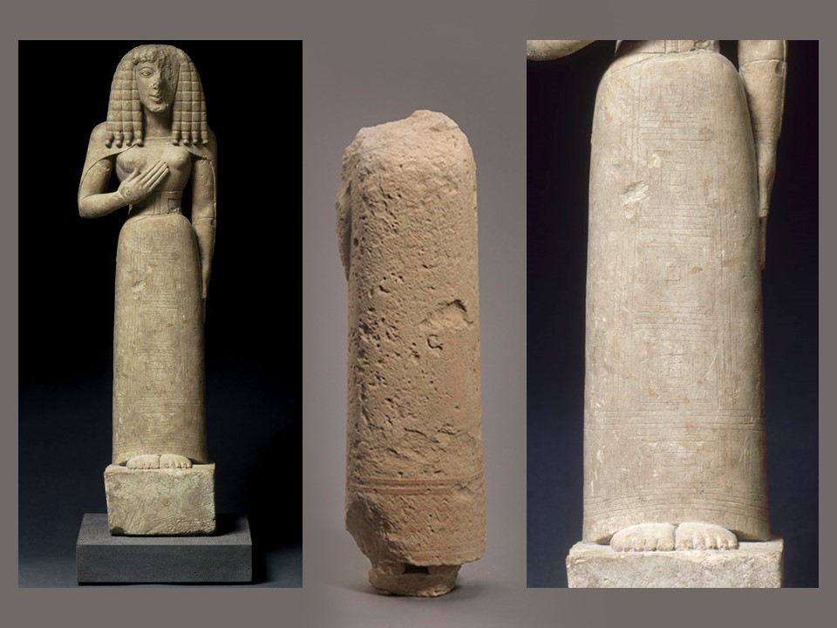

Slide 3
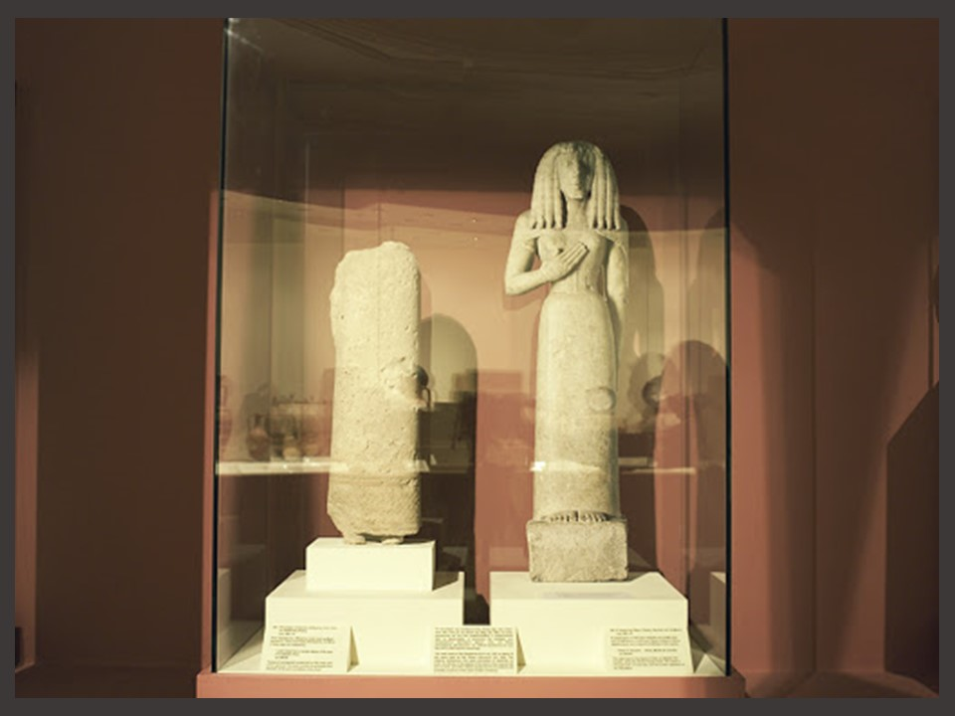

Slide 4
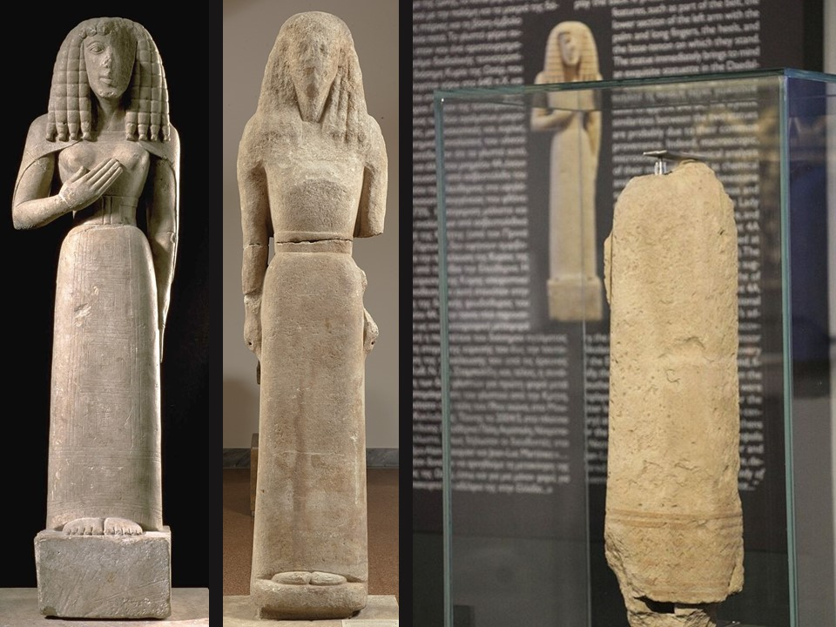
Between the Lady of Auxerre and the Daughter of Eleutherna…
The Kore of Nikandre, c. 650 BC, from Delos, Parian marble, height 1.75 m, National Archaeological Museum, Athens
The Inscription reads: Nikandre dedicated me to the Far-Shooter of arrows, the excellent daughter of Deinodikes of Naxos, sister of Deinomenes, wife of Phraxos

Slide 5
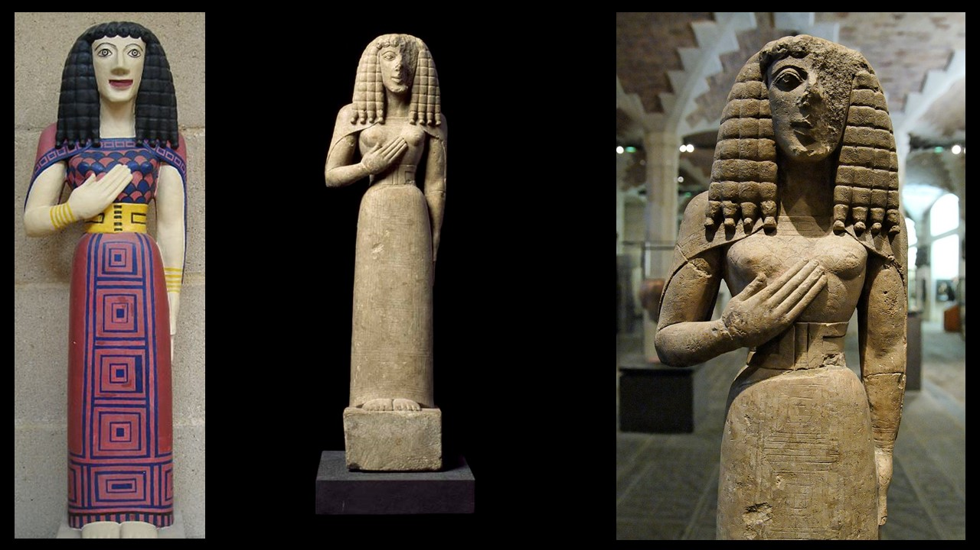
Lady of Auxerre, c. 640-630 BC, from Crete, limestone statuette, H. 0.63 m, the Louvre, Paris
Daughter of Eleutherna, 7th century BC, limestone statuette, the surviving height of 60 cm, so a total of about one meter, Museum of Ancient Eleutherna

Slide 6
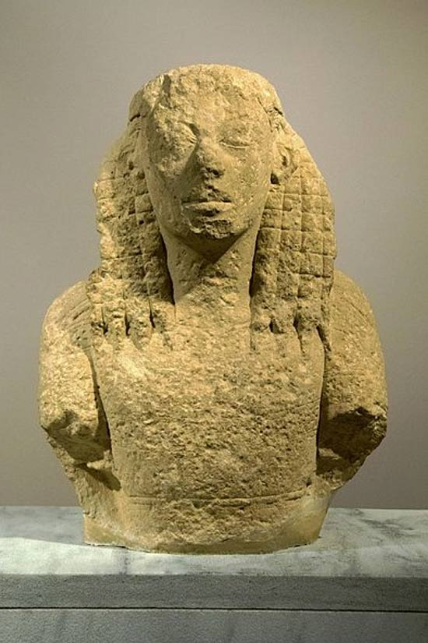
Fragment of a Daedalic statue of a Kore from Eleutherna, 7th century BC, poros stone, Archaeological Museum of Heraklion

Slide 7
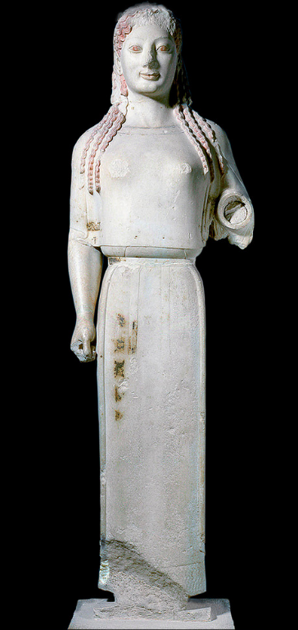
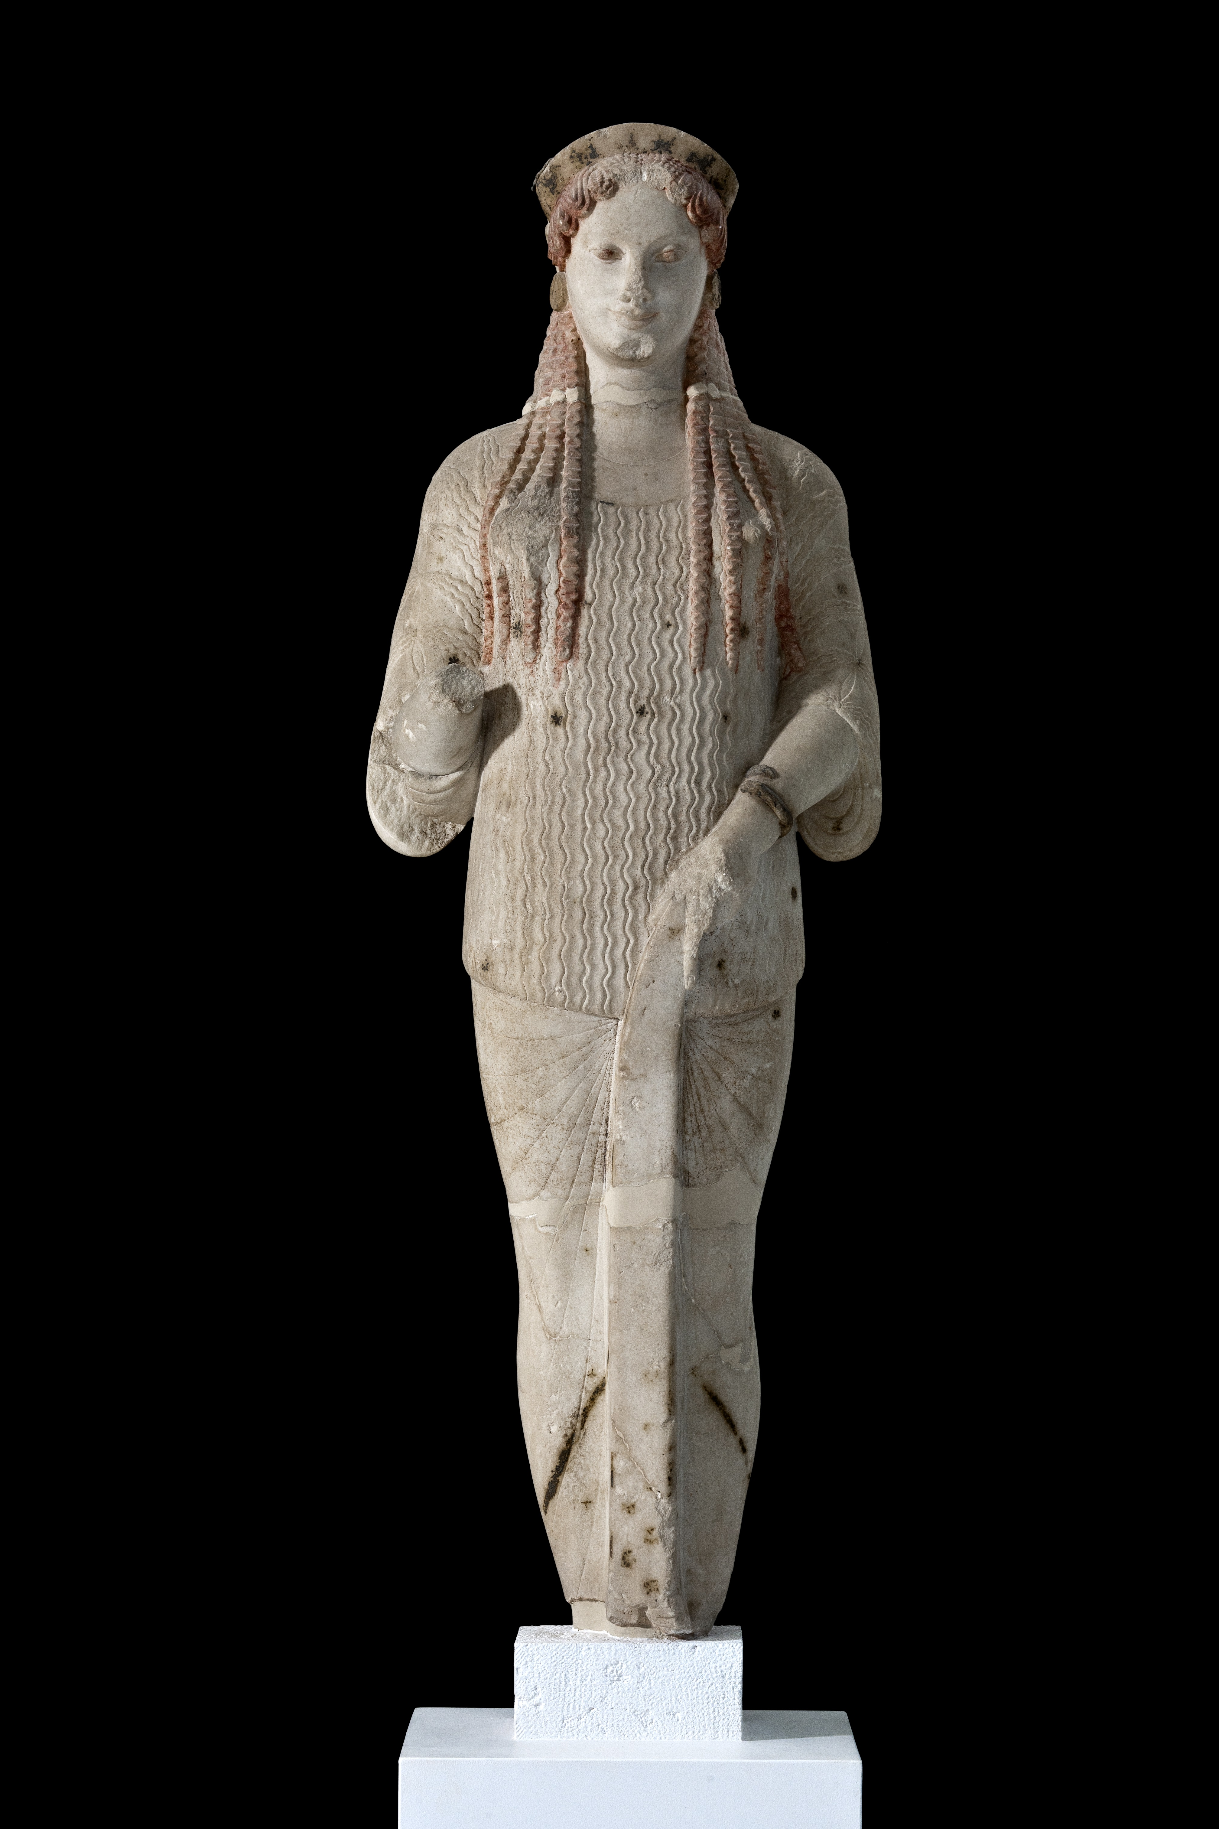
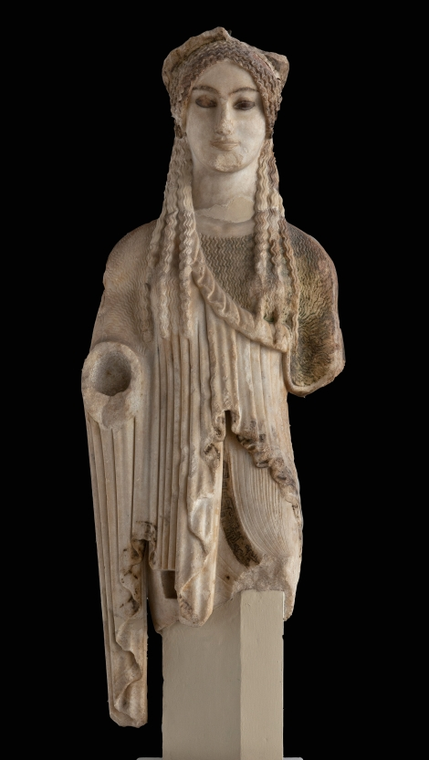
Peplos Kore, c. 530 BC, Parian Marble, Acropolis Museum
Acropolis Kore 670, ca. 520-500 BC BC, island marble, H. 1.15 m, Acropolis Museum
Kore with Almond Eyes, c. 500 BC, Parian marble, Acropolis Museum

Slide 8
Credits for Photographs: https://www.akg-images.com/archive/Dame-d%E2%80%99Auxerre-2UMDHUH75U8W.html http://en.mae.com.gr/exhibits.html https://burgondiart.wordpress.com/2015/02/19/la-mysterieuse-dame-dauxerre-est-elle-vraiment-bourguignonne/ http://gjclarthistory.blogspot.com/2017/04/the-lady-of-auxerre.html https://www.ancient-origins.net/artifacts-other-artifacts/lady-of-auxerre-0010215 https://gr.pinterest.com/pin/493707177885369040/?nic_v2=1a7FXhvpJ https://onassisusa.org/multimedia/eros-stringing-his-bow https://www.theacropolismuseum.gr/en/content/women-acropolis-museum

