Slide 1
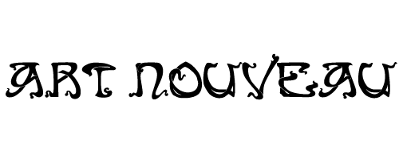

Slide 2
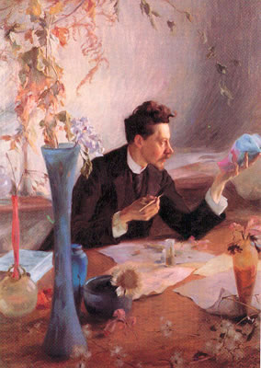
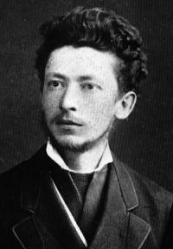
Émile Gallé, 1846–1904
Victor Prouvé, 1858-1943 Portrait of Emile Gallé, 1892, oil on canvas, Musée de l'Ecole de Nancy

Slide 3
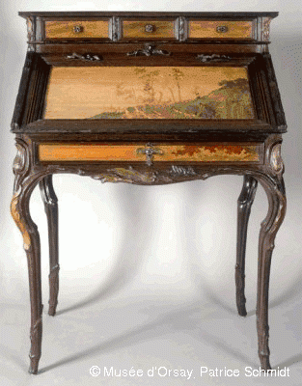
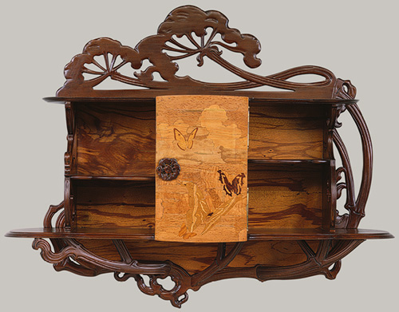
Lorraine Forest Desk, 1900, Sculpted lakeside oak with mouldings, inlay work of various woods, 108.5 x 78.5 x 56 cm, Musée d'Orsay, Paris
Hanging cabinet, ca. 1890, French (Nancy), Beechwood, various marquetry woods, 101.6 cm x 30.5 cm x 121.9 cm, the MET, NY

Slide 4
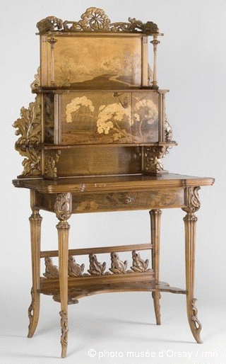
Les Ombellules, 1900, bureau de dame, wood and marqueterie of different woods, 1.6x0.84x0.55 cm, Musée d'Orsay, Paris

Slide 5
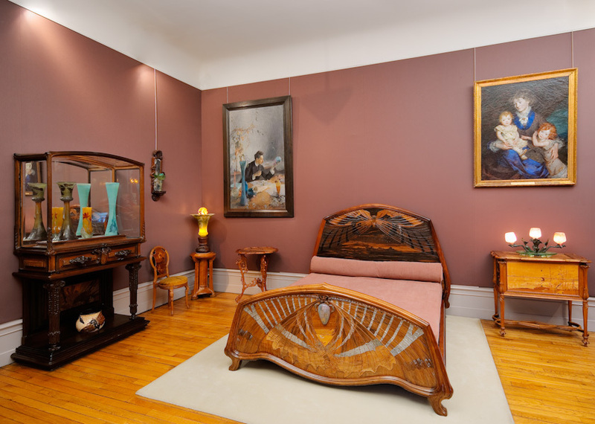
Émile Gallé Room, Musée de l'École de Nancy

Slide 6
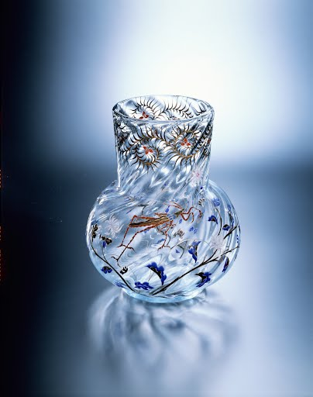
Vase with Grasshopper design, ca 1878, Enamel Vase, Suntory Museum of Art

Slide 7
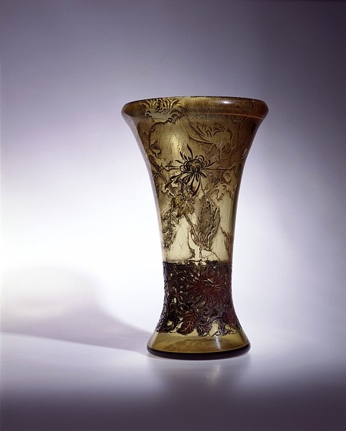
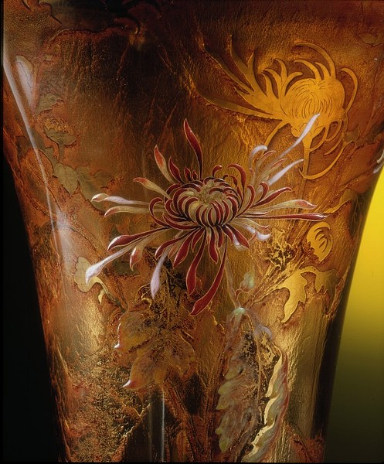
Vase, 1900, Acid-etched glass, enamelled and gilded, The Victoria and Albert Museum, Inscribed "Galle Exposition 1900"and "chrysanthemum“ in Greek

Slide 8
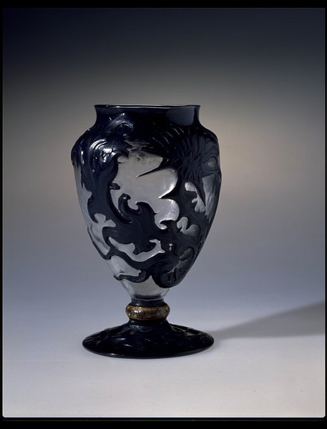
Vase, 1900, cased, wheel-cut glass, with mount of enamel on copper, the Victoria and Albert Museum, London
Shown in the international exhibition, Paris, 1900 at which Gallé was awarded a gold medal.

Slide 9
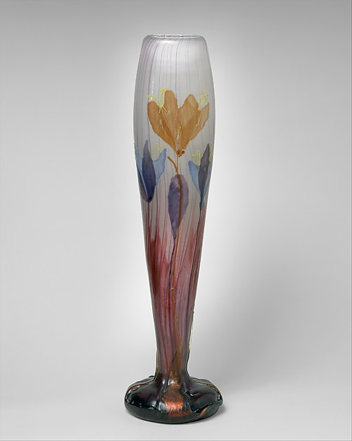
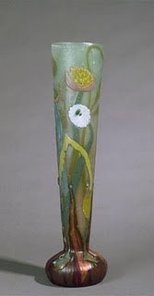
"Autumn Crocus" Vase, 1900, Glass, 44.1 cm in height, the MET, NY
Vase, 1900, Glass, 43 cm in height, Musée d'Orsay

Slide 10
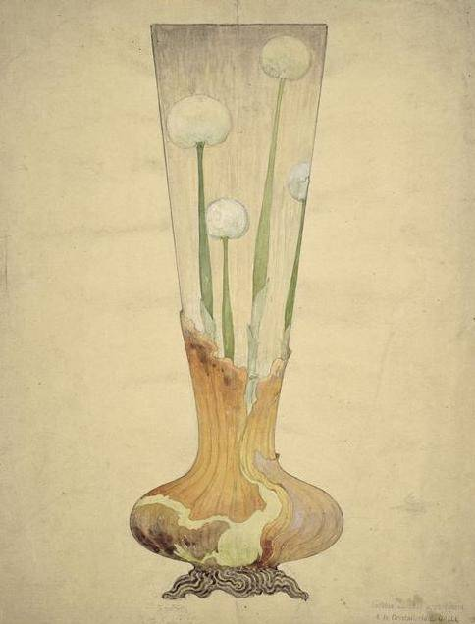
Émile Gallé Dessign Study Musée d'Orsay

Slide 11
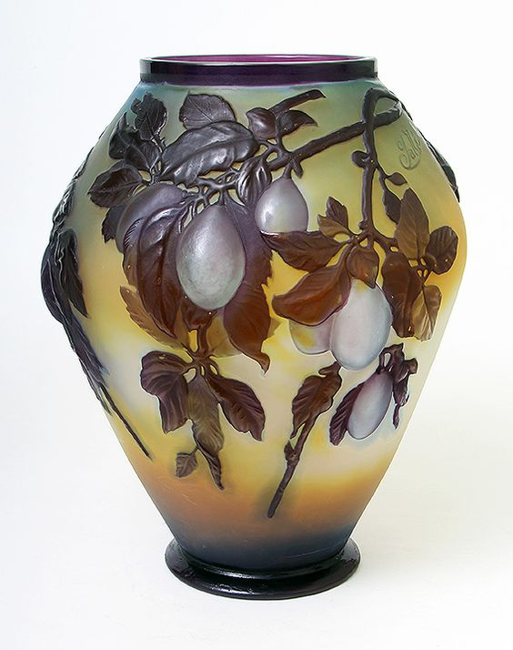
Blownout Plum Vase, 1900, Camao Glass, private collection

Slide 12
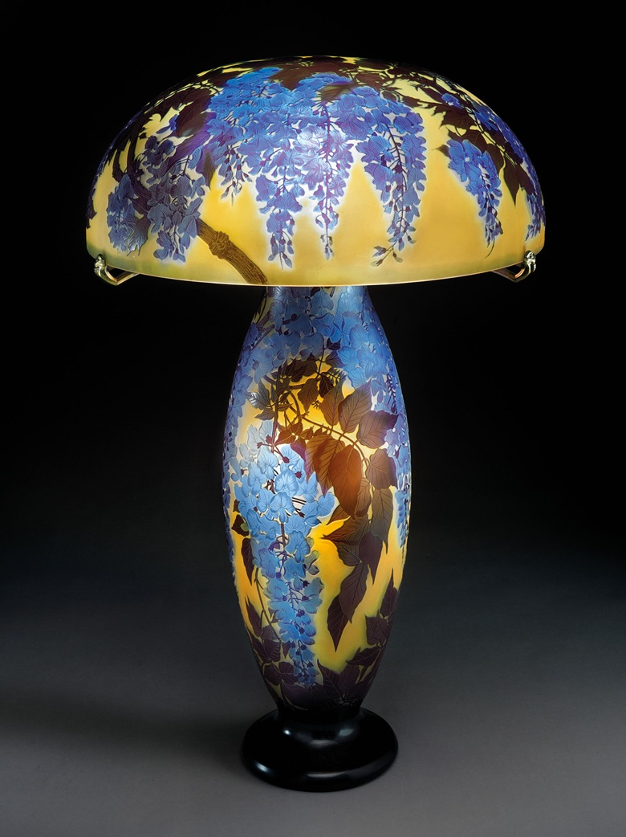
A rare and important
Wisteria table lamp, 76.2 x 52.1 cm diameter of shade This lot was offered at Christie’s in New York and sold for $331,500 to a private collector.

Slide 13
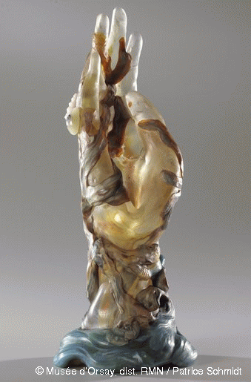
Hand with Seaweed an
Hand with Seaweed and Shells, 1904, Glass modelled under heat with inclusions of metallic oxides, veins, applications in low and high relief and wheel engraving, 33.4 x 13.4 cm, Musée d'Orsay
Doubtless the last work of crafted glass produced by the master from Nancy, this straight, upright hand represents the culmination of his technical mastery. Shaped under heat, the hand is decorated with polychromatic applications, some in high relief. It was exhibited Nancy in 1904 in a showcase entitled The Deep Sea.

Slide 14
