Slide 1
Our Classroom … then

Slide 2
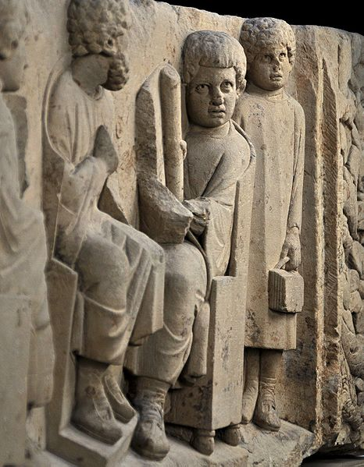
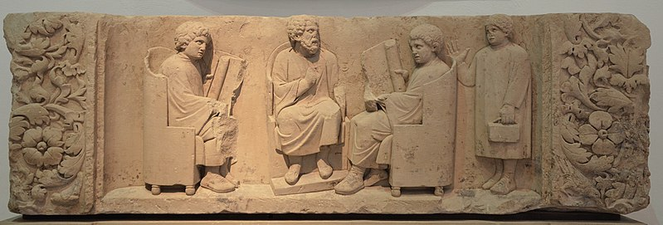
1st Slide
Funerary relief sculpture of a teacher with three “discipuli”, Gallo-Roman relief sculpture, 180–185 AD, sandstone, Rheinisches Landesmuseum, Trier, Germany

Slide 3
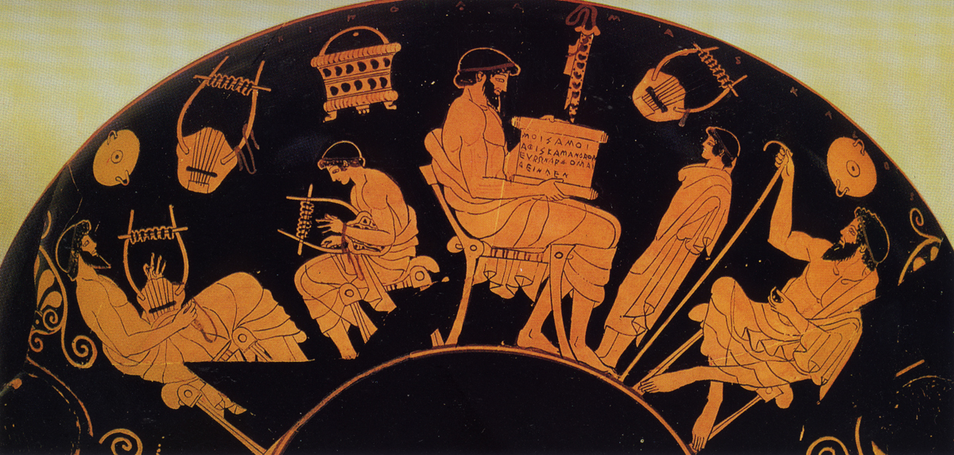
2nd Slide
School Scene A: lessons of music and reading between 3 bearded teachers and two young students, while representations of a basket, a pipes case, barbtions (musical stringed instruments) and cups hang above, Red Figure drinking Cup (Kylix), from Cerveteri, 480 BC, by the Douris painter, Antikensammlung, Staatliche Museen, Berlin, Germany

Slide 4
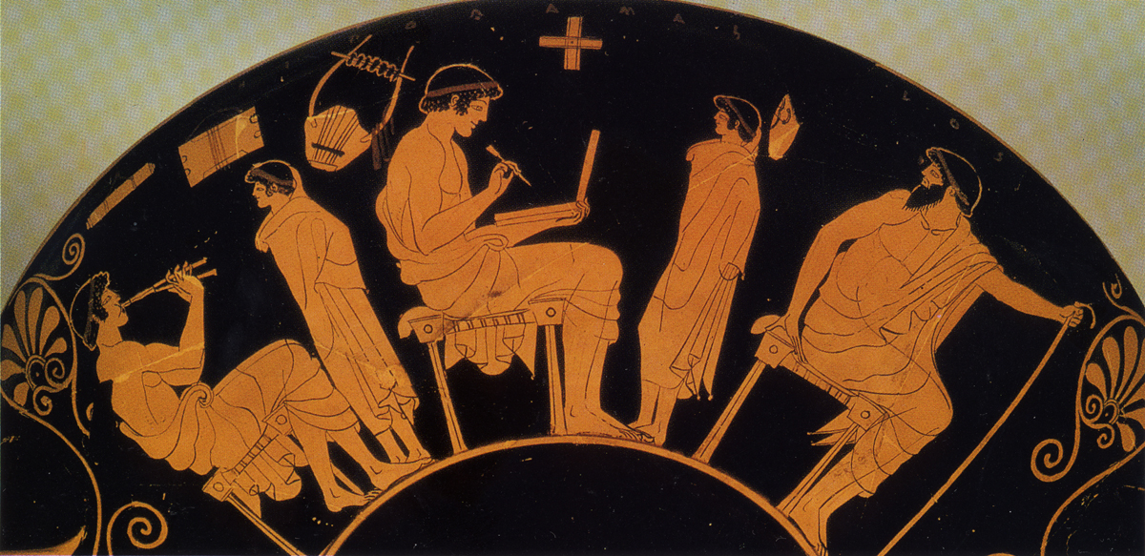
3rd Slide
School Scene B: lessons of music and writing between a Teacher, 2 older Students and 2 younger students, while representations of a pipes case, a barbtion (musical stringed instrument) and a writing case hang above, Red Figure drinking Cup (Kylix), from Cerveteri, 480 BC, by the Douris painter, Antikensammlung, Staatliche Museen, Berlin, Germany

Slide 5
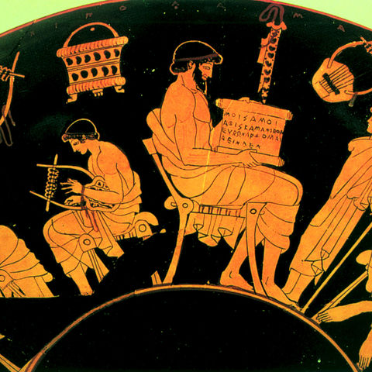
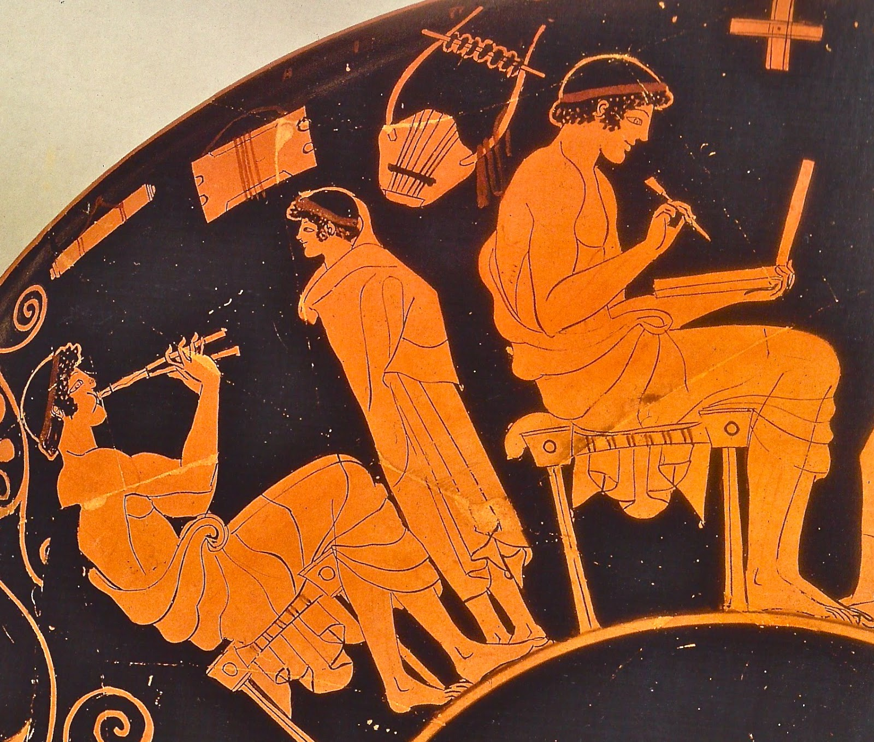

Slide 6
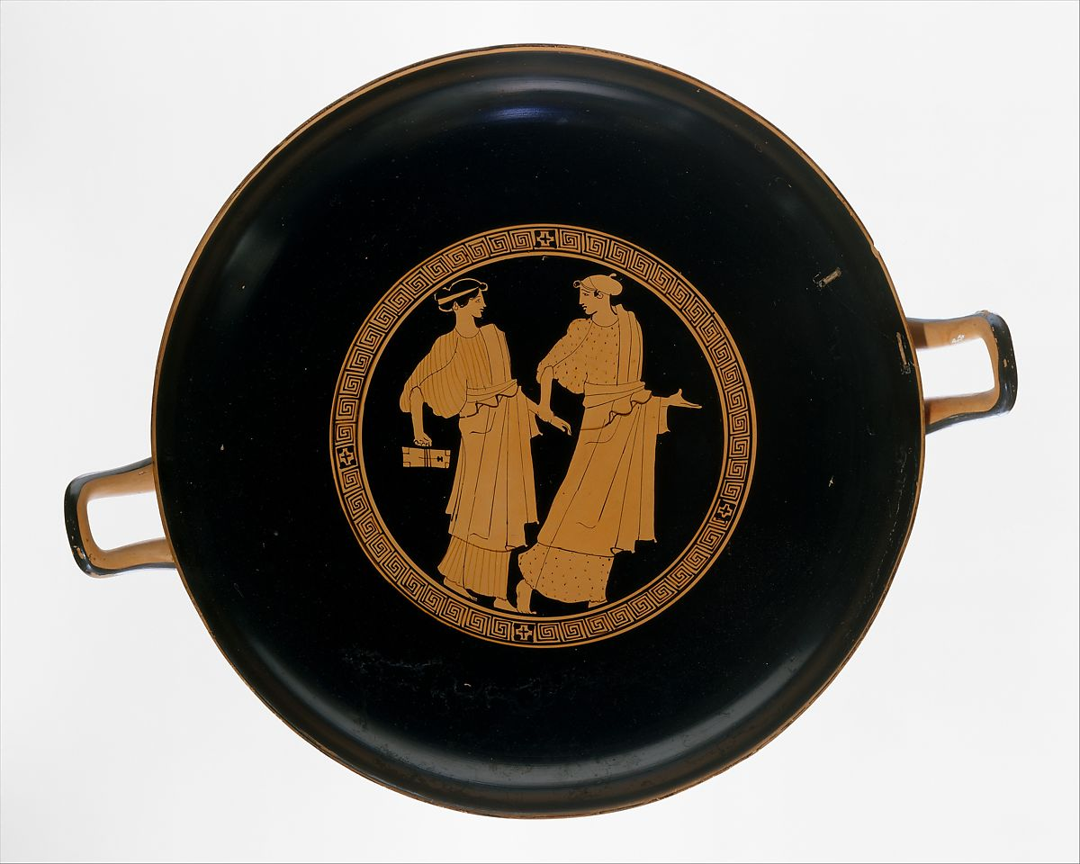
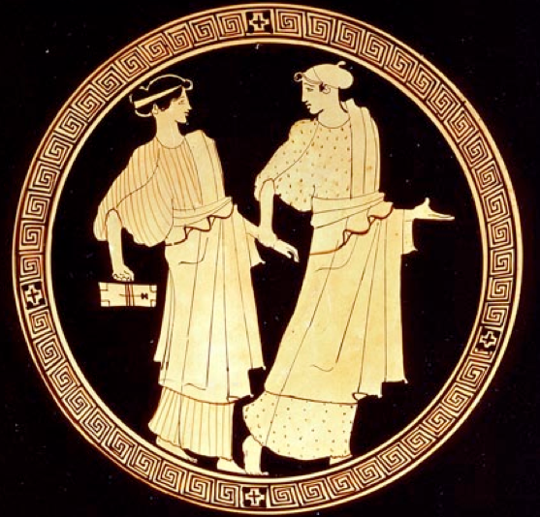
4th Slide
Kylix with two School Girls, Attic red-figure, attributed to the Painter of Bologna 417, ca. 460 BC, The MET

Slide 7
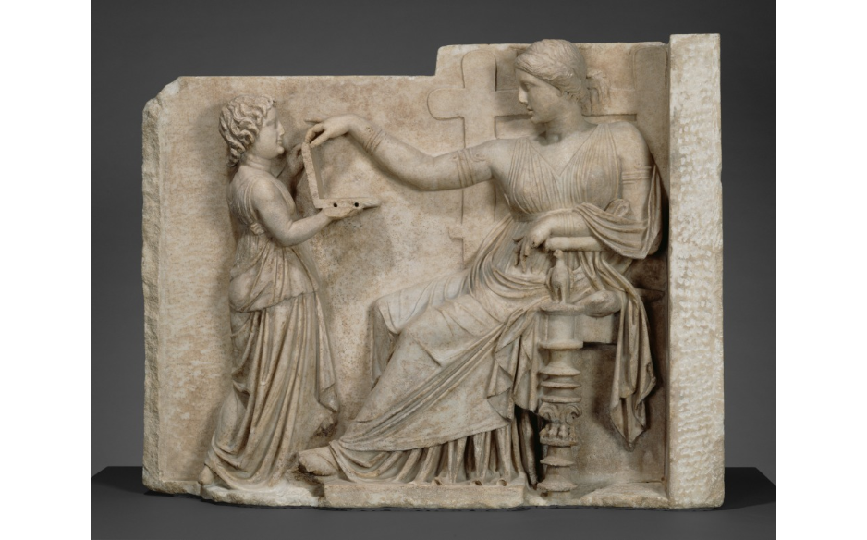
5th Slide
Grave Naiskos of an Enthroned Woman with an Attendant, 100 BC, Marble, 94.6 × 120.7 × 21.6 cm, the Getty Museum

Slide 8
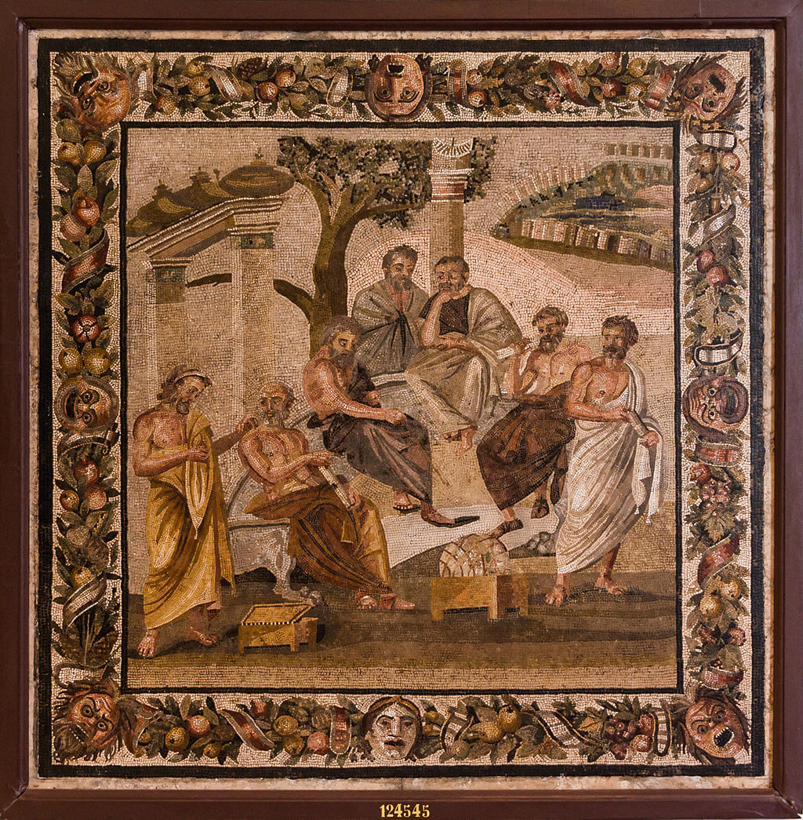
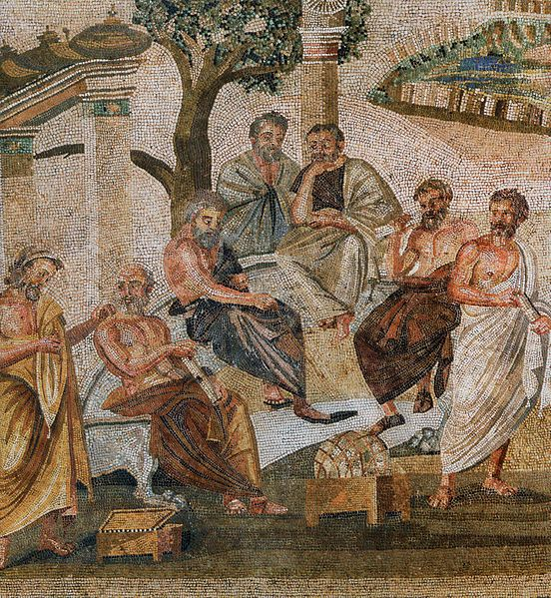
6th Slide
Plato’s Academy, Roman mosaic of the 1st century BC, originally from Pompeii, now at the Museo Nazionale Archeologico, Naples, Italy

Slide 9
Copyright for “Classroom” PP
1st Slide
Funerary relief sculpture of a teacher with three “discipuli”, Gallo-Roman relief sculpture, 180–185 AD, sandstone, Rheinisches Landesmuseum, Trier, Germany https://commons.wikimedia.org/wiki/File:Funerary_relief_found_in_Neumagen_near_Trier,_a_teacher_with_three_discipuli,_around_180-185_AD,_Rheinisches_Landesmuseum_Trier,_Germany_(29656302165).jpg
Public Domain https://vici.org/image.php?id=7242
Public Domain -
GNU Free Documentation License
2nd and 3rd Slides
School Scene A: lessons of music and reading between 3 bearded teachers and two young students, while representations of a basket, a pipes case, barbtions (musical stringed instruments) and cups hang above, Red Figure drinking Cup (Kylix), from Cerveteri, 480 BC, by the Douris painter, Antikensammlung, Staatliche Museen, Berlin, Germany https://www.beazley.ox.ac.uk/images/pottery/painters/keypieces/tiverios/21-p156top-medium.jpg
Public Domain
4th Slide
Kylix with two School Girls, Attic red-figure, attributed to the Painter of Bologna 417, ca. 460 BC, The MET https://www.metmuseum.org/art/collection/search/247330
Public Domain
5th Slide
Grave Naiskos of an Enthroned Woman with an Attendant, 100 BC, Marble, 94.6 × 120.7 × 21.6 cm, the Getty Museum http://www.getty.edu/art/collection/objects/7009/unknown-maker-grave-naiskos-of-an-enthroned-woman-with-an-attendant-east-greek-about-100-bc/
Digital image courtesy of the Getty's Open Content Program.
6th Slide
Plato’s Academy, Roman mosaic of the 1st century BC, originally from Pompeii, now at the Museo Nazionale Archeologico, Naples, Italy https://commons.wikimedia.org/w/index.php?search=Plato%27s+Academy+Pompeii&title=Special%3ASearch&go=Go&ns0=1&ns6=1&ns12=1&ns14=1&ns100=1&ns106=1
Public Domain

