Slide 1
Villa of the Mosaic Columns
1st century AD, Pompeii

Slide 2
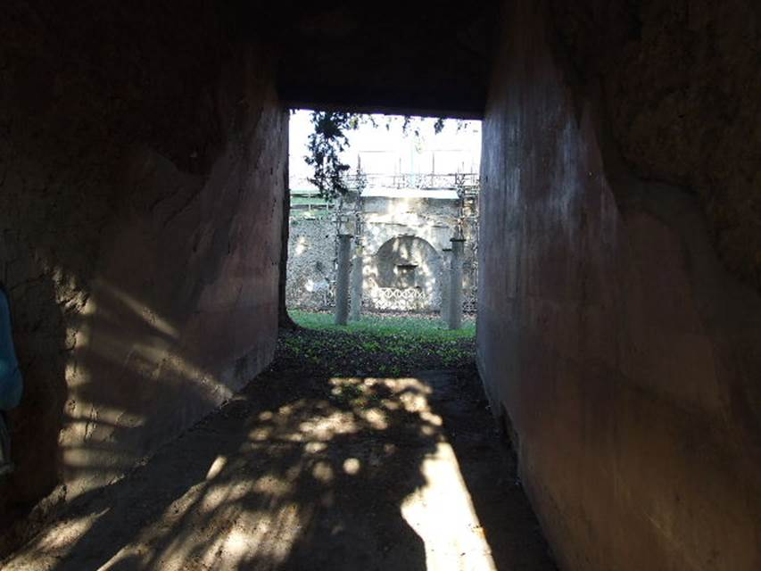
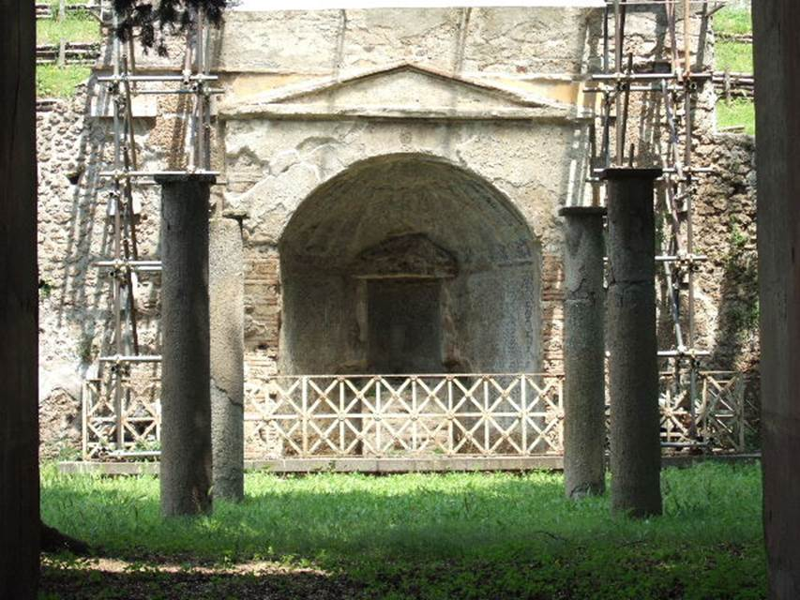
The Villa of the Mosaic Columns’ Pompeiian address is on the northern side of Via delle Tombe. Either way you choose to enter this interesting Villa (Entrance A or B)… you enter a Garden. I like to choose Entrance A because the Garden is bigger, it has a Nymphaeum and a pergola supported on four magnificent Mosaic Columns. It is thanks to these unique mosaic columns that the Villa, justifiably, took its name.

Slide 3
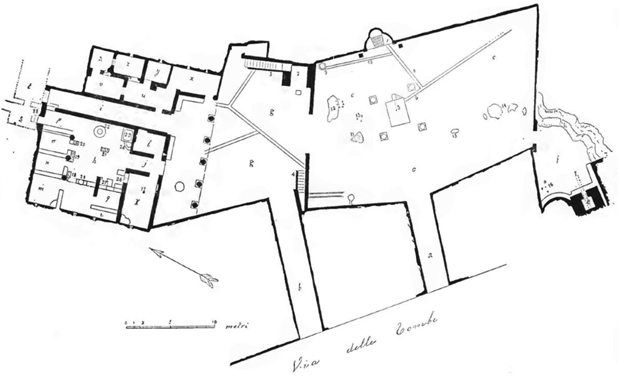

Slide 4
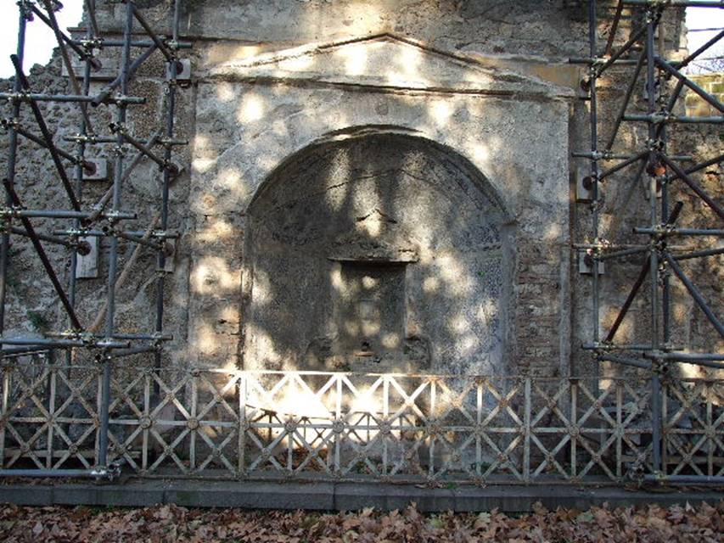
The Villa’s Nymphaeum decorated with Mosaics, unfortunately substantially damaged.

Slide 5
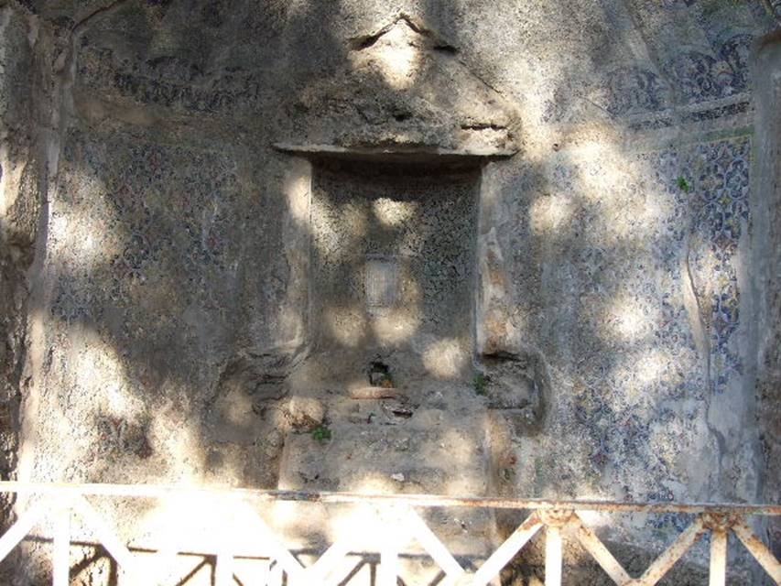
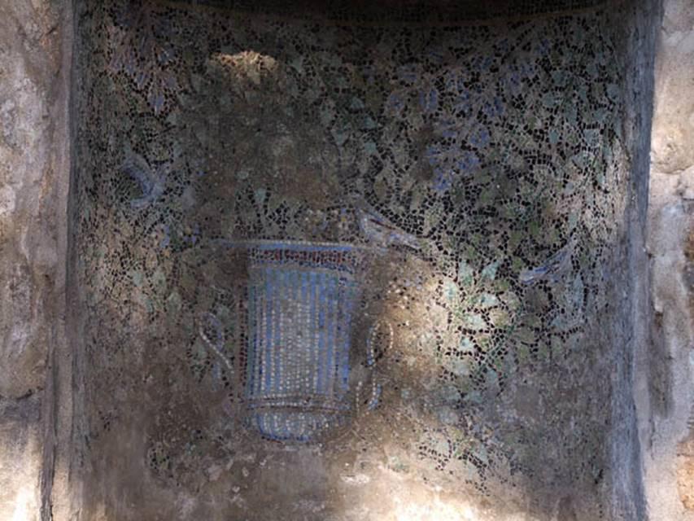

Slide 6
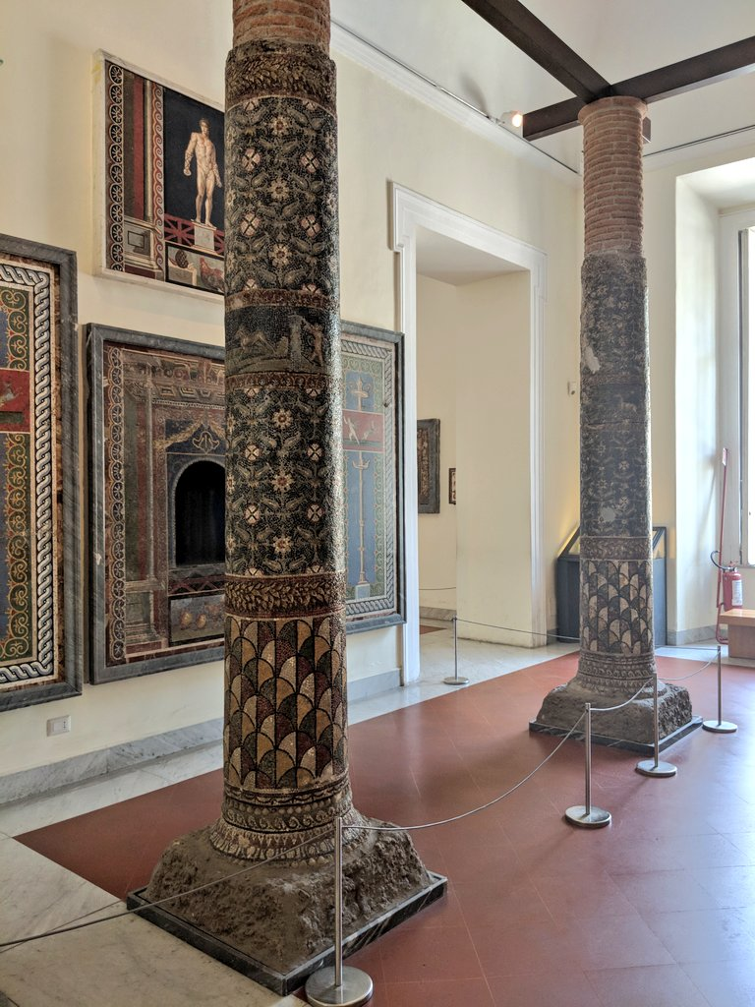
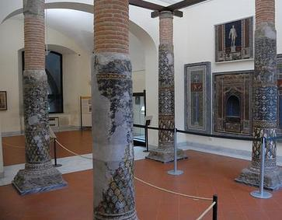
The columns were covered in colourful mosaics with successive bands of geometric, floral and figurative designs. Photo courtesy of Carlo Raso

Slide 7
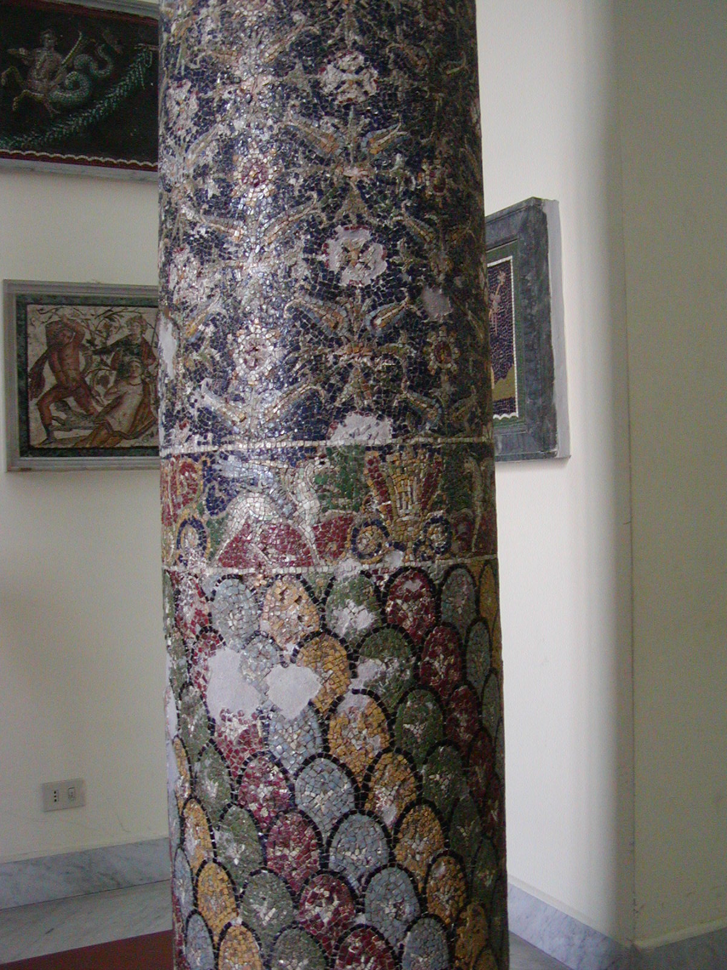
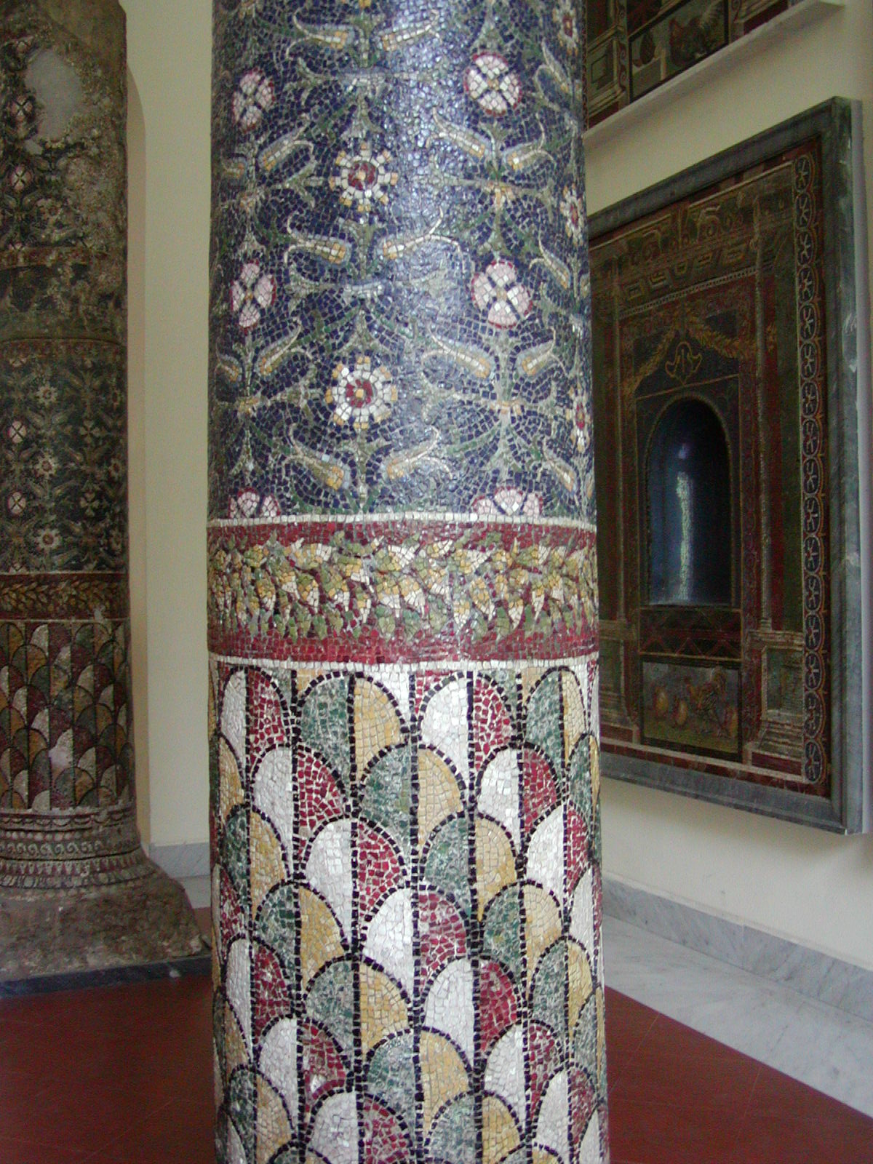
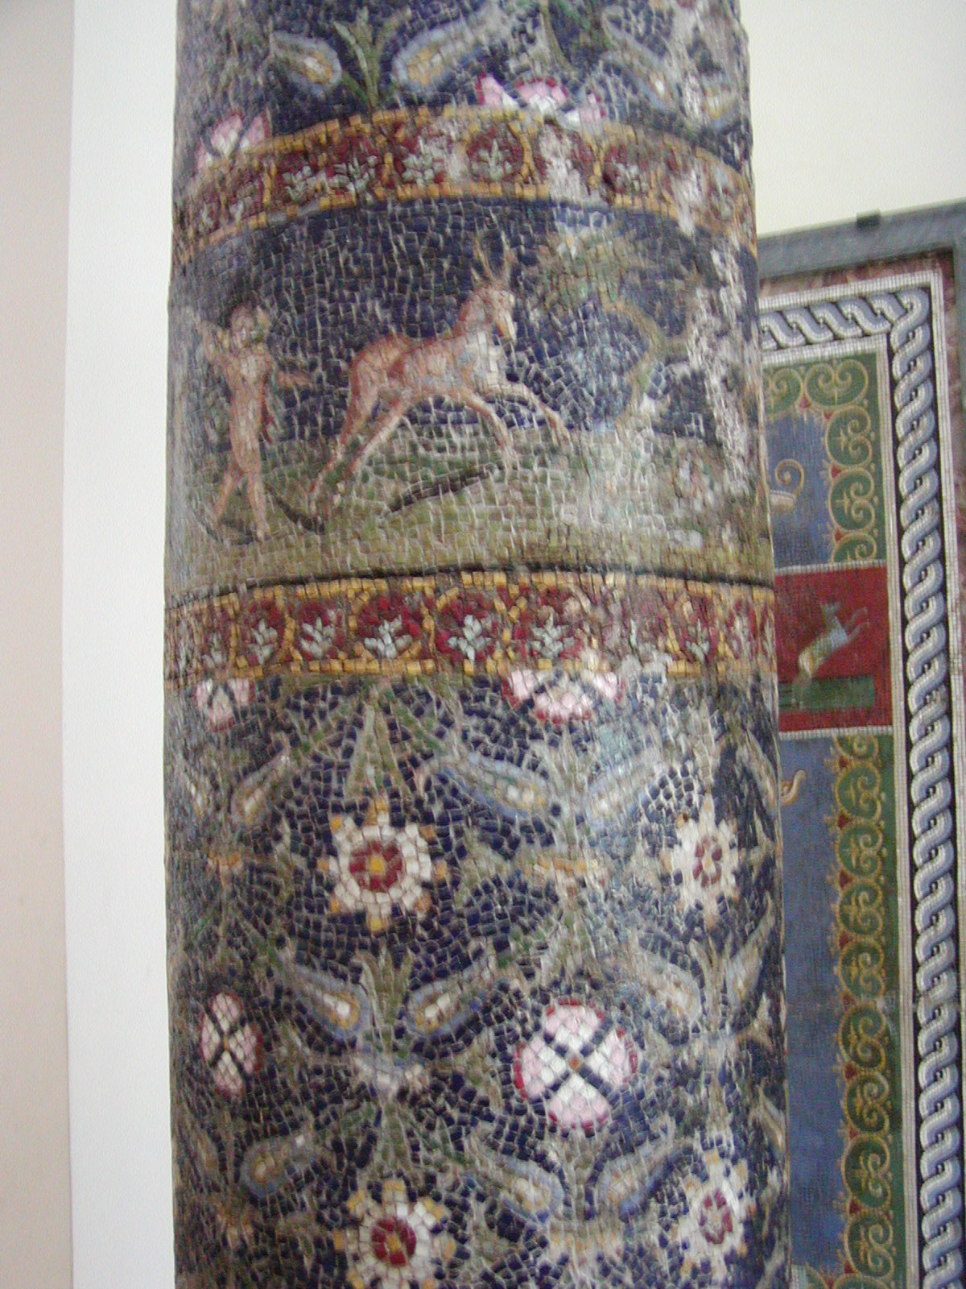
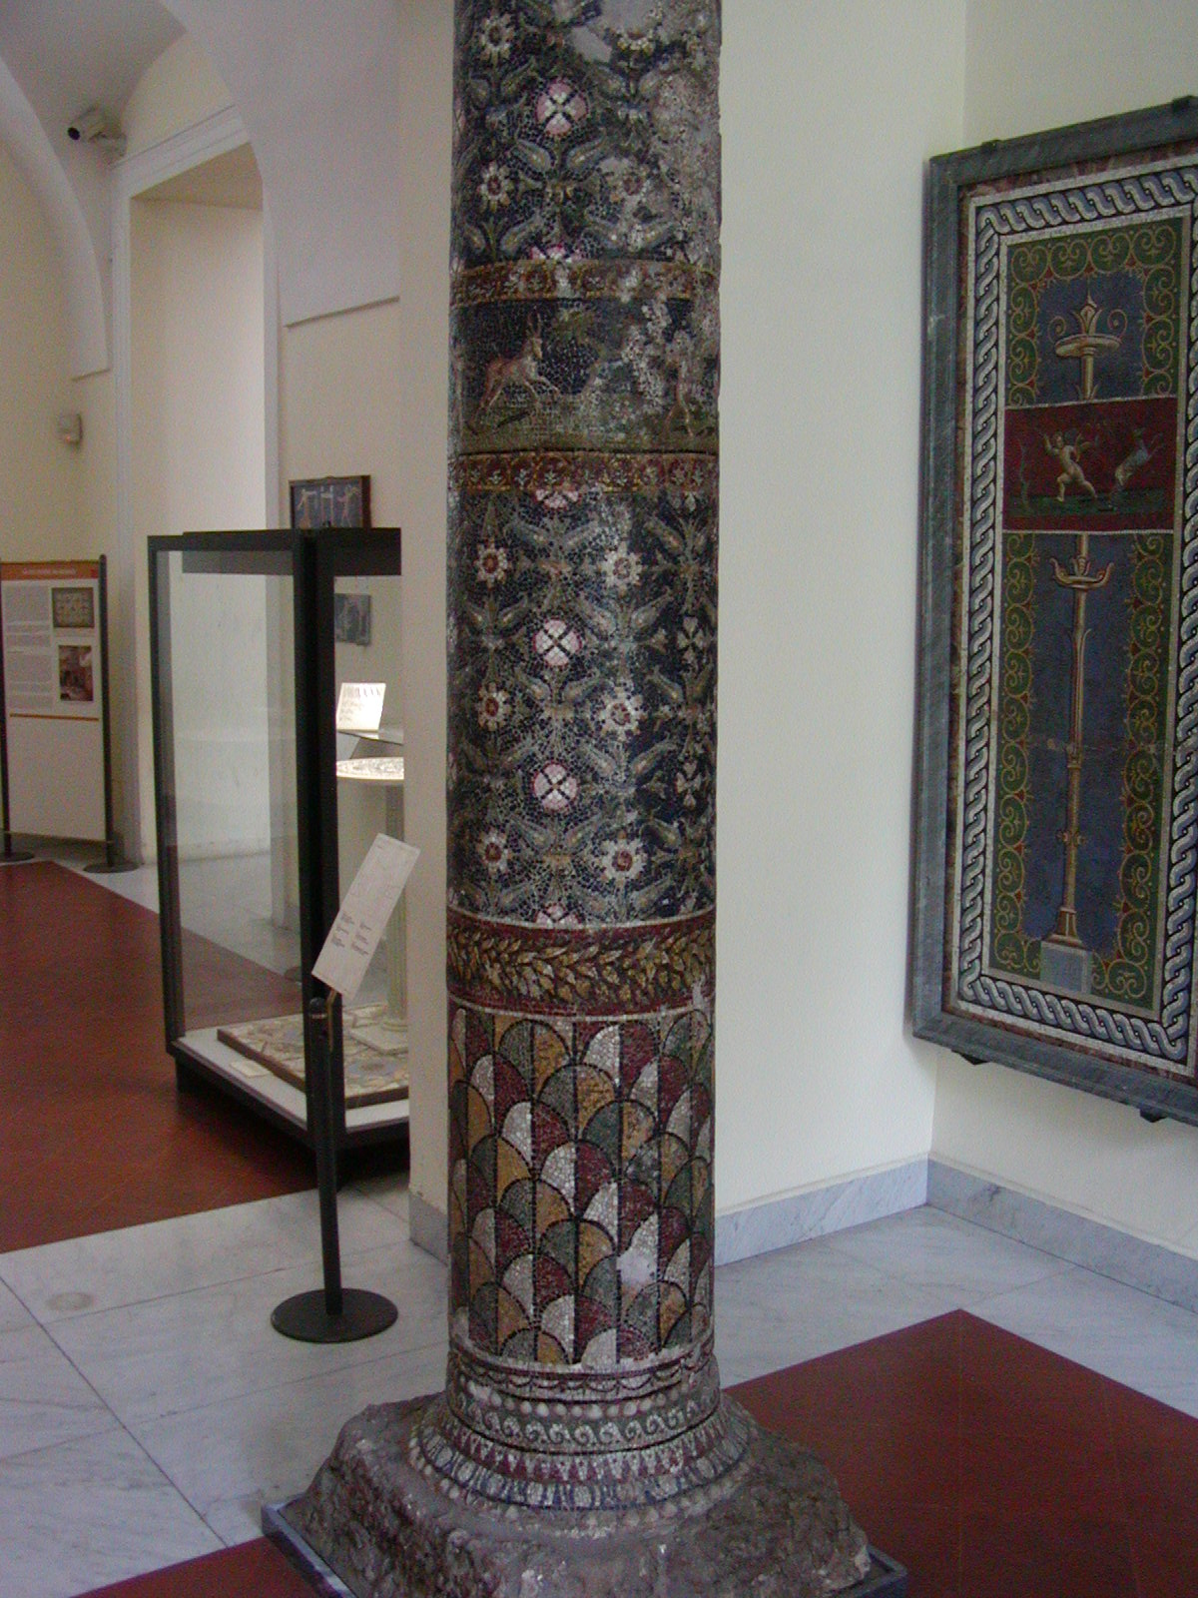
The Villa’s Columns are magnificent!!!
Photo credits: https://sights.seindal.dk/italy/campania/pompeii/villa-of-the-mosaic-columns/

Slide 8
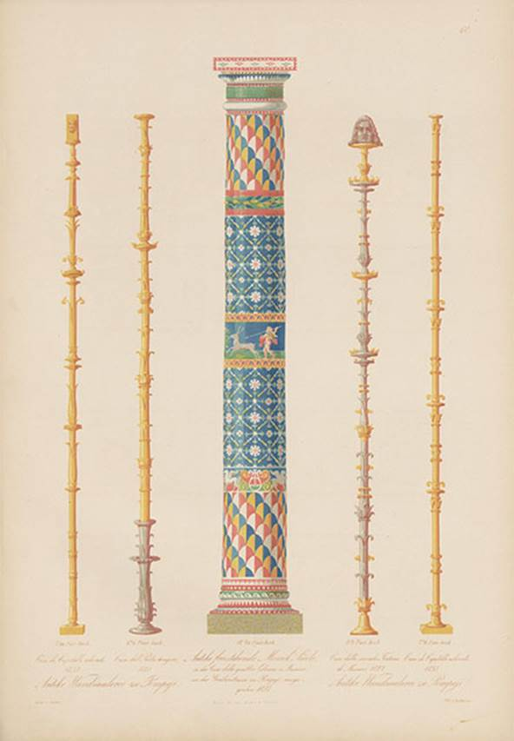
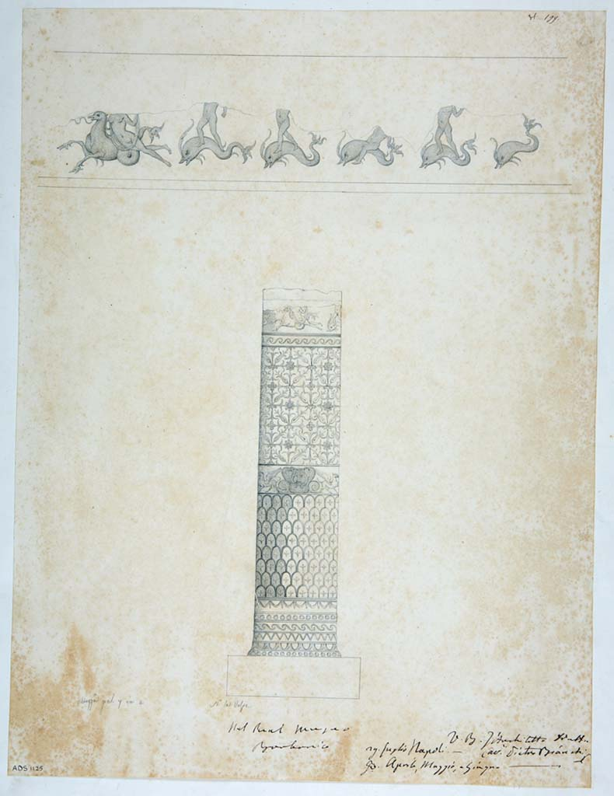
Villa of the Mosaic Columns
1870 and of the frieze painting by W. Zahn of one of the mosaic columns
1842 drawing by N. La Volpe of the mosaic columns and marine-style frieze composed of a Nereid brought by a sea monster and tritons on dolphins. The Mosaic zones of the Column depict colourful scales, a frieze with heraldic animals, floral motifs, and frieze with a marine group.
Photo © ICCD. http://www.catalogo.beniculturali.it

Slide 9
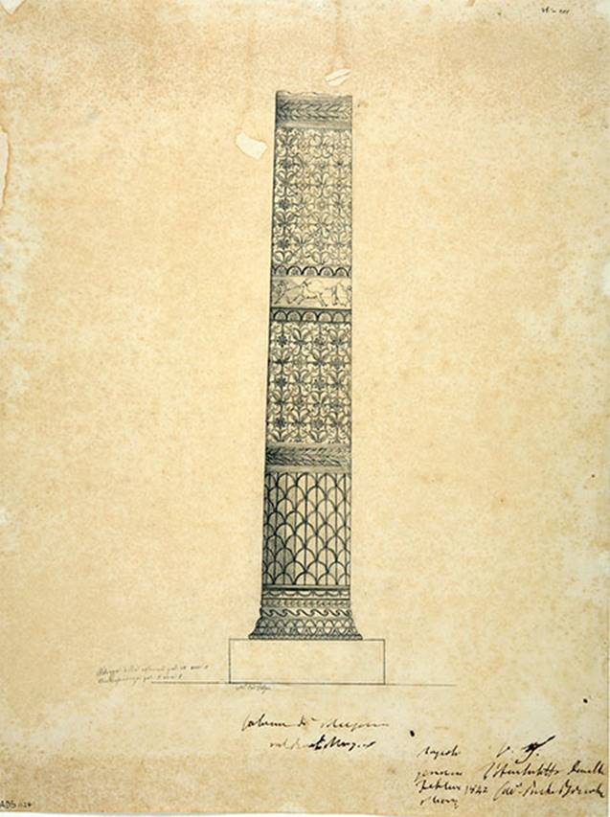
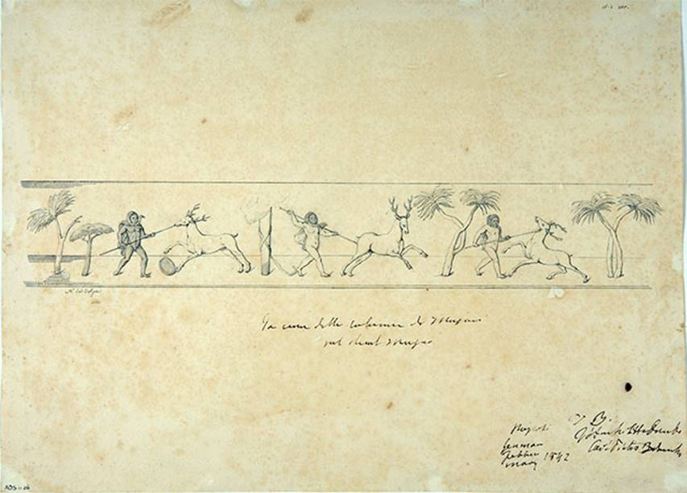
Villa of the Mosaic Columns
1842 drawing by N. La Volpe of the frieze on one of the mosaic columns
The drawing depicts a column decorated with mosaic motifs with scales in the lower third, a headband with garland of leaves, floral motifs in the middle third, and a frieze with cupids hunting, and floral motifs in the upper third topped with a headband of a garland of leaves.
Below, the drawing depicting a hunting frieze with three "Retiarii" Cupids, each of which, armed with a lance, is intent on striking a deer.
Photo © ICCD. http://www.catalogo.beniculturali.it

Slide 10
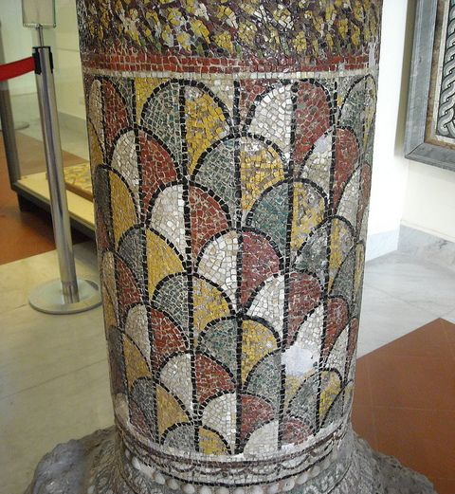
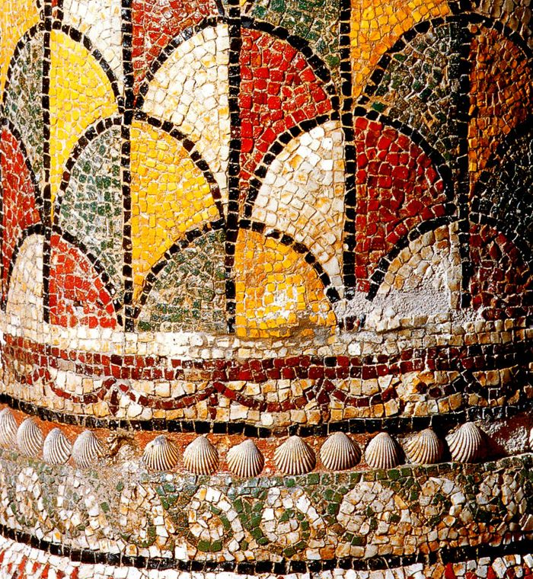

Slide 11
Villa of the Mosaic Columns
1st century AD, Pompeii
The Blue Glass Vase

Slide 12
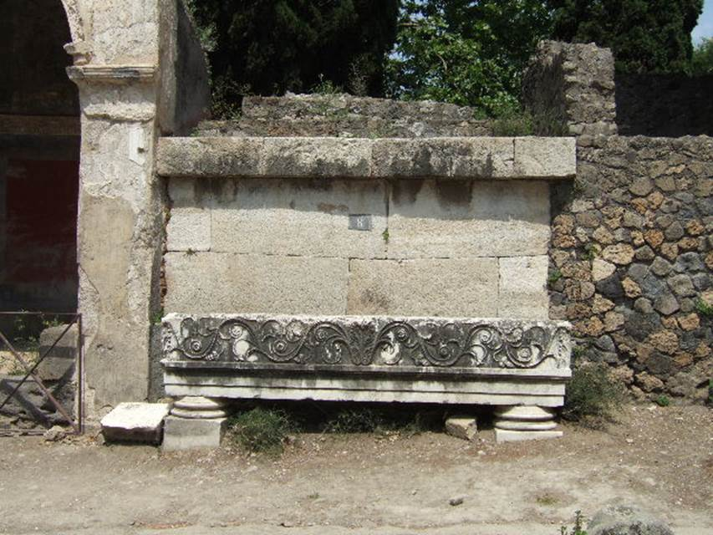
An interesting discovery lays at the Villa’s south/east side where, within a gated enclosure, a Tomb and a unique Blue and White Glass Vase were discovered.

Slide 13
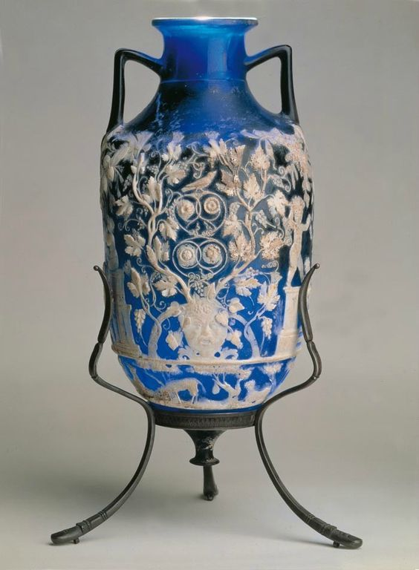
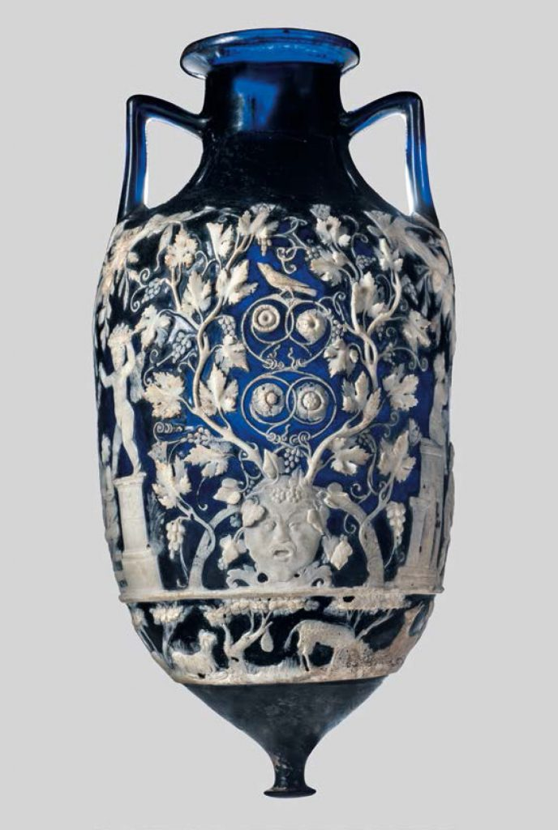
The Blue Glass Vase, 1st century AD, Naples Archaeological Museum

Slide 14
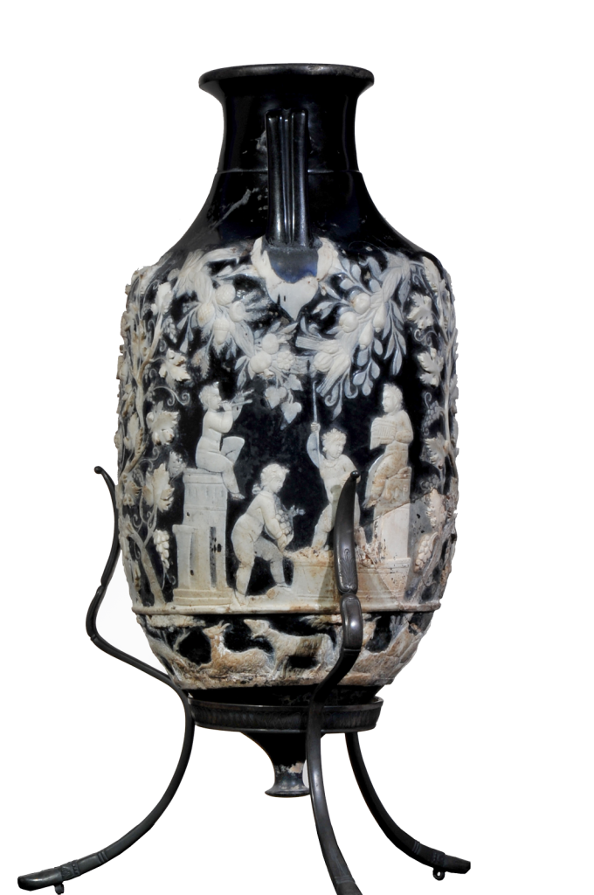
The Funeral enclosure of the Villa of the Mosaic Columns, 1st century AD, Pompeii According to Jashemski – “Since this was the only tomb that had a door leading from the tomb chamber into the garden, and since the only entrance to the garden was from the villa of the Mosaic Columns, it was obvious that the tomb and its garden belonged to this villa.”

Slide 15
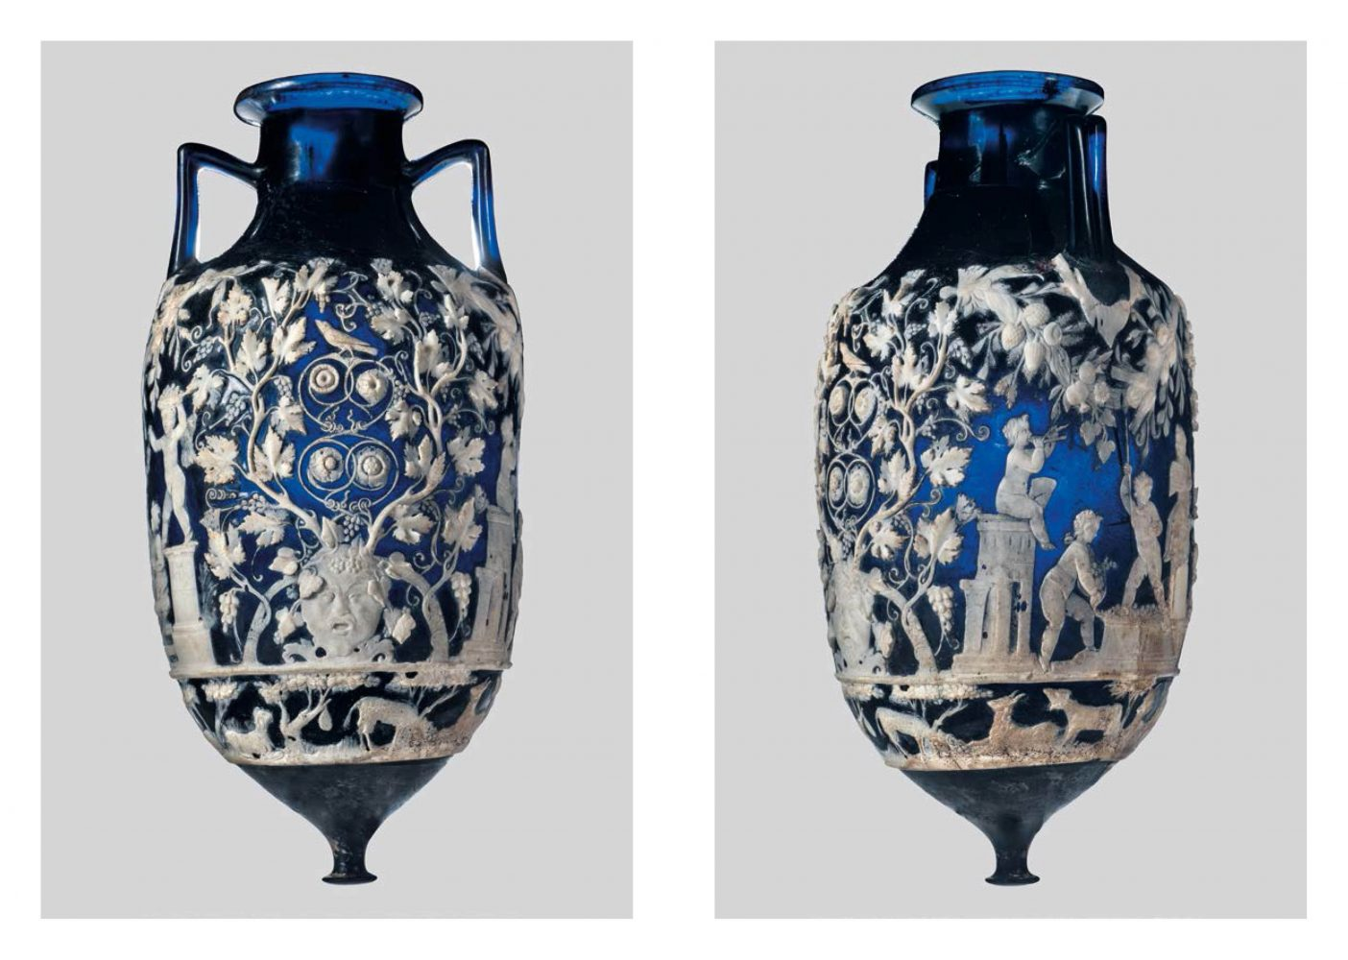

Slide 16
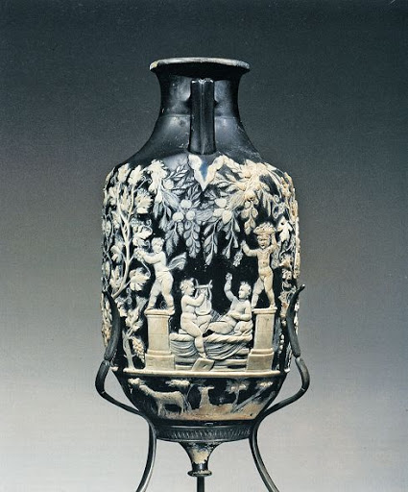
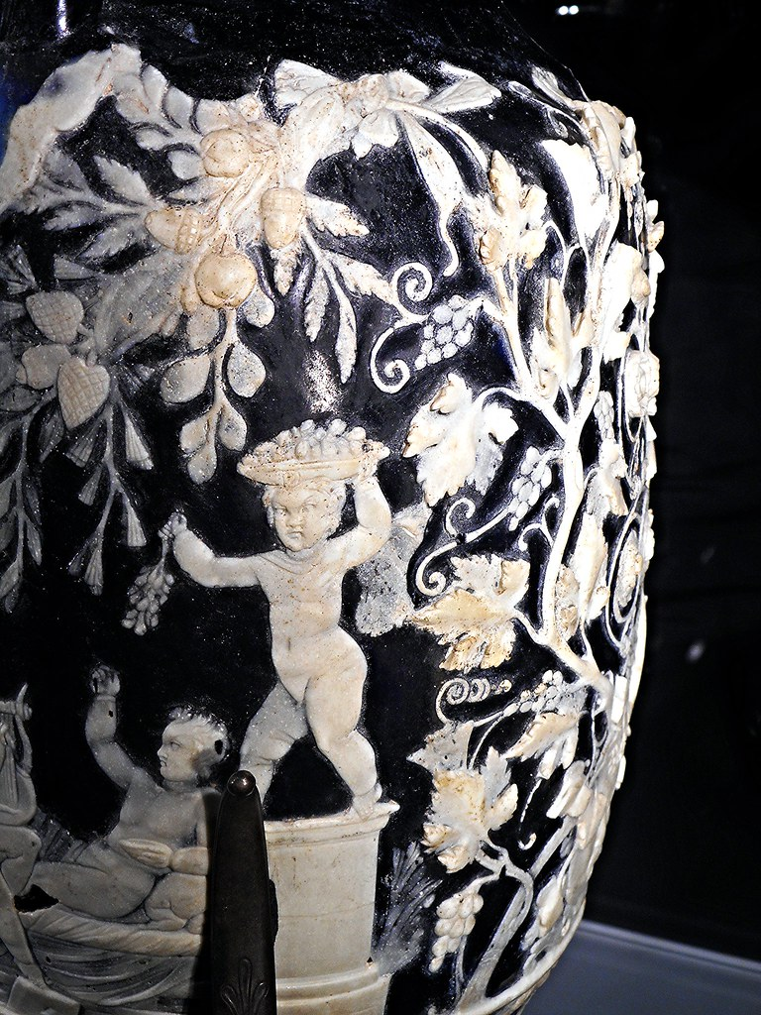

Slide 17
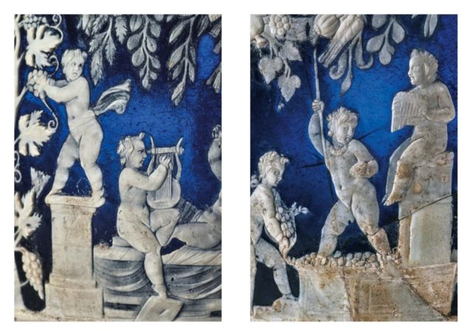

Slide 18
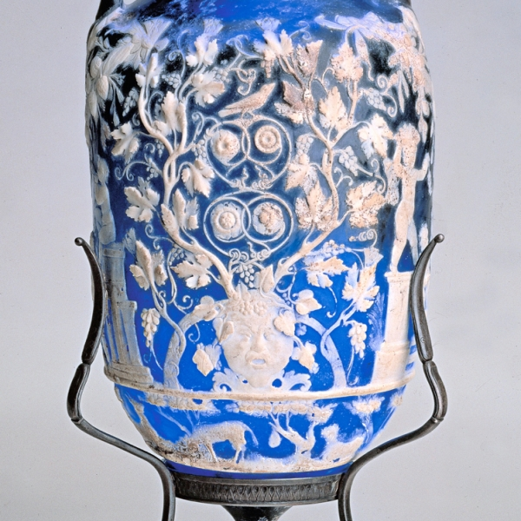

Slide 19
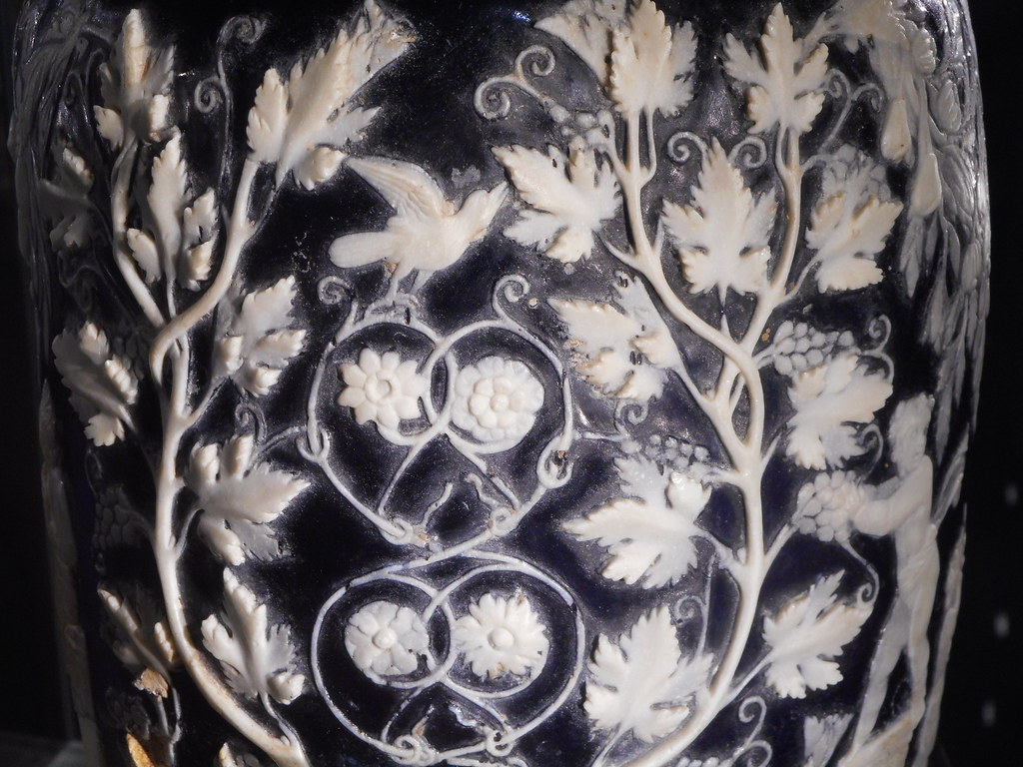

Slide 20
I LOVE POMPEII

