Slide 1
Torre Aquila
Castello del Buonconsiglio
Trento, Italy
The Months of
August and September

Slide 2
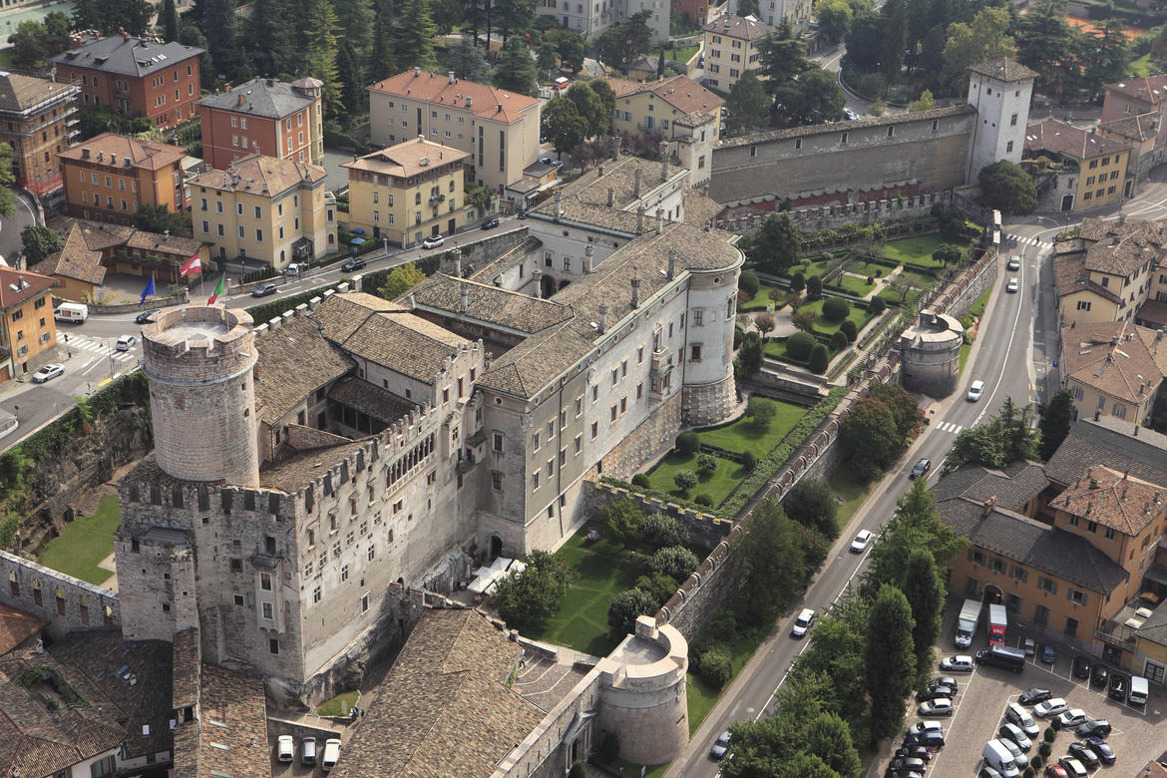
Castello del Buonconsiglio,
Trento,
Italy

Slide 3
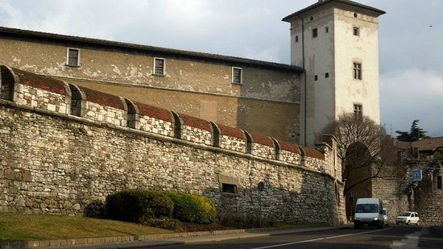
Torre Aquila, Castello del Buonconsiglio, Trento, Italy

Slide 4
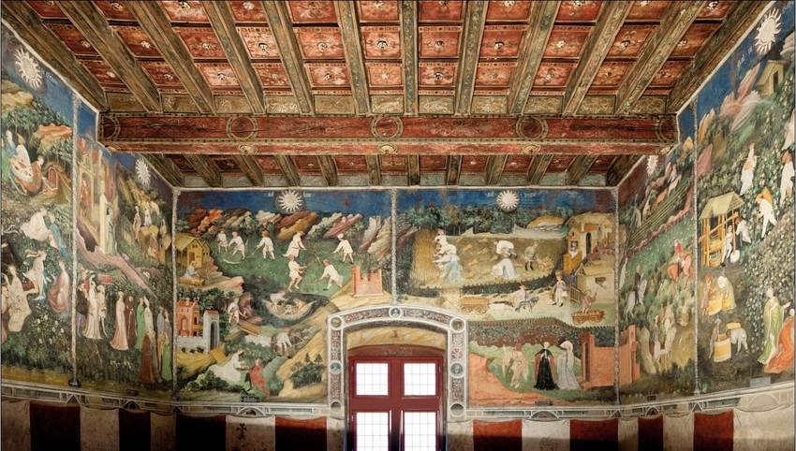
Cycle of the Twelve Months – Torre Aquila

Slide 5
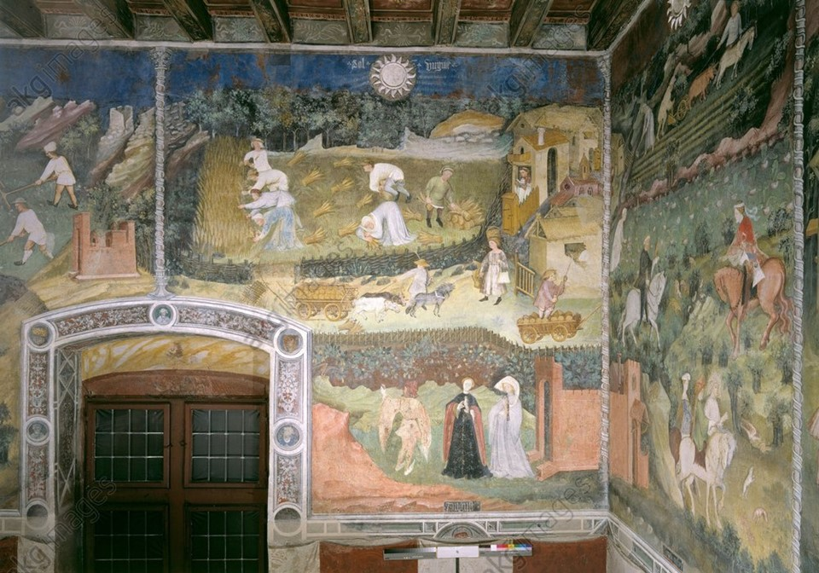
Cycle of the Twelve Months – August and September - Torre Aquila

Slide 6
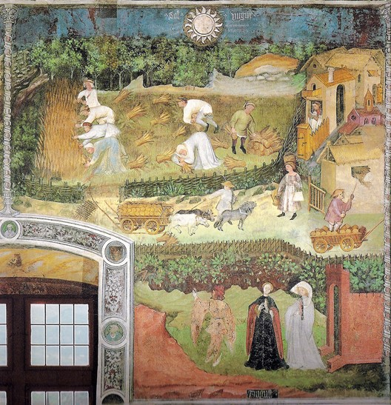
The Month of August, late 14th century-latest 1407, possibly by Maestro Venceslao, fresco, Torre Aquila

Slide 7
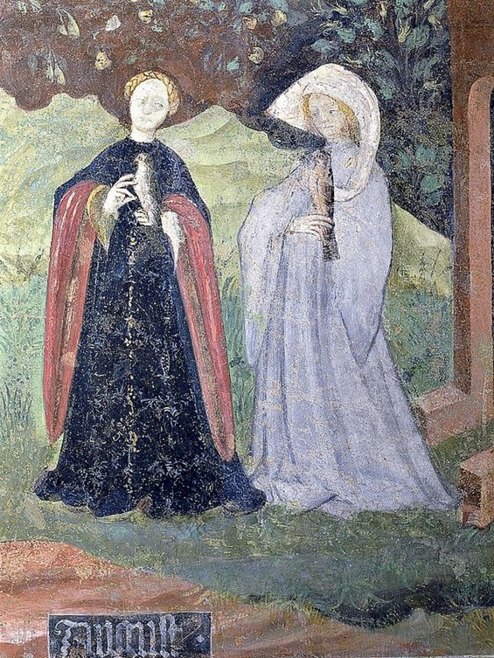
The fresco depicts two elegant ladies, one dressed in light blue, the other in dark blue… and a gentleman holding a long stick, ready to start hunting!

Slide 8
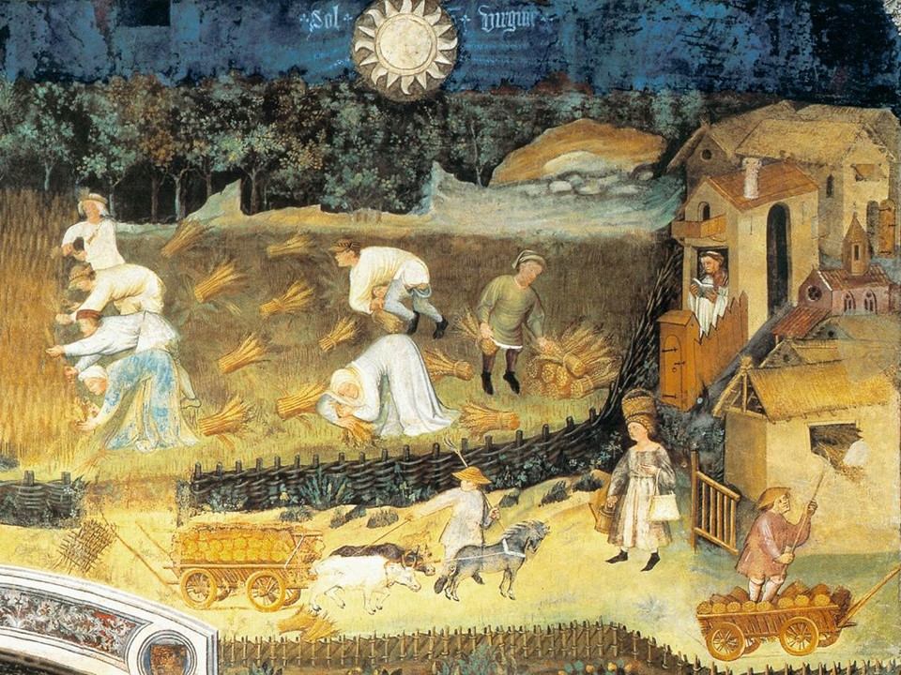
Maestro Venceslao dedicates the biggest part of the August composition to the hard-working peasants of Trento

Slide 9
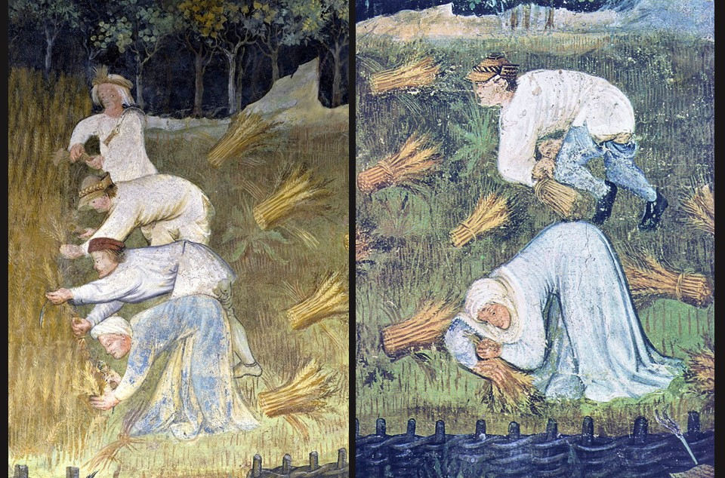

Slide 10
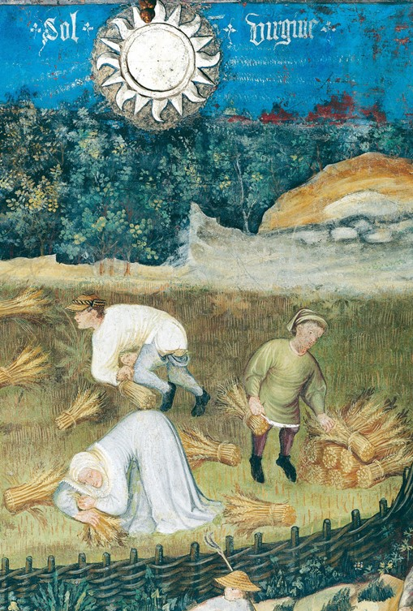
It is harvest time, the landscape is turned to golden yellow and both men and women work hard, bending under the blazing sun, to scythe the crops, collect the ears, tie them in sheaves and arrange them in stacks.

Slide 11
Cycle of the Twelve Months – August and September - Torre Aquila

Slide 12
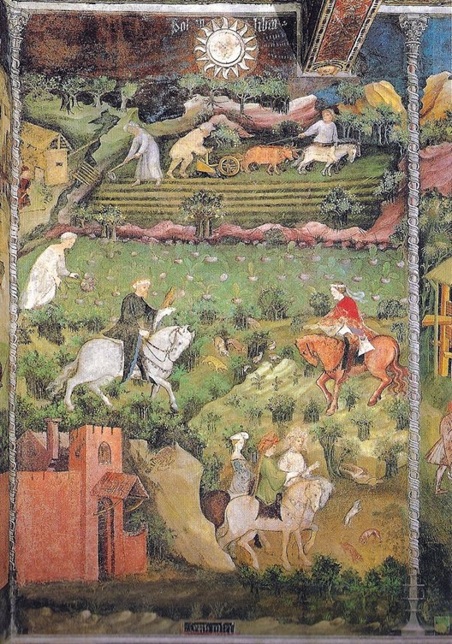
The Month of September, late 14th century-latest 1407, possibly by Maestro Venceslao, fresco, Torre Aquila

Slide 13
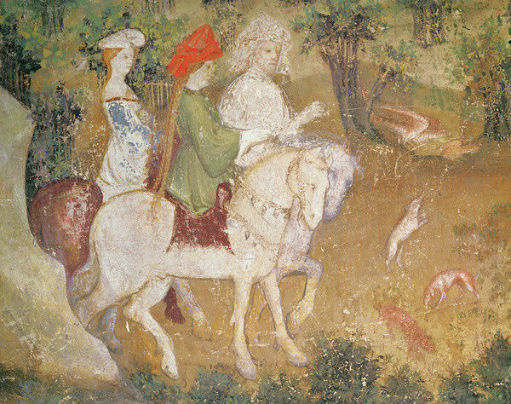
The lower part of the composition is entirely devoted to the pleasures and amusements of courtly society.

Slide 14
