Slide 1
Apollo
and
Daphne

Slide 2
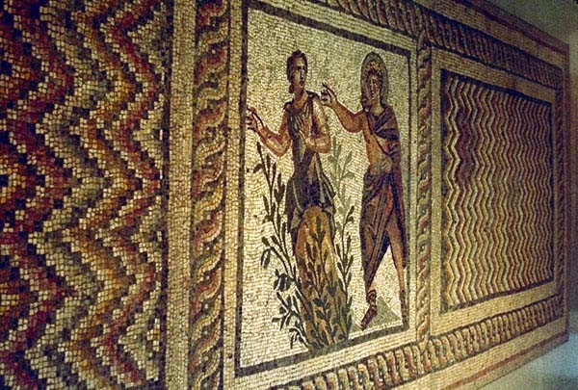
Apollo and Daphne, 250-75 AD, mosaic, from the House of Menander in Daphne, Antakya Archaeological Museum, Antioch

Slide 3
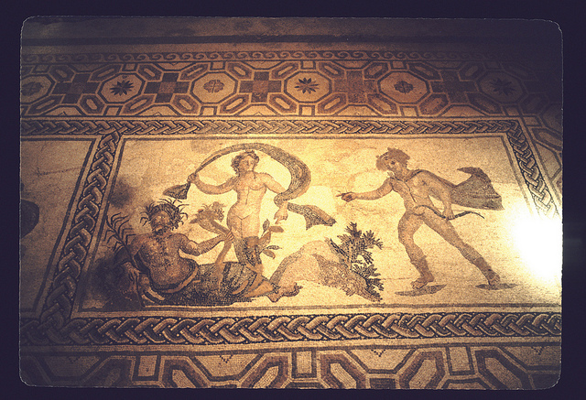
Apollo and Daphne, 2nd cent. AD, mosaic, from the House of Dionysos in Paphos, Cyprus

Slide 4
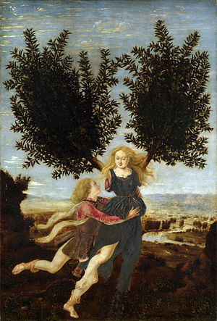
Piero del Pollaiuolo, about 1441 - before 1496
Apollo and Daphne, 1470-1480, oil on wood, 29.5 x 20 cm, The National Gallery, London

Slide 5
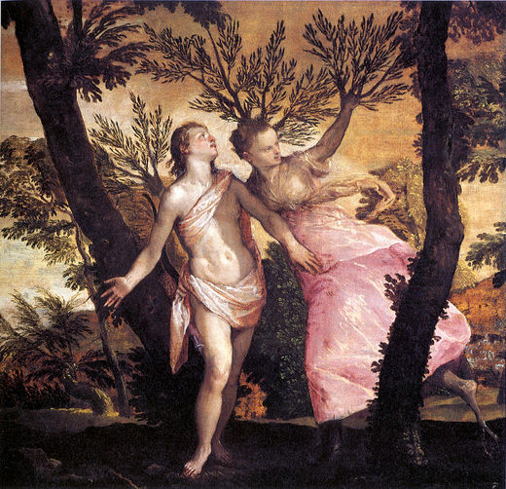
Paolo Veronese, 1528-1588 Apollo and Daphne, 1575, Oil on canvas, 109 x 113 cm, San Diego Museum of Art, San Diego

Slide 6
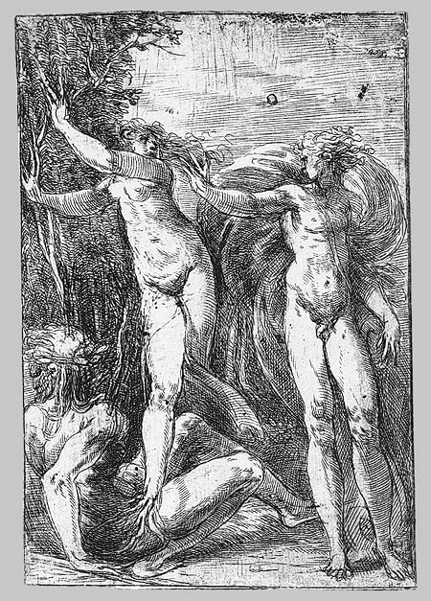
Andrea Schiavone, c. 1510/15–1563
Apollo and Daphne, ca. 1538–40, Etching,
14.6 x 9.9 cm
The MET, New York

Slide 7
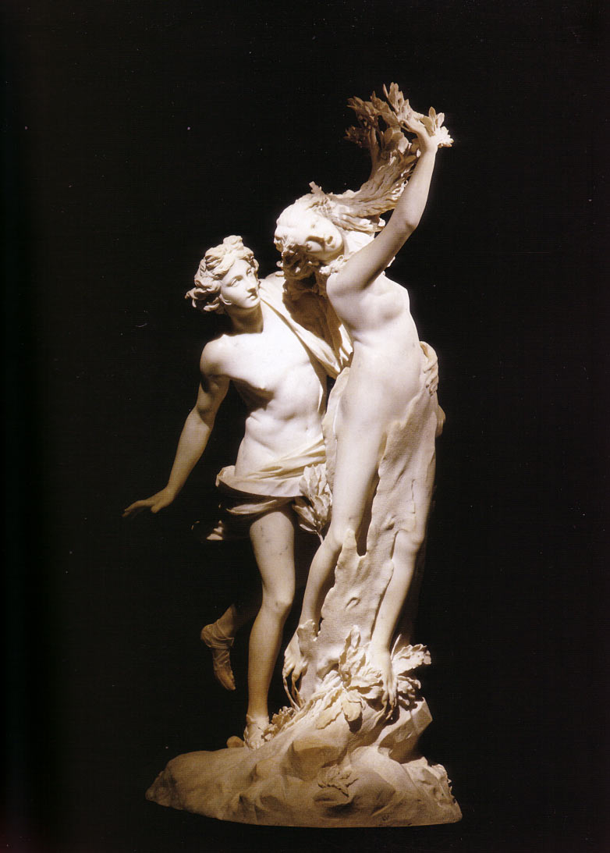
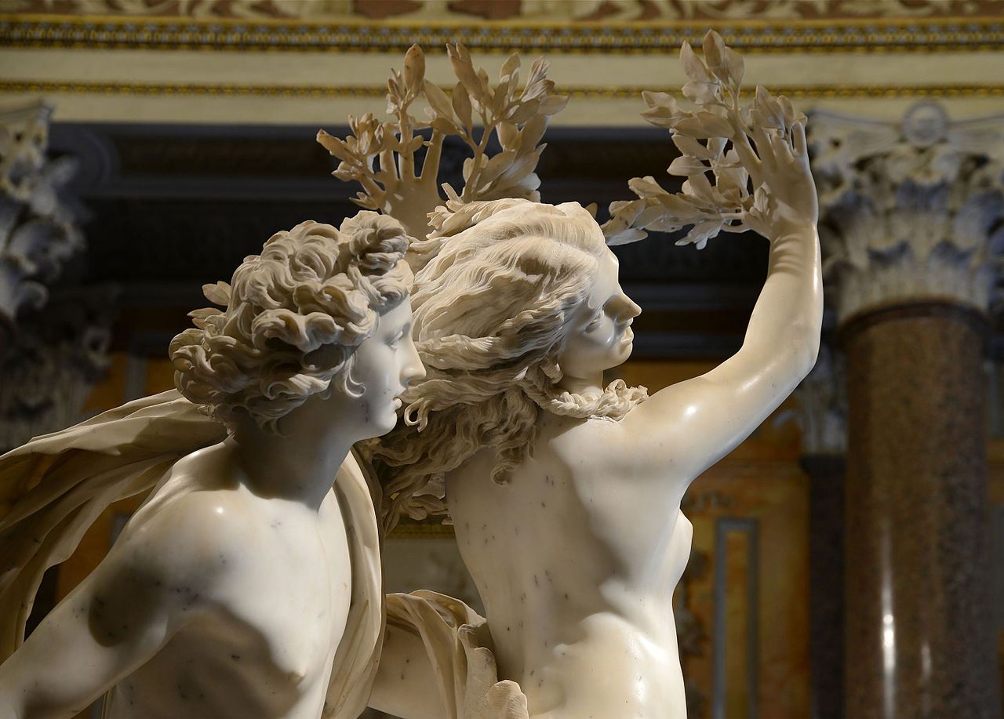
Gian Lorenzo Bernini, 1598-1680
Apollo and Daphne, 1622-25, Carrara marble, height 243 cm, Galleria Borghese, Rome

Slide 8
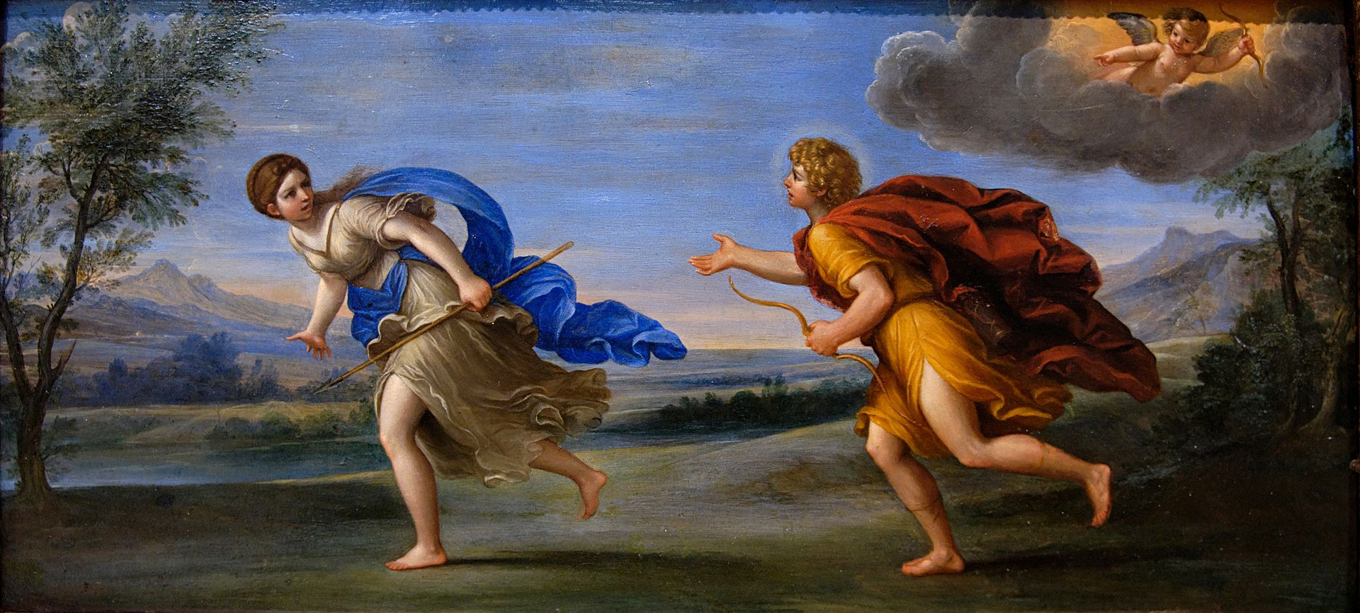
Francesco Albani, 1578-1660
Apollo and Daphne, 1615-20, oil on canvas, 17,5 x 35,5 cm, the Louvre, Paris

Slide 9
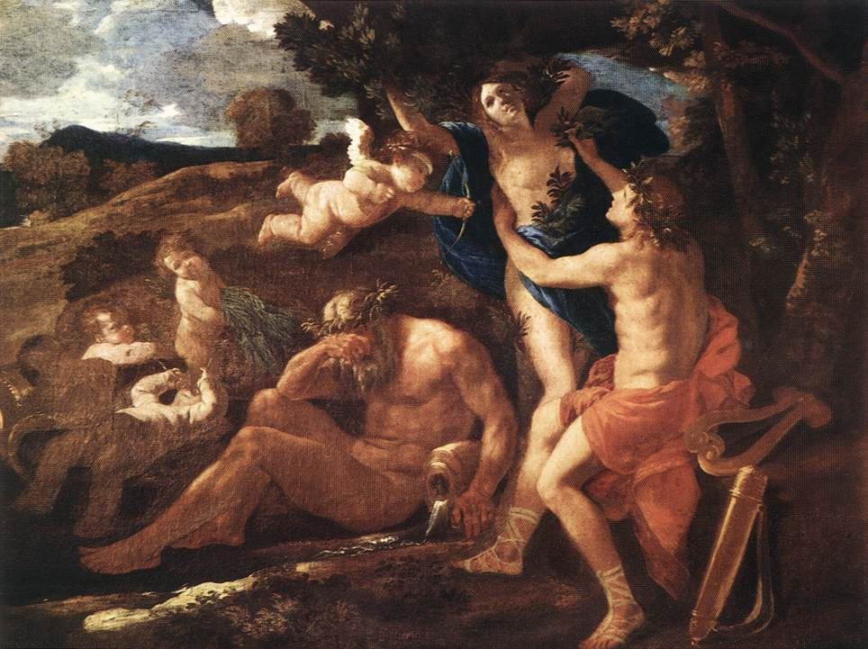
Nicolas Poussin, 1594 - 1665
Apollo and Daphne, 1625, oil on canvas,97x131 cm, Alte Pinakothek, Munich

Slide 10
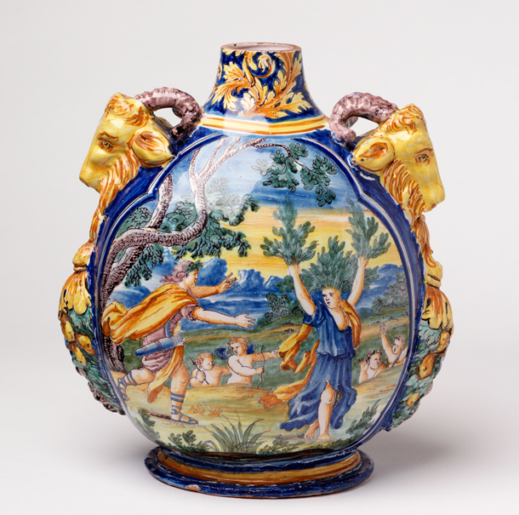
Apollo and Daphne,
1600-1650,
Ceramic Pilgrim bottle from Nevers in France,
V&A Museum, London

Slide 11
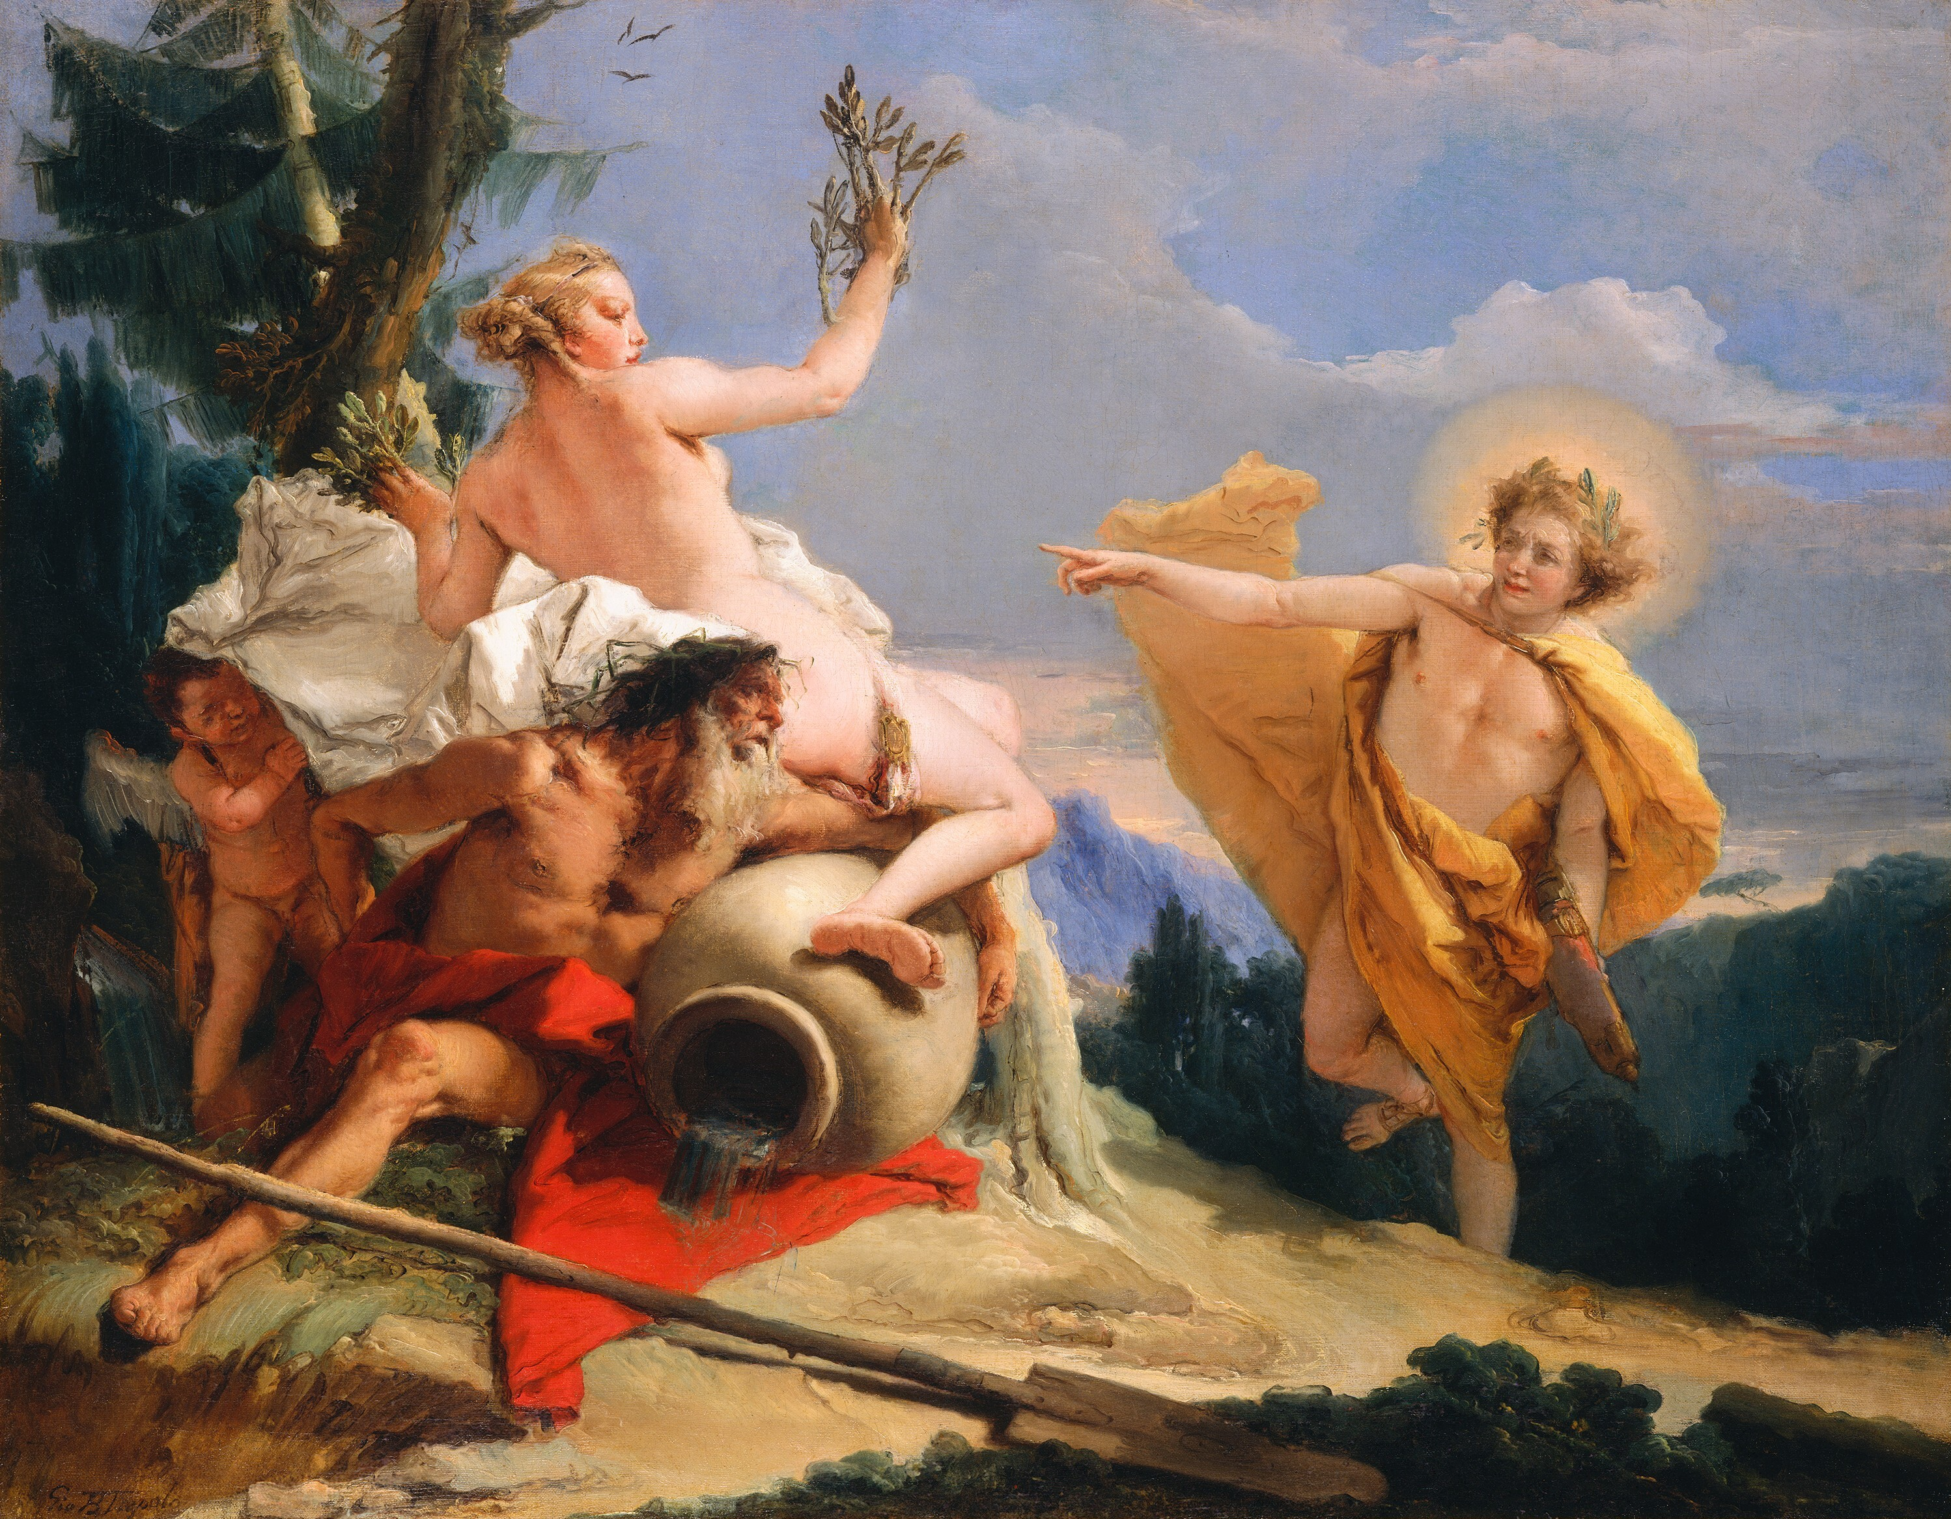
Giovanni Battista Tiepolo, 1696-1770
Apollo Pursuing Daphne, 1755-60, oil on canvas, 68.5 x 87 cm, NGA, Washington DC

Slide 12
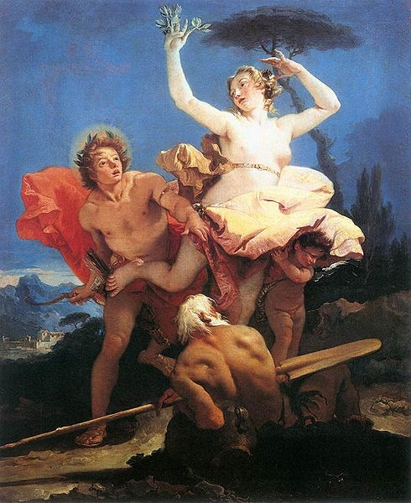
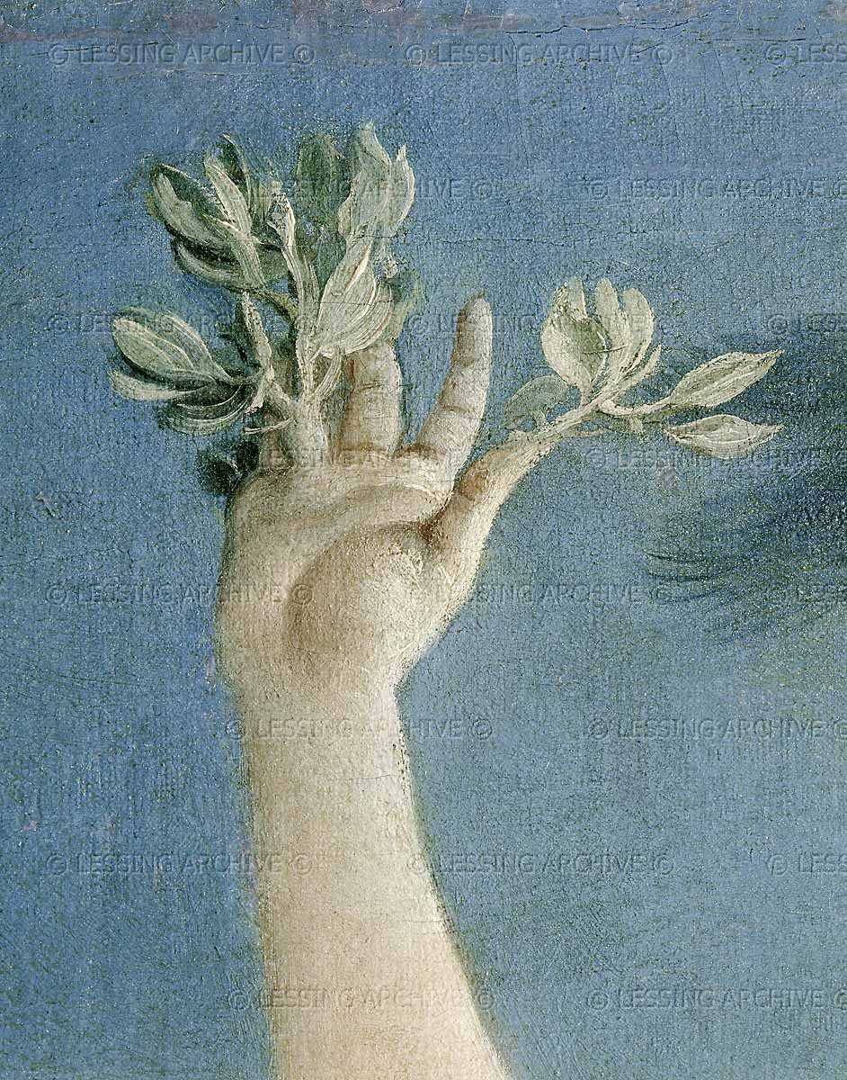
Giovanni Battista Tiepolo, Apollo and Daphne, 1745, oil on canvas, 96 x 79 cm,
Louvre, Paris

Slide 13
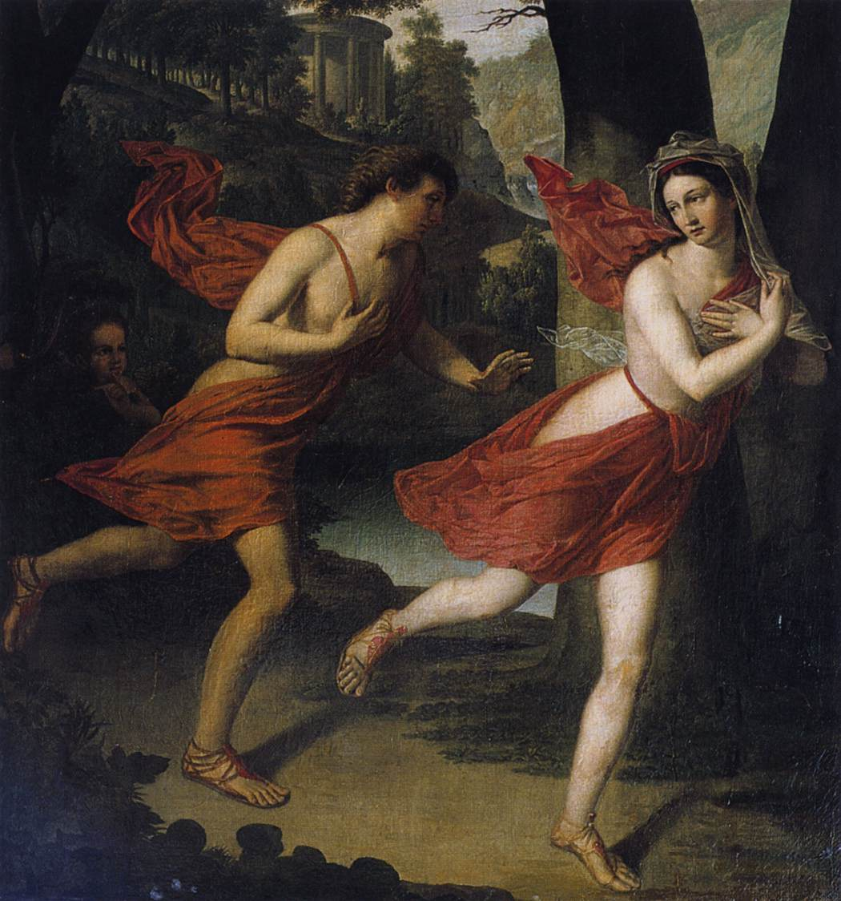
Robert Lefevre, 1755-1830
Apollo and Daphne,1810,
Oil on canvas,
119 x 105 cm,
Private collection

Slide 14
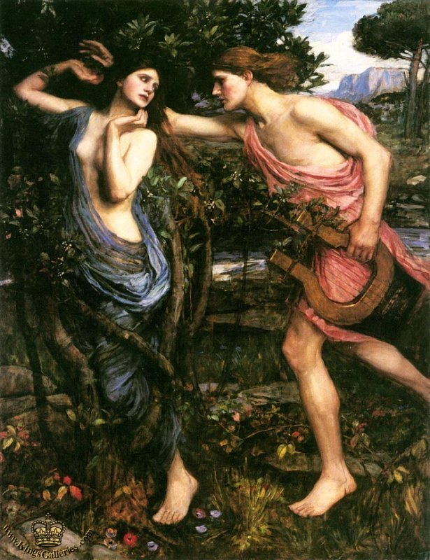
John William
Waterhouse, 1849-1917
Apollo and Daphne,
1908, oil on canvas,
145 x 112 cm,
Private Collection

Slide 15
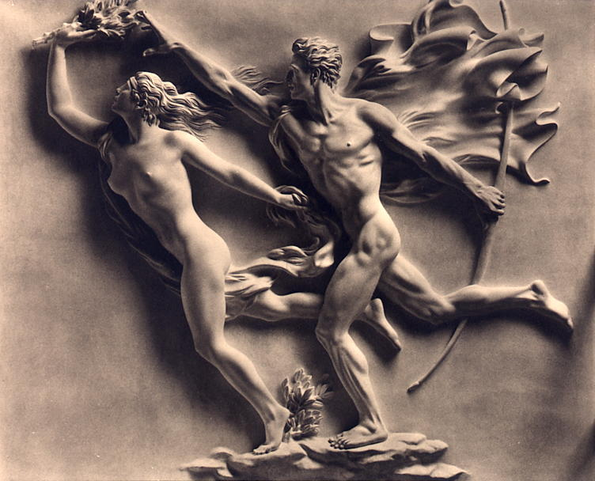
Arno Breker,1900-1991
Apollo and Daphne, 1940, Bronze,
Arno-Breker-Museum, Schloss Nörvenich, Cologne

