Slide 1
The Rotunda Ambo
Collection of Photos

Slide 2
The Rotunda Ambo
Photo Credits go to:
Dick Osseman
https://pbase.com/dosseman/image/58466693

Slide 3
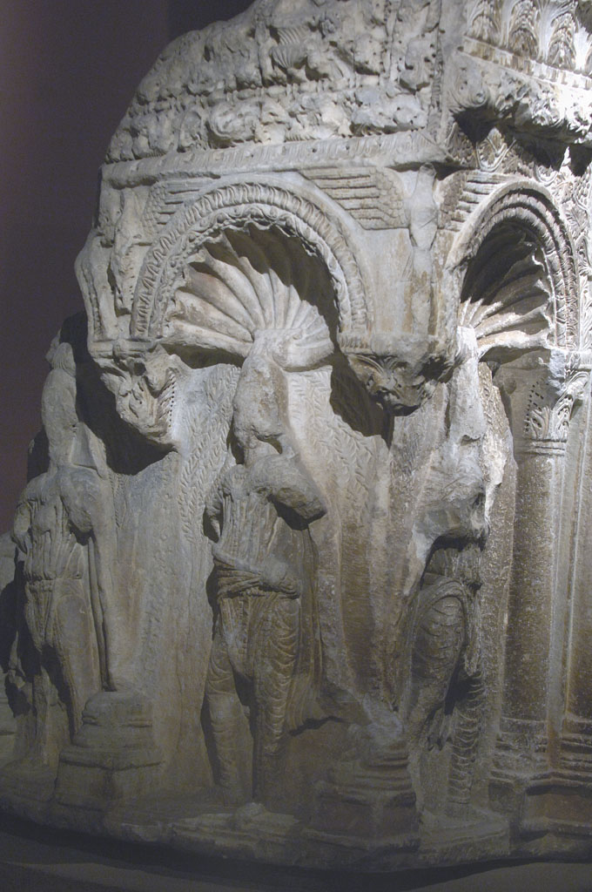
Rotunda Ambo, early 6th century, marble, Istanbul Archaeoligical Museum
Photo copyright: Dick Osseman https://pbase.com/dosseman/image/58466693 and https://pbase.com/dosseman/profile

Slide 4
The Rotunda Ambo
Photo Credits go to:
BYZART. EU
https://cmc.byzart.eu/search?query=Ambo&query_type=keyword&record_types%5B%5D=Item&record_types%5B%5D=File&record_types%5B%5D=Collection&submit_search=Search

Slide 5
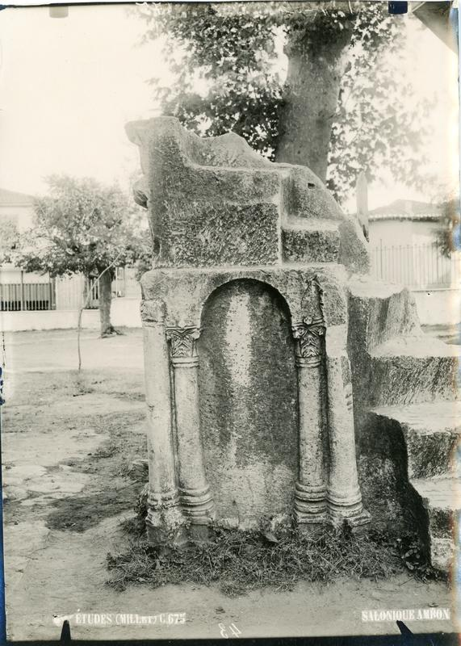
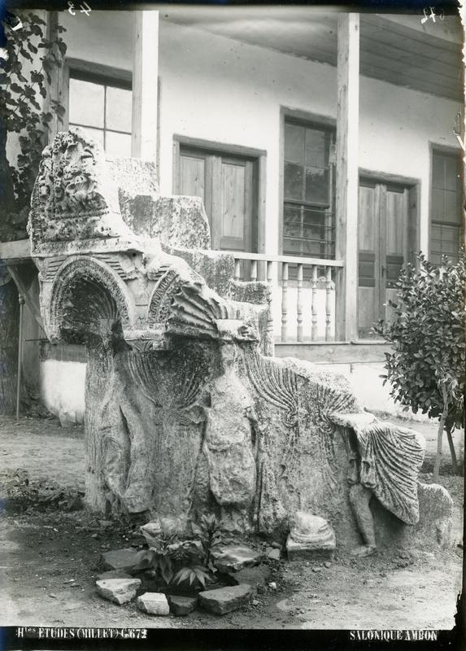

Slide 6
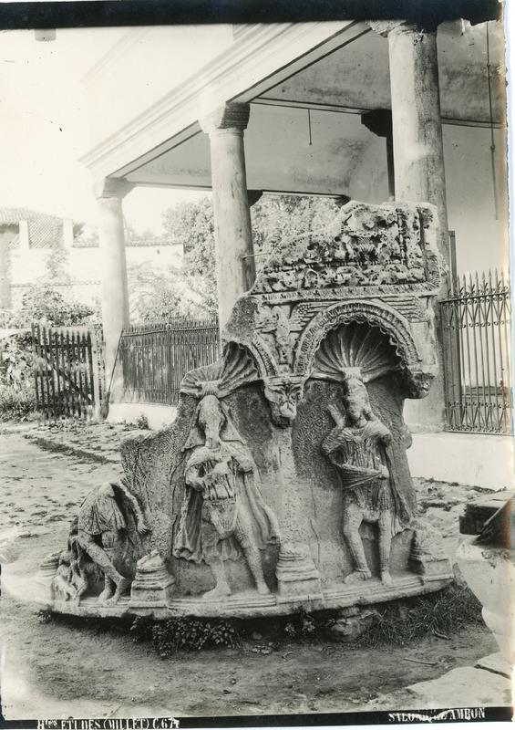
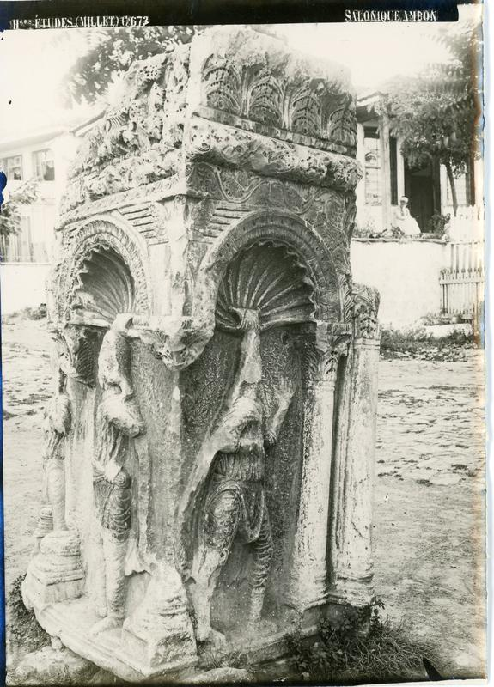

Slide 7
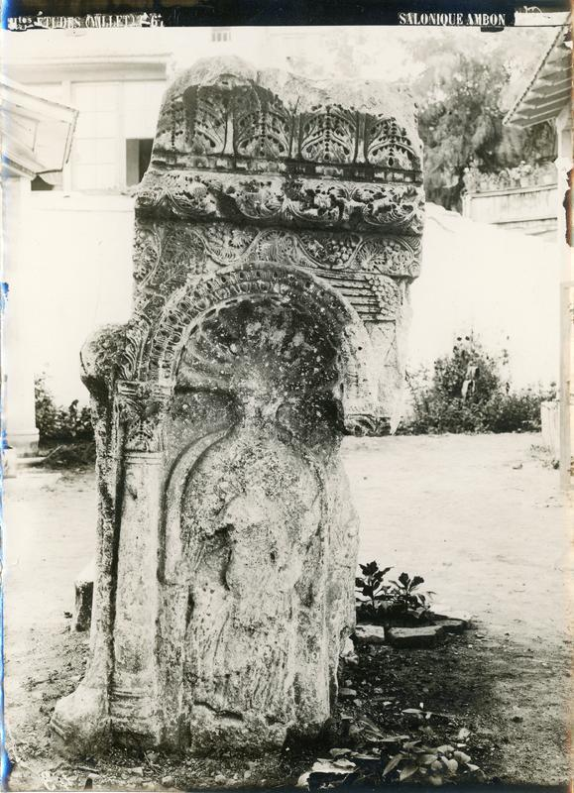

Slide 8
The Rotunda Ambo
Photo Credits go to:
OMNIA
http://www.omnia.ie/index.php?navigation_function=3&europeana_query=Arch%C3%A4ologisches+Museum&europeana_cursor=%2A&europeana_prev_cursor=%2A&dpla_nav_start=0&prev_obcnt=-807

Slide 9
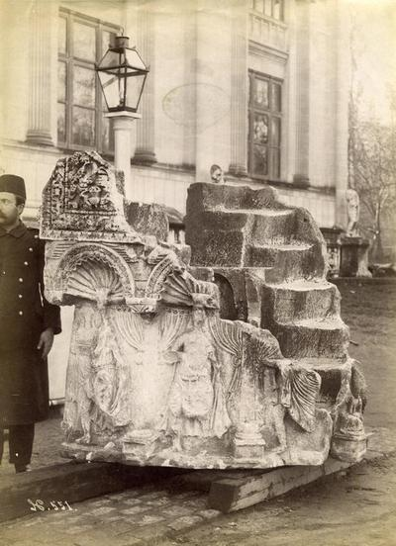
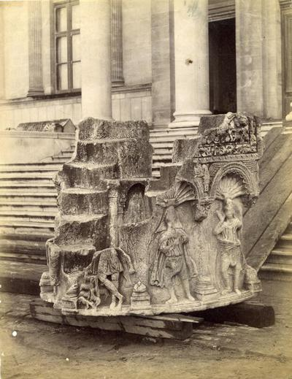

Slide 10
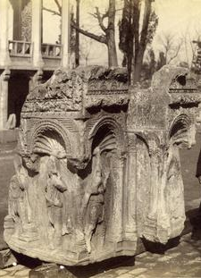
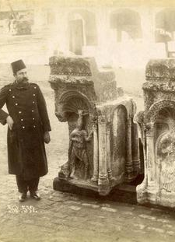

Slide 11
The Rotunda Ambo
Photo Credits go to:
Aikaterini Laskaridis Foundation
http://eng.travelogues.gr/item.php?view=44800

Slide 12
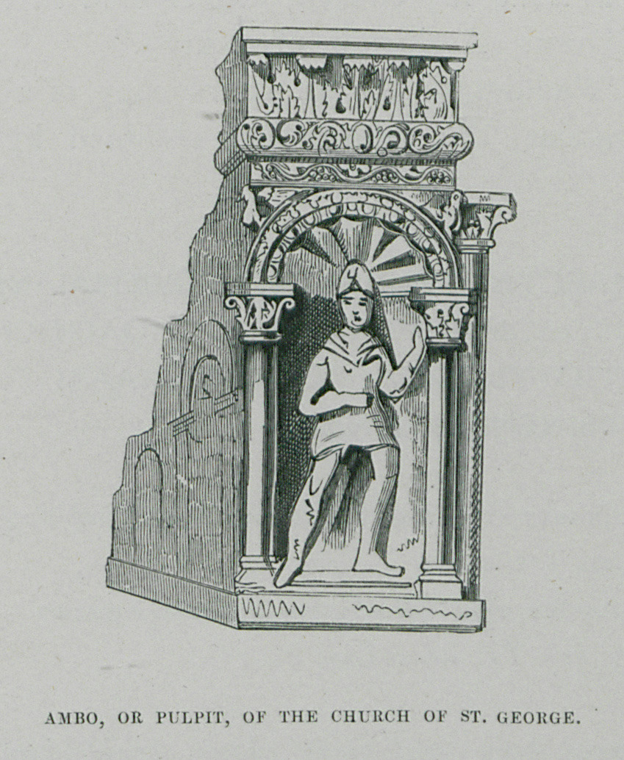
TEXIER, Charles. Byzantine Architecture illustrated by a series of the earliest Christian edifices in the East, London, Day and Son, 1864 http://eng.travelogues.gr/item.php?view=44800

