Slide 1
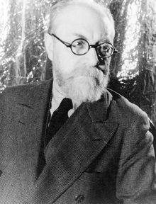
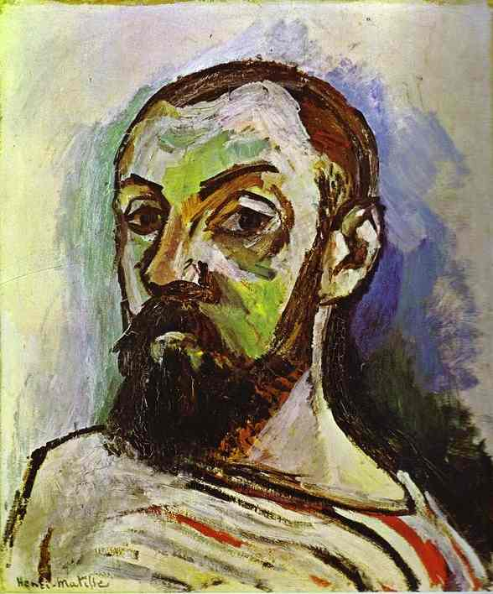
Henri-Émile-Benoît Matisse, 1869-1954
Self-Portrait, 1906, oil on canvas, 55 x 46 cm, Statens Museum for Kunst, Copenhagen

Slide 2
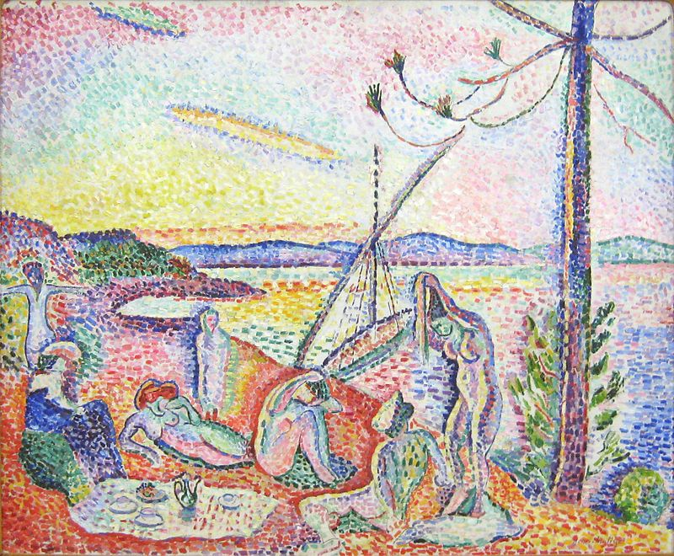
Luxury,
Calm and Pleasure, 1904, oil on canvas, 98 x 118.5 cm, Musée d'Orsay, Paris
The painting's title comes from The Flowers of Evil.
There all is order and beauty,
Luxury, peace, and pleasure. https://www.youtube.com/watch?v=7d6S8y2kYSg

Slide 3
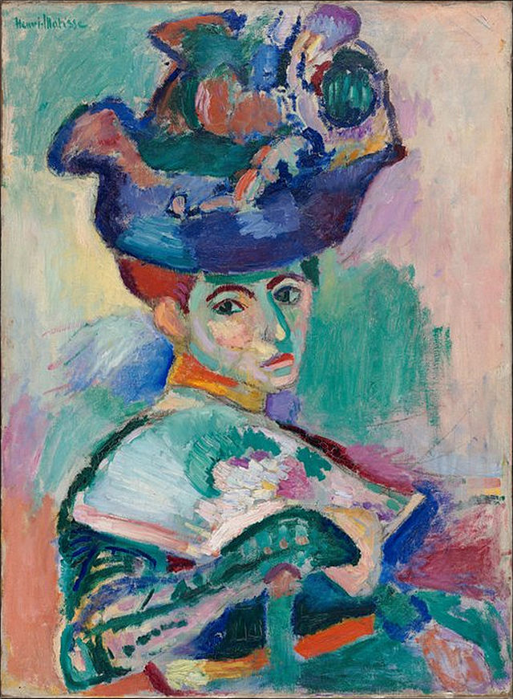
Woman with a Hat, 1905, oil on canvas, 80.56x59.69 cm, San Francisco Museum of Modern Art
Femme au chapeau marked a stylistic change from the regulated brushstrokes of Matisse's earlier work to a more expressive individual style. His use of non-naturalistic, arbitrary colors and loose brushwork, which contributed to a sketchy or "unfinished" quality, seemed shocking to the viewers of the day.
The expatriate Stein family (Michael, Sarah, Leo, and Gertrude) bought the painting soon after its initial showing.

Slide 4
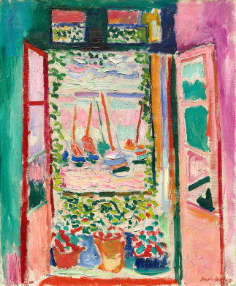
Open Window, Collioure, 1905, oil on canvas,
55.3 x 46 cm, National Gallery of Art, Washington, DC
An icon of early modernism, this small but explosive work, is celebrated as one of the most important early paintings of the so-called Fauve school.
*Maximum intensity of color *Dazzling variety of brushstrokes
*Pulsating cross-rhythms
*Frames within frames
*A new direction in modern art, one in which paintings develop an increasing autonomy from the things they depict.

Slide 5
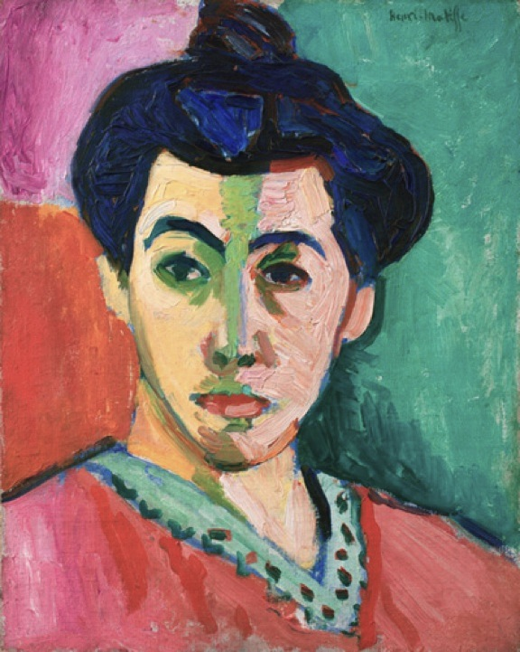
Portrait of Madame Matisse (The green line), 1905, oil and tempera on canvas, 40.50x32.5, Statens Museum for Kunst, Copenhagen, Denmark https://www.smk.dk/en/highlight/portrait-of-madame-matisse-the-green-line-1905/

Slide 6
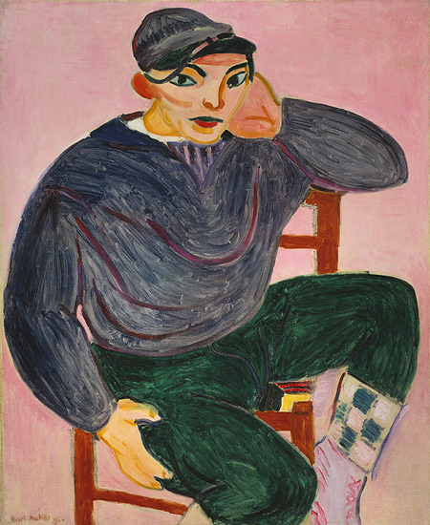
The Young Sailor, 1906, oil on canvas, 101.6 x 83.2 cm , the MET, NY
Against the flat, bright pink background, Germain wears typical fisherman's garb. His broad face is flat and mask-like, and the contours of his rounded limbs are crisp and defined, creating a sharp contrast to the loose brushstrokes that constitute them.
*Theatrical looks
*Bold palette
*This is a most decorative portrait in the Fauve manner.

Slide 7
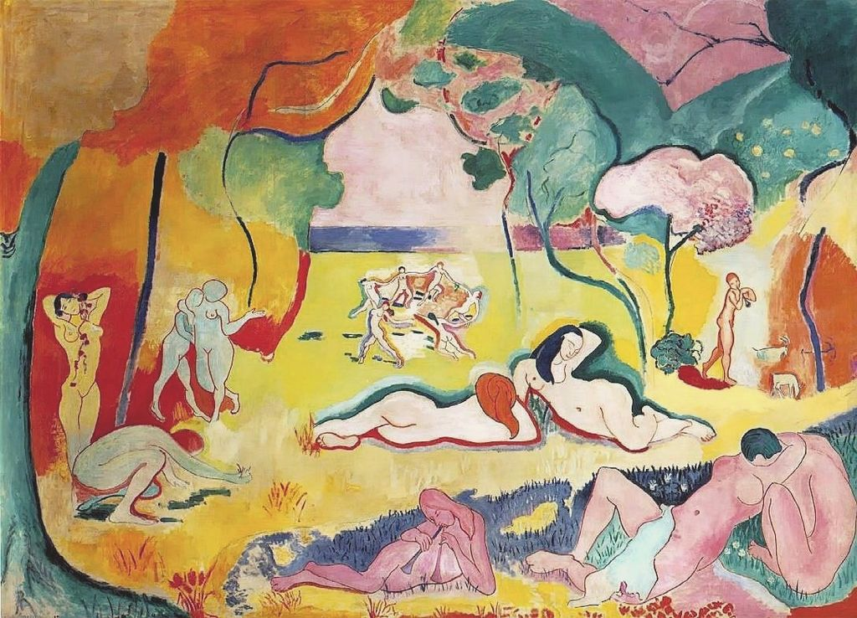
Le bonheur de vivre, 1905–6, oil on canvas, 176.5x240.7 cm, Barnes Foundation

Slide 8
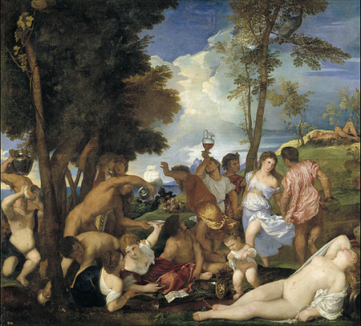
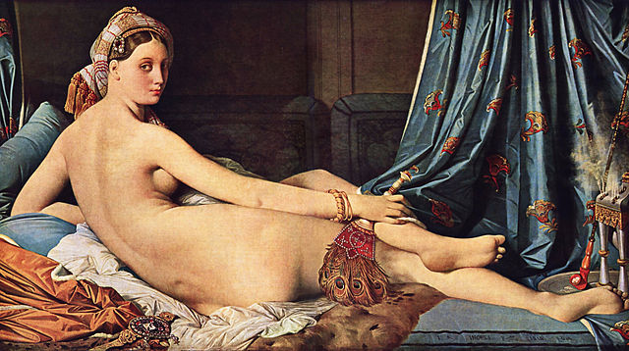
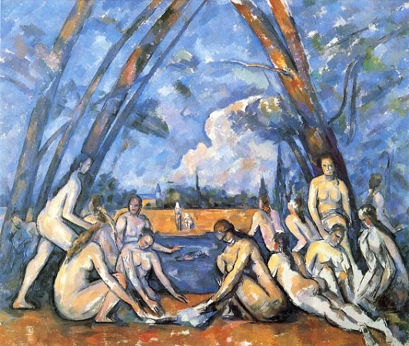
*This is the epitome of Fauvism, a radical new approach that incorporates purely expressive, bright, clear colors and wildly sensual forms.
*By incorporating shifting perspectives, the viewer relates differently to the painting and is required to "enter" the scene.

Slide 9
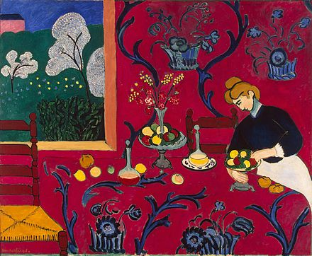
The Dessert: Harmony in Red (The Red Room), 1908, oil on canvas, 180 cm × 220 cm, Hermitage Museum, St. Petersburg
The luxuriant raspberry red fabric with its energetic twists of blue pattern seems to sink down from the wall, taking over the surface of the table and uniting it in a single whole, swallowing up the three-dimensional space of the room and masterfully confirming the decorative potential of the canvas surface.
The painting was originally purchased by the
Russian collector
Sergey Shchukin.

Slide 10
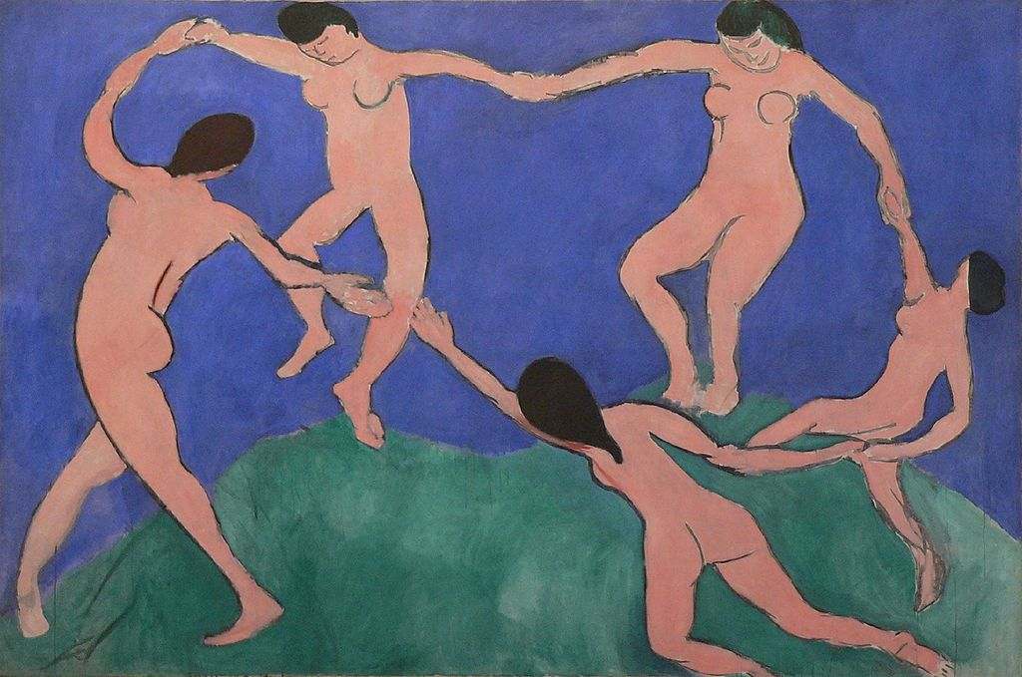
The Dance (first version), 1909, oil on canvas, 259.7 cm × 390.1 cm, MOMA, NY https://www.moma.org/collection/works/79124

Slide 11
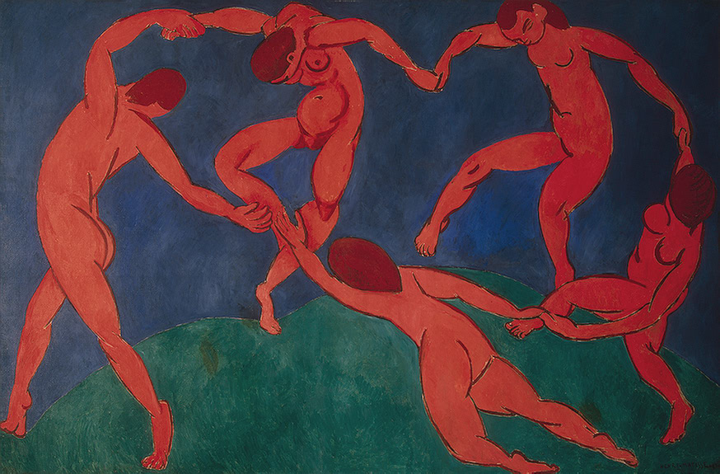
The Dance, 1910, oil on canvas, 260 x 391 cm, Hermitage Museum, St. Petersburg

Slide 12
Post-Fauvism Periods

Slide 13
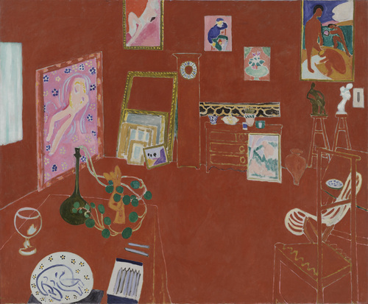
The Red Studio, 1911, oil on canvas, 181 x 219.1 cm, MOMA, NY https://www.youtube.com/watch?v=nz_zwsgjRbw

Slide 14
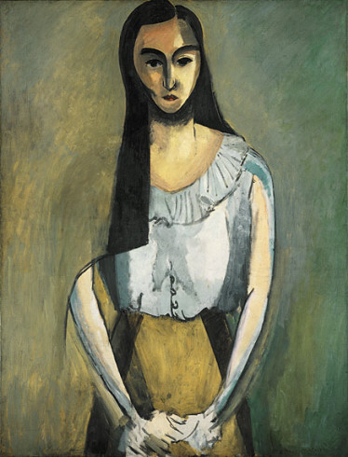
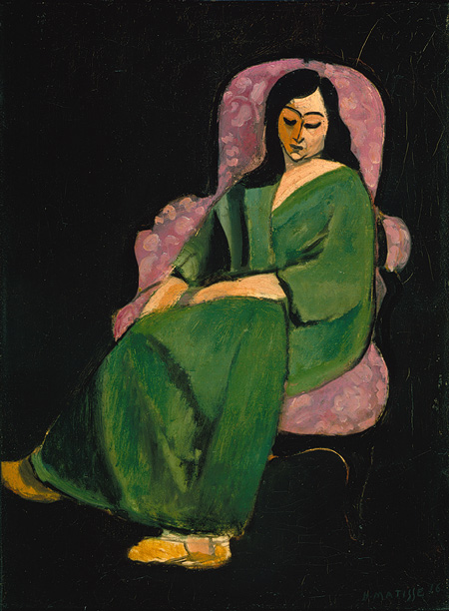
The Italian Woman (L'Italienne), 1916, oil on canvas, 116.7 x 89.5 cm, the Guggenheim, NY
Laurette in a Green Robe (Black Background), 1916, oil on canvas, 73 x 54.3 cm, the MET, NY

Slide 15
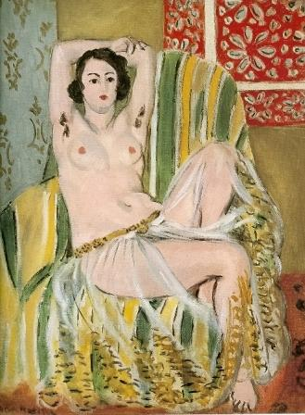
Odalisque with Arms Raised, (of Henriette Darricarrière), 1923, oil on canvas,
68 cm × 64 cm, National Gallery of Art, Washington, D.C.

Slide 16
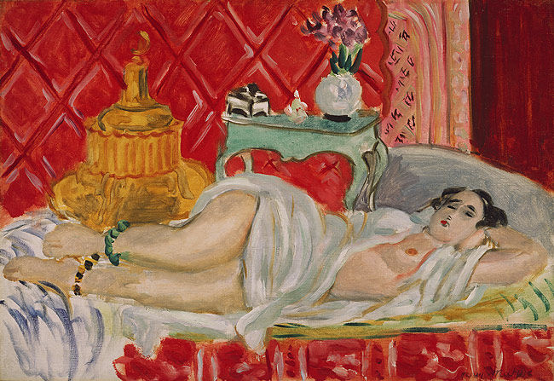
Reclining Odalisque (Harmony in Red), 1927, oil on canvas,
38.4 x 55 cm, the MET, NY https://www.youtube.com/watch?v=ctxpA4e5EO4
Oil on canvas; 15 1/8 x 21 5/8 in. (38.4 x 55 cm

Slide 17
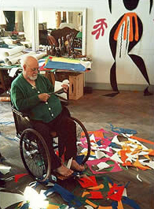
“Une seconde vie”, a second life, was what he called the last fourteen years of his life. Following an operation for cancer he found renewed and unexpected energies and the beautiful Russian-born assistant,
Lydia Delectorskaya, to keep him company. Vast in scale
(though not always in size), lush and rigorous in color, his cutouts are among the most admired and influential works of Matisse's entire career.
This new lease of life led to an extraordinary burst of expression, the culmination of half a century of work, but also to a radical renewal that made it possible for him to create what he had always struggled for: “I have needed all that time to reach the stage where I can say what I want to say.” With the aid of Lydia Delectorskaya and assistants he set about creating cut paper collages, often on a enormous scale, called gouaches découpés. By maneuvering scissors through prepared sheets of paper, he inaugurated a new phase of his career.

Slide 18
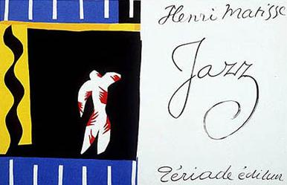
Among his first adventures with paper cutouts was a cheerful book called Jazz, which Matisse prepared during the war but which was only published in 1947. The book and the concurrently published album with the twenty color plates was only printed in a hundred copies. The lively multicolor forms, both abstract and figurative, seem to echo the voice of a man stubbornly refusing to be cowed by the times. But he was also enchanted by the technique. "The walls of my bedroom are covered with cutouts," he wrote to André Rouveyre in 1948. "I still don't know what I'll do with them."

Slide 19
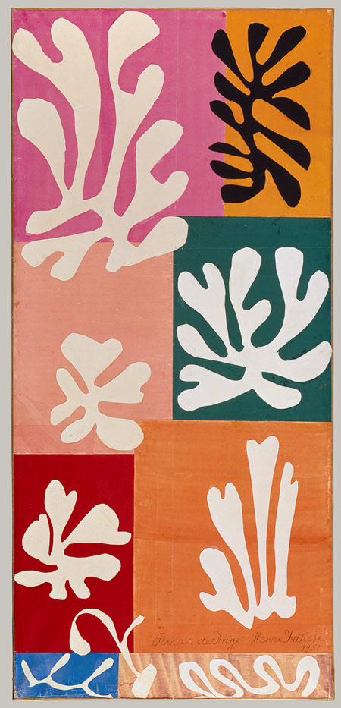
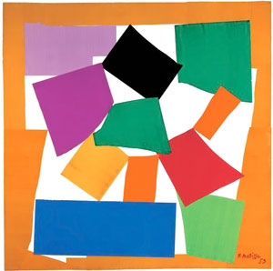
Snow Flowers, watercolor and gouache on cut and pasted papers; 174 x 80.6 cm, the MET, NY
The Snail, 1953, gouache on paper, cut and pasted, on white paper, 2864 x 2870 mm, TATE Modern

Slide 20
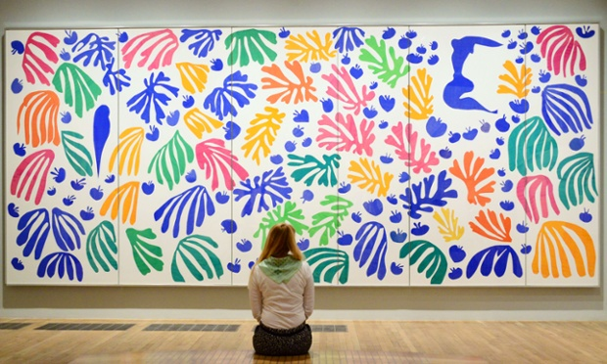
The Parakeet and the Mermaid, Gouache on paper, cut and pasted, and charcoal on white paper, 337 x 768.5 cm, Tate Modern

Slide 21
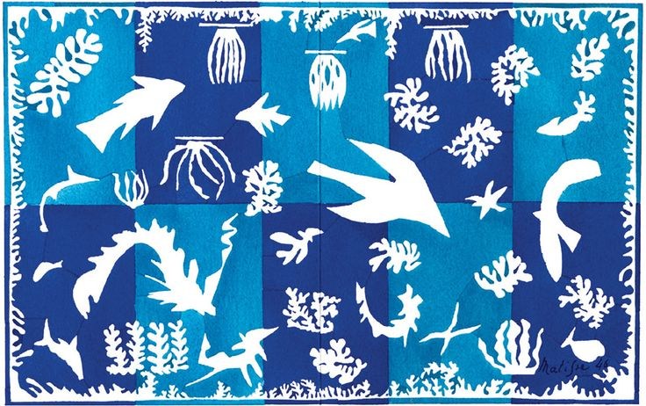
Polynésie, la mer, 1946, paper cutouts painted in gouache glued on paper on canvas, 196 x 314 cm, Musée National d'Art Moderne, Centre Georges Pompidou, Paris

Slide 22
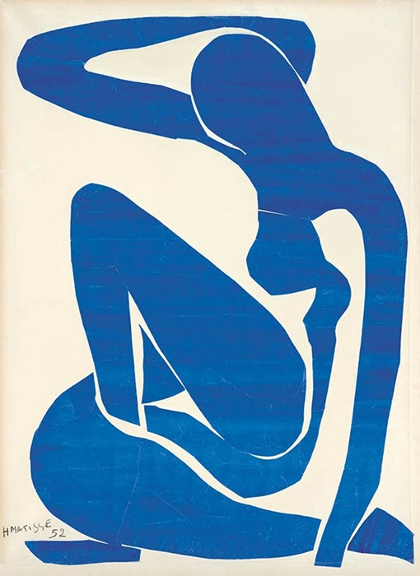
Blue Nude (I), 1952, paper cutouts painted in gouache glued on paper on canvas, 106 × 78 cm, Musée National d'Art Moderne, Centre Georges Pompidou, Paris

Slide 23
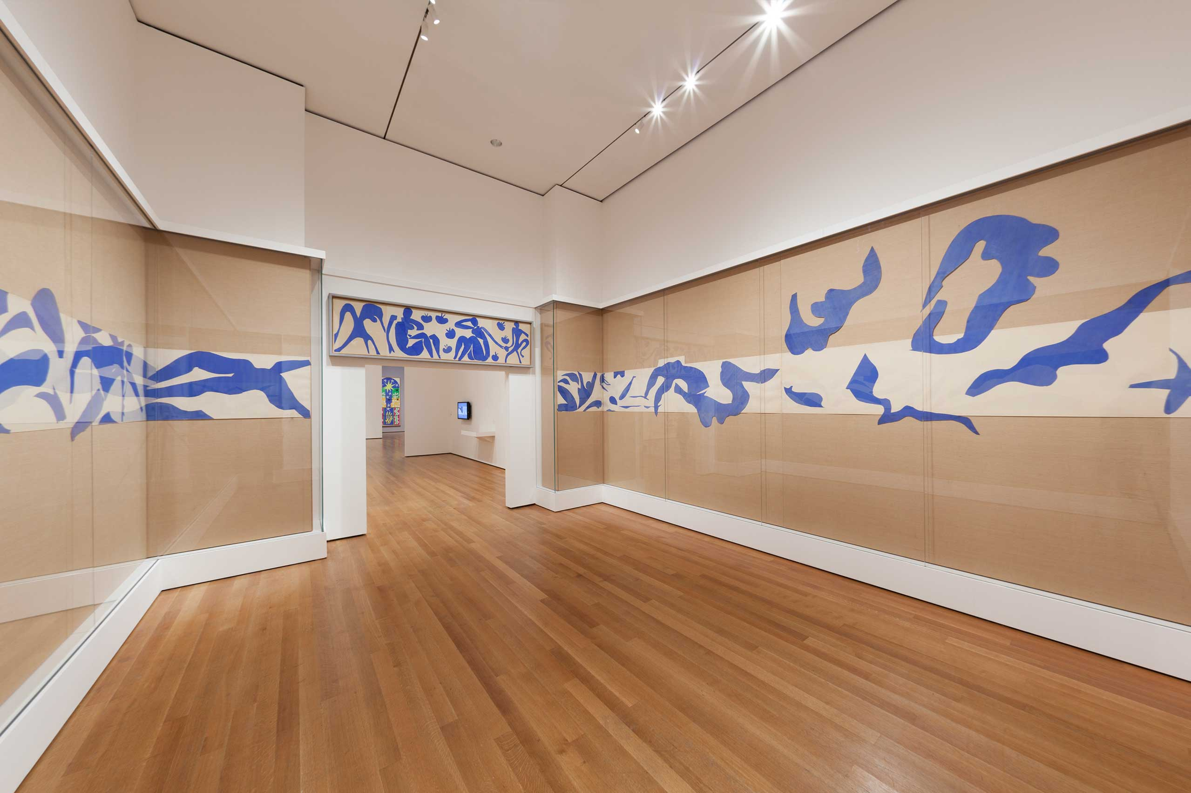
The Swimming Pool, 1952, Gouache on paper, cut and pasted, on painted paper, 185.4 x 1643.3 cm, MOMA, NY

Slide 24
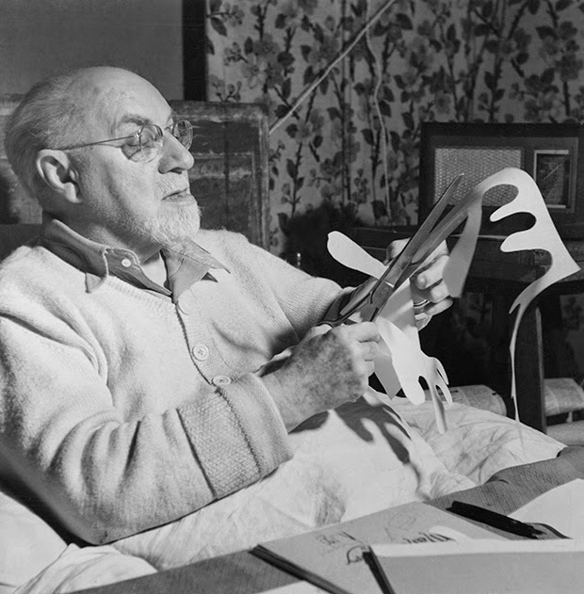
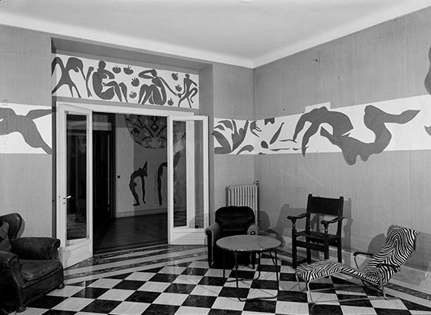
One morning in the summer of 1952, Matisse told his studio assistant and secretary Lydia Delectorskaya that “he wanted to see divers,” so they set out to a favorite pool in Cannes. Suffering under the “blazing sun,” they returned home, where Matisse declared, “I will make myself my own pool.” He asked Delectorskaya to ring the walls of his dining room at the Hôtel Régina in Nice with a band of white paper, positioned just above the level of his head, breaking only at the windows and door at opposite ends of the room. The room itself was lined with tan burlap, a popular wall covering of the time. Matisse then cut his own divers, swimmers, and sea creatures out of paper painted in an ultramarine blue. The blue forms were pinned on the white paper, which helped define the aquatic ballet of bodies, splashing water, and light.
The result was Matisse’s first and only self-contained, site-specific cut-out. With its reduction of forms, its dynamic deployment of positives and negatives, and its lateral expansion across the walls, The Swimming Pool was the culmination of Matisse’s work in cut paper up until that point. Matisse saw in paper’s pliability a perfect representation of the fluidity of water, making The Swimming Pool a perfect melding of subject and means.

Slide 25
