Slide 1
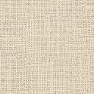
Northern ReNAISSANCE
at Mauritshuis

Slide 2
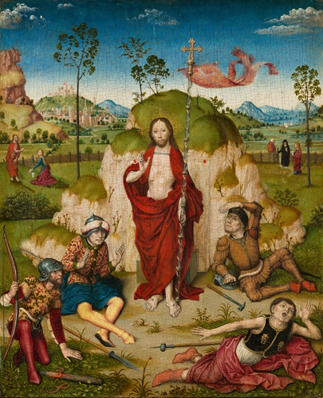
Circle of Dirk Bouts, c. 1410 – 1475
The Resurrection of Christ, 1480,oil on panel,
28.5 x 23.5 cm, the Mauritshuis in the Hague

Slide 3
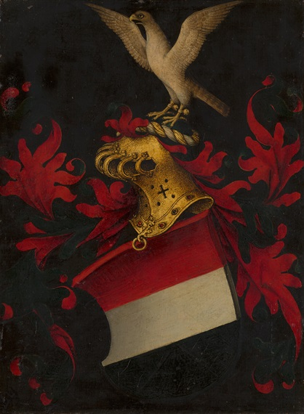
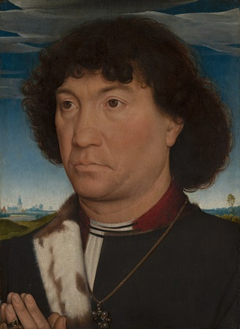
Hans Memling, c. 1440 – 1494
Portrait of a Man from the Lespinette Family, 1485-90, oil on panel, 30.1 x 22.3 cm, the Mauritshuis in the Hague

Slide 4
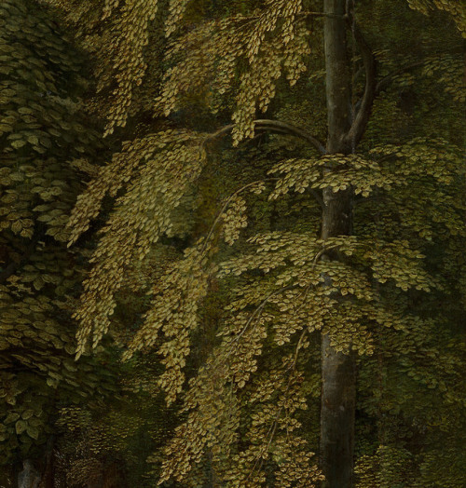
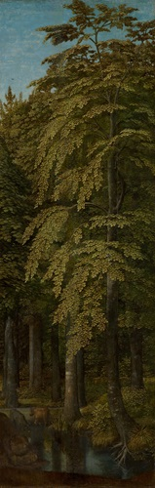
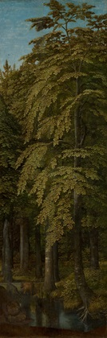
G
Gerard David, c. 1450 - 1523
Wooded Landscape, c. 1510-15, oil on panel, 89.9 x 30.7 cm, the Mauritshuis in the Hague

Slide 5
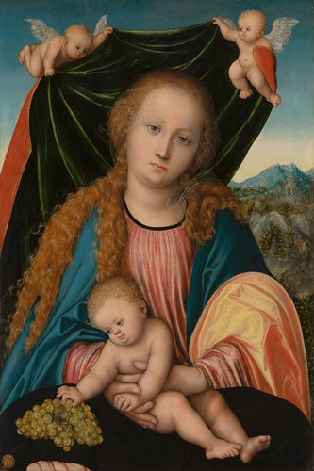
Lucas Cranach the Elder,
1472 – 1553
Virgin and Child, c. 1515-20, oil on panel, 62.7 x 42 cm, the Mauritshuis in the Hague

Slide 6
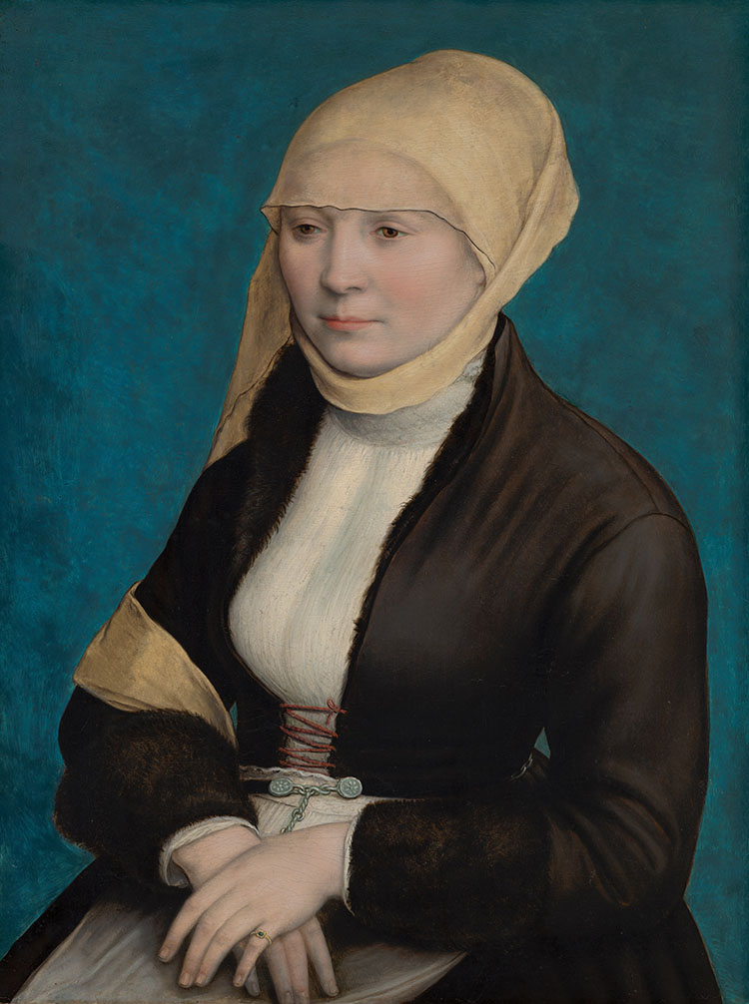
Hans Holbein the Younger (formerly attributed to)
Portrait of a Woman from Southern Germany, c. 1520 – 1525, oil on panel, 45x34 cm, the Mauritshuis in the Hague

Slide 7
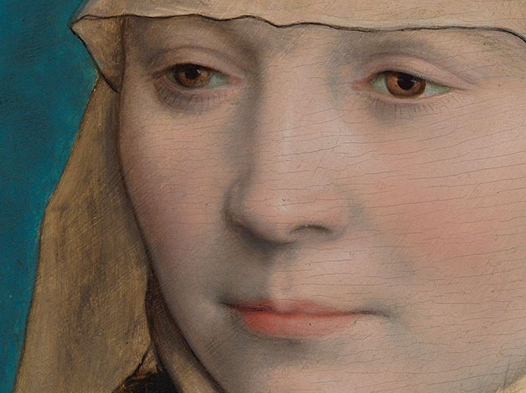

Slide 8
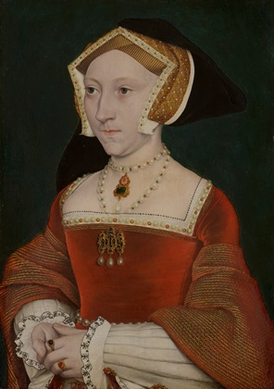
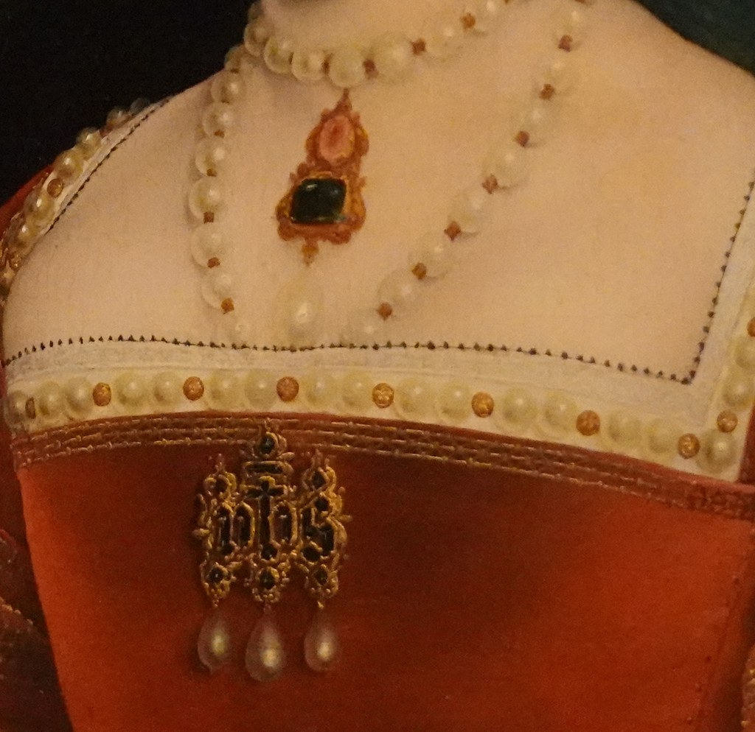
Studio of Hans Holbein the Younger, 1497/1498 – 1543
Portrait of Jane Seymour, c. 1540, oil on panel, 26.4 x 18.7 cm, the Mauritshuis in the Hague

Slide 9
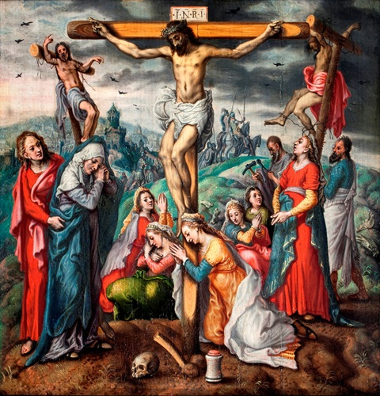
Atributed to Pieter Aertsen, 1509 – 1575
Crucifixion, c. 1550, oil on panel, 27.6 x 26.7 cm, the Mauritshuis in the Hague

Slide 10
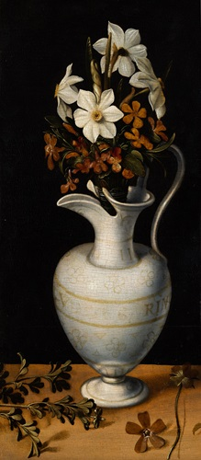
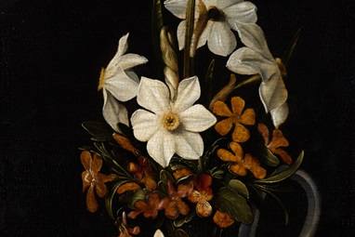
Ludger tom Ring the Younger, 1522 – 1584
Narcissi, Periwinkle and Violets in a Ewer, 1562, oil on panel, 35 x 15.5 cm, the Mauritshuis in the Hague

Slide 11
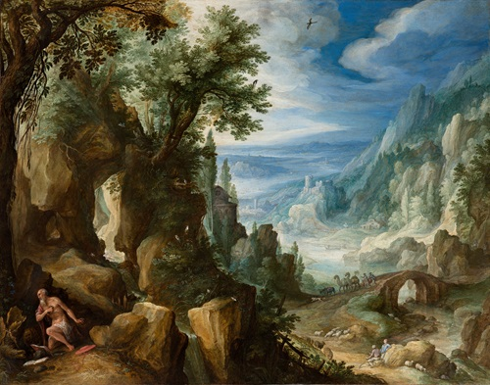
Paul Bril, c. 1553/1554 – 1626
Mountainous Landscape with Saint Jerome, 1592, oil, copper on panel, 25.7 x 32.8 cm, the Mauritshuis in the Hague

Slide 12
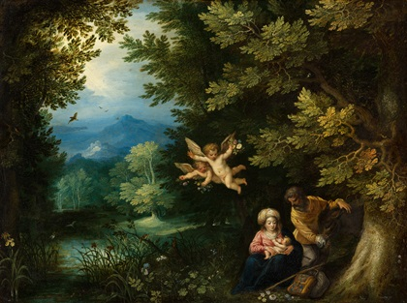
Jan Brueghel the Elder, 1568 – 1625 and Hans Rottenhammer, 1564 – 1624
Rest on the Flight into Egypt, 1595, oil, copper on panel, 22 x 29.1 cm, the Mauritshuis in the Hague

