Slide 1
Tabula Peutingeriana

Slide 2
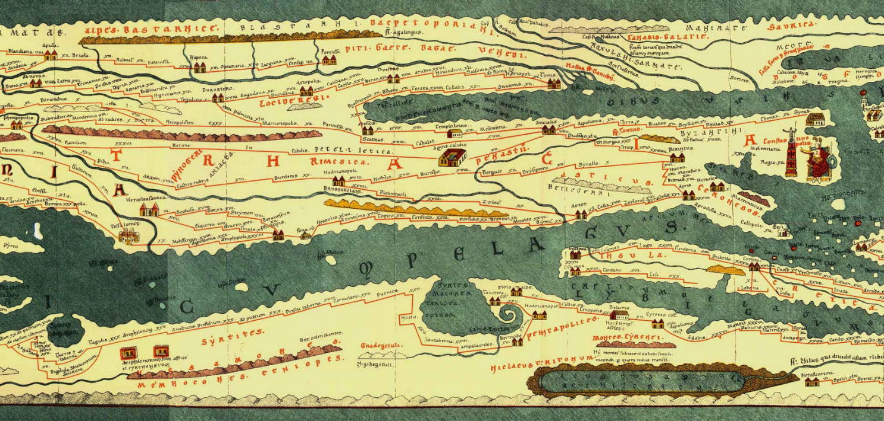
Tabula Peutingeriana
What we know today about Rome’s road system comes from a famous Itinerarium, the Tabula Peutingeriana, named for its former owner, Conrad Peutinger, a German humanist. The Tabula Peutingeriana is a 13th century copy of an antique world Itinerarium of Roman roads from the British Isles up to India and Central Asia, created sometime around the 4th century A.D. The entire map was originally a long, narrow parchment roll and in its present state measures 6.75 meters long but only 34 centimeters wide.
The Tabula Peutingeriana is one of the Austrian National Library's greatest treasures.
Section of the Tabula Peutingeriana where Via
Egnatia and Philippi can be seen.
Julius Caesar and Mark Antony commissioned the first Roman Itinerarium back in 44 BC. For
25 years, Zenodoxus, Theodotus, and Polyclitus, three Greek geographers, worked hard to compile it. It was engraved in stone and set up near the
Pantheon in Rome.

Slide 3
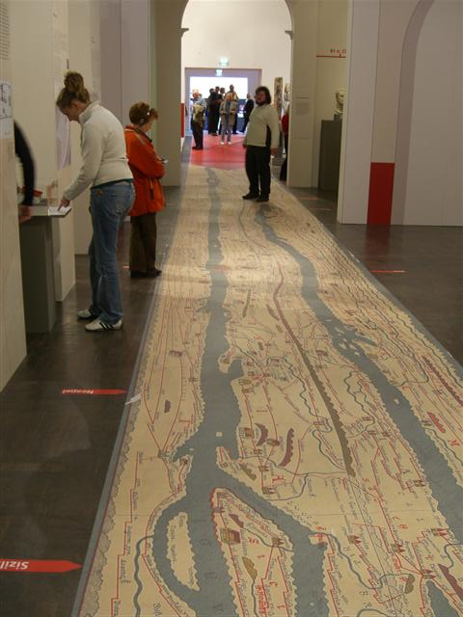
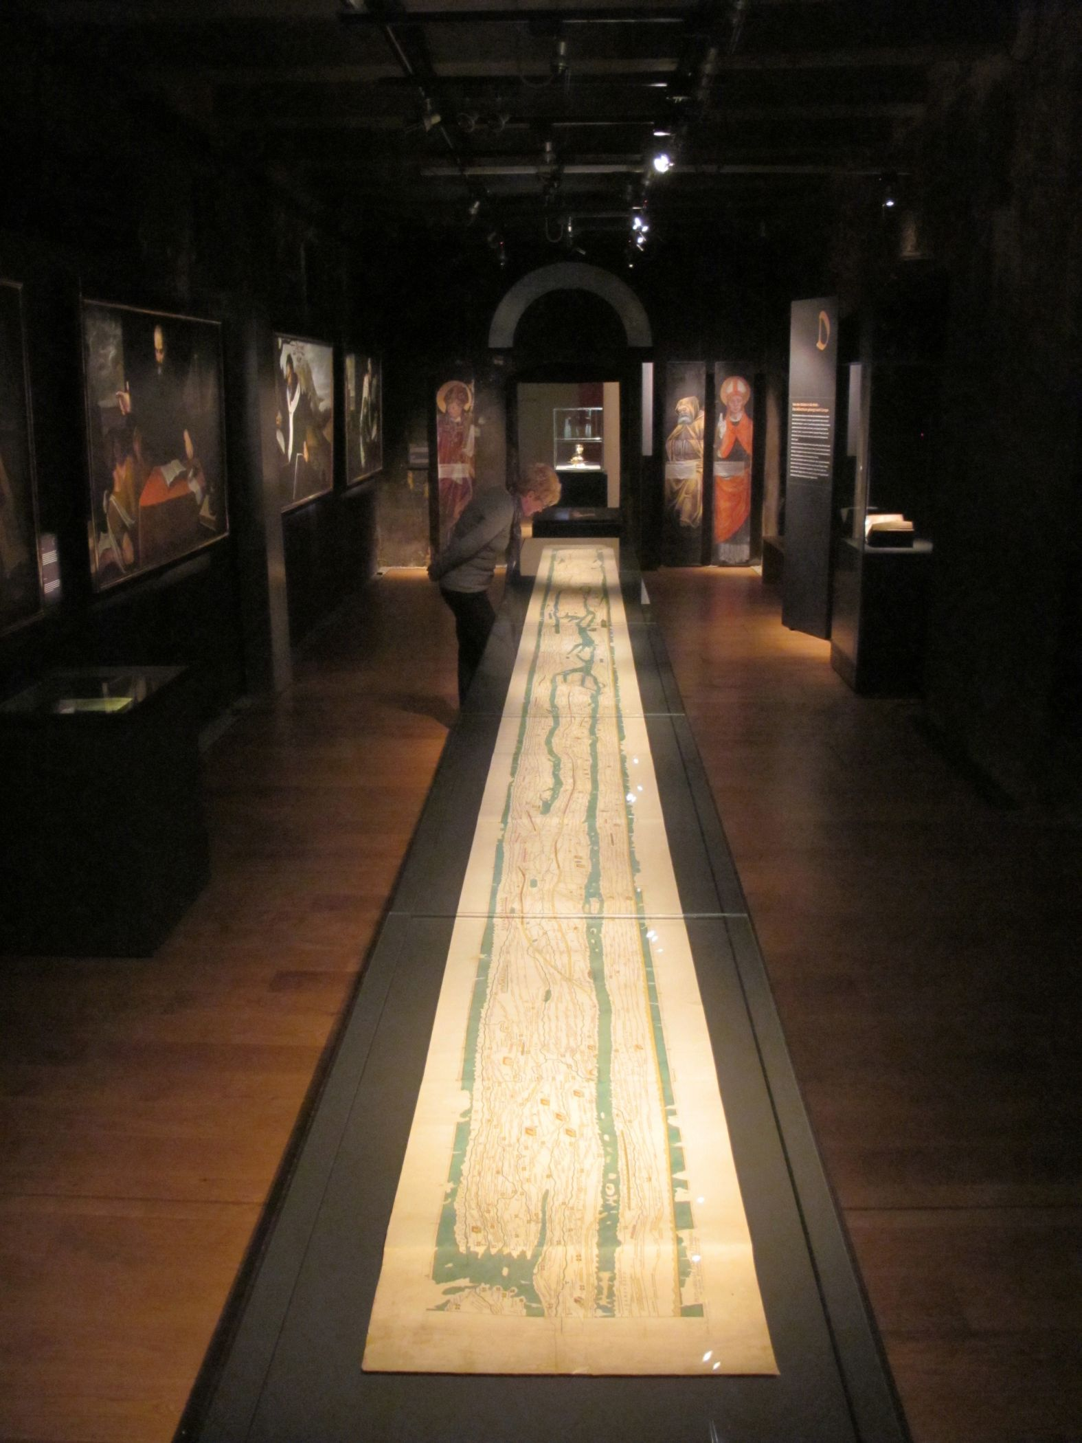
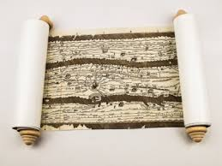
A high-quality film print of the
Tabula Peutingeriana by: http://www.roman-shop.com/
An Enlargement of the Tabula Peutingeriana in the Institute for Classical Philologie, Regensburg
From the Exhibition “Rom von der Rolle“ in the Dalheim Cloister Museum

Slide 4
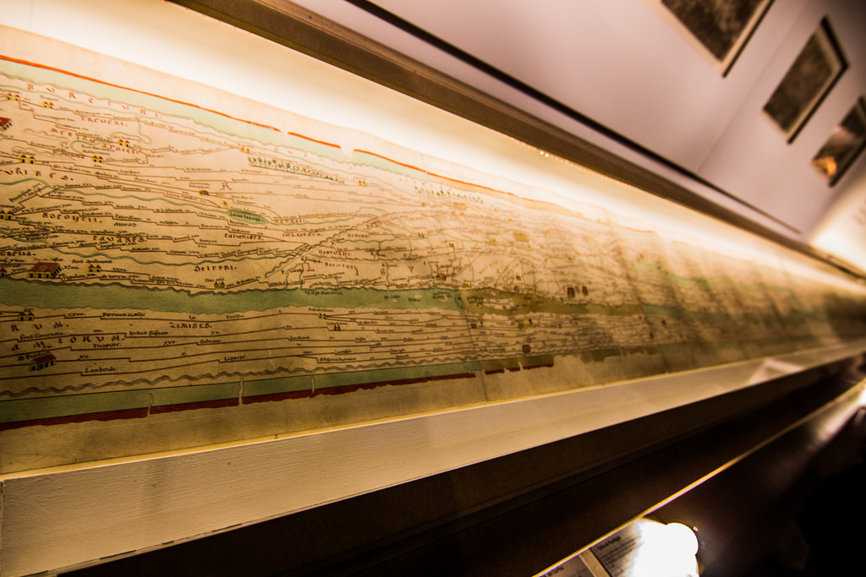
One more copy of Tabula Peutingeriana exhibited in the Musée de Cluny, Paris

Slide 5
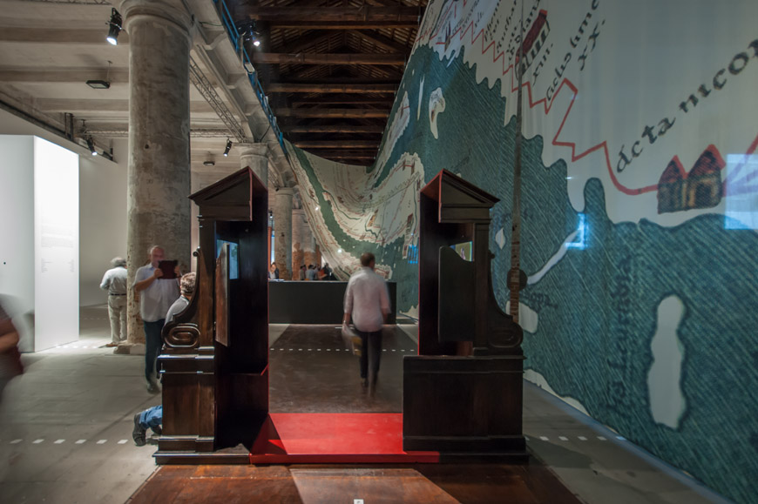
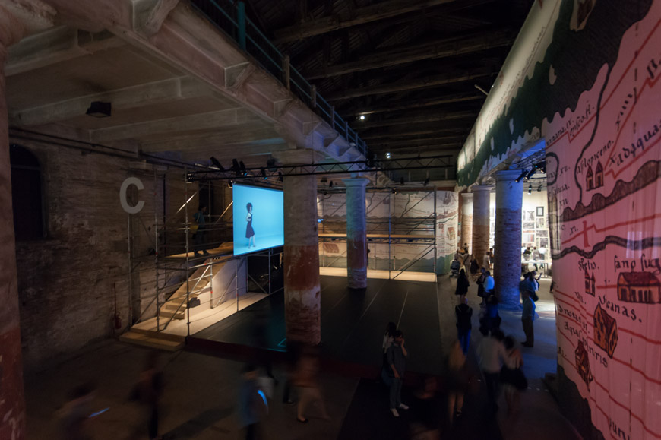
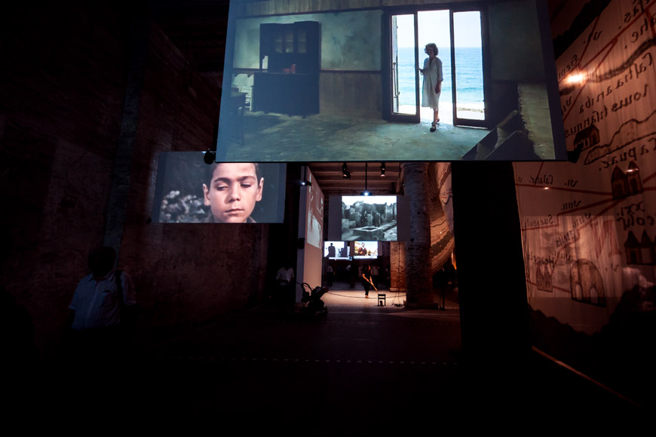
Tabula Peutingeriana and Modern Art
“Fundamentals” is a Venice Architecture Biennale exhibition, curated by Rem Koolhaas, that, taking the cue from the contradictions produced by the market economy triumph, tries to find the causes that have led architecture to its current state.
“Monditalia”, one of the three parts of the exhibition, is a huge stage running along the whole Corderie space of the Arsenale, where contributions by different Biennale’s departments, dance, cinema and music, are presented. “Monditalia” is a scan of Italy, taken as a paradigm for the present economical, social and political crisis, but also embodying the creative potentials that are essential for overcoming it.
The guiding thread of the exhibition is a reproduction, spanning for 316 m. along the
Corderie, of the
Tabula Peutingeriana, depicting the map of
Italy which forms the frame-set for the
“Monditalia” exhibits.

Slide 6
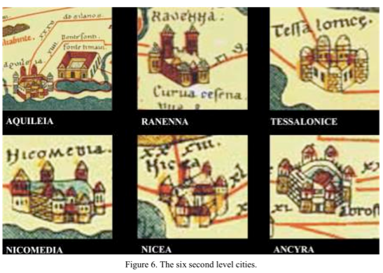
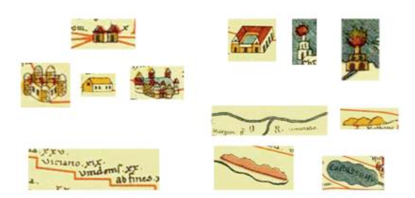
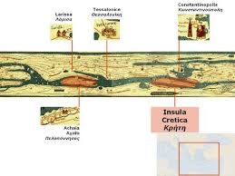
Samples of symbols used in Tabula Peutingeriana: road, cities (commercial, administrative, military centres), mansiones, mutationes, baths, buildings, lighthouses, distance between stations, geographical characteristics (mountain, river, sea, gulf, forests).
Can you design your own symbols for a new Tabula Peutingeriana?

