Slide 1
Torre Aquila
Castello del Buonconsiglio
Trento, Italy
The Months of
April, May and June

Slide 2
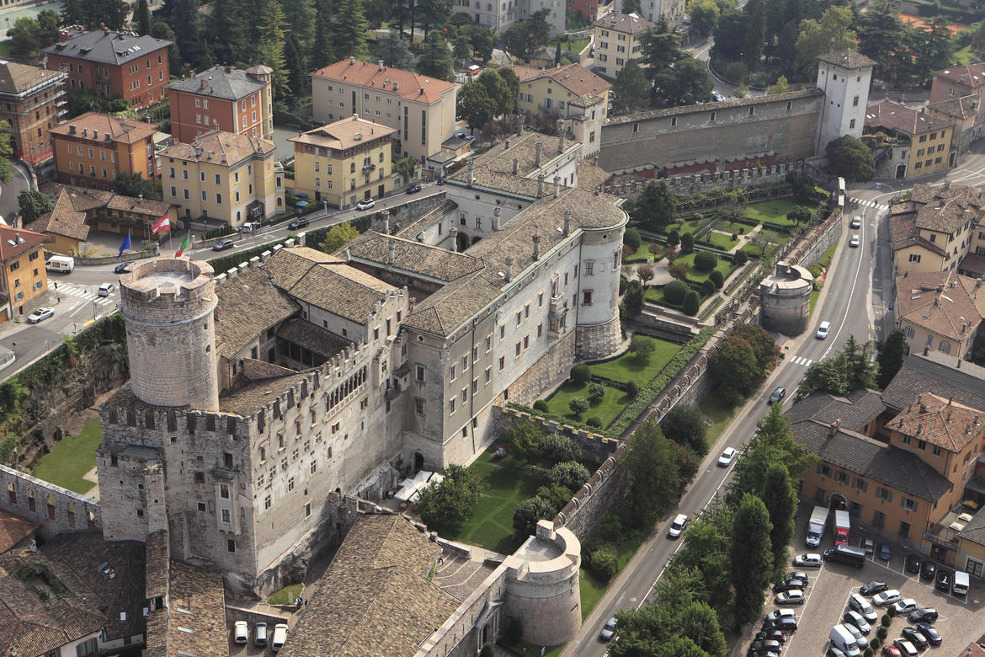
Castello del Buonconsiglio,
Trento,
Italy

Slide 3
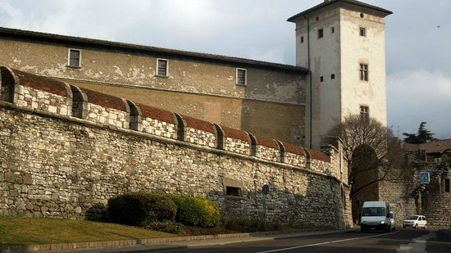
Torre Aquila, Castello del Buonconsiglio, Trento, Italy

Slide 4
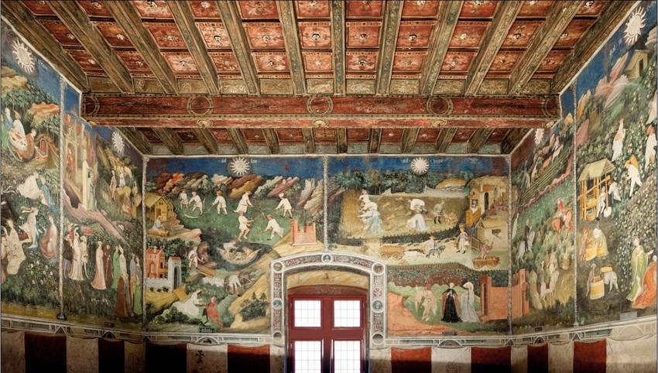
Cycle of the Twelve Months – Torre Aquila

Slide 5
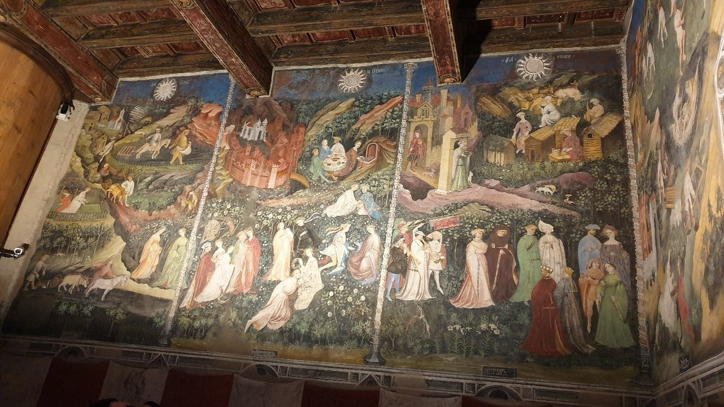
Cycle of the Twelve Months – Southern Wall – April, May and June - Torre Aquila

Slide 6
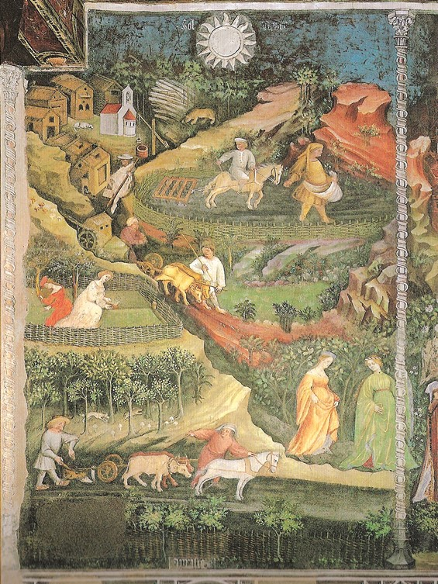
The Month of April, late 14thcentury-latest 1407, possibly by Maestro Venceslao, fresco, Torre Aquila

Slide 7

At the top of the composition, a pilgrim, fully dressed in white with a hat and a cane, walks through a borough of thatched-roof houses arranged around a small church, empty of villagers… silent. Even the dogs in this village keep silent, as they are both dozing.!

Slide 8
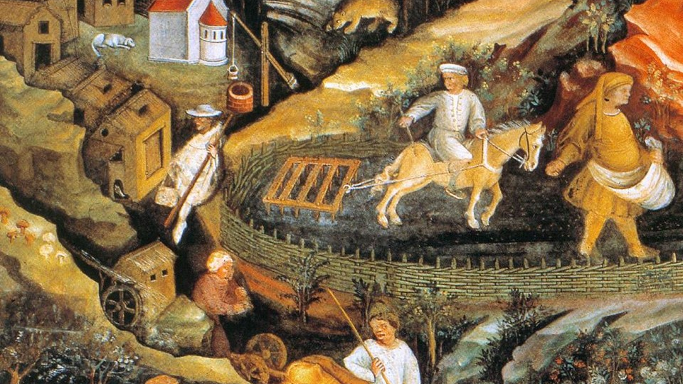
Further down to the left, farmers prepare the land for ploughing…

Slide 9
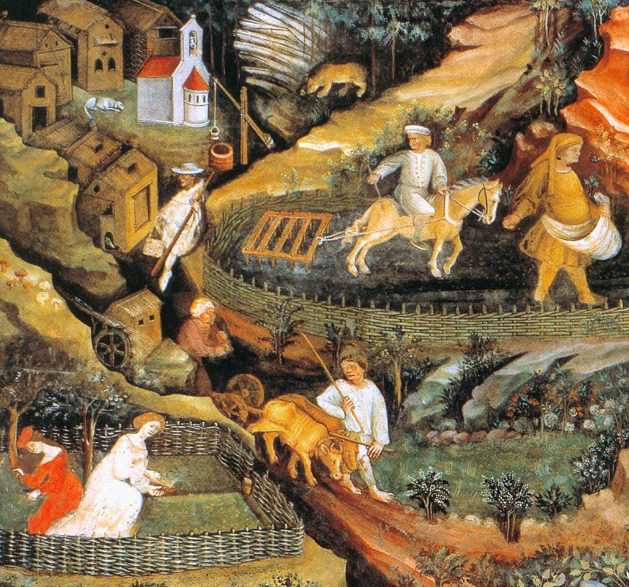
Even further down to the left, two men, probably coming from a water-mill, carry sacks of flour on a cart driven by oxen. Women do not remain idle. Two of them, taking advantage of the beautiful weather, participate in the fervour of spring activities, gardening their well-fenced plot!

Slide 10
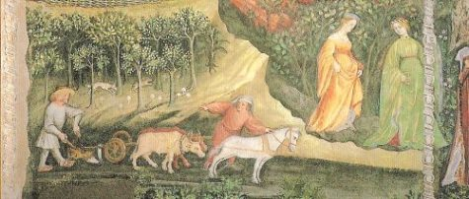
At the lowest part of the April composition, two farmers plough the land with a heavy wheeled plough pulled by a pair of oxen and a horse.
The presence of two aristocratic young ladies, in the lower, right part of the composition, can not be missed, as elegantly dressed, they walk towards the festive procession depicted in the following month of May!

Slide 11
Cycle of the Twelve Months – Southern Wall – April, May and June - Torre Aquila

Slide 12
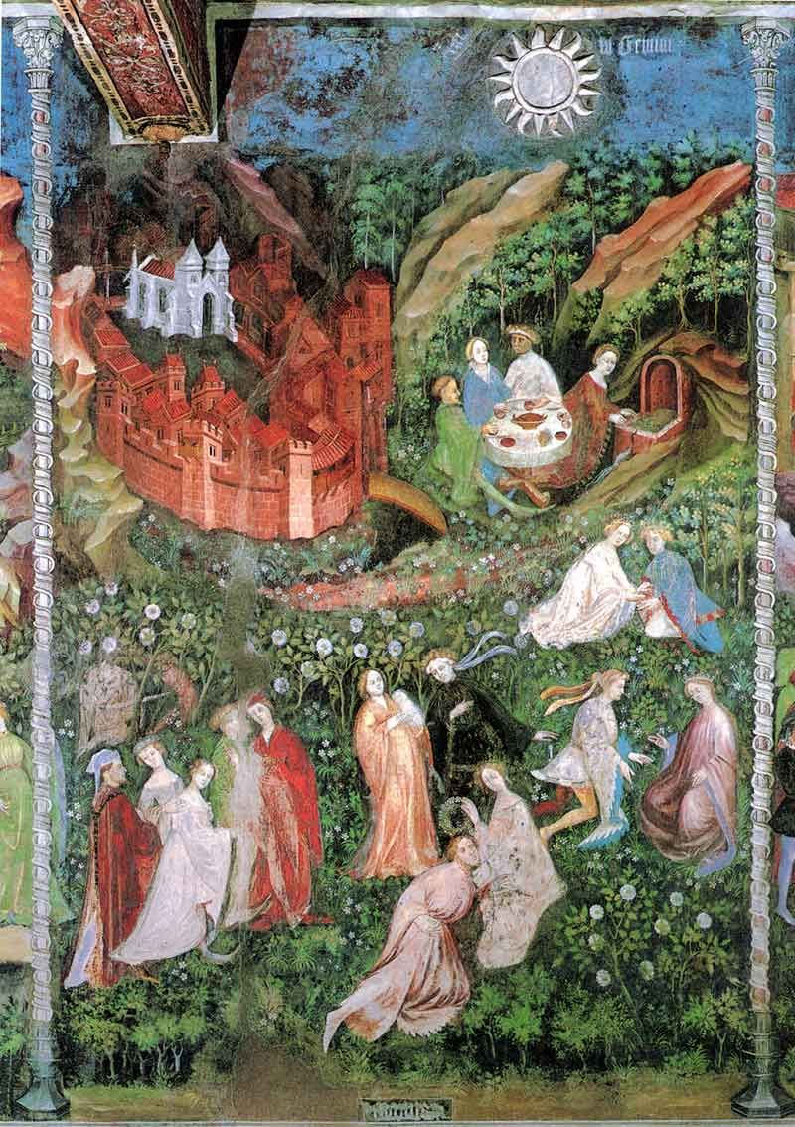
The Month of May, late 14th century-latest 1407, possibly by Maestro Venceslao, fresco, Torre Aquila

Slide 13
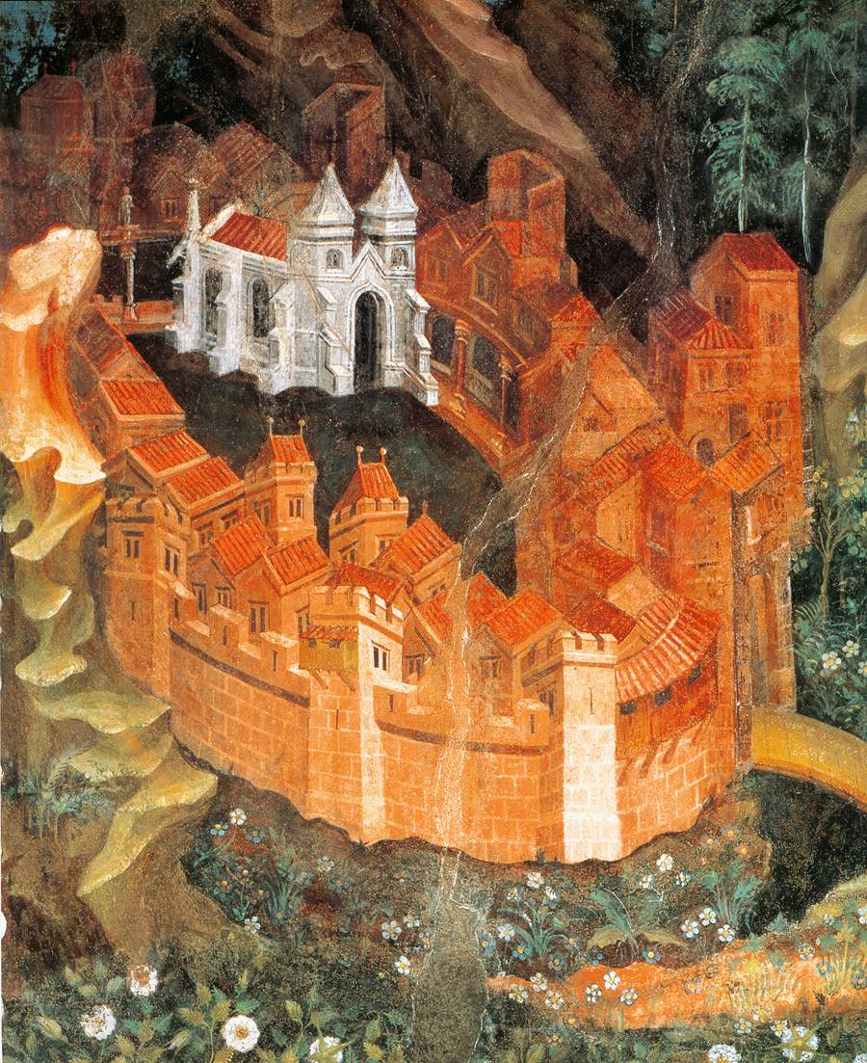
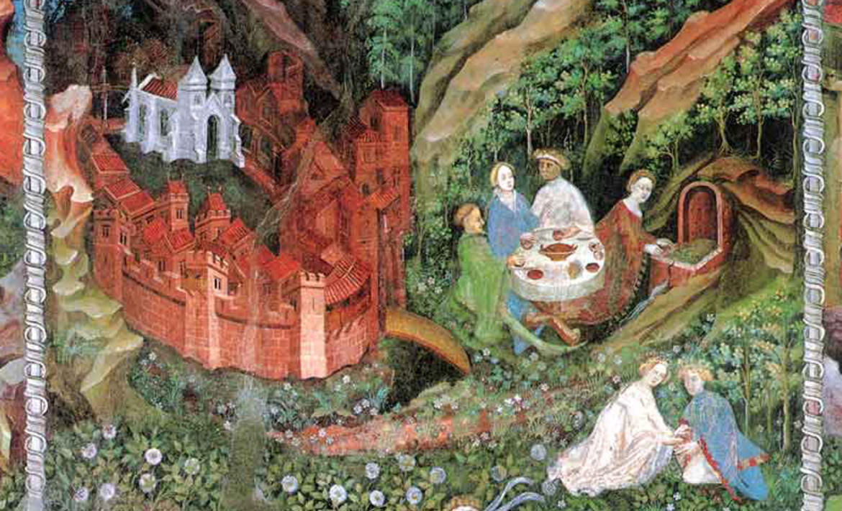
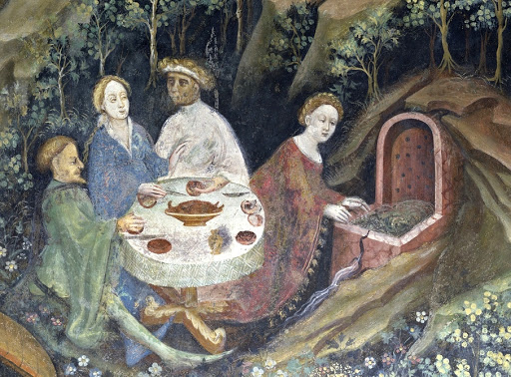

Slide 14
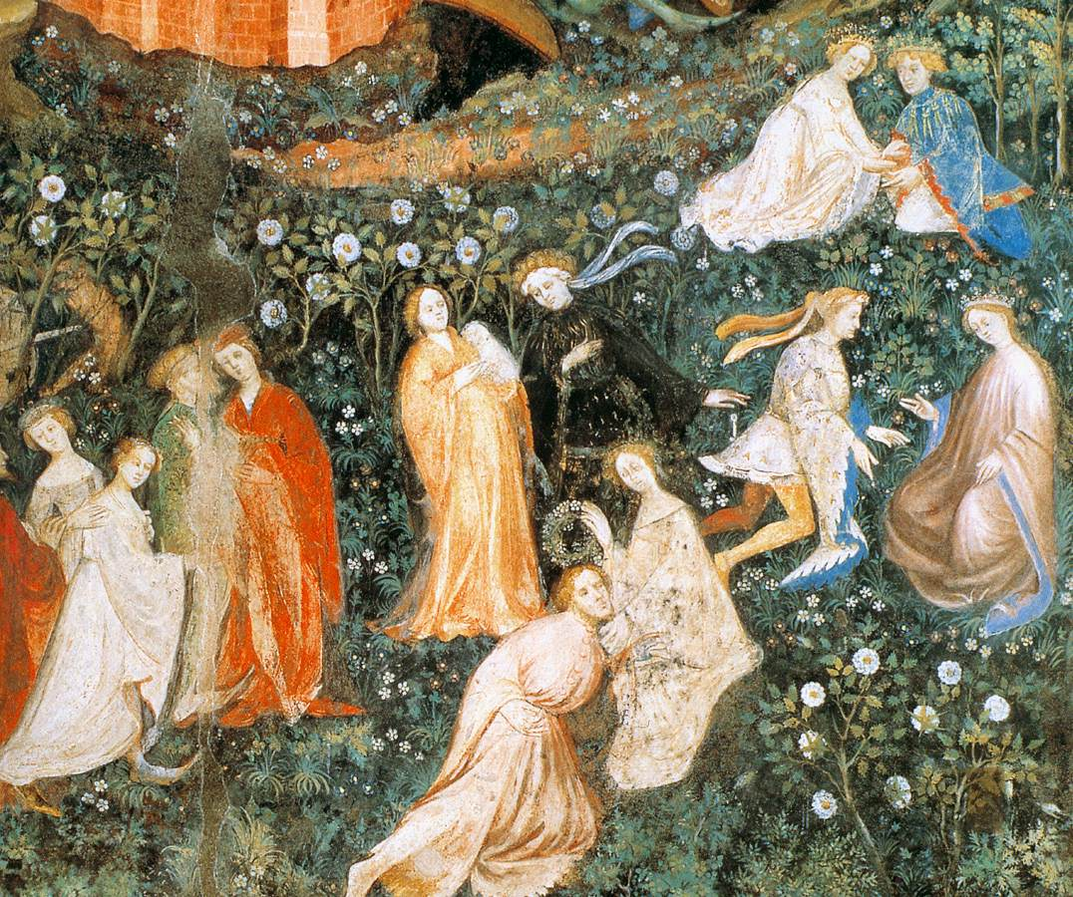
The lower part of the composition is entirely devoted to the pleasures and amusements of courtly society.

Slide 15
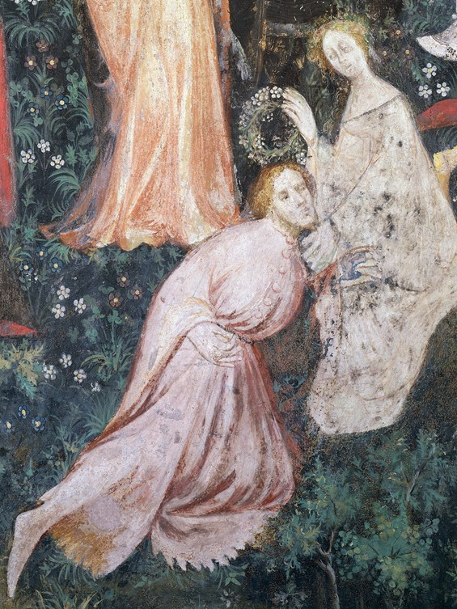
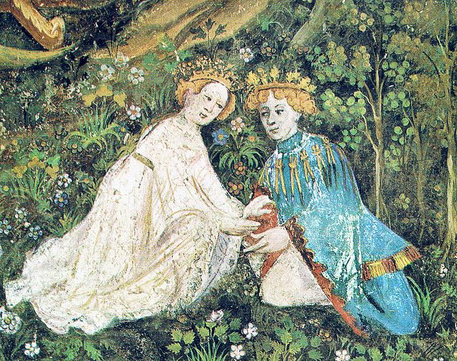

Slide 16
Cycle of the Twelve Months – Southern Wall – April, May and June - Torre Aquila

Slide 17
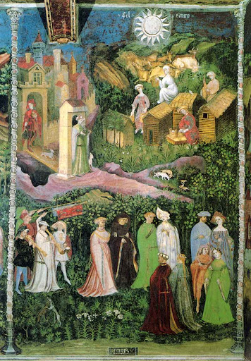

The Month of June, late 14 thcentury-latest 1407, possibly by Maestro Venceslao, fresco, Torre Aquila

Slide 18
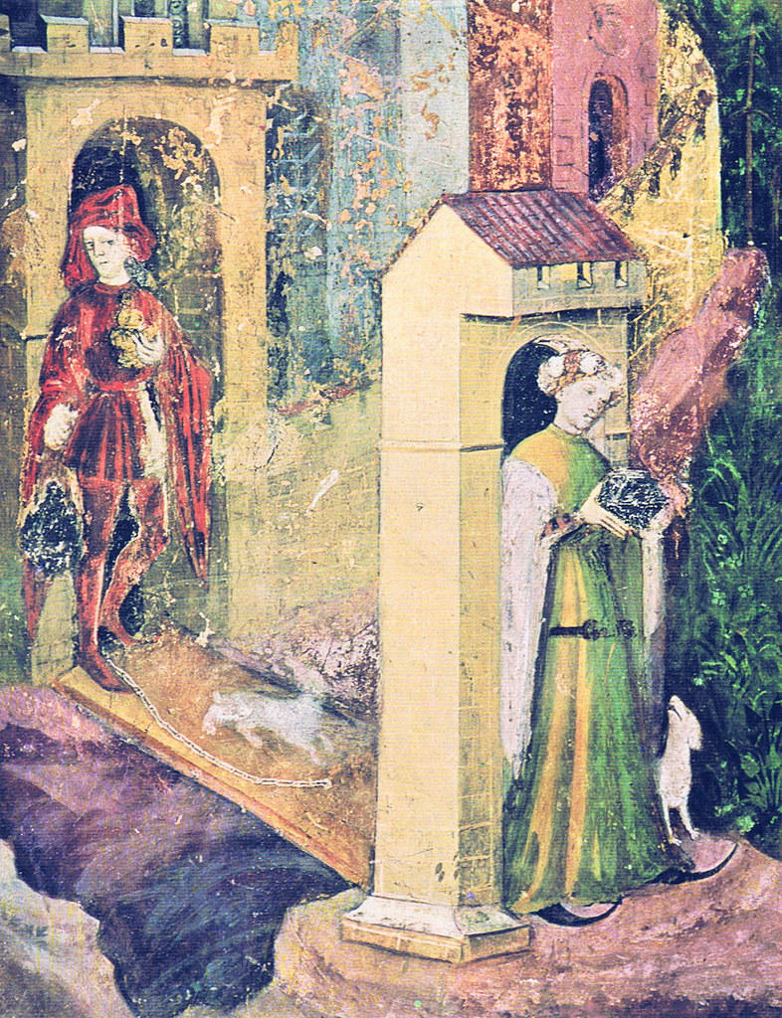
Cycle of the Twelve Months – June - Eastern Wall - Torre Aquila

Slide 19
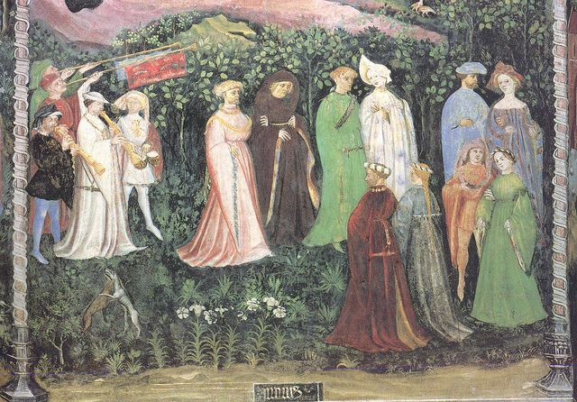
Cycle of the Twelve Months – June - Eastern Wall - Torre Aquila

Slide 20
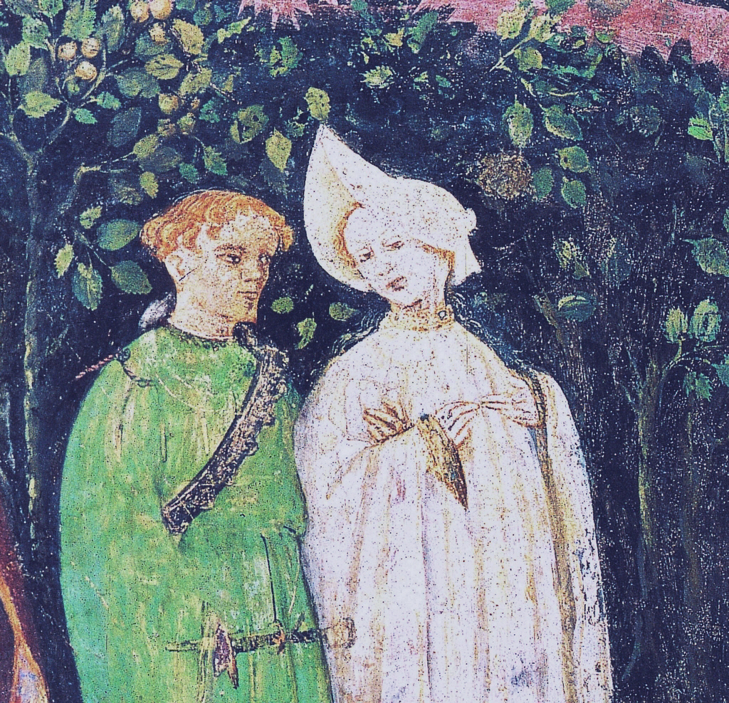
Cycle of the Twelve Months – June - Eastern Wall - Torre Aquila

Slide 21
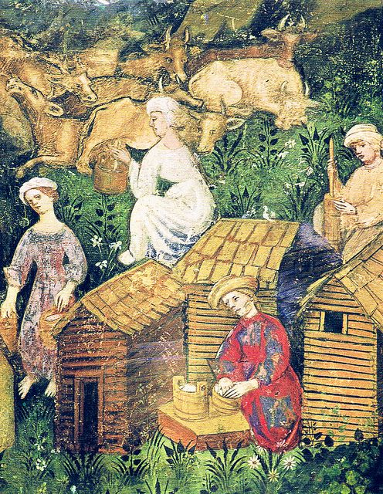
Cycle of the Twelve Months – June - Eastern Wall - Torre Aquila

