Slide 1
The Small Arch of Galerius in the Archaeological Museum of Thessaloniki

Slide 2
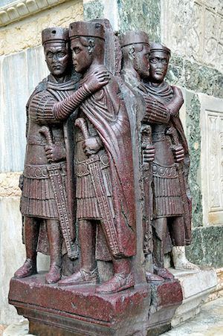
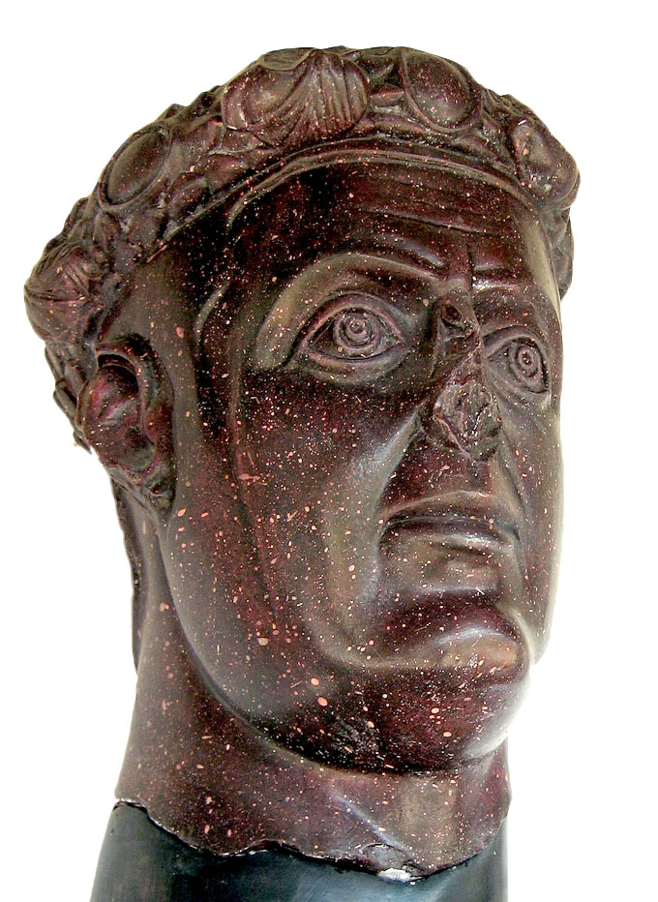
The Tetrarchs, 3rd cent. AD, porphyry, Saint Marc’s Cathedral, Venice
Tetrarchy refers to the establishment by the Roman Emperor Diocletian of a 4-part division of the Roman empire. Diocletian and Maximian, his equal and co-emperor, ruled the East and relatively the West. They both held the title of Augustus as they were emperors. In 293, they took two “assistants” dubbed as Caesars: Galerius, in the East, and Constantius in the West.
Galerius’ Portrait in porphyry, from his palace in Romuliana (Gamzigrad), 3rd century AD

Slide 3
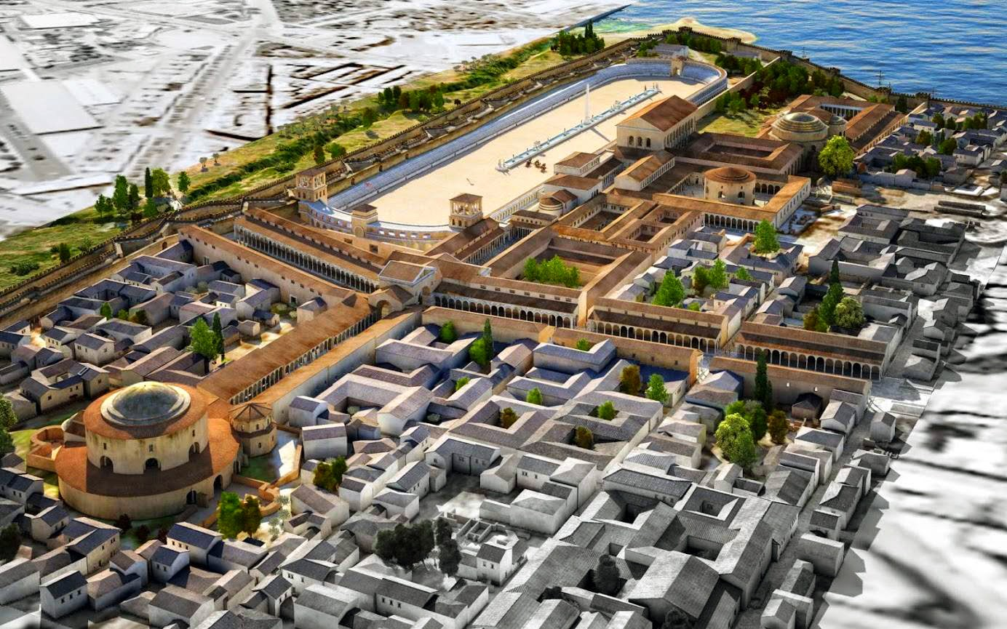
Thessaloniki the Galerian Complex and the Rotunda

Slide 4
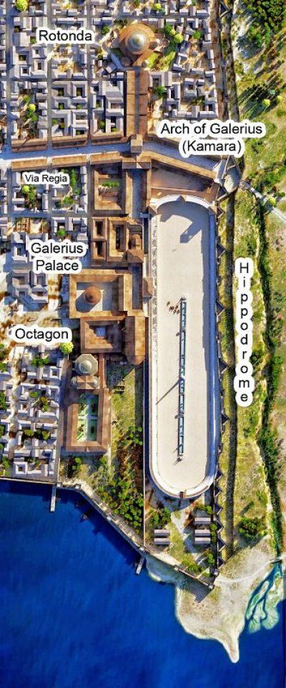
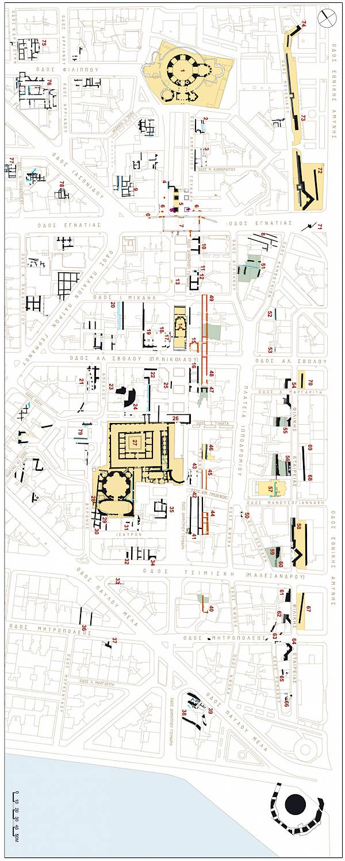
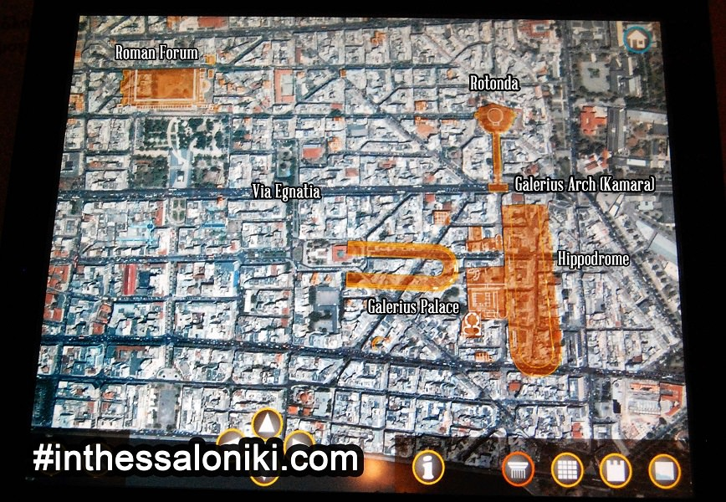
“The palace of Galerius is one of Thessaloniki’s most important late antique monuments, and the only one of this period in Europe which is preserved in nearly its original form to such an extent.” http://galeriuspalace.culture.gr/en/

Slide 5
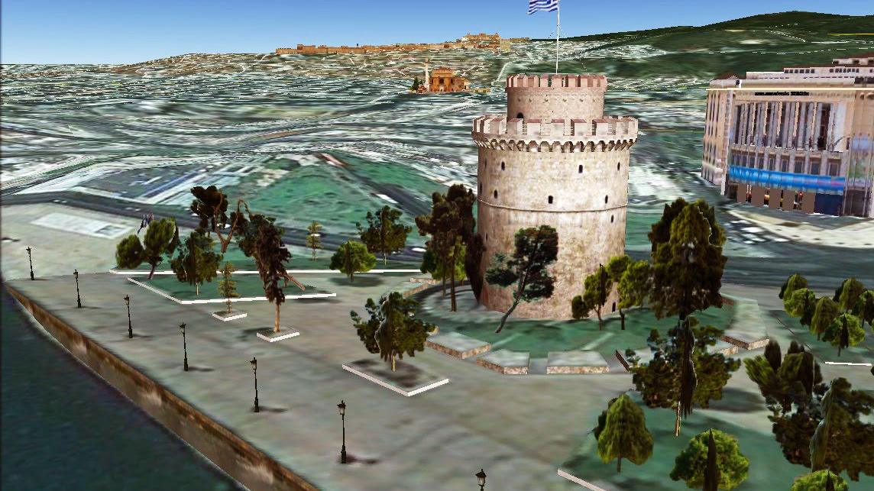

Slide 6
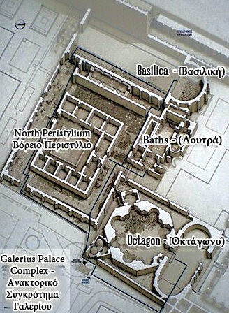

Slide 7
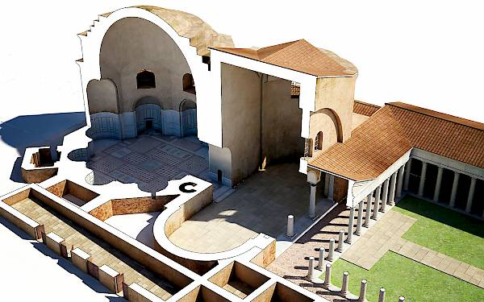
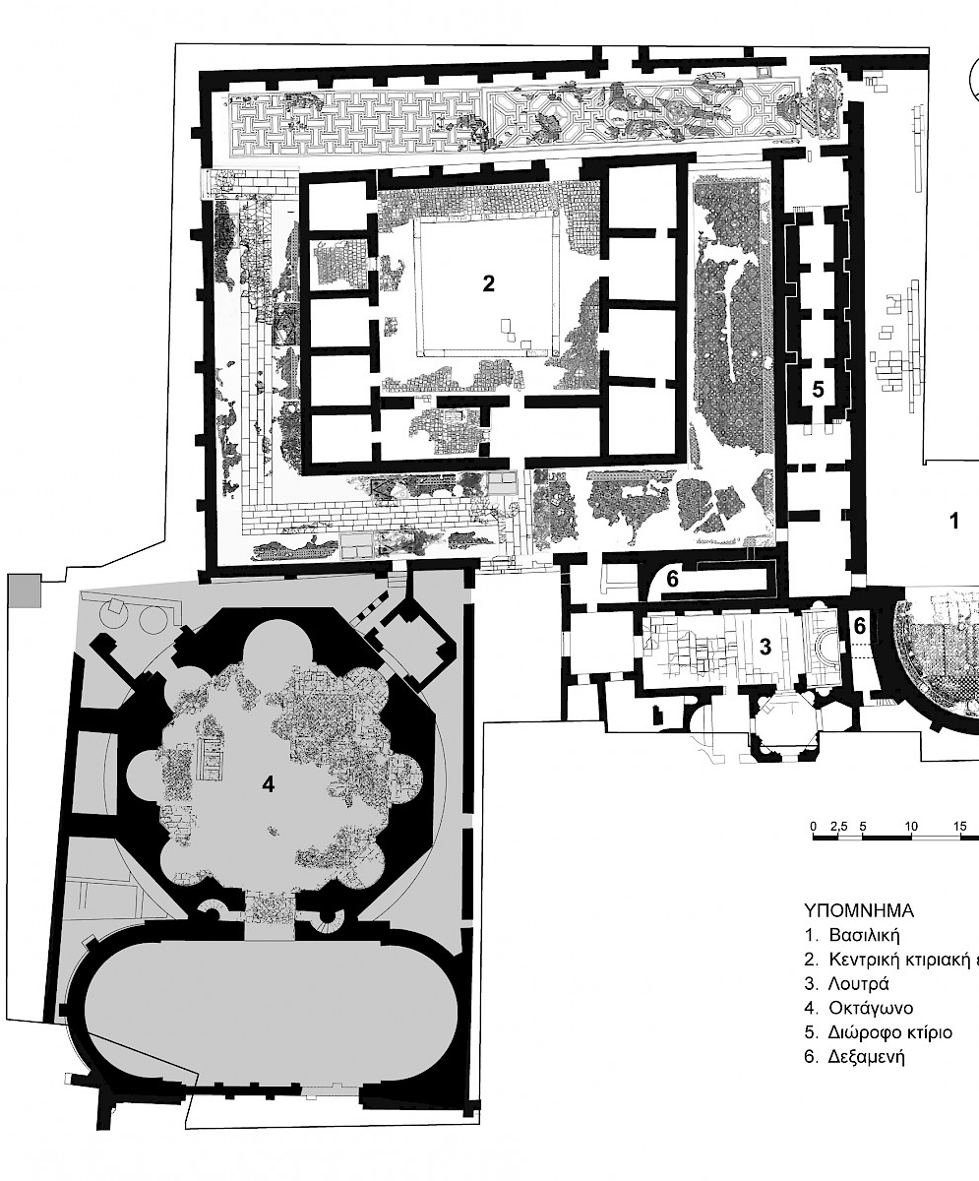
The Octagon is one of the most important buildings of the Galerian Complex. It was built west of the baths, and its main entrance faced the sea. Consisting of two parts, an impressive Octagonal Hall and a Vestibule with two semi-circular niches on its narrow ends, the structure had an equally impressive opening, a columned Tribelon, to the South, leading to a large Peristyle Court (width 47m., length 88m.).

Slide 9
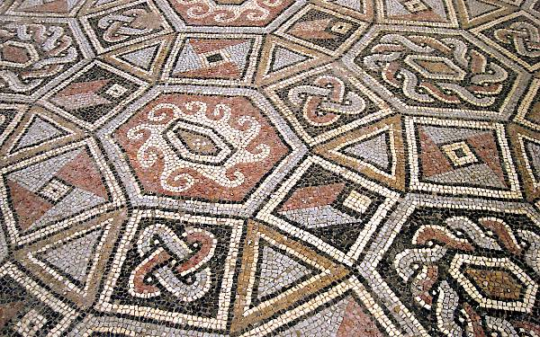
The grand, South Peristyle Court Portico floors were adorned with magnificent Mosaics

Slide 10
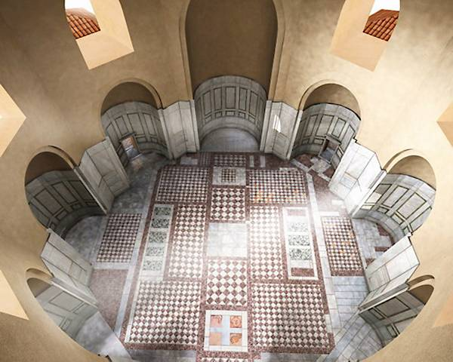
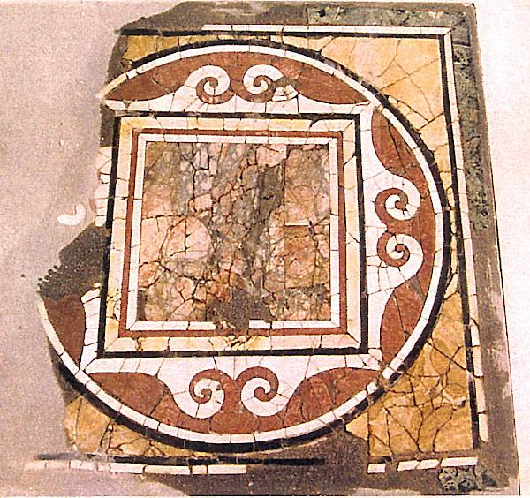
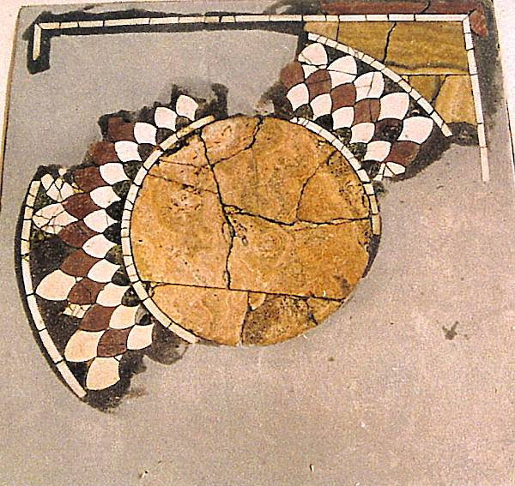
The Οctagon walls were covered with multicoloured marble revetments and square panels, intricately worked in the opus sectile technique. The floor, featuring marble geometric motifs, created simple yet elegant chromatic oppositions… and there were four different Emblemata on its southern side.

Slide 11
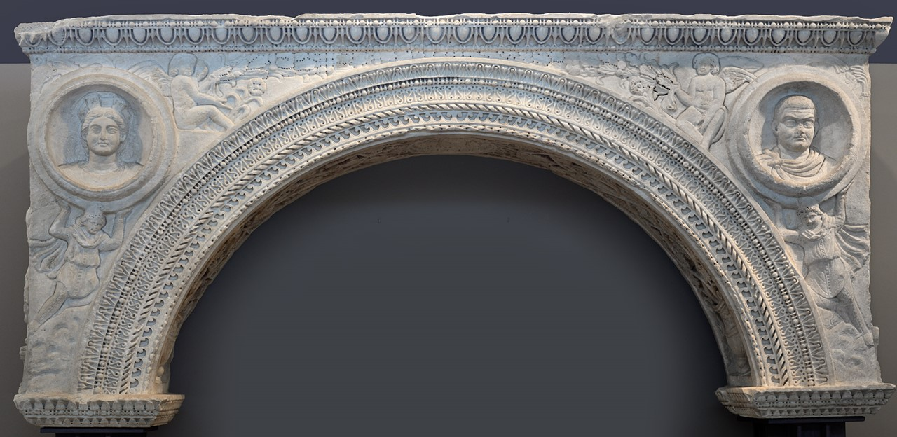
At the north end of the east portico, which led to the marble staircase of the south corridor, there was a horseshoe-shaped niche framed by pilasters supporting a marble arch found during excavation of the site. This arch, known by the conventional name “The Small Arch of Galerius”, is on display in the Archaeological Museum of Thessaloniki.

Slide 12
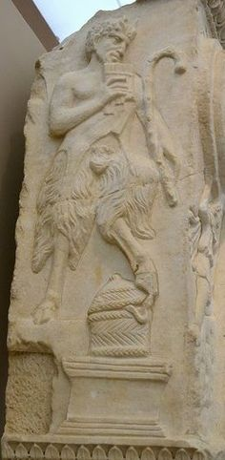
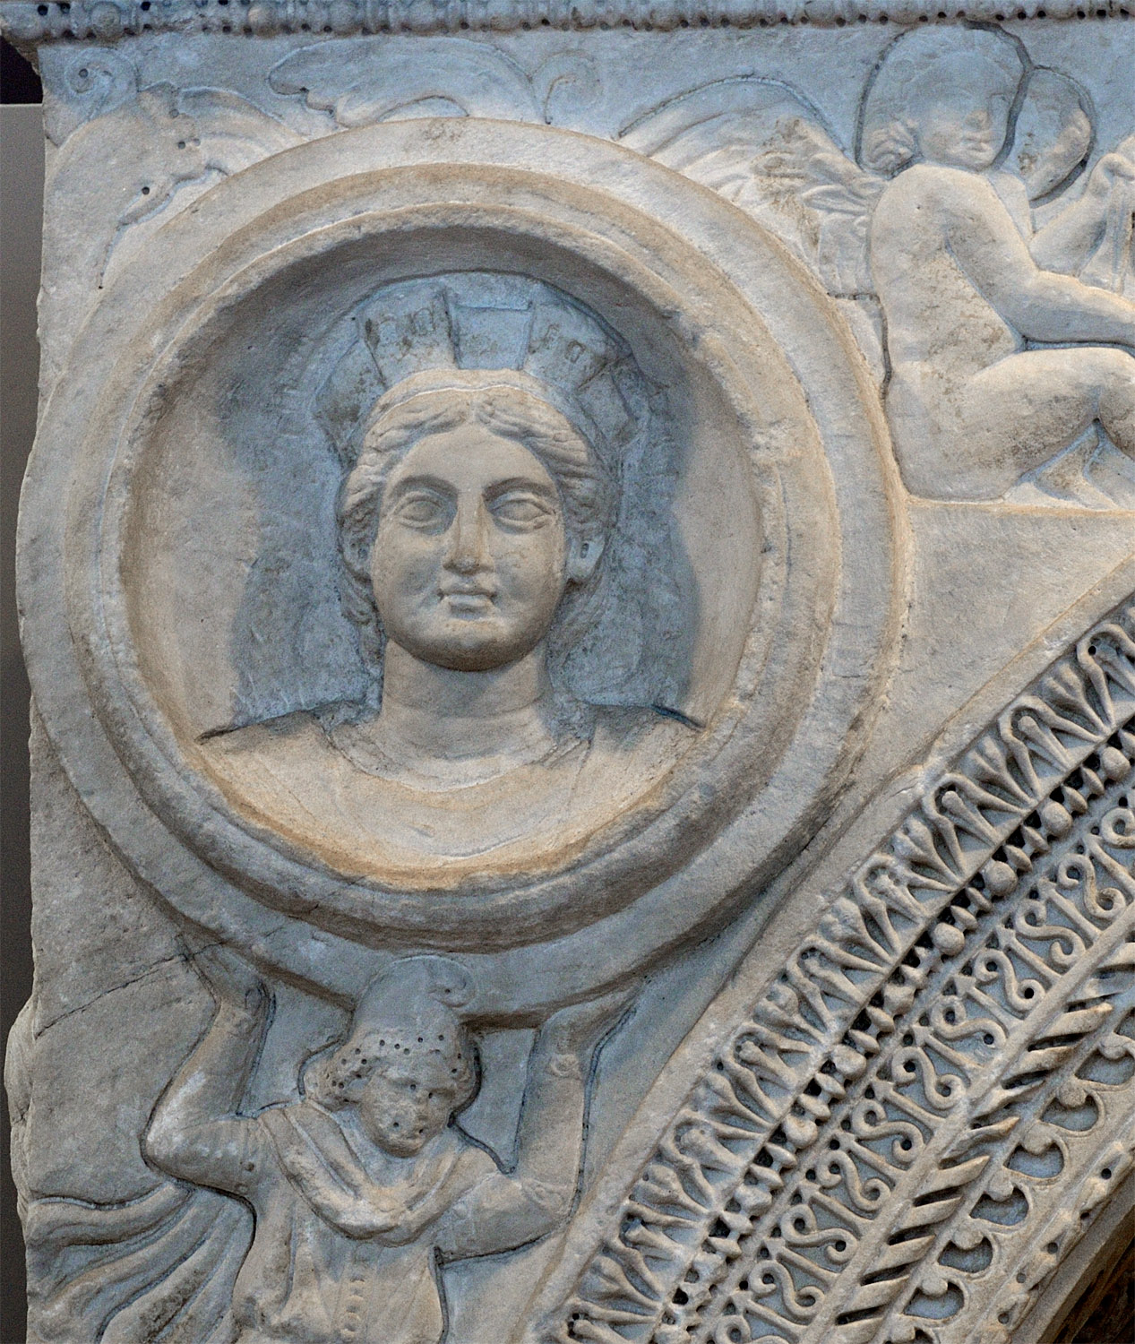
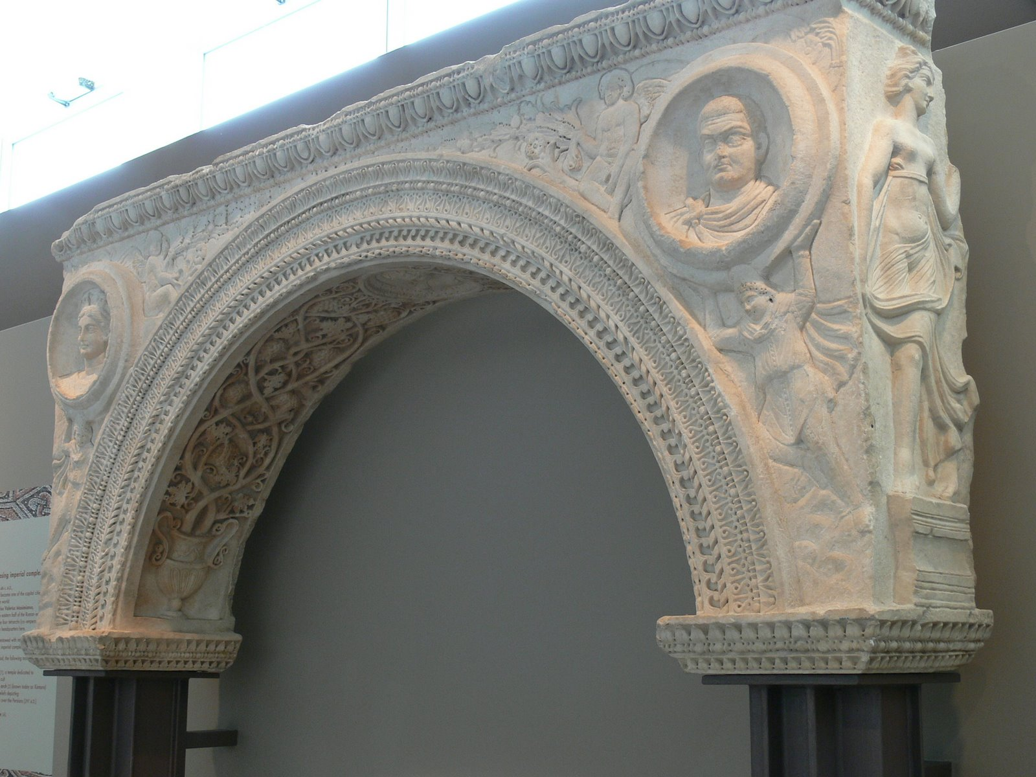
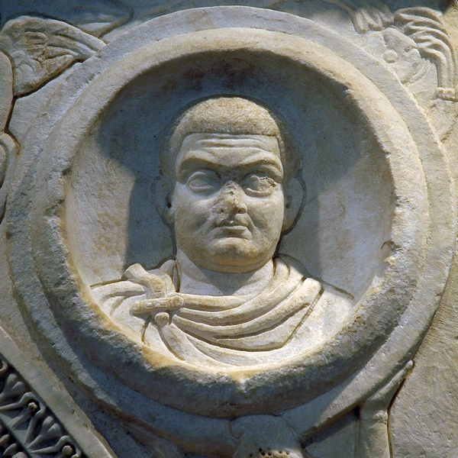
The small Arch of Galerius, a work of high artistic quality, is the product of a local workshop in Thessaloniki. “The rich relief decorations occupy three sides of the arch. The main side depicts two men from the East, possibly Persians, raising two circular medallions with their hands. The right medallion depicts Gaius Galerius Valerius Maximianus, while the left one initially depicted his wife, Galeria Valeria.” https://www.amth.gr/en/exhibitions/highlights

Slide 13
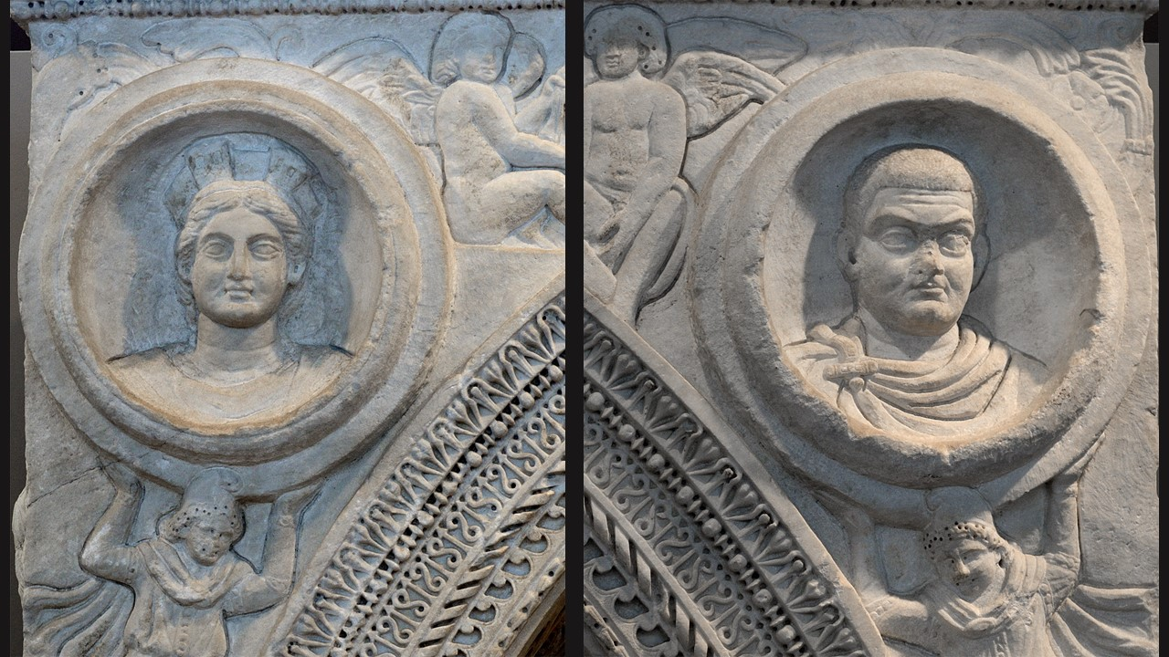

Slide 14
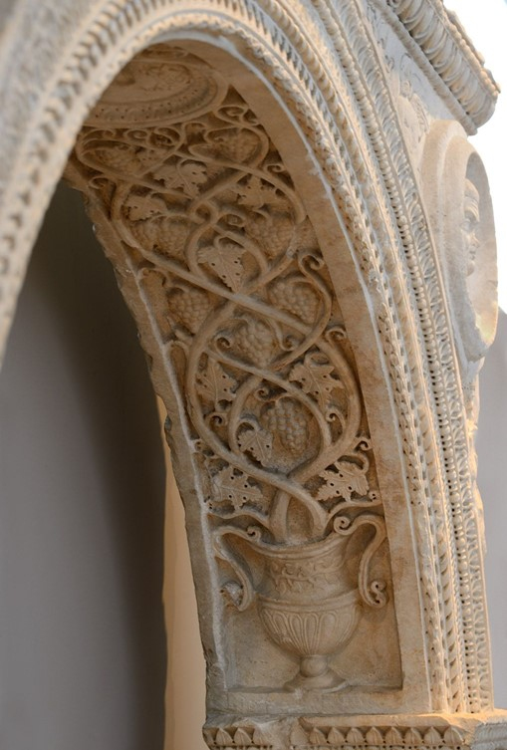
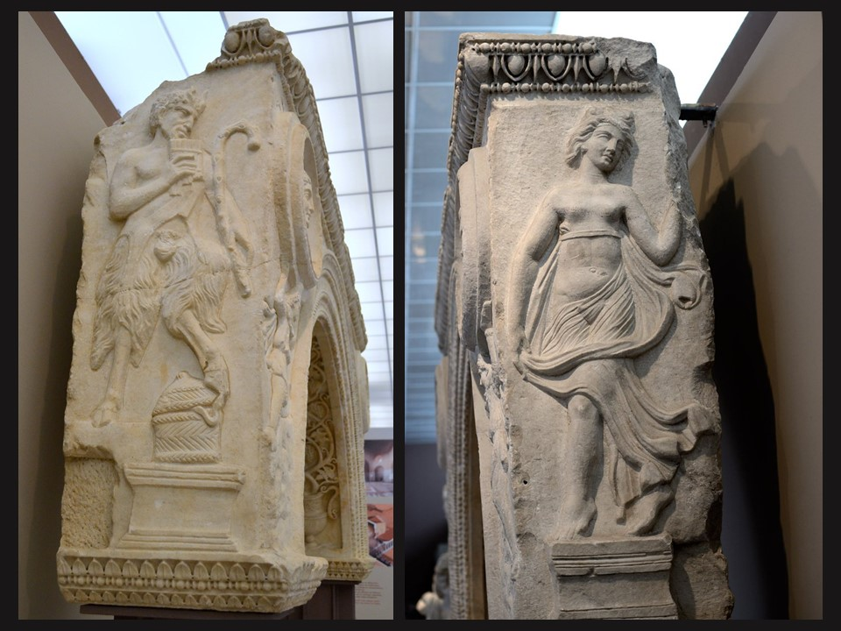
“A medallion with a bust of Dionysos is located at the inner part of the arch, surrounded by vine branches. The right side of the arch depicts the hooved god Pan, and the left side depicts a maenad. .” https://www.amth.gr/en/exhibitions/highlights

