Slide 1
Domenikos Theotokopoulos:
The
Formative
Years

Slide 2
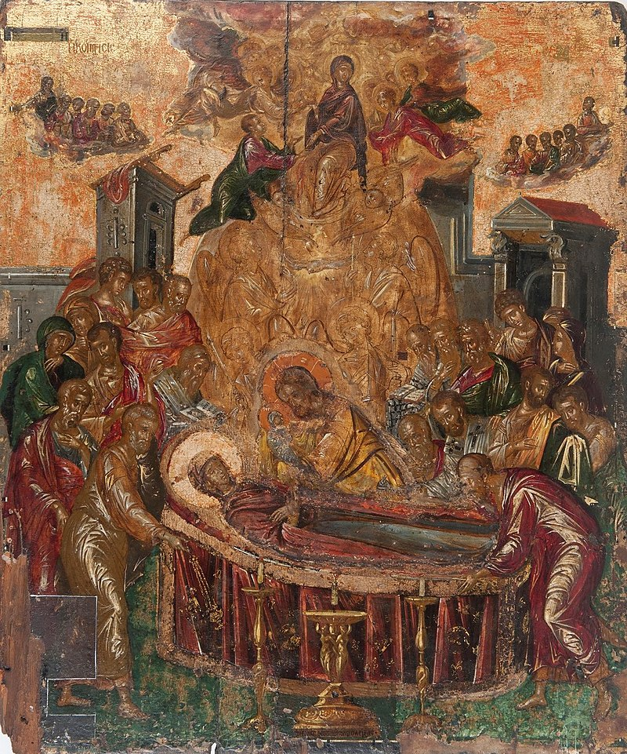
Domenikos Theotokopoulos or El Greco, 1541 – 1614
The Dormition of the Virgin, pre 1567, egg tempera on wood, Holy Cathedral of the Dormition of the Virgin, Syros island, Greece

Slide 3
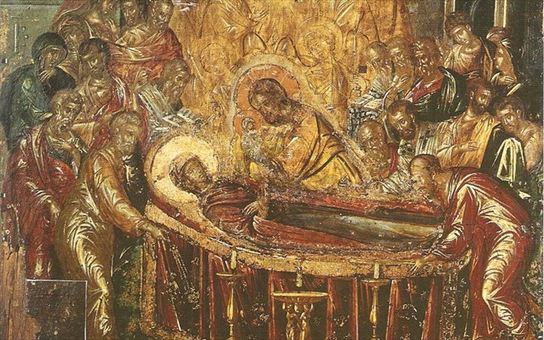

Slide 4
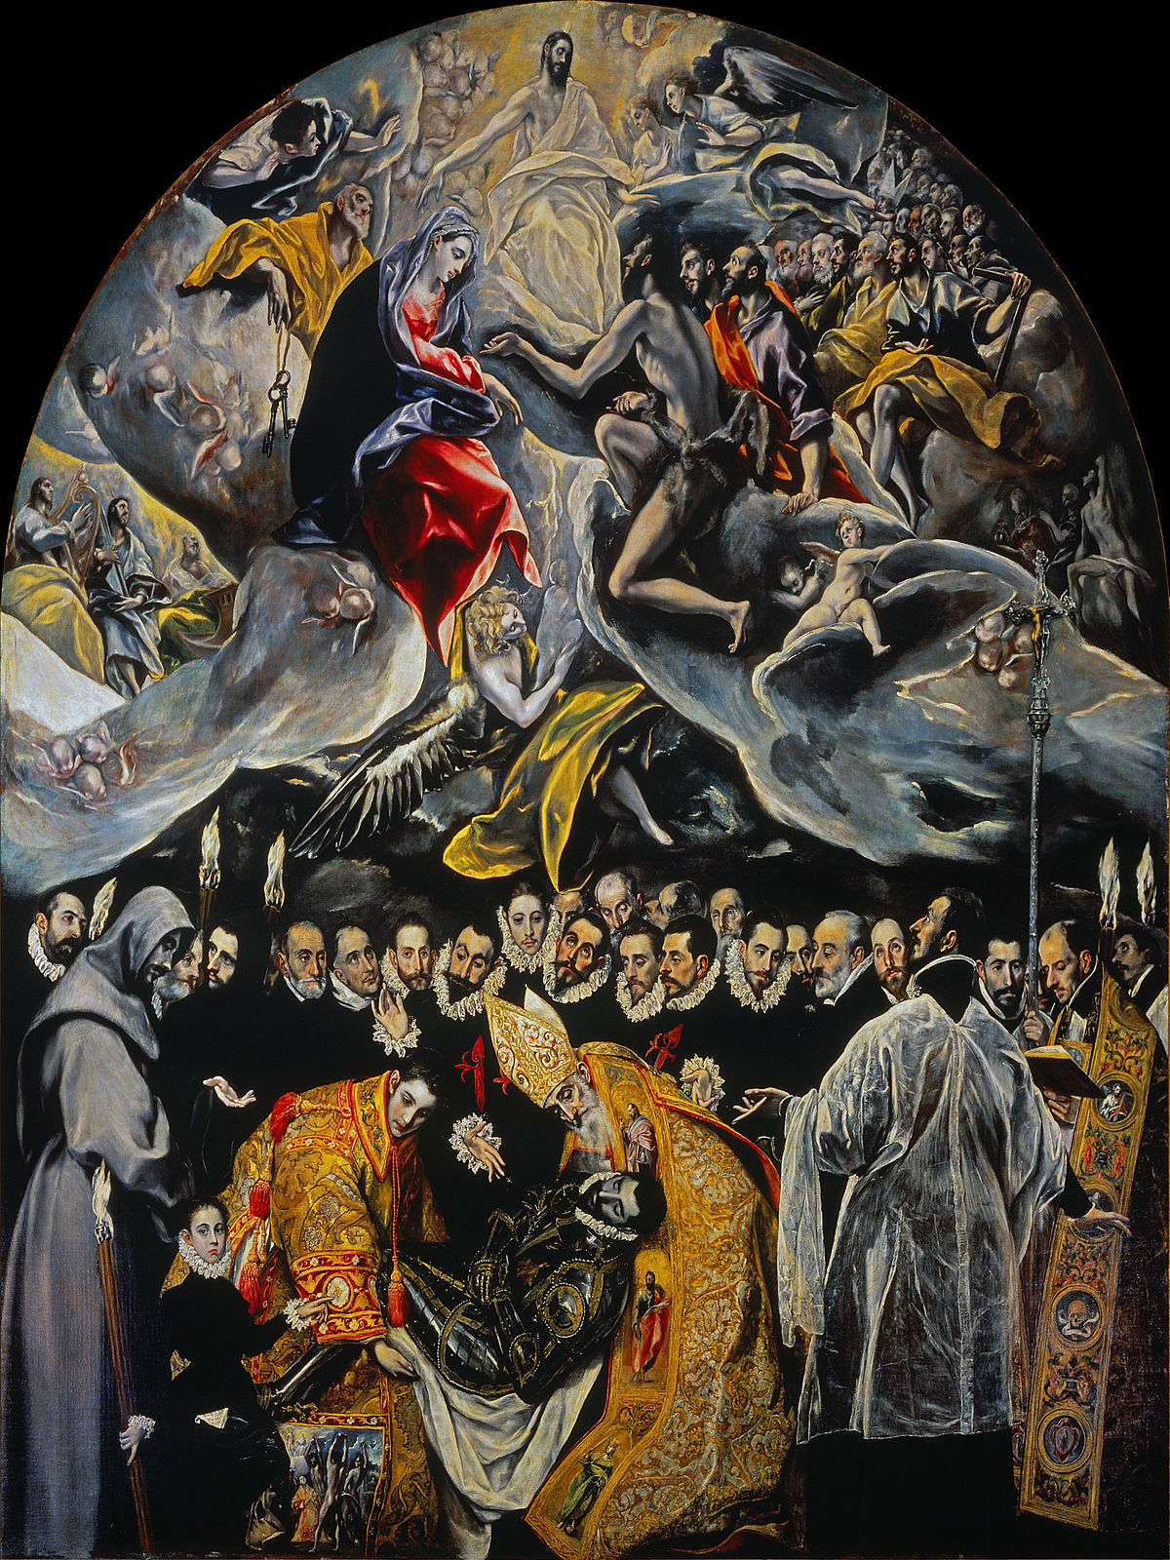
Domenikos Theotokopoulos
El Greco,
1541 – 1614
The Dormition of the Virgin, before 1567, egg tempera on wood, Holy Cathedral of the Dormition of the Virgin, Syros island, Greece
The Burial of the Count of Orgaz, between 1586 and 1588, oil on canvas, 480 cm × 360 cm, Iglesia de Santo Tomé, Toledo

Slide 5
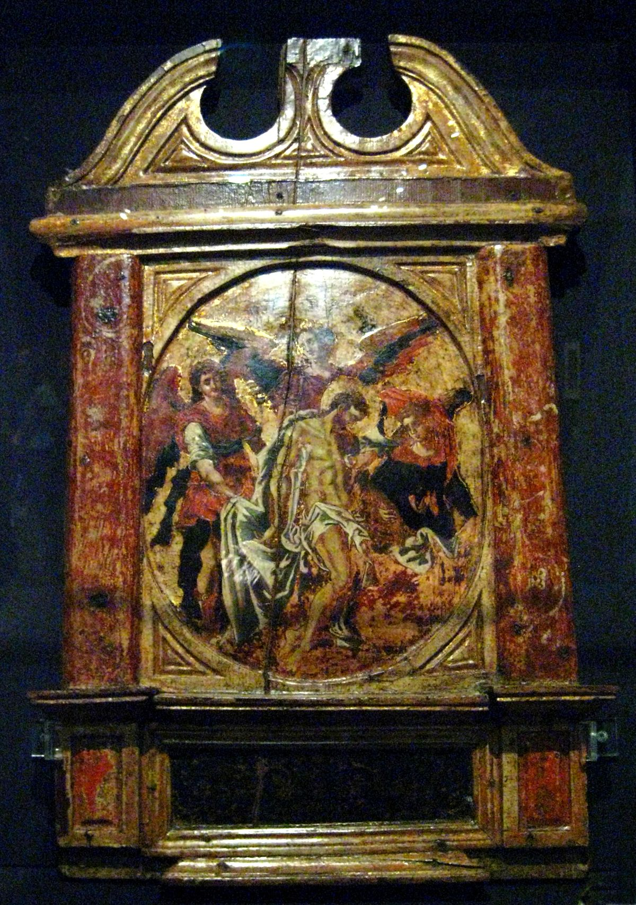
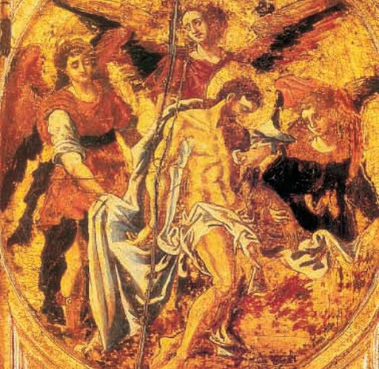
Doenikos Theotokopoulos or El Greco, 1541 – 1614
The Passion of Christ - Pieta with Angels,
1566, egg tempera on wood, Velimezis Collection

Slide 6
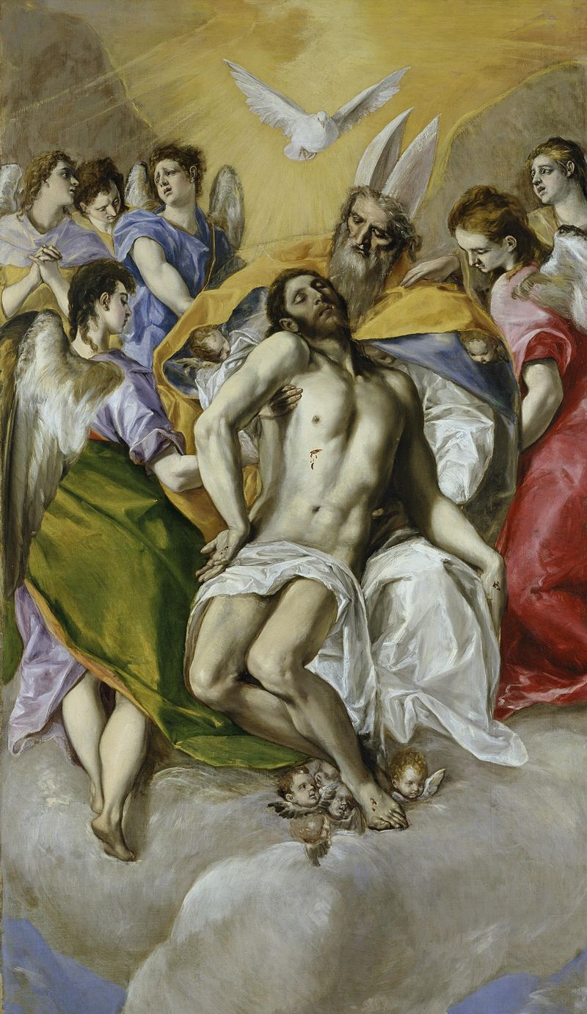
Domenikos Theotokopoulos or El Greco, 1541 – 1614
The Passion of Christ - Pieta with Angels,
1566, egg tempera on wood, Velimezis Collection
The Holy Trinity,
1577–1579, oil on canvas, 300 × 178 cm, Museo del Prado, Madrid

Slide 7
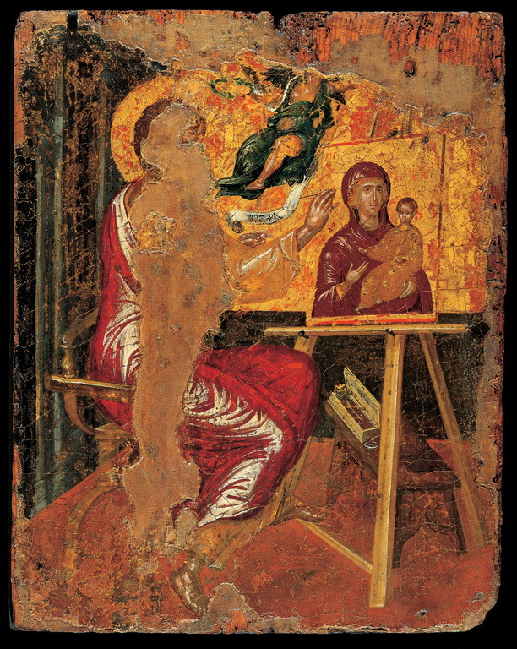
Domenikos Theotokopoulos or El Greco,
1541 – 1614
The Apostle Luke painting an image of the Virgin Hodegetria, before 1567, egg tempera on wood, 0.41x0.33 m, Benaki Museum, Athens

Slide 8
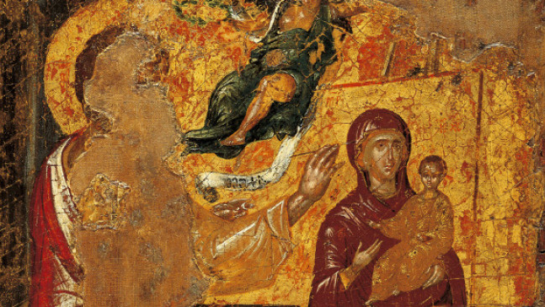

Slide 9
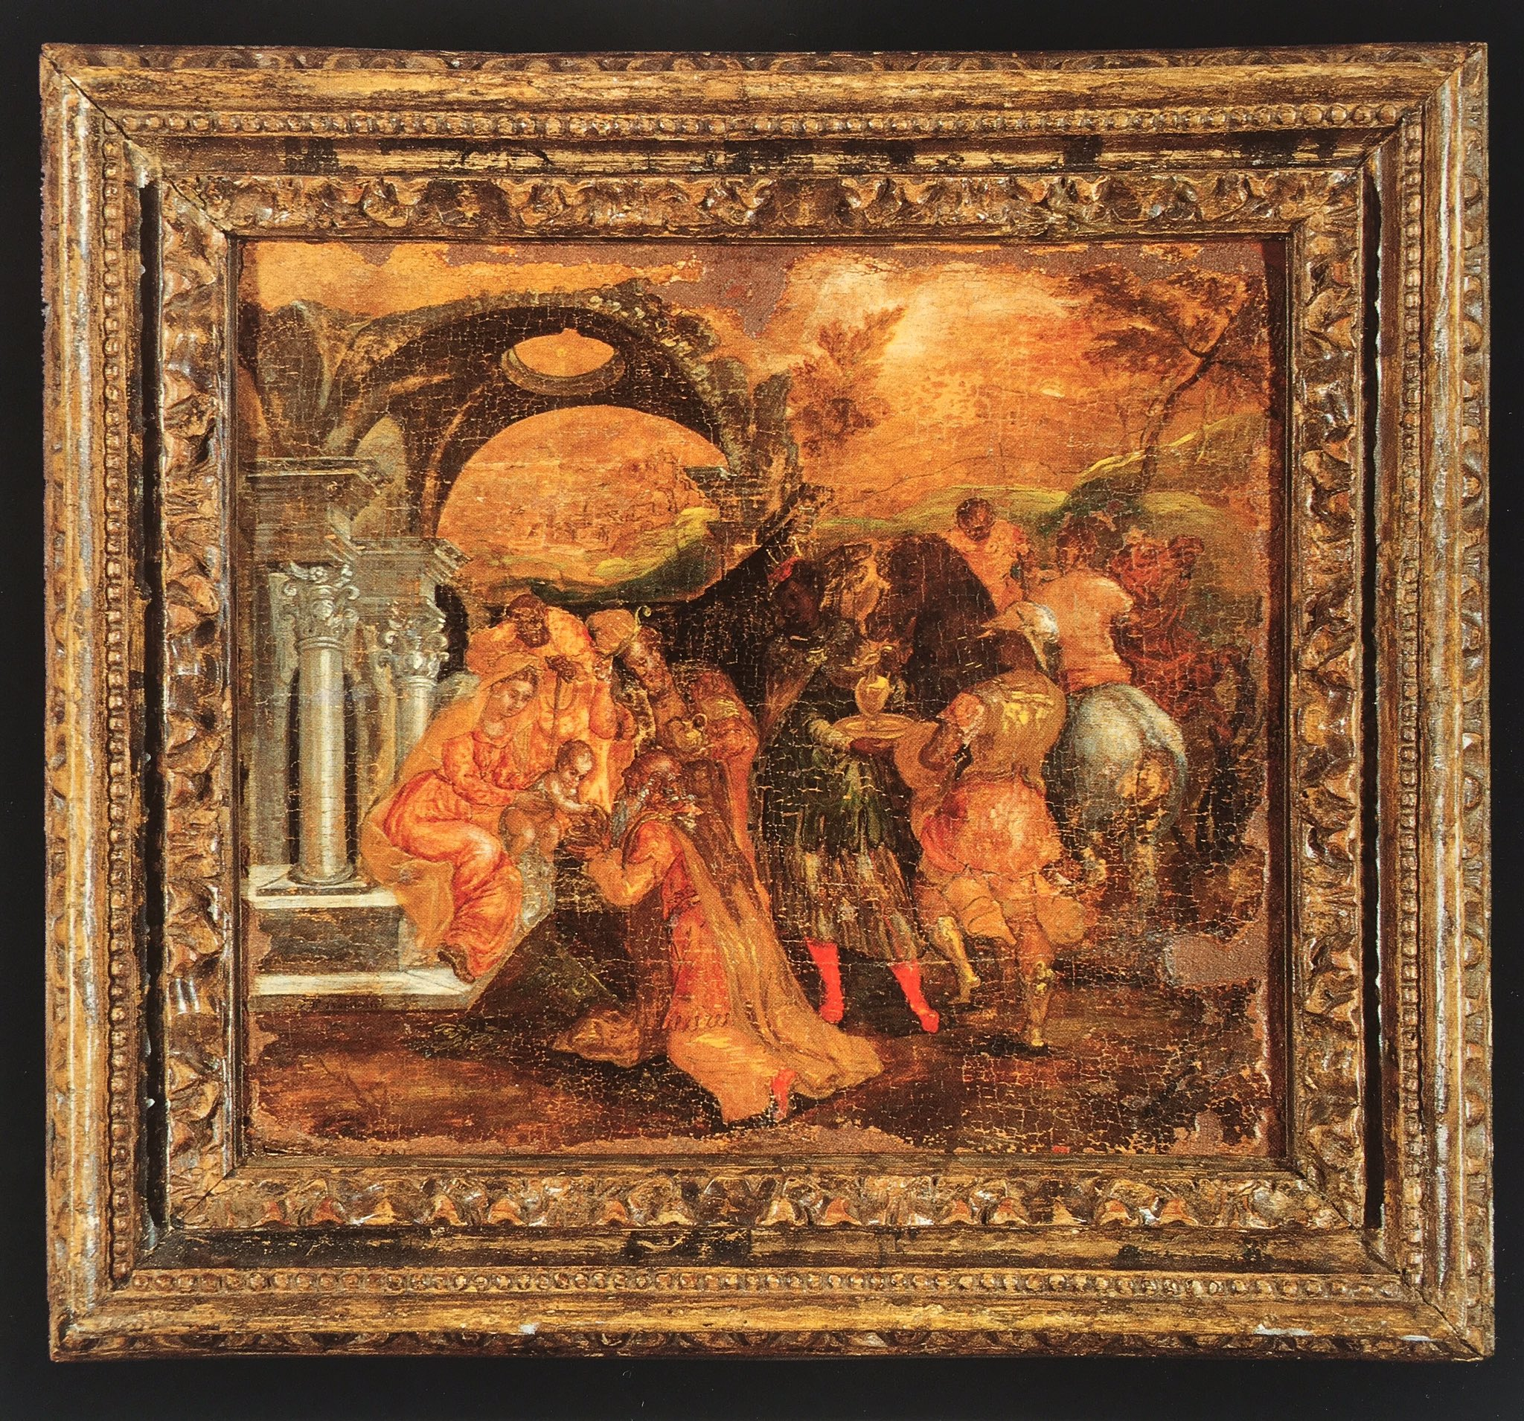
Domenikos Theotokopoulos or El Greco,
1541 – 1614
The Adoration of the Magi,

Slide 10
