Slide 1
Pompeiian Portraits of Distinction

Slide 2
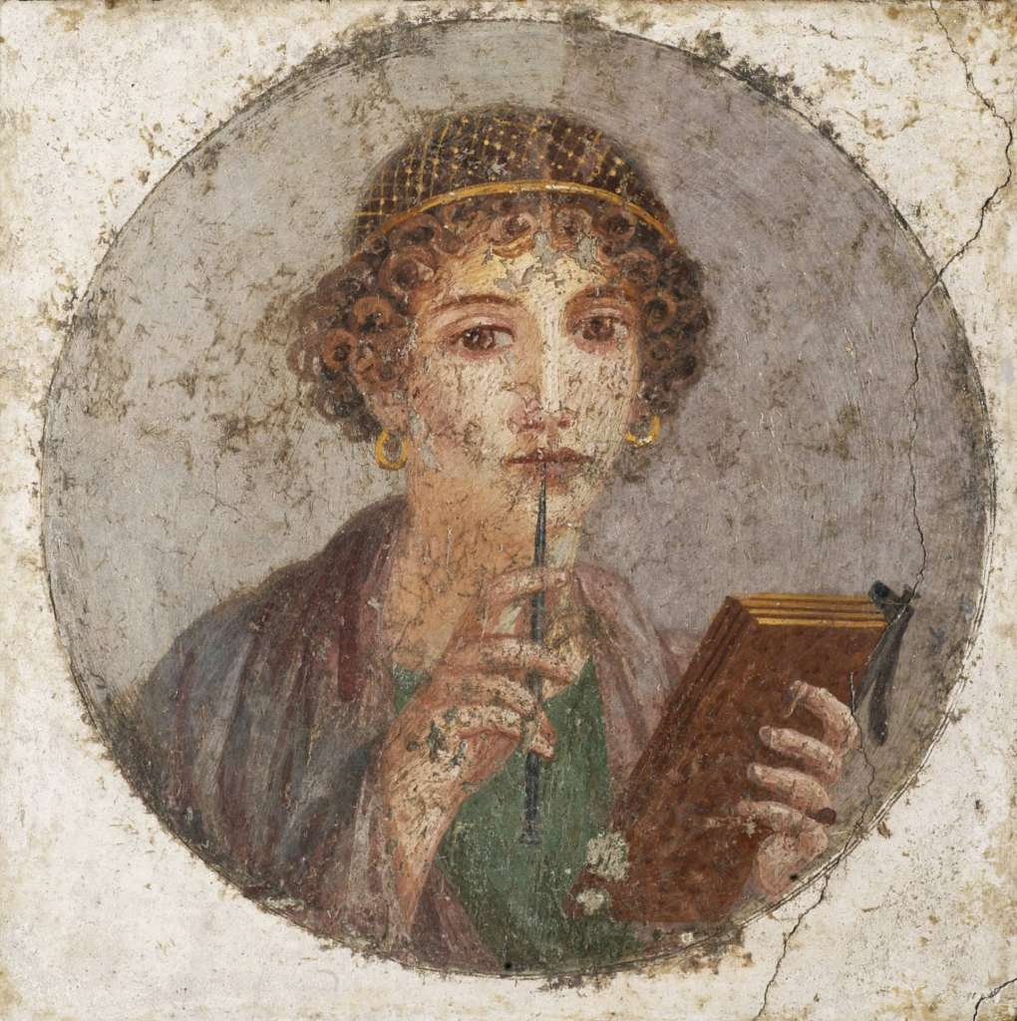
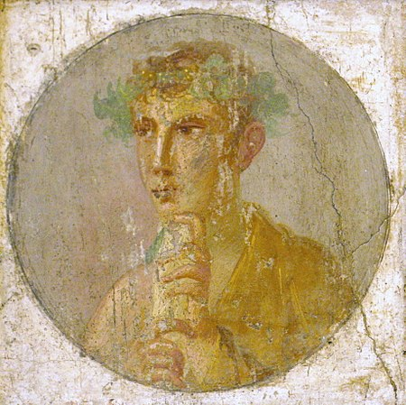

Slide 3
Woman with wax tablets and stylus, 55-79 AD, fresco in the IV Pompeian style, 37 x 38 cm, discovered in Pompeii VI- Insula Occidentalis, Museo Archeologico Nazionale di Napoli https://www.museoarcheologiconapoli.it/en/room-and-sections-of-the-exhibition/frescoes/

Slide 4
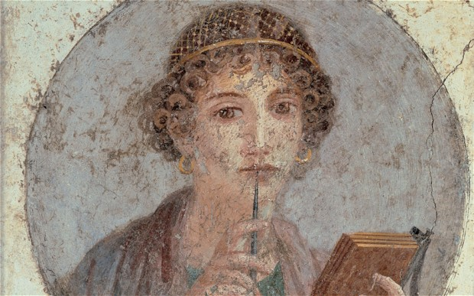

Slide 5
Portrait of a man holding a papyrus roll, 55-79 AD, fresco in the IV Pompeian style, discovered in Pompeii VI- Insula Occidentalis, Museo Archeologico Nazionale di Napoli https://commons.wikimedia.org/wiki/File:A_fresco_portrait_of_a_man_holding_a_papyrus_roll,_Pompeii,_Italy,_1st_century_AD.jpg

Slide 6
The other famous Pompeiian Fresco Painting of a Couple…

Slide 7
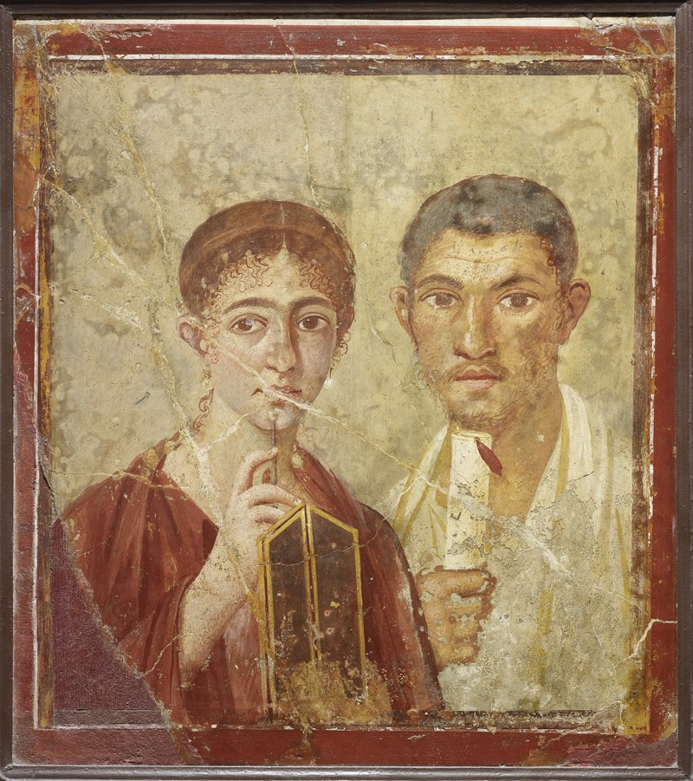
Wall painting of the baker Terentius Neo and his wife, 50 to 79 AD, fresco in the IV Pompeiian Style, discovered in Pompeii in the House of Terentio Neo, Museo Archeologico Nazionale di Napoli
Copyright Soprintendenza Speciale per i Beni Archeologici di Napoli e Pompei / Trustees of the British Museum https://www.world-archaeology.com/museum/life-and-death-in-pompeii-and-herculaneum-ordinary-people-in-extraordinary-times/#jp-carousel-6781

Slide 8
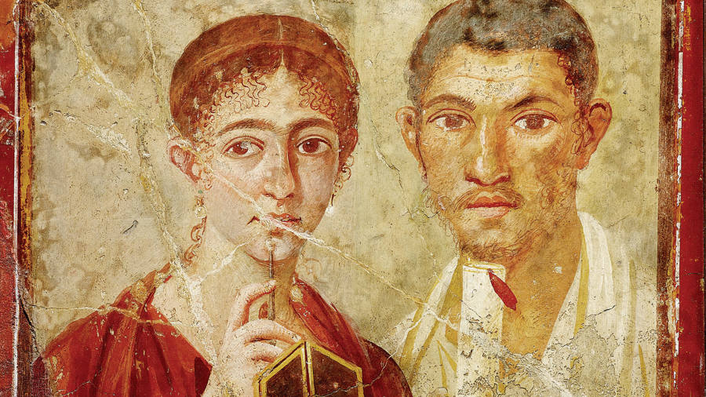
Copyright: https://www.ft.com/content/da9c0dea-8b1c-11e2-b1a4-00144feabdc0

