Slide 1
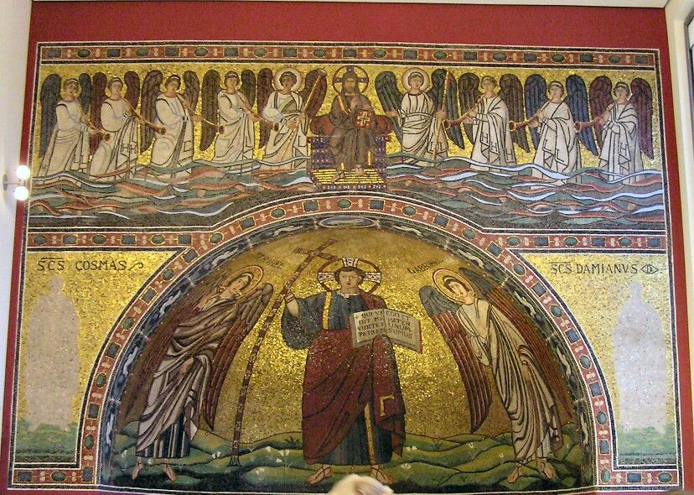
San Michele in Africisco Apse Mosaic, 6th century, Bode Museum, Berlin

Slide 2
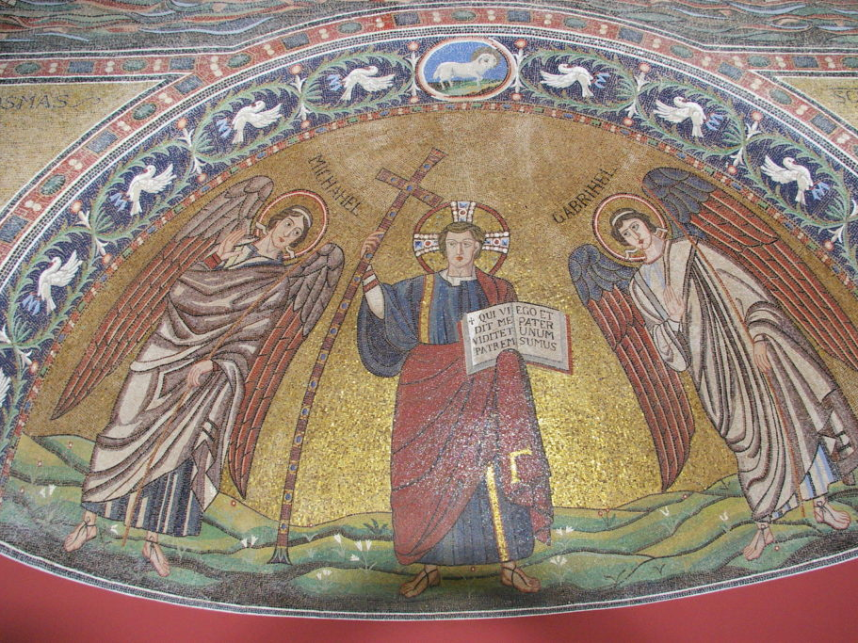

Slide 3
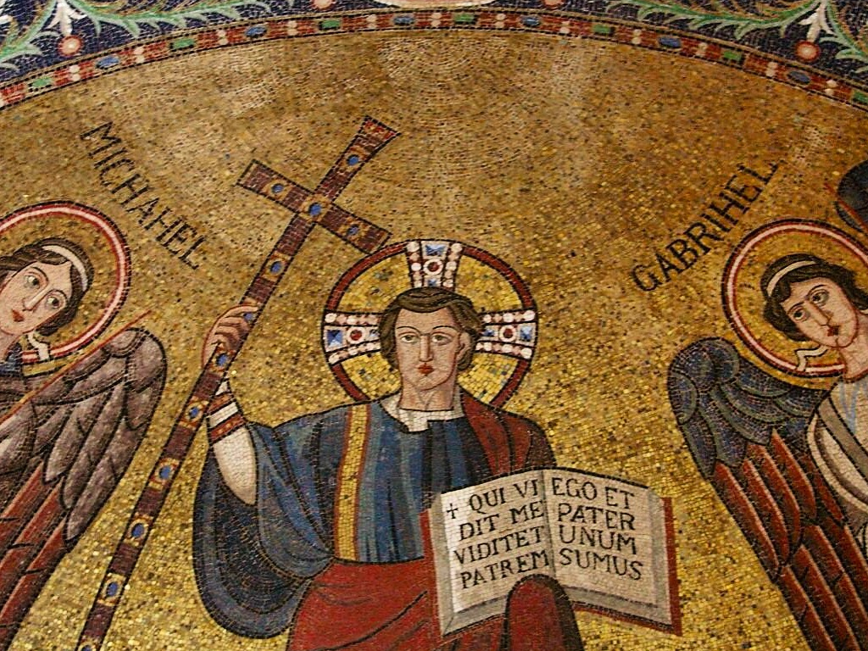

Slide 4
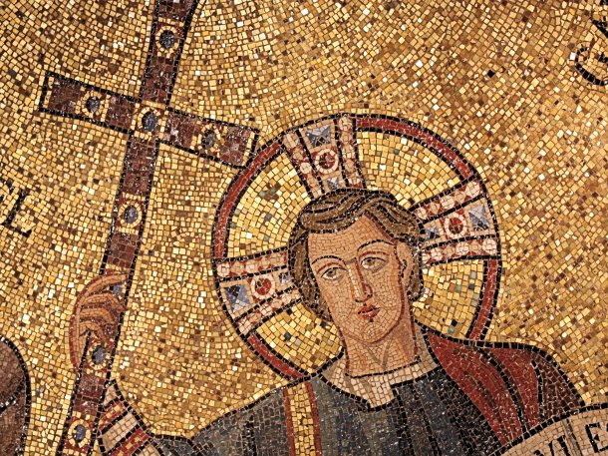

Slide 5
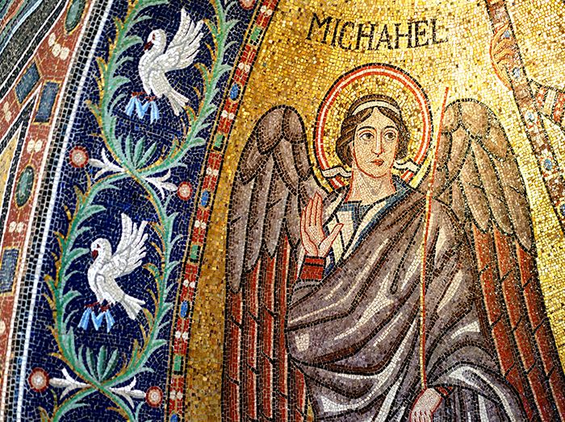

Slide 6
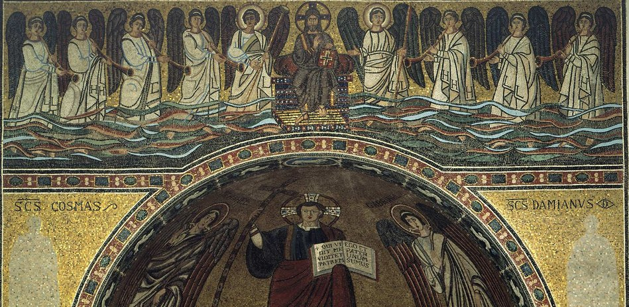

Slide 7
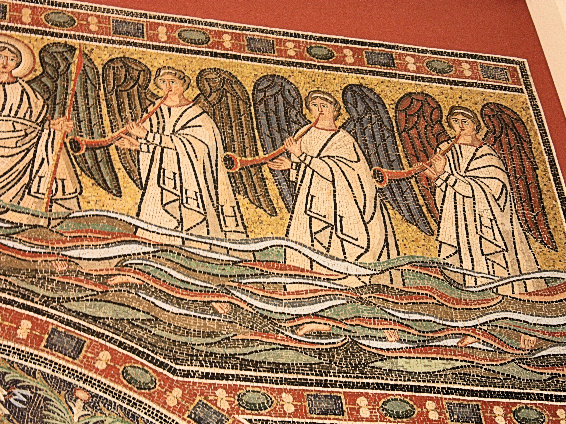

Slide 8
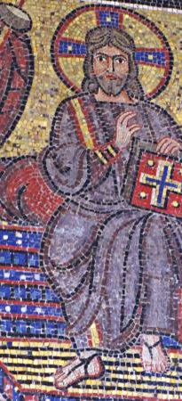
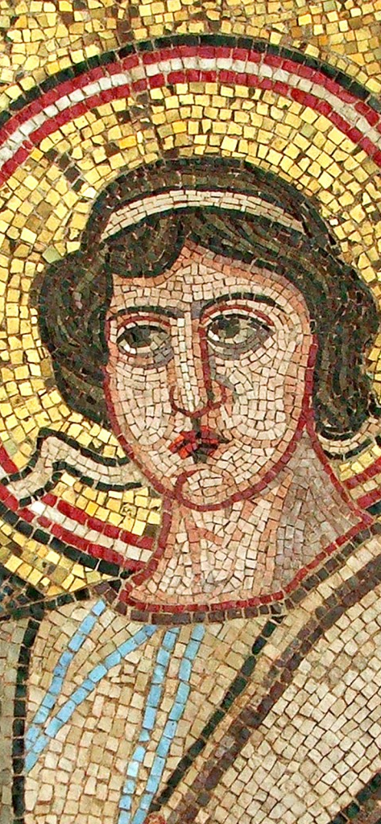
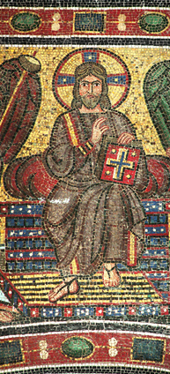

Slide 9
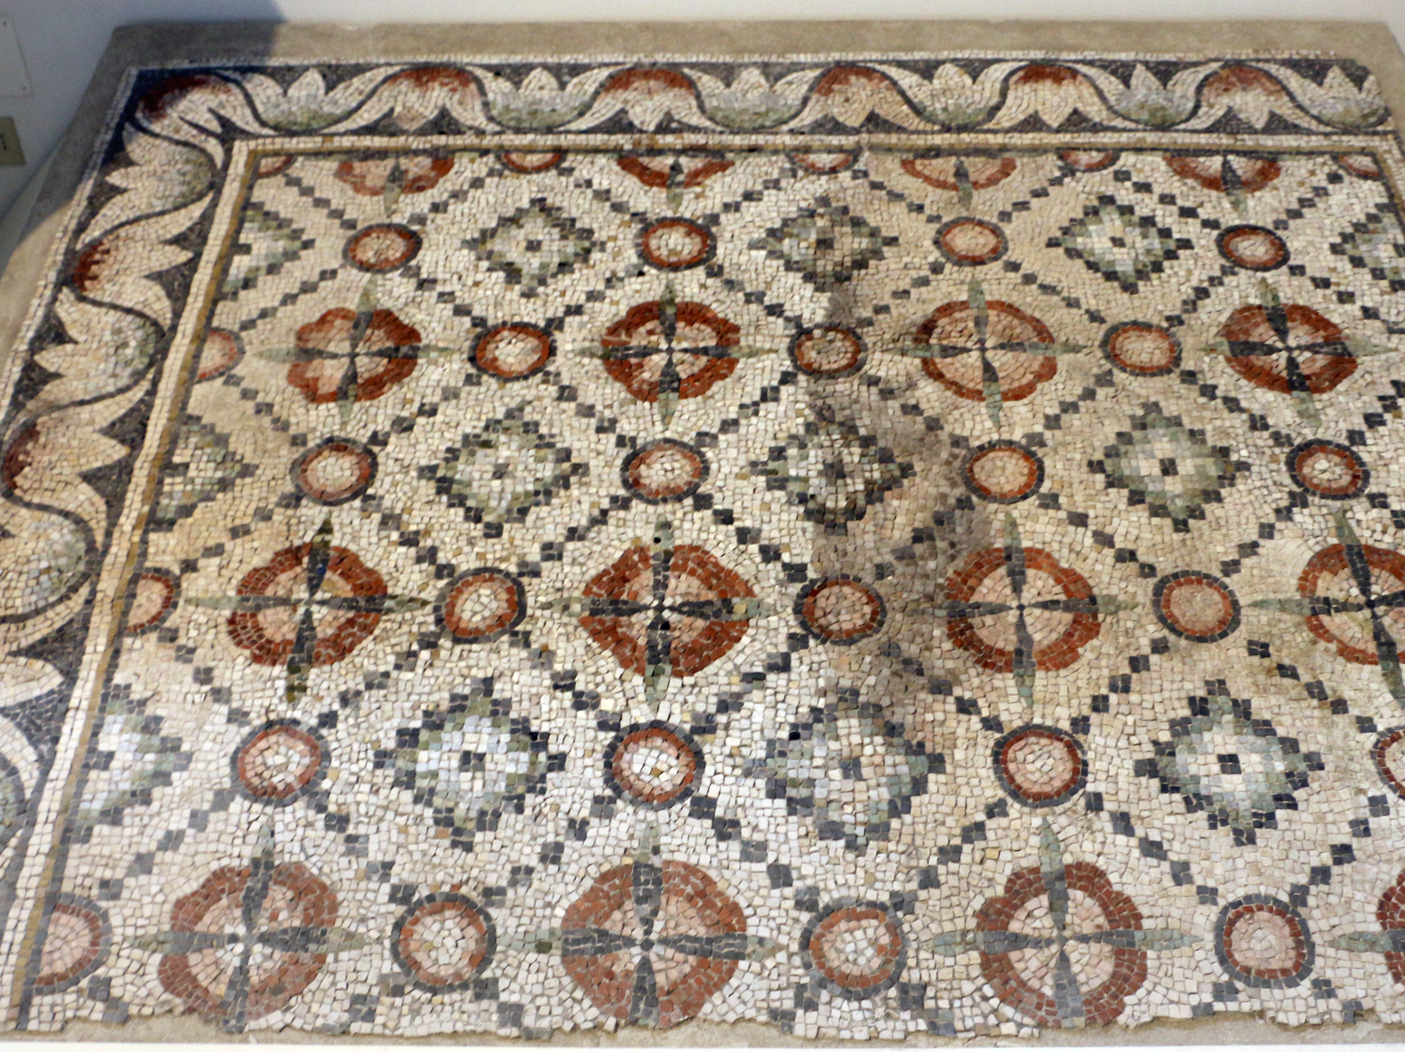

Slide 10
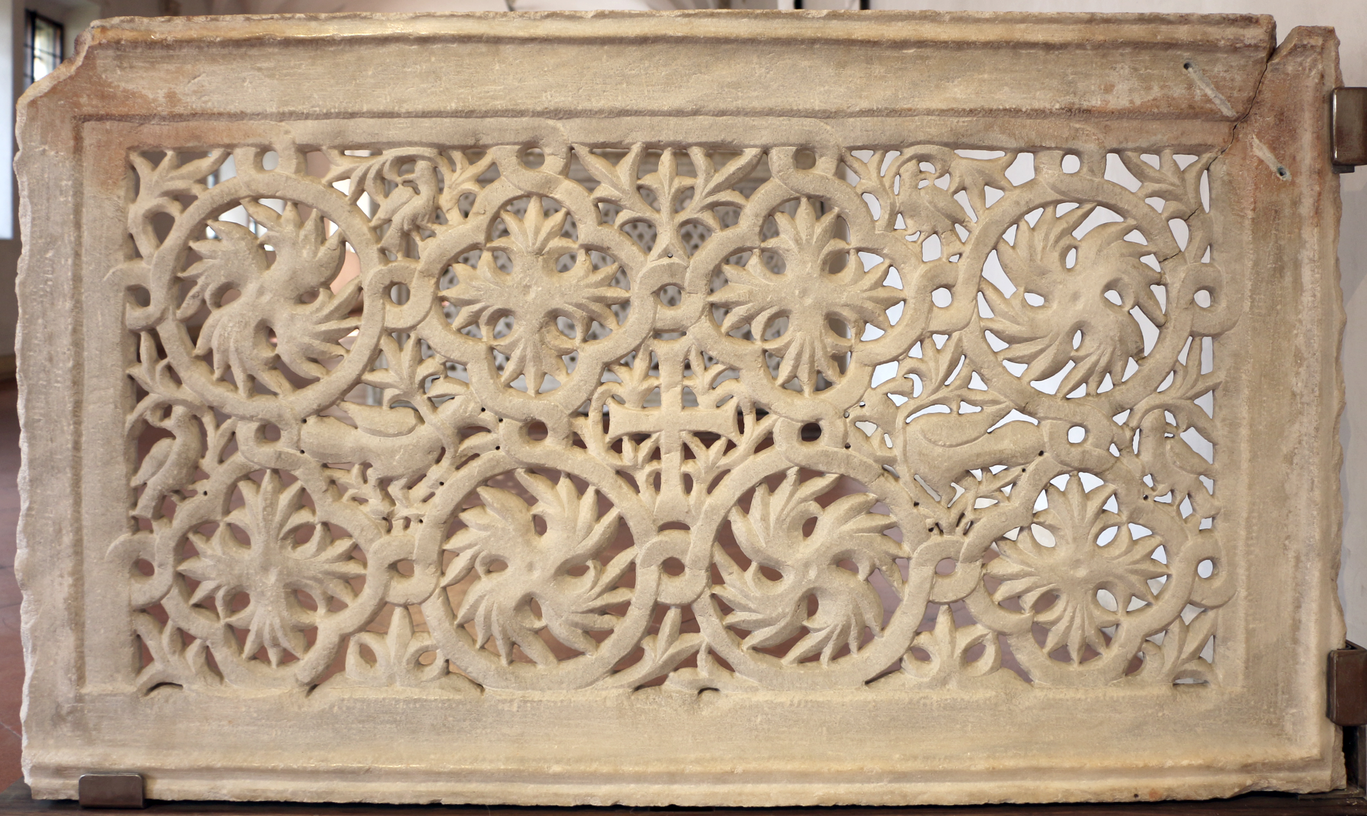

Slide 11
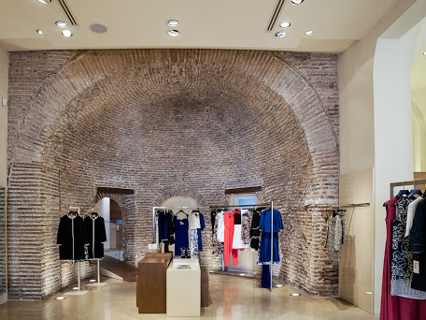
The Holy Apse of San Michele in Africisco as it is today, a Max Mara shop

Slide 12
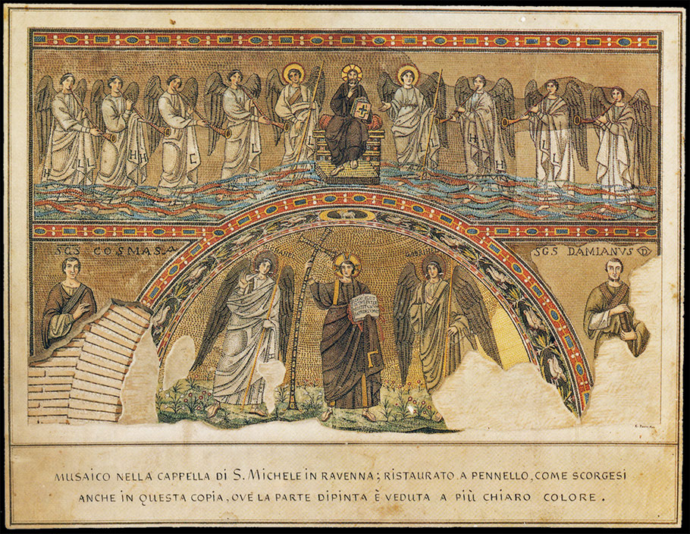

Slide 13
Photo Credits: https://fr.wikipedia.org/wiki/Fichier:Ravenna_Bode_Berlin_1.jpg http://www.livingromagna.com/service/ex-chiesa-san-michele-in-africisco-oggi-negozio-max-mara-a-ravenna/ http://www.livingromagna.com/service/ex-chiesa-san-michele-in-africisco-oggi-negozio-max-mara-a-ravenna/ https://jauntingjen.com/2013/12/30/the-byzantine-beauty-in-berlin/ http://www.romehistory.co.uk/con/byzantineculture.html https://www.smb.museum/en/museums-institutions/bode-museum/education-outreach/schools-day-cares-and-kindergartens/detailansicht-angebote-fuer-schulen-kindertageseinrichtungen.html?tx_smb_pi1%5BschoolOffer%5D=27330&cHash=6f207411516eca313c906f9351cf1d3f https://jauntingjen.com/2013/12/30/the-byzantine-beauty-in-berlin/ https://www.tripadvisor.ru/LocationPhotoDirectLink-g187323-d624830-i166071240-Bode_Museum-Berlin.html http://www.mosaicoravenna.it/convegno/la-diaspora-dellarcangelo-san-michele-in-africisco-e-leta-giustinianea/?lang=en http://www.mosaicocidm.it/Mosaico/Read_main.action?cardNumber=351&leaves=0 https://commons.wikimedia.org/wiki/File:Mosaico_pavimentale_da_s._michele_in_africisco,_500-550_dc_ca.jpg https://commons.wikimedia.org/wiki/File:Transenna_marmorea_traforata,_dalla_chiesa_di_san_michele_in_africisco,_500-550_ca._01.jpg http://www.edificistoriciravenna.it/en/san-michele-africisco/ https://www.quis-ut-deus.de/werke/4-10-jahrhundert/ravenna-545/

