Slide 1
Torre Aquila
Castello del Buonconsiglio
Trento, Italy
The Months of
January and February

Slide 2
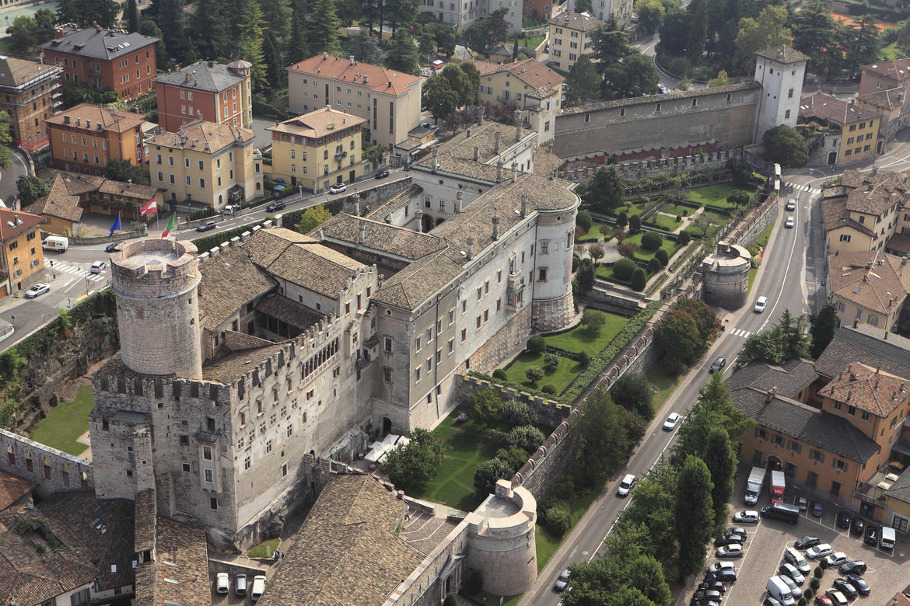
Castello del Buonconsiglio,
Trento,
Italy

Slide 3
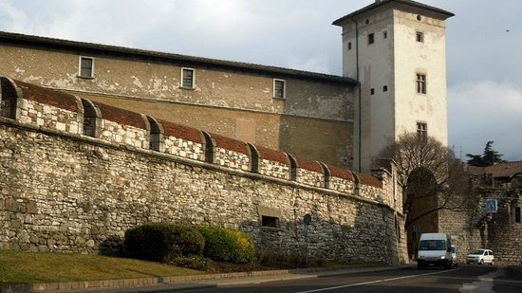
Torre Aquila, Castello del Buonconsiglio, Trento, Italy

Slide 4
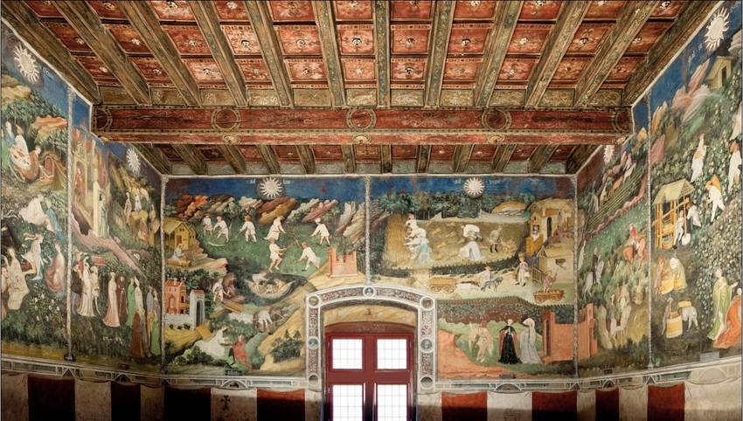
Cycle of the Twelve Months – Torre Aquila

Slide 5
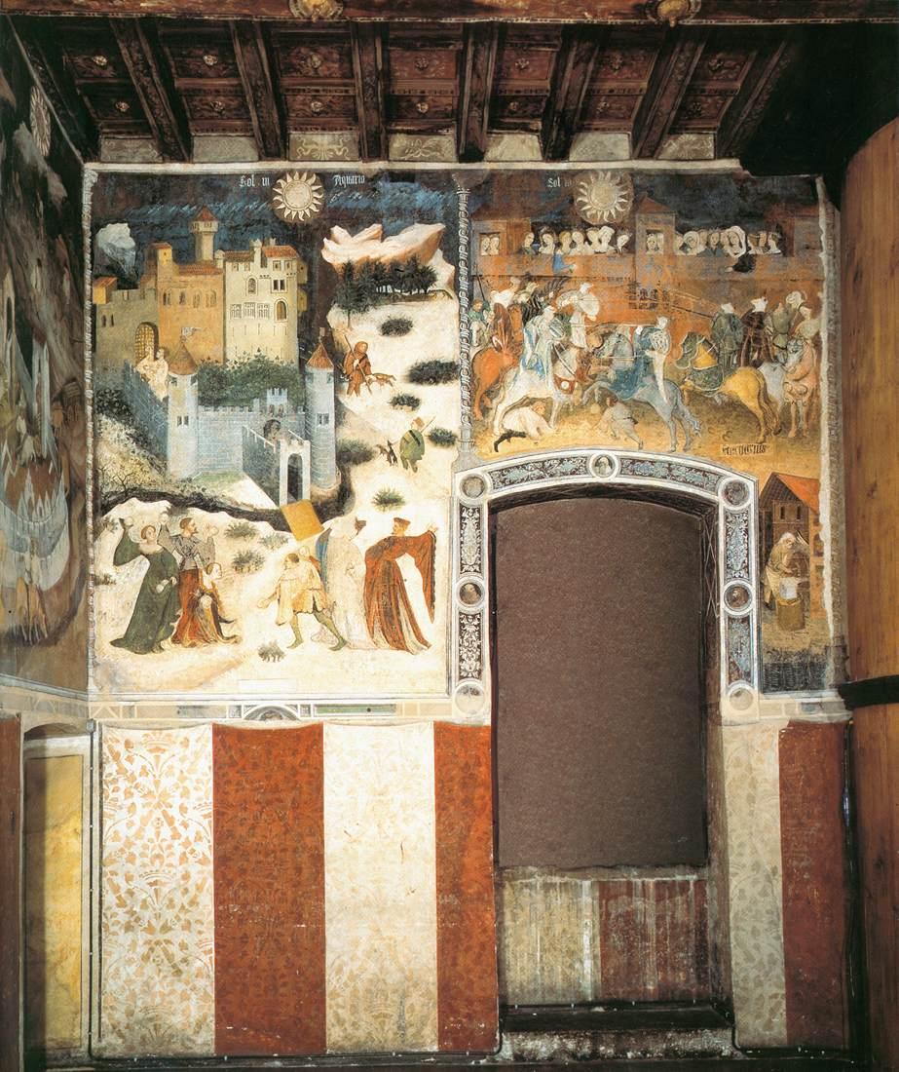
Cycle of the Twelve Months – Eastern Wall - Torre Aquila
The Months of January and February and a nice depiction of the decorative lower part of the painted eastern wall.
To the right, part of the wooden staircase that destroyed the painted panel depicting the Month of March.

Slide 6
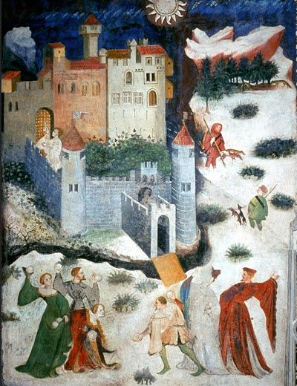
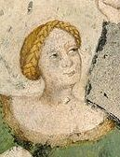
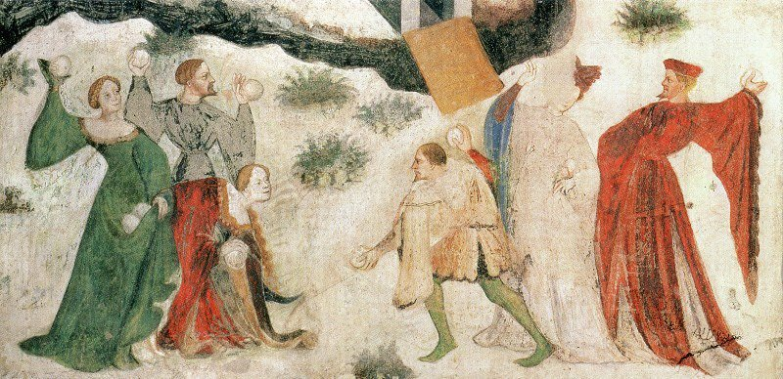
The Month of January, late 14thcentury-latest 1407, possibly by Maestro Venceslao, fresco, Torre Aquila

Slide 7
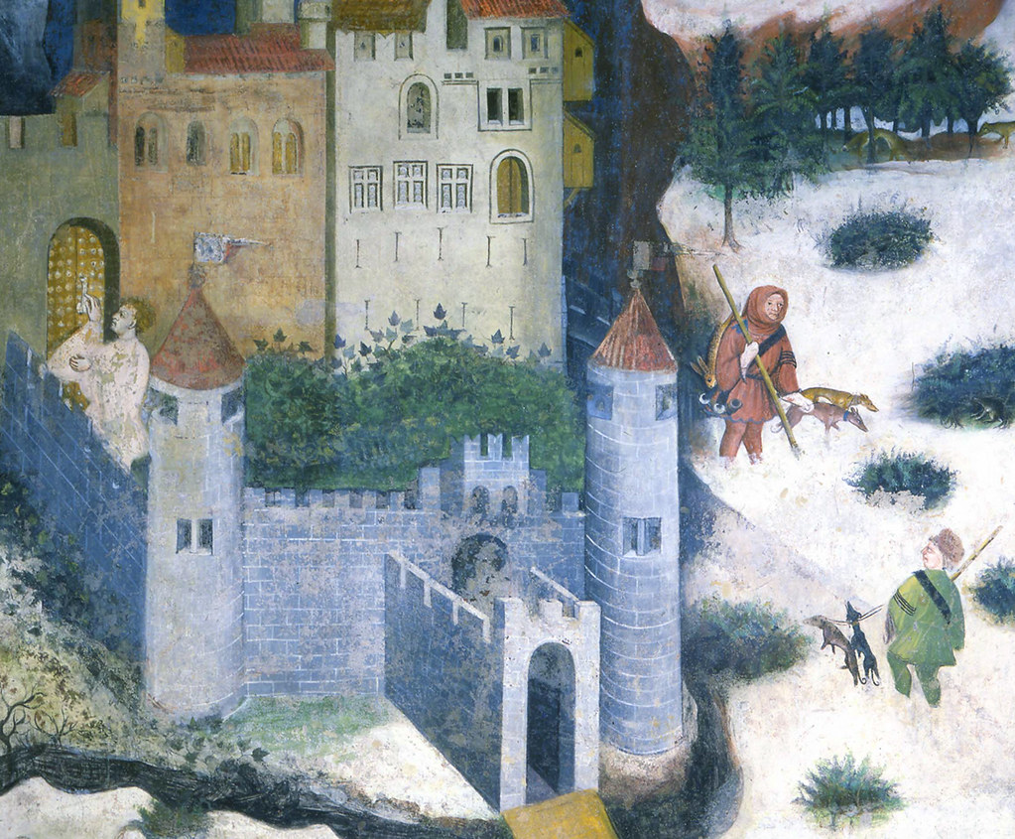
A scene full of details!
Two Peasant wearing their masters’ liveries – one goes hunting, the other, comes back with a hare!
A badger hiding under a shrub.
A young man knocking at the Castel’s Door.
A vivid winter landscape, yet the Castle’s inner court is lush and green!

Slide 8
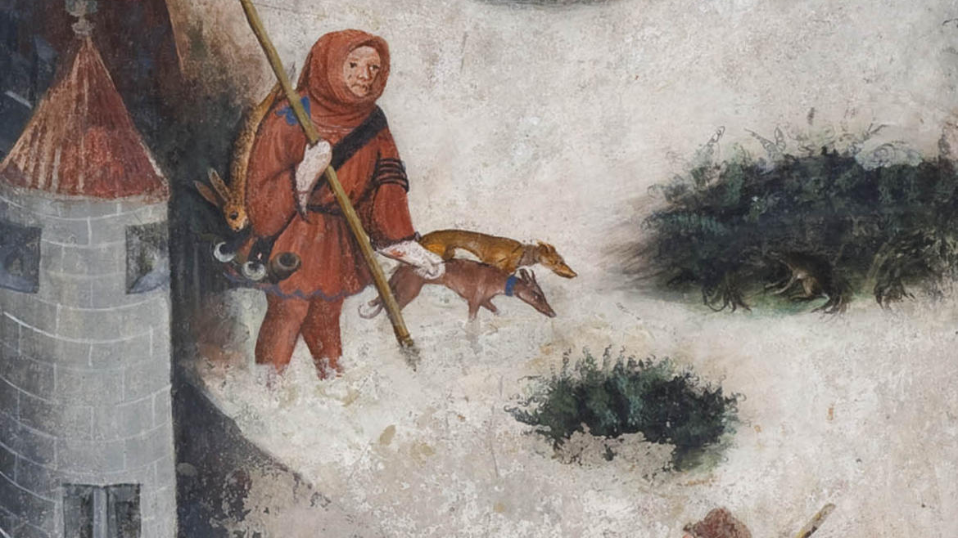

Slide 9
Cycle of the Twelve Months – Eastern Wall - Torre Aquila
The Months of January and February and a nice depiction of the decorative lower part of the painted eastern wall.
To the right, part of the wooden staircase that destroyed the painted panel depicting the Month of March.

Slide 10
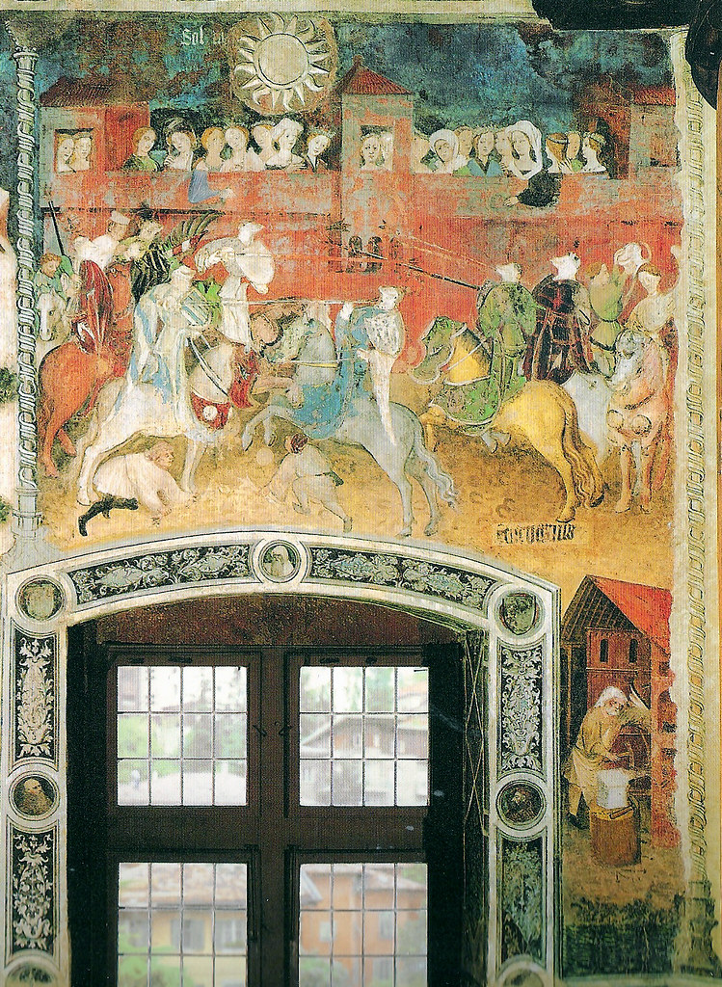
The Month of February, late 14thcentury-latest 1407, possibly by Maestro Venceslao, fresco, Torre Aquila

Slide 11
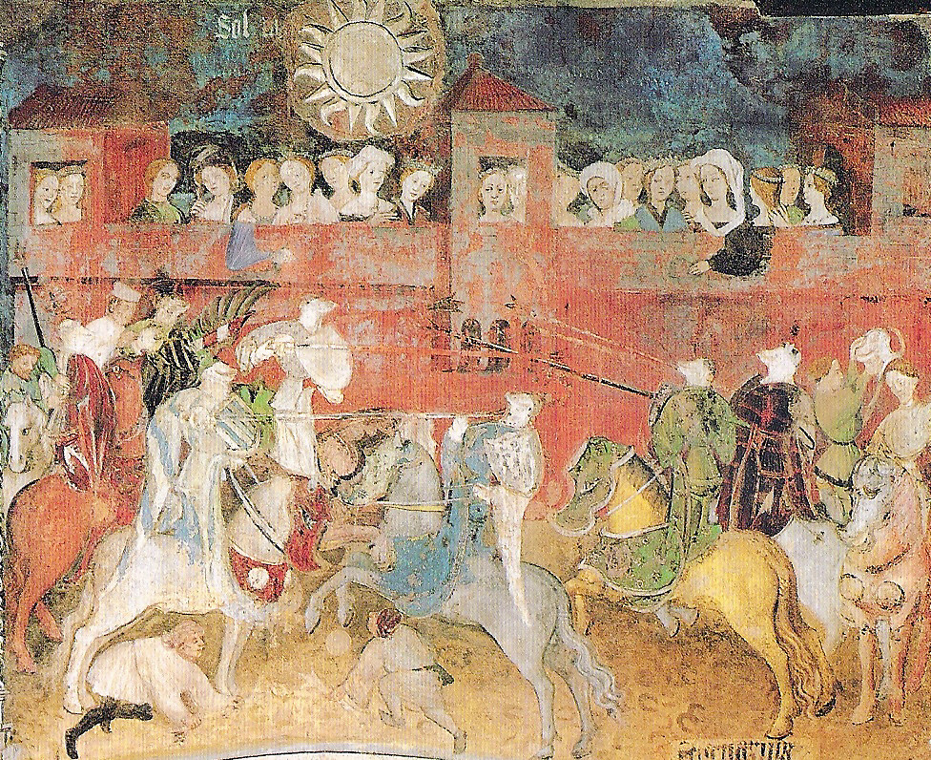
“Is there among you any gentleman who for the love of his lady is willing to try with me some feat of arms? If there should be any such, here I am, quite ready to sally forth completely armed and mounted, to tilt three courses with the lance, to give three blows with the battle axe, and three strokes with the dagger. Now look, you English, if there be none among you in love.”

Slide 12
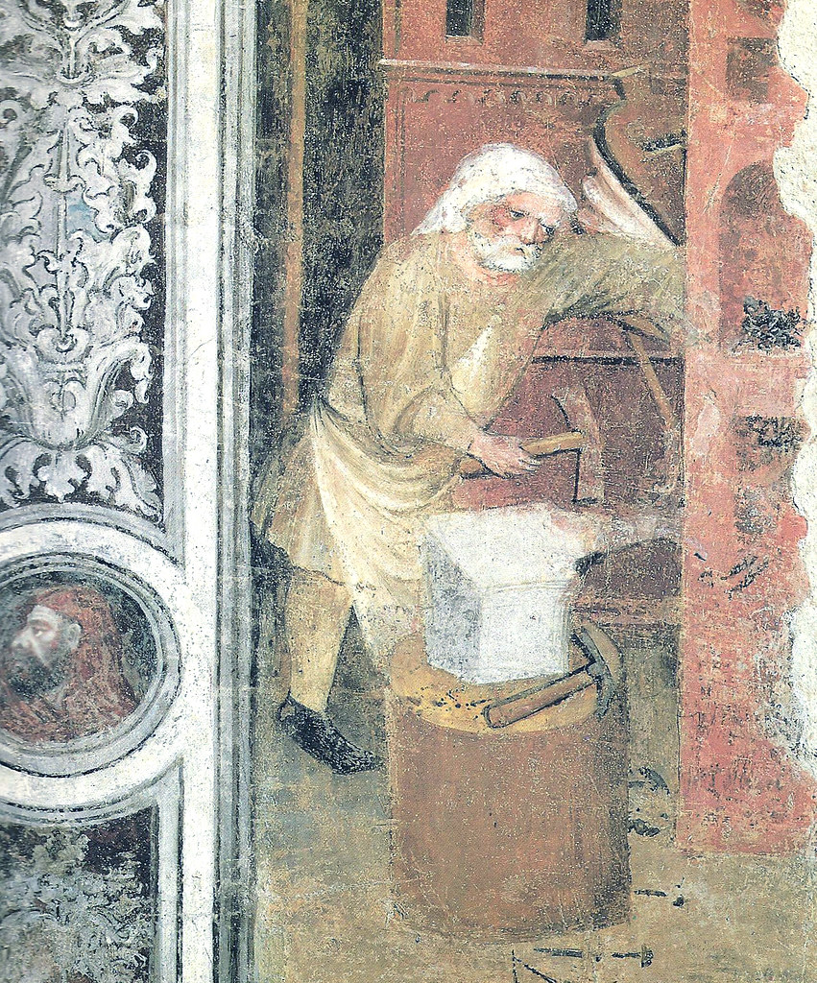
In the narrow space between the room’s window and the staircase, the artist included a vignette of an older blacksmith toiling hard in his workshop. Let’s not forget this is a fresco cycle of the Labors of the Months!

