Slide 1
Late Antique
Early Christian
FEMALE Portraits

Slide 2
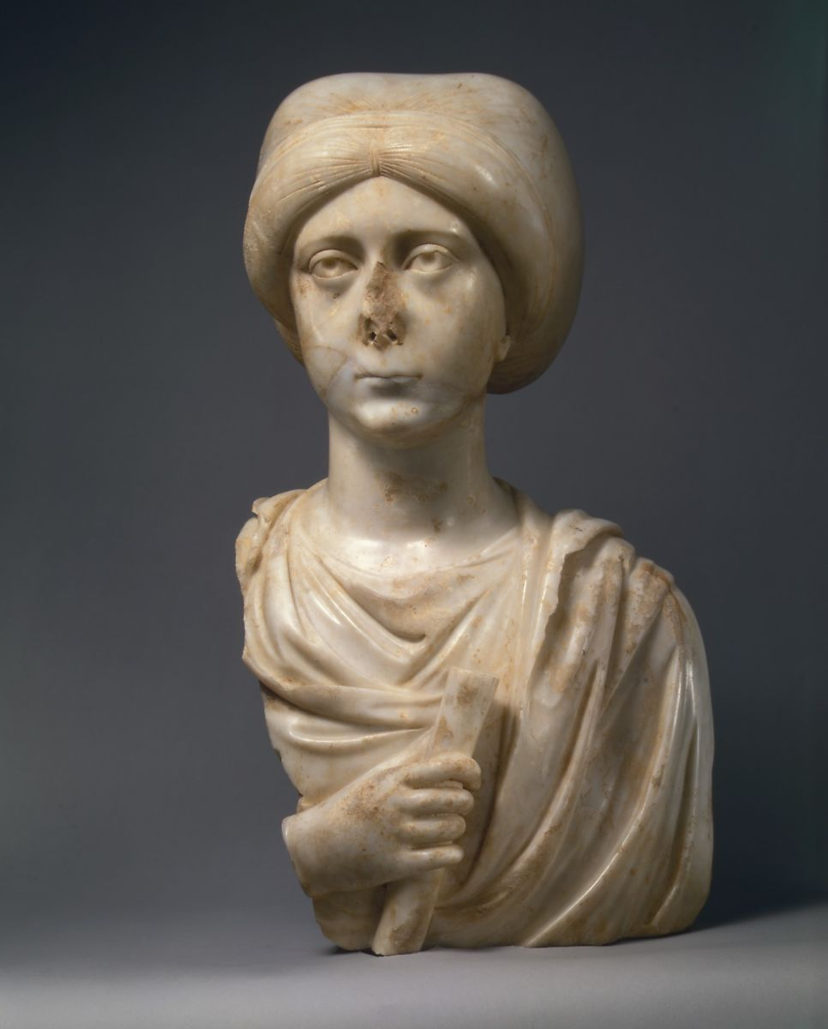
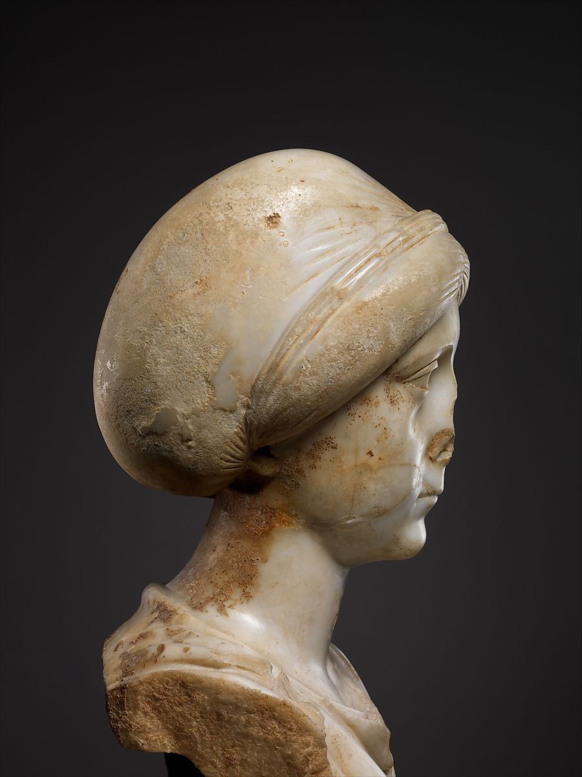
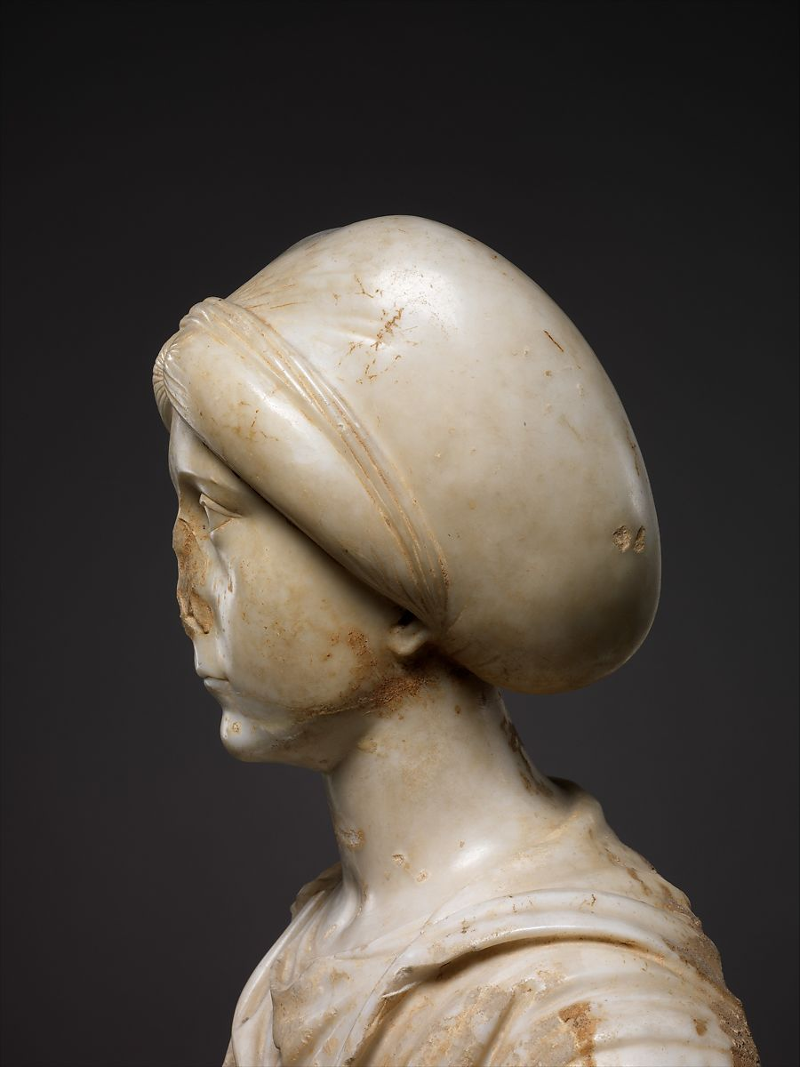
Portrait Bust of a Woman with Scroll, late 4th-early 5th century, Pentelic marble,
53 x 27.5 x 22.2 cm, the MET, NY

Slide 3
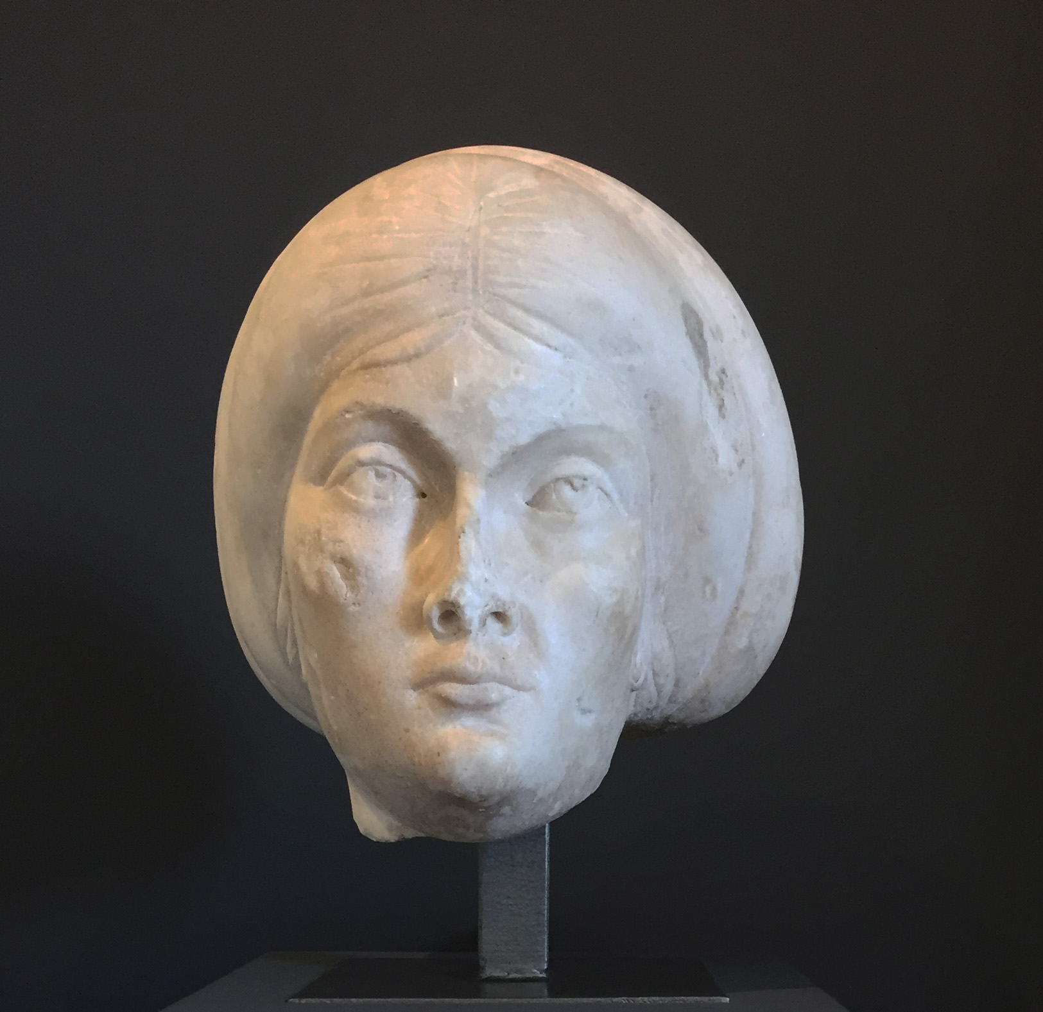
Female Portrait, about 375-425, Marble, 33,5 × 30 × 30 cm, Musée Saint-Raymond, Toulouse

Slide 4
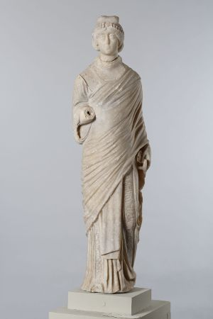
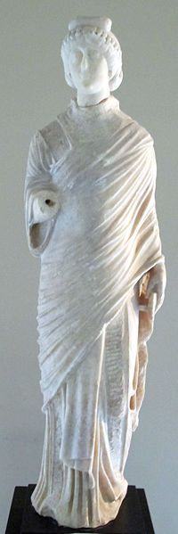
Statuette of Aelia Flacilla, Constantinople, c. 380-390, Marble, 78 cm, Bibliothèque Nationale de France, Cabinet des Médailles

Slide 5
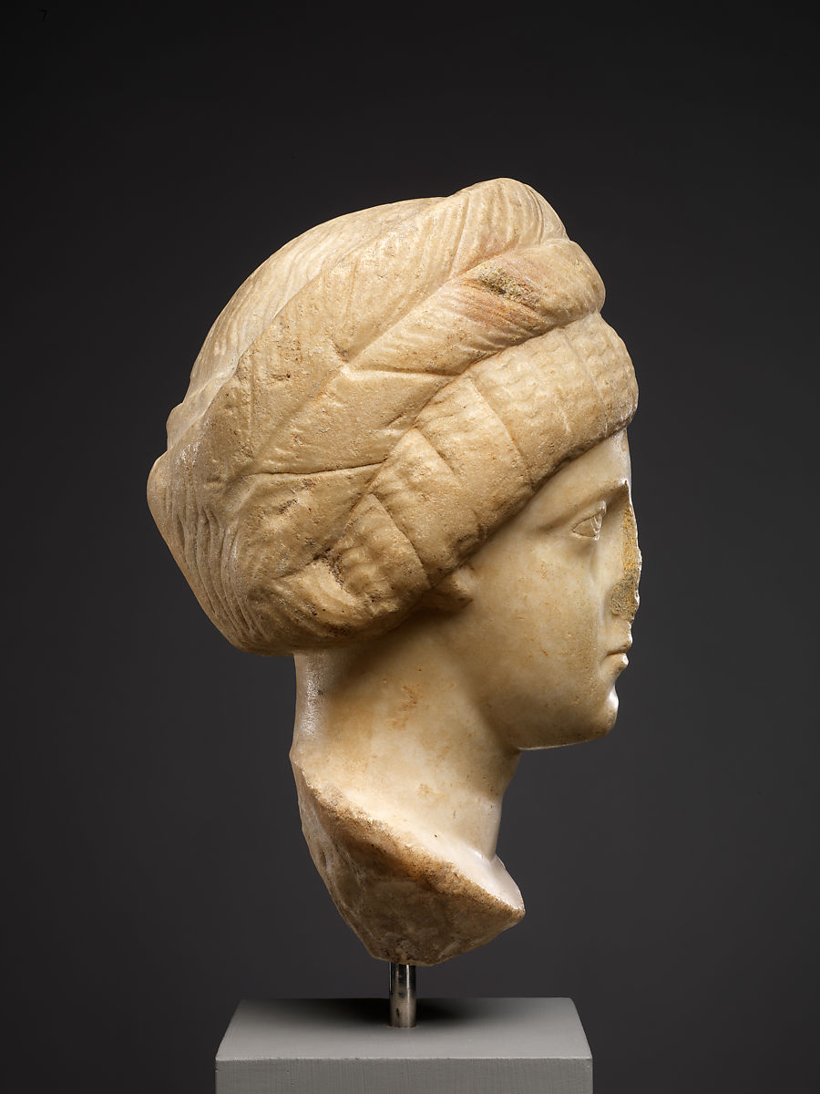
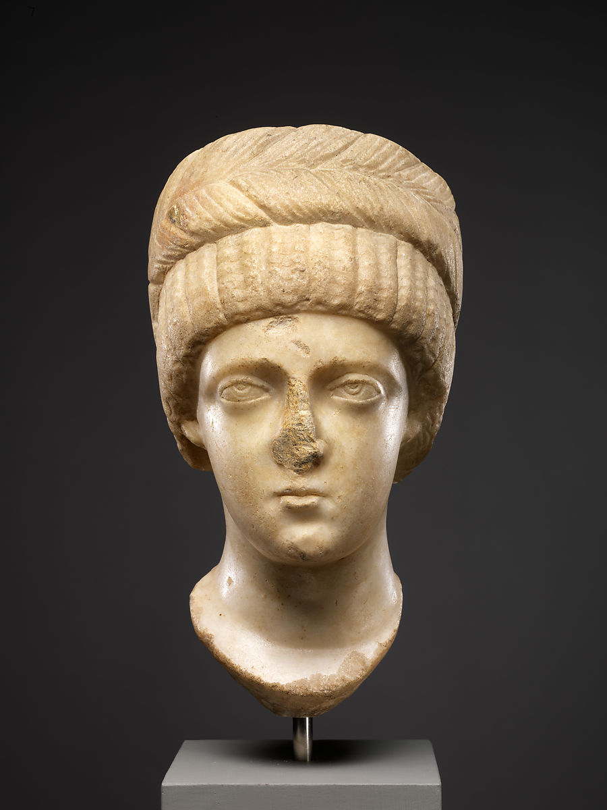
Marble bust of a woman, possibly of Empress
Aelia Flaccilla, c. 380-90, Marble,
27.2 x 15.5 x 17 cm, the MET, NY

Slide 6
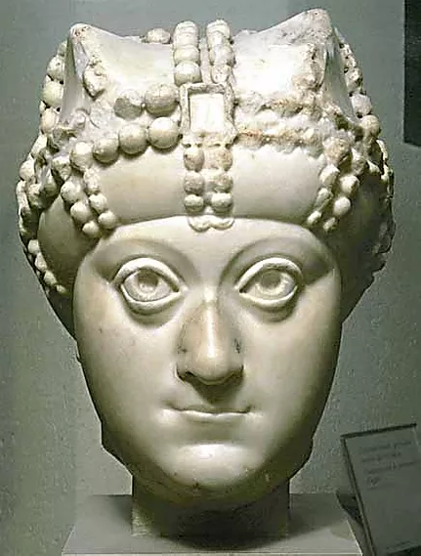
Portrait of Empress Ariadne, about 500, 474-515, Marble, 25.7 x 22.8 x 23 cm., the Louvre, Paris
The Empress Ariadne?
There are two other portraits known of this woman of high rank in Rome. (Rome, Palazzo dei Conservatori and St. John in Lateran)
She is identified as the Empress Ariadne (474-515) but also as Licénia Eudoxia, wife Valentinian III, or Amalasuntha, daughter of Theodoric the Great, king of the Goths.

Slide 7
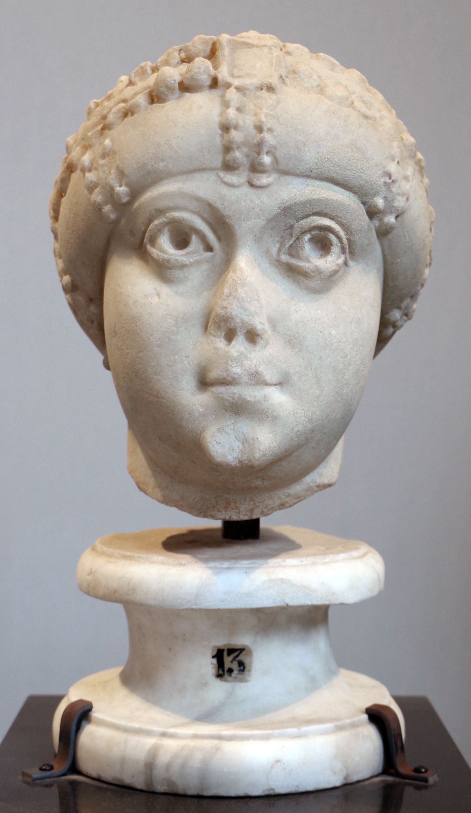
Female Portrait (of the Ariadne Amalasunta type), 480-525 AD, Marble, Height: 33 cm, Capitoline Museums,
Palazzo dei Conservatori, Rome

Slide 8
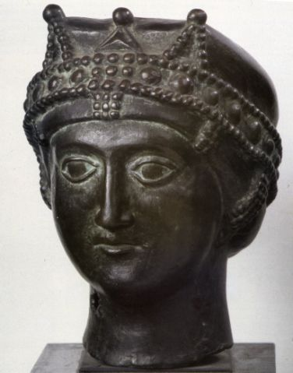
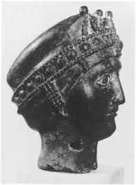
Head of an Empress, Mid 5th to earlier 6th century, Bronze, Height: 29 cm, Narodni Muzej, Niš

Slide 9
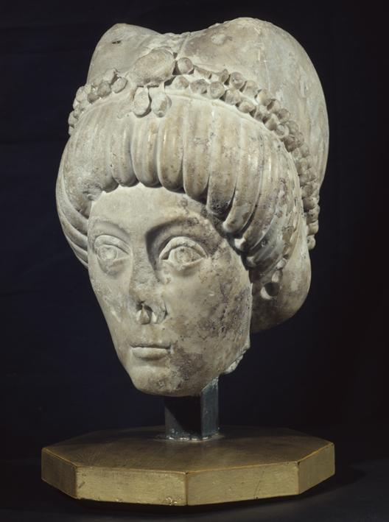
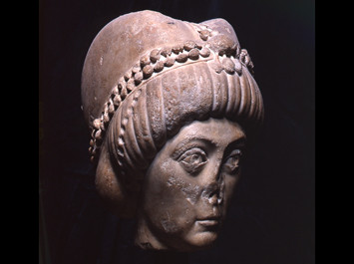
Head of Theodora, about 530-540, Marble, Height: 27 cm, Castello Sforzesco, Museo del’Arte Antiqua, Milan

