Slide 1
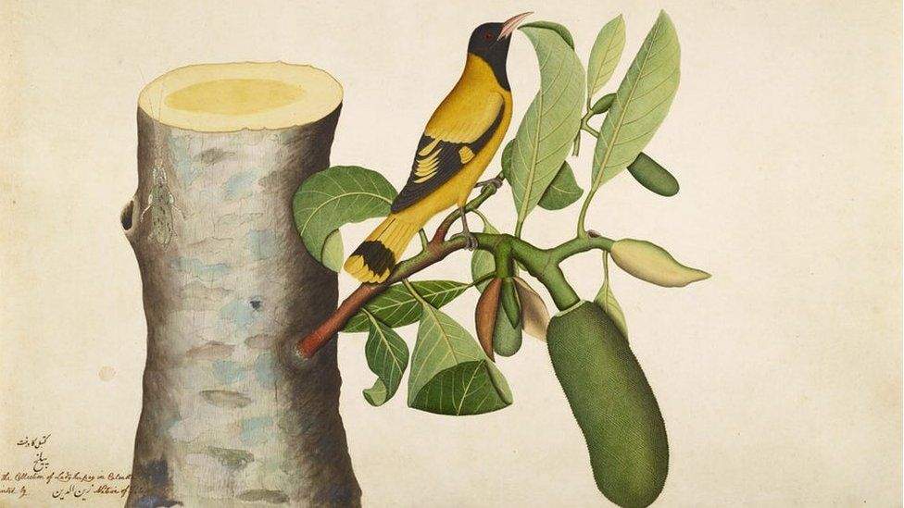
Forgotten Masters: Indian Painting for the East India Company
Wallace Collection, 4 December 2019 – 19 April 2020

Slide 2
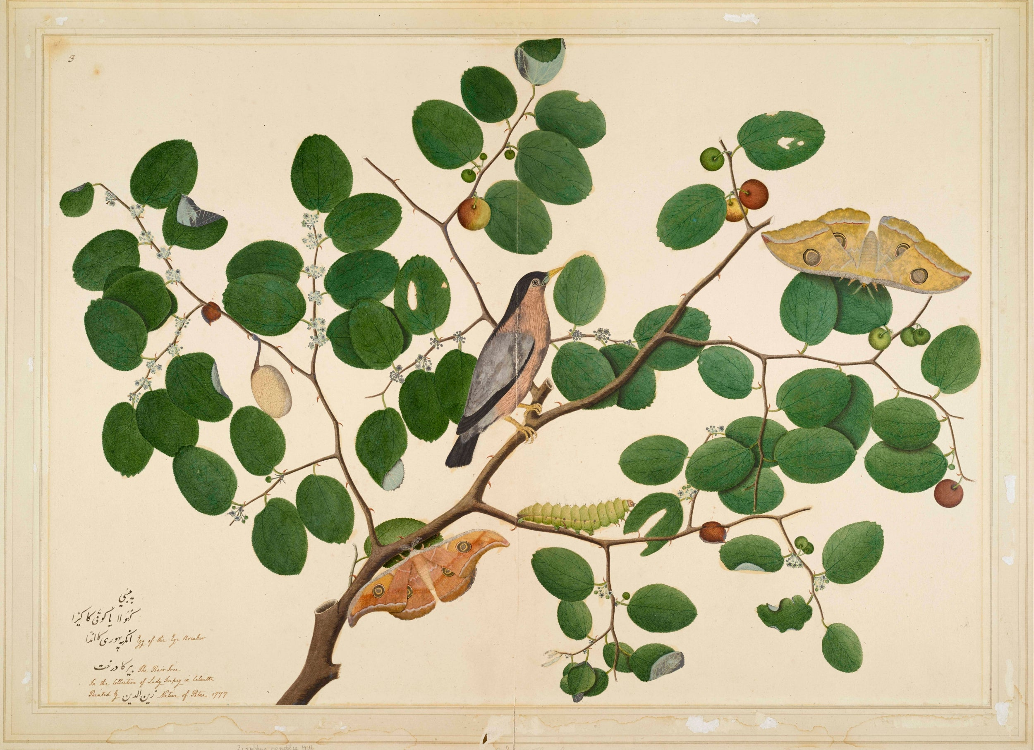
Shaikh Zain al-Din, Brahminy Starling with Two Anteraea Moths, Caterpillar and Cocoon in Indian Jujube Tree, from the Impey Album,
Minneapolis Institute of Arts

Slide 3
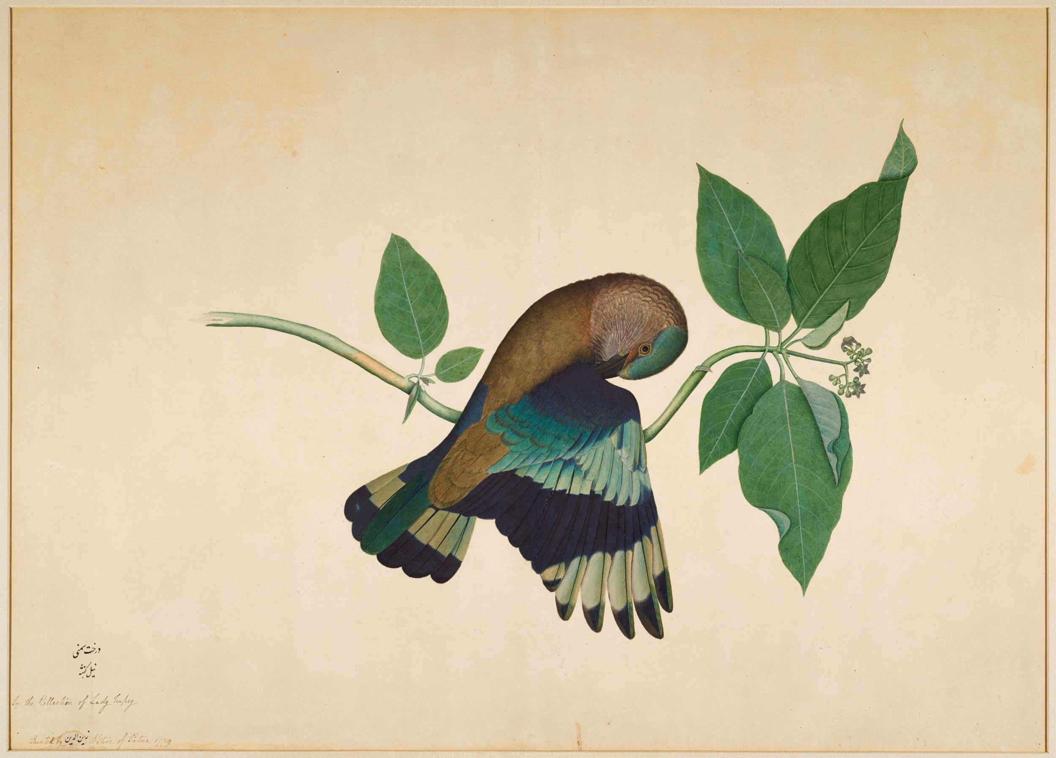
Shaikh Zain al-Din, Indian Roller on Sandalwood Branch, from the Impey Album,
Minneapolis Institute of Arts

Slide 4
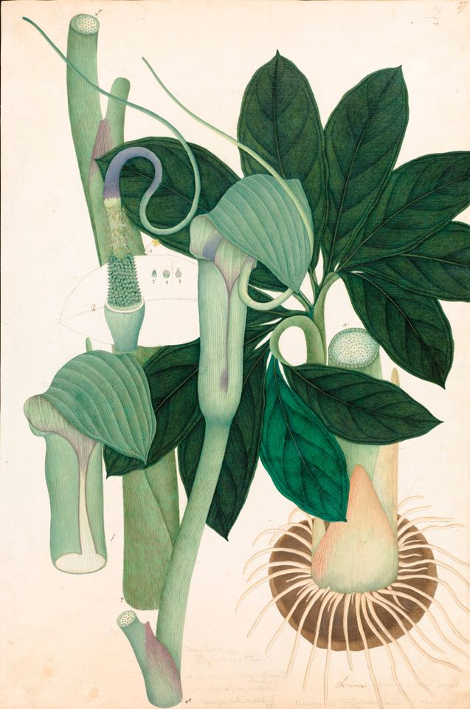
Arum tortuosum, Vishnupersaud (c. 1821) © The Board of Trustees of the Royal Botanic Gardens, Kew

Slide 5
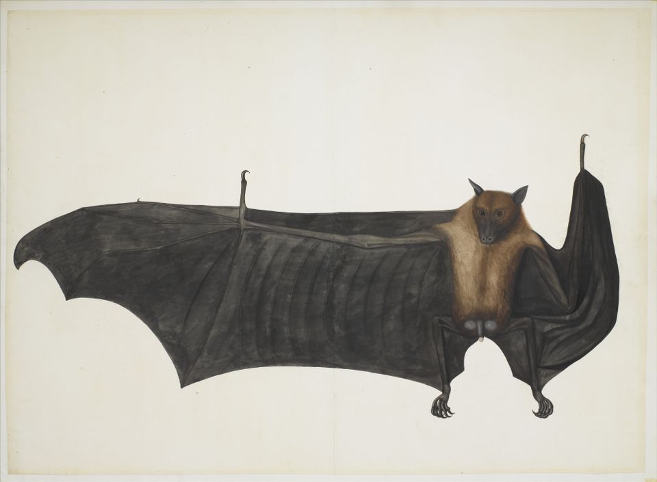
Great Indian Fruit Bat, 1777-82, attributed to Bhawani Das, Metropolitan Museum of Art, New York

Slide 6
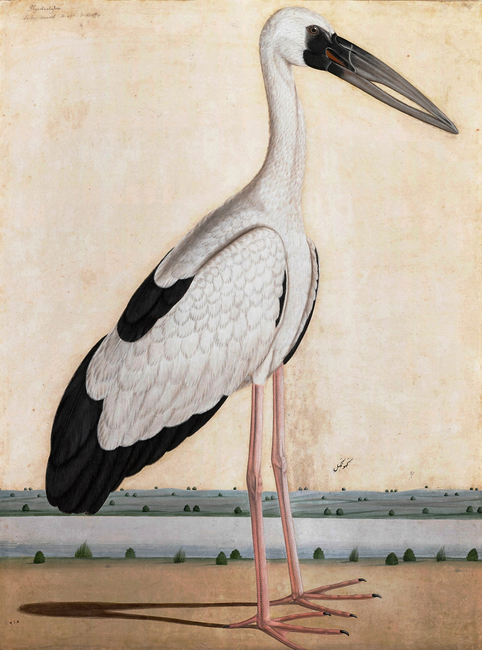
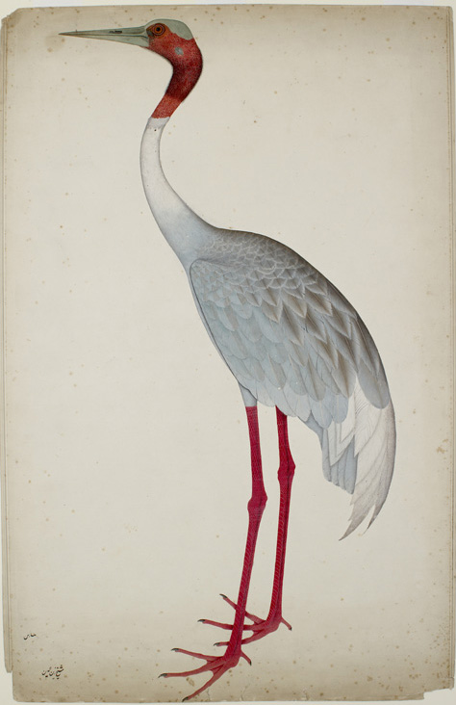
Unknown Artist, Asian Openbill Stork in a Landscape, Private Collection
Shaikh Zain Ud-Din, Sarus Crane, Bodleian Libraries, University of Oxford. © Ashmolean Museum, University of Oxford

Slide 7
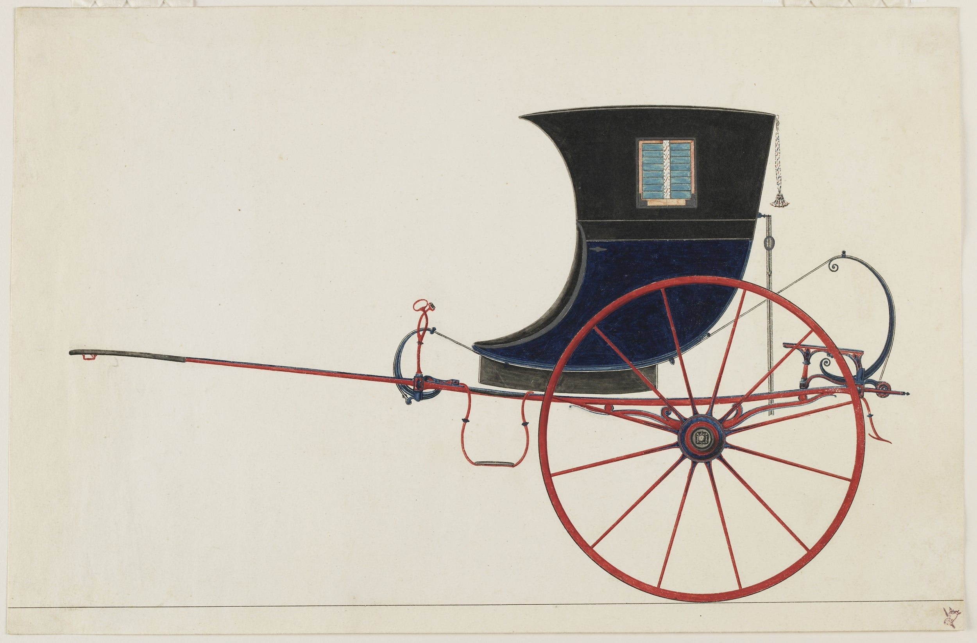
Sheikh Mohammah Amir, English Gig, 1840, Freer Gallery of Art and Arthur M Sackler Gallery (Smithsonian Institution)

Slide 8
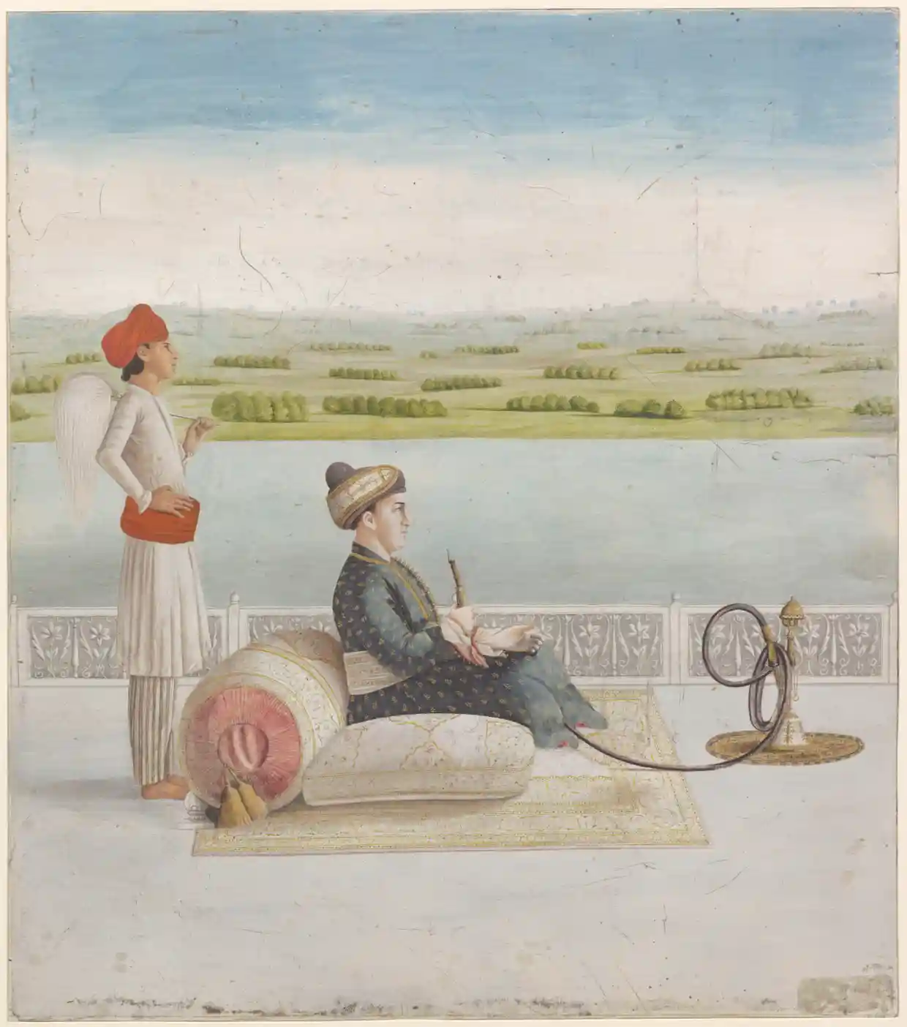
Portrait of John Wombwell smoking a hookah, Fondation Custodia, Collection Frits Lugt, Paris

Slide 9
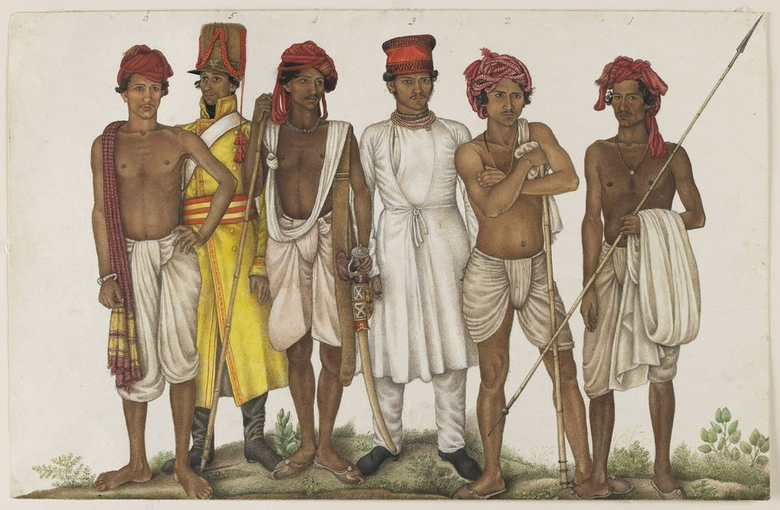
Ghulam Ali Khan’s Six Recruits
(1815-16) was commissioned by Colonel James Skinner, an East India Company officer © Freer Gallery of Art and Arthur M. Sackler Gallery

Slide 10
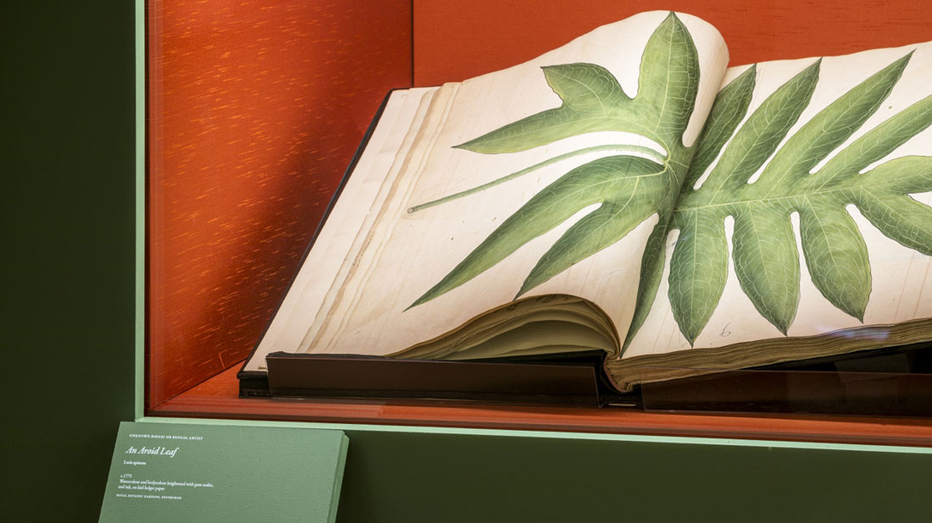
Forgotten Masters: Indian Painting for the East India Company
Wallace Collection, 4 December 2019 – 19 April 2020
Exhibition Photograhs: http://www.attitude-mag.com/en/blog/all/2019-12-20-forgotten-masters-indian-painting-for-the-east-india-company/

Slide 11
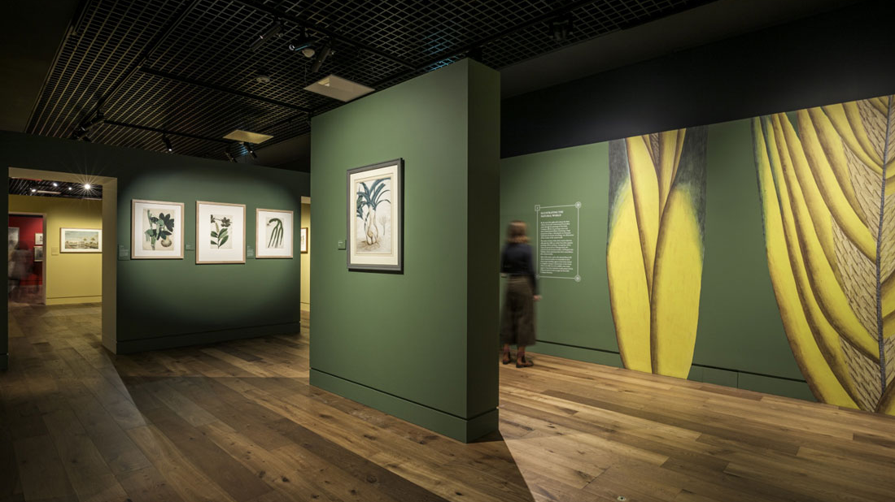

Slide 12
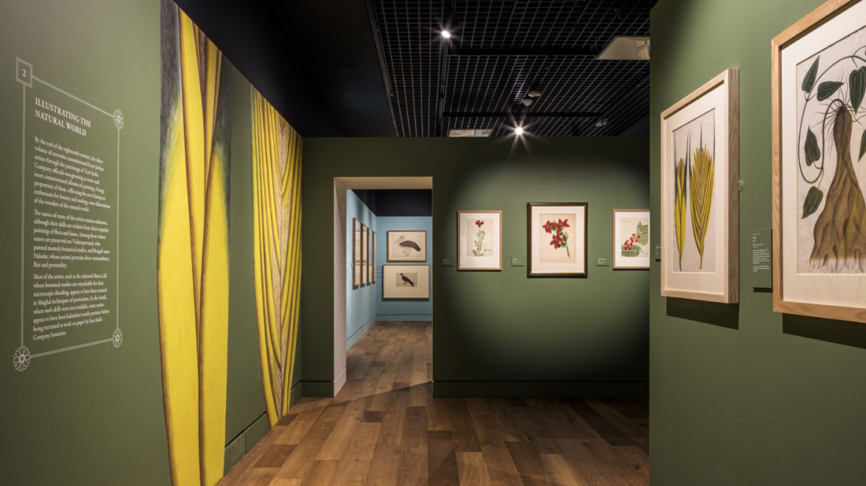

Slide 13
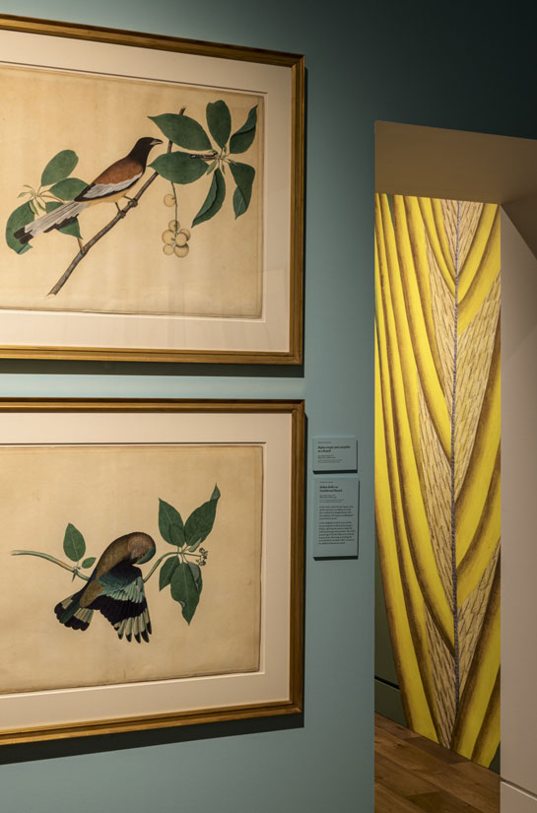
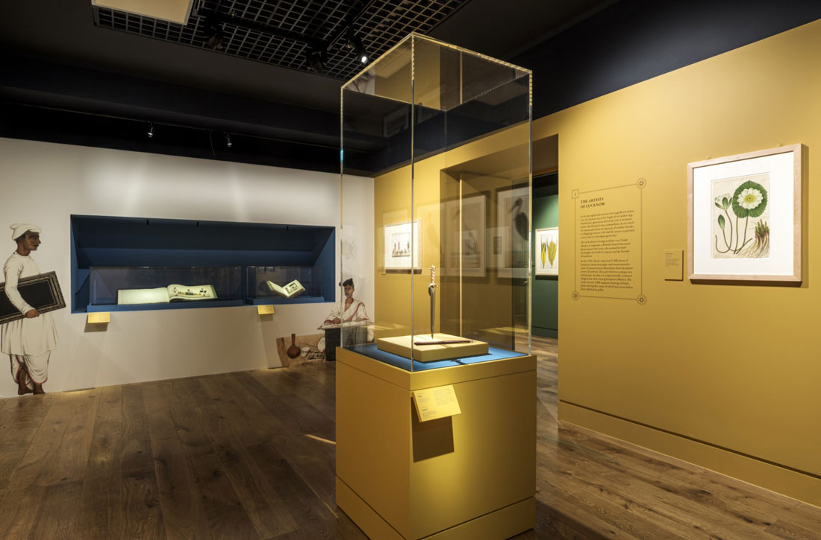

Slide 14
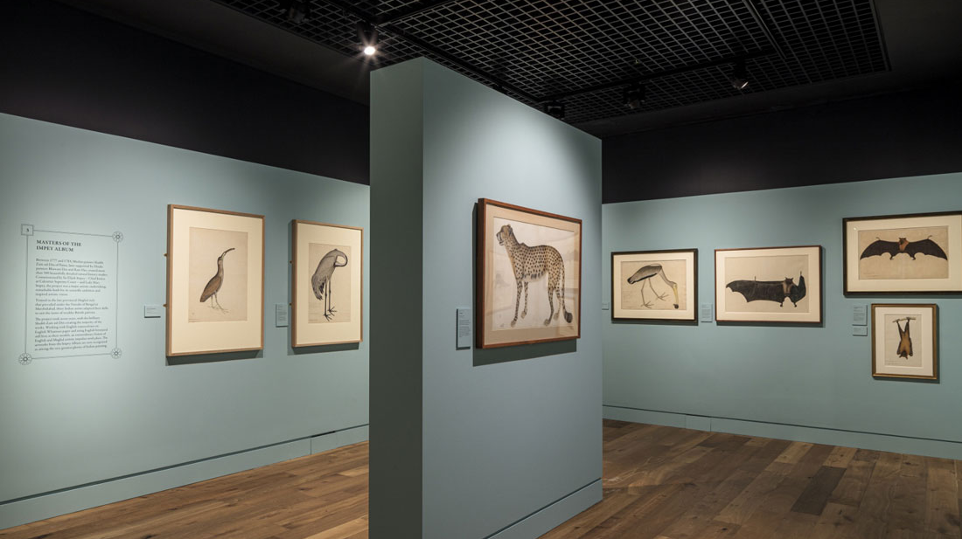

Slide 15
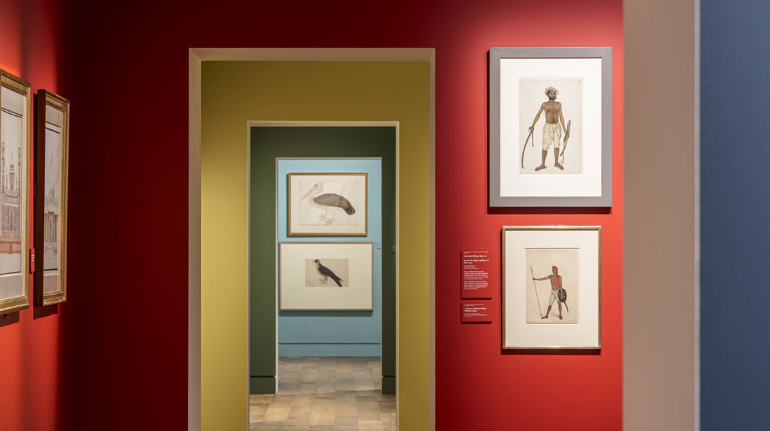

Slide 16
