Slide 1
Torre Aquila
Castello del Buonconsiglio
Trento, Italy
The Month of January

Slide 2
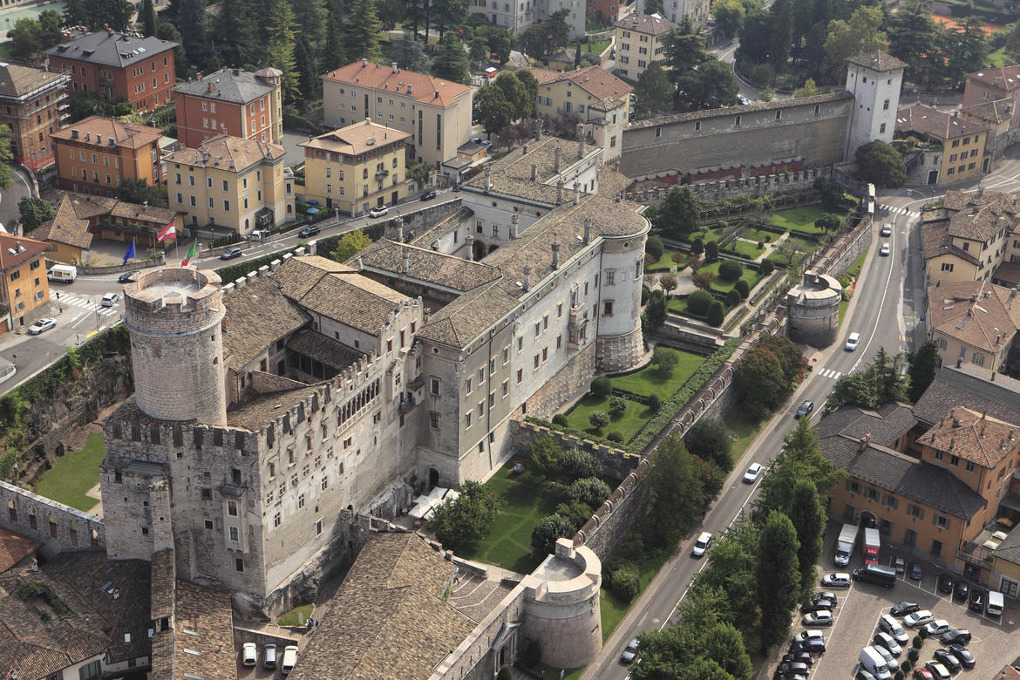
Castello del Buonconsiglio,
Trento,
Italy

Slide 3
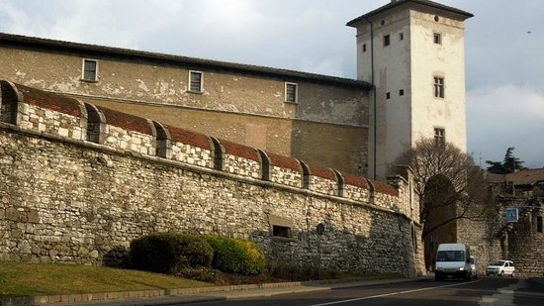
Torre Aquila, Castello del Buonconsiglio, Trento, Italy

Slide 4
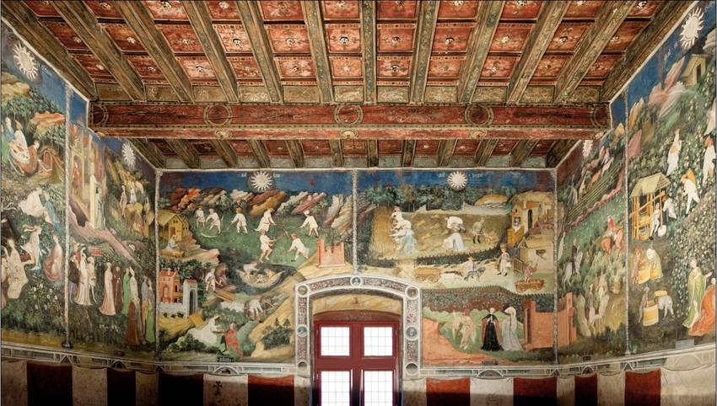
Cycle of the Twelve Months – Torre Aquila

Slide 5
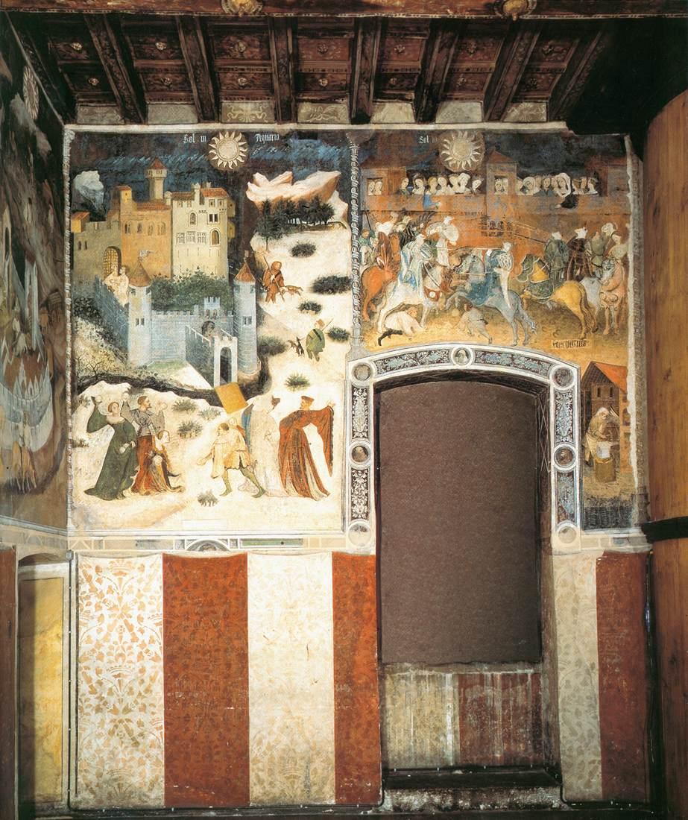
Cycle of the Twelve Months – Eastern Wall - Torre Aquila
The Months of January and February and a nice depiction of the decorative lower part of the painted eastern wall.
To the right, part of the wooden staircase that destroyed the painted panel depicting the Month of March.

Slide 6
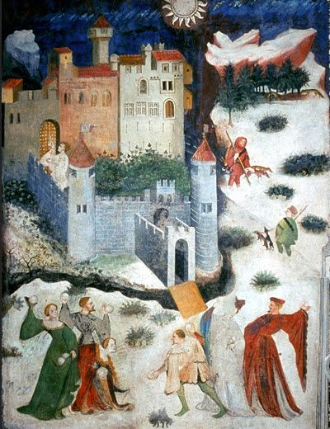
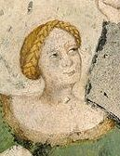
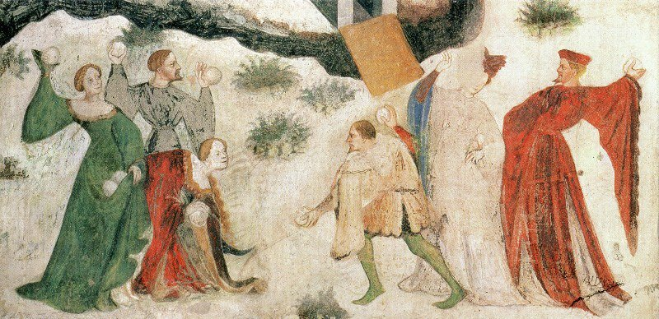
The Month of January, late 14thcentury-latest 1407, possibly by Maestro Venceslao, fresco, Torre Aquila

Slide 7
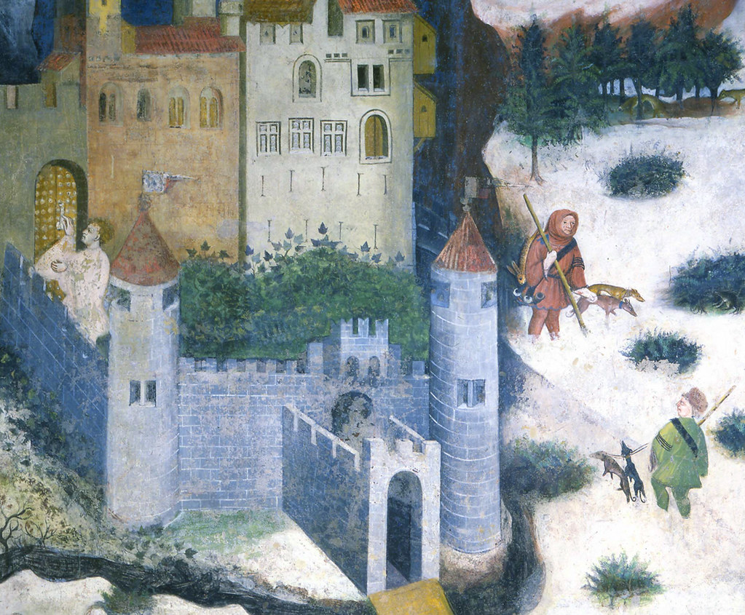
A scene full of details!
Two Peasant wearing their masters’ liveries – one goes hunting, the other, comes back with a hare!
A badger hiding under a shrub.
A young man knocking at the Castel’s Door.
A vivid winter landscape, yet the Castle’s inner court is lush and green!

Slide 8
